Slide 1
Emotion Recognition in Audio & Video using Deep Neural Networks
Mandeep Singh & Yuan Fang
https://tinyurl.com/y8795rbt
CS231N Final Project
Stanford University
06/09/2020

Slide 2
Contents
Problem Statement & Application
Dataset & Data pre-processing
Model architecture
Results
Future work

Slide 3
Problem Statement
&
Application

Slide 4
Problem Statement & Application
Given an audio/video:
Classify it into one of the four emotions, i.e. happy, anger, sad, neutral
Emotion detection in audio is key area wherein it can assist:
Siri/Alexa to give good recommendations after detecting the emotion.
911 operator based on interpreting emotions in different languages.

Slide 5
Dataset
&
Data pre-processing

Slide 6
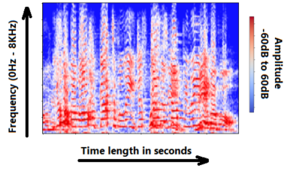

Dataset & Data pre-processing
IEMOCAP¹ dataset from USC.
12 hours audiovisual data of 5 females, 5 males speaking in 9 emotions.
Each utterance has an emotion label.
Data Pre-processing
Audio:
Extract 3 second audio waveform and convert it into spectrogram of size 200x300.
Video:
Extract 20 frames of size 60x100 from the video corresponding to 3 second audio.
Footnote:
1. C. L. A. K. E. M. S. K. J. C. S. L. C. Busso, M. Bulut and S. Narayanan. Iemocap: Interactive emotional dyadic motion capture database, December 2008.

Slide 7
Dataset & Data pre-processing
IEMOCAP¹ dataset from USC.
12 hours audiovisual data of 5 females, 5 males speaking in 9 emotions.
Each utterance has an emotion label.
Data Pre-processing
Audio:
Extract 3 second audio waveform and convert it into spectrogram of size 200x300.
Video:
Extract 20 frames of size 60x100 from the video corresponding to 3 second audio.
Footnote:
1. C. L. A. K. E. M. S. K. J. C. S. L. C. Busso, M. Bulut and S. Narayanan. Iemocap: Interactive emotional dyadic motion capture database, December 2008.

Slide 8
Model Architecture

Slide 9
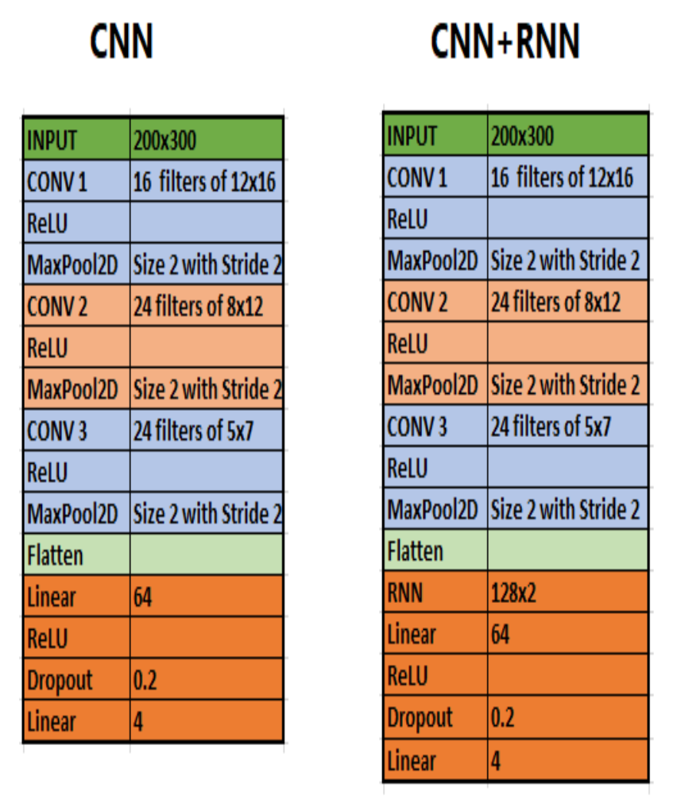
Model Architecture
Audio Models:
Explored CNN, CNN+RNN & CNN+LSTM model architectures.

Slide 10
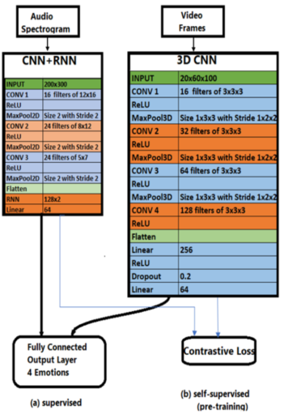
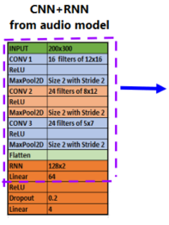
Model Architecture
Audio + Video Model:

Slide 11
Results

Slide 12
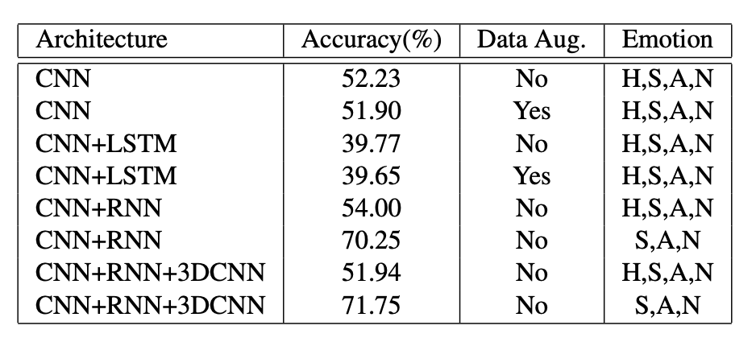
Results
Accuracy Table
Best Accuracy (4 emotions):
Audio Model: 54%
Audio+Video Model: 51.94%

Slide 13
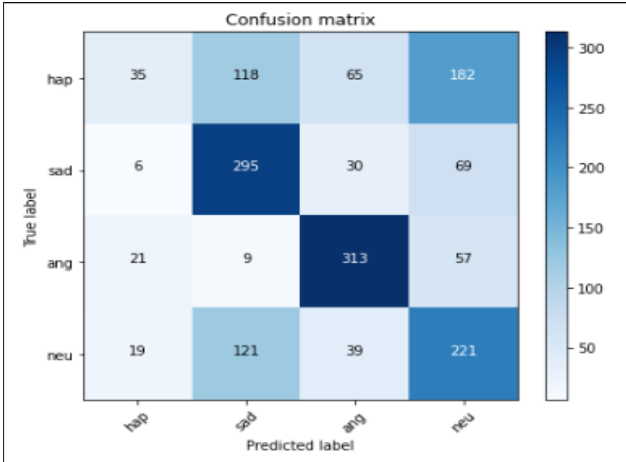
Results
Confusion Matrix
Audio: CNN+RNN
4 Emotions
Analysis:
Unbalanced Dataset: Low count of happiness

Slide 14
Results
Accuracy Table
Accuracy on (3 emotions) jumps from 70.25% to 71.75%
Implying Audio+Video model works.

Slide 15
Conclusion
&
Future work

Slide 16
Conclusion & Future Work
Conclusion:
Explored different deep neural network architectures to predict emotion:
CNN, CNN+RNN, CNN+LSTM, CNN+RNN+3DCNN
Best performing models:
Audio model: CNN+RNN with accuracy of 54%.
Video model: CNN+RNN+3DCNN with accuracy of 51.94%.
Analysis:
Low count of happy emotion in the dataset.
Audio+video model works with training on 3 emotions resulting in accuracy jump from 70.25% to 71.75%.
Future Work:
Increase input & output dimensions in each layer in the network.
Auto crop to focus on the face of the actor in video frames.
Explore noise removal algorithms.

Slide 17
Conclusion & Future Work
Conclusion:
Explored different deep neural network architectures to predict emotion:
CNN, CNN+RNN, CNN+LSTM, CNN+RNN+3DCNN
Best performing models:
Audio model: CNN+RNN with accuracy of 54%.
Video model: CNN+RNN+3DCNN with accuracy of 51.94%.
Analysis:
Low count of happy emotion in the dataset.
Audio+video model works with training on 3 emotions resulting in accuracy jump from 70.25% to 71.75%.
Future Work:
Increase input & output dimensions in each layer in the network.
Auto crop to focus on the face of the actor in video frames.
Explore noise removal algorithms.

Slide 18
Thank you

