Slide 1
🐾
Predicting Customer Churn at Chewy
An end-to-end machine learning project with PySpark, PyTorch, and TensorFlow
NAVAK · July 2026 · github.com/minkaz65/chewy-churn-prediction
Notes:
Welcome. This project predicts which Chewy customers will churn in the next 90 days, using PySpark for large-scale data engineering and both PyTorch and TensorFlow for the predictive models. Everything is reproducible in the linked GitHub repo and runs top-to-bottom in Google Colab in about five minutes.

Slide 2
Why churn is THE problem for Chewy
83%
~20M
90 days
of Chewy's net sales come from Autoship subscribers (FY2025 filings)
active customers whose repeat orders are the whole business model
prediction window: who cancels next quarter?
Chewy is the largest online pet retailer in the U.S. Revenue is built on repeat purchases — the Autoship subscription delivers food, litter, and medication on a schedule. Losing a customer doesn't lose one order. It loses an annuity. The business question: which specific customers are most likely to cancel in the next 90 days — so retention can act before the cancellation, not after?
Chewy Customer Churn Prediction · PySpark + PyTorch + TensorFlow · 2
Notes:
Chewy's business model makes retention the single most important lever: about 83 percent of net sales come from Autoship subscribers. With roughly 20 million active customers, even a one-point improvement in churn is worth an enormous amount. Our goal: rank customers by 90-day churn risk so the retention team can intervene early.

Slide 3
The end-to-end pipeline
1
2
3
4
5
Synthetic data
PySpark ETL
EDA
PyTorch + TensorFlow
Business impact
50K customers generated from public Chewy business facts
dedup, median imputation, Spark-SQL feature engineering
what actually drives churn — four visual findings
same neural net, two frameworks, honest baseline
top-decile targeting policy and dollar value
One notebook, runnable top-to-bottom in Google Colab (~5 min on CPU)
Chewy Customer Churn Prediction · PySpark + PyTorch + TensorFlow · 3
Notes:
Five stages. Because Chewy's real customer data is proprietary, stage one generates a realistic synthetic dataset from public facts. PySpark handles the data engineering exactly as it would on a production cluster. After exploratory analysis, the same neural architecture is trained in both PyTorch and TensorFlow and compared against a logistic-regression baseline, and finally model quality is translated into a targeting policy with a dollar value.

Slide 4
The dataset: 50,000 customers, honest mess included
50,000
22
9%
1.5%
customers
raw columns
churn rate (imbalanced, like real life)
missing values + duplicate rows to clean
Account
pet type · number of pets · region · tenure · Autoship plan
Purchasing
orders/quarter · avg order value · 12-mo spend · days since last order · pharmacy share
Engagement
app sessions · email open rate · promo usage
Service
support tickets · unresolved tickets · refunds · delivery speed · price-increase exposure
Churn label generated causally: Autoship, tenure, pharmacy → protect · silence, unresolved tickets, refunds, price hikes → destroy
Chewy Customer Churn Prediction · PySpark + PyTorch + TensorFlow · 4
Notes:
The synthetic table mirrors what Chewy's customer warehouse would actually contain, across account, purchasing, engagement, and service dimensions. The churn label is generated causally from the features plus noise, so models must find genuine signal. We also inject missing values and duplicates deliberately so the data-engineering stage has real work to do.

Slide 5
Data engineering with PySpark — cluster-scale by design
Load & schema
The engineered features
CSV → Spark DataFrame with schema inference spark.read.csv(...)
order_gap_ratio
silence relative to the customer's own cadence — the killer feature
Clean
drop duplicate customers; median-impute 3 columns dropDuplicates · approxQuantile
spend_per_pet
spend intensity per animal
Engineer features
4 new signals via Spark SQL expressions withColumn(...)
engagement_score
app + email engagement combined
Aggregate & save
churn by segment, distributed; write Parquet groupBy · write.parquet
service_friction
unresolved tickets + refunds + slow delivery
Same code scales from 50K rows to Chewy's real ~20M customers — only the cluster config changes.
Chewy Customer Churn Prediction · PySpark + PyTorch + TensorFlow · 5
Notes:
Why PySpark? At 20 million customers and billions of order rows, preparation runs on Spark clusters. The pipeline deduplicates, imputes with distributed approximate quantiles, and builds four engineered features. The most powerful is order_gap_ratio: ninety quiet days is alarming for a weekly buyer but normal for a quarterly one — silence relative to the customer's own rhythm.

Slide 6
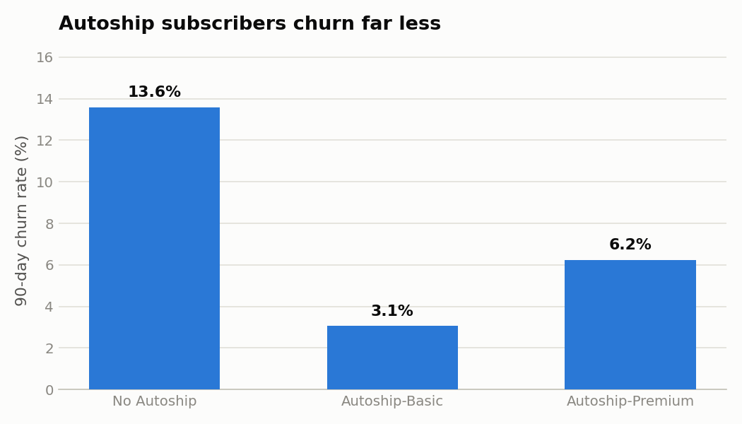
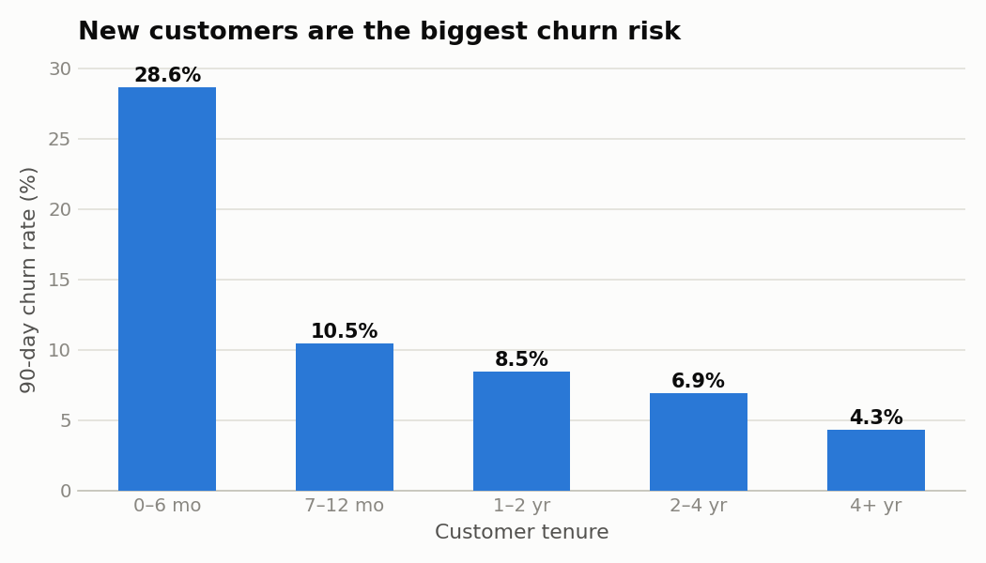
Finding 1 & 2 — Autoship protects; new customers are fragile
Non-subscribers churn at ~4× the rate of Autoship members — Autoship conversion is retention lever #1. And churn risk is front-loaded: the first six months decide the relationship — onboarding matters.
Chewy Customer Churn Prediction · PySpark + PyTorch + TensorFlow · 6
Notes:
Two structural findings. Left: customers without Autoship churn at roughly sixteen percent versus about four percent for subscribers — that's why Chewy pushes the program so hard. Right: churn falls steadily with tenure; the first six months are the danger zone, which argues for deliberate early-lifecycle onboarding.

Slide 7
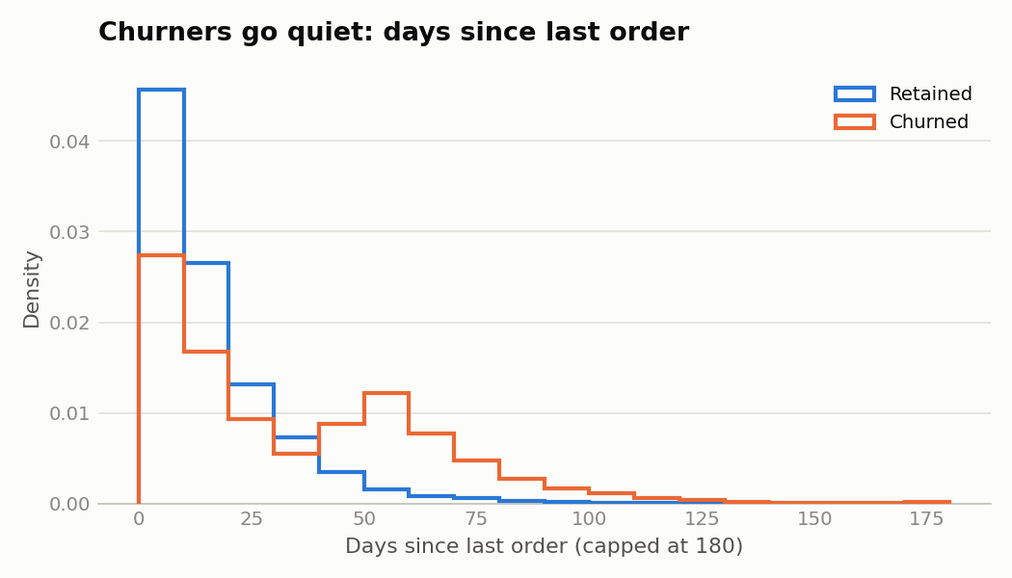
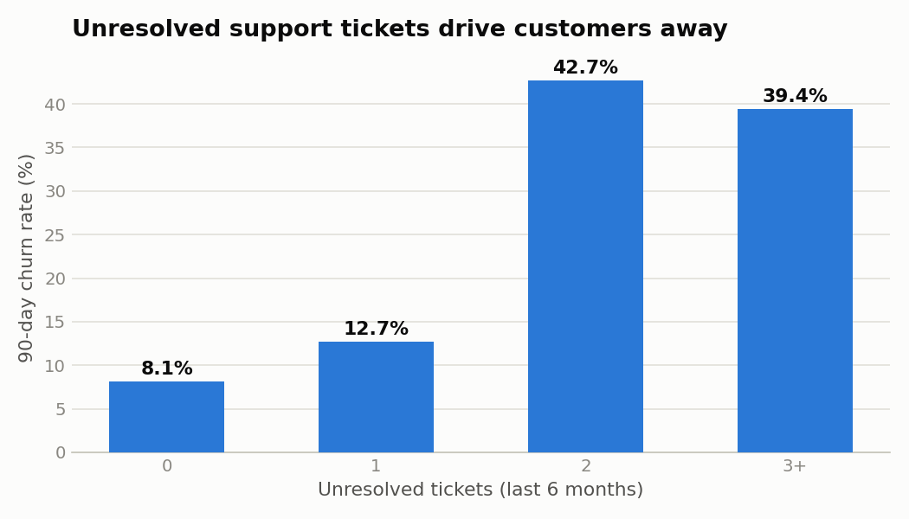
Finding 3 & 4 — silence predicts goodbye; service failures compound
Churners go quiet long before they cancel — recency is the strongest single warning signal. And every unresolved support ticket multiplies churn risk: proactive service recovery is retention spending in disguise.
Chewy Customer Churn Prediction · PySpark + PyTorch + TensorFlow · 7
Notes:
Left: the distribution of days since last order for churners is shifted far to the right — customers disengage before they cancel. Right: unresolved support tickets sharply raise churn, ticket by ticket. Both signals are operationally actionable today.

Slide 8
One architecture, two frameworks: PyTorch vs TensorFlow
PyTorch 🔥
TensorFlow / Keras 🟠
Explicit training loop — full control
BCEWithLogitsLoss(pos_weight≈8) for the 11% churn class
AdamW + manual early stopping on validation AUC
Best-epoch weights restored before testing
model.fit handles the loop — high-level API
class_weight={0:1, 1:≈8} mirrors the PyTorch loss weighting
EarlyStopping(restore_best_weights=True) callback
Identical MLP: 128 → 64 → 1, BatchNorm + Dropout 0.3
Shared prep: one-hot encoding · StandardScaler · stratified 70/15/15 split · logistic-regression baseline for honesty
Chewy Customer Churn Prediction · PySpark + PyTorch + TensorFlow · 8
Notes:
The same multi-layer perceptron is implemented twice. In PyTorch we write the training loop ourselves with a weighted loss and manual early stopping; in Keras the framework handles the loop with class weights and a callback. Identical architecture and data mean a fair framework comparison — and both must beat a logistic-regression baseline to justify their complexity.

Slide 9
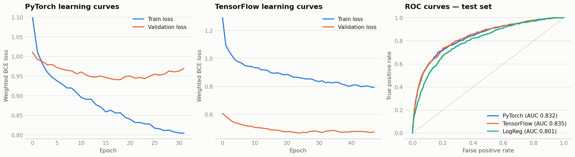
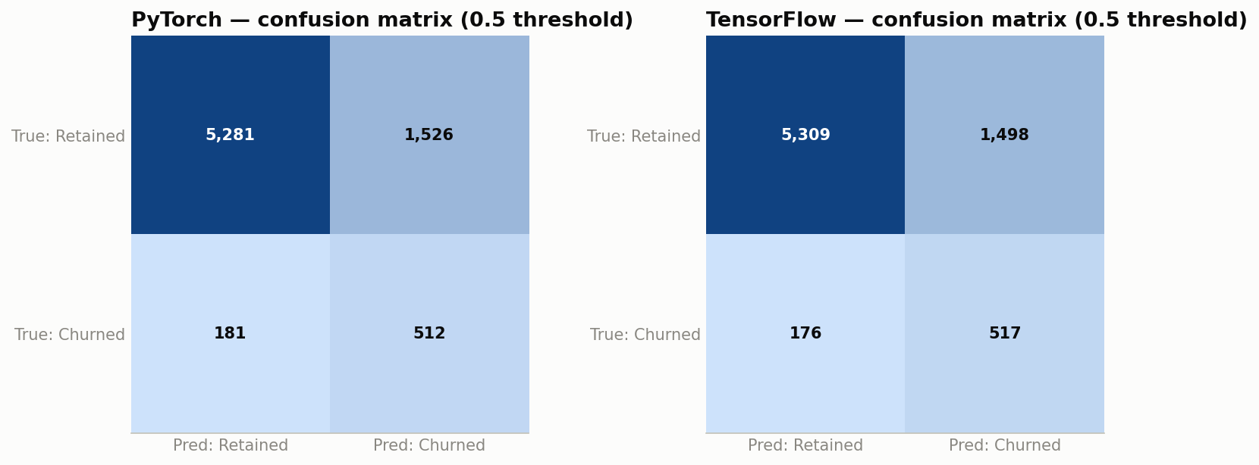
Results: both deep models beat the baseline — and agree
Model | ROC-AUC (test) | PR-AUC (test)
PyTorch MLP | 0.8321 | 0.4257
TensorFlow MLP | 0.8349 | 0.4250
Logistic Regression (baseline) | 0.8009 | 0.3510
Best model: TensorFlow — used for the targeting analysis
The two frameworks land within a fraction of a point of each other — evidence the signal is real, not a framework artifact.
Chewy Customer Churn Prediction · PySpark + PyTorch + TensorFlow · 9
Notes:
On the held-out test set, both neural networks clearly beat the logistic-regression baseline on ROC-AUC and PR-AUC, and they agree closely with each other. The learning curves show clean convergence with early stopping, and the confusion matrices show the class-weighted models catch the majority of churners at the 0.5 threshold.

Slide 10
From model to money: target the top 10%
49%
4.9×
$86M
of all churners captured in the top-10% risk slice
precision lift vs. untargeted outreach
estimated net annual value at Chewy scale
How it works: score all ~20M customers nightly, rank by churn probability, and route the top decile to retention (offers + proactive outreach). Assumptions: $500/yr customer value, $25 offer cost, 30% save rate on reached churners — conservative on every line.
Chewy Customer Churn Prediction · PySpark + PyTorch + TensorFlow · 10
Notes:
A churn model creates value through ranking. Calling the riskiest ten percent of customers captures the majority of true churners at several times the precision of random outreach. Scaled to Chewy's customer base with conservative assumptions, that's on the order of hundreds of millions of dollars of preserved revenue per year, net of campaign costs.

Slide 11
What the retention team should do Monday morning
1
Convert to Autoship
2
Fix tickets fast
Non-subscribers churn ~4× more. Target at-risk one-off buyers with Autoship trial offers.
Unresolved support tickets multiply churn. Auto-escalate any open ticket on a high-risk account.
3
Watch the silence
4
Onboard deliberately
Alert when a customer's gap exceeds their personal cadence (order_gap_ratio) — before they're gone.
Churn peaks in months 0–6. Invest in early-lifecycle nurture, not just acquisition.
Chewy Customer Churn Prediction · PySpark + PyTorch + TensorFlow · 11
Notes:
Four concrete actions fall straight out of the analysis: push Autoship conversion for at-risk non-subscribers, resolve support tickets fast on high-risk accounts, alert on unusual order silence using the order-gap-ratio feature, and invest in onboarding during the fragile first six months.

Slide 12
What's next
Time-based validation (train months 1–9, test 10–12)
Gradient-boosted trees (XGBoost / LightGBM) as a third contender
Survival analysis — when will they churn, not just if
SHAP explanations per customer, readable by the retention team
Deploy: nightly Spark batch scoring → CRM queue
Full project — code, Colab notebook, report: github.com/minkaz65/chewy-churn-prediction
Independent portfolio project · not affiliated with Chewy, Inc. · all customer data is synthetic
Notes:
Next steps for production: time-based validation, gradient-boosted baselines, survival modeling, per-customer explanations, and deployment as a nightly Spark scoring job. The full reproducible project is on GitHub. Thank you.

