Slide 1
SRT AI Session Game
Min Kwon, minkwon@snu.ac.kr
https://github.com/minkwon1252/2025_SRT_AI_Politics

Slide 2



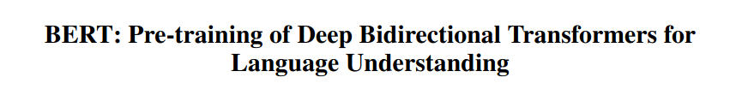

Game Objective & Flow
SRT
vs
US, China
AI Models
 | # of notable models | # of notable papers
KR | 150 | 1
JP | 200 | 0
TW | 50 | 0
MN | 1 | 0
 | # of notable models | # of notable papers
US | 3200 | 40
CN | 2000 | 15
AI Papers
*Based on Stanford HAI 2025 report
Secure your country’s success in AI development + Catch up US and China by cooperation

Slide 3
Game Objective & Flow
Circumstance
Determine your country's domestic event (D1) and the international event (I1) for this round. Hints are also provided here for the "Policy" stage.
Policy
Set your country’s AI industry policy. This stage determines your country’s inherent growth rate of AI research papers—for example, 174 papers per year.
Cooperation
Engage in negotiations with others to gain extra models and papers. Successful cooperation in international events grants bonus outcomes.
Events
You receive an additional domestic event (D2) and international event (D2). You are allowed one policy revision, including the option to betray previous commitments.
Summary
The final outcomes for each country, including the US and China, are presented in this section. See who cooperated, who betrayed, and who ultimately thrived.
Login → ( Round 1) Circumstance → Policy → Cooperation (Negotiation) → Events → Summary → (Round 2)

Slide 4
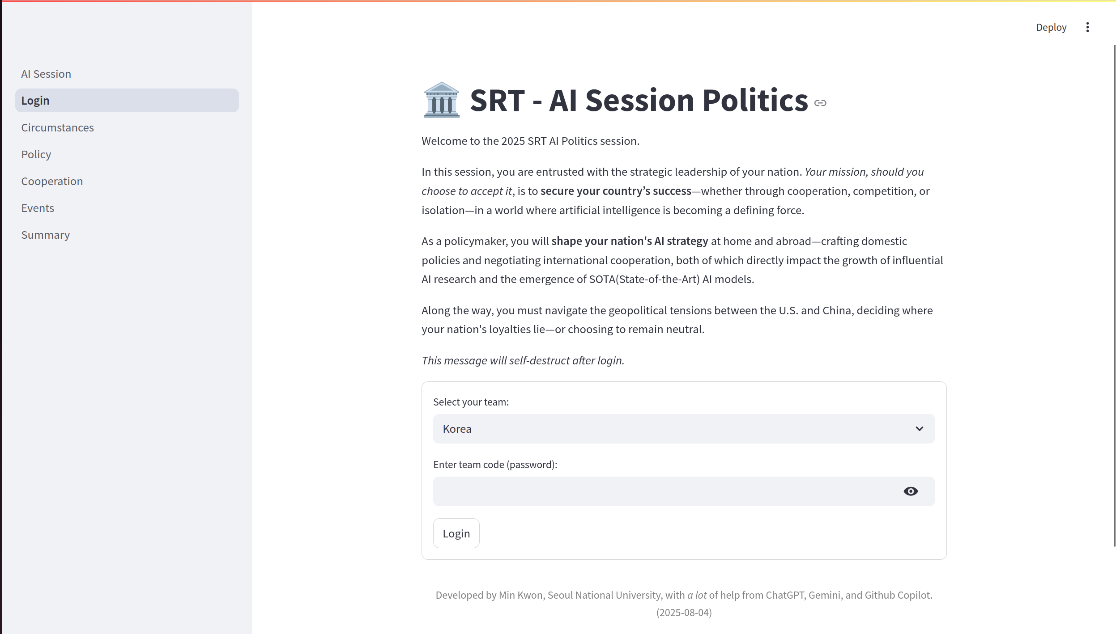
0_Login
Game Flow : Go to the AI Session for an overview of the game’s concept.
Login Box :
Select your team and input password

Slide 5
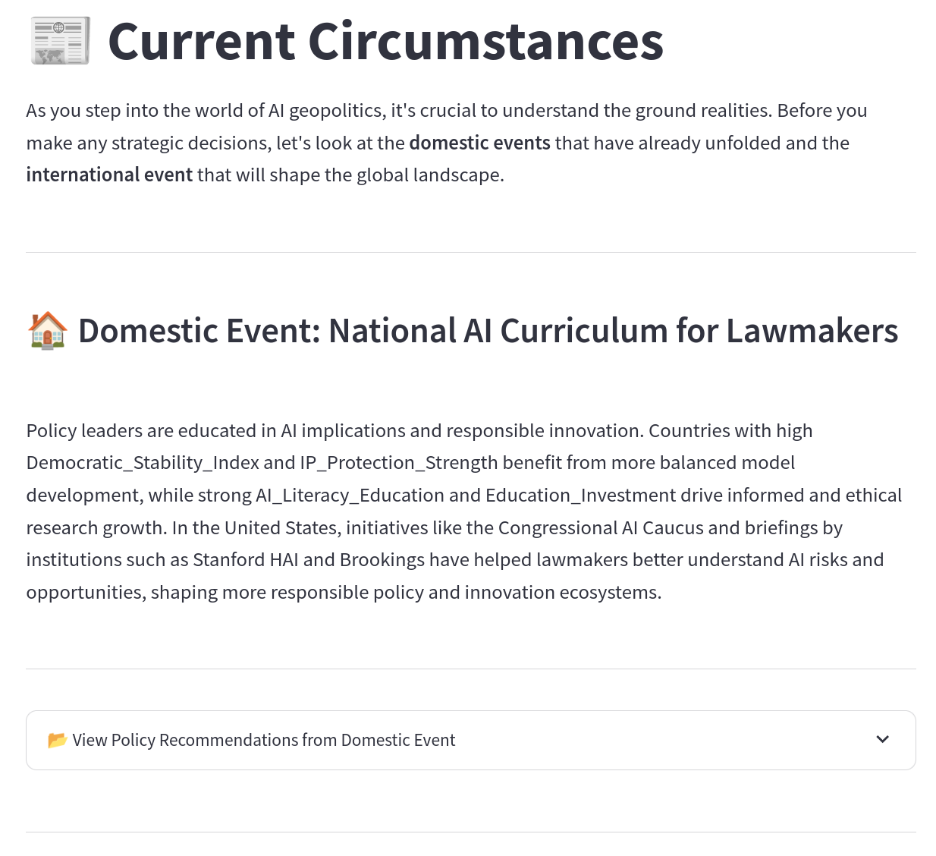
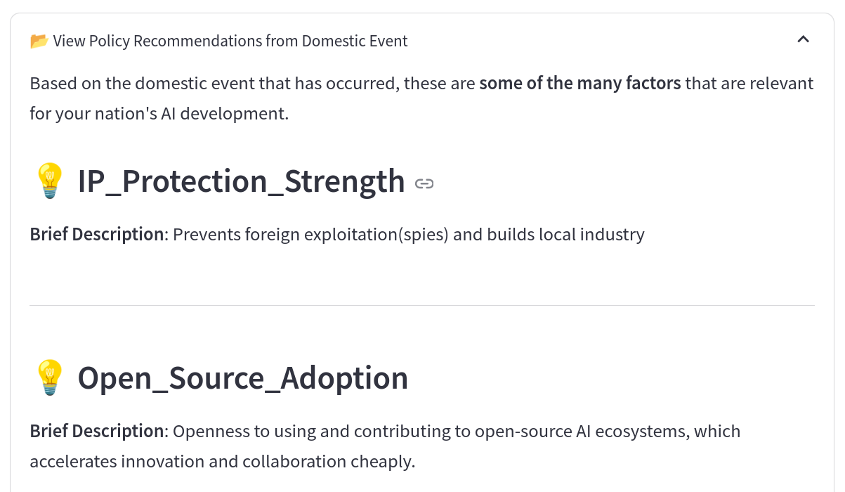
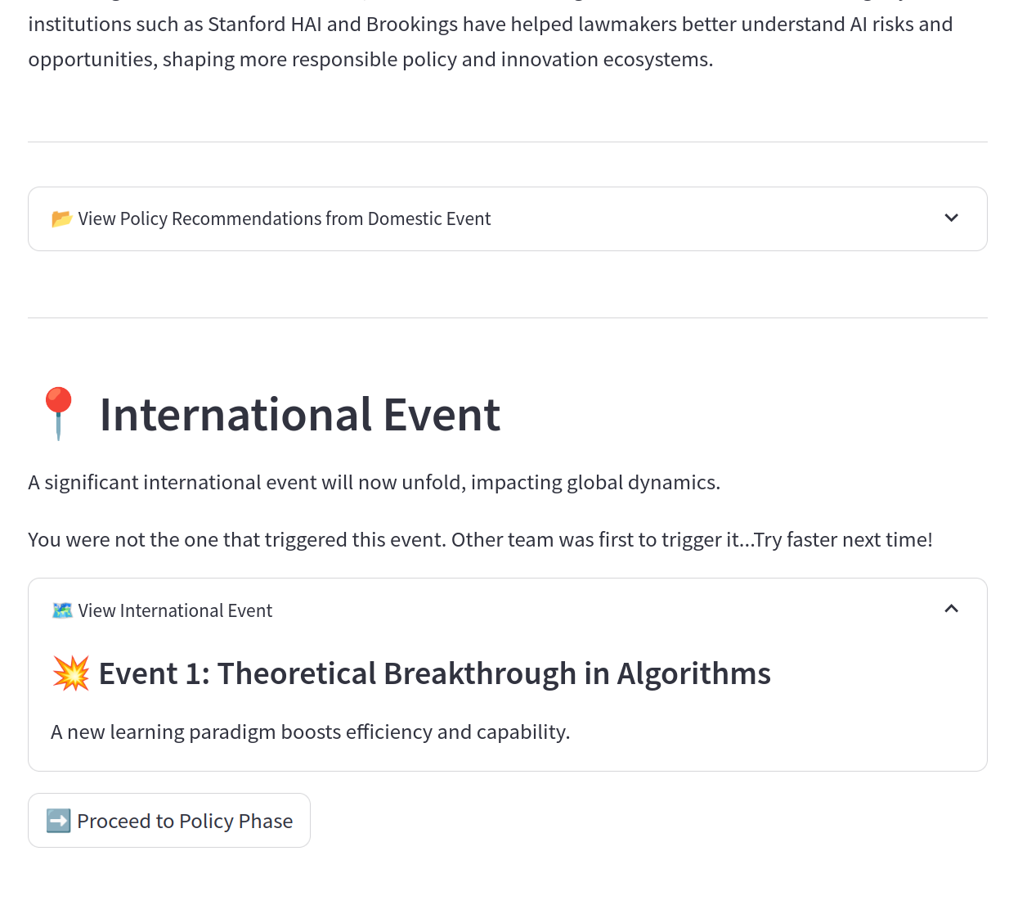
1_Circumstance
Opening it will provide hints to help guide your policy decision.
D1 and its description: pay close attention; it could guide your policy decision.
E1 and its description: this is the same for all four countries.
Move on to the next page

Slide 6
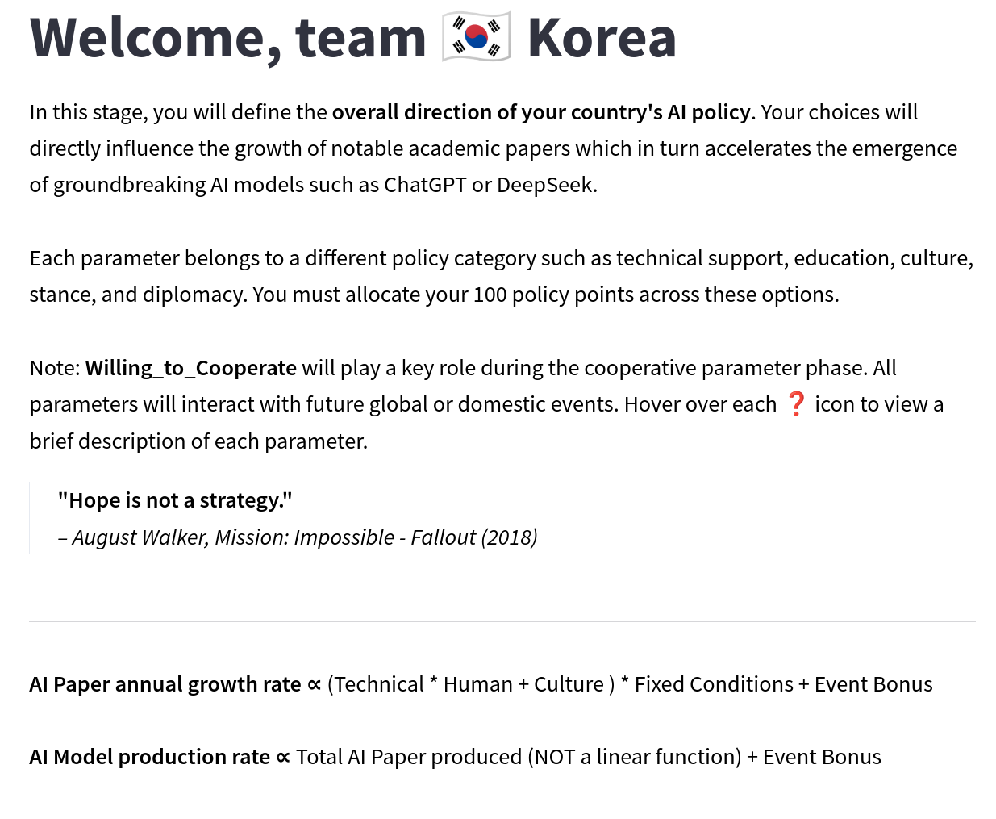
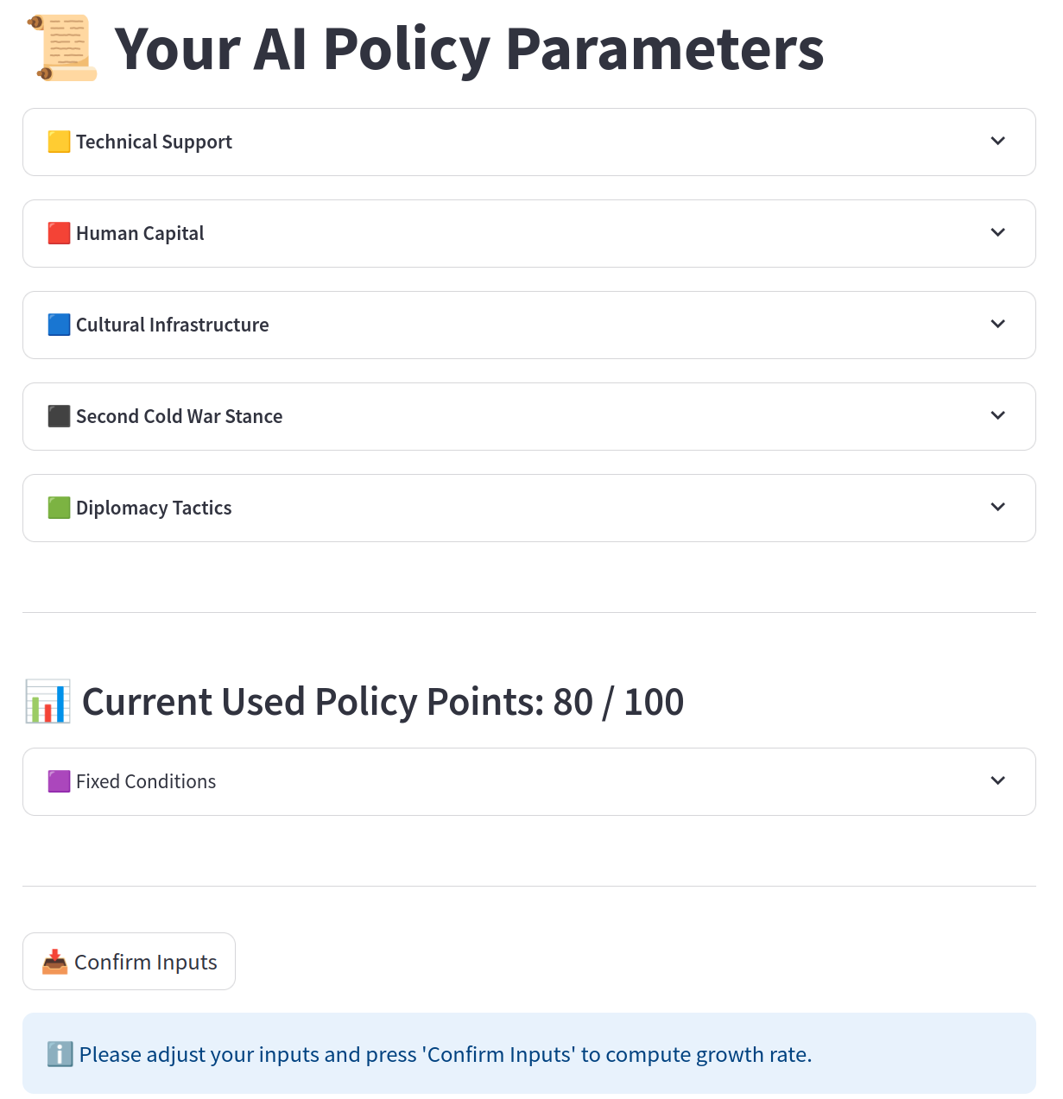
2_Policy
An approximate formula for the inherent growth rate of AI research papers and models
5 policy categories, each containing multiple parameters—15 in total.

Slide 7
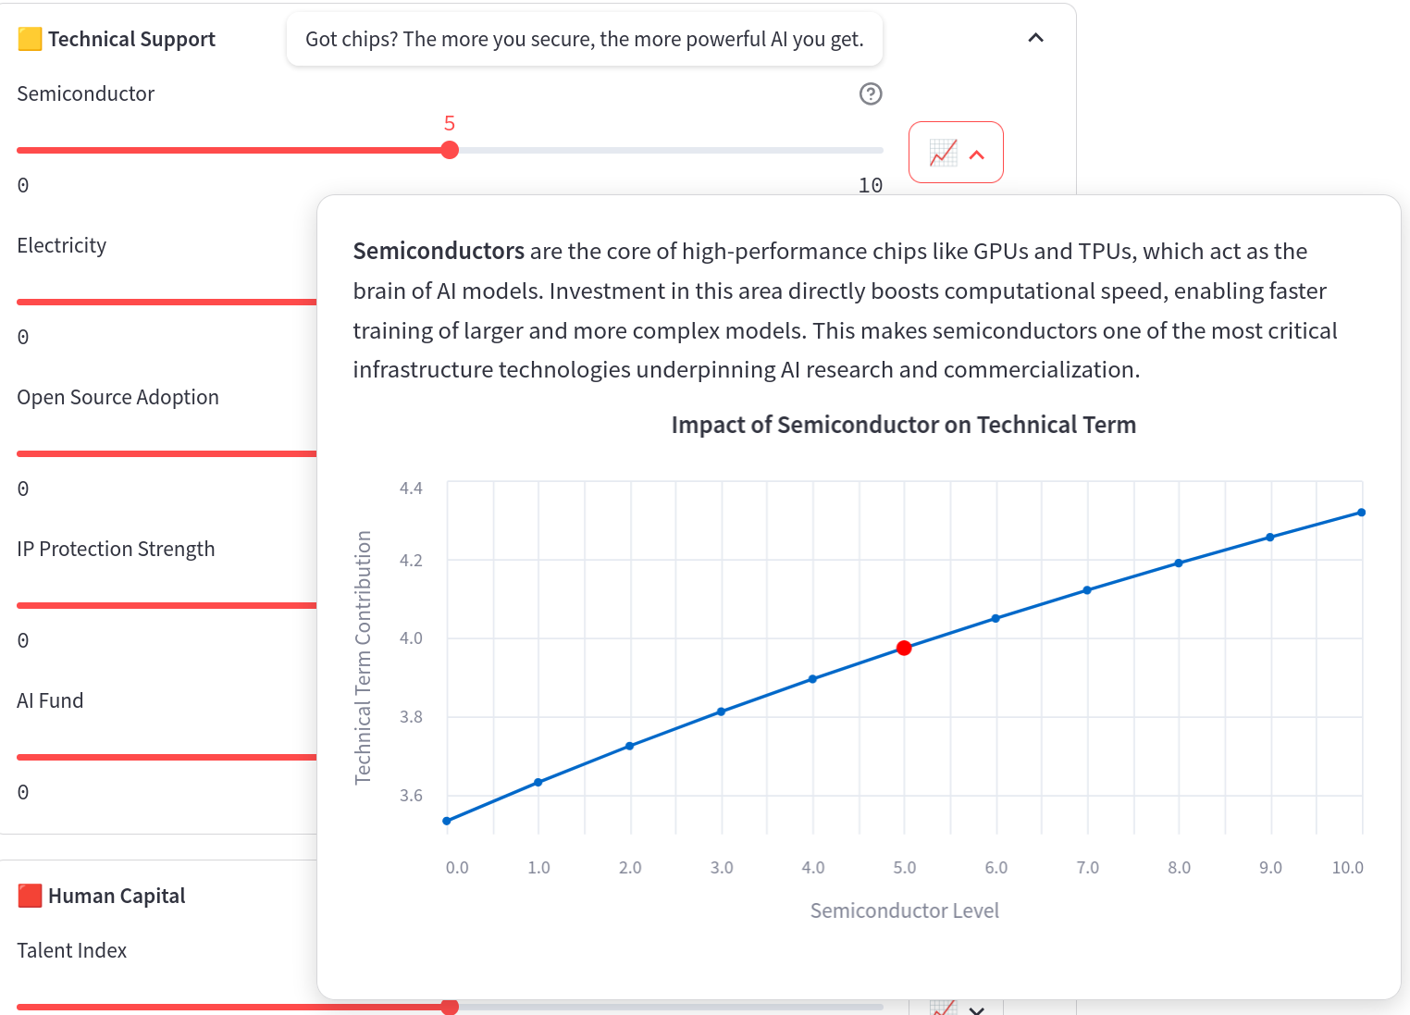
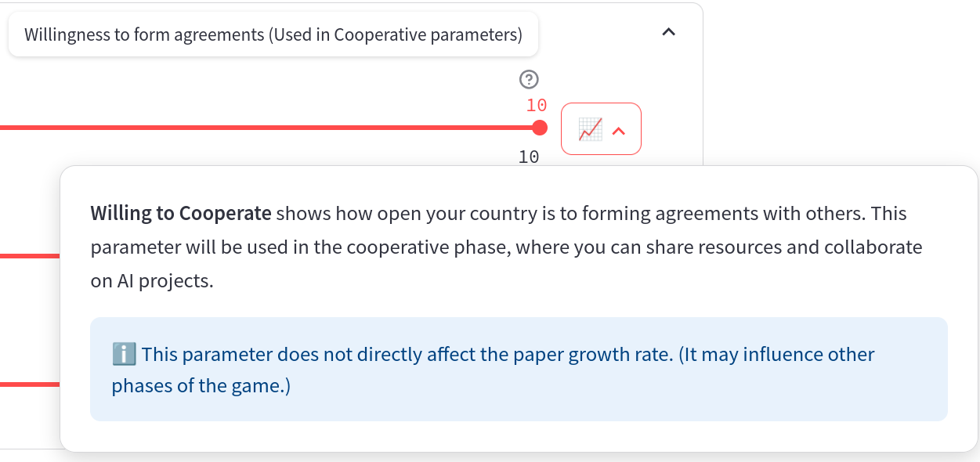
2_Policy
Example of Tech policy
Some parameters are used in later phases—for example, Willing_to_Cooperate is used during 3_Cooperation.

Slide 8
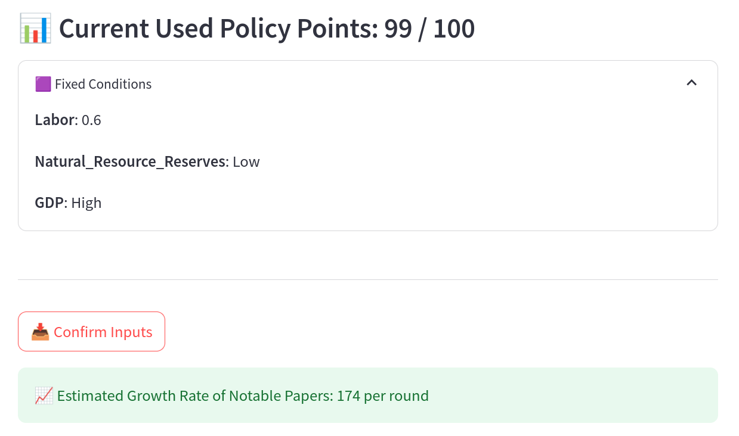
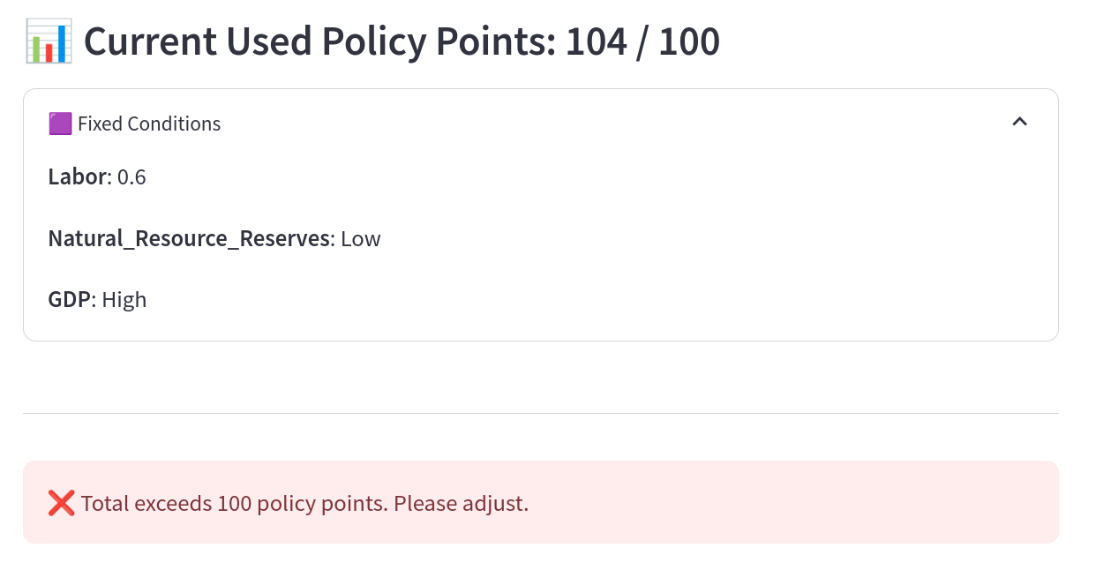
2_Policy
When successful...
If not,
your country’s inherent growth rate of AI research papers

Slide 9
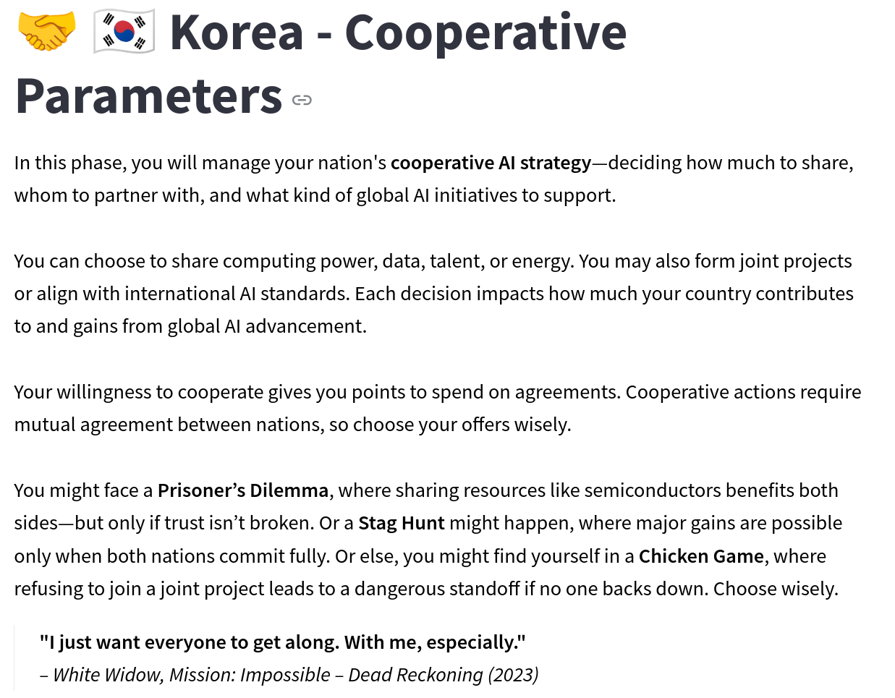
3_Cooperation
In this phase, you should meet with other countries and engage in negotiations for cooperation.
There are three types of cooperation: (1) Resource Sharing, (2) Emergency Pact, and (3) Joint Projects.

Slide 10
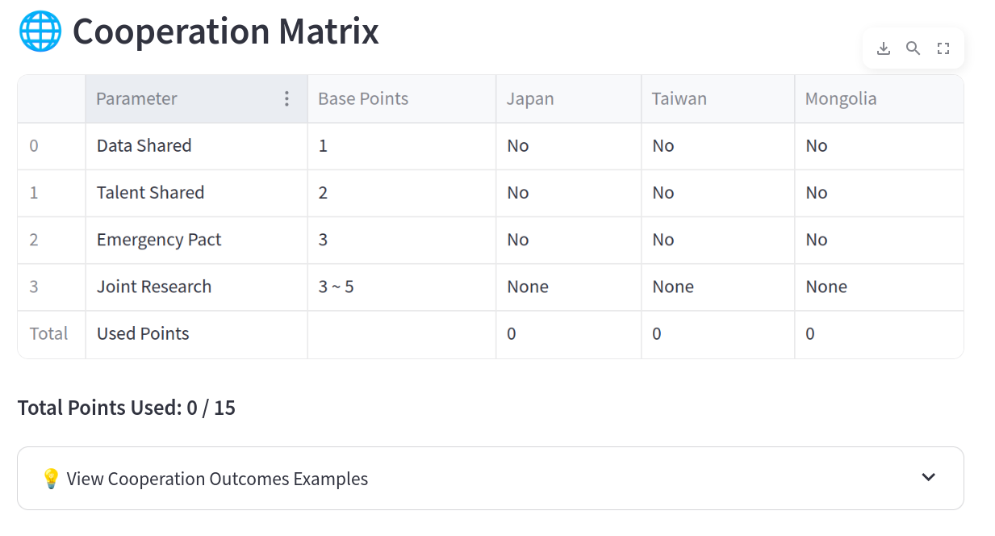



3_Cooperation
Explains how cooperation can affect your papers and models Type 1 : Non cooperative event Type 2 : Cooperative Event
 | B Resource > 7 | B Resource <= 7
A resource > 7 | Both earn lot | B gains a lot, A loose
A Resource <= 7 | B gains a lot, A loose | Both loose
Base point 10
This matrix updates when you press...

Slide 11
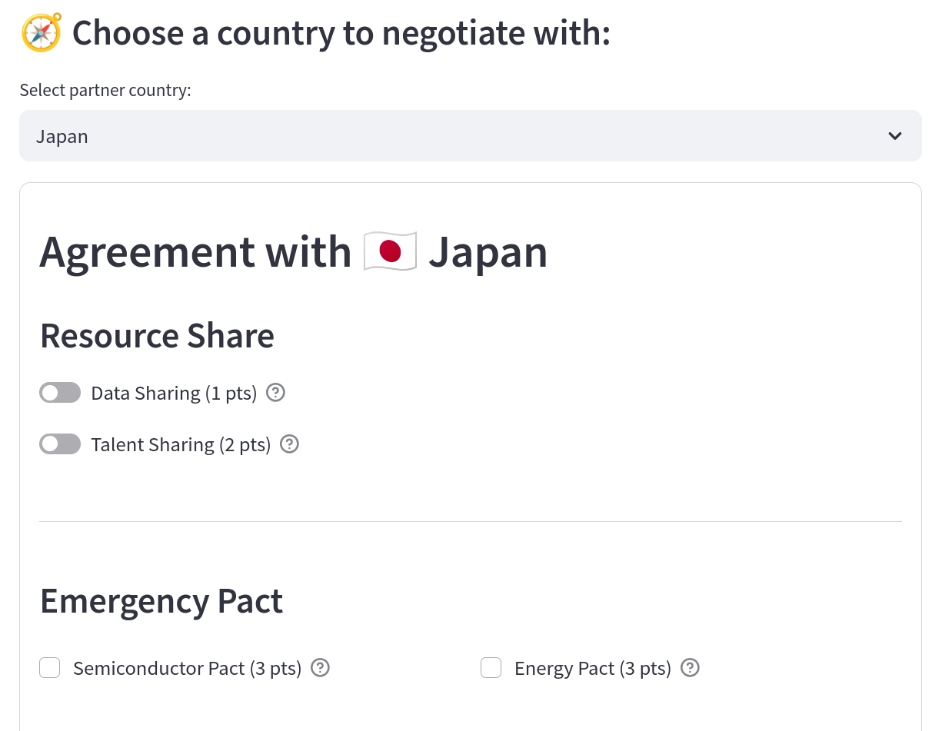
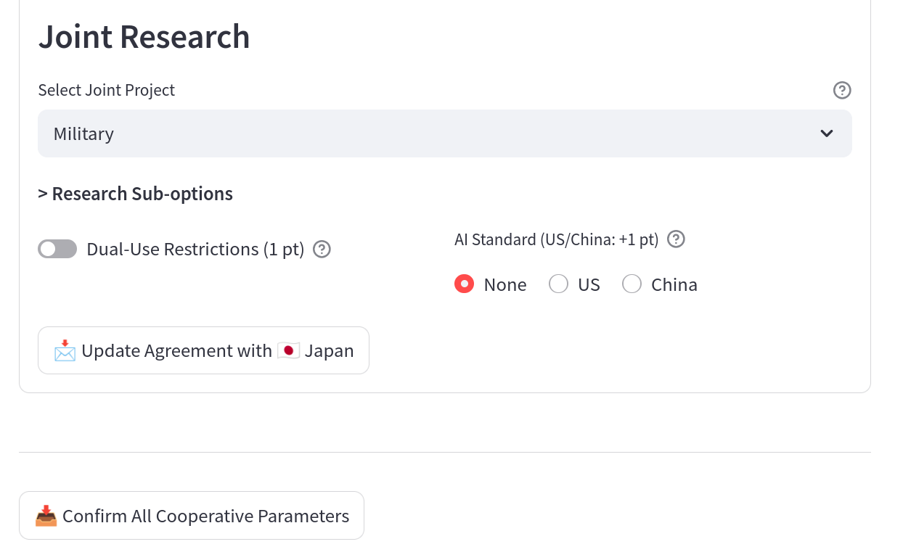
3_Cooperation
Choose the country to negotiate with
This pops up after you select joint project and update agreement
Move on to the next page

Slide 12
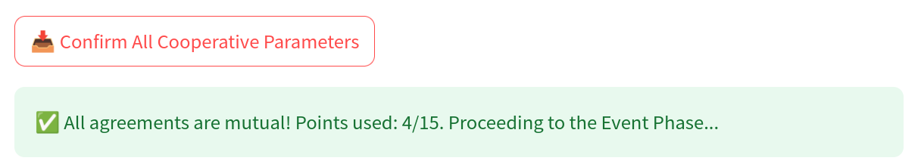
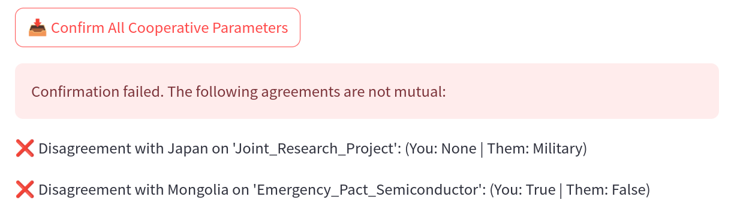
3_Cooperation
If all agreements are met...
If not ...

Slide 13
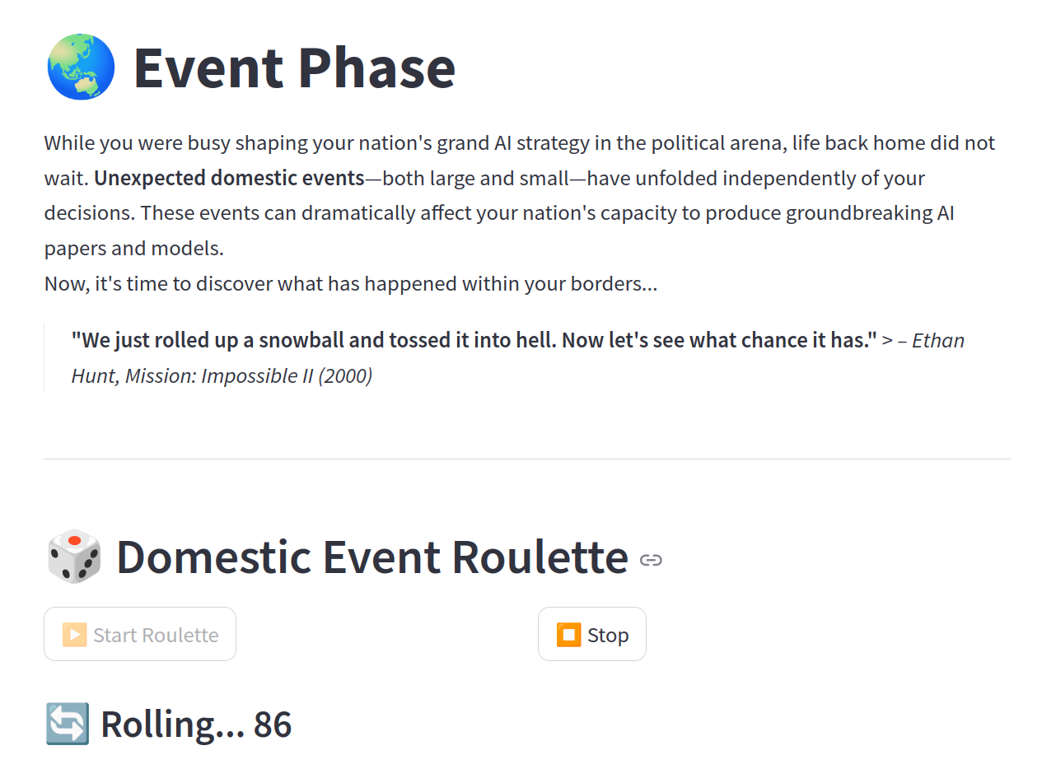
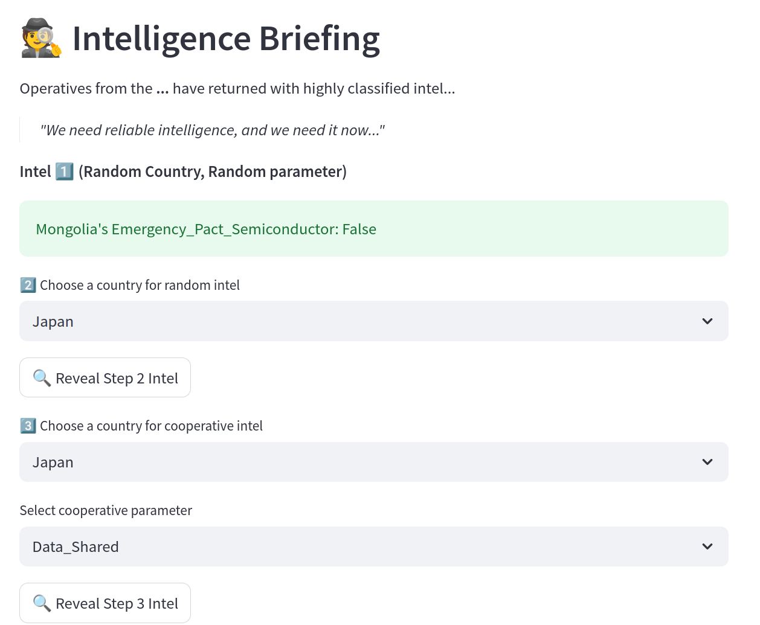
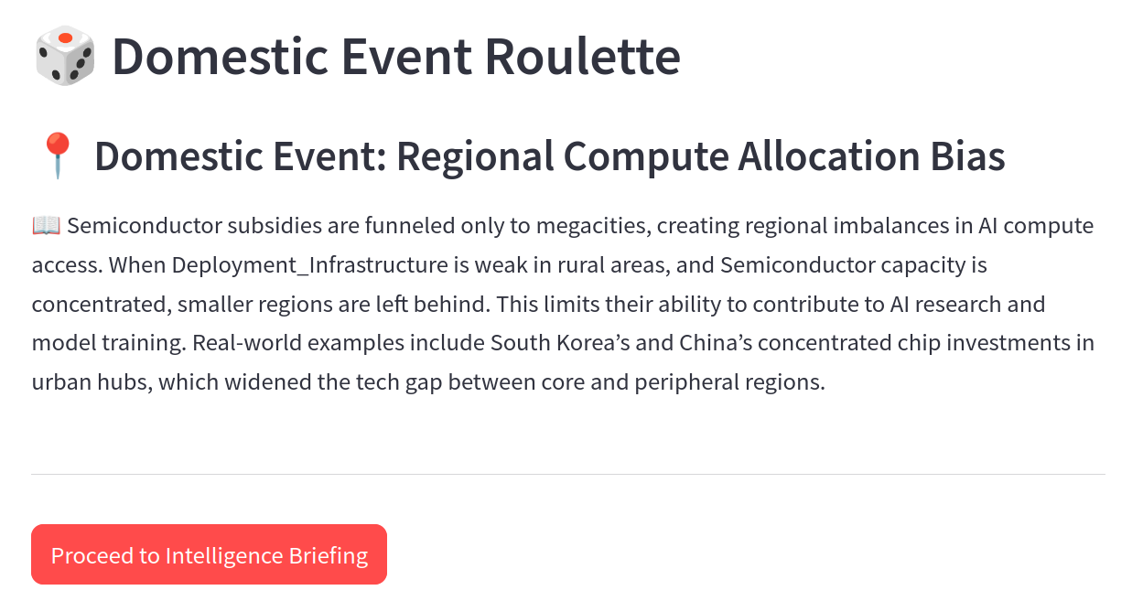
4_Event
Roll the dice to determine your second Domestic event
Investigate what others chose
Roll → (D2) Domestic event → Investigate → Policy Revision → (I2) International event → Summary

Slide 14
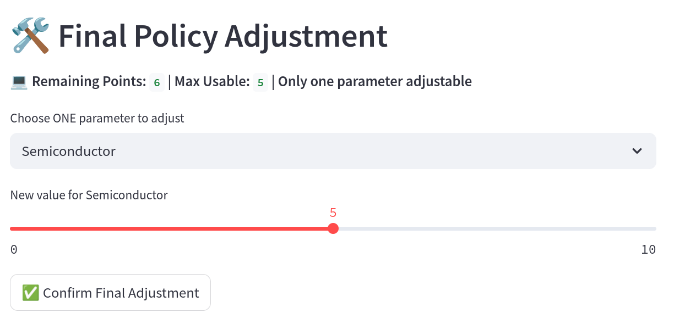
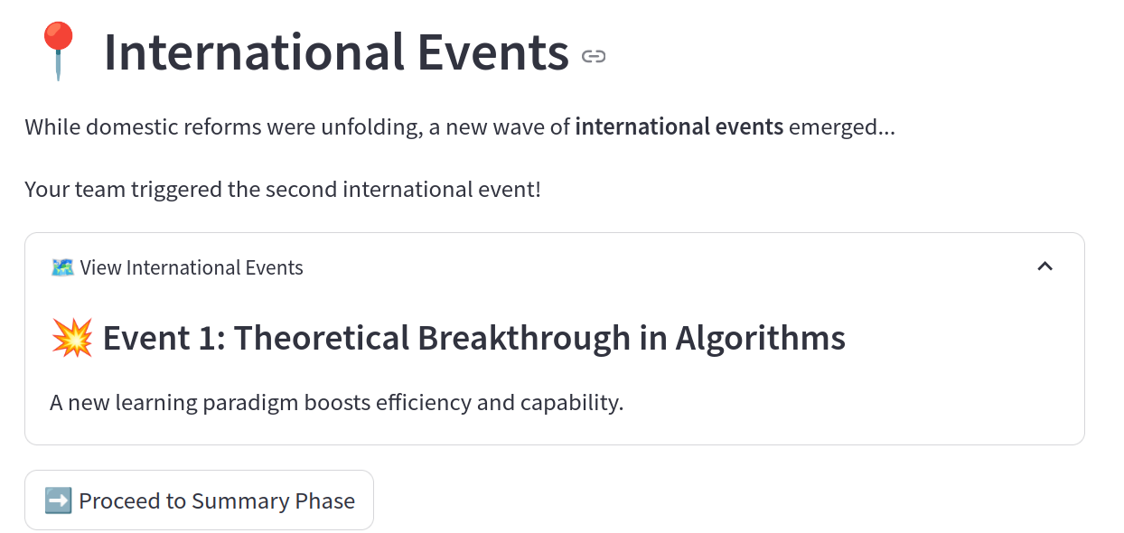
4_Event
Adjust your policy
Second international event
Roll → (D2) Domestic event → Investigate → Policy Revision → (I2) International event → Summary

Slide 15
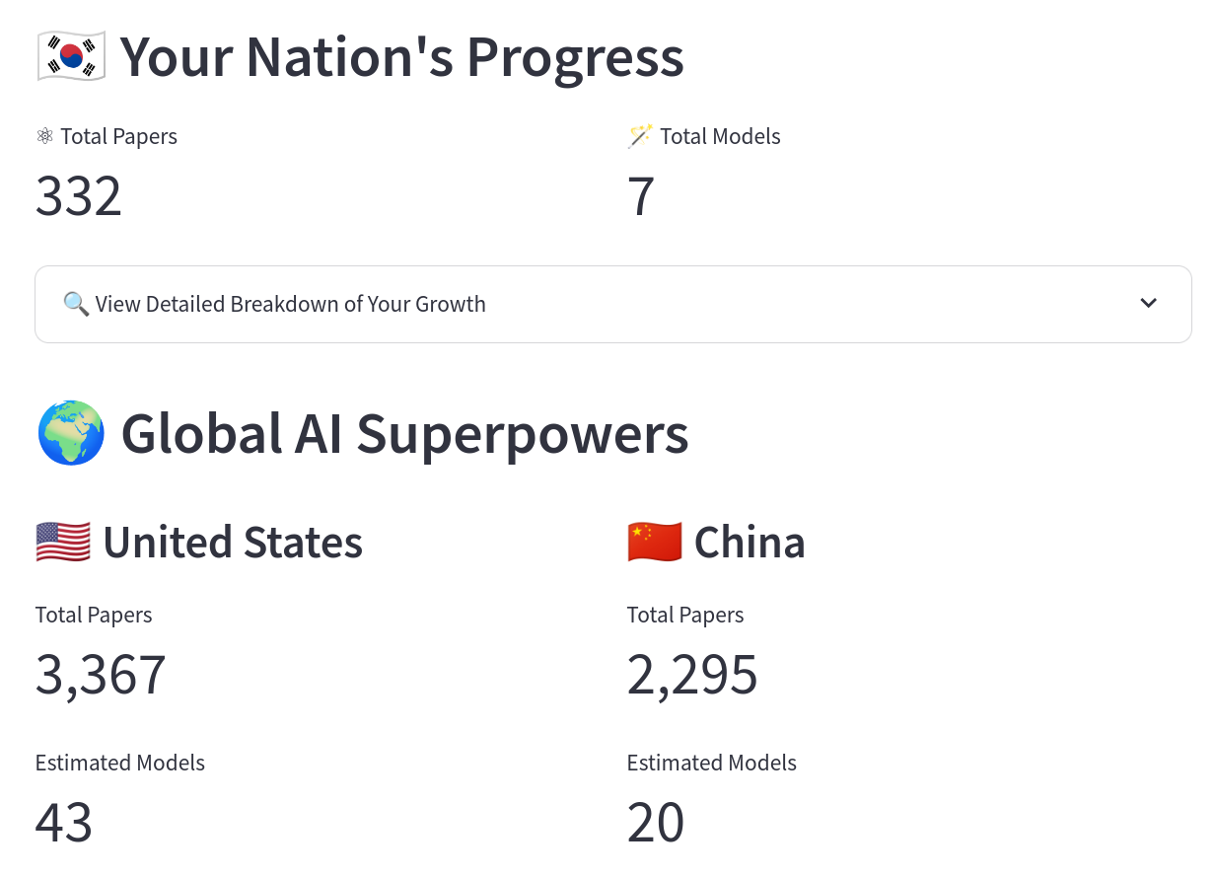
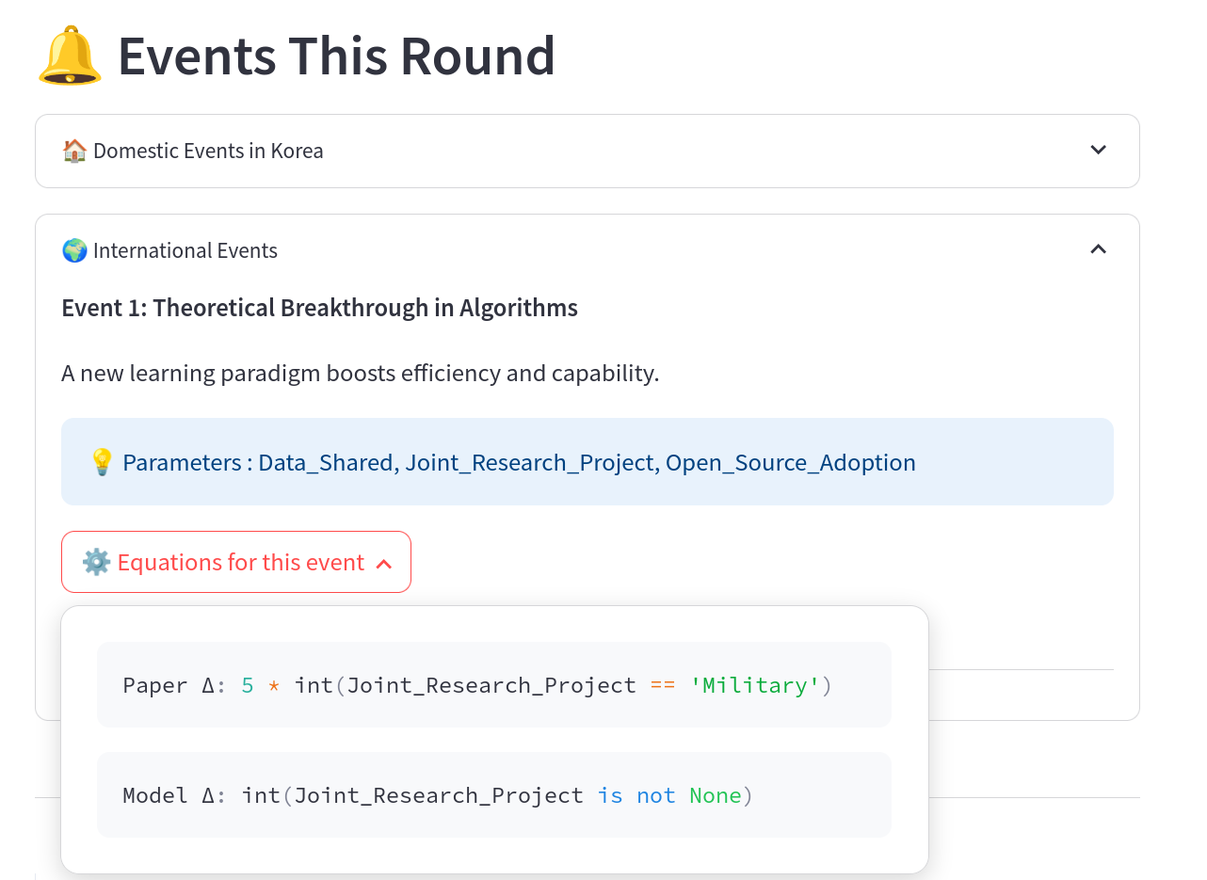
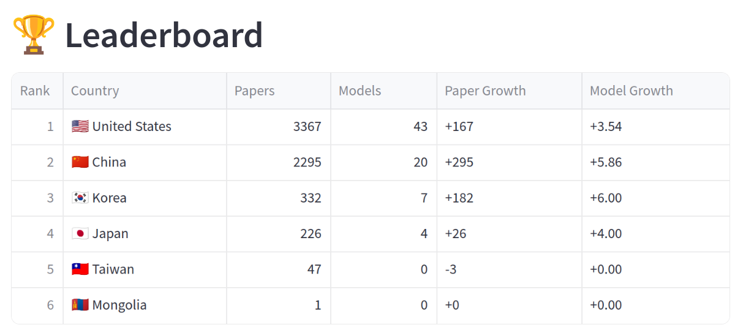
5_Summary
Some hints for the results
+

Slide 16
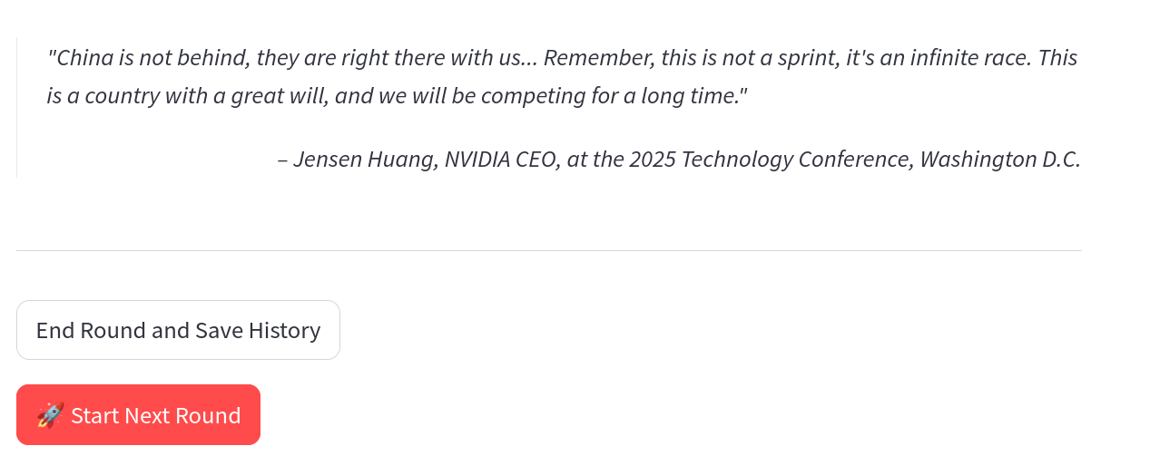
5_Summary
Please save your history and press 'Start Next Round.' You will be sent back to Phase 1: Circumstance.

Slide 17
Questions

