Slide 1

UE24AM342AA1 – Advanced Foundations in Machine Learning
Project Title: Does a Learned Starting Point Make Viscosity Estimation Cheaper?
A cost-counted study on the Burgers equation
Team member 1 SRN and name: Sampreeth Jaladi
Team member 2 SRN and name: Samarth
Team member 3 SRN and name: Sarva Sandip
Team member 4 SRN and name: Sai Likhith S

Slide 2
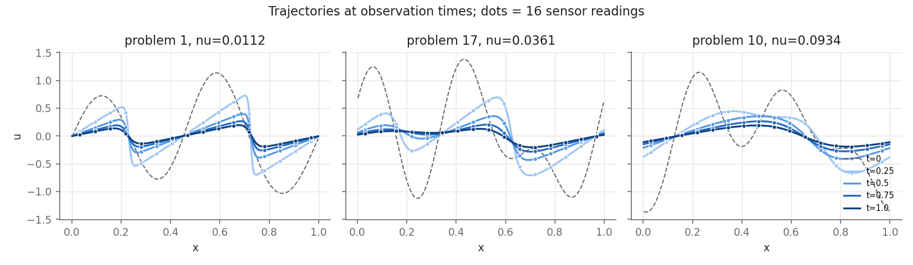
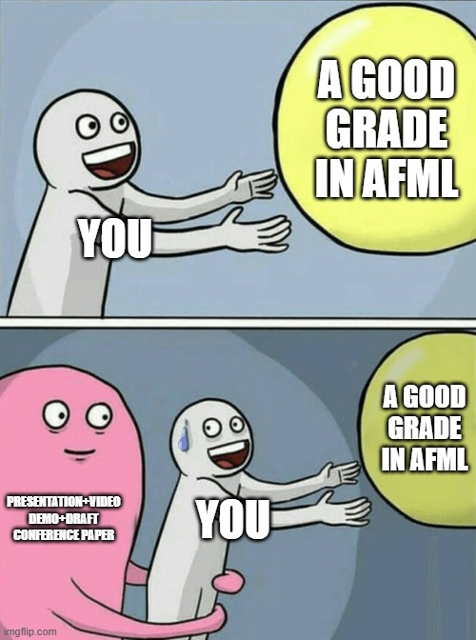
Topic
Goal: find the viscosity of a fluid (1-D Burgers equation) from a few noisy sensor readings
Standard way: run the simulator again and again until it matches the readings; each run costs time
Our question: if a small neural network guesses the viscosity first, does the fit need fewer runs?
Fair test: against the best classical search, counting every run and the network's training cost

Slide 3
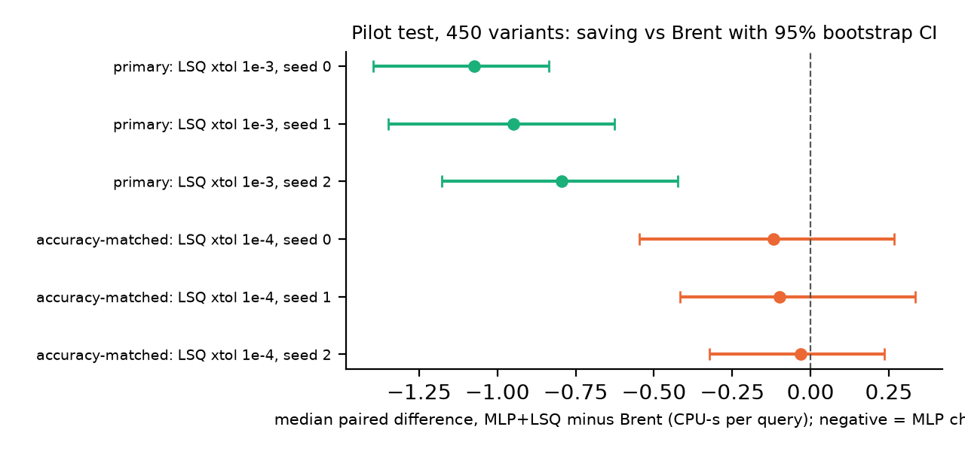
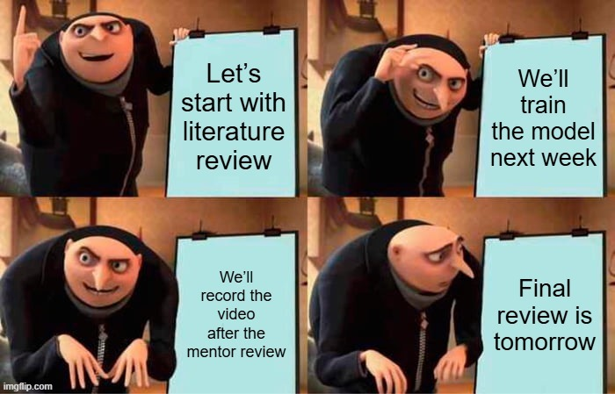
Uniqueness
Compared with a strong baseline (Brent's search), not only with a poor starting guess
Counts the network's training cost and gives a break-even number of queries
Test protocol written down and committed before the test data were used
Checks accuracy against the theoretical limit (Cramér–Rao bound)
Reports a negative result honestly: the 2x target was not met

Slide 4
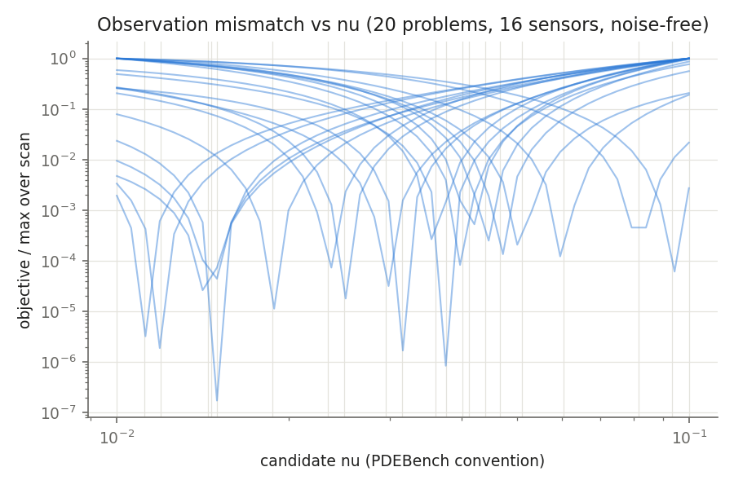
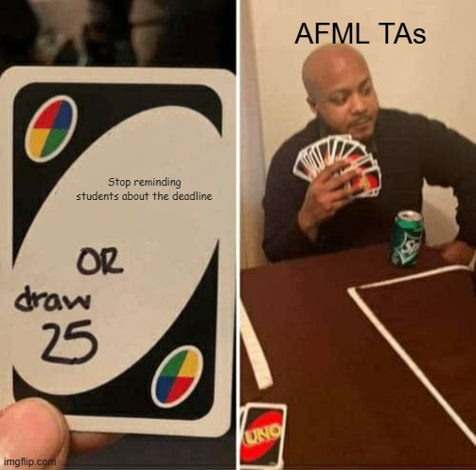
Dataset
Source: generated by our own Burgers solver (no public dataset; PDEBench scheme)
Size: 3,000 train / 50 val / 50 test trajectories = 27,000 / 450 / 450 cases
Attributes: 16 sensors x 4 times; 4, 8 or 16 sensors on; 0 / 1 / 5% noise; known starting state
Target: log viscosity, viscosity in [0.01, 0.1]
Robustness sets: 3 x 50 new trajectories (new starting states, finer grid, unseen sensor patterns)
Checks: split by trajectory seed; 9 automated integrity checks

Slide 5
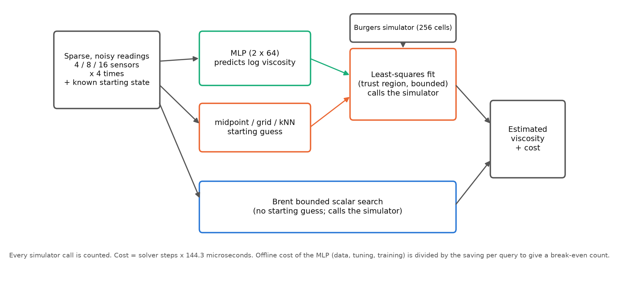

Overall design or approach in a free hand diagram
Same simulator, bounds and cost accounting for every method; every simulator run is counted

Slide 6
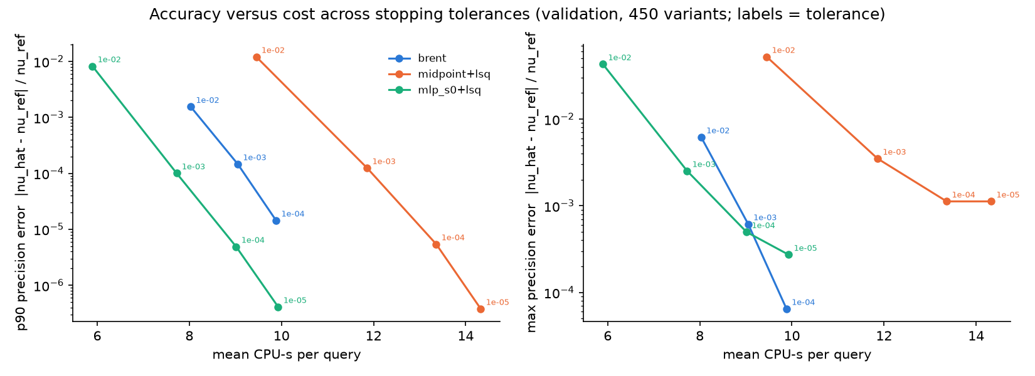
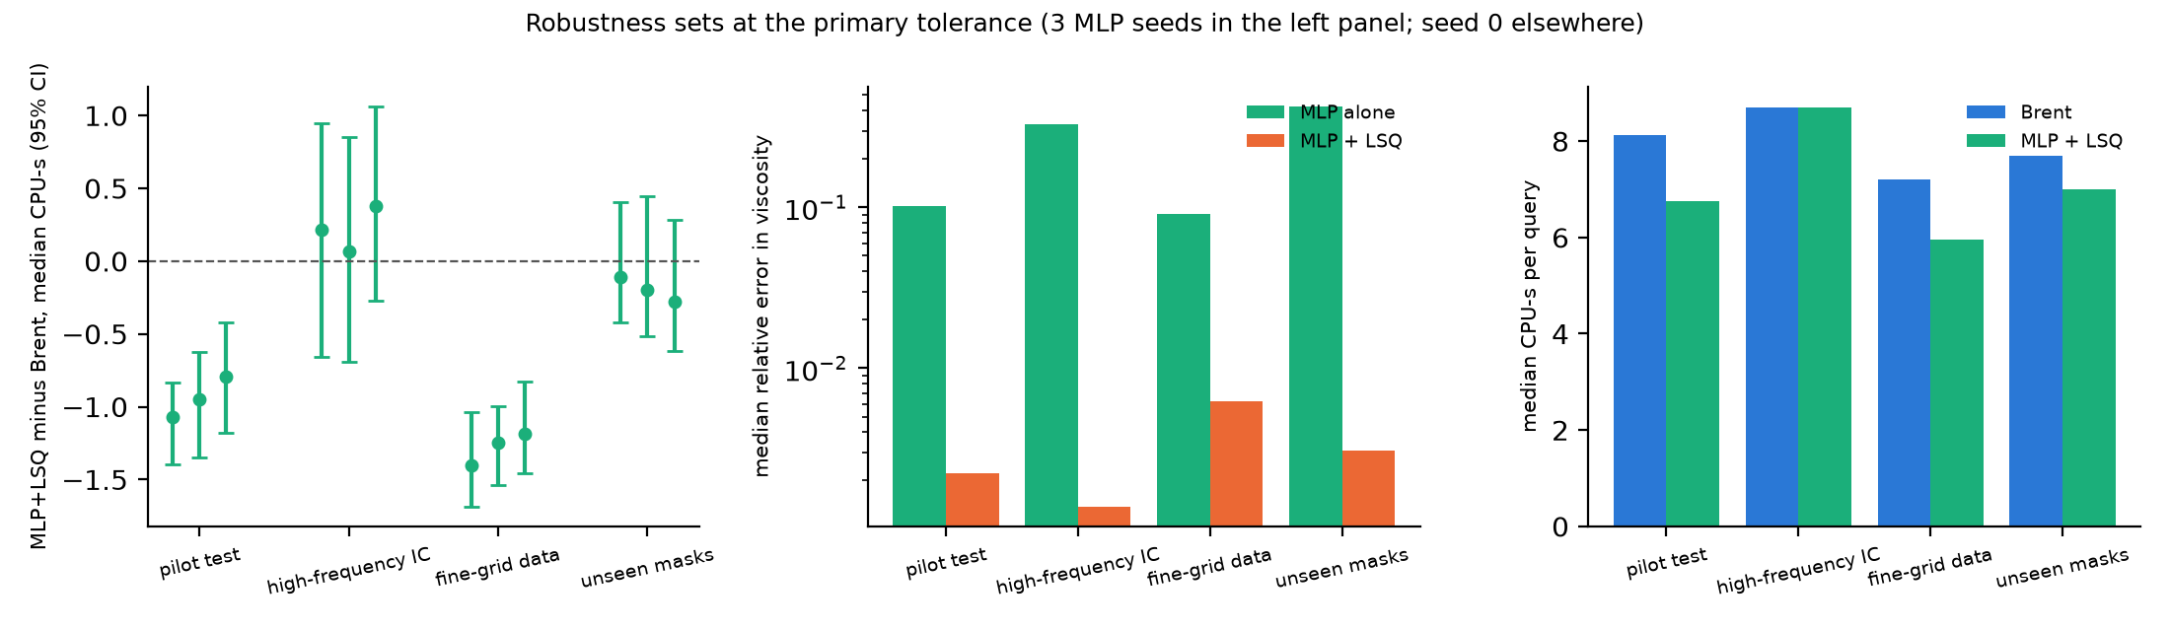
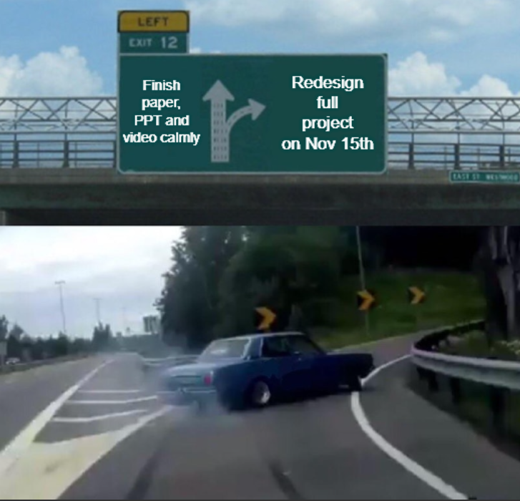
Final results so far
Same accuracy for all methods (0.22% median error); matches the Cramér–Rao limit
Learned start vs midpoint start: about 2 CPU-s saved per query on the pilot test
Learned start vs Brent: 0.8–1.1 CPU-s saved at the loose tolerance, ~0 at the tight one
Pre-registered test: not positive; 2x target not met (1.2x at matched typical precision)
Follow-up (after the test): MLP guess as a bracket for Brent saves 8–10%
Break-even 2,600–4,500 queries; saving gone for unseen starting states / sensor patterns

Slide 7
Done vs Remaining to be done?
No | Description | Done or To be done
1 | Burgers solver + 11 correctness tests (exact Cole–Hopf solution) | Done
2 | Classical methods: Brent, midpoint / grid / kNN + least squares | Done
3 | Dataset generator, 9 integrity checks; MLP trained (3 seeds) | Done
4 | Pre-registered test evaluation and go/no-go verdict | Done
5 | Tolerance curves, Cramér–Rao bound, robustness sets, ablations | Done
6 | IEEE paper, slides, repository documentation | Done
7 | Larger 200-trajectory test set (optional); presentation video | To be done

Slide 8
Quantity and quality of work
no | Code functionality | % Complete | Runs without problem (Y/N) | If there are minor issues, indicate
1 | Burgers finite-volume solver | 100 | Y | ~1 s per run at high viscosity
2 | Inverse methods (Brent, LSQ, starts) | 100 | Y | —
3 | Dataset build + integrity checks | 100 | Y | ~4 min on 8 cores
4 | MLP training and tuning | 100 | Y | —
5 | Paired evaluation (resumable) | 100 | Y | ~45 min per test set, 12 workers
6 | Bootstrap analysis + break-even | 100 | Y | —
7 | Tolerance curves / Cramér–Rao bound | 100 | Y | —
8 | Robustness sets + ablations | 100 | Y | fine-grid build is slowest
9 | Test suite (pytest) | 100 | Y | 29 tests pass

Slide 9
Top learning points
Serial No | Top learning in this project
1 | Pick the strongest baseline: a learned start that beats a midpoint guess can still lose to a direct search
2 | A speed-up can depend on the stopping rule: compare at matched precision, not at one tolerance pair
3 | Count everything: derivative runs and training cost change the verdict (break-even in queries)
4 | Pre-registering the test stopped us from tuning to the result we hoped for
5 | A network helps only on inputs like its training data; refinement hides the error but not the cost

Slide 10
Top unresolved challenges
Serial No | Brief description of unresolved challenges | Type of challenge (scope/data/design/implementation / others)
1 | One equation, one scalar unknown: a 1-D search is already cheap | Scope
2 | Synthetic data only; the finer-grid set is the only model-mismatch test | Data
3 | Cost = solver steps x fixed time per step (laptop timings not clean) | Design
4 | Small test sets (50 trajectories) give wide confidence intervals | Data
5 | Learned start fails on unseen sensor patterns and starting states | Design

Slide 11
Reference papers, if any
No | Paper Title | Authors | Publication Year
1 | Learning to Warm-Start Fixed-Point Optimization Algorithms | R. Sambharya, G. Hall, B. Amos, B. Stellato | 2024
2 | A Neural Network Warm-Start Approach for the Inverse Acoustic Obstacle Scattering Problem | M. Zhou, J. Han, M. Rachh, C. Borges | 2023
3 | PDEBench: An Extensive Benchmark for Scientific Machine Learning | M. Takamoto et al. | 2022
4 | Tutorial on Amortized Optimization | B. Amos | 2023
5 | Deep Learning for Fast Inference of Mechanistic Models' Parameters | M. Borisyak, S. Born, P. Neubauer, M. N. Cruz-Bournazou | 2023
6 | The Frontier of Simulation-Based Inference | K. Cranmer, J. Brehmer, G. Louppe | 2020
7 | A Sparse Control Approach to Optimal Sensor Placement in PDE-Constrained Parameter Estimation | I. Neitzel, K. Pieper, B. Vexler, D. Walter | 2019

