Slide 1
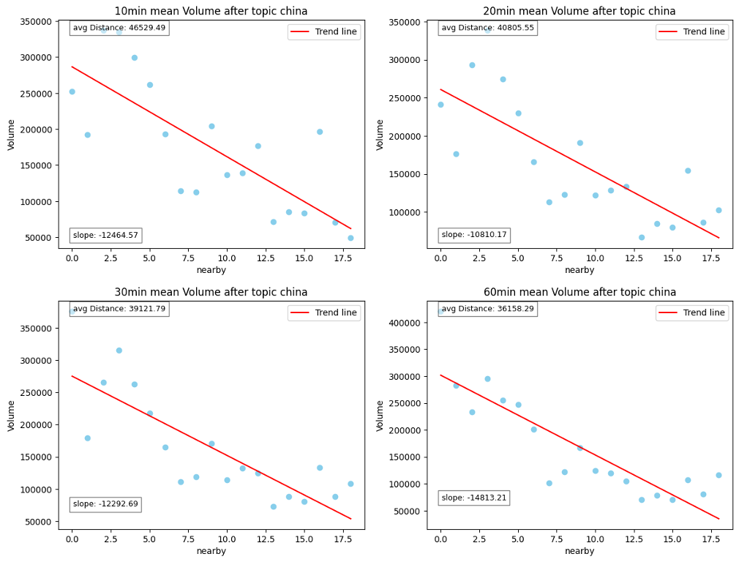
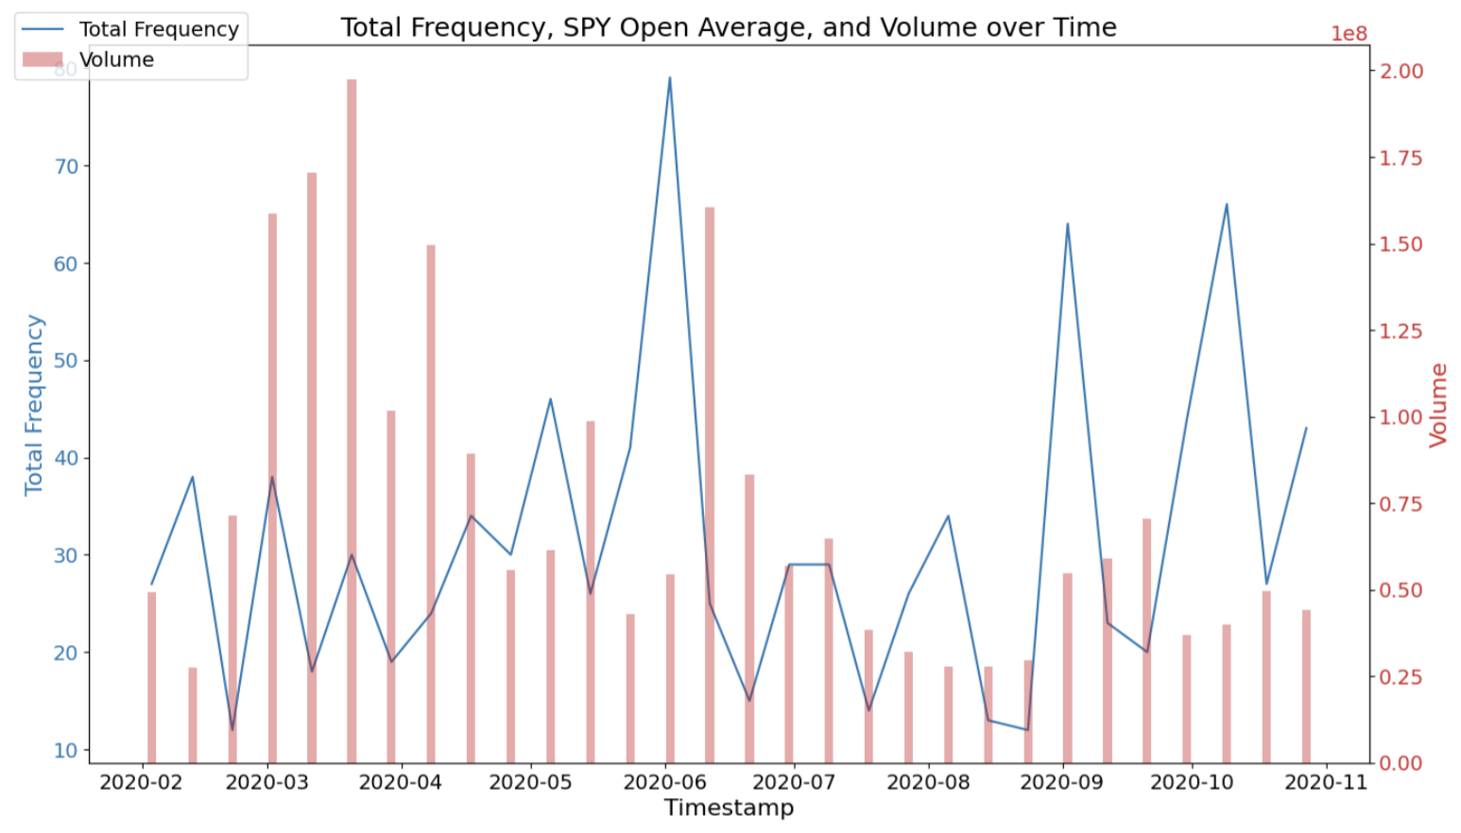
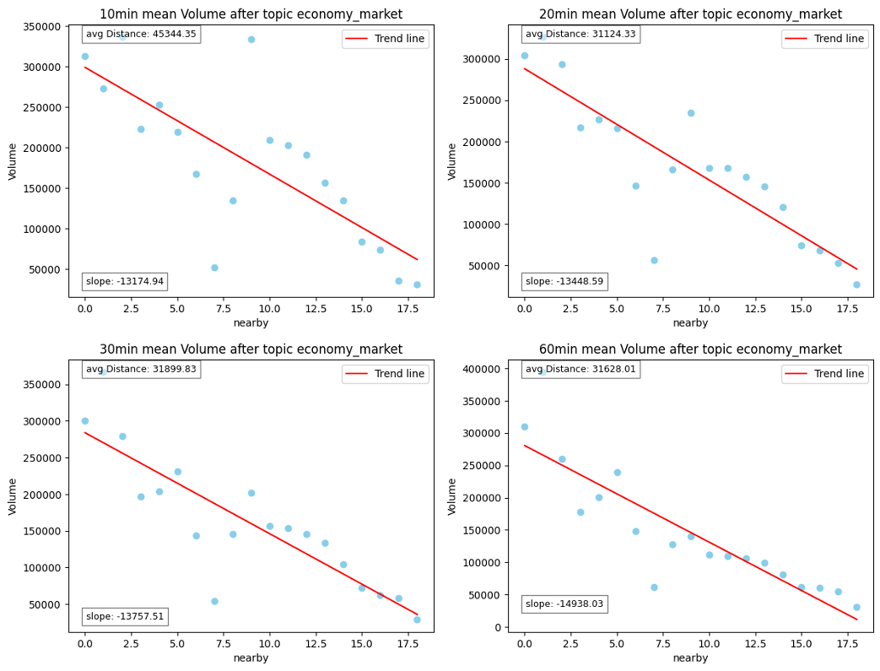
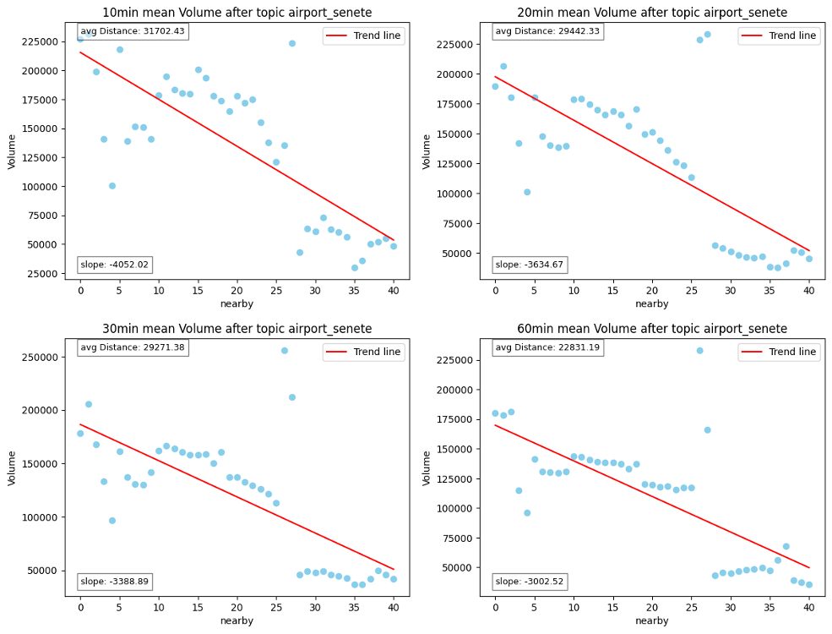
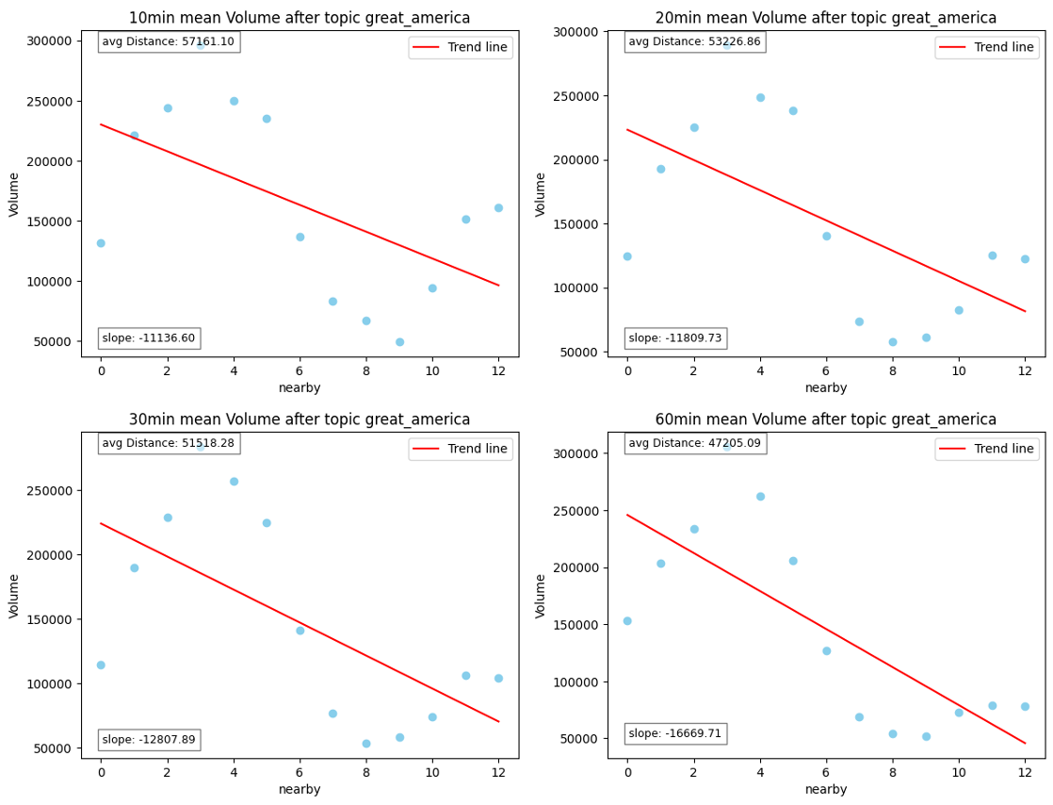
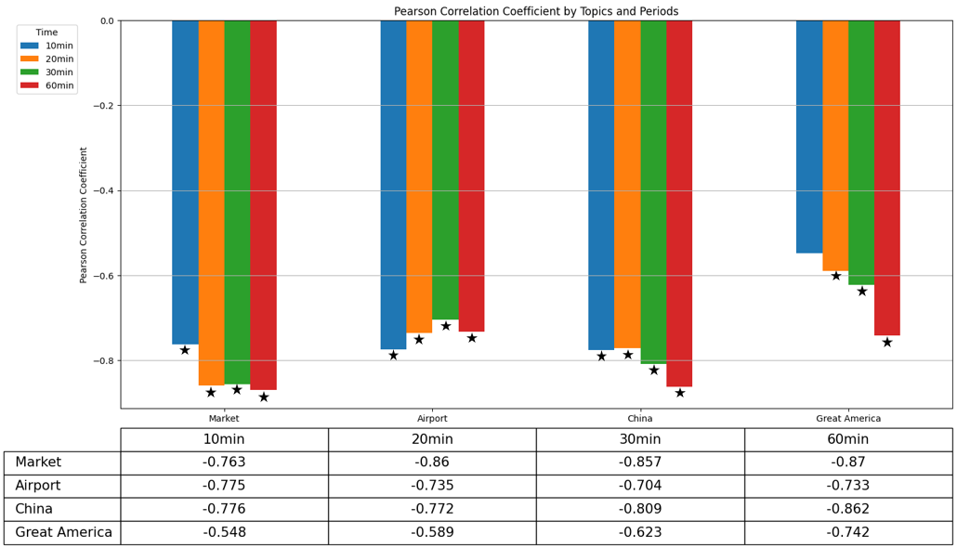
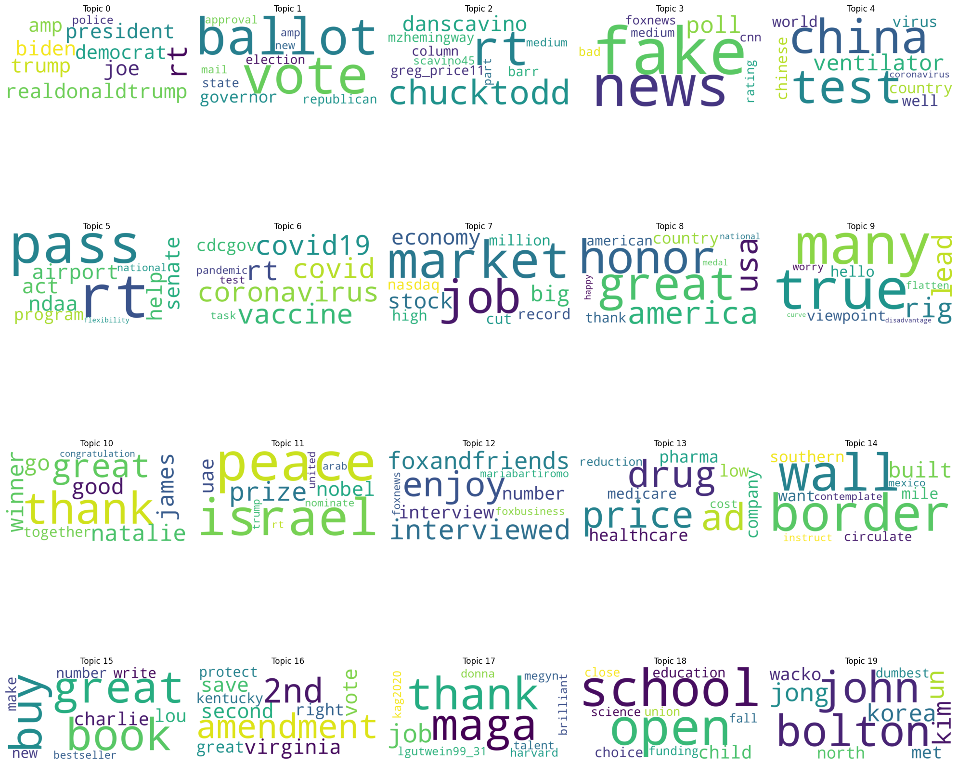
Analyzing the Influence of Presidential Candidates' Tweets on Stock Market Volatility: A Dynamic Topic Modeling Approach
Yungeun Song 20200332 Sanghyeon Lee 20200460 Minkyung Choi 20234447
Research Topic
Macro Analysis Results
Aiming to explore the impact of President Donald Trump’s tweets on stock market volatility
Leveraging Dynamic Topic Modeling (DTM) to analyze the temporal evolution of tweet topics and their impacts on the market indices
Research Hypothesis
Higher frequencies of tweets lead to larger stock trading volumes on a monthly scale.
Result Analysis
Analyzing the aggregation of the top 20 most frequently mentioned topics, there is no significant trend.
Compared to the peaks of tweets’ frequencies (blue line), the S&P 500 volumes are relatively low.
Similarly, compared to the peaks of S&P 500 volumes (red bar), tweets’ frequencies are relatively low.
Background
Predicting stock prices is critical to investors, financial markets, and the broader economy.
Previous studies have shown that tweet moods correlate with market movements, as Twitter quickly disseminates information, making it essential for gauging market sentiment and public opinion.
Researchers have found that Trump's tweets are followed by increased market uncertainty, trading volume, and sometimes negative market returns.
By focusing solely on specific words, the study may overlook the political timeline influence on market behavior.
Thus, integrating temporal political factors into the analysis could provide a more holistic perspective on the impact of politicians' social media activity on financial markets.
Micro Analysis Results
Research Hypothesis
A Trump tweet is more influential to stock market volatility when there are fewer recent tweets on the same topic.
Result Analysis
Data
Trump Twitter
Source: Twitter Stance Election 2020
Duration: 2020.02 ~ 2020.11 (weekday 9AM to 4PM)
All tweets(9,868) during the election period
Stock Market Data
Source: Alpha Vantage Stock API
Duration: 2020.02 ~ 2020.11 (weekday 9AM to 4PM)
S&P 500 data per minute (81,806) during the election period
Note:
`Nearby`: The number of tweets for each topic within a 14-day period before the next tweet on the same topic
`Volume`: The average of 10/20/30/60-minute S&P 500 volumes after the tweeted time of a given tweet
Methods
Strong negative correlation between the number of tweets on the same topic within 14 days and average trading volume, except for market-irrelevant topics like "Great America".
Most topics exhibit statistically significant differences across various time intervals.
Tweet Topic Modeling
Categorizing Trump’s tweets with BERTopic into top 20 frequently mentioned topics
Macro Analysis
Comparing between total frequency of all the topics and S&P 500 volumes within the same timeline (2020.02 ~ 2020.11)
Micro Analysis
Analyzing the impact of the frequency of each topic on the average S&P 500 volumes across different time intervals
(10min, 20min, 30min, 60min)
Discussion and Limitation
High topic frequency within 14 days leads to decreased stock volatility.
Most topics show statistically significant differences across time intervals, indicating Trump's tweets impact lasts up to one hour.
Potential for clearer correlation and accurate assessment of market sensitivity to specific topics by using sentiment-based weighting methods such as VADER or GPT.
Challenges in obtaining general and robust results due to reliance on the number of tweets during market hours and topic diversity.
Despite data limitations, a valuable attempt to explore the impact of prominent politicians' tweets on stock market volatility.

