Slide 1

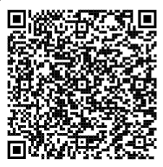
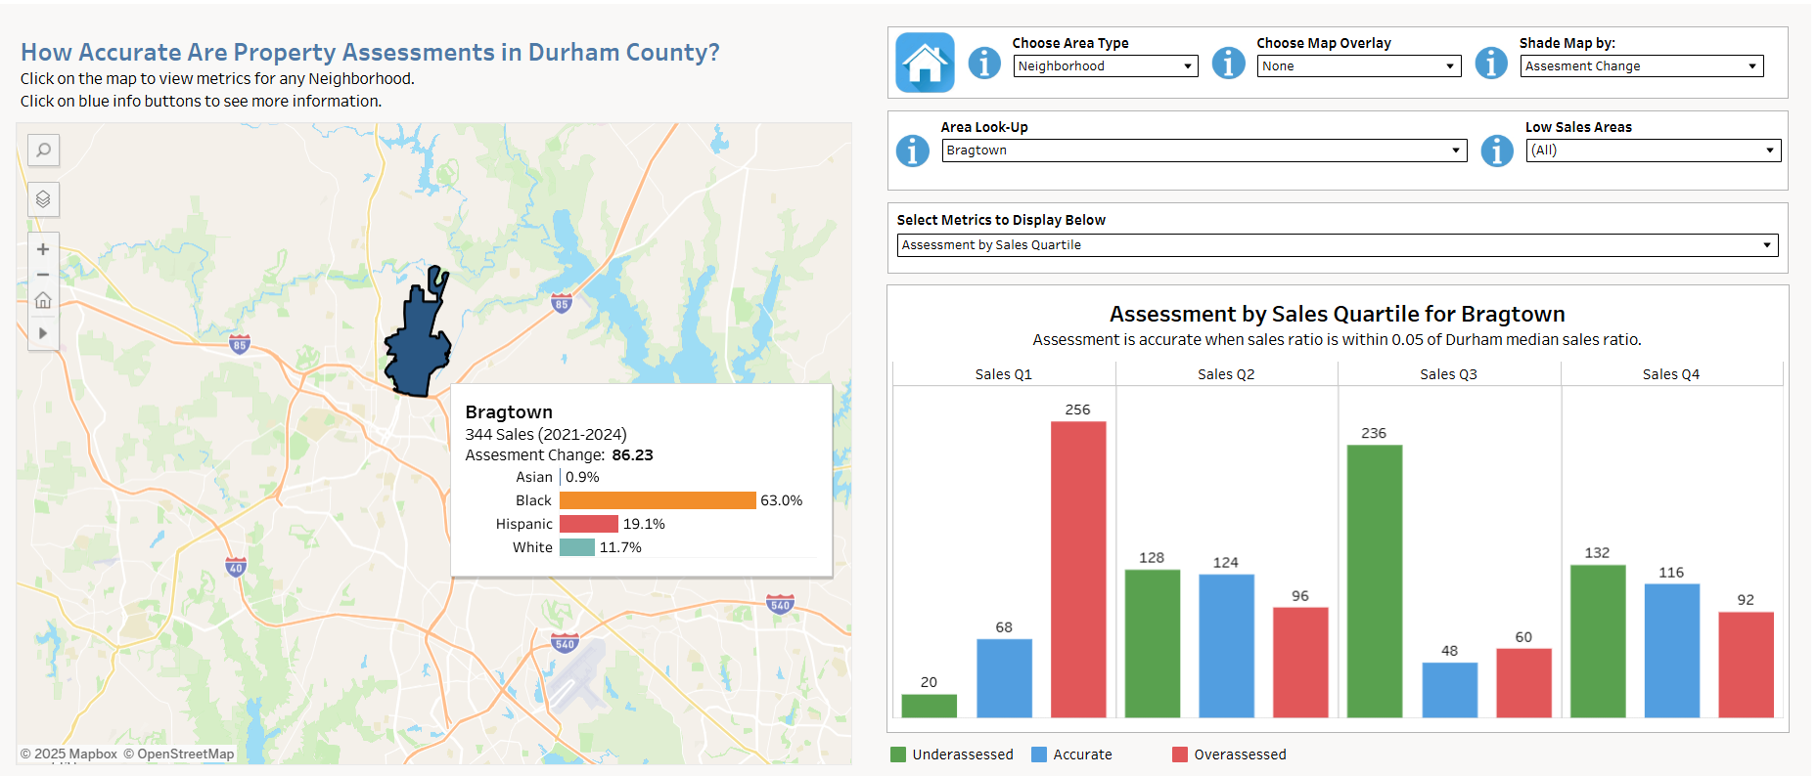
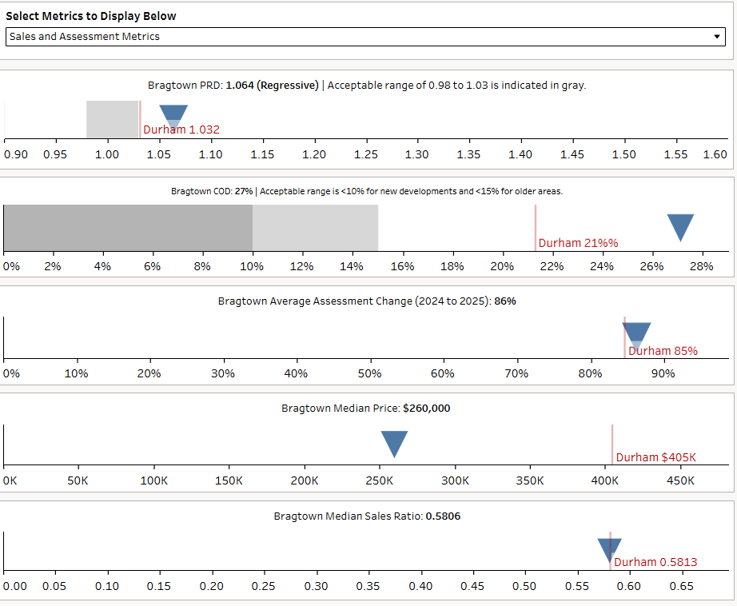
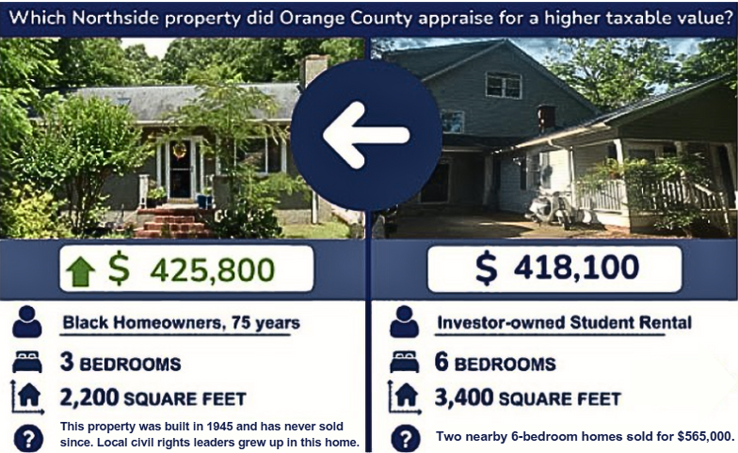
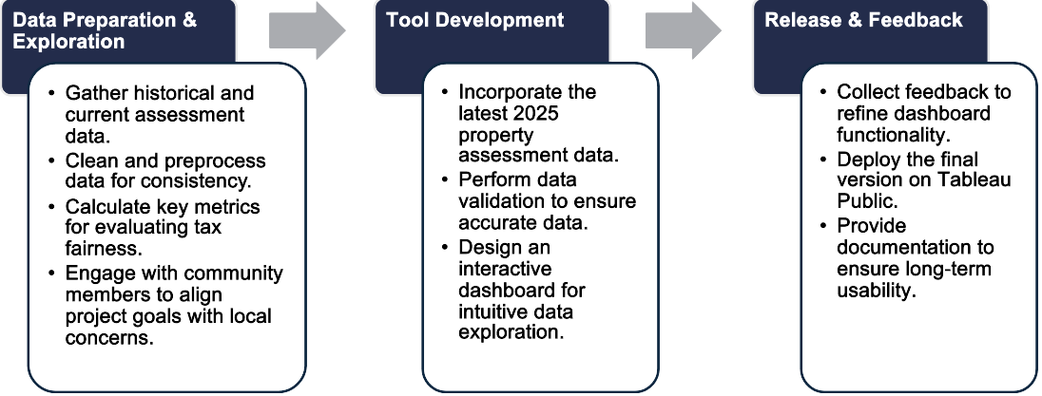
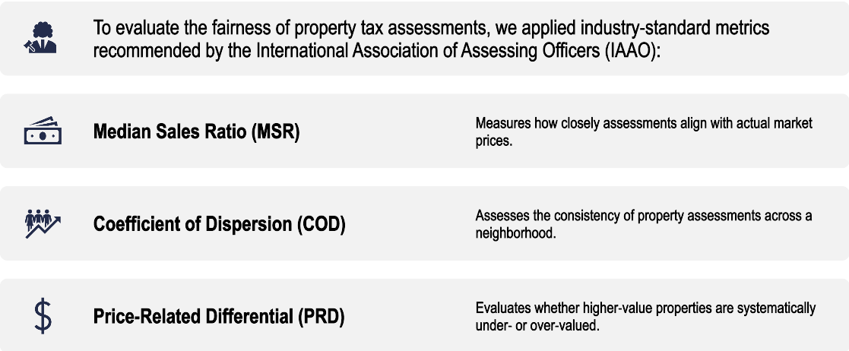
Visualizing Property Tax Regressivity in Durham County
QR CODE
Authors: Shatha Alzouby, Stephanie Johnston, Drew Keener, Minli Zheng, Ziyin Zheng
BACKGROUND
DASHBOARD DESIGN & FEATURES
Lower-value homes are more likely to be overassessed, increasing tax burdens for low-income homeowners.
Property values are assessed using mass appraisal methods, but systemic issues cause inaccuracies, disproportionately affecting marginalized homeowners.
Homes in historically marginalized neighborhoods are more likely to be overassessed while high-value homes tend to be underassessed, creating a regressive tax system.
Many overassessed homeowners lack the resources or knowledge to appeal successfully.
Advocacy groups support affected communities, but there is a lack of accessible data tools to identify and address property tax inequities.
Our team, in partnership with DataWorks NC, has developed an interactive tool to identify and address tax inequities.
Filters allow users to customize map display.
Users can choose which metrics to display (alternate view shown below).
This interactive map visualizes property tax disparities across Durham County. The tooltip displays racial/ethnic makeup and assessment metrics for the selected area.
AIMS & OBJECTIVES
Develop an interactive dashboard in Tableau to analyze and communicate property tax assessment disparities at the neighborhood and assessment group level.
Show relationships between home sales value, neighborhood demographics, and assessment accuracy.
Facilitate informed decision-making for advocacy groups and stakeholders.
The bar chart illustrates the distribution of overassessed, accurately assessed, and underassessed properties across sales quartiles for each neighborhood.
This view provides a detailed breakdown of assessment metrics for the selected neighborhood and for Durham County, comparing them to acceptable ranges.
METHODOLOGY
DISCUSSION
Sales and assessment data were provided by the Durham County Tax Assessor’s office, and demographic data came from the 2022 American Community Survey.
3
Mass assessment often leads to situations like the one pictured on the left.
Identifying tax regressivity is a complex process, especially for the homeowners most affected by it. Advocacy groups play a crucial role in addressing these inequities, but they often lack accessible data and tools to support their efforts. Our dashboard simplifies this process by providing clear, visual insights into tax assessment disparities. Advocacy groups can quickly identify overassessed neighborhoods, analyze trends, and use this information to educate homeowners on how tax regressivity affects them. They can also guide homeowners through the appeals process, ensuring they have the necessary evidence to challenge unfair assessments.
Many homeowners are unaware of their ability to challenge unfair assessments. This dashboard serves as an educational tool, providing data-driven evidence for the appeals process.
CONCLUSION & IMPACT
This dashboard bridges the gap between raw data and actionable insights, equipping advocacy groups with the tools needed to challenge unfair assessments.
By highlighting patterns of overassessment, it helps homeowners understand their tax burden and gather the necessary evidence to support appeals.
With accessible data-driven analysis, the dashboard supports broader efforts to promote transparency, fairness, and equity in property taxation.
REFERENCES
ACKNOWLEDGEMENTS
International Association of Assessing Officers - IAAO. (2013) Standard on ratio studies. https://www.iaao.org/wp-content/uploads/Standard_on_Ratio_Studies.pdf
Infographic of Orange County homes provided by the North Carolina Housing Coalition.
DataWorks NC
Durham County Tax Assessor
The Community Justice Collaborative of the NC Housing Coalition
Allison Young

