Slide 1
NYRA Horse Racing Performance Analysis Using GPS Tracking Data
MinJoo Kim
Github

Slide 2
Data Overview
Ultimate Goal: Forecast race outcomes using GPS data + environmental factors
Economic Impact
Dataset Scale
Source: NYRA Big Data Derby 2022
1,821 races across 3 tracks (AQU, BEL, SAR)
18,476 horse-race combinations
5.2M GPS tracking points at 0.25s intervals
Race purses: $20K to $1M+ per race
Problem Types
Difficulty
Regression:
Predict finish position (1st-12th)
race time
performance metrics
Large data set
Non iid

Slide 3
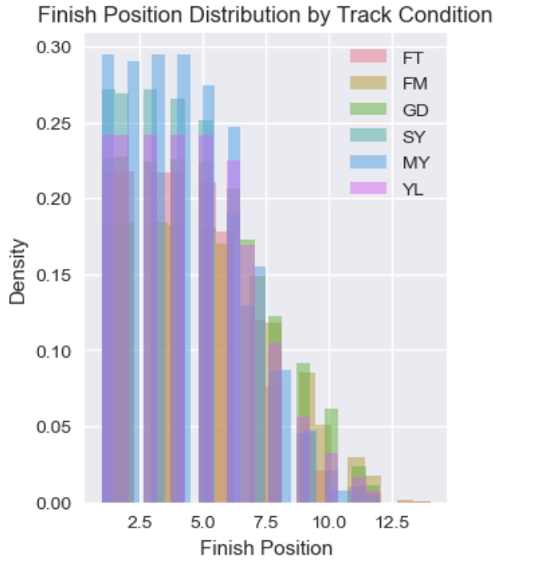
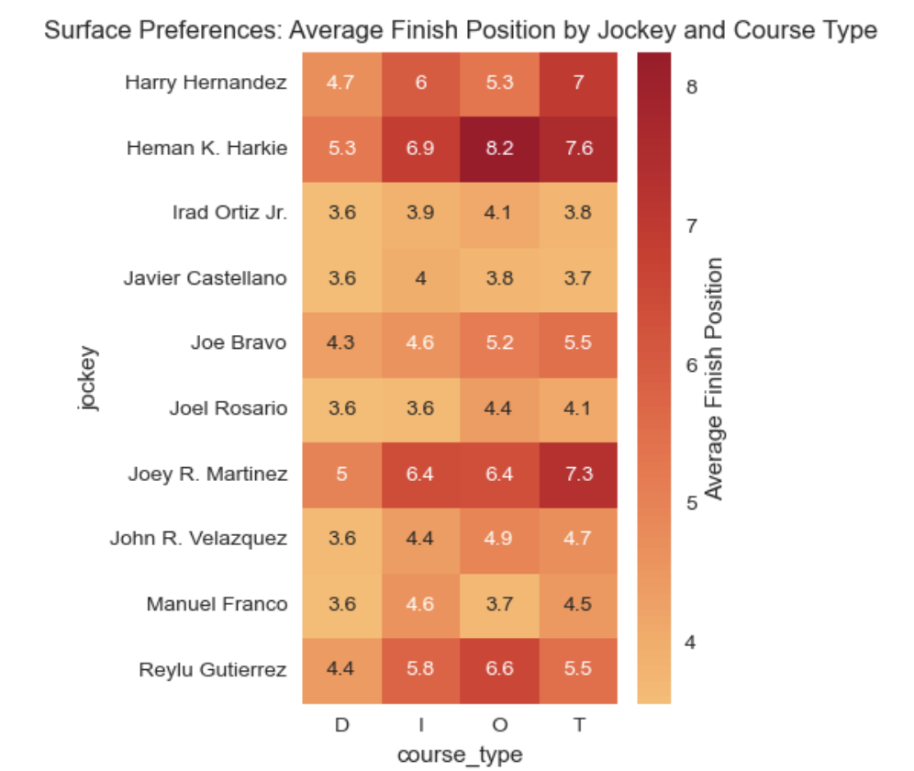
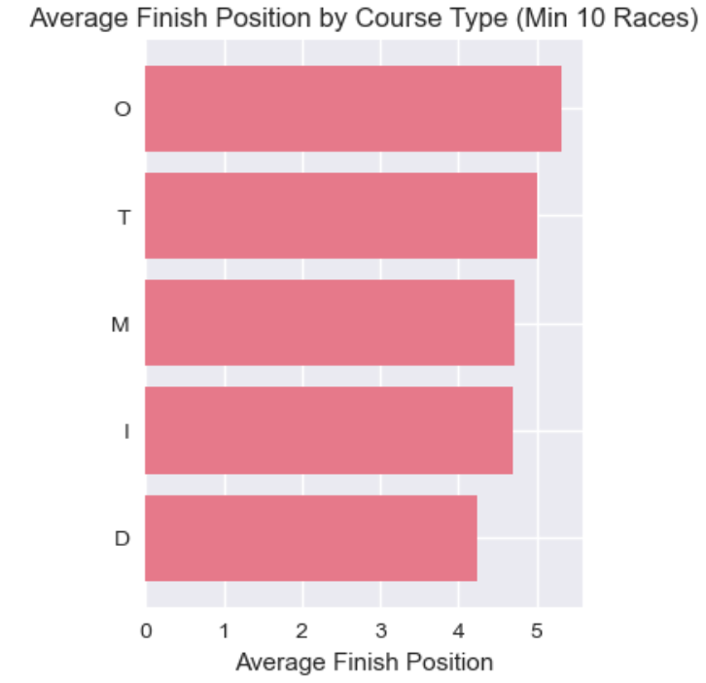
EDA - Multi-Dimensional Track Condition Analysis
Non-IID + Muddy equalizer
Jockey specialization
Categorical variable
Preprocessing Decision : GroupShuffleSplit by race ID, OneHot + TargetEncoder

Slide 4
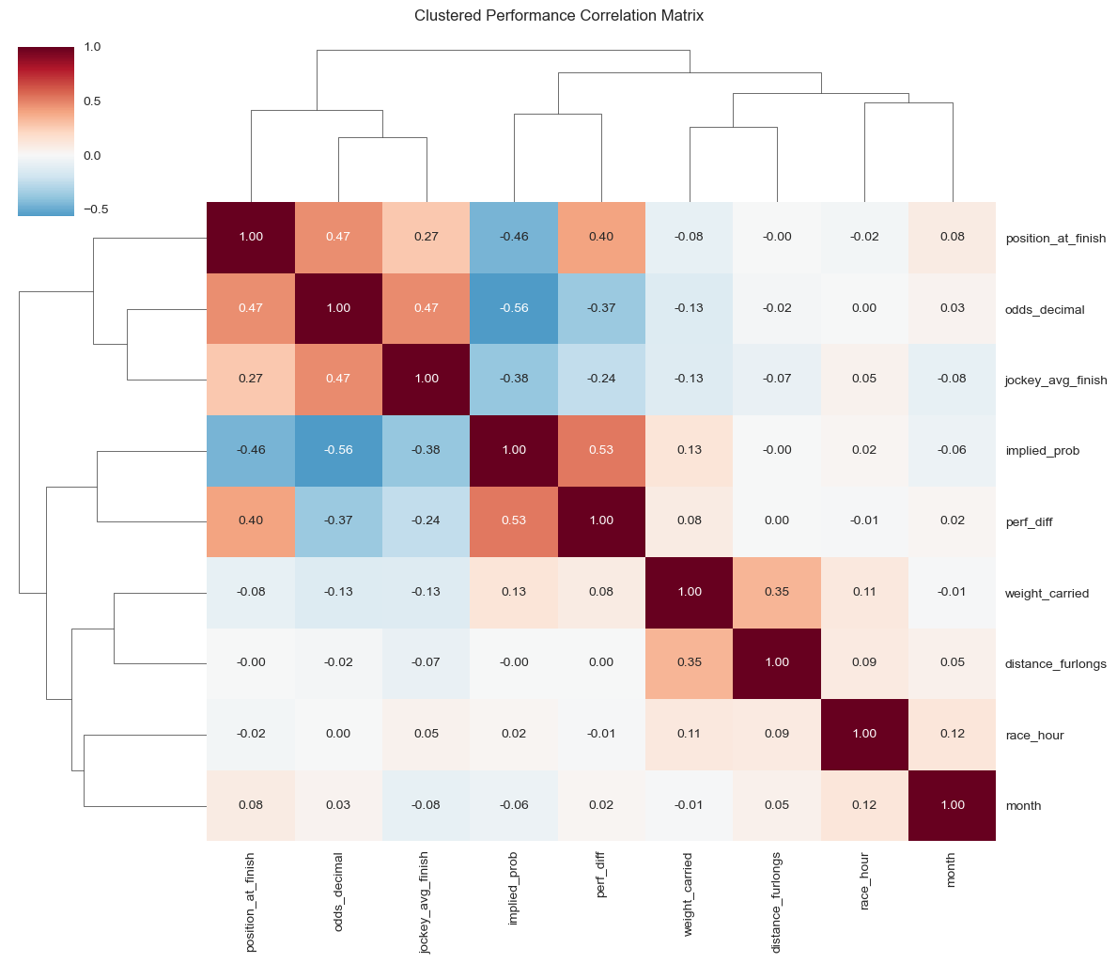
EDA - Correlation & Feature Relationships
Goal:
Identify variable relationships
Detect redundant or grouped features
Key Findings:
• Moderate market efficiency (r=0.47)
• Odds & Implied prob consistent (r=-0.56)
• 3 main variable clusters
Betting-related metrics
Performance indicators
Race characteristics
• Time variables (month, hour) independent
Preprocessing Decision
Feature grouping for encoding & regularization

Slide 5
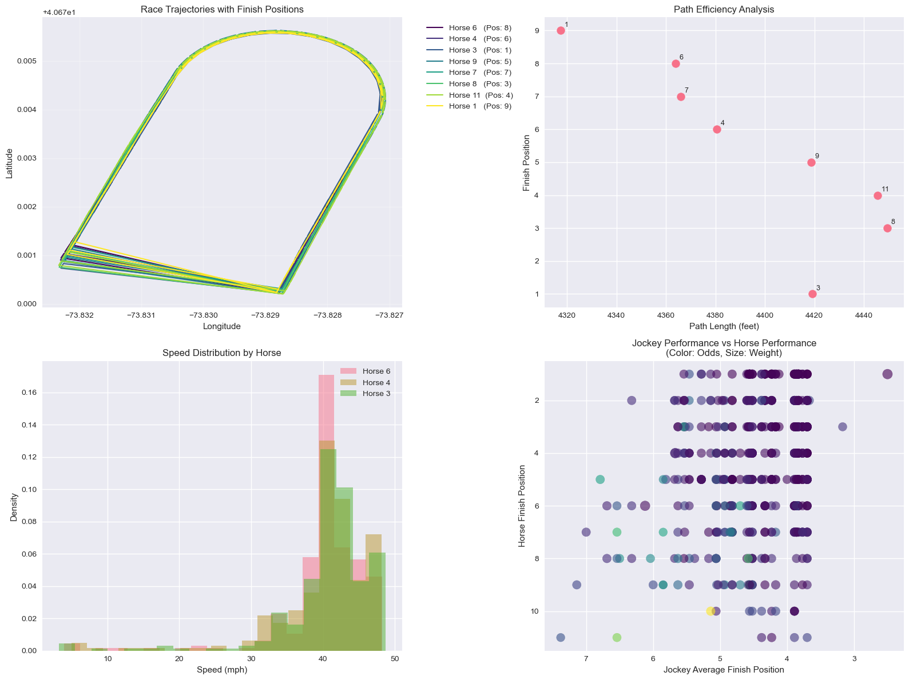
EDA - GPS-Based Path Efficiency Analysis
Insights:
Bimodal path distribution (sprints vs. routes)
High scatter in efficiency rankings (substantial noise)
Clear running lanes trump shortest path
Preprocessing Needs:
Robust scaling methods

Slide 6
Splitting Strategy
GPS Data too large > summarized it by grouping data by race and horse
Race-level grouping key = track_id + date + race_number
Non-IID structure → GroupShuffleSplit
Ratios: 60 / 20 / 20 (train / val / test)
Prevents leakage between horses in same race

Slide 7
Preprocessing Pipeline
Step | Technique | EDA Justification
Data Splitting | GroupShuffleSplit (60/20/20) | Non-IID structure
Categorical (Low) | OneHotEncoder | 3-6 categories
Categorical (High) | TargetEncoder | 80+ categories
Feature Scaling | StandardScaler | 5 orders of magnitude
Regularization | Ridge (L2) & Lasso (L1) | Multicollinearity
Transformation:
Before: 14,915 entries, 22 raw features
After: 14,915 entries, ~28 preprocessed features

