Slide 1
Image you have severe residential buildings. At the end of each month,
you have to calculate everyone’s utility bill and then send to each of them MANUMALLY……

Slide 2
You probably don't want to do it by yourself. And it seems very costly to hire someone else to do such TEDIOUS work......

Slide 3

PropTech solves every concern you have!

Slide 4
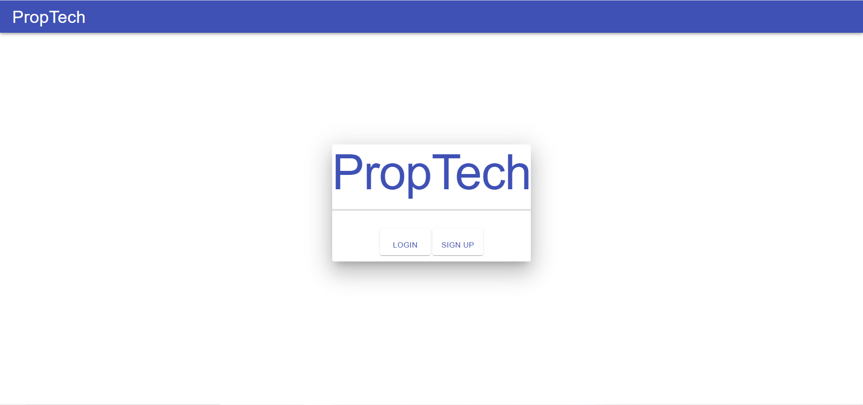
It is a platform where users can register an account as administrator , and assign managers to manage buildings and tenants who live in the building.

Slide 5
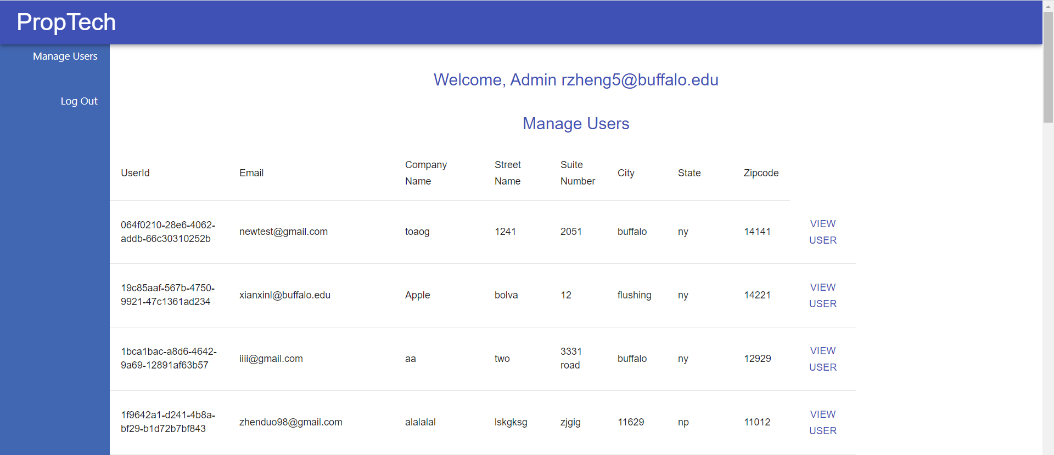
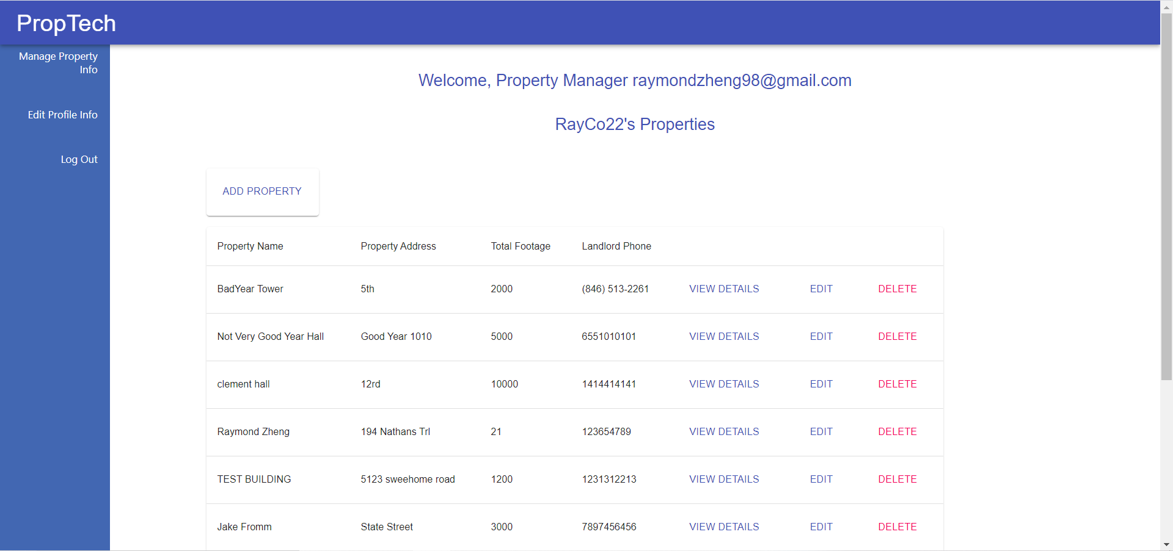
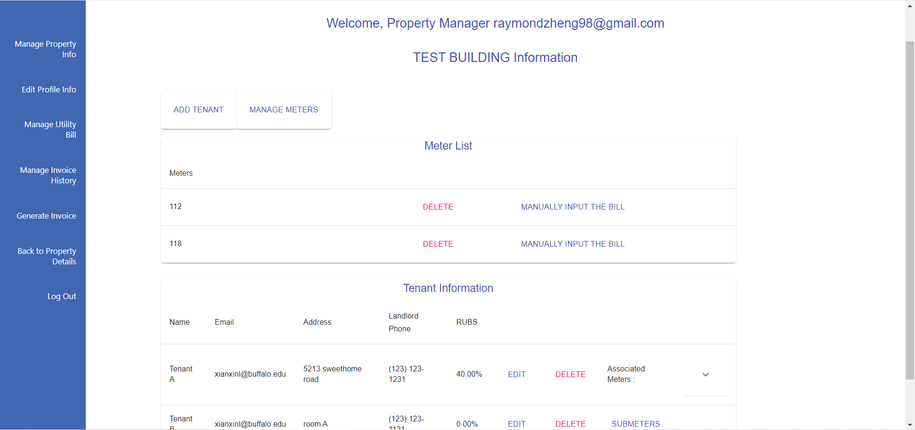
It uses the hierarchy management system. The administrator can manage building managers. And the building managers can manage severe buildings and tenants live inside the building.
It uses the hierarchy management system. The administrator can manage building managers. And the building managers can manage severe buildings and tenants live inside the building.

Slide 6
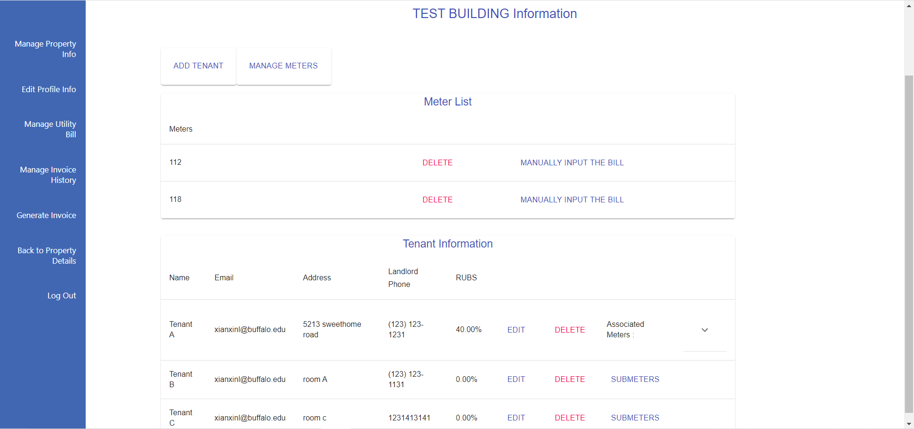
The manager only needs to input the basic information about tenants and meters, and then the backend will perform calculations and generate bill amounts instantly.

Slide 7
It is not only the calculator…….
It is a rather powerful server to help you manage everything about the bill……

Slide 8
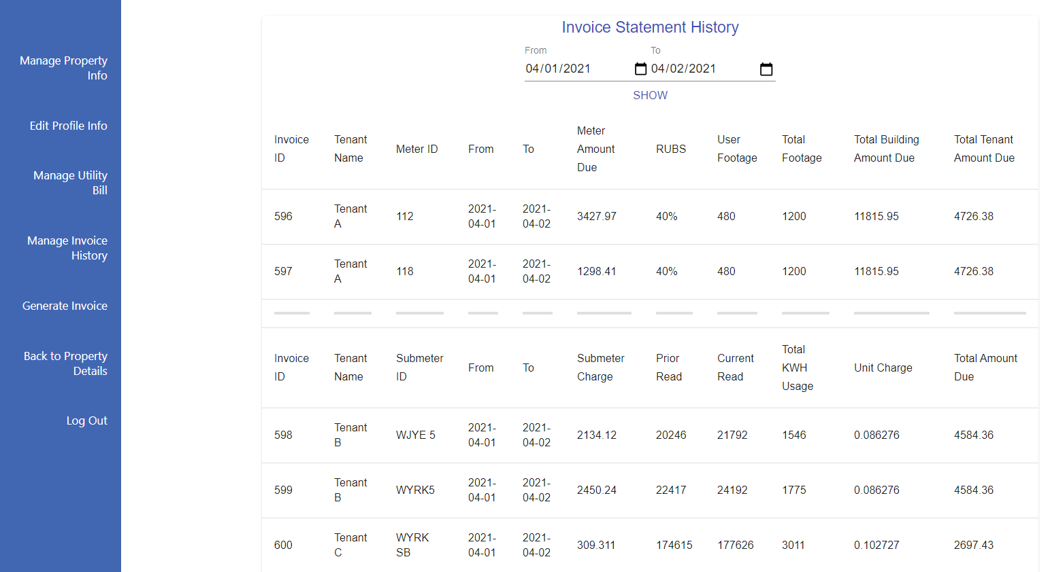
The after invoices are generated, it can be viewed in the history anytime. And it can be generated into the PDFs.

Slide 9
The more importantly……

Slide 10
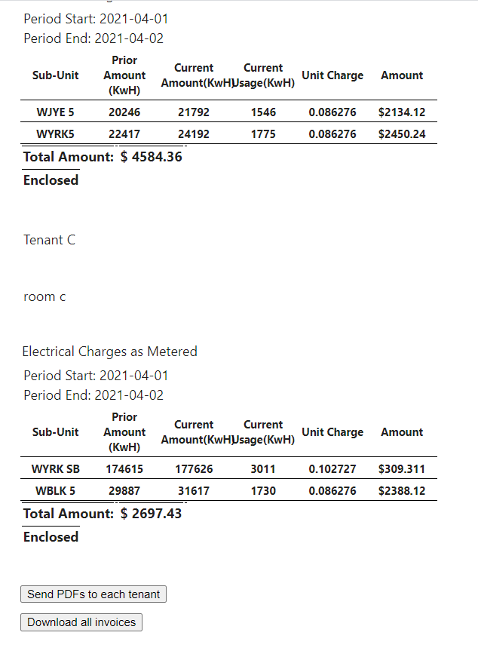
The displayed invoices can be split into individual invoices for every tenant, and they can be downloaded or sent to its tenant by ONE CLICK!

Slide 11

Don't let property manage you.
Let Property be managed by the Technology.

