Slide 1




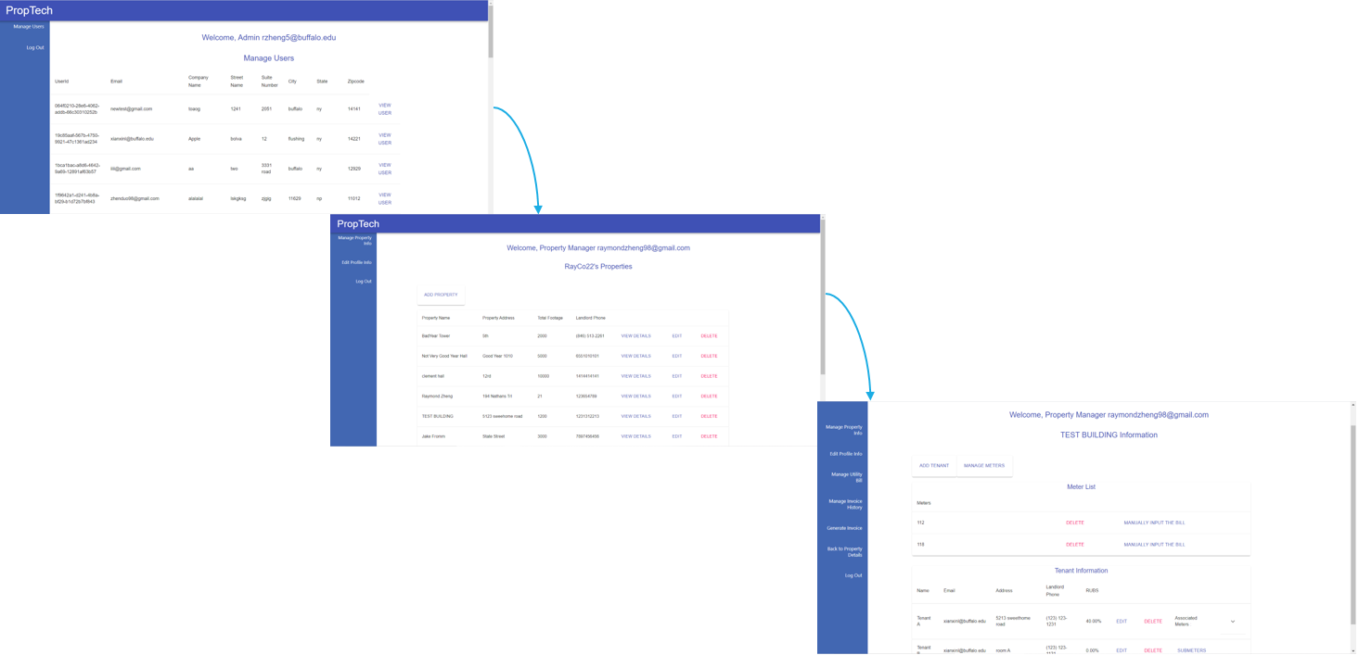

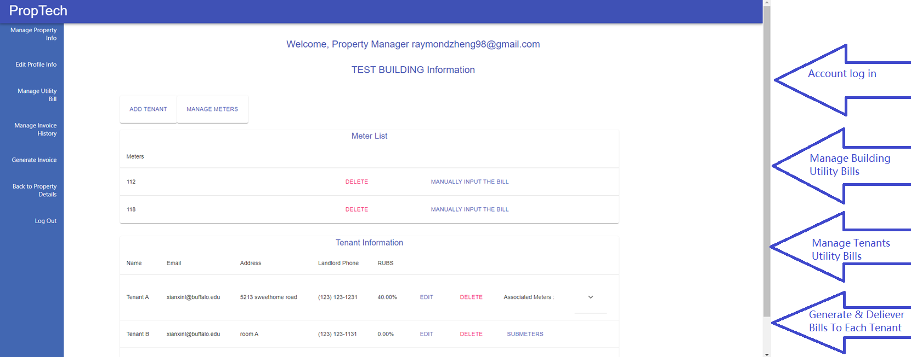
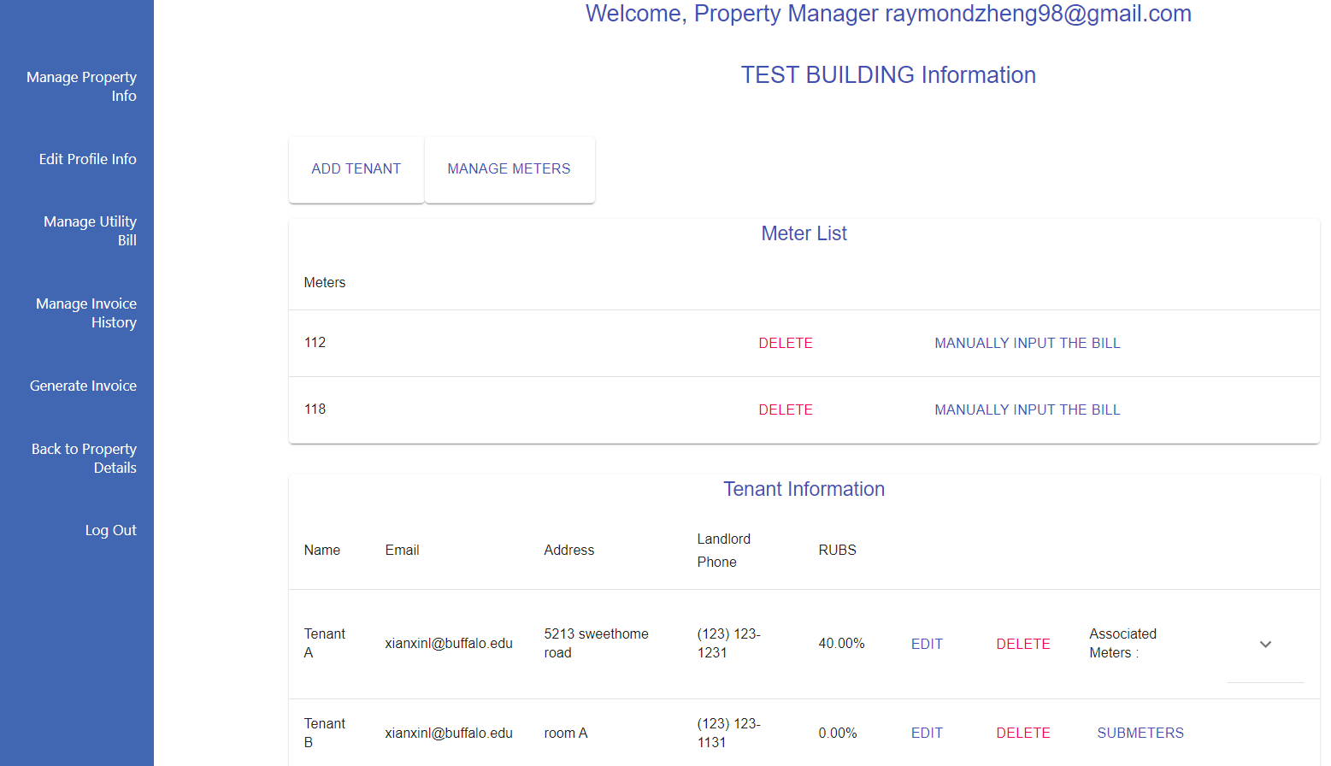

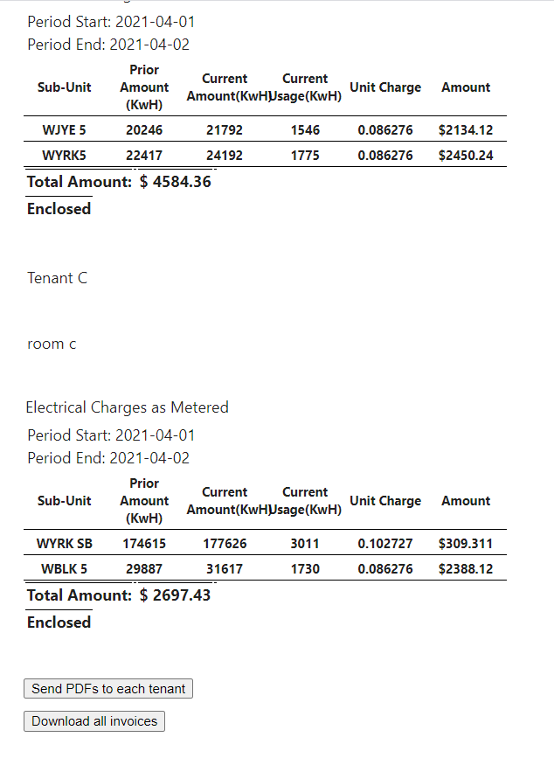

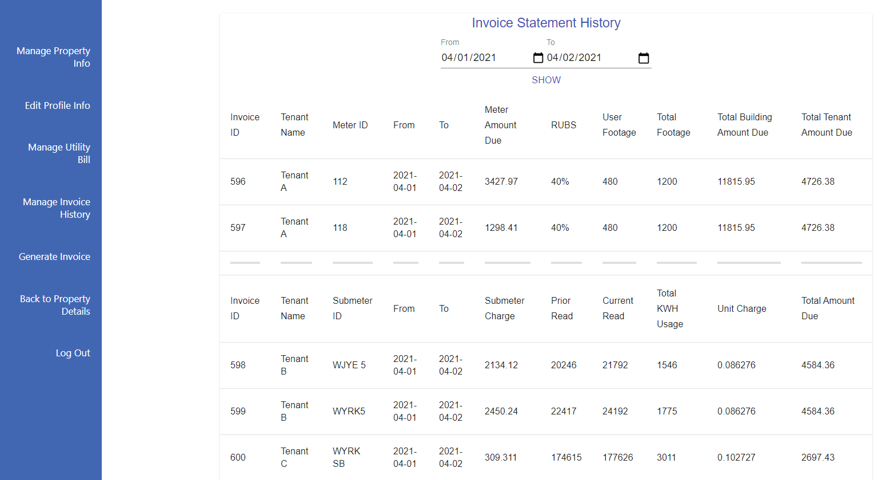
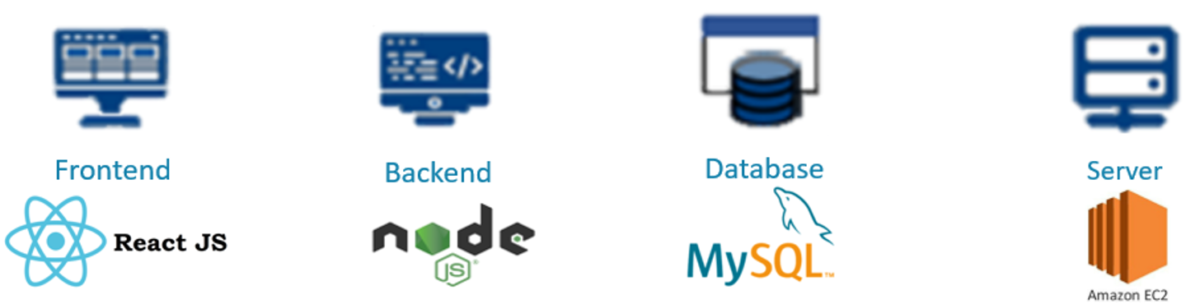
Problem:
Managing utility bills is annoying process. At the end of each month, building managers receive the utility bills. They have to split bills for each tenant based on their meters by calculating manually, and then manually send out these bills with email or mails.
It uses the hierarchy management system and makes managing buildings and tenants efficiently!
Solution:
PropTech is the platform that allows building managers to manager these tedious utility bills smartly!
It uses the hierarchy management system and makes managing buildings and tenants efficiently!
Calculating the bill amount instantly by using input meter and submeter information!
Generate and send out invoice to each tenant by ONE CLICK!
History of the invoices are stored and can be reviewed anytime!
The manager only needs to input the basic information about tenants and meters, and then the backend will perform calculations and generate bill amounts instantly.
The displayed invoices can be split into individual invoices for every tenant, and they can be downloaded or sent to its tenant.
The after invoices are generated, it can be viewed in the history anytime. And it can be generated into the PDFs.
Frontend: Zhen Duo Lin, Min Dong. Backend & Server: Xian Xin Lin, Raymond Zheng. Database: Xin Yu Chen

