Slide 1
Linux File System in Graph

Slide 2
Contents
File system overview
VFS overview
dentry, inode lookup
read()/write()
Block layer

Slide 3
File system overview
USER APP
Mount /dev/sdX to /mnt/
/mnt/file
VFS
dentry cache (of mnt/file)
Inode cache (of mnt/file)
Page Cache (of mnt/file)
p.4
ext2
ext4
XXX
BLK DEV
(sdX)
Block DEV HW

Slide 4
VFS overview
USER APP
fd = open(/mnt/file)
USER APP
read(fd, buf, size)
USER APP
write(fd, buf, size)
Mount /dev/sdX to /mnt/
/mnt/file
fd
fd
fd
dentry cache (of mnt/file)
Inode cache (of mnt/file)
create
Page Cache-1 (of mnt/file)
Y
dentry & inode cache hit ?
Page cache hit?
Y
N
N
p.5
ext4
p.6
BLK DEV
Block DEV HW

Slide 5
dentry, inode lookup
Read/write
File lookup
dentry cache
inode cache
Different filename but same hash value
Page Cache
Filename
Dentry Hash table
inode
inode
Hash
Entry
Entry
Entry
Entry
Entry
Entry
dentry
dentry
Page Cache
Entry
HIT
dentry
inode
dentry
2 filename points 1 exact file
Page Cache
MISS
dentry
inode
dentry
inode
Page Cache
Create new entry
fs.lookup
ext4
Create new inode
Scan filename on block device
Block DEV

Slide 6

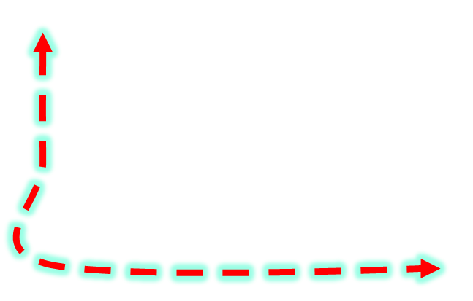
read()/write()
Read, cache hit
APP
APP
Read, cache miss
Write
Writeback
read()
write()
libc
VFS
Page Cache
NFS
ext4
FAT
Periodically launch and launch by sync, no_mem……
Block Device
File system basic: with writeback cache
BLOCK Device Driver
Writeback thread
Writeback thread is writeback a block device
Block Device HW

Slide 7
read()
write()
ioctl()
/mnt/file
VFS
Page Cache
of /mnt/file
Writeback thread
N
Cache hit
Y
ioctl()
trigger
read_page()
write_page()
ioctl()
ext4
Common block device (sda)
Request queue
ioctl()
Create block device
Specific block device driver
(SCSI block)
ioctl()
Block DEV HW

