Slide 1

CS 456/656
Computer Networks
Lecture 13: Network Layer – Part 5
Mina Tahmasbi Arashloo and Uzma Maroof
Fall 2025

Slide 2

A note on the slides
Adapted from the slides that accompany this book.
All material copyright 1996-2023
J.F Kurose and K.W. Ross, All Rights Reserved
Computer Networking: A Top-Down Approach
8th edition
Jim Kurose, Keith Ross
Pearson, 2020

Slide 3
Network Layer in the Internet
The Internet Protocol (IP)
Internet Routing
  Hierarchical routing
  Intra-ISP routing: OSPF
  Inter-ISP routing: BGP
Internet Forwarding

Slide 4
Network Layer in the Internet
The Internet Protocol (IP)
Internet Routing
  Hierarchical routing
  Intra-ISP routing: OSPF
  Inter-ISP routing: BGP
Internet Forwarding
  Destination-based forwarding

Slide 5
Destination-based forwarding
Destination Prefix | Link Interface
10.20.30.0/24 | 0
5.4.0.0/16 | 1
… | …
How does the router use this for forwarding?
  When a packet comes in with destination address X
  Check whether X matches a prefix in the table
  If yes, send it to the corresponding interface (action)
  If not, drop the packet.

Slide 6

Destination-based forwarding
Destination Prefix | Link Interface
10.20.30.0/24 | 0
5.4.0.0/16 | 1
10.20.0.0/16 | 2
… | …
Destination IP address:
10.20.30.5
What if a packet matches multiple entries?

Slide 7
How do overlapping entries happen?
10.20.0.0/16
B
B, 10.20.0.0./16
provider
network
A
legend:
w
y
customer
network:
C
x
x, 10.20.30.0./24
10.20.30.0/24

Slide 8
Destination-based forwarding
Destination Prefix | Link Interface
10.20.30.0/24 | 0
5.4.0.0/16 | 1
10.20.0.0/16 | 2
… | …
Destination IP address:
10.20.30.5
What if a packet matches multiple entries?
  Pick the one that has the longest prefix matching the packet’s destination
  In the above example, 10.20.30.5 matches
    the first 24 bits of 10.20.30.0/24
    the first 16 bits of 10.20.0.0/16
    So, the router picks the first entry, and sends the packet out of interface 0

Slide 9
Destination-based forwarding
Destination Prefix | Link Interface
10.20.30.0/24 | 0
5.4.0.0/16 | 1
10.20.0.0/16 | 2
… | …
Destination IP address:
10.20.30.5
What if a packet matches multiple entries?
  Pick the one that has the longest prefix matching the packet’s destination
  i.e., the ”most specific” prefix

Slide 10
Make sure you know
What the forwarding table looks like for destination-based forwarding
What longest-prefix matching means
E.g., Given a packet and a table, you should be able to determine what the outgoing interface is.

Slide 11
Network Layer in the Internet
The Internet Protocol (IP)
Internet Routing
  Hierarchical routing
  Intra-ISP routing: OSPF
  Inter-ISP routing: BGP
Internet Forwarding
  Destination-based forwarding
ICMP

Slide 12
The Internet needs error reporting and testing
What happens when something goes wrong during forwarding?
transport layer: TCP, UDP
routing protocols
path selection
OSPF, BGP, ect.
IP protocol
addressing
datagram format
packet handling conventions
network
layer
forwarding
table
ICMP protocol
error reporting
router “signaling”
link layer
physical layer

Slide 13
ICMP: internet control message protocol
used by hosts and routers to communicate network-level information
  error reporting: unreachable host, network, port, protocol
  echo request/reply (used by ping)
ICMP messages carried in IP datagrams
  Still considered part of the network-layer, not transport
ICMP message: type, code plus first 8 bytes of IP datagram causing error
Type Code description
0 0 echo reply (ping)
3 0 dest. network unreachable
3 1 dest host unreachable
3 2 dest protocol unreachable
3 3 dest port unreachable
3 6 dest network unknown
3 7 dest host unknown
4 0 source quench (congestion
control - not used)
8 0 echo request (ping)
9 0 route advertisement
10 0 router discovery
11 0 TTL expired
12 0 bad IP header

Slide 14

Traceroute and ICMP
traceroute program: provides delay measurement (RTT) from source to router along end-end Internet path towards destination
  implemented using TTL in the IP datagram header and ICMP message (type 11, code 0: TTL expired)
3 probes
3 probes
3 probes

Slide 15
Traceroute and ICMP
3 probes
3 probes
3 probes
source sends sets of UDP segments to destination
  1st set has TTL =1, 2nd set has TTL=2, etc.
datagram in nth set arrives to nth router:
  router discards datagram and sends source ICMP message (type 11, code 0)
  ICMP message possibly includes name of router & IP address
stopping criteria:
UDP segment eventually arrives at destination host
destination returns ICMP “port unreachable” message (type 3, code 3)
source stops
when ICMP message arrives at source: record RTTs

Slide 16
Network Layer in the Internet
The Internet Protocol (IP)
Internet Routing
  Hierarchical routing
  Intra-ISP routing: OSPF
  Inter-ISP routing: BGP
Internet Forwarding
  Destination-based forwarding
ICMP
Beyond destination-based routing and forwarding
  The end-to-end argument
  Middleboxes
  Software-defined network (SDNs)

Slide 17
Network Layer in the Internet
The Internet Protocol (IP)
Internet Routing
  Hierarchical routing
  Intra-ISP routing: OSPF
  Inter-ISP routing: BGP
Internet Forwarding
  Destination-based forwarding
ICMP
Beyond destination-based routing and forwarding
  The end-to-end argument
  Middleboxes
  Software-defined network (SDNs)

Slide 18
Architectural Principles of the Internet
RFC 1958
“Many members of the Internet community would argue that there is no architecture, but only a tradition, which was not written down for the first 25 years (or at least not by the IAB). However, in very general terms, the community believes that
the goal is connectivity, the tool is the Internet Protocol, and the intelligence is end to end rather than hidden in the network.”
Three cornerstone beliefs:
simple connectivity
IP protocol: that narrow waist
intelligence, complexity at network edge

Slide 19
Architectural Principles of the Internet
RFC 1958
“Many members of the Internet community would argue that there is no architecture, but only a tradition, which was not written down for the first 25 years (or at least not by the IAB). However, in very general terms, the community believes that
the goal is connectivity, the tool is the Internet Protocol, and the intelligence is end to end rather than hidden in the network.”
Three cornerstone beliefs:
simple connectivity
IP protocol: that narrow waist
intelligence, complexity at network edge

Slide 20
The end-to-end argument
We have talked about how some of the more complex network functionality, e.g., reliable data transfer and congestion control, is implemented in the transport layer at the end points
  as opposed to inside the network (e.g., in the routers)
But that didn’t necessarily have to be the case
One could come up with a network design where these functionalities are implemented inside the network
  In fact, Infiniband networks have made different choices in this regard compared to the current Internet

Slide 21





The end-to-end argument
application
transport
network
data link
physical
end-end implementation of reliable data transfer
application
transport
network
data link
physical
application
transport
network
data link
physical
application
transport
network
data link
physical
hop-by-hop (in-network) implementation of reliable data transfer
network
link
physical
network
link
physical
network
link
physical
network
link
physical
network
link
physical
network
link
physical

Slide 22
The end-to-end argument
application
transport
network
data link
physical
end-end implementation of reliable data transfer
application
transport
network
data link
physical
?
?
?
?
?
?
?
?
application
transport
network
data link
physical
application
transport
network
data link
physical
hop-by-hop (in-network) implementation of reliable data transfer
network
link
physical
network
link
physical
network
link
physical
network
link
physical
network
link
physical
network
link
physical

Slide 23
The end-to-end argument
“The function in question can completely and correctly be implemented only with the knowledge and help of the application standing at the end points of the communication system. Therefore, providing that questioned function as a feature of the communication system itself is not possible. (Sometimes an incomplete version of the function provided by the communication system may be useful as a performance enhancement.)
We call this line of reasoning against low-level function implementation the “end-to-end argument.”
Saltzer, Reed, Clark 1981
Notes:
File corruption at the host (the other end has to check anyway)

Slide 24
The end-to-end argument
In the Internet, the choice ended up being…
application
transport
network
data link
physical
end-end implementation of reliable data transfer
application
transport
network
data link
physical
👍
application
transport
network
data link
physical
application
transport
network
data link
physical
👎
hop-by-hop (in-network) implementation of reliable data transfer
network
link
physical
network
link
physical
network
link
physical
network
link
physical
network
link
physical
network
link
physical

Slide 25
The IP hourglass
HTTP
SMTP
RTP
…
Internet’s “thin waist”:
one network layer protocol: IP
must be implemented by every (billions) of Internet-connected devices
QUIC
DASH
many protocols in physical, link, transport, and application layers
TCP
UDP
IP
Ethernet
…
PPP
PDCP
WiFi
Bluetooth
copper radio fiber

Slide 26
Side note: end-to-end argument is not set in stone
This was a design decision made by the designers of the Internet protocol stack to meet their requirements for the Internet
Other networks with different requirements can make different choices
For example, the InfiniBand protocol stack offers reliable data transfer at the network layer
  No packets will be lost!
  More limited in scale
  Can’t easily inter-operate with the Internet

Slide 27
Make sure you know
What the end-to-end argument is
  With an example
How it affected the design of the Internet and its protocol stack

Slide 28
Network Layer in the Internet
The Internet Protocol (IP)
Internet Routing
  Hierarchical routing
  Intra-ISP routing: OSPF
  Inter-ISP routing: BGP
Internet Forwarding
  Destination-based forwarding
ICMP
Beyond destination-based routing and forwarding
  The end-to-end argument
  Middleboxes
  Software-defined network (SDNs)

Slide 29






What if we need to do more in the network?
Following the end-to-end argument, routers in the network would only do destination-based forwarding
  No parsing beyond network layer header
  No changing anything in the packet
    Except for, say, flags like ECN or TTL
But, it turned out, we may need more from the network after all.
Internet (until early 2000s)
“intelligence” at the end point
Notes:
The 20th century phone network had dumb network endpoints, really by definition. The end points were rotary phones that maybe only your parents and grandparents remember; they weren’t computers. They really were dumb devices, and therefore the phone network had programmable switches that were quite smart. All functionality – well, all of the intelligence - was implemented within the network. It HAD to be. The end systems could not do anything more than send digits and send audio signals.
When the Internet came along, the endpoints and the switches were both programmable computers. So where to put the complexity? RFC 1958 – the architectural principles of the Internet RFC - that says “intelligence is end to end rather than hidden in the network.” That puts the intelligence clearly at the edge, like we see here. And that’s possible because the edge devices are smart; they’re programmable. Well that’s the diagram as I remember it 20 years ago.
And in the 20 years since, as we see the rise of middleboxes and SDN, we’re now seeing intelligence (in software) layered on top of “dumb” whiteboxes within the network. So I might add a brain here today. And with datacenters and content distribution networks, we see even smarter and more sophisticated application-level infrastructure being connected at points within the network. So now there are clearly much much bigger, much more computationally intensive and complex, endpoints if you will in today’s Internet

Slide 30
Middleboxes
Middlebox (RFC 3234)
“any intermediary box performing functions apart from normal, standard functions of an IP router on the data path between a source host and destination host”

Slide 31







Middleboxes everywhere!
Firewalls, Intrusion Detection System (IDS): drop suspicious traffic
national or global ISP
NAT: modifies IP addresses and ports
Caches: keep copies of popular data
Load balancers:
pick the server packets should go to
datacenter
network
enterprise
network

Slide 32
Middleboxes (or Network Functions)
initially: proprietary (closed) hardware solutions
move towards “whitebox” hardware
  Hardware providing an open API (programming interface)
Sometimes, high-speed implementation in software
  network functions virtualization (NFV): specialized packet processing in, say, a VM.

Slide 33
The (more realistic) IP hourglass
HTTP
SMTP
RTP
…
QUIC
DASH
TCP
UDP
Internet’s new waist?
middleboxes, operating inside the network
caching
Do middleboxes break the end-to-end argument?
NAT
IP
NFV
Firewalls
Ethernet
…
PPP
PDCP
WiFi
Bluetooth
copper radio fiber

Slide 34
What if we need to do more in the network?
Internet (until early 2000s)
intelligence, computing at edge
Internet (now)
Middleboxes/NFV
Software defined networks (SDNs)
programmable network devices

Slide 35
Make sure you know
What a middleboxes is
Know some example middleboxes and what they do
How the functionality inside the network has changed since its early days

Slide 36
Network Layer in the Internet
The Internet Protocol (IP)
Internet Routing
  Hierarchical routing
  Intra-ISP routing: OSPF
  Inter-ISP routing: BGP
Internet Forwarding
  Destination-based forwarding
ICMP
Beyond destination-based routing and forwarding
  The end-to-end argument
  Middleboxes
  Software-defined network (SDNs)

Slide 37
A more general packet processing model
Routers ➝ Forwarding table that maps destination IP addresses of incoming packets to the outgoing interface
Middleboxes ➝ Each has their own custom approach to packet processing that goes beyond what routers traditionally do
  Make decisions based on headers in other layers (e.g., transport)
  Modify packet header and/or content
  …
OpenFlow ➝ A proposal for generalized packet processing model devices in the network
  One of the original building blocks of software-defined networking (SDN)

Slide 38
Generalized forwarding: match plus action
Review: each router contains a forwarding table
“match plus action” abstraction: match bits in arriving packet, take action
(aka: flow table)
  destination-based forwarding: forward based on dest. IP address
values in arriving
packet header
  generalized forwarding:
    many header fields can determine action
    many action possible: drop/copy/modify/log packet
0111
1
3
2
forwarding table
(aka: flow table)

Slide 39
Flow table abstraction
flow: defined by header field values (in link-, network-, transport-layer fields)
generalized forwarding: simple packet-handling rules
  match: pattern values in packet header fields
  actions: for matched packet: drop, forward, modify, matched packet or send matched packet to controller
  priority: disambiguate overlapping patterns
  counters: #bytes and #packets
Flow table
Router’s flow table define router’s match+action rules
match
action

Slide 40
Flow table abstraction
flow: defined by header fields
generalized forwarding: simple packet-handling rules
  match: pattern values in packet header fields
  actions: for matched packet: drop, forward, modify, matched packet or send matched packet to controller
  priority: disambiguate overlapping patterns
  counters: #bytes and #packets
src = *.*.*.*, dest=3.4.*.* forward(2)
Flow table
match
action
src=1.2.*.*, dest=*.*.*.* drop
src=10.1.2.3, dest=*.*.*.* send to controller
* : wildcard
1
4
3
2

Slide 41
OpenFlow: flow table entries
Match
Action
Stats
Packet + byte counters
Forward packet to port(s)
Drop packet
Modify fields in header(s)
Encapsulate and forward to controller
Header fields to match:
Ingress Port
Src MAC
Dst MAC
Eth Type
VLAN
ID
VLAN
Pri
IP Src
IP Dst
IP Proto
IP
ToS
TCP/UDP Src Port
TCP/UDP Dst Port
Link layer
Network layer
Transport layer

Slide 42
OpenFlow: examples
Destination-based forwarding:
Switch
Port
MAC
src
MAC
dst
Eth
type
VLAN
ID
VLAN
Pri
IP
Src
IP
Dst
IP
Prot
IP
ToS
TCP
s-port
TCP
d-port
Action
*
*
*
*
*
*
*
51.6.0.8
*
*
*
*
port6
IP datagrams destined to IP address 51.6.0.8 should be forwarded to router output port 6
Firewall:
Switch
Port
MAC
src
MAC
dst
Eth
type
VLAN
ID
VLAN
Pri
IP
Src
IP
Dst
IP
Prot
IP
ToS
TCP
s-port
TCP
d-port
Action
*
*
*
*
*
*
*
*
*
*
*
22
drop
Block (do not forward) all datagrams destined to TCP port 22 (ssh port #)
Switch
Port
MAC
src
MAC
dst
Eth
type
VLAN
ID
VLAN
Pri
IP
Src
IP
Dst
IP
Prot
IP
ToS
TCP
s-port
TCP
d-port
Action
*
*
*
*
*
*
128.119.1.1
*
*
*
*
*
drop
Block (do not forward) all datagrams sent by host 128.119.1.1

Slide 43
OpenFlow: examples
Layer 2 destination-based forwarding:
Switch
Port
MAC
src
MAC
dst
Eth
type
VLAN
ID
VLAN
Pri
IP
Src
IP
Dst
IP
Prot
IP
ToS
TCP
s-port
TCP
d-port
Action
*
*
22:A7:23:
11:E1:02
*
*
*
*
*
*
*
*
*
port3
layer 2 frames with destination MAC address 22:A7:23:11:E1:02 should be forwarded to output port 3

Slide 44
OpenFlow abstraction
match+action: abstraction unifies different kinds of devices
Router
  match: longest destination IP prefix
  action: forward out a link
Switch
  match: destination MAC address
  action: forward or flood
Firewall
  match: IP addresses and TCP/UDP port numbers
  action: permit or deny
NAT
  match: IP address and port
  action: rewrite address and port

Slide 45
OpenFlow abstraction
match+action: abstraction unifies different kinds of devices
Router
  match: longest destination IP prefix
  action: forward out a link
Switch
  match: destination MAC address
  action: forward or flood
Firewall
  match: IP addresses and TCP/UDP port numbers
  action: permit or deny
NAT
  match: IP address and port
  action: rewrite address and port
In SDN, we call all of them (packet) switches
Even outside of SDN context, it is now quite common to use the name switches to refer to a generic network device.

Slide 46
How does routing work in this generalized forwarding model?
The routing protocols we had learned about so far were distributed
  Every router runs an instance of the protocol
  They communicate to figure out the best forwarding paths based on costs
They were also designed with destination-based forwarding in mind.
Software-Defined Networking takes a different approach…

Slide 47
Software-Defined Networking (SDN)

Slide 48
Software-Defined Networking (SDN)
CP
CP
CP
DP
CP
DP
DP
DP
CP
DP

Slide 49
Software-Defined Networking (SDN)
Instead of running distributed control-plane algorithms here …
CP
CP
CP
DP
CP
DP
DP
DP
CP
DP

Slide 50
Software-Defined Networking (SDN)
Run them here, and directly tell the router data plane how to forward traffic.
Logically Centralized Control-Plane
DP
DP
DP
DP
DP

Slide 51
Software-Defined Networking (SDN)
Has a global view of the network
Has direct control over the routers
Logically Centralized Control-Plane
DP
DP
DP
DP
DP

Slide 52
Software-Defined Networking (SDN)
Has a global view of the network
Has direct control over the routers
Logically Centralized Control-Plane
A control layer for local control tasks, e.g., communicating with the SDN controller.
DP
DP
DP
DP
DP

Slide 53
Software-Defined Networking (SDN)
Has a global view of the network
Has direct control over the routers
Logically Centralized Control-Plane
A control layer for local control tasks, e.g., communicating with the SDN controller.
DP
DP
DP
Generalized forwarding tables
DP
DP

Slide 54


OpenFlow example
Orchestrated tables can create network-wide behavior, e.g.,:
datagrams from hosts h5 and h6 should be sent to h3 or h4, via s1 and from there to s2
Host h6
10.3.0.6
1
s3
controller
2
3
4
Host h5
10.3.0.5
1
s1
s2
Host h1
10.1.0.1
1
2
Host h4
10.2.0.4
4
2
4
3
3
Host h2
10.1.0.2
Host h3
10.2.0.3

Slide 55
OpenFlow example
match
action
Orchestrated tables can create network-wide behavior, e.g.,:
datagrams from hosts h5 and h6 should be sent to h3 or h4, via s1 and from there to s2
IP Src = 10.3.*.*
IP Dst = 10.2.*.*
Host h6
10.3.0.6
forward(3)
1
s3
controller
2
3
4
Host h5
10.3.0.5
1
s1
s2
Host h1
10.1.0.1
1
2
Host h4
10.2.0.4
4
2
4
3
3
match
action
match
action
Host h2
10.1.0.2
Host h3
10.2.0.3
ingress port = 2
IP Dst = 10.2.0.3
ingress port = 2
IP Dst = 10.2.0.4
ingress port = 1
IP Src = 10.3.*.*
IP Dst = 10.2.*.*
forward(3)
forward(4)
forward(4)

Slide 56
Generalized forwarding: summary
“match plus action” abstraction: match bits in arriving packet header(s) in any layers, take action
  matching over many fields (link-, network-, transport-layer)
  local actions: drop, forward, modify, or send matched packet to controller
  “program” network-wide behaviors
simple form of “network programmability”
  program the network with OpenFlow rules
  historical roots: active networking
  today: more generalized programming:
  P4 (see p4.org).

Slide 57
Remarks on Software-Defined Networking (SDN)
SDN provides global visibility and direct control
Generalized forwarding model is one of the enablers
Why software-defined?
Because the "software" running on the SDN controller will "define" the behavior of the network
  As opposed to the interactions of several instances of a distributed protocol.

Slide 58
Make sure you know
What generalized forwarding mean
  In contrast with (traditional) destination-based forwarding
What an OpenFlow flow table looks like and how it is used to process incoming packets
How a controller can setup rules in flow tables to determine how packets are processed in the network
E.g., given a set of paths for different traffic flows, you should be able to write down the entries in each switch flow table.

Slide 59
SDN/OpenFlow Exercise
H2
30.53.0.5
Switches should not drop any packets destined to H1, H2, or H3 unless specified by the network policy.
Web traffic between H1 and H3 should pass S3 (suppose the webserver is running on port 80).
H2 should not be able to send packets to H1
Traffic between H2 and H3 should not have any links in common with traffic between H1 and H3 (except for S5 – H3).
What do the OpenFlow rules on the switches look like?
4
S2
3
H1
72.68.3.2
H3
12.15.63.3
1
2
1
1
1
3
3
S3
S1
2
2
S5
2
2
1
3
S4

Slide 60
One Potential Answer
There exist multiple solutions to this exercise. To fill out the flow tables, first determine the flow path sets based on the requirements, and then figure out the generalized forwarding rules in the flow tables. Here are two possible path sets:
Flow Path Set 1 (all traffic between H1 and H3 traverses the same path)
  H2 -> S2 -> S5 -> H3
  H1 -> S1 -> S2 -> S3 -> S4 -> S5 ->H3
  H3 -> S5 -> S2 -> H2
  H1 -> S1 -> S2 -> H2
  H3 -> S5 -> S4 -> S3 -> S2 -> S1 -> H1
Flow Path Set 2 (web traffic between H1 and H3 traverses one path and non-web-traffic traverses an alternative path)
  H2 -> S2 -> S5 -> H3
  H1 -> S1 -> S2 -> S3 -> S4 -> S5 ->H3 (web traffic)
  H1 -> S1 -> S4 -> S5 ->H3 (non-web traffic)
  H3 -> S5 -> S2 -> H2
  H1 -> S1 -> S2 -> H2
  H3 -> S5 -> S4 -> S3 -> S2 -> S1 -> H1 (web traffic)
  H3 -> S5 -> S4 -> S1 -> H1 (non-web traffic)

Slide 61
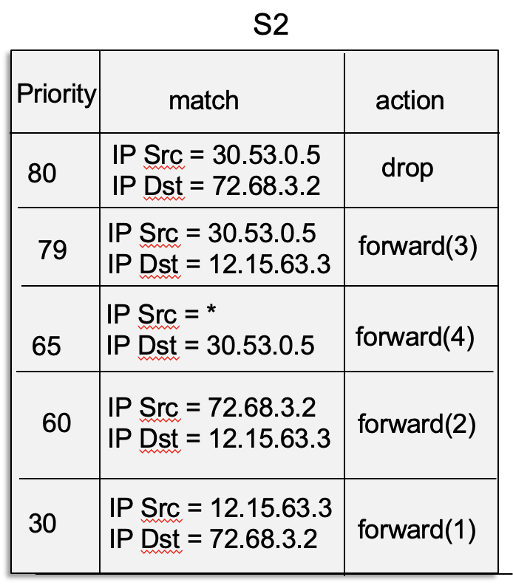
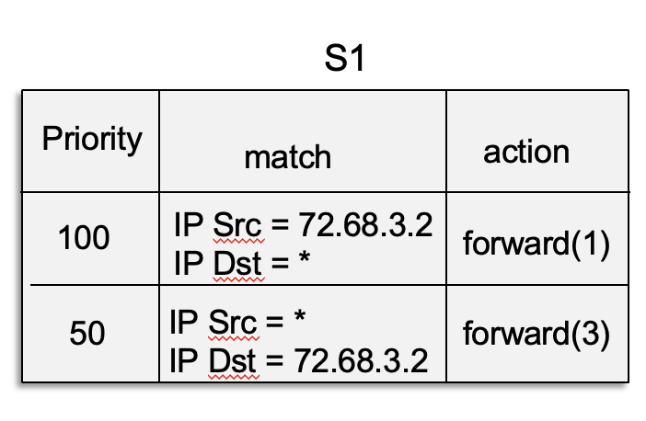
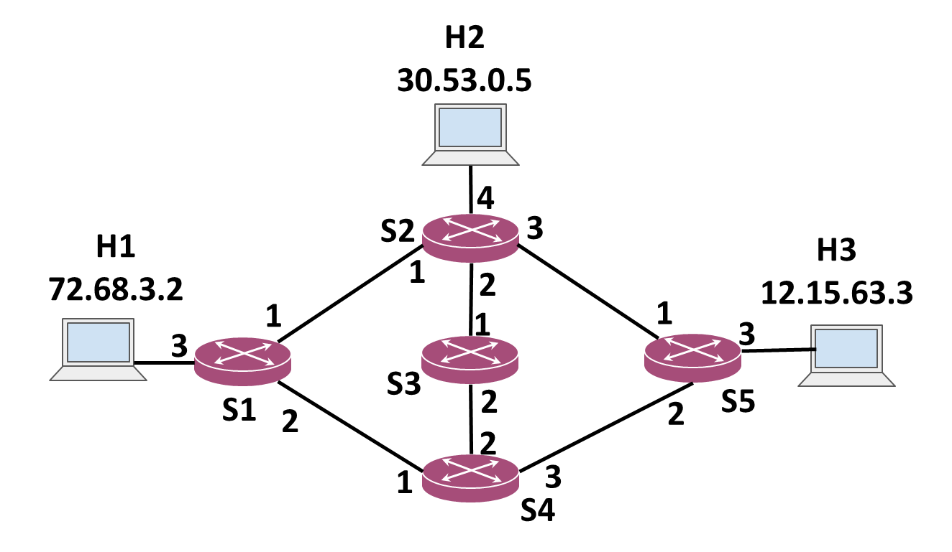
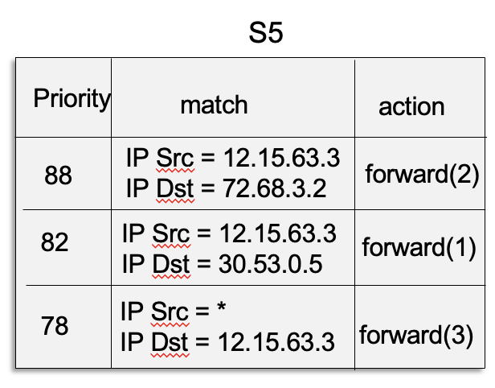
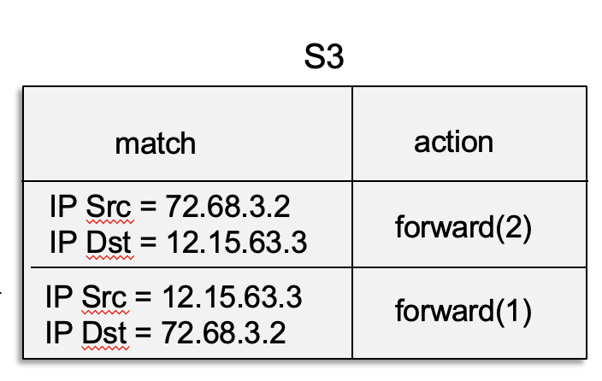
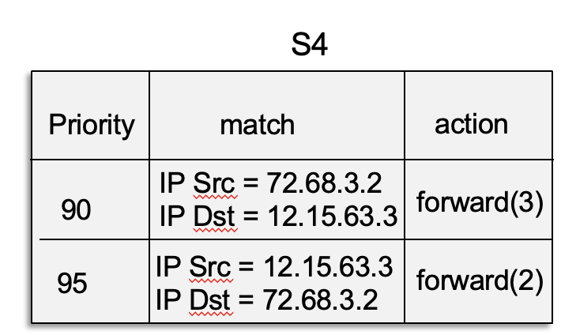
Flow tables for Path Set 1

Slide 62
Network Layer in the Internet
The Internet Protocol (IP)
Internet Routing
  Hierarchical routing
  Intra-ISP routing: OSPF
  Inter-ISP routing: BGP
Internet Forwarding
  Destination-based forwarding
ICMP
Beyond destination-based routing and forwarding
  The end-to-end argument
  Middleboxes
  Software-defined network (SDNs)
We are done with the network layer!
Next Up: Link Layer and Local Area Networks (LANs)

