Slide 1

CS 456/656 Computer Networks
Lecture 5: Transport Layer – Part 1
Mina Tahmasbi Arashloo and Uzma Maroof
Fall 2025

Slide 2
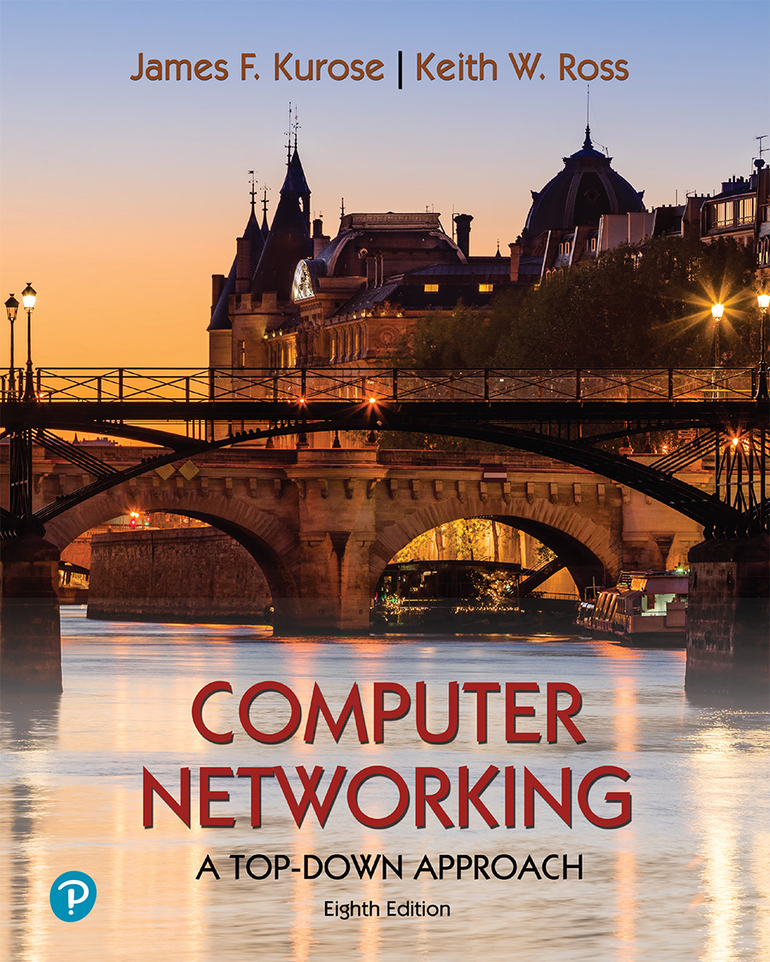
A note on the slides
Adapted from the slides that accompany this book.
All material copyright 1996-2023
J.F Kurose and K.W. Ross, All Rights Reserved
Computer Networking: A Top-Down Approach 8th edition Jim Kurose, Keith Ross Pearson, 2020

Slide 3

Transport layer: roadmap
Transport-layer overview
Multiplexing and demultiplexing
Connectionless transport: UDP
Principles of reliable data transfer
Connection-oriented transport: TCP
Principles of congestion control
TCP congestion control
Evolution of transport-layer functionality

Slide 4
Transport layer: roadmap
Transport-layer overview
Multiplexing and demultiplexing
Connectionless transport: UDP
Principles of reliable data transfer
Connection-oriented transport: TCP
Principles of congestion control
TCP congestion control
Evolution of transport-layer functionality

Slide 5
Transport layer: overview
Provide service to the application layer
Transport to Application: “If you give me some data and the ID of the other communication endpoint (e.g., the (IP, port) for the destination socket), I will get the data to that communication endpoint.”
Using the services of the network layer
Network to transport: “If you give me some data and the ID of the computer (host) that is the destination (e.g., the IP address for the host), I will get the data to that destination host."
Notes:
In each kind of network, the services of the network layer could be different, so let’s look at the Internet as an example.

Slide 6






Transport layer: in the Internet
Host ($H_{1}$)
Host ($H_{2}$)
Application
Application
App 1
App N
App 1
…
App M
…
$$S_{1}$$
$$S_{N}$$
$$S_{1}$$
$$S_{M}$$
Transport
Transport
Network (IP)
Network (IP)
Link
Link
Physical
Physical
Notes:
\

Slide 7
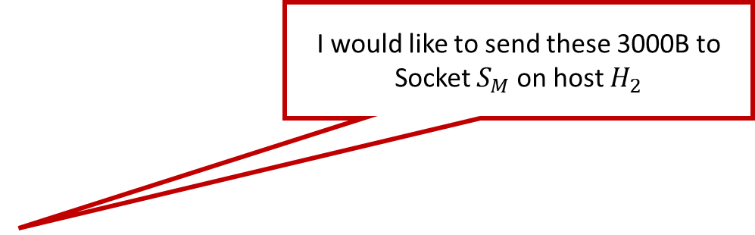
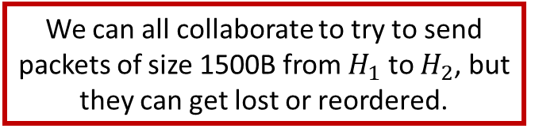
Transport layer: in the Internet
Host ($H_{1}$)
I would like to send these 3000B to Socket $S_{M}$ on host $H_{2}$
Host ($H_{2}$)
Application
Application
App 1
App N
App 1
…
App M
…
$$S_{1}$$
$$S_{N}$$
$$S_{1}$$
$$S_{M}$$
Transport
Transport
We can all collaborate to try to send packets of size 1500B from $H_{1}$ to $H_{2}$, but they can get lost or reordered.
Network (IP)
Network (IP)
Link
Link
Physical
Physical
Notes:
\

Slide 8
Transport layer: in the Internet
Host ($H_{1}$)
I would like to send these 3000B to Socket $S_{M}$ on host $H_{2}$
Host ($H_{2}$)
Application
Application
App 1
App N
App 1
…
App M
…
$$S_{1}$$
$$S_{N}$$
$$S_{1}$$
$$S_{M}$$
Transport-layer protocols bridge this gap
Transport
Transport
We can all collaborate to try to send packets of size 1500B from H1 to H2, but it can get lost or reordered.
Network (IP)
Network (IP)
Link
Link
Physical
Physical
Notes:
\

Slide 9
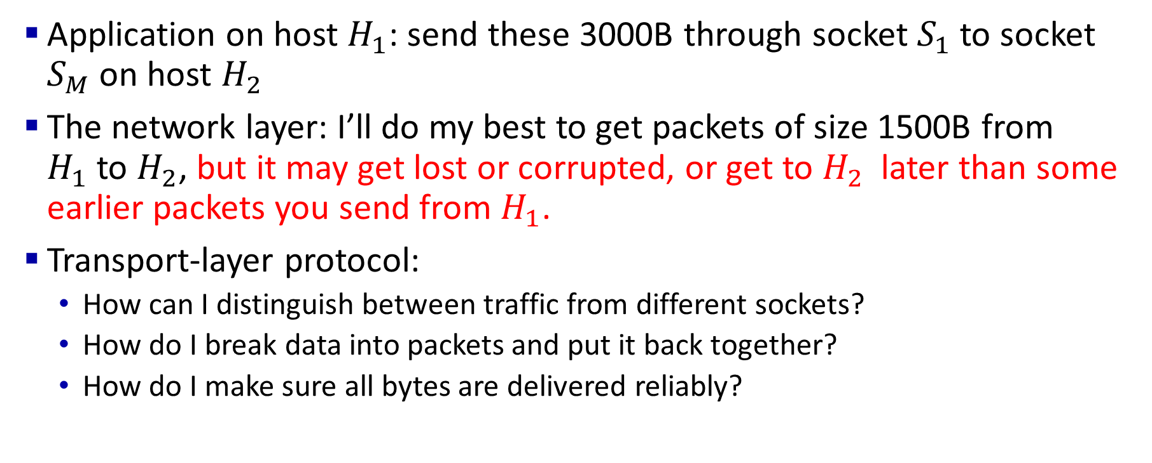
Transport layer: in the Internet
Application on host $H_{1}$: send these 3000B through socket $S_{1}$to socket $S_{M}$ on host $H_{2}$
The network layer: I’ll do my best to get packets of size 1500B from $H_{1}$to $H_{2}$, but it may get lost or corrupted, or get to $H_{2}$ later than some earlier packets you send from $H_{1}$.
Transport-layer protocol:
How can I distinguish between traffic from different sockets?
How do I break data into packets and put it back together?
How do I make sure all bytes are delivered reliably?

Slide 10
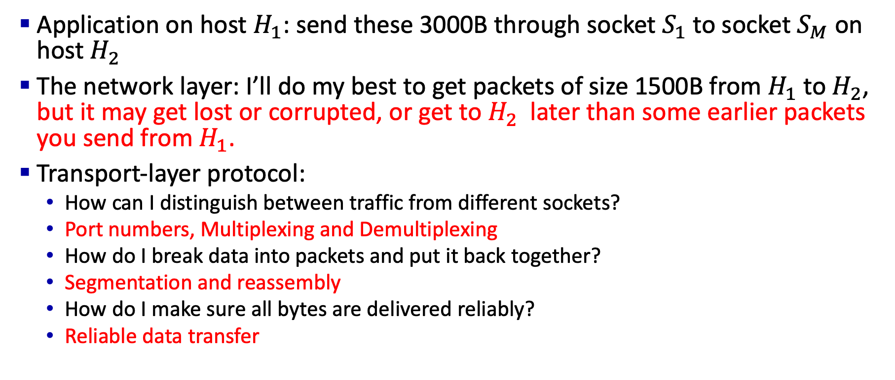
Transport layer: in the Internet
Application on host $H_{1}$: send these 3000B through socket $S_{1}$to socket $S_{M}$ on host $H_{2}$
The network layer: I’ll do my best to get packets of size 1500B from $H_{1}$to $H_{2}$, but it may get lost or corrupted, or get to $H_{2}$ later than some earlier packets you send from $H_{1}$.
Transport-layer protocol:
How can I distinguish between traffic from different sockets?
Port numbers, Multiplexing and Demultiplexing
How do I break data into packets and put it back together?
Segmentation and reassembly
How do I make sure all bytes are delivered reliably?
Reliable data transfer

Slide 11
Transport Layer: in the Internet
Sender:
is passed an application-layer message
application
application
app. msg
Attached its own metadata (header) to help with (de)mux, segmentation and reassembly, and reliable data delivery
T_{h}
transport
app. msg
transport
T_{h}
network
creates segment (transport header + data)
network
link
link
physical
passes segment to the network layer
physical
Notes:
May modify the segmentation and reassembly a bit

Slide 12
Transport Layer: in the Internet
Receiver:
receives segment (transport header + data) from network layer
application
application
use header values to reassemble bytes if needed
app. msg
transport
transport
app. msg
T_{h}
extracts application-layer message
network
network
link
use header values to demultiplex message up to application via socket.
link
physical
physical

Slide 13








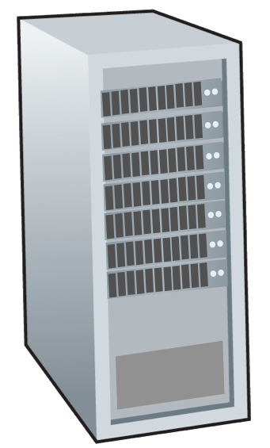







Two principal Internet transport protocols
application
transport
network
data link
physical
TCP: Transmission Control Protocol
segmentation and reassembly
reliable, in-order delivery
UDP: User Datagram Protocol
no segmentation and reassembly
no reliability or ordering guarantees
no-frills extension of “best-effort” IP protocol in the network layer
Both do mux and demux between sockets
services not available:
delay guarantees
bandwidth guarantees
mobile network
national or global ISP
logical end-end transport
local or regional ISP
home network
content
provider
network
application
transport
network
data link
physical
datacenter
network
enterprise
network

Slide 14
Transport layer: roadmap
Transport-layer overview
Multiplexing and demultiplexing
Connectionless transport: UDP
Principles of reliable data transfer
Connection-oriented transport: TCP
Principles of congestion control
TCP congestion control
Evolution of transport-layer functionality

Slide 15
Multiplexing/demultiplexing
Need an extra identifier!
multiplexing as sender:
demultiplexing as receiver:
handle data from multiple
sockets, add transport header (later used for demultiplexing)
use header info to deliver
received segments to correct
socket
App
App
App
App
App
App
End-to-end communication
Transport
Transport
?
Network
Network
Network
multiplexing
Link
Link
Link
de-multiplexing
Physical
Physical
Physical
Host
Router
Host

Slide 16
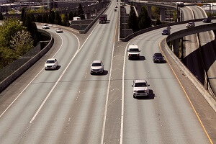
Multiplexing

Slide 17
How demultiplexing works
host receives datagrams
each datagram has source network address, destination network address (e.g., IP addresses)
each datagram carries one transport-layer segment
each segment has source, destination port number
host uses network addresses (e.g., IP addresses) & port numbers to direct segments to appropriate sockets
32 bits
source port #
dest port #
other header fields
application
data
(payload)
TCP/UDP segment format

Slide 18
Connectionless demultiplexing
when receiving host receives UDP segment:
checks destination port # in segment
directs UDP segment to socket with that port #
Recall:
when creating socket, must specify host-local port #:
serverSocket.bind((‘’, 12000))
when sending data into UDP socket, must specify
destination IP address
destination port #
IP/UDP datagrams with same dest. port #, but different source IP addresses and/or source port numbers will be directed to same socket at receiving host
UDP sockets are identified with a pair of IP and port

Slide 19

Connectionless demultiplexing: an example
serverSocket.bind((‘’, 6428))
mySocket2.bind((‘’, 9157))
mySocket1.bind((‘’, 5775))
application
application
P1
application
P3
P4
transport
transport
network
transport
network
link
network
link
physical
link
physical
physical
source port: 6428
dest port: 9157
source port: ?
dest port: ?
source port: 9157
dest port: 6428
source port: ?
dest port: ?

Slide 20
Connection-oriented demultiplexing
TCP socket identified by 4-tuple:
source IP address
source port number
dest IP address
dest port number
server may support many simultaneous TCP sockets:
each socket identified by its own 4-tuple
each socket associated with a different connecting client
demux: receiver uses all four values (4-tuple) to direct segment to appropriate socket

Slide 21

Connection-oriented demultiplexing: example
application
application
P4
P5
P6
application
P1
P2
P3
transport
transport
network
transport
network
link
network
link
physical
link
physical
server: IP address B
physical
host: IP address A
source IP,port: B,80
dest IP,port: A,9157
host: IP address C
source IP,port: C,5775
dest IP,port: B,80
source IP,port: A,9157
dest IP, port: B,80
source IP,port: C,9157
dest IP,port: B,80
Three segments, all destined to IP address: B,
dest port: 80 are demultiplexed to different sockets

Slide 22
Summary of (de)multiplexing
Multiplexing, demultiplexing: based on transport segment and network datagram header field values
UDP: demultiplexing at the destination host using destination IP and port number (only)
TCP: demultiplexing at the destination host using 4-tuple: source and destination IP addresses, and port numbers
Notes:
We don’t really talk about this?

Slide 23
Transport layer: roadmap
Transport-layer overview
Multiplexing and demultiplexing
Connectionless transport: UDP
Principles of reliable data transfer
Connection-oriented transport: TCP
Principles of congestion control
TCP congestion control
Evolution of transport-layer functionality

Slide 24
UDP – User Datagram Protocol
How does UDP distinguish between traffic from different sockets?
Already covered in (de)multiplexing section
How does UDP break data into packets and put it back together ?
It doesn’t! You can only put as much data into a UDP segment that will fit into a single packet. Otherwise, it will give the application an error.
How does UDP make sure all bytes are delivered reliably?
It doesn’t!
“no frills,” “bare bones” Internet transport protocol
“best effort” service, UDP segments may be lost or delivered out-of-order to app
Why do we have UDP again?

Slide 25
UDP: User Datagram Protocol
“no frills,” “bare bones” Internet transport protocol
“best effort” service, UDP segments may be:
lost
delivered out-of-order to app
Connectionless?:
no handshaking between UDP sender, receiver
each UDP segment handled independently of others

Slide 26
UDP: User Datagram Protocol
Why is there a UDP?
“no frills,” “bare bones” Internet transport protocol
“best effort” service, UDP segments may be:
lost
delivered out-of-order to app
no connection establishment (which can add RTT delay)
simple: no connection state at sender, receiver
small header size
no congestion control
UDP can blast away as fast as desired!
can function in the face of congestion
connectionless:
no handshaking between UDP sender, receiver
each UDP segment handled independently of others

Slide 27
UDP: User Datagram Protocol
UDP use:
streaming multimedia apps (loss tolerant, rate sensitive)
HTTP/3
Other network apps or protocols like DNS and SNMP (discussed later)
if reliable transfer needed over UDP:
add needed reliability at application layer

Slide 28
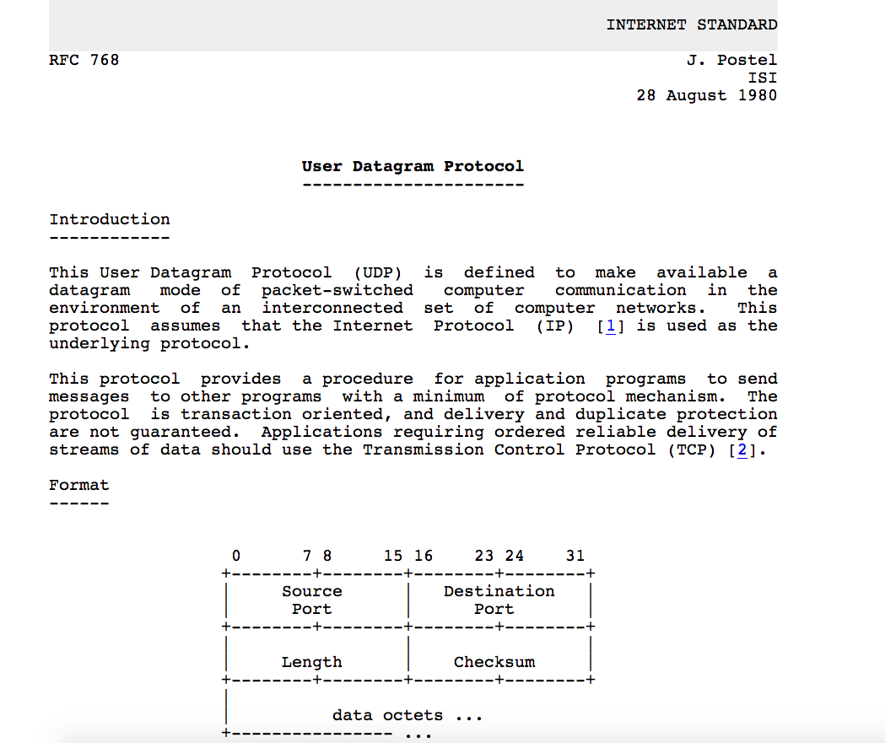
UDP: User Datagram Protocol [RFC 768]
Notes:
read this RFC – it’s only 2.5 pages!

Slide 29
UDP: Transport Layer Actions
application
application
transport
(UDP)
transport
(UDP)
network (IP)
network (IP)
link
link
physical
physical

Slide 30
UDP: Transport Layer Actions
UDP sender actions:
application
application
is passed an application-layer message
app msg
transport
(UDP)
transport
(UDP)
determines UDP segment header fields values
UDP_{h}
app msg
UDP_{h}
creates UDP segment
network (IP)
network (IP)
passes segment to IP
link
link
physical
physical

Slide 31
UDP: Transport Layer Actions
UDP receiver actions:
application
receives segment from IP
application
checks UDP checksum header value
transport
(UDP)
transport
(UDP)
app msg
extracts application-layer message
network (IP)
network (IP)
app msg
UDP_{h}
demultiplexes message up to application via socket
link
link
physical
physical

Slide 32
UDP segment header
32 bits
source port #
dest port #
length
checksum
application
data
(payload)
length, in bytes of UDP segment, including header
data to/from application layer
UDP segment format

Slide 33

UDP checksum
Goal: detect errors (i.e., flipped bits) in transmitted segment
1st number
2nd number
sum
Transmitted: 5 6 11
Received: 4 6 11
receiver-computed
checksum
=
sender-computed
checksum (as received)

Slide 34
Internet checksum
Goal: detect errors (i.e., flipped bits) in transmitted segment
sender:
treat contents of UDP segment (including UDP header fields and IP addresses) as sequence of 16-bit integers
checksum: addition (one’s complement sum) of segment content
checksum value put into UDP checksum field
receiver:
compute checksum of received segment
check if computed checksum equals checksum field value:
not equal - error detected
equal - no error detected.
But maybe errors nonetheless?
More later ….
no error detected.

Slide 35
Internet checksum: an example
example: add two 16-bit integers
1 1 1 0 0 1 1 0 0 1 1 0 0 1 1 0
1 1 0 1 0 1 0 1 0 1 0 1 0 1 0 1
wraparound
1 1 0 1 1 1 0 1 1 1 0 1 1 1 0 1 1
sum
1 0 1 1 1 0 1 1 1 0 1 1 1 1 0 0
checksum
0 1 0 0 0 1 0 0 0 1 0 0 0 0 1 1
Note: when adding numbers, a carryout from the most significant bit needs to be added to the result
* Check out the online interactive exercises for more examples: http://gaia.cs.umass.edu/kurose_ross/interactive/

Slide 36
Internet checksum: weak protection!
example: add two 16-bit integers
0 1
1 1 1 0 0 1 1 0 0 1 1 0 0 1 1 0
1 0
1 1 0 1 0 1 0 1 0 1 0 1 0 1 0 1
wraparound
1 1 0 1 1 1 0 1 1 1 0 1 1 1 0 1 1
Even though numbers have changed (bit flips), no change in checksum!
sum
1 0 1 1 1 0 1 1 1 0 1 1 1 1 0 0
checksum
0 1 0 0 0 1 0 0 0 1 0 0 0 0 1 1

Slide 37
Summary: UDP
“no frills” protocol:
segments may be lost, delivered out of order
best effort service: “send and hope for the best”
UDP has its benefits:
no setup/handshaking needed (no RTT incurred)
helps with reliability (checksum)
…
build additional functionality on top of UDP in application layer

