Slide 1

CS 456/656
Computer Networks
Lecture 18: Router/Switch Architecture
Mina Tahmasbi Arashloo and Uzma Maroof
Fall 2025

Slide 2

A note on the slides
Adapted from the slides that accompany this book.
All material copyright 1996-2023
J.F Kurose and K.W. Ross, All Rights Reserved
Computer Networking: A Top-Down Approach
8th edition
Jim Kurose, Keith Ross
Pearson, 2020
And lecture notes from Anirudh Sivaraman, NYU

Slide 3

What we discussed before
Packets can be buffered in routers
  delay and loss
  network congestion
Host C
Host A
R
R
Router
R
Host B
R
R
Host D

Slide 4
What we discussed before
Packets can be buffered in routers
  delay and loss
  network congestion
Host C
Host A
Packets are queued in the router
R
R
Router
R
Host B
R
R
Host D

Slide 5
What we discussed before
Packets can be buffered in routers
  delay and loss
  network congestion
Host C
Host A
Packets are queued in the router
R
R
Router
R
Host B
R
R
Host D
This Lecture: How are packets buffered and managed in routers?

Slide 6
Router architecture and buffer management
Router architecture
  Output queueing
  Input queueing
  …
Buffer management and scheduling

Slide 7
What is inside a router?
high-level view of generic router architecture:
routing, management
control plane (software)
operates in millisecond
time frame
routing
processor
forwarding data plane (hardware) operates in nanosecond timeframe
high-speed
switching
fabric
router input ports
router output ports

Slide 8


Input port functions
forwarding
line
termination
link
layer
protocol
(receive)
switch
fabric
physical layer:
bit-level reception
Datagram
forwarding: The forwarding table we have been talking about goes here!
  Looks up the next hop/interface the packet should go to.
  The switching fabric will then move the packet to exit from that interface (output port)
link layer:
e.g., Ethernet
Frame
Notes:
Green box is a physical layer responsible for receiving bit level transmission. Copper, fiber wireless.
Link layer in blue – bit assemble into Ethernet frame. We will discuss this in details in chapter 6.
But most critical one, is here. Lookup, forwarding function. Lookup and forward is “Match plus action” behavior.
GOAL – processing at “line speed”, otherwise, buffer will be full and packet will be lost

Slide 9
Switching fabrics
transfer packets from input links to appropriate output links
Suppose
  All packets are of the same size
  Define the time it takes to send/receive a packet on a port as our time unit, and call it a tick (today, that’s usually a few nanoseconds!)
R
R
. . .
high-speed
switching
fabric
. . .
N input ports
N output ports
R
R

Slide 10
Switching fabrics
In each tick, we can
  receive at most a packet on each input port (up to N ports)
  send at most a packet on each output port (up to N ports)
R
R
. . .
high-speed
switching
fabric
. . .
N input ports
N output ports
R
R

Slide 11
Switching fabrics
On each tick, we can
  receive a packet on each input port
  send a packet on each output port
Ideally, the switching fabric can move N packets in each tick
  If the link rates are R, an ideal switching fabric moves packets at rate NR.
R
(rate: NR, ideally)
R
. . .
high-speed
switching
fabric
. . .
N input ports
N output ports
R
R

Slide 12
Switching fabrics
On each tick, we can
  receive a packet on each input port
  send a packet on each output port
If two or more input ports have a packet destined to the same output port
  only one can go out in the next tick(s)
  the rest have to wait somewhere
R
(rate: NR, ideally)
R
. . .
high-speed
switching
fabric
. . .
N input ports
N output ports
R
R

Slide 13
Switching fabrics
On each tick, we can
  receive a packet on each input port
  send a packet on each output port
If two or more input ports have a packet destined to the same output port
  only one can go out in the next tick(s)
  the rest have to wait somewhere
Queued in a buffer (where?)
R
(rate: NR, ideally)
R
. . .
high-speed
switching
fabric
. . .
N input ports
N output ports
R
R

Slide 14
Router architecture and buffer management
Router architecture
  Output queueing
  Input queueing
  …
Buffer management and scheduling

Slide 15
Output queuing
N separate memories, one for each output port
Input port receives a packet, and then puts it in the memory of the output port it is supposed to exit from
Output port pulls the next packet from its corresponding memory
…
mem
…
..…
mem
…
…
mem
…

Slide 16
Router architecture and buffer management
Router architecture
  Output queueing
  Input queueing
  …
Buffer management and scheduling

Slide 17
Input queuing
N separate memory pools, one for each input port.
Input port receives a packet, puts it in the dedicated memory for that input port.
  1 enqueue per tick
Output port gets the next packet from the memory of one of the input ports that have packets destined to it
  1 dequeue per tick

Slide 18
Input queuing
At most one enqueue in each memory per tick
1
mem
1
2
3
2
2
mem
3
1
3
3
mem
2
1

Slide 19
Input queuing
At most one dequeue from each memory per tick
1
mem
1
2
3
2
2
mem
3
1
3
3
mem
2
1

Slide 20
Input queuing
At most one dequeue from each memory per tick
1
mem
1
1
2
2
2
mem
3
3
3
mem
3
2
1

Slide 21
Input queuing
How do we coordinate packets between inputs and outputs?
1
mem
In every tick
Each input sends to at most one output
Each output receives from at most each input
1
2
3
2
2
mem
3
1
3
3
mem
2
1
A single buffer per input can lead to head of line blocking… look up virtual output queuing for a common solution
Coordinates between inputs and outputs
by solving a bi-partite matching problem!

Slide 22
Architecture trends
Today, there is a renewed interest in output-queued (and shared memory) architectures
Data centers have many switches (100s of thousands)
To keep the costs down, vendors have reduced the amount of memory available for buffering in these switches
  Easier, e.g., compared to a WAN, to keep the queues shorter in DCs, specially with the help of congestion control algorithms.
Easier to make smaller high-speed memory with multiple enqueues and/or dequeues per tick
With output-queued (or shared-memory architectures), no need for dealing with efficient scheduling of a crossbar.

Slide 23
Router architecture and buffer management
Router architecture
  Output queueing
  Input queueing
  …
Buffer management and scheduling

Slide 24
Queue/Buffer management and scheduling
Independent of where the queues are in the router architecture, there are some important questions:
  Buffer size: How large should a buffer be?
  Queue management: When the queue is full, which packet do we drop? What do we do when the queue starts building up?
  Packet scheduling: Which packet in the queue gets dequeued first? Should it be first-in first-out? Something else?

Slide 25
How large should a buffer be?
There is no easy answer:
Too small: can’t absorb bursts, keeps dropping packets
Too large: can hurt performance
  buffer bloat: When the buffer is too large, it will take a long time to fill up before a packet is dropped (however, TCP only realizes there is congestion when a packet is dropped and will not decrease its sending rate). In the meantime, all packets will experience increasing queueing delay.
  Delay-based congestion control algorithms do better here.

Slide 26
Queue management – Drop policy
When a new packet arrives to a full queue, which packet do we drop?
Tail drop: drop arriving packet
Priority: drop/remove based on priority
  E.g., if the incoming packet has higher priority than a packet already in the queue, drop the lower priority packet and insert the incoming packet into the queue.
packet
arrivals
packet
departures
queue
(waiting area)
link
(server)

Slide 27
Queue management – Marking
When the queue starts filling up, one strategy is to mark packets to signal the onset of congestion to the end points
Recall our discussion about Early Congestion Notification (ECN) and its role in congestion control
When should we start/stop marking packets?
Which packets do we mark?
  All packets after the queue size passes a threshold?
  From the flow with the most packets in the queue?
  …

Slide 28
Packet scheduling
So far, we have assumed that our queues are first in first out (FIFO)
Abstraction: queue
packet
departures
packet
arrivals
queue
(waiting area)
scheduler
But, there are other packet scheduling algorithms as well.

Slide 29
Packet scheduling
Priority
Round-Robin
Weighted Round Robin
…
scheduler
classify
arrivals
departures
Instead of one queue for all packets going to the same output port (in an output-queued switch), there are separate queues for different ”traffic classes”

Slide 30
Additional Slides

Slide 31
Output queuing
On each tick, we can
  receive a packet on each input port
  send a packet on each output port
For every tick:
each memory needs to support N enqueues
  all input ports may receive packets going to the same output port
each memory only needs to support 1 dequeue per tick
…
mem
…
..…
mem
…
…
mem
…

Slide 32
Output queuing
Pros: For each memory, 1 dequeue per tick
Cons:
  Static allocation of memory to output ports: if port 1 is not getting too much traffic and port 2 is, can’t give port 1’s unused memory to port 2
  Each memory has to support N enqueues per tick
…
mem
…
..…
mem
…
…
mem
…

Slide 33
Input queuing
In every tick
Each input sends to at most one output
Each output receives from at most each input
1
mem
2
3
2
mem
3
1
3
mem
2
1
1
2
3

Slide 34
Input queuing
In every tick
Each input sends to at most one output
Each output receives from at most each input
1
mem
2
3
2
mem
3
1
3
mem
2
1
1
2
3

Slide 35
Input queuing
In every tick
Each input sends to at most one output
Each output receives from at most each input
1
mem
2
3
2
mem
3
1
3
mem
2
1
Known as the crossbar
1
2
3

Slide 36
Input queuing
In every tick
Each input sends to at most one output
Each output receives from at most each input
1
mem
2
2
mem
3
3
mem
2
1
Known as the crossbar
1
2
3

Slide 37
Input queuing
In every tick
Each input sends to at most one output
Each output receives from at most each input
1
mem
2
2
mem
3
3
mem
2
1
Known as the crossbar
1
2
3
Scheduling the crossbar:
Bipartite matching

Slide 38
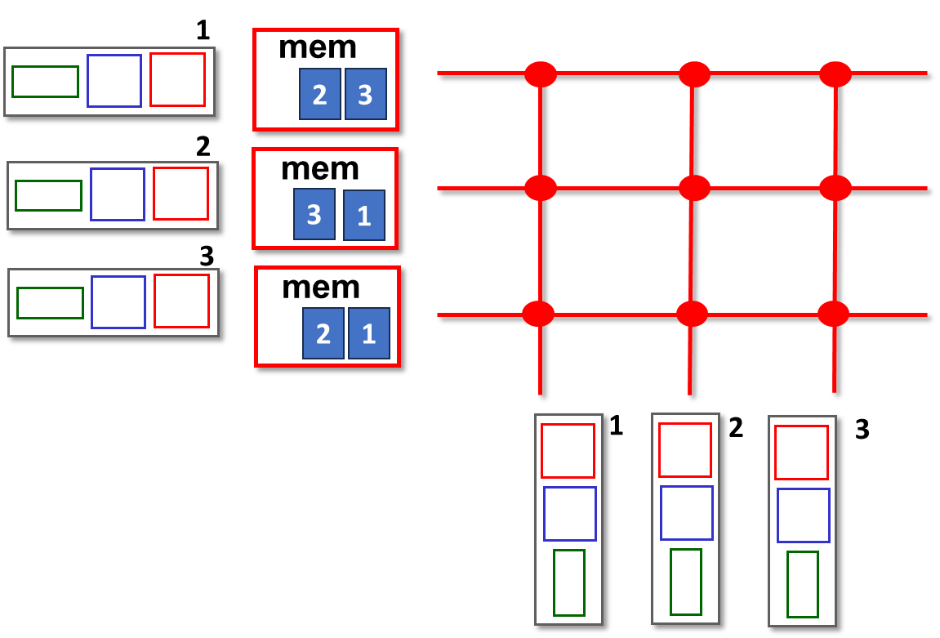
Input queuing
Pros:
  For each memory, 1 enqueue and 1 dequeue per tick
Cons:
  Static allocation of memory resources to input ports
  Head of line blocking (HoL blocking)

Slide 39
Head of line blocking
1
mem
2
3
2
mem
3
1
3
mem
2
1
The “path” between 3 and 2 is open!
(does not collide with any other transfer)
But, the head of the line (packet going to 1) is blocking this packet to get to output port 2
1
2
3

Slide 40
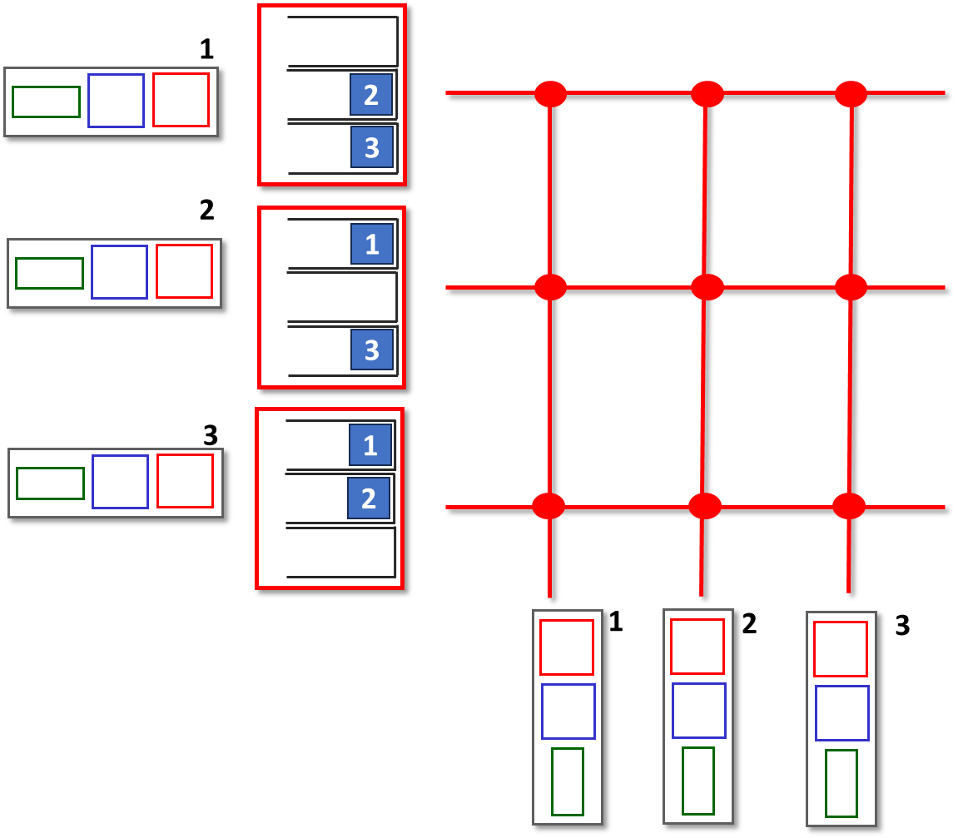
Virtual output queuing
Instead of one queue at each input port, have N queues at each input port, one for the packets destined to one output port.
Virtual output queue (VOQ) j at input port i
  is located in input port i’s memory
  buffers the packets entering from input port i and destined towards output port j

Slide 41
Virtual output queuing
1
2
3
2
1
3
3
1
2
1
2
3
Not stuck behind the packet going to output port 1 anymore

Slide 42
Virtual output queuing
1
2
3
2
1
3
3
1
2
1
2
3
Not stuck behind the packet going to output port 1 anymore

Slide 43
Packet scheduling: priority
Instead of one queue for all packets going to the same output port, there are two queues, one for each priority
Priority scheduling:
arriving traffic classified to figure out priority
  any header fields can be used for classification
high priority queue
arrivals
classify
scheduler
departures
low priority queue
2
send packet from highest priority queue that has buffered packets
  FIFO within priority class
1
3
4
5
arrivals
packet in service
1
3
2
4
5
departures
1
3
2
4
5

Slide 44
Packet scheduling: round robin
Round Robin (RR) scheduling:
arriving traffic classified, queued by class
  any header fields can be used for classification
scheduler
scheduler cyclically, repeatedly scans class queues, sending one complete packet from each class (if available) in turn
classify
arrivals
departures

Slide 45
Packet scheduling: weighted fair queueing
Weighted Fair Queuing (WFQ):
generalized Round Robin
each class, i, has weight, w_{i}, and gets weighted amount of service in each cycle:
w₁
scheduler
w₂
w_{i}
Σ_{j}w_{j}
classify
arrivals
departures
w₃
minimum bandwidth guarantee (per-traffic-class)

