Slide 1

CS 456/656 Computer Networks
Lecture 10: Network Layer – Part 2
Mina Tahmasbi Arashloo and Uzma Maroof
Fall 2025

Slide 2

A note on the slides
Adapted from the slides that accompany this book.
All material copyright 1996-2023
J.F Kurose and K.W. Ross, All Rights Reserved
Computer Networking: A Top-Down Approach 8th edition Jim Kurose, Keith Ross Pearson, 2020

Slide 3
Thanks for filling out the survey!
If you have not, there is still time
We’ll discuss the results and potential upcoming changes soon

Slide 4
Network layer: roadmap
Network layer overview
Routing algorithms
Link state
Distance vector
Network layer in the Internet

Slide 5
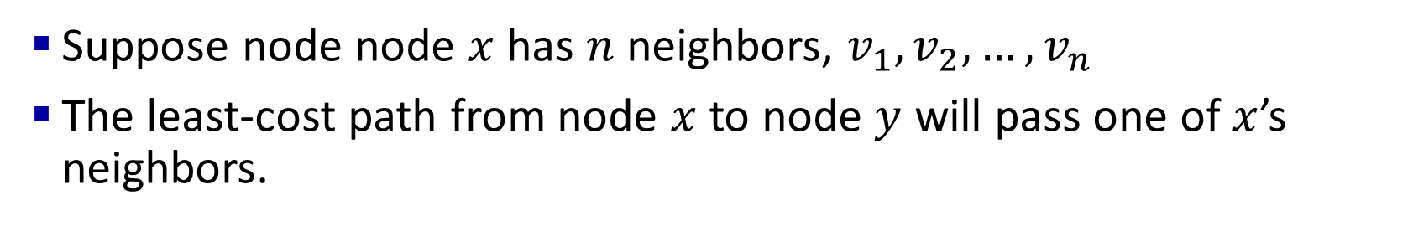



Distance vector routing algorithms
Suppose node node $x$ has $n$ neighbors, $v_{1}, v_{2},…, v_{n}$
The least-cost path from node $x$ to node $y$ will pass one of $x$’s neighbors.
$$v_{1}$$
$$v_{2}$$
y
x
…
$$v_{n}$$

Slide 6
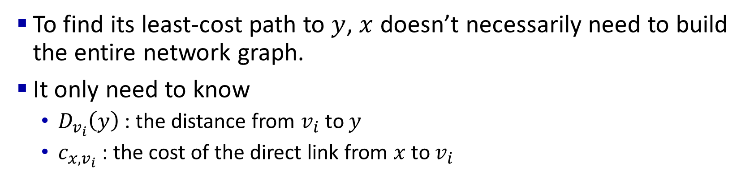





Distance vector routing algorithms
To find its least-cost path to $y$, $x$ doesn’t necessarily need to build the entire network graph.
It only need to know
$D_{v_{i}}\left(y\right)$ : the distance from $v_{i}$ to $y$
$c_{x,v_{i}}$ : the cost of the direct link from $x$ to $v_{i}$
$$v_{1}$$
$$D_{v_{1}}(y)$$
$$c_{x,v_{1}}$$
$$v_{2}$$
y
x
…
$$v_{n}$$

Slide 7
Distance vector algorithm
Based on Bellman-Ford (BF) equation (dynamic programming):
Bellman-Ford equation
Let D_{x}(y): cost of least-cost path from x to y.
Then:
D_{x}(y) = min_{v} { c_{x,v} + D_{v}(y) }
v’s estimated least-cost-path cost to y
min taken over all neighbors v of x
direct cost of link from x to v

Slide 8
Bellman-Ford example
Suppose that u’s neighboring nodes, x,v,w, know that for destination c:
D_{v}(c) = 6
D_{w}(c) = 4
Bellman-Ford equation says:
5
b
1
D_{u}(c) = min { c_{u,v} + D_{v}(c),
c_{u,x} + D_{x}(c),
c_{u,w} + D_{w}(c) }
a
v
3
w
2
5
1
u
z
c
2
1
3
1
= min {2 + 6,
1 + 4,
5 + 4} = 5
1
2
x
y
1
D_{x}(c) = 4
node achieving minimum (node x) is next hop on estimated least-cost path to destination (node c)

Slide 9
Distance vector algorithm
key idea:
from time-to-time, each node sends its own distance vector estimate to neighbors
when x receives new DV estimate from any neighbor, it updates its own DV using B-F equation:
D_{x}(y) ← min_{v}{c_{x,v} + D_{v}(y)} for each node y ∊ N
under minor, natural conditions, the estimate D_{x}(y) converge to the actual least cost d_{x}(y)

Slide 10
Distance vector algorithm:
each node:
iterative, asynchronous: each local iteration caused by:
local link cost change
DV update message from neighbor
wait for (change in local link cost or msg from neighbor)
recompute DV estimates using DV received from neighbor
distributed, self-stopping: each node notifies neighbors only when its DV changes
neighbors then notify their neighbors – only if necessary
no notification received, no actions taken!
if DV to any destination has changed, notify neighbors

Slide 11
Distance vector example: iteration
We will walk through an example of distance vector routing
For simplicity, we are not adding the end-host (orange) nodes to the example
They do not participate in routing
But, the routers will include the distance to them in their advertised distance vectors.

Slide 12
Distance vector example: iteration
DV in a: D_{a}(a)=0
D_{a}(b) = 8
D_{a}(c) = ∞
D_{a}(d) = 1
D_{a}(e) = ∞
D_{a}(f) = ∞
D_{a}(g) = ∞
D_{a}(h) = ∞
D_{a}(i) = ∞
a
b
c
8
1
t=0
1
1
All nodes have distance estimates to nearest neighbors (only)
A few asymmetries:
missing link
larger cost
d
e
f
1
1
All nodes send their local distance vector to their neighbors
1
1
1
g
h
i
1
1

Slide 13
Distance vector example: iteration
a
b
c
8
1
t=1
1
1
All nodes:
receive distance vectors from neighbors
compute their new local distance vector
send their new local distance vector to neighbors
d
e
f
1
1
1
1
1
g
h
i
1
1

Slide 14
Distance vector example: iteration
a
compute
compute
compute
b
c
8
1
t=1
1
1
All nodes:
receive distance vectors from neighbors
compute their new local distance vector
send their new local distance vector to neighbors
d
compute
e
f
compute
compute
1
1
1
1
1
g
h
i
compute
compute
1
compute
1

Slide 15
Distance vector example: iteration
a
b
c
8
1
t=1
1
1
All nodes:
receive distance vectors from neighbors
compute their new local distance vector
send their new local distance vector to neighbors
d
e
f
1
1
1
1
1
g
h
i
1
1

Slide 16
Distance vector example: iteration
a
b
c
8
1
t=2
1
1
All nodes:
receive distance vectors from neighbors
compute their new local distance vector
send their new local distance vector to neighbors
d
e
f
1
1
1
1
1
g
h
i
1
1

Slide 17
Distance vector example: iteration
compute
compute
compute
a
b
c
2
1
t=2
1
1
All nodes:
receive distance vectors from neighbors
compute their new local distance vector
send their new local distance vector to neighbors
d
compute
compute
compute
e
f
1
1
1
1
1
g
compute
compute
compute
h
i
8
1

Slide 18
Distance vector example: iteration
a
b
c
8
1
t=2
1
1
All nodes:
receive distance vectors from neighbors
compute their new local distance vector
send their new local distance vector to neighbors
d
e
f
1
1
1
1
1
g
h
i
1
1

Slide 19
Distance vector example: iteration
…. and so on
Let’s next take a look at the iterative computations at nodes
* Check out the online interactive exercises for more examples: http://gaia.cs.umass.edu/kurose_ross/interactive/

Slide 20
Distance vector example: iteration
…. and so on
Let’s next take a look at the iterative computations at nodes
Let’s look at the computation at node b at t = 1
Remember, b’s neighbors have sent b their DV record version at t = 0
* Check out the online interactive exercises for more examples: http://gaia.cs.umass.edu/kurose_ross/interactive/

Slide 21
Distance vector example: computation
DV in b:
DV in c:
D_{c}(a) = ∞
D_{c}(b) = 1
D_{c}(c) = 0
D_{c}(d) = ∞
D_{c}(e) = ∞
D_{c}(f) = ∞
D_{c}(g) = ∞
D_{c}(h) = ∞
D_{c}(i) = ∞
D_{b}(a) = 8
D_{b}(c) = 1
D_{b}(d) = ∞
D_{b}(e) = 1
D_{b}(f) = ∞
D_{b}(g) = ∞
D_{b}(h) = ∞
D_{b}(i) = ∞
DV in a: D_{a}(a)=0
D_{a}(b) = 8
D_{a}(c) = ∞
D_{a}(d) = 1
D_{a}(e) = ∞
D_{a}(f) = ∞
D_{a}(g) = ∞
D_{a}(h) = ∞
D_{a}(i) = ∞
a
b
c
8
1
t=1
1
1
b receives DVs from a, c, e
DV in e:
D_{e}(a) = ∞
D_{e}(b) = 1
D_{e}(c) = ∞
D_{e}(d) = 1
D_{e}(e) = 0
D_{e}(f) = 1
D_{e}(g) = ∞
D_{e}(h) = 1
D_{e}(i) = ∞
d
e
f
1
1
1
1
1
g
h
i
1
1

Slide 22
Distance vector example: computation
DV in b:
DV in c:
D_{c}(a) = ∞
D_{c}(b) = 1
D_{c}(c) = 0
D_{c}(d) = ∞
D_{c}(e) = ∞
D_{c}(f) = ∞
D_{c}(g) = ∞
D_{c}(h) = ∞
D_{c}(i) = ∞
D_{b}(a) = 8
D_{b}(c) = 1
D_{b}(d) = ∞
D_{b}(e) = 1
D_{b}(f) = ∞
D_{b}(g) = ∞
D_{b}(h) = ∞
D_{b}(i) = ∞
DV in a: D_{a}(a)=0
D_{a}(b) = 8
D_{a}(c) = ∞
D_{a}(d) = 1
D_{a}(e) = ∞
D_{a}(f) = ∞
D_{a}(g) = ∞
D_{a}(h) = ∞
D_{a}(i) = ∞
a
b
c
b
8
compute
1
t=1
1
1
b receives DVs from a, c, e, computes:
DV in e:
D_{e}(a) = ∞
D_{e}(b) = 1
D_{e}(c) = ∞
D_{e}(d) = 1
D_{e}(e) = 0
D_{e}(f) = 1
D_{e}(g) = ∞
D_{e}(h) = 1
D_{e}(i) = ∞
e
d
e
f
1
1
D_{b}(a) = min{c_{b,a}+D_{a}(a), c_{b,c} +D_{c}(a), c_{b,e}+D_{e}(a)} = min{8,∞,∞} = 8
D_{b}(c) = min{c_{b,a}+D_{a}(c), c_{b,c} +D_{c}(c), c _{b,e} +D_{e}(c)} = min{∞,1,∞} = 1
D_{b}(d) = min{c_{b,a}+D_{a}(d), c_{b,c} +D_{c}(d), c _{b,e} +D_{e}(d)} = min{9,∞,2} = 2
1
1
1
D_{b}(e) = min{c_{b,a}+D_{a}(e), c_{b,c} +D_{c}(e), c _{b,e} +D_{e}(e)} = min{∞,∞,1} = 1
DV in b:
D_{b}(f) = min{c_{b,a}+D_{a}(f), c_{b,c} +D_{c}(f), c _{b,e} +D_{e}(f)} = min{∞,∞,2} = 2
D_{b}(g) = min{c_{b,a}+D_{a}(g), c_{b,c} +D_{c}(g), c _{b,e}+D_{e}(g)} = min{∞, ∞, ∞} = ∞
D_{b}(a) = 8
D_{b}(c) = 1
D_{b}(d) = 2
D_{b}(e) = 1
D_{b}(f) =2
D_{b}(g) = ∞
D_{b}(h) = 2
D_{b}(i) = ∞
g
h
1
i
1
D_{b}(h) = min{c_{b,a}+D_{a}(h), c_{b,c} +D_{c}(h), c _{b,e}+D_{e}(h)} = min{∞, ∞, 2} = 2
D_{b}(i) = min{c_{b,a}+D_{a}(i), c_{b,c} +D_{c}(i), c _{b,e}+D_{e}(i)} = min{∞, ∞, ∞} = ∞

Slide 23
Distance vector example: iteration
Now, let’s look at the computation at node c at t = 1
Remember, c’s neighbors have sent c their DV record version at t = 0
* Check out the online interactive exercises for more examples: http://gaia.cs.umass.edu/kurose_ross/interactive/

Slide 24
Distance vector example: computation
DV in b:
DV in c:
D_{c}(a) = ∞
D_{c}(b) = 1
D_{c}(c) = 0
D_{c}(d) = ∞
D_{c}(e) = ∞
D_{c}(f) = ∞
D_{c}(g) = ∞
D_{c}(h) = ∞
D_{c}(i) = ∞
D_{b}(a) = 8
D_{b}(c) = 1
D_{b}(d) = ∞
D_{b}(e) = 1
D_{b}(f) = ∞
D_{b}(g) = ∞
D_{b}(h) = ∞
D_{b}(i) = ∞
a
b
c
8
1
t=1
1
1
c receives DVs from b
d
e
f
1
1
1
1
1
g
h
i
1
1

Slide 25
Distance vector example: computation
DV in b:
DV in c:
D_{c}(a) = ∞
D_{c}(b) = 1
D_{c}(c) = 0
D_{c}(d) = ∞
D_{c}(e) = ∞
D_{c}(f) = ∞
D_{c}(g) = ∞
D_{c}(h) = ∞
D_{c}(i) = ∞
D_{b}(a) = 8
D_{b}(c) = 1
D_{b}(d) = ∞
D_{b}(e) = 1
D_{b}(f) = ∞
D_{b}(g) = ∞
D_{b}(h) = ∞
D_{b}(i) = ∞
a
b
c
1
compute
8
t=1
1
1
c receives DVs from b computes:
d
e
f
D_{c}(a) = min{c_{c,b}+D_{b}(a}} = 1 + 8 = 9
DV in c:
D_{c}(a) = 9
D_{c}(b) = 1
D_{c}(c) = 0
D_{c}(d) = 2
D_{c}(e) = ∞
D_{c}(f) = ∞
D_{c}(g) = ∞
D_{c}(h) = ∞
D_{c}(i) = ∞
D_{c}(b) = min{c_{c,b}+D_{b}(b)} = 1 + 0 = 1
D_{c}(d) = min{c_{c,b}+D_{b}(d)} = 1+ ∞ = ∞
D_{c}(e) = min{c_{c,b}+D_{b}(e)} = 1 + 1 = 2
D_{c}(f) = min{c_{c,b}+D_{b}(f)} = 1+ ∞ = ∞
D_{c}(g) = min{c_{c,b}+D_{b}(g)} = 1+ ∞ = ∞
g
h
i
D_{c}(h) = min{c_{bc,b}+D_{b}(h)} = 1+ ∞ = ∞
D_{c}(i) = min{c_{c,b}+D_{b}(i)} = 1+ ∞ = ∞

Slide 26
Distance vector example: iteration
Now, let’s look at the computation at node e at t = 1
Remember, e’s neighbors have sent e their DV record version at t = 0
* Check out the online interactive exercises for more examples: http://gaia.cs.umass.edu/kurose_ross/interactive/

Slide 27
Distance vector example:
DV in b:
D_{b}(a) = 8
D_{b}(c) = 1
D_{b}(d) = ∞
D_{b}(e) = 1
D_{b}(f) = ∞
D_{b}(g) = ∞
D_{b}(h) = ∞
D_{b}(i) = ∞
DV in e:
D_{e}(a) = ∞
D_{e}(b) = 1
D_{e}(c) = ∞
D_{e}(d) = 1
D_{e}(e) = 0
D_{e}(f) = 1
D_{e}(g) = ∞
D_{e}(h) = 1
D_{e}(i) = ∞
DV in d:
D_{c}(a) = 1
D_{c}(b) = ∞
D_{c}(c) = ∞
D_{c}(d) = 0
D_{c}(e) = 1
D_{c}(f) = ∞ D_{c}(g) = 1
D_{c}(h) = ∞
D_{c}(i) = ∞
a
b
c
8
1
t=1
Q: what is new DV computed in e at t=1?
1
1
e receives DVs from b, d, f, h
d
compute
f
DV in f:
D_{f}(a) = ∞
D_{f}(b) = ∞
D_{f}(c) = ∞
D_{f}(d) = ∞
D_{f}(e) = 1
D_{f}(f) = 0
D_{f}(g) = ∞
D_{f}(h) = ∞
D_{f}(i) = 1
e
DV in h:
D_{h}(a) = ∞
D_{h}(b) = ∞
D_{h}(c) = ∞
D_{h}(d) = ∞
D_{h}(e) = 1
D_{h}(f) = ∞
D_{h}(g) = 1
D_{h}(h) = 0
D_{h}(i) = 1
1
1
1
1
1
g
h
i
1
1

Slide 28
Distance vector: state information diffusion
Iterative communication, computation steps diffuses information through network:
t=0
c’s state at t=0 is at c only
a
b
c
8
1
c’s state at t=0 has propagated to b, and may influence distance vector computations up to 1 hop away, i.e., at b
t=1
1
1
t=1
t=2
c’s state at t=0 may now influence distance vector computations up to 2 hops away, i.e., at b and now at a, e as well
t=2
d
e
f
1
1
t=3
c’s state at t=0 may influence distance vector computations up to 3 hops away, i.e., at d, f, h
1
1
1
t=3
c’s state at t=0 may influence distance vector computations up to 4 hops away, i.e., at g, i
t=4
g
h
i
1
1
t=4

Slide 29
Distance vector is asynchronous
The example we discussed was simplified…
We assumed there is a synchronized clock between all routers
Syncing the message transfers and computation.
In reality, the routers are not all synchronized with each other

Slide 30
Distance vector: link cost changes
link cost changes:
node detects local link cost change
updates routing info, recalculates local DV
if DV changes, notify neighbors
1
y
4
1
x
z
50
t₀ : y detects link-cost change, updates its DV, informs its neighbors.
“good news
travels fast”
t₁ : z receives update from y, updates its DV, computes new least cost to x , sends its neighbors its DV.
t₂ : y receives z’s update, updates its DV. y’s least costs do not change, so y does not send a message to z.

Slide 31
Distance vector: link cost changes
link cost changes:
node detects local link cost change
“bad news travels slow” – count-to-infinity problem:
60
y
4
1
x
z
50
y sees direct link to x has new cost 60, but z has said it has a path at cost of 5. So y computes “my new cost to x will be 6, via z); notifies z of new cost of 6 to x.
z learns that path to x via y has new cost 6, so z computes “my new cost to x will be 7 via y), notifies y of new cost of 7 to x.
y learns that path to x via z has new cost 7, so y computes “my new cost to x will be 8 via y), notifies z of new cost of 8 to x.
z learns that path to x via y has new cost 8, so z computes “my new cost to x will be 9 via y), notifies y of new cost of 9 to x.
…

Slide 32
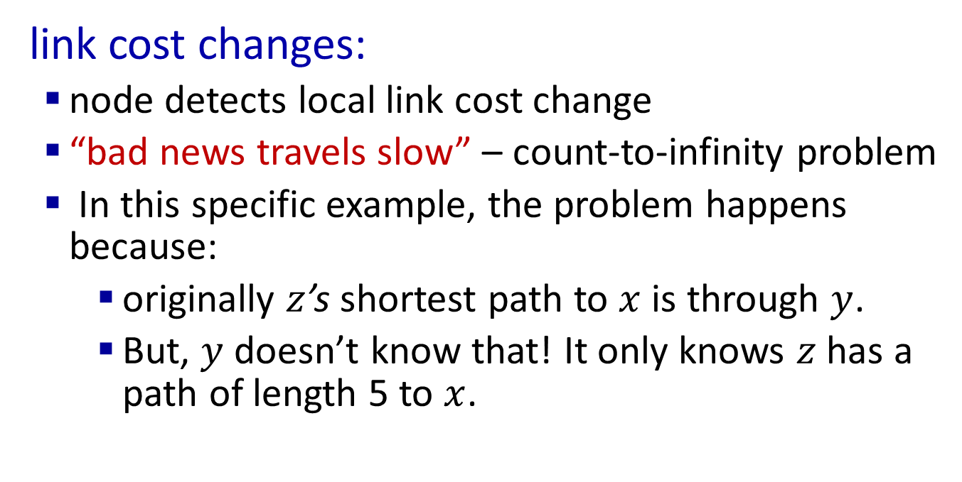
Distance vector : count-to-infinity problem
link cost changes:
node detects local link cost change
“bad news travels slow” – count-to-infinity problem
In this specific example, the problem happens because:
originally $z$’s shortest path to $x$ is through $y$.
But, $y$ doesn’t know that! It only knows $z$ has a path of length 5 to $x$.
60
y
4
1
x
z
50

Slide 33
Distance vector : count-to-infinity problem
link cost changes:
node detects local link cost change
“bad news travels slow” – count-to-infinity problem
This problem does not only happen between two neighboring nodes
See textbook for a solution for the two-node case
It can happen with loops involving three or more nodes.
60
y
4
1
x
z
50
Distributed algorithms are tricky!

Slide 34
What you need to know about distance vector routing algorithms
How they work, i.e.,
How routers disseminate information
How each router builds its table of distance to different destinations
E.g., given DV tables and messages from neighboring routers, you should be able to continue executing the algorithm and update DV tables for subsequent timesteps.
The count-to-infinity problem
What it is
Why it happens
Be able to demonstrate it with an example.

Slide 35
Possible ways to practice more with DV
Continue the example in the slide for t = 2.
Be careful to keep track of which node has received which messages at which time and what is DV looks like.
Variation: Add an end-host node to the topology and re-do the first two timesteps for a few routers.
What does the forwarding table look like at each stage?

Slide 36
Comparison of LS and DV algorithms
Messages
LS: Each router’s “Advertisement”, i.e., link state, will have to be propagated to all the other routers.
DV: Several messages exchanged between neighbors until we converge to the least cost paths; convergence time varies
speed of convergence:
If you change the costs, how long until routes are stable again?
LS :
Converges when
Messages about the change propagate
Dijkstra’s algorithm for least-cost path computation has to run
DV:
may have routing loops
count-to-infinity problem

Slide 37
Comparison of LS and DV algorithms
robustness: what happens if router malfunctions, or is compromised?
LS:
router can advertise incorrect link cost
each router computes only its own table based on the topology
DV:
DV router can advertise incorrect path cost (“I have a really low-cost path to everywhere”): black-holing
each router’s DV is based on DV of other routers
No full picture of the network
Harder to detect such problems locally
Errors propagate (easier) through the network.

Slide 38
What you need to know about routing algorithms so far
Link State (LS) algorithms and how they work
Distance Vector (DV) algorithms and how they work
How LS and DV are different from each other.

