Slide 1

CS 456/656 Computer Networks
Lecture 6: Transport Layer – Part 2
Mina Tahmasbi Arashloo and Uzma Maroof
Fall 2025

Slide 2

A note on the slides
Adapted from the slides that accompany this book.
All material copyright 1996-2023
J.F Kurose and K.W. Ross, All Rights Reserved
Computer Networking: A Top-Down Approach 8th edition Jim Kurose, Keith Ross Pearson, 2020

Slide 3

Transport layer: roadmap
Transport-layer overview
Multiplexing and demultiplexing
Connectionless transport: UDP
Principles of reliable data transfer
Connection-oriented transport: TCP
Principles of congestion control
TCP congestion control
Evolution of transport-layer functionality

Slide 4
Transport layer: roadmap
Transport-layer overview
Multiplexing and demultiplexing
Connectionless transport: UDP
Principles of reliable data transfer
Connection-oriented transport: TCP
Principles of congestion control
TCP congestion control
Evolution of transport-layer functionality

Slide 5
Reliable data transfer (rdt)
How can I make sure all bytes are delivered reliably? Reliable data transfer (rdt)
One of the most important services a transport protocol can provide over an unreliable network layer

Slide 6
Principles of RDT - Agenda
rdt at a glance
Stop-and-wait approach
sender sends one pkt, then waits for receiver’s response
Pipelined approach
Go-back-N (GBN)
Selective Repeat (SR)

Slide 7
Principles of RDT - Agenda
rdt at a glance
Stop-and-wait approach
sender sends one pkt, then waits for receiver’s response
Pipelined approach
Go-back-N (GBN)
Selective Repeat (SR)

Slide 8

Reliable data transfer at a glance
sending process
receiving process
sending process
receiving process
application
data
data
application
data
data
transport
transport
reliable channel
sender-side of
reliable data transfer protocol
receiver-side
of reliable data transfer protocol
reliable service abstraction
transport
network
unreliable channel
reliable service implementation
Notes:
note arrows through reliable data transfer channel is just one way – reliably send from sender to receiver

Slide 9
Reliable data transfer at a glance
sending process
receiving process
sending process
receiving process
application
data
data
application
data
data
transport
transport
reliable channel
sender-side of
reliable data transfer protocol
receiver-side
of reliable data transfer protocol
reliable service abstraction
transport
network
unreliable channel
reliable service implementation
Notes:
Spend some time talking about how its to the sender and receiver side protocol that IMPLEMENTS reliable data transfer
Communication over unreliable channel is TWO-way: sender and receiver will exchange messages back and forth to IMPLEMENT one-way reliable data transfer

Slide 10
Reliable data transfer protocol (rdt): interfaces
rdt_send(): called from above, (e.g., by app.). Passed data to deliver to receiver upper layer
deliver_data(): called by rdt to deliver data to upper layer
sending process
receiving process
rdt_send()
data
data
deliver_data()
data
sender-side
implementation of rdt reliable data transfer protocol
receiver-side
implementation of rdt reliable data transfer protocol
One transport-layer segment (a.k.a a packet over the network)
udt_send()
Header
data
Header
data
rdt_rcv()
unreliable channel
udt_send(): called by rdt
to transfer packet over
unreliable channel to receiver
rdt_rcv(): called when packet arrives on receiver side of channel
Bi-directional communication over unreliable channel
(e.g., for reliable data transfer)

Slide 11
Reliable data transfer at a glance
Complexity of reliable data transfer protocol will depend (strongly) on characteristics of unreliable channel
Bit-errors
Pkt loss
Out-of-order delivery
sending process
receiving process
application
data
data
transport
sender-side of
reliable data transfer protocol
receiver-side
of reliable data transfer protocol
Requirements of rdt
No corrupted bits
All bits are delivered
No duplicates
Data is received in the order sent
transport
network
unreliable channel
reliable service implementation
Notes:
So we have a sender side and a receiver side. How much work they’ll have to do depends on the IMPAIRMENTS introduced by channel – if the channel is perfect – no problem!

Slide 12

Reliable data transfer at a glance
sending process
receiving process
application
data
data
transport
sender-side of
reliable data transfer protocol
receiver-side
of reliable data transfer protocol
Sender, receiver do not know the “state” of each other, e.g., was a message received?
unless communicated via a message
transport
network
unreliable channel
reliable service implementation
Notes:
Here’s a point of view to keep in mind – it’s easy for US to look at sender and receiver together and see what is happening. OH – that message sent was lost.
But think about it say from senders POV How does the sender know if its transmitted message over the unreliable channel got though?? ONLY if receiver somehow signals to the sender that it was received.
The key point here is that one side does NOT know what is going on at the other side – it’s as if there’s a curtain between them. Everything they know about the other can ONLY be learned by sending/receiving messages.
Sender process wants to make sure a segment got through. But it can just somehow magically look through curtain to see if receiver got it. It will be up to the receiver to let the sender KNOW that it (the receiver) has correctly received the segment.
How will the sender and receiver do that – that’s the PROTOCOL.
Before starting to develop a protocol, let’s look more closely at the interface (the API if you will)

Slide 13
Reliable data transfer: getting started
We will:
incrementally develop sender, receiver sides of reliable data transfer protocol (rdt)
We will discuss a unidirectional data transfer
but remember, each end of the communication can act both as a sender and a receiver
Data and control packets can flow in both directions
achieve rdt based on error-detection + retransmission
General approach to reliable data transfer in different layers
Notes:
SO let’s get started in developing our reliable data transfer protocol, which we’ll call rdt (need a good acronym for protocol – like HTTP, TCP, UDP, IP)
Bullet points 1 and 2
NOW if we are going to develop a protocol, so we’ll need some way to SPECIFY a protocol. How do we do that?
We could write text, but as all know, that’s prone to misinterpretation, and might be incomplete. You might write a specification, and then think “oh yeah – I forgot about that case”
What we need is more formal way to specify a protocol. In fact, with a formal specification there may be ways to PROVE PROPERTIES about a specification. But that’s an advanced topic we won’t get into here. We’ll start here by adopting a fairly simple protocol specification technique known as finite state machines (FSM)
And as the name might suggest, a central notion of finite state machines is the notion of STATE
<talk about state>

Slide 14
Tools for reliable data transfer (rdt)
Detecting “errors” – i.e., lost, out of order, or corrupt segments
Sequence number
Identify data segments and their order
Avoid duplicate delivery
Maintain in-order delivery
Timer expiration
Detect pkt lost in the absence of feedback
Checksum
Detect bit errors
Used in many layers and protocols
Receiver feedback
Positive acknowledge (ACK)
I have received these segments!
Negative acknowledge (NAK)
I have not received these segments!
How do we recover?
Sender retransmission

Slide 15
Principles of RDT - Agenda
rdt at a glance
Stop-and-wait approach
sender sends one pkt, then waits for receiver’s response
Sliding-window approach
Go-back-N (GBN)
Selective Repeat (SR)

Slide 16
Stop and wait approach
Send a segment
Wait to make sure it is delivered properly
Then send the next one

Slide 17
Reliable data transfer using FSMs
We will:
use finite state machines (FSM) to specify sender, receiver
event causing state transition
actions taken on state transition
state: when in this “state” next state uniquely determined by next event
State 1
event
State 2
actions

Slide 18
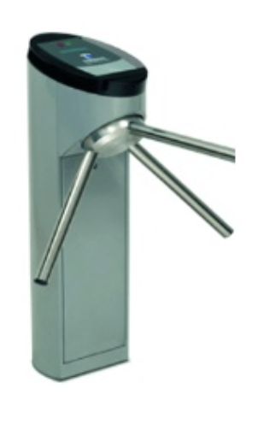
Sidenote: Finite State Machine (FSM) Refresher

Slide 19
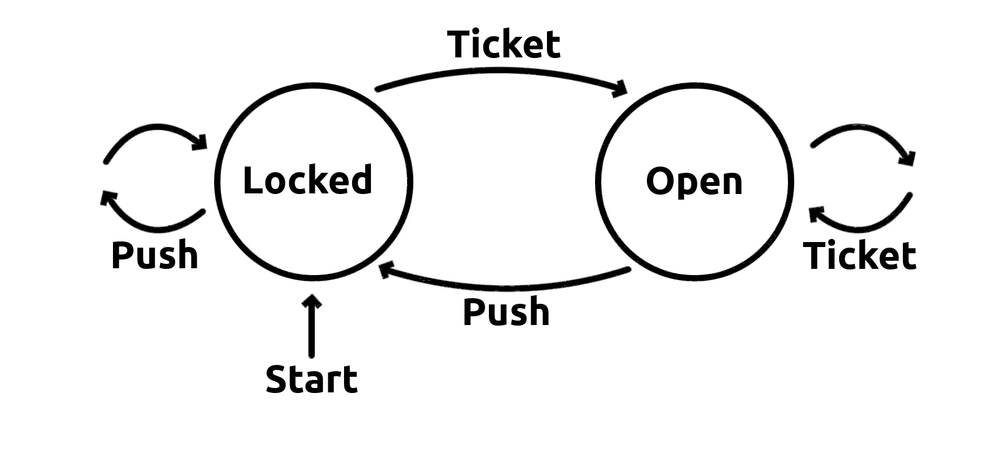
Sidenote: Finite State Machine (FSM) Refresher
State | Event | Action | Next State
Locked | Push | None | Locked
Locked | Ticket | Unlock | Open
Open | Push | Lock | Locked
Open | Ticket | None | Open

Slide 20
Finite State Machine (FSM): Subway
State | Event | Action | Next State
Locked | Push | None | Locked
Locked | Ticket | Unlock | Open
Open | Push | Lock | Locked
Open | Ticket | None | Open

Slide 21
Warm-up: What if the underlying channel is reliable?
underlying channel perfectly reliable
no bit errors
no loss of packets
We use separate FSMs to show the logic of the sender & receiver side:
sender sends data into underlying channel
receiver read data from underlying channel
Remember that a host can act simultaneously as a sender and receiver

Slide 22
Warm-up: What if the underlying channel is reliable?
When will sender come out of this state???
Wait for call from above
rdt_send(data)
State | Event | Action | Next State
Wait for call from above (data from application) | App-Layer says to send data | Send to network layer | Wait for call from above (data from application)
packet = make_pkt(data)
reliable_chn_send(packet)
a. sending side
Wait for call from below
rdt_rcv(packet)
State | Event | Action | Next State
Wait for call from below (data from network) | Network layer pkt arrives | Send to app layer (program) | Wait for call from below (data from network)
extract (packet,data)
deliver_data(data)
b. receiving side

Slide 23
Warm-up: What if the underlying channel is reliable?
When will sender come out of this state???
Wait for call from above
rdt_send(data)
State | Event | Action | Next State
Wait for call from above (data from application) | App-Layer says to send data | Send to network layer | Wait for call from above (data from application)
packet = make_pkt(data)
reliable_chn_send(packet)
a. sending side
Wait for call from below
rdt_rcv(packet)
State | Event | Action | Next State
Wait for call from below (data from network) | Network layer pkt arrives | Send to app layer (program) | Wait for call from below (data from network)
extract (packet,data)
deliver_data(data)
b. receiving side

Slide 24
Unreliable channel v1: Channel with bit errors
Remember: complexity of reliable data transfer protocol will depend (strongly) on characteristics of unreliable channel
For the example stop-and-wait protocol v1, we start with an underlying channel that may flip bits in packet

Slide 25

Simple stop-and-wait protocol (v1)
Unreliable channel
rdt tools
sender
receiver
send pkt
corrupted
Channel with bit errors
?
rcv pkt

Slide 26
Unreliable channel v1: Channel with bit errors
underlying channel may flip bits in packet
checksum (e.g., Internet checksum) to detect bit errors
the question: how to recover from errors?
Q: How do humans recover from “errors” during conversation?

Slide 27
Unreliable channel v1: Channel with bit errors
underlying channel may flip bits in packet
checksum to detect bit errors
the question: how to recover from errors?
acknowledgements (ACKs): receiver explicitly tells sender that pkt received OK
negative acknowledgements (NAKs): receiver explicitly tells sender that pkt had errors
sender retransmits pkt on receipt of NAK

Slide 28
Example stop-and-wait protocol (v1)
Sender
Receiver
Send a pkt
Wait to get an ACK/NAK
If NAK, resend the pkt
go back to waiting
If ACK, proceed with sending next pkt
When pkt is received
examine checksum
If correct pkt, send ACK
deliver data to app layer
If corrupted pkt, send NAK
Tools used: Checksum, ACK/NAK, retransmission

Slide 29
Channel with bit errors
underlying channel may flip bits in pkts
checksum to detect bit errors
the question: how to recover from errors?
ACKs: receiver explicitly tells sender that pkt received OK
NAKs: receiver explicitly tells sender that pkt had errors
sender retransmits pkt on receipt of NAK

Slide 30
Example stop-and-wait protocol (v1)
sender
receiver
Unreliable channel
rdt tools
send pkt
corrupted
Channel with bit errors
Corrupted data pkts
Checksum, ACK/NAK, retransmission
rcv pkt
send nak
rcv nak
resend pkt
rcv pkt
send ack
rcv ack
send next pkt

Slide 31
Example stop-and-wait protocol (v1) - FSM
rdt_send(data)
sender
sndpkt = make_pkt(data, checksum)
udt_send(sndpkt)
receiver
rdt_rcv(rcvpkt) &&
isNAK(rcvpkt)
Wait for call from above
Wait for ACK or NAK
rdt_rcv(rcvpkt) &&
corrupt(rcvpkt)
udt_send(sndpkt)
udt_send(NAK)
rdt_rcv(rcvpkt) && isACK(rcvpkt)
Λ
Wait for call from below
rdt_rcv(rcvpkt) &&
notcorrupt(rcvpkt)
extract(rcvpkt,data)
deliver_data(data)
udt_send(ACK)

Slide 32
No corruptions
rdt_send(data)
sender
sndpkt = make_pkt(data, checksum)
udt_send(sndpkt)
receiver
rdt_rcv(rcvpkt) &&
isNAK(rcvpkt)
Wait for call from above
Wait for ACK or NAK
rdt_rcv(rcvpkt) &&
corrupt(rcvpkt)
udt_send(sndpkt)
udt_send(NAK)
rdt_rcv(rcvpkt) && isACK(rcvpkt)
Wait for call from below
Λ
Wait for call from below
rdt_rcv(rcvpkt) &&
notcorrupt(rcvpkt)
extract(rcvpkt,data)
deliver_data(data)
udt_send(ACK)

Slide 33
Corruption scenario
rdt_send(data)
sender
sndpkt = make_pkt(data, checksum)
udt_send(sndpkt)
receiver
rdt_rcv(rcvpkt) &&
isNAK(rcvpkt)
Wait for call from above
Wait for ACK or NAK
rdt_rcv(rcvpkt) &&
corrupt(rcvpkt)
udt_send(sndpkt)
udt_send(NAK)
rdt_rcv(rcvpkt) && isACK(rcvpkt)
Wait for call from below
Λ
Wait for call from below
rdt_rcv(rcvpkt) &&
notcorrupt(rcvpkt)
extract(rcvpkt,data)
deliver_data(data)
udt_send(ACK)

Slide 34
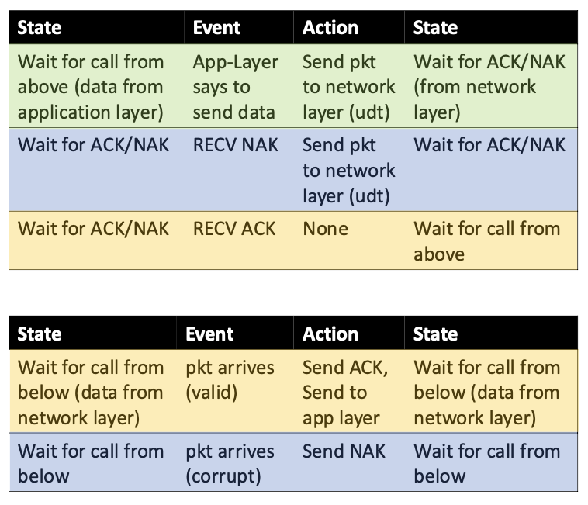
Example stop-and-wait protocol (v1) - FSM

Slide 35
Example stop-and-wait protocol (v1)
sender
receiver
Unreliable channel
rdt tools
send pkt
corrupted
Channel with bit errors
Corrupted data pkts
Corrupted feedback
Checksum, ACK/NAK, retransmission + ?
rcv pkt
send nak
rcv nak
resend pkt
rcv pkt
send ack
rcv ack
send next pkt
corrupted
what happens if ACK/NAK corrupted?

Slide 36
Corrupted feedback
what happens if ACK/NAK corrupted?
sender doesn’t know what happened at receiver!
So it should retransmit (to be on the safe side)
But how will the rcvr distinguish between new and retransmitted data
possible duplicate
handling duplicates:
Sender retransmits current pkt if ACK/NAK corrupted
sender adds sequence number to each pkt
receiver discards (doesn’t deliver up) duplicate pkt

Slide 37
rdt2.0 has a fatal flaw!
what happens if ACK/NAK corrupted?
sender doesn’t know what happened at receiver!
So it should retransmit (to be on the safe side)
But how will the rcvr distinguish between new and retransmitted data
possible duplicate
handling duplicates:
Sender retransmits current pkt if ACK/NAK corrupted
sender adds sequence number to each pkt
receiver discards (doesn’t deliver up) duplicate pkt
stop and wait
Sender sends one packet,
then waits for receiver
response

Slide 38
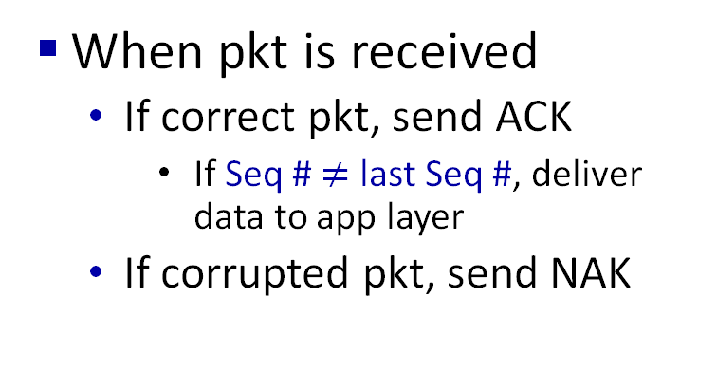
Example stop-and-wait protocol (v2)
Sender
Receiver
Send a pkt
Seq # = 1 – last seq #
Wait to get an ACK/NAK
If NAK or corrupted, resend
go back to waiting
If ACK, proceed with next pkt
When pkt is received
If correct pkt, send ACK
If Seq # $≠$ last Seq #, deliver data to app layer
If corrupted pkt, send NAK
Tools used: Checksum, ACK/NAK, retransmission, 1-bit sequence number

Slide 39
Example stop-and-wait protocol (v2)
sender
receiver
Unreliable channel
rdt tools
send pkt0
corrupted
rcv pkt0
Channel with bit errors
Corrupted data pkts
Corrupted feedback
Checksum, ACK/NAK, retransmission, sequence number
nak
send nak
rcv nak
send pkt0
pkt0
rcv pkt0
ack
send ack
rcv ack
deliver to app
send pkt1
pkt1
rcv pkt1
corrupted
send ack
rcv ack
deliver to app
send pkt1
pkt1
rcv pkt1
ack
send ack
rcv ack
Duplicate pkt is not delivered to app layer

Slide 40
Example stop-and-wait protocol (v2)
Sender:
Seq # added to pkt
How many sequence numbers are required?
Two seq. #’s (0,1) will suffice.
Must check if received ACK/NAK corrupted
twice as many states
State must “remember” whether “current” pkt has 0 or 1 seq. #
Receiver:
Must check if received packet is duplicate
State indicates whether 0 or 1 is expected pkt seq #
Note: receiver does not have a way of knowing if its last ACK/NAK received OK at sender

Slide 41
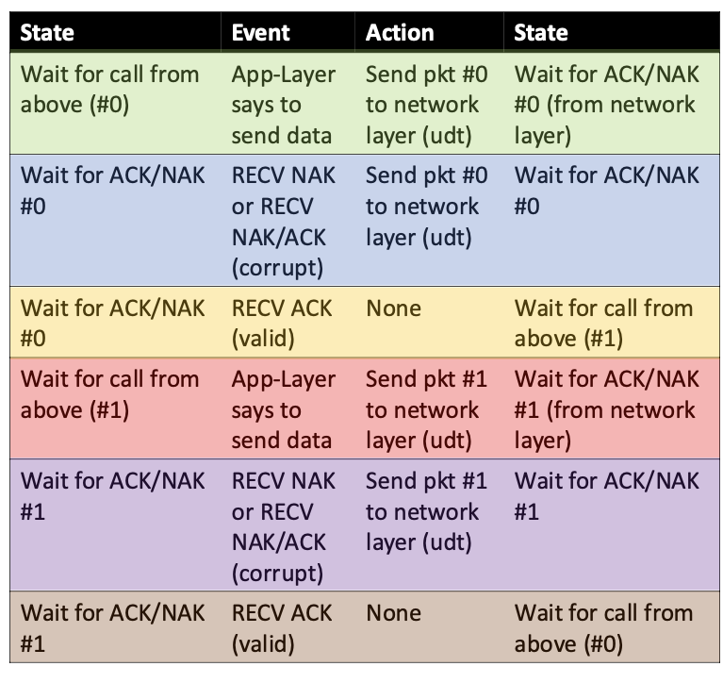
Sender FSM
rdt_send(data)
sndpkt = make_pkt(0, data, checksum)
udt_send(sndpkt)
rdt_rcv(rcvpkt) && (corrupt(rcvpkt) ||
isNAK(rcvpkt) )
Wait for call 0 from above
Wait for ACK or NAK 0
udt_send(sndpkt)
rdt_rcv(rcvpkt)
&& notcorrupt(rcvpkt)
&& isACK(rcvpkt)
rdt_rcv(rcvpkt)
&& notcorrupt(rcvpkt)
&& isACK(rcvpkt)
Λ
Λ
Wait for ACK or NAK 1
Wait for
call 1 from above
rdt_rcv(rcvpkt)
&& (corrupt(rcvpkt) ||
isNAK(rcvpkt) )
rdt_send(data)
udt_send(sndpkt)
sndpkt = make_pkt(1, data, checksum)
udt_send(sndpkt)

Slide 42
Receiver FSM
rdt_rcv(rcvpkt) && notcorrupt(rcvpkt)
&& has_seq0(rcvpkt)
extract(rcvpkt,data)
deliver_data(data)
sndpkt = make_pkt(ACK, chksum)
udt_send(sndpkt)
rdt_rcv(rcvpkt) && (corrupt(rcvpkt)
rdt_rcv(rcvpkt) && (corrupt(rcvpkt)
sndpkt = make_pkt(NAK, chksum)
udt_send(sndpkt)
sndpkt = make_pkt(NAK, chksum)
udt_send(sndpkt)
Wait for
0 from below
Wait for
1 from below
rdt_rcv(rcvpkt) &&
not corrupt(rcvpkt) &&
has_seq1(rcvpkt)
rdt_rcv(rcvpkt) &&
not corrupt(rcvpkt) &&
has_seq0(rcvpkt)
sndpkt = make_pkt(ACK, chksum)
udt_send(sndpkt)
sndpkt = make_pkt(ACK, chksum)
udt_send(sndpkt)
rdt_rcv(rcvpkt) && notcorrupt(rcvpkt)
&& has_seq1(rcvpkt)
extract(rcvpkt,data)
deliver_data(data)
sndpkt = make_pkt(ACK, chksum)
udt_send(sndpkt)

Slide 43
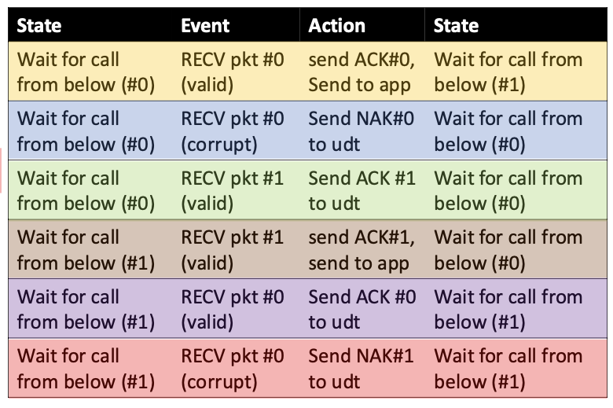
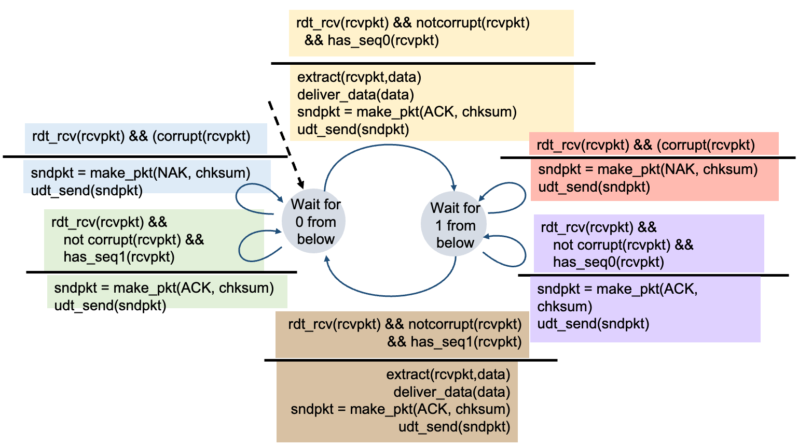
Receiver FSM

Slide 44
Example stop-and-wait protocol (v2+): NAK-free
Same functionality, using ACKs only
Instead of NAK, receiver sends ACK for last pkt correctly received
Receiver must explicitly include seq # of pkt being ACKed
Duplicate ACK at sender results in same action as NAK: retransmit current pkt

Slide 45
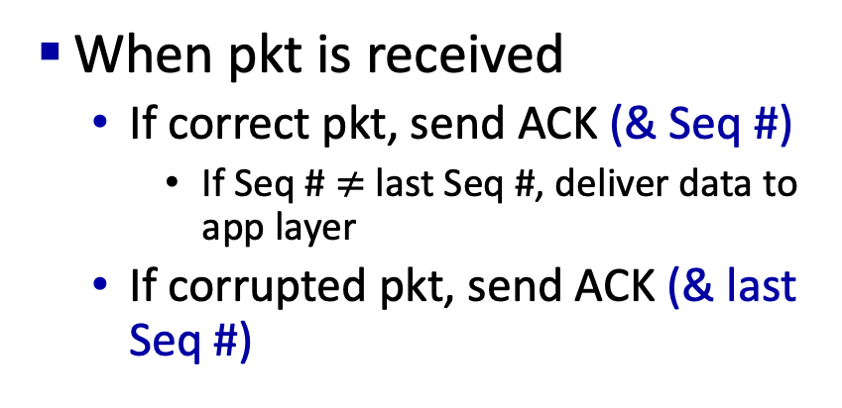
Example stop-and-wait protocol (v2+): NAK-free
Sender
Receiver
Send a pkt
Seq # = 1 – last seq #
Wait to get an ACK
If ACK (& last Seq #) or corrupted, resend
go back to waiting
If ACK (& Seq #), proceed with next pkt
When pkt is received
If correct pkt, send ACK (& Seq #)
If Seq # $≠$ last Seq #, deliver data to app layer
If corrupted pkt, send ACK (& last Seq #)
instead of NAK, receiver sends ACK for last pkt correctly received
receiver must explicitly include seq # of pkt being ACKed
duplicate ACK at sender results in the same action as NAK: retransmit current pkt

Slide 46
Example stop-and-wait protocol (v2+): NAK-free
sender
receiver
Unreliable channel
rdt tools
send pkt0
corrupted
rcv pkt0
Channel with bit errors
Corrupted data pkts
Corrupted feedback
Checksum, ACK, retransmission, sequence number
ack1
send ack1
rcv ack1
send pkt0
pkt0
rcv pkt0
ack0
send ack0
rcv ack0
deliver to app
send pkt1
pkt1
rcv pkt1
corrupted
send ack1
rcv ack1
deliver to app
send pkt1
pkt1
rcv pkt1
ack1
send ack1
rcv ack1

Slide 47
FSM sender, receiver fragments
rdt_send(data)
sndpkt = make_pkt(0, data, checksum)
udt_send(sndpkt)
rdt_rcv(rcvpkt) && (corrupt(rcvpkt) ||
isACK(rcvpkt,1) )
Wait for call 0 from above
Wait for ACK or NAK 0
udt_send(sndpkt)
sender FSM
fragment
rdt_rcv(rcvpkt)
&& notcorrupt(rcvpkt)
&& isACK(rcvpkt,0)
Wait for
0 from below
rdt_rcv(rcvpkt) &&
not corrupt(rcvpkt) &&
has_seq1(rcvpkt)
receiver FSM
fragment
Λ
sndpkt = udt_send(sndpkt)
rdt_rcv(rcvpkt) && notcorrupt(rcvpkt)
&& has_seq1(rcvpkt)
extract(rcvpkt,data)
deliver_data(data)
sndpkt = make_pkt(ACK1, chksum)
udt_send(sndpkt)

Slide 48
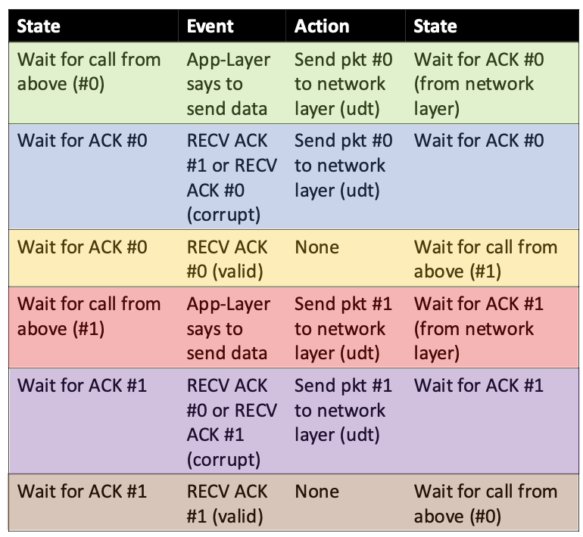
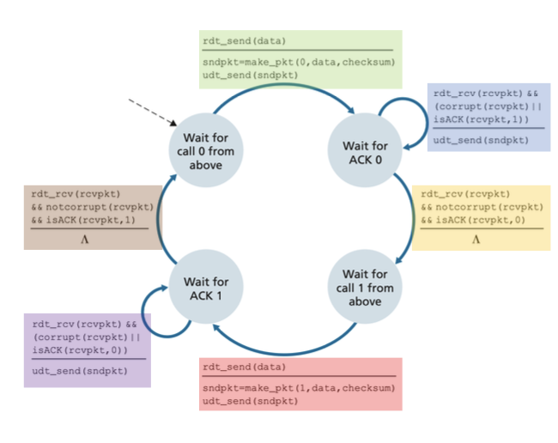
Sender FSM

Slide 49
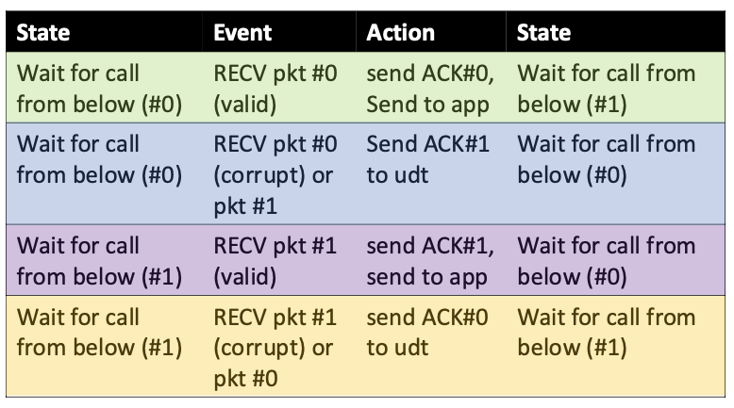
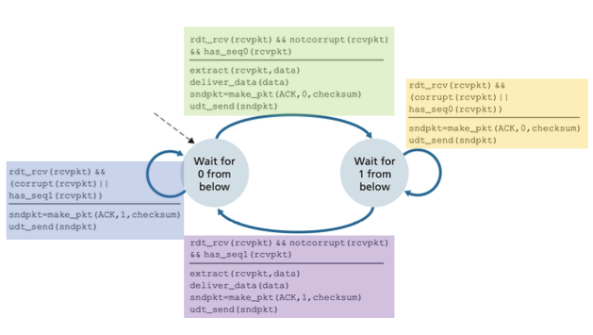
Receiver FSM

Slide 50
Unreliable channel v2: Channel with errors and loss
New channel assumption: underlying channel can also lose packets (data or ACKs)
checksum, sequence #s, ACKs, retransmissions will be of help … but not quite enough
sender
receiver
Q1: What is the difference between data corruption and data loss?
send pkt0
pkt0
rcv pkt0
ack0
send ack0
rcv ack0
Q2: How do humans handle lost sender-to-receiver words in conversation?
send pkt1
pkt1
X
loss
Notes:
Q: diferenece from bits errors

Slide 51

Unreliable channel v2: Channel with errors and loss
Approach: sender waits “reasonable” amount of time for ACK
retransmits if no ACK received in this time
if pkt (or ACK) just delayed (not lost):
retransmission will be duplicate, but seq #s already handles this!
receiver must specify seq # of packet being ACKed
use countdown timer to interrupt after “reasonable” amount of time
timeout

Slide 52
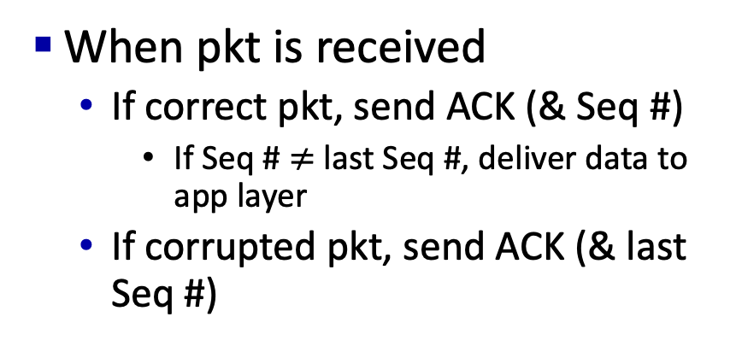
Example stop-and-wait protocol (v3)
Sender
Receiver
Send a pkt
Seq # = 1 – last Seq #
Set timer
Wait to get an ACK
If ACK (& last Seq #) or corrupted, resend pkt and reset timer
go back to waiting
If ACK (& Seq #), remove timer and proceed with next pkt
If timer goes off, resend pkt and reset timer
When pkt is received
If correct pkt, send ACK (& Seq #)
If Seq # $≠$ last Seq #, deliver data to app layer
If corrupted pkt, send ACK (& last Seq #)
Tools used: Checksum, ACK, retransmission, 1-bit sequence number, timer

Slide 53
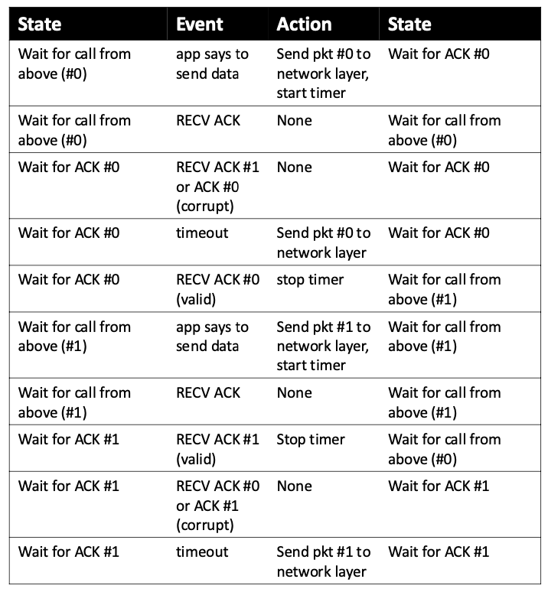
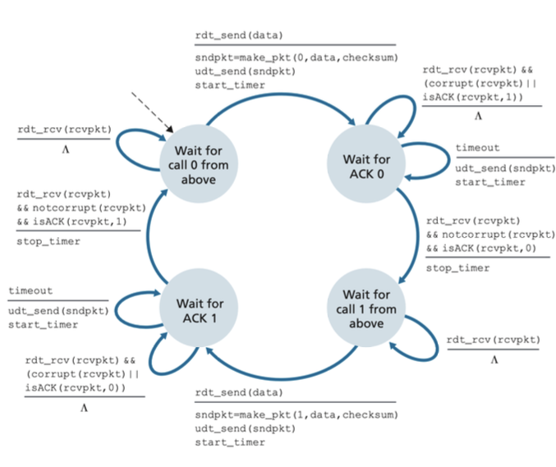
Sender FSM

Slide 54
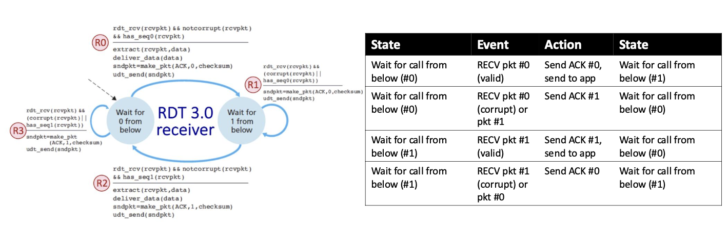
Receiver FSM

Slide 55

Example stop-and-wait protocol (v3)
sender
receiver
send pkt0
Unreliable channel
rdt tools
pkt0
rcv pkt0
ack0
send ack0
rcv ack0
Channel with bit errors
Corrupted data pkts
Corrupted feedback
Checksum, ACK, retransmission, sequence number
send pkt1
pkt1
X
loss
timeout
resend pkt1
Channel with errors and lost
lost data pkts
Checksum, ACK, retransmission, sequence number, timer
pkt1
rcv pkt1
ack1
send ack1
rcv ack1
send pkt0
pkt0
rcv pkt0
ack0
send ack0
(a) packet loss

Slide 56
Example stop-and-wait protocol (v3)
sender
receiver
Unreliable channel
rdt tools
send pkt0
pkt0
rcv pkt0
ack0
send ack0
Channel with bit errors
Corrupted data pkts
Corrupted feedback
rcv ack0
Checksum, ACK, retransmission, sequence number
send pkt1
pkt1
rcv pkt1
ack1
send ack1
X
loss
timeout
resend pkt1
Channel with errors and lost
lost data pkts
lost feedback
Checksum, ACK, retransmission, sequence number, timer
pkt1
rcv pkt1
ack1
(detect duplicate)
rcv ack1
send ack1
send pkt0
pkt0
rcv pkt0
ack0
send ack0
(b) ACK loss

Slide 57
Example stop-and-wait protocol (v3)
sender
receiver
send pkt0
rdt tools
pkt0
Unreliable channel
rcv pkt0
send ack0
rcv ack0
ack0
Channel with bit errors
Corrupted data pkts
Corrupted feedback
Checksum, ACK, retransmission, sequence number
send pkt1
pkt1
rcv pkt1
send ack1
ack1
timeout
resend pkt1
Channel with errors and lost
lost data pkts
lost feedback
pkt1
rcv pkt1
Checksum, ACK, retransmission, sequence number, timer
rcv ack1
(detect duplicate)
send pkt0
pkt0
send ack1
ack1
rcv pkt0
rcv ack1
send ack0
send pkt0
pkt0
ack0
rcv pkt0
(detect duplicate)
ack0
send ack0
Duplicate pkt continues
(c) premature timeout/ delayed ACK

Slide 58

Example stop-and-wait protocol (v3)
Sender
Receiver
Send a pkt
Seq # = 1 – last Seq #
Set timer
Wait to get an ACK
If ACK (& last Seq #) or corrupted,
do nothing
If ACK (& Seq #), remove timer and proceed with next pkt
If timer goes off, resent pkt and reset timer
When pkt is received
If correct pkt, send ACK (& Seq #)
If Seq # $≠$ last Seq #, deliver data to app layer
If corrupted pkt, send (& last Seq #)
Timer can handle all retransmissions
Tools used: Checksum, ACK, retransmission, 1-bit sequence number, timer
Notes:
Didn’t we rely on the retransmission when we removed the NAK? Can we safely remove this because of the timer?

Slide 59
Example stop-and-wait protocol (v3)
sender
receiver
send pkt0
rdt tools
pkt0
Unreliable channel
rcv pkt0
send ack0
rcv ack0
ack0
Channel with bit errors
Corrupted data pkts
Corrupted feedback
Checksum, ACK, retransmission, sequence number
send pkt1
pkt1
rcv pkt1
send ack1
ack1
timeout
resend pkt1
Channel with errors and lost
lost data pkts
lost feedback
pkt1
rcv pkt1
Checksum, ACK, retransmission, sequence number, timer
rcv ack1
(detect duplicate)
send pkt0
pkt0
send ack1
ack1
rcv pkt0
rcv ack1
send ack0
(ignore)
ack0
pkt1
(c) premature timeout/ delayed ACK

Slide 60
Principles of reliable data transfer (rdt)
rdt at a glance
Stop-and-wait approach
sender sends one pkt, then waits for receiver’s response
Pipelined approach
Go-back-N (GBN)
Selective Repeat (SR)

Slide 61
Stop-and-wait protocol has a problem
U _{sender}: utilization – fraction of time sender busy sending
example: 1 Gbps link, 15 ms prop. delay, 8000 bit packet
time to transmit packet into channel:
L
8000 bits
D_{trans} =
=
=
8 microsecs
R
10⁹ bits/sec
Notes:
if RTT=30 msec, 1KB pkt every 30 msec: 33kB/sec thruput over 1 Gbps link
network protocol limits use of physical resources
Let’s develop a formula for utilization

Slide 62
Stop-and-wait protocol has a problem
sender
receiver
first packet bit transmitted, t = 0
first packet bit arrives
RTT
last packet bit arrives, send ACK
ACK arrives, send next
packet, t = RTT + L / R

Slide 63
Stop-and-wait protocol has a problem
sender
receiver
L / R
=
L/R
U_{sender}
RTT
+ L / R
.008
RTT
=
30.008
=
0.00027
Protocol performance stinks!
Protocol limits performance of underlying infrastructure (channel)

Slide 64
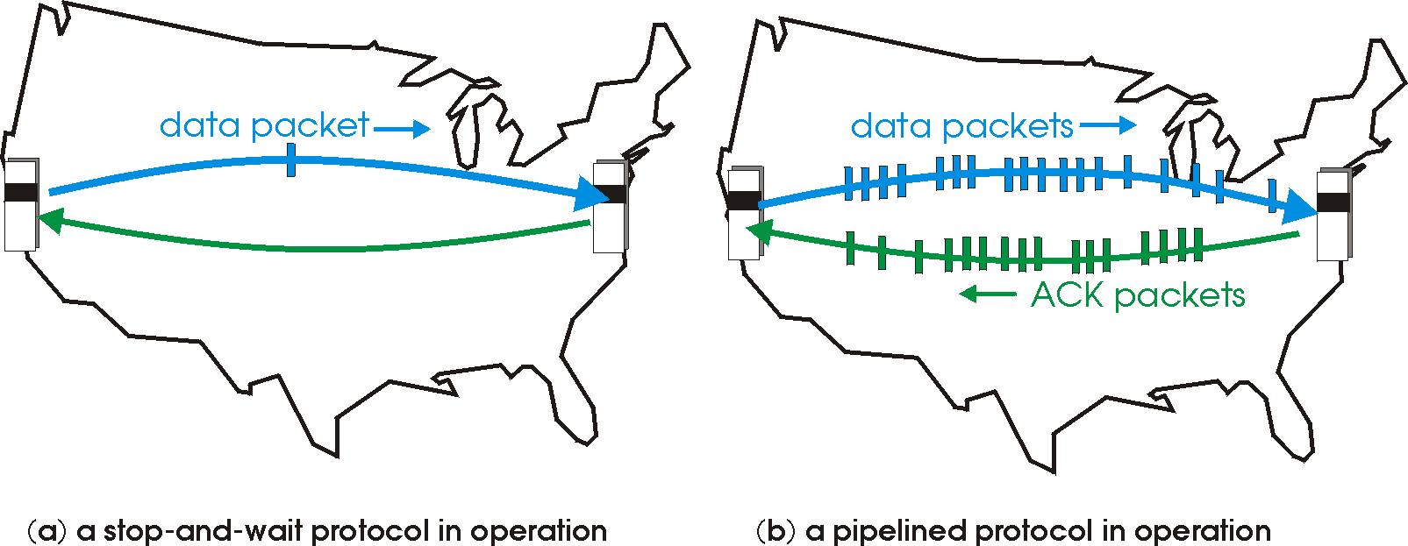
Pipelined protocols operation
pipelining: sender allows multiple, “in-flight”, yet-to-be-acknowledged packets
range of sequence numbers must be increased
buffering at sender and/or receiver
two example forms of the pipelined approach: go-Back-N, selective repeat

Slide 65
Pipelining: increased utilization
sender
receiver
first packet bit transmitted, t = 0
last bit transmitted, t = L / R
first packet bit arrives
RTT
last packet bit arrives, send ACK
last bit of 2nd packet arrives, send ACK
last bit of 3rd packet arrives, send ACK
ACK arrives, send next
packet, t = RTT + L / R
3-packet pipelining increases
utilization by a factor of 3!
Notes:
two generic forms of pipelined protocols: go-Back-N, selective repeat

Slide 66
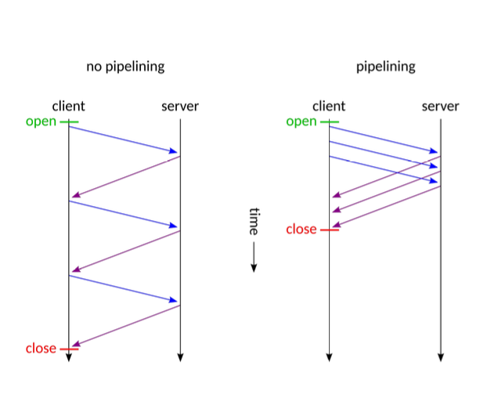
Recall: HTTP 1.0 (stop-and-wait) vs. HTTP 1.1 (Pipelining)
server
GET O₄
GET O₃
GET O₂
GET O₁

Slide 67
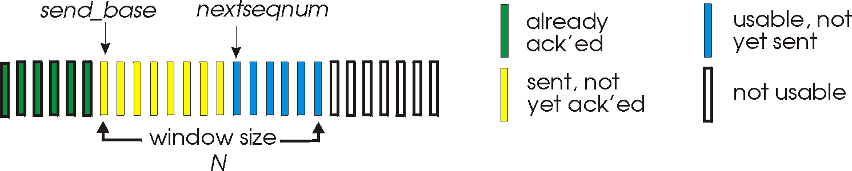
Go-Back-N: sender
sender: “window” of up to N, consecutive transmitted but unACKed pkts
k-bit seq # in pkt header
cumulative ACK: ACK(n): ACKs all packets up to, including seq # n
on receiving ACK(n): move window forward to begin at n+1
Single timer for oldest in-flight packet
timeout(n): retransmit packet n and all higher seq # packets in window
Notes:
Look at the animation in class
window size of 14, 8 have been sent but are not yet acknowledged, 6 sequence numbers are available for us. In window, but no calls from above to use them.
Note – we’ll skip the Go-Back-N FSM specification you can check that out in PowerPoint slides or book)
TCP uses cumulative ACK

Slide 68
Go-Back-N: receiver
ACK-only: always send ACK for correctly-received packet so far, with highest in-order seq #
may generate duplicate ACKs
need only remember rcv_base
on receipt of out-of-order packet:
can discard (don’t buffer) or buffer: an implementation decision
re-ACK pkt with highest in-order seq #
Receiver view of sequence number space:
received and ACKed
…
…
Out-of-order: received but not ACKed
rcv_base
Not received
Notes:
Note – we’ll skip the Go-Back-N FSM specification (actually it’s

Slide 69
Go-Back-N: sender extended FSM
rdt_send(data)
if (nextseqnum < base+N) {
sndpkt[nextseqnum] = make_pkt(nextseqnum,data,chksum)
udt_send(sndpkt[nextseqnum])
if (base == nextseqnum)
start_timer
nextseqnum++
}
else
refuse_data(data)
Λ
base=1
nextseqnum=1
timeout
Wait
udt_send(sndpkt[base])
udt_send(sndpkt[base+1])
…
udt_send(sndpkt[nextseqnum-1])
start_timer
rdt_rcv(rcvpkt)
&& corrupt(rcvpkt)
Λ
rdt_rcv(rcvpkt) &&
notcorrupt(rcvpkt)
base = getacknum(rcvpkt)+1
If (base == nextseqnum)
stop_timer
else
start_timer

Slide 70
Go-Back-N: receiver extended FSM
any other event
udt_send(sndpkt)
rdt_rcv(rcvpkt)
&& notcorrupt(rcvpkt)
&& hasseqnum(rcvpkt,expectedseqnum)
…
…
Λ
Wait
extract(rcvpkt,data)
deliver_data(data)
sndpkt = make_pkt(expectedseqnum,ACK,chksum)
udt_send(sndpkt)
expectedseqnum++
expectedseqnum=1
sndpkt =
make_pkt(expectedseqnum,ACK,chksum)
rcv_base
expectedseqnum
ACK-only: always send ACK for correctly-received packet with highest in-order seq #
may generate duplicate ACKs
need only remember expectedseqnum
out-of-order packet:
discard (don’t buffer): no receiver buffering!
re-ACK pkt with highest in-order seq #

Slide 71
Go-Back-N in action
sender window (N=4)
sender
receiver
0 1 2 3 4 5 6 7 8
send pkt0
send pkt1
send pkt2
send pkt3
(wait)
0 1 2 3 4 5 6 7 8
receive pkt0, send ack0
0 1 2 3 4 5 6 7 8
X
0 1 2 3 4 5 6 7 8
loss
0 1 2 3 4 5 6 7 8
rcv ack0, send pkt4
Notes:
Let’s skip FSM specification for GBN – check out the book or ppt – and let’s watch GBN sender and receivers in action.
Let assume a window size of 4. at t=0, sender sends packets 0, 1, 2 3, 4, and packet 2 will be lost
At the receiver:
Packet 0 received ACK0 generated
Packet 1 received ACK1 generated
Packet 2 is lost, and so when packet 3 is received, ACK 1 is sent – that’s the cumulative ACK, re-Acknowledging the receipt of packet 1. and in this implementation packet 3 is discarded

Slide 72
Go-Back-N in action
sender window (N=4)
sender
receiver
0 1 2 3 4 5 6 7 8
send pkt0
send pkt1
send pkt2
send pkt3
(wait)
0 1 2 3 4 5 6 7 8
receive pkt1, send ack1
receive pkt3,
discard, (re)send ack1
receive pkt0, send ack0
0 1 2 3 4 5 6 7 8
X
0 1 2 3 4 5 6 7 8
loss
0 1 2 3 4 5 6 7 8
rcv ack0, send pkt4
0 1 2 3 4 5 6 7 8
rcv ack1, send pkt5
receive pkt4,
discard, (re)send ack1
ignore duplicate ACK
receive pkt5,
discard, (re)send ack1
pkt 2 timeout
0 1 2 3 4 5 6 7 8
send pkt2
send pkt3
send pkt4
send pkt5
0 1 2 3 4 5 6 7 8
0 1 2 3 4 5 6 7 8
rcv pkt2, deliver, send ack2
rcv pkt3, deliver, send ack3
rcv pkt4, deliver, send ack4
rcv pkt5, deliver, send ack5
0 1 2 3 4 5 6 7 8
Notes:
Let’s skip FSM specification for GBN – check out the book or ppt – and let’s watch GBN sender and receivers in action.
Let assume a window size of 4. at t=0, sender sends packets 0, 1, 2 3, 4, and packet 2 will be lost
At the receiver:
Packet 0 received ACK0 generated
Packet 1 received ACK1 generated
Packet 2 is lost, and so when packet 3 is received, ACK 1 is sent – that’s the cumulative ACK, re-Acknowledging the receipt of packet 1. and in this implementation packet 3 is discarded

Slide 73
Go-Back-N in action
Animation here:
https://media.pearsoncmg.com/ph/esm/ecs_kurose_compnetwork_8/cw/content/interactiveanimations/go-back-n-protocol/index.html

Slide 74
Selective repeat: the approach
pipelining: multiple packets in flight
receiver individually ACKs all correctly received packets
buffers packets, as needed, for in-order delivery to upper layer
sender:
maintains (conceptually) a timer for each unACKed pkt
timeout: retransmits single unACKed packet associated with timeout
maintains (conceptually) “window” over N consecutive seq #s
limits pipelined, “in flight” packets to be within this window
Notes:
An important mechanism of GBN was the use of the cumulative acknowledgements, and as we mentioned, cumulative ACKs are used in TCP
An alternate ACK mechanism would be for the receiver to individually acknowledge specific packets as they are received. This mechanism is at the heart of the Selective repeat protocol.

Slide 75
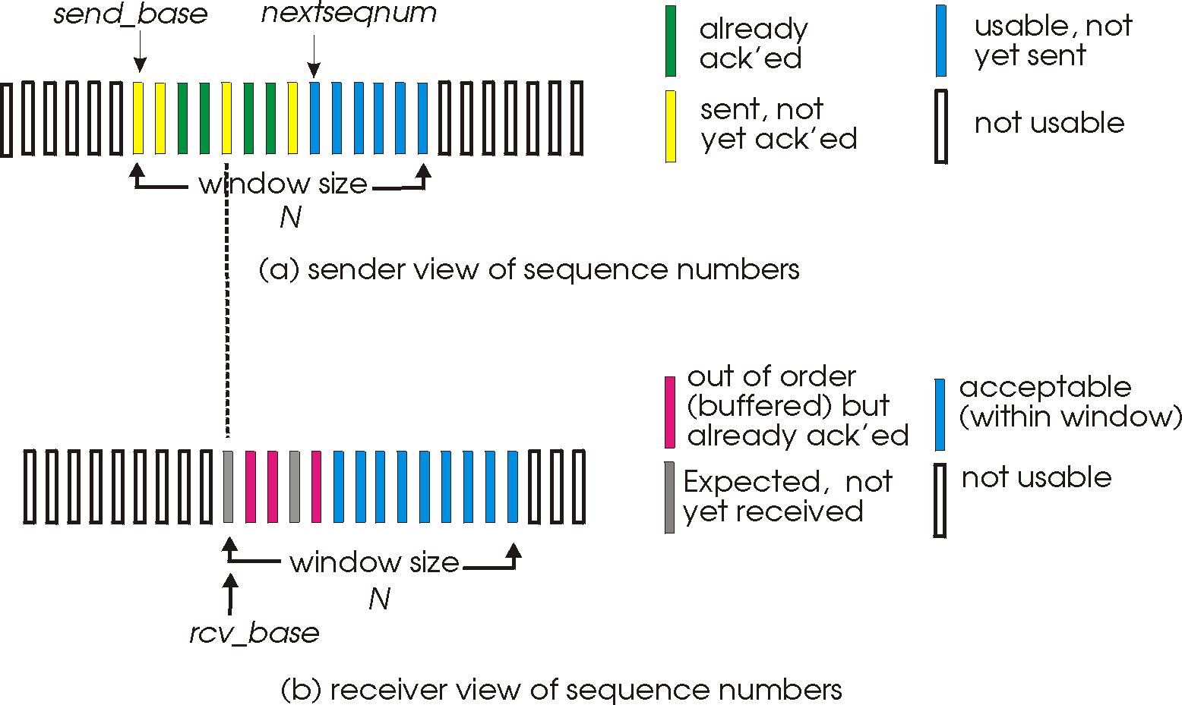
Selective repeat: sender, receiver windows

Slide 76
Selective repeat: sender, receiver windows

Slide 77
Selective repeat: sender, receiver windows

Slide 78
Selective repeat: sender, receiver windows

Slide 79
Selective repeat: sender and receiver
sender
receiver
data from above:
if next available seq # in window, send packet
timeout(n):
resend packet n, restart timer
ACK(n) in [sendbase,sendbase+N-1]:
mark packet n as received
if n smallest unACKed packet, advance window base to next unACKed seq #
packet n in [rcvbase, rcvbase+N-1]
send ACK(n)
out-of-order: buffer
in-order: deliver (also deliver buffered, in-order packets), advance window to next not-yet-received packet
packet n in [rcvbase-N,rcvbase-1]
ACK(n)
otherwise:
ignore
Notes:
If the packet is in order, its data will be delivered, as will any buffered data that can now be delivered in order

Slide 80
Selective Repeat in action
sender window (N=4)
sender
receiver
0 1 2 3 4 5 6 7 8
send pkt0
send pkt1
send pkt2
send pkt3
(wait)
0 1 2 3 4 5 6 7 8
receive pkt0, send ack0
receive pkt1, send ack1
receive pkt3, buffer,
send ack3
0 1 2 3 4 5 6 7 8
X
0 1 2 3 4 5 6 7 8
loss
0 1 2 3 4 5 6 7 8
rcv ack0, send pkt4
0 1 2 3 4 5 6 7 8
rcv ack1, send pkt5
receive pkt4, buffer,
send ack4
record ack3 arrived
receive pkt5, buffer,
send ack5
pkt 2 timeout
0 1 2 3 4 5 6 7 8
send pkt2
(but not 3,4,5)
rcv pkt2; deliver pkt2,
pkt3, pkt4, pkt5; send ack2
Q: what happens when ack2 arrives?

Slide 81
Selective Repeat in action
Animation here:
https://media.pearsoncmg.com/ph/esm/ecs_kurose_compnetwork_8/cw/content/interactiveanimations/selective-repeat-protocol/index.html

Slide 82
Selective repeat: a dilemma!
sender window
(after receipt)
receiver window
(after receipt)
0 1 2 3 0 1 2
pkt0
0 1 2 3 0 1 2
pkt1
0 1 2 3 0 1 2
0 1 2 3 0 1 2
pkt2
0 1 2 3 0 1 2
example:
seq #s: 0, 1, 2, 3 (base 4 counting)
window size=3
0 1 2 3 0 1 2
0 1 2 3 0 1 2
pkt3
X
0 1 2 3 0 1 2
pkt0
will accept packet
with seq number 0
(a) no problem
0 1 2 3 0 1 2
pkt0
0 1 2 3 0 1 2
pkt1
0 1 2 3 0 1 2
0 1 2 3 0 1 2
pkt2
X
0 1 2 3 0 1 2
X
0 1 2 3 0 1 2
X
timeout
retransmit pkt0
0 1 2 3 0 1 2
pkt0
will accept packet
with seq number 0
(b) oops!

Slide 83

Selective repeat: a dilemma!
sender window
(after receipt)
receiver window
(after receipt)
0 1 2 3 0 1 2
pkt0
0 1 2 3 0 1 2
pkt1
0 1 2 3 0 1 2
0 1 2 3 0 1 2
pkt2
0 1 2 3 0 1 2
example:
seq #s: 0, 1, 2, 3 (base 4 counting)
window size=3
0 1 2 3 0 1 2
0 1 2 3 0 1 2
pkt3
X
0 1 2 3 0 1 2
receiver can’t see sender side
receiver behavior identical in both cases!
something’s (very) wrong!
pkt0
will accept packet
with seq number 0
(a) no problem
Q: what relationship is needed between sequence # size and window size to avoid problem in scenario (b)?
pkt0
0 1 2 3 0 1 2
0 1 2 3 0 1 2
pkt1
0 1 2 3 0 1 2
0 1 2 3 0 1 2
pkt2
X
0 1 2 3 0 1 2
X
0 1 2 3 0 1 2
X
timeout
retransmit pkt0
0 1 2 3 0 1 2
pkt0
will accept packet
with seq number 0
(b) oops!

Slide 84
Selective repeat: a dilemma!
sender window
(after receipt)
receiver window
(after receipt)
0 1 2 3 0 1 2
pkt0
0 1 2 3 0 1 2
pkt1
0 1 2 3 0 1 2
0 1 2 3 0 1 2
pkt2
0 1 2 3 0 1 2
example:
seq #s: 0, 1, 2, 3 (base 4 counting)
window size=3
0 1 2 3 0 1 2
0 1 2 3 0 1 2
pkt3
X
0 1 2 3 0 1 2
pkt0
will accept packet
with seq number 0
(a) no problem
0 1 2 3 0 1 2
pkt0
0 1 2 3 0 1 2
pkt1
0 1 2 3 0 1 2
0 1 2 3 0 1 2
pkt2
X
0 1 2 3 0 1 2
X
0 1 2 3 0 1 2
X
timeout
retransmit pkt0
0 1 2 3 0 1 2
pkt0
will accept packet
with seq number 0
(b) oops!

Slide 85
Selective repeat: a dilemma!
sender window
(after receipt)
receiver window
(after receipt)
0 1 2 3 0 1 2
pkt0
0 1 2 3 0 1 2
pkt1
0 1 2 3 0 1 2
0 1 2 3 0 1 2
pkt2
0 1 2 3 0 1 2
example:
seq #s: 0, 1, 2, 3 (base 4 counting)
window size=3
0 1 2 3 0 1 2
0 1 2 3 0 1 2
pkt3
X
0 1 2 3 0 1 2
receiver can’t see sender side
receiver behavior identical in both cases!
something’s (very) wrong!
pkt0
will accept packet
with seq number 0
(a) no problem
Q: what relationship is needed between sequence # size and window size to avoid problem in scenario (b)?
pkt0
0 1 2 3 0 1 2
0 1 2 3 0 1 2
pkt1
0 1 2 3 0 1 2
0 1 2 3 0 1 2
pkt2
X
0 1 2 3 0 1 2
X
0 1 2 3 0 1 2
X
timeout
retransmit pkt0
0 1 2 3 0 1 2
pkt0
will accept packet
with seq number 0
(b) oops!

Slide 86


Summary for rdt tools
ACK/NAK
provides receiver feedback
can also be corrupted or lost
Sequence number
detects duplicate pkts
Has to be a bounded number of bits
Timer
detects pkt/feedback loss
may lead to duplicate pkts
Sliding window
allows for pipelining pkt
reuses sequence number

