Slide 1

CS 456/656
Computer Networks
Lecture 8: Transport Layer – Part 4
Mina Tahmasbi Arashloo and Uzma Maroof
Fall 2025

Slide 2

A note on the slides
Adapted from the slides that accompany this book.
All material copyright 1996-2023
J.F Kurose and K.W. Ross, All Rights Reserved
Computer Networking: A Top-Down Approach
8th edition
Jim Kurose, Keith Ross
Pearson, 2020

Slide 3

Transport layer: roadmap
Transport-layer overview
Multiplexing and demultiplexing
Connectionless transport: UDP
Principles of reliable data transfer
Connection-oriented transport: TCP
Principles of congestion control
TCP congestion control
Evolution of transport-layer functionality

Slide 4



Principles of congestion control
Congestion:
informally: “too many sources sending too much data too fast for network to handle”
manifestations:
  long delays (queueing in router buffers)
  packet loss (buffer overflow at routers)
different from flow control!
congestion control: too many senders, sending too fast
a top-10 problem!
flow control: one sender too fast for one receiver

Slide 5

Throughput cannot exceed available capacity
The transmission rate for all links is R bps
So, if host A wants to send out data at R bps, the link can carry it to the router
But, A has to share the link between Router X and Router Y with the traffic from Host B
Host A
shared output link buffer
R
R
R
Router Y
R
Router X
R
Host B

Slide 6
Throughput cannot exceed available capacity
Q. What happens if both Host A and Host B send data to their destinations at R bps?
  Suppose the available bandwidth from Router X Router Y is shared fairly between traffic from A and B.
Host A
shared output link buffer
R
R
R
Router Y
R
Router X
R
Host B

Slide 7
Throughput cannot exceed available capacity
No matter how fast A and B send data to the router, the router’s bandwidth to Y is limited to R.
So, host C can receive at most R/2 bps from A, and so does Host D from B
In the best case, all the R/2 bits every second are sent exactly once
  whatever is sent, it is delivered the first time
So, in the best case, the throughput at which data is received by the application running in Host C is R/2 bps.
Host C
Host A
shared output link buffer
R
R
R
Router Y
R
Router X
R
Host B
Host D

Slide 8


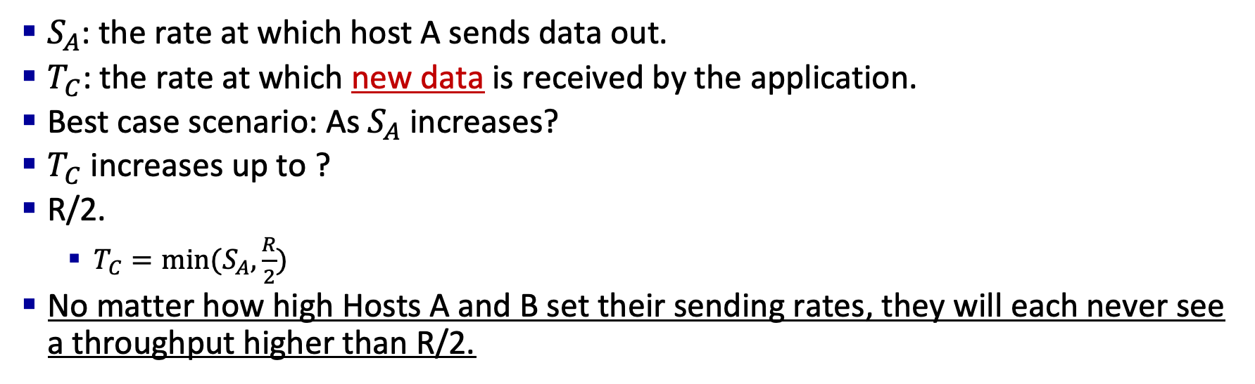
Throughput cannot exceed available capacity
$S_{A}$: the rate at which host A sends data out.
$T_{C}$: the rate at which new data is received by the application.
Best case scenario: As $S_{A}$ increases?
$T_{C}$ increases up to ?
R/2.
  $T_{C}=min⁡(S_{A},\frac{R}{2})$
No matter how high Hosts A and B set their sending rates, they will each never see a throughput higher than R/2.
Host C
Host A
R/2
shared output link buffer
R
R
$$T_{C}$$
Router Y
R
$$S_{A}$$
R/2
R
Router X
R
maximum per-connection throughput: R/2
Host B
Host D

Slide 9


Throughput cannot exceed available capacity
When would this best case happen?
Host C
Host A
R/2
shared output link buffer
R
R
$$T_{C}$$
Router Y
R
$$S_{A}$$
R/2
R
Router X
R
maximum per-connection throughput: R/2
Host B
Host D

Slide 10


Ideal case 1: Infinite buffers
When would this best case happen?
  The buffer at Router X has infinite capacity.
  So, no packets are dropped, they may just take longer and longer to get to Host C. (Why?)
  No packet drops ⇨ all the R/2 bits per second getting to Host C have been sent exactly once.
Host C
Host A
R/2
shared output link buffer
R
R
$$T_{C}$$
Router Y
R
$$S_{A}$$
R/2
R
Router X
R
maximum per-connection throughput: R/2
Host B
Host D

Slide 11
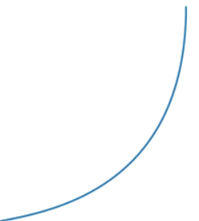


Ideal case 1: Infinite buffers
Achieving a per-connection throughput of R/2 is good thing
  The link is fully utilized
What about delay?
As the sending rate approaches R/2 the average delay becomes?
  larger and larger
When the sending rate exceeds R/2
  Average number of queued packets in the router is unbounded
  Average delay between source and destination becomes infinite
Host C
Host A
R/2
shared output link buffer
R
R
$$T_{C}$$
$$Delay$$
Router Y
R
$$S_{A}$$
R/2
$$S_{A}$$
R/2
R
Router X
R
Host B
Host D

Slide 12
Ideal case 1: Infinite buffers
original data: λ_{in}
throughput: λ_{out}
Simplest scenario:
Host A
one router, infinite buffers
input, output link capacity: R
infinite shared output link buffers
two flows
R
R
no retransmissions needed
Host B
R/2
As arrival rate λ_{in} approaches R/2
λ_{out}
delay
throughput:
λ_{in}
R/2
λ_{in}
R/2
maximum per-connection throughput: R/2
large delays as arrival rate λ_{in} approaches capacity
R/2

Slide 13
Ideal case 2: Finite buffers but perfect knowledge of capacity
Could there be no packet loss if the buffer is finite?
  Yes, if Host A has perfect knowledge of the available buffer capacity.
  That is, if Host A only sends when router buffers are available.
Host C
Host A
R/2
shared output link buffer
R
R
$$T_{C}$$
Router Y
R
$$S_{A}$$
R/2
R
Router X
R
maximum per-connection throughput: R/2
Host B
Host D

Slide 14


Ideal case 2: Finite buffers but perfect knowledge of capacity
Idealization: perfect knowledge
sender sends only when router buffers available
R/2
$$T_{C}$$
Host A
$$S_{A}$$
copy
R/2
free buffer space!
R
R
Host B
finite shared output link buffers

Slide 15
Ideal case 2: Finite buffers but perfect knowledge of capacity
Could there be no loss if the buffer is finite?
  Yes, if Host A has perfect knowledge of the available capacity.
  That is, if Host A only sends when router buffers are available.
  No packet drops all the R/2 bits per second getting to Host C have been sent exactly once.
Q. Can this ideal case happen in the Internet?
(hint: packet switching vs circuit switching)
Host C
Host A
R/2
shared output link buffer
R
R
$$T_{C}$$
Router Y
R
$$S_{A}$$
R/2
R
Router X
R
maximum per-connection throughput: R/2
Host B
Host D

Slide 16
What happens if packets are lost?
In reality, host A may not have real-time information of the available buffer capacity.
With reliable data transfer, if a packet is lost, the transport layer will retransmit the corresponding data segments.
Retransmission = Wasted capacity
Why?
Host C
Host A
shared output link buffer
R
R
R
Router Y
R
Router X
R
Host B
Host D

Slide 17

What happens if packets are lost?
Idealization: some perfect knowledge
packets can be lost (dropped at router) due to full buffers
sender knows when packet has been dropped: only resends if packet known to be lost
Host A
copy
no buffer space!
R
R
Host B
finite shared output link buffers

Slide 18


What happens if packets are lost?
Idealization: some perfect knowledge
packets can be lost (dropped at router) due to full buffers
sender knows when packet has been dropped: only resends if packet known to be lost
R/2
“wasted” capacity due to retransmissions
$$T_{C}$$
when sending at R/2, some packets need retransmissions
Host A
$$S_{A}$$
R/2
free buffer space!
R
R
Host B
finite shared output link buffers

Slide 19




What happens if packets are lost?
Realistic scenario: un-needed duplicates
packets can be lost, dropped at router due to full buffers – requiring retransmissions
but sender timer can go off prematurely, sending two copies, both of which are delivered
R/2
“wasted” capacity due to un-needed retransmissions
$$T_{C}$$
when sending at R/2, some packets are retransmissions, including needed and un-needed duplicates, that are delivered!
Host A
$$S_{A}$$
copy
R/2
timeout
free buffer space!
R
R
Host B
finite shared output link buffers

Slide 20


What happens if packets are lost?
Realistic scenario: un-needed duplicates
packets can be lost, dropped at router due to full buffers – requiring retransmissions
but sender timer can go off prematurely, sending two copies, both of which are delivered
R/2
“wasted” capacity due to un-needed retransmissions
$$T_{C}$$
when sending at R/2, some packets are retransmissions, including needed and un-needed duplicates, that are delivered!
$$S_{A}$$
R/2
“costs” of congestion:
more work (retransmission) for given receiver throughput
unneeded retransmissions: link carries multiple copies of a packet
  decreasing maximum achievable throughput

Slide 21
What happens if packets are lost along a path?
Realistic scenario: retransmissions triggered by loss throughout the network
whenever a packet is dropped at Router Y, the work done by Router X (buffering and forwarding) is wasted
upstream transmission capacity / buffering wasted for packets lost downstream
In extreme cases, this can lead to a situation called congestion collapse, where the network keeps carrying retransmitted packets, only for them to be dropped later in the path.
No data gets delivered.
This happened in the early days of the Internet!
Loss of a packet at Router Y wastes the transmission capacity of Router X
Host C
Host A
R
R/6
R
Router Y
R
Router X
R
Host B
Host D

Slide 22
How can we avoid congestion?
Throughput can’t exceed available capacity
Sending over capacity ⇨ packet loss or long delays
Packet loss or long delay ⇨ retransmission
Retransmission ⇨ Wasted capacity
Constant retransmission throughout the network ⇨ congestion collapse
Congestion control: Have each sender estimate the available capacity in the network before sending, and only send out what the network can handle.
Host C
Host A
shared output link buffer
R
R
R
Router Y
R
Router X
R
Host B
Host D

Slide 23
Causes/costs of congestion: insights
throughput can never exceed capacity
delay increases as capacity approached
loss/retransmission decreases effective throughput
un-needed duplicates further decreases effective throughput
upstream transmission capacity / buffering wasted for packets lost downstream

Slide 24
Congestion control
If a sender perceives no congestion
  then the sender increases its send rate
If the sender perceives congestion
  then the sender reduces its send rate
Three questions:
How does a sender perceive that there is congestion on the path between itself and the destination?
How does a sender limit the rate at which it sends traffic into its connection?
What algorithm should the sender use to change its send rate as a function of perceived end-to-end congestion?

Slide 25
Approaches towards congestion control
End-end congestion control:
no explicit feedback from network
congestion inferred from observed loss, delay
ACKs
data
data
ACKs
approach taken by TCP

Slide 26
Approaches towards congestion control
Network-assisted congestion control:
routers provide direct feedback to sending/receiving hosts with flows passing through congested router
may indicate congestion level or explicitly set sending rate
explicit congestion info
ACKs
data
data
ACKs
TCP ECN, ATM, DECbit protocols

Slide 27
Discussion
What if some senders decide to send more data than the available network capacity anyway?

Slide 28
Transport layer: roadmap
Transport-layer services
Multiplexing and demultiplexing
Connectionless transport: UDP
Principles of reliable data transfer
Connection-oriented transport: TCP
Principles of congestion control
TCP congestion control
Evolution of transport-layer functionality

Slide 29
TCP congestion control: AIMD
approach: senders can increase sending rate until packet loss (congestion) occurs, then decrease sending rate on loss event
Additive Increase
Multiplicative Decrease
  increase sending rate by 1 maximum segment size every RTT until loss detected
  cut sending rate in half at each loss event
AIMD sawtooth
behavior: probing
for bandwidth
TCP sender Sending rate
time

Slide 30
TCP AIMD: more
Multiplicative decrease detail: sending rate is
Cut in half on loss detected by triple duplicate ACK (TCP Reno)
Cut to 1 MSS (maximum segment size) when loss detected by timeout (TCP Tahoe)
Why AIMD?
AIMD – a distributed, asynchronous algorithm – has been shown to:
  optimize congested flow rates network wide!
  have desirable stability properties

Slide 31
TCP congestion control: details
sender sequence number space
TCP sending behavior:
roughly: send cwnd bytes, wait RTT for ACKS, then send more bytes
cwnd
last byte
ACKed
cwnd
sent, but not-yet ACKed
(“in-flight”)
available but not used
TCP rate
~
bytes/sec
~
RTT
last byte sent
TCP sender limits transmission:
cwnd is dynamically adjusted in response to observed network congestion (implementing TCP congestion control)
<
cwnd
LastByteSent- LastByteAcked

Slide 32
TCP slow start
Host A
Host B
when connection begins, increase rate exponentially until first loss event:
  initially cwnd = ?
  1 MSS
  double cwnd every RTT
  done by incrementing cwnd for every ACK received
one segment
RTT
two segments
four segments
summary: initial rate is slow, but ramps up exponentially fast
time

Slide 33


TCP: from slow start to congestion avoidance
Q: when should the exponential increase switch to linear?
A: when cwnd gets to 1/2 of its value before timeout.
X
Implementation:
variable ssthresh
on loss event, ssthresh is set to 1/2 of cwnd just before loss event
* Check out the online interactive exercises for more examples: http://gaia.cs.umass.edu/kurose_ross/interactive/

Slide 34
TCP: from slow start to congestion avoidance
Q: when should the exponential increase switch to linear?
A: when cwnd gets to 1/2 of its max value before timeout.
X
Implementation:
variable ssthresh
on loss event, ssthresh is set to 1/2 of cwnd just before loss event
* Check out the online interactive exercises for more examples: http://gaia.cs.umass.edu/kurose_ross/interactive/

Slide 35
Summary: TCP congestion control
New
ACK!
New
ACK!
.
duplicate ACK
new ACK
dupACKcount++
new ACK
cwnd = cwnd + MSS (MSS/cwnd)
dupACKcount = 0
transmit new segment(s), as allowed
cwnd = cwnd+MSS
dupACKcount = 0
transmit new segment(s), as allowed
Λ
cwnd = 1 MSS
ssthresh = 64 KB
dupACKcount = 0
cwnd > ssthresh
slow
start
Λ
congestion
avoidance
timeout
ssthresh = cwnd/2
cwnd = 1 MSS
dupACKcount = 0
retransmit missing segment
duplicate ACK
timeout
dupACKcount++
ssthresh = cwnd/2
cwnd = 1 MSS
dupACKcount = 0
retransmit missing segment
timeout
New
ACK!
ssthresh = cwnd/2
cwnd = 1
dupACKcount = 0
retransmit missing segment
New ACK
dupACKcount == 3
cwnd = ssthresh
dupACKcount = 0
dupACKcount == 3
ssthresh= cwnd/2
cwnd = ssthresh + 3
retransmit missing segment
ssthresh= cwnd/2
cwnd = ssthresh + 3
retransmit missing segment
fast
recovery
duplicate ACK
cwnd = cwnd + MSS
transmit new segment(s), as allowed

Slide 36
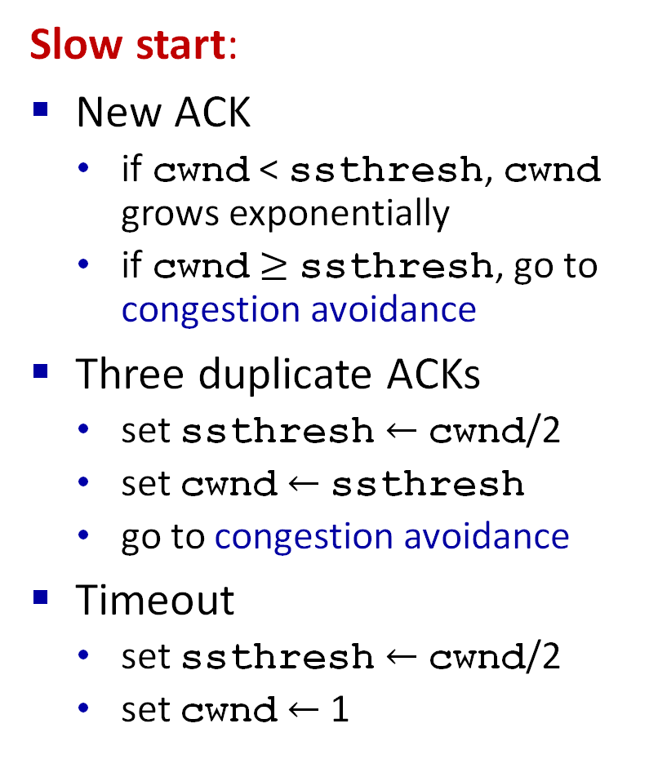

TCP congestion control
Slow start:
New ACK
  if cwnd < ssthresh, cwnd grows exponentially
  if cwnd $≥$ ssthresh, go to congestion avoidance
Three duplicate ACKs
  set ssthresh $←$ cwnd/2
  set cwnd $←$ ssthresh
  go to congestion avoidance
Timeout
  set ssthresh $←$ cwnd/2
  set cwnd $←$ 1
Congestion avoidance:
New ACK
  cwnd increases linearly
Three duplicate ACKs
  set ssthresh $←$ cwnd/2
  set cwnd $←$ ssthresh
Timeout
  set ssthresh $←$ cwnd/2
  set cwnd $←$ 1
  go to slow start
AIMD

Slide 37
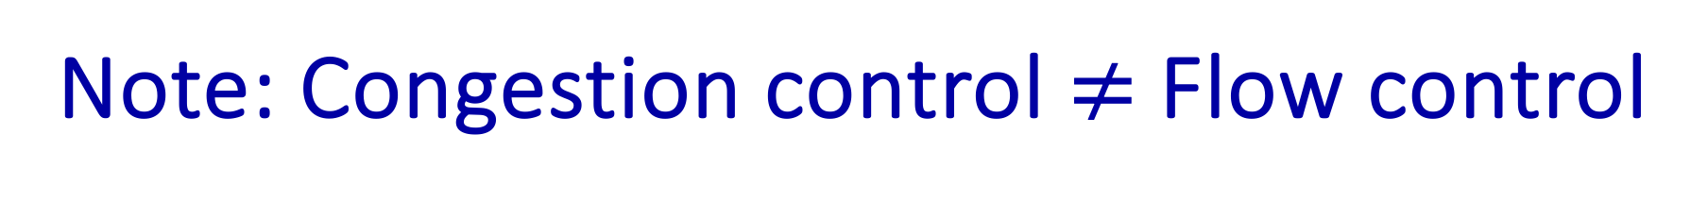
Note: Congestion control $≠$ Flow control
sending process
receiving process
application
data
data
transport
In rdt tools, windows are used to manage pipelined transfer
TCP has two windows
  Flow control window
  Congestion control window
Sender is limited by the smallest window
TCP
send buffer
TCP
receive buffer
transport
network
unreliable channel
Flow control
  Sender will not overwhelm receiver
Congestion control
  Sender will not overwhelm the network

Slide 38
TCP CUBIC
Is there a better way than AIMD to “probe” for usable bandwidth?
Insight/intuition:
  W_{max}: sending rate at which congestion loss was detected
  congestion state of bottleneck link probably (?) hasn’t changed much
  after cutting rate/window in half on loss, initially ramp to to W_{max} faster, but then approach W_{max} more slowly
W_{max}
classic TCP
TCP CUBIC - higher throughput in this example
W_{max}/2

Slide 39
TCP CUBIC
K: point in time when TCP window size will reach W_{max}
  K itself is tunable
increase W as a function of the cube of the distance between current time and K
  larger increases when further away from K
  smaller increases (cautious) when nearer K
TCP CUBIC default in Linux, most popular TCP for popular Web servers
W_{max}
TCP Reno
TCP CUBIC
TCP
sending
rate
time
t₀
t₁
t₂
t₃
t₄

Slide 40
So far we have seen..
Loss-based congestion control??
There are other approaches too
Delay-based
Network input based

Slide 41
TCP and the congested “bottleneck link”
TCP (classic, CUBIC) increase TCP’s sending rate until packet loss occurs at some router’s output: the bottleneck link
source
destination
application
TCP
network
link
physical
application
TCP
network
link
physical
packet queue almost never empty, sometimes overflows packet (loss)
bottleneck link (almost always busy)
Notes:
Loss based approaches
increase the rate until a loss occurs, at some bottleneck router
For simplicity assume that other routers are fine and not the problem

Slide 42
TCP and the congested “bottleneck link”
TCP (classic, CUBIC) increase TCP’s sending rate until packet loss occurs at some router’s output: the bottleneck link
understanding congestion: useful to focus on congested bottleneck link
insight: increasing TCP sending rate will not increase end-end throughout with congested bottleneck
source
destination
application
TCP
network
link
physical
application
TCP
network
link
physical
insight: increasing TCP sending rate will increase measured RTT
Goal: “keep the end-end pipe just full, but not fuller”
RTT

Slide 43
Delay-based TCP congestion control
Keeping sender-to-receiver pipe “just full enough, but no fuller”: keep bottleneck link busy transmitting, but avoid high delays/buffering
# bytes sent in last RTT interval
RTT_{measured}
measured
throughput
=
RTT_{measured}
Delay-based approach:
RTT_{min} - minimum observed RTT (uncongested path)
uncongested throughput with congestion window cwnd is cwnd/RTT_{min}
if measured throughput “very close” to uncongested throughput
increase cwnd linearly /* since path not congested */
else if measured throughput “far below” uncongested throughout
decrease cwnd linearly /* since path is congested */

Slide 44
Delay-based TCP congestion control
a number of deployed TCPs take a delay-based approach
  Bottleneck Bandwidth and Round-trip propagation time (BBR)
  BBR deployed on Google’s (internal) backbone network

Slide 45
Explicit congestion notification (ECN)
TCP deployments often implement network-assisted congestion control:
two bits in IP header (ToS field) marked by network router to indicate congestion
  policy to determine marking chosen by network operator
congestion indication carried to destination
destination sets ECE bit on ACK segment to notify sender of congestion
involves both IP (IP header ECN bit marking) and TCP (TCP header C,E bit marking)
source
TCP ACK segment
destination
application
TCP
network
link
physical
application
TCP
network
link
physical
ECE=1
ECN=10
ECN=11
IP datagram

Slide 46
TCP segment structure
32 bits
source port #
dest port #
sequence number
acknowledgement number
head
len
not
used
C
E
A
P
R
S
F
receive window
U
checksum
Urg data pointer
options (variable length)
C, E: congestion notification
ECE: Explicit Congestion Notification Echo
CWR: Congestion Window Reduced
application
data
(variable length)
Notes:
4-bit header length

Slide 47
TCP fairness
Fairness goal: if K TCP sessions share same bottleneck link of bandwidth R, each should have average rate of ?
R/K
TCP connection 1
bottleneck
router
capacity R
TCP connection 2

Slide 48
Q: is TCP Fair?
Assumptions:
  Suppose each connection is transferring a large file
  There is no UDP traffic passing through the bottleneck link
  Only two TCP connections sharing a single link with transmission rate R
  Assume that the two connections have the same MSS and RTT
  Ignore the slow-start phase of TCP
  Assume the TCP connections are operating in CA mode (AIMD) at all times.
TCP connection 1
bottleneck
router
capacity R
TCP connection 2

Slide 49
Q: is TCP Fair?
Example: two competing TCP sessions:
additive increase gives slope of 1, as throughout increases
multiplicative decrease decreases throughput proportionally
R
equal bandwidth share
Is TCP fair?
A: Yes, under idealized assumptions:
same RTT
fixed number of sessions only in congestion avoidance
loss: decrease window by factor of 2
congestion avoidance: additive increase
Connection 2 throughput
loss: decrease window by factor of 2
congestion avoidance: additive increase
Connection 1 throughput
R

Slide 50
Fairness: must all network apps be “fair”?
Fairness and UDP
multimedia apps often do not use TCP
  do not want rate throttled by congestion control
instead use UDP:
  send audio/video at constant rate, tolerate packet loss
there is no “Internet police” policing use of congestion control
Fairness, parallel TCP connections
application can open multiple parallel connections between two hosts
web browsers do this , e.g., link of rate R with 9 existing connections:
  new app asks for 1 TCP, gets rate R/10
  new app asks for 11 TCPs, gets R/2

Slide 51
Transport layer: roadmap
Transport-layer services
Multiplexing and demultiplexing
Connectionless transport: UDP
Principles of reliable data transfer
Connection-oriented transport: TCP
Principles of congestion control
TCP congestion control
Evolution of transport-layer functionality

Slide 52
Evolving transport-layer functionality
TCP, UDP: principal transport protocols for 40 years
different “flavors” of TCP developed, for specific scenarios:
Scenario | Challenges
Long, fat pipes (large data transfers) | Many packets “in flight”; loss shuts down pipeline
Wireless networks | Loss due to noisy wireless links, mobility; TCP treat this as congestion loss
Long-delay links | Extremely long RTTs
Data center networks | Latency sensitive
Background traffic flows | Low priority, “background” TCP flows
moving transport–layer functions to application layer, on top of UDP
  HTTP/3: QUIC

Slide 53
Adhoc Wireless/Mobile network
What happens to the Congestion Window?
What about throughput?
Sender
Reciever

Slide 54
QUIC: Quick UDP Internet Connections
application-layer protocol, on top of UDP
  increase performance of HTTP
  deployed on many Google servers, apps (Chrome, mobile YouTube app)
HTTP/2
HTTP/2 (slimmed)
Application
HTTP/3
TLS
QUIC
Transport
TCP
UDP
Network
IP
IP
HTTP/2 over TCP
HTTP/2 over QUIC over UDP

Slide 55
QUIC: Quick UDP Internet Connections
application-layer protocol, on top of UDP
  increase performance of HTTP
  deployed on many Google servers, apps (Chrome, mobile YouTube app)
HTTP/2
HTTP/2 (slimmed)
Application
HTTP/3
TLS
QUIC
Transport
TCP
UDP
Network
IP
IP
HTTP/2 over TCP
HTTP/2 over QUIC over UDP

Slide 56
QUIC: Quick UDP Internet Connections
adopts approaches we’ve studied in this chapter for connection establishment, error control, congestion control
  error and congestion control: “Readers familiar with TCP’s loss detection and congestion control will find algorithms here that parallel well-known TCP ones.” [from QUIC specification]
  connection establishment: reliability, congestion control, authentication, encryption, state established in one RTT
multiple application-level “streams” multiplexed over single QUIC connection
  separate reliable data transfer, security
  common congestion control

Slide 57
QUIC: Connection establishment
TCP handshake
(transport layer)
QUIC handshake
data
TLS handshake
(security)
data
TCP (reliability, congestion control state) + TLS (authentication, crypto state)
2 serial handshakes
QUIC: reliability, congestion control, authentication, crypto state
1 handshake

Slide 58
QUIC: streams: parallelism, no HOL blocking
HTTP
GET
HTTP
GET
HTTP
GET
HTTP
GET
HTTP
GET
application
HTTP
GET
QUIC
encrypt
QUIC
encrypt
QUIC
encrypt
QUIC
encrypt
QUIC
encrypt
QUIC
encrypt
TLS encryption
TLS encryption
QUIC
RDT
QUIC
RDT
QUIC
RDT
QUIC
RDT
QUIC
RDT
QUIC
RDT
error!
QUIC Cong. Cont.
QUIC Cong. Cont.
TCP RDT
TCP RDT
error!
transport
TCP Cong. Contr.
TCP Cong. Contr.
UDP
UDP
(a) HTTP 1.1
(b) HTTP/2 with QUIC: no HOL blocking

Slide 59
QUIC: streams: parallelism, no HOL blocking
HTTP
GET
HTTP
GET
HTTP
GET
HTTP
GET
HTTP
GET
application
HTTP
GET
QUIC
encrypt
QUIC
encrypt
QUIC
encrypt
QUIC
encrypt
QUIC
encrypt
QUIC
encrypt
TLS encryption
TLS encryption
QUIC
RDT
QUIC
RDT
QUIC
RDT
QUIC
RDT
QUIC
RDT
QUIC
RDT
QUIC Cong. Cont.
QUIC Cong. Cont.
TCP RDT
TCP RDT
transport
TCP Cong. Contr.
TCP Cong. Contr.
UDP
UDP
(a) HTTP 1.1
(b) HTTP/2 with QUIC: no HOL blocking

Slide 60
QUIC: streams: parallelism, no HOL blocking
HTTP
GET
HTTP
GET
HTTP
GET
HTTP
GET
HTTP
GET
application
HTTP
GET
QUIC
encrypt
QUIC
encrypt
QUIC
encrypt
QUIC
encrypt
QUIC
encrypt
QUIC
encrypt
TLS encryption
TLS encryption
QUIC
RDT
QUIC
RDT
QUIC
RDT
QUIC
RDT
QUIC
RDT
QUIC
RDT
error!
QUIC Cong. Cont.
QUIC Cong. Cont.
TCP RDT
TCP RDT
error!
transport
TCP Cong. Contr.
TCP Cong. Contr.
UDP
UDP
(a) HTTP 1.1
(b) HTTP/2 with QUIC: no HOL blocking

Slide 61
Transport layer: summary
principles behind transport layer services:
  multiplexing, demultiplexing
  reliable data transfer
  flow control
  congestion control
instantiation, implementation in the Internet
  UDP
  TCP
Up next:
leaving the network “edge” (application, transport layers)
into the network “core”

Slide 62
Additional Slides

Slide 63
Packet drops along the path
four senders
multi-hop paths
timeout/retransmit
Q: what happens as λ_{in} and λ_{in}’ increase ?
A: as red λ_{in}’ increases, all arriving blue pkts at upper queue are dropped, blue throughput g 0
Host A
λ_{in} : original data
λ'_{in}: original data, plus retransmitted data
Host B
finite shared output link buffers
Host D
λ_{out}
Host C

Slide 64
Packet drops along the path
R/2
λ_{out}
λ_{in}’
R/2
another “cost” of congestion:
when packet dropped, any upstream transmission capacity and buffering used for that packet was wasted!

