Slide 1
CHATBOTs
Minnah Jafar

Slide 2
Introduction
Developed two AI-based applications:
AI Chatbot
RAG PDF Chatbot
Designed to improve communication and document search efficiency.
Built with a business-focused approach for practical real-world use cases.

Slide 3
AI CHATBOT
Project overview
PROJECT
1
Developed an AI chatbot capable of generating human-like responses.
Supports multi-turn conversations and context-based interaction.
Built using Python, Groq API, and Streamlit.

Slide 4
BUISNESS PURPOSE
Reduces repetitive manual communication
Provides faster customer interaction
Improves response efficiency
Helps automate communication systems

Slide 5
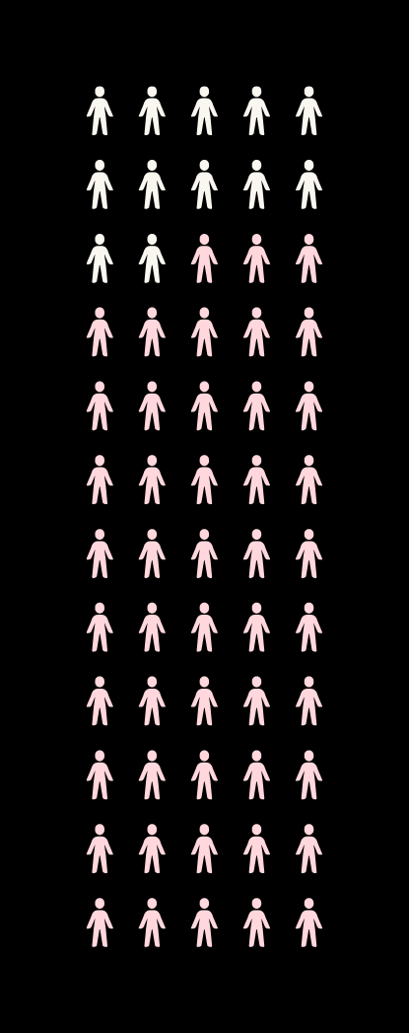
KEY FEATURES
AI-generated responses
Multi-turn conversation support
Chat history management
Adjustable response settings
Fast response generation using Groq AP
TECHNOLOGIES USED
Python
Groq API
Streamlit

Slide 6
My Contributions
Developed chatbot logic using Python
Integrated Groq API
Managed conversation flow and history
Tested chatbot using different AI settings
Improved response quality and interaction handling

Slide 7
Challenges Faced
Understanding API integration
Managing chatbot memory
Tuning AI response quality
Solutions Implemented
Experimented with temperature and max_tokens
Improved prompt handling
Structured conversation storage
Challenges AND
Solutions

Slide 8
RAG Chatbot
Project overview
PROJECT
2
Developed a RAG-based chatbot capable of answering questions from PDF documents.
Uses Retrieval-Augmented Generation for intelligent document search.
Built using LangChain, ChromaDB, Streamlit, and Groq API.

Slide 9
BUISNESS PURPOSE
Helps users retrieve information quickly from documents
Reduces time spent manually searching PDFs
Improves productivity and accessibility
Enables intelligent document interaction

Slide 10

KEY FEATURES
PDF upload support
Text extraction from PDFs
Text chunking
Embedding generation
ChromaDB vector storage
Intelligent retrieval system
AI-generated answers

Slide 11
My Contributions
Implemented PDF processing workflow
Built retrieval pipeline using LangChain
Integrated ChromaDB vector database
Connected LLM for answer generation
Designed Streamlit chatbot interface

Slide 12
Challenges Faced
ChromaDB permission issues
Streamlit rerun handling
Managing uploaded PDFs
Solutions Implemented
Improved project structure
Optimized retrieval workflow
Better session handling
Challenges AND
Solutions

