Slide 1
PrepScore Career Profile Optimizer
Minna Joby
Roll No: 35
Reg.No.: KTE24MCA-2038
Guided By : Prof. Shilpa M. Thomas /Dr. Reena Murali
Department of Computer Applications
Rajiv Gandhi Institute Of Technology, Kottayam

Slide 2
Introduction
Students lack a data-driven way to measure their job readiness; traditional resumes are static and offer no feedback.
A smart web application to build a comprehensive digital profile (skills, education, experience).
An intelligent engine that analyzes the profile to generate a real-time Career Readiness Score.

Slide 3
Existing Systems
A review was conducted on the primary tools students use for professional profile management.
The analysis focused on two main categories:
Professional Networking Platforms (e.g., LinkedIn)
Online Resume Builders (e.g., Zety, Canva)
The objective was to evaluate their core features to identify functional gaps in providing career readiness guidance.

Slide 4
Literature Review
Tool Category | Strengths | Limitations / Gap
Networking Platforms (e.g., LinkedIn) | Builds online presence; has a basic profile strength meter. | Lacks a deep, quantitative analysis of skills. Feedback is generic and not personalized.
Resume Builders | Creates visually appealing, well-formatted PDF resumes. | Acts as a static, one-time tool. Offers no content analysis or guidance for improvement.

Slide 5
Gap Identified
No Quantitative Score: Existing tools fail to provide a simple, data-driven score to benchmark job readiness.
Static, Not Strategic: Platforms focus on listing past achievements, not providing a strategic path for future improvement.
The Need: A dedicated Profile Optimizer with a dynamic feedback loop.

Slide 6
Proposed System
A Centralized Profile Hub: A secure web app with full CRUD functionality for users to manage their skills, education, and experience.
Intelligent Scoring Engine: A core algorithm that analyzes the profile to generate a real-time, quantitative "Career Readiness Score."
Dynamic Feedback Loop: The score updates instantly with profile changes, providing immediate feedback to guide strategic improvement.

Slide 7
System Requirements
Software Requirements | Development Tools
Operating System: Windows, Linux | Version Control: Git & GitHub
Backend: Python 3.+, Django 5.+ | Code Editor: Visual Studio Code
Frontend: HTML5, CSS3 | Database GUI: pgAdmin
Hardware Requirements
Development: Standard PC/Laptop
Minimum 4GB of RAM
End-User: Any device with a modern browser

Slide 8
Problem Statement
To develop a web application that solves the uncertainty students face by replacing static resumes with a dynamic analysis of their professional profile.The core challenge is to generate a quantitative "Career Readiness Score" to serve as a clear benchmark for self-assessment and guided improvement.

Slide 9
Objectives
Develop a Full-Featured Web Application: Build a secure platform with user authentication and complete CRUD (Create, Read, Update, Delete) functionality for all profile sections.
Implement an Intelligent Scoring Engine: Create a rule-based algorithm to score a user's profile in real-time, with the future scope of evolving it into a predictive Machine Learning model.
Provide Actionable Feedback & Guidance: Generate personalized suggestions based on the profile analysis to help users strategically improve their career readiness.

Slide 10
Scope & Relevance
Scope
A full-stack web application with user authentication, complete profile CRUD, and a real-time, rule-based scoring engine . Students and recent graduates preparing for the job market . Implementation of an advanced ML model and personalized suggestions.
Relevance
Addresses student uncertainty by providing a data-driven tool for career self-assessment . Shifts the focus from static resumes to dynamic profile optimization . Integrates full-stack development, database management, and data analysis principles.

Slide 11
Development Methodology - Model
The project was developed using an Agile methodology, specifically following an Iterative and Incremental process.
Why Agile?
Flexibility: Allowed for continuous improvement and adaptation to new requirements.
Rapid Prototyping: Delivered functional parts of the application in short, manageable cycles (iterations).
Early Feedback: Enabled testing and validation of features at each stage, reducing overall risk.

Slide 12
Development Methodology - Phases
Phase 1: Requirement Analysis & Design
Conducted literature review, identified gaps, and defined the project scope, objectives, and system architecture. Designed the database schema (ER Diagram).
Phase 2: Foundation & Authentication
Set up the Django project, configured the PostgreSQL database, and implemented the complete, secure user authentication system (Register, Login, Logout).
Phase 3: Core Feature Implementation (CRUD)
Developed the full Create, Read, Update, and Delete functionality for all core profile components (Profile, Skills, Education, Experience, Certifications).
Phase 4: Intelligence Layer & UI Polish
Currently implementing the rule-based scoring engine and integrating it with the user dashboard. This phase also includes final UI enhancements and testing.

Slide 13
Development Methodology - Workflow
A systematic and repeatable workflow was followed for the implementation of each feature:
Plan: A clear, specific task was identified from the project plan (e.g., "Implement User Login").
Develop (MVT Pattern): The feature was built following Django's Model-View-Template architecture, ensuring a clean separation of concerns.
Test: The functionality was manually and thoroughly tested in the browser to identify and fix any bugs immediately.
Commit & Document: Once working, the code was saved to version control with a clear Git commit message, and the progress was logged in the Scrum Book.

Slide 14
Data Flow Diagram
Profile Data
User
PrepScore System
.
.
Calculated PrepScore & Feedback
FIG 1: DFD LEVEL 0

Slide 15
Data Flow Diagram
Manage Authentication
Login Credentials
User Records
Profile Updates
Manage Profile
User
Profile Data
Dashboard View
User & Profile Database
Calculate Score
Profile Data
Calculated Score & Feedback
FIG 2: DFD LEVEL 1

Slide 16
Implementation Details
Backend Logic
Framework: Built on the Django 5.2.4 MVT (Model-View-Template) architecture.
Core Logic:
Views: Handle all business logic, with sensitive pages protected by the @login_required decorator.
Custom Authentication: A custom backend allows users to log in with either a username or an email.
Forms: Django ModelForms are used for rapid development and validation of all CRUD forms.

Slide 17
Implementation Details
Frontend
Template Inheritance:
Utilizes a base.html for public pages and a separate dashboard_base.html app shell for a consistent, logged-in user experience.
This maximizes code reusability (DRY principle).
Dynamic Rendering:
Conditional Logic ({% if %}): Used to display different navigation for guests vs. logged-in users.
Loops ({% for %}): Used to dynamically display lists of user data (skills, education) on the dashboard.

Slide 18
Implementation Details
Database & Security
Database: A robust PostgreSQL relational database ensures data integrity.
Data Security:
Ownership Checks: All Update/Delete views verify that the user (request.user) owns the data they are trying to modify.
CSRF Protection: Django's built-in CSRF tokens are used in all forms to prevent cross-site attacks.
Configuration Security:
Sensitive credentials (e.g., SECRET_KEY, DB password) are securely stored in a .env file and are excluded from version control.

Slide 19
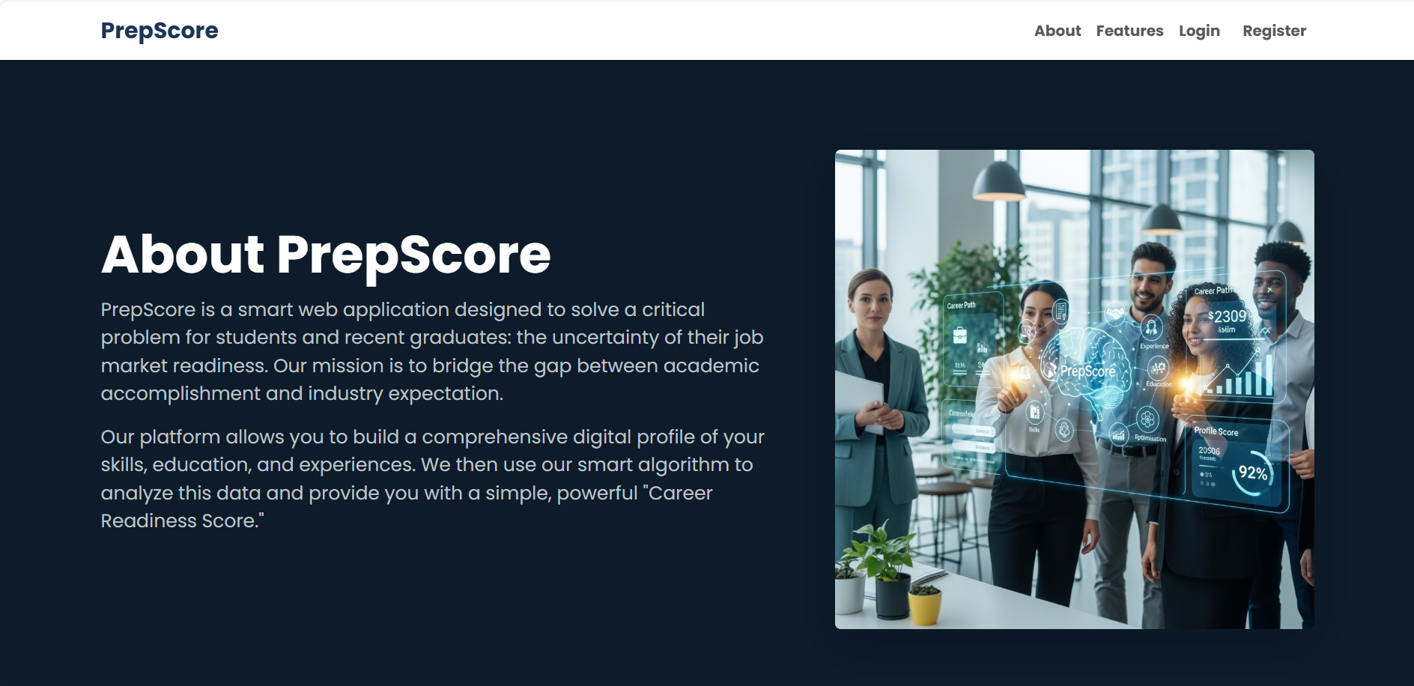
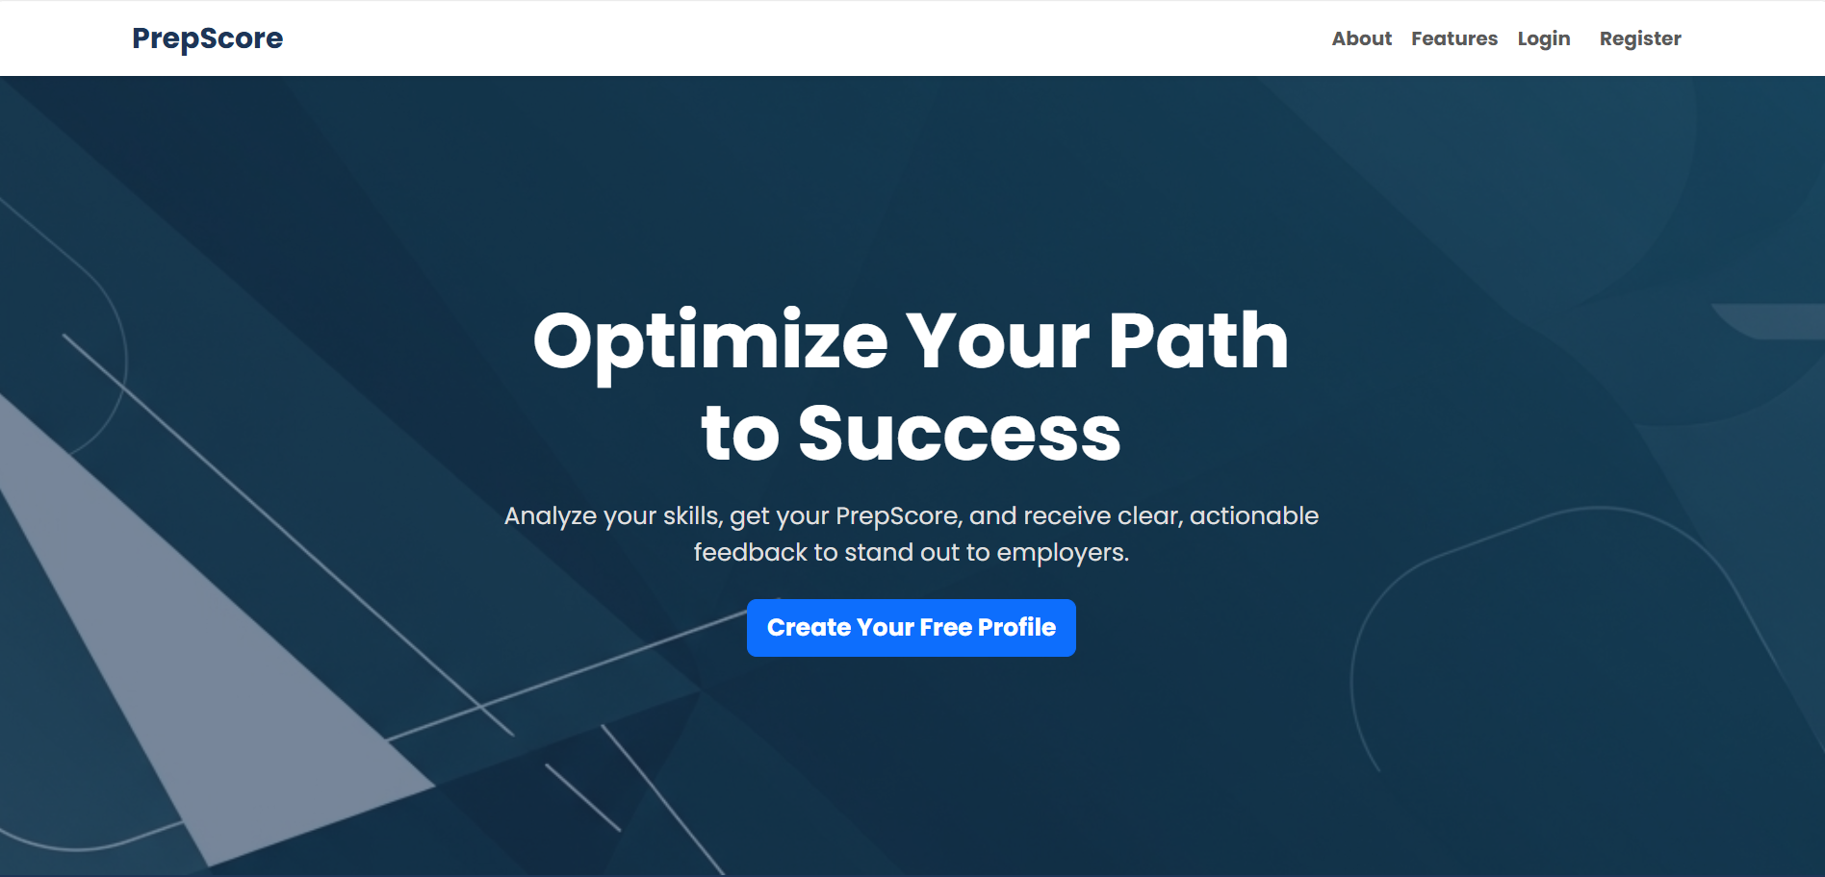
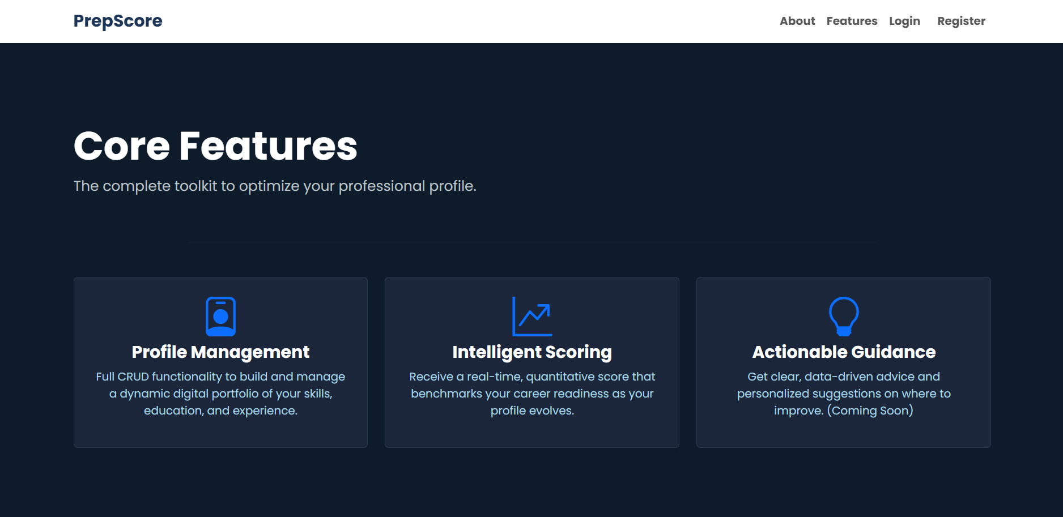
Results
FIG 4: ABOUT SECTION
FIG 3: HOMEPAGE
FIG 5: FEATURES

Slide 20
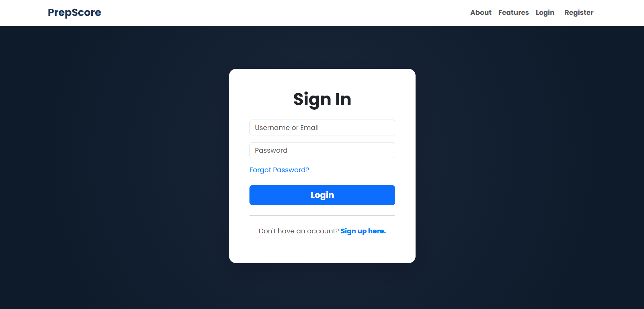
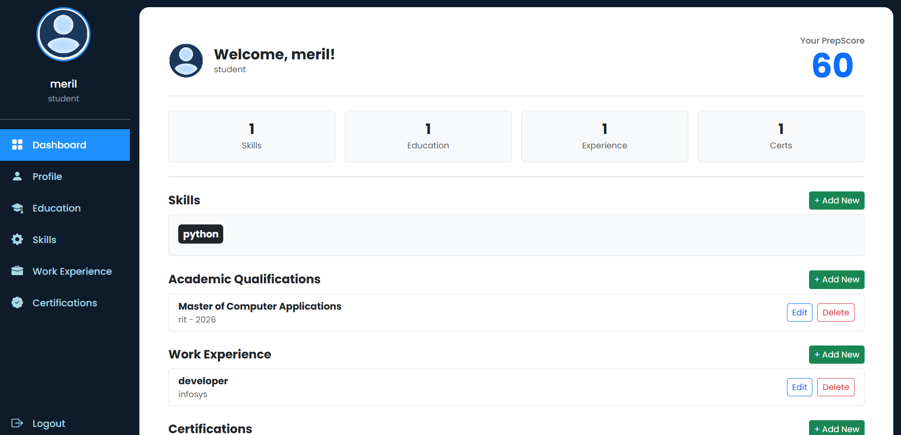
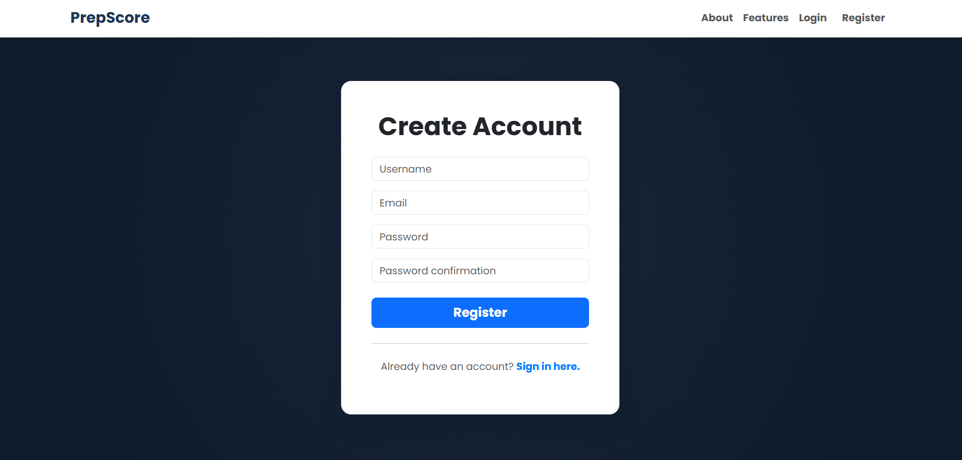
Results
FIG 6: LOGIN
FIG 8: DASHBOARD
FIG 7: REGISTER

Slide 21
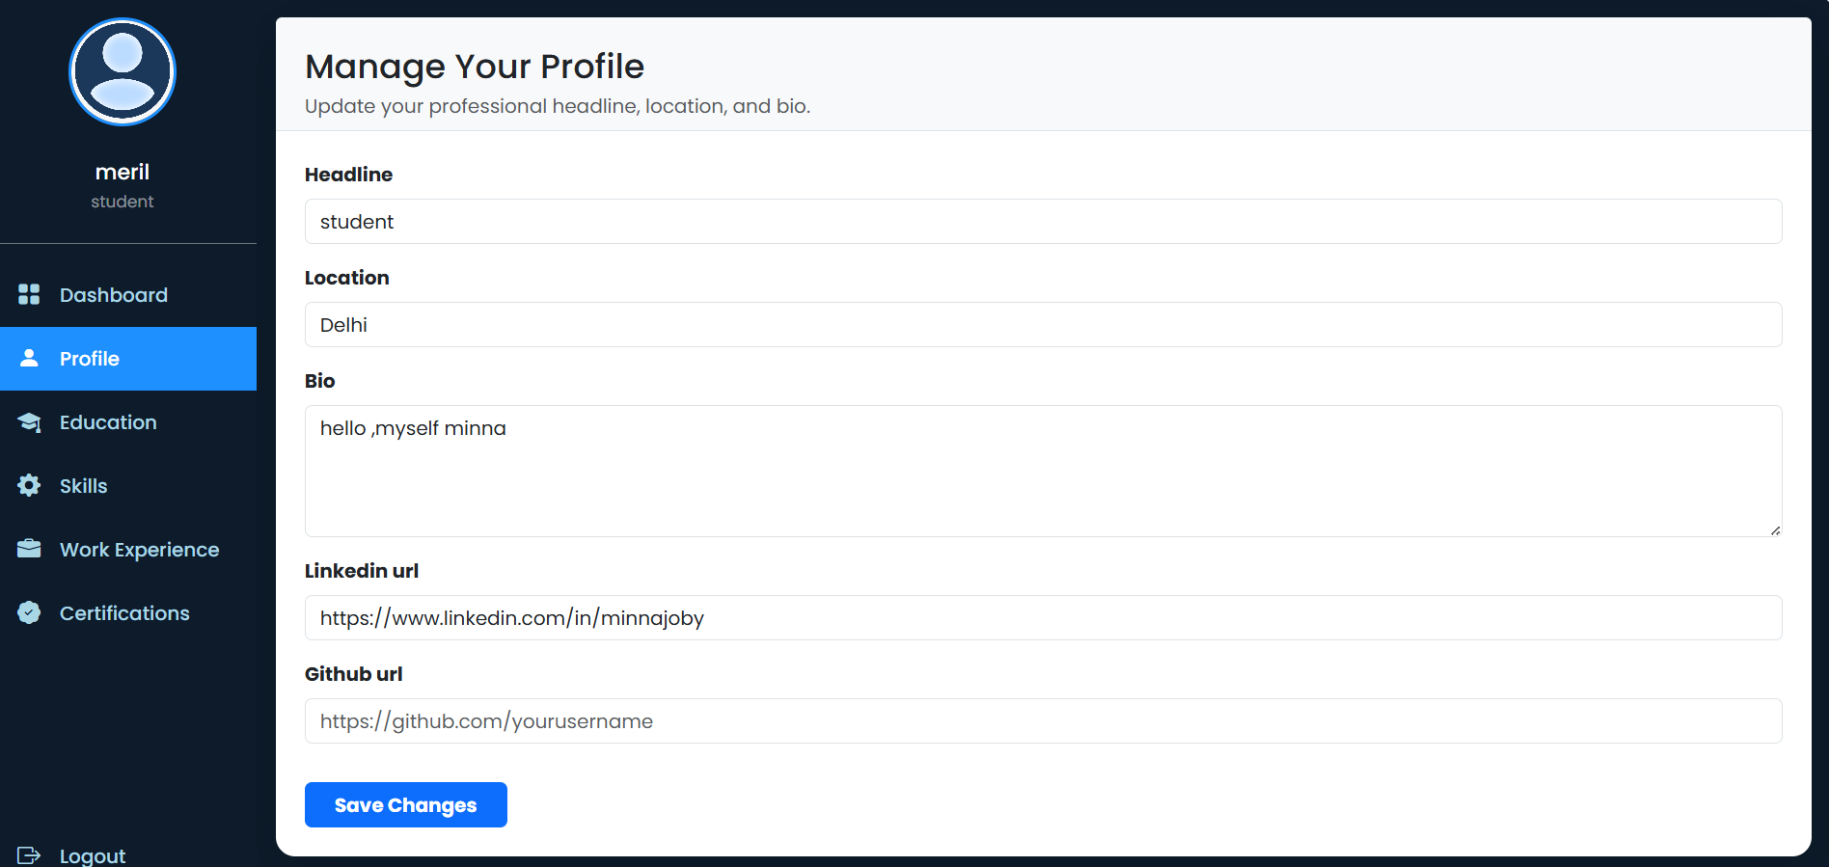
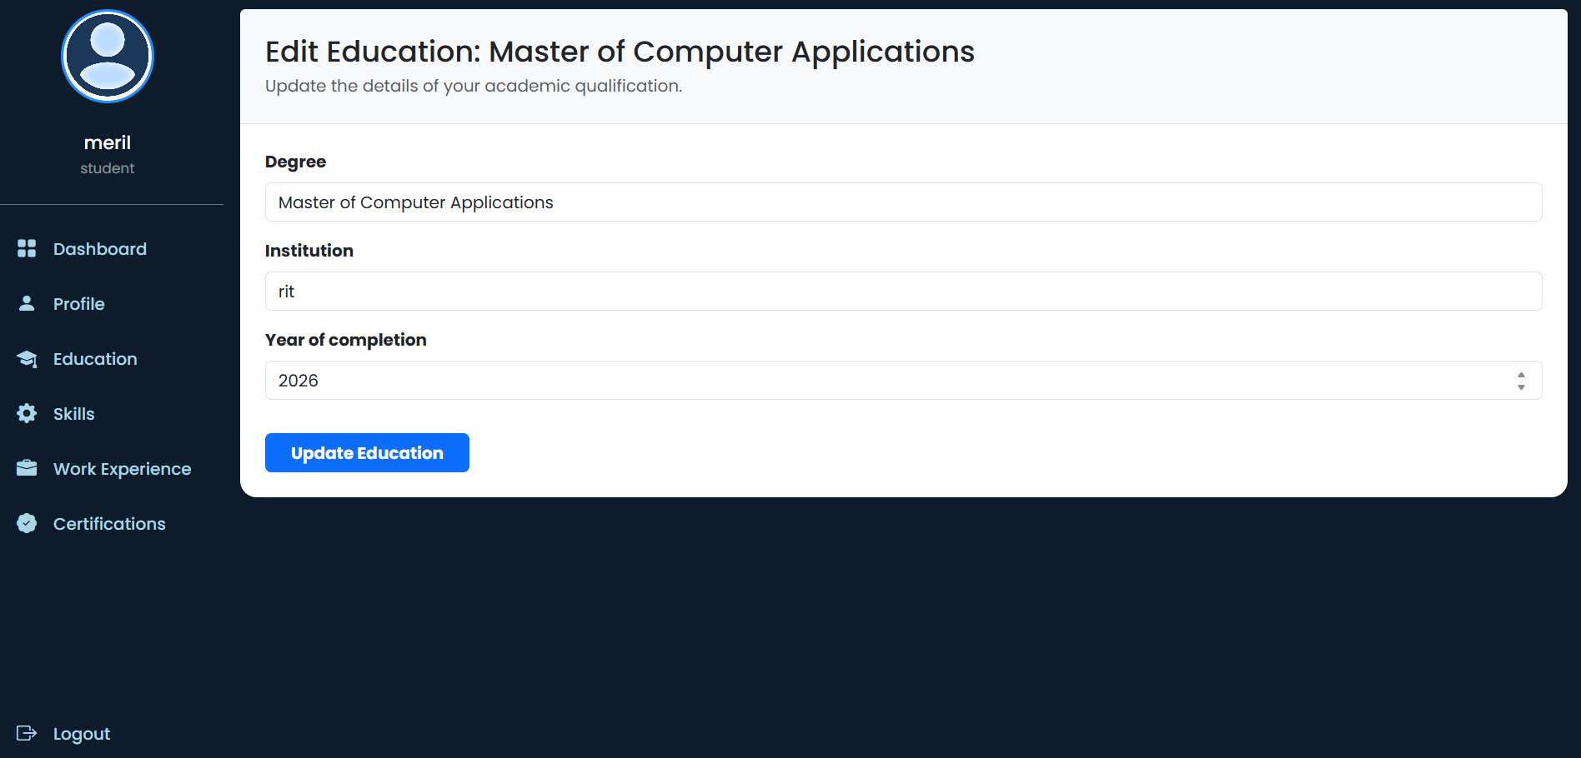
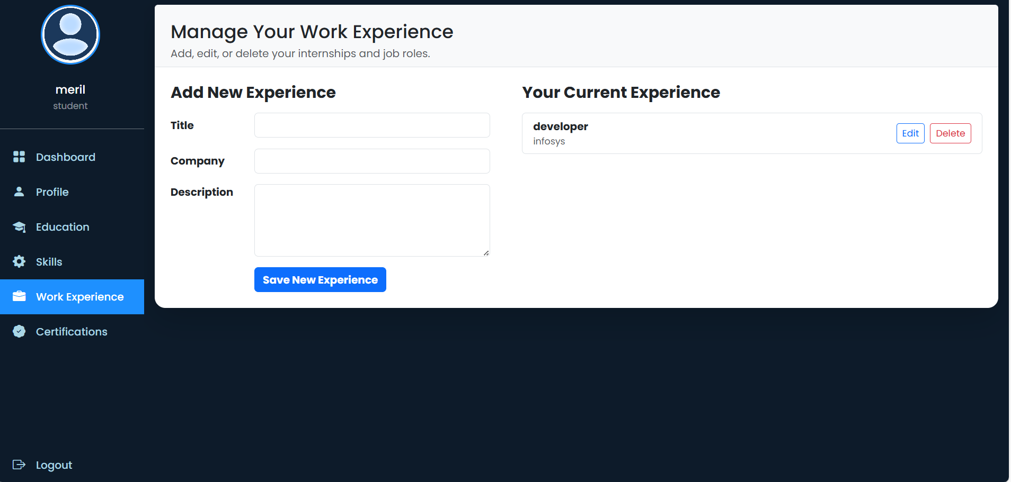
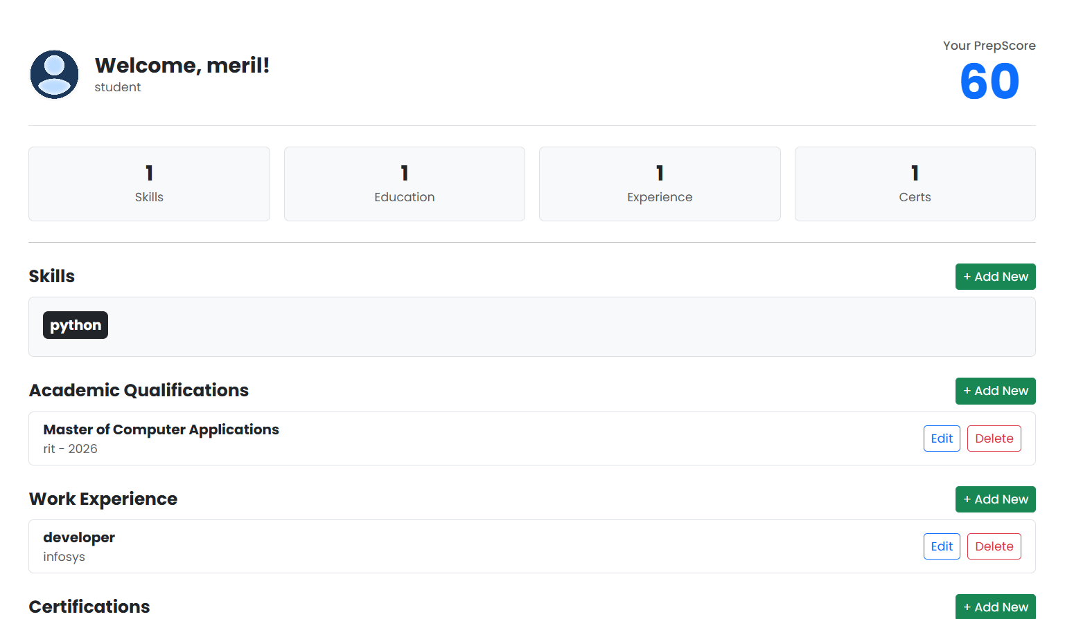
Results
FIG 9: PROFILE MANAGEMENT
FIG 10: EDITING FEATURE
FIG 11: EXPERIENCE FORM
FIG 12 : PREPSCORE

Slide 22
Current Status of Work
The project is currently 70% complete.
All foundational architecture and core user-facing features required for a functional application are implemented and working.
Completed Components:
Full User Authentication System (Login, Register, Logout)
Complete Profile Management (Full CRUD for all models)
A functional, real-time, rule-based Scoring Engine
A professional and responsive user interface

Slide 23
Work Progress
Foundation & Security (Complete):
Project setup, PostgreSQL database, and user authentication are fully implemented.
Core Functionality (Complete):
Full CRUD (Create, Read, Update, Delete) for the entire user profile is functional.
Intelligence Engine (In Progress):
A rule-based scoring algorithm has been successfully implemented.
Next Step: Evolve the engine into a predictive Machine Learning model.

Slide 24
Pending Works
Evolve to a Machine Learning Model:
Advance the current rule-based scoring engine by training a predictive Machine Learning model for a more accurate and nuanced profile analysis.
Implement Personalized Guidance Engine:
Develop the algorithm to generate targeted, data-driven suggestions for user improvement based on their profile data.
Enhance UI & Finalize:
Improve the dashboard with data visualizations (e.g., charts for the score) and conduct final end-to-end testing and documentation.

Slide 25
Project Plan
Phase | Phases | Key Deliverables | Timeline (Weeks) | Status
1 | Analysis & Design | Requirement Analysis, System Design (DFD, ERD), Database Schema | 1 - 2 | Completed
2 | Foundation & Auth | Project Setup, Security, Full User Authentication System | 2 - 4 | Completed
3 | Core Functionality | Full CRUD for Profile, Skills, Education, Experience, Certifications | 4 - 6 | Completed
4 | Intelligence & Polish | Rule-Based Scoring, UI Enhancements, Final Testing | 6 - 8 | In Progress

Slide 26
Conclusion & Future Scope
Conclusion:
Successfully developed a secure, functional web application with a complete profile CRUD system and a working rule-based scoring engine. The project is 70% complete and meets all evaluation milestones.
Future Scope:
Evolve the scoring engine into a predictive Machine Learning model.
Implement a personalized suggestions engine.
Add a PDF resume generation feature.

Slide 27
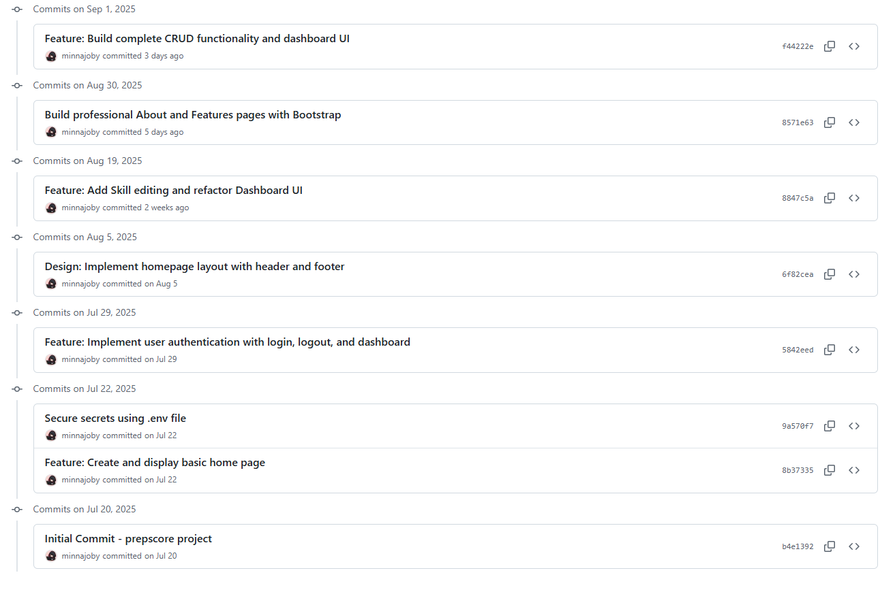
Git History

Slide 28
Bibliography
Core Technologies & Documentation:
Python:
Official Documentation: https://docs.python.org/3/
Django Framework:
Official Documentation: https://docs.djangoproject.com/en/5.2/
PostgreSQL:
Official Documentation: https://www.postgresql.org/docs/

Slide 29
Thank you

