Slide 1
Gaming Analytics
Data Engineering Pipeline
Python ingestion • PostgreSQL • dbt transformations • Tests • Orchestration
1

Slide 2
Business Context
Operational gaming-machine data converted into reporting-ready layer.
Source fields
Business date, venue, EGM description, manufacturer and FP
Financial measures
Turnover and GMP
Activity measure
Games played
The source arrives as a CSV, not as a reporting table.
The pipeline keeps raw ingestion separate from transformation logic.
The final outputs support daily, venue and EGM-level analysis.
2

Slide 3
Architecture
Local stack with clear responsibilities at each layer
CSV
input file
ingestion.py
Python loader
PostgreSQL
raw storage
dbt staging
typed model
dbt reporting views
reports
dbt tests
validation
1. Load raw CSV into PostgreSQL
2. Standardise and type data in dbt staging
3. Build marts for reporting questions
4. Run tests before treating outputs as trusted
3

Slide 4
Project Organisation
Folders are separated by responsibility
data_engineer_challenge/
├── data/
│ ├── Data Engineer Challenge_input.csv
│ └── mock_incremental_rows.csv
├── ingestion/
│ └── ingestion.py
├── orchestration/
│ └── run_pipeline.py
├── gaming_analytics/
│ ├── dbt_project.yml
│ ├── models/
│ │ ├── staging/
│ │ │ ├── sources.yml
│ │ │ ├── staging.yml
│ │ │ └── stg_game_performance.sql
│ │ └── marts/
│ │ ├── daily_summary.sql
│ │ ├── egm_venue_revenue.sql
│ │ ├── venue_turnover.sql
│ │ └── marts.yml
│ └── tests/
│ ├── no_null_manufacturer.sql
│ ├── positive_turnover.sql
│ ├── raw_to_staging_completeness.sql
│ └── valid_games_played.sql
├── requirements.txt
└── README.md
ingestion/
Reads CSV files and loads them into the raw PostgreSQL schema.
gaming_analytics/models/
Contains the dbt staging model and reporting marts.
gaming_analytics/tests/
Contains custom SQL tests for business/data rules.
orchestration/run_pipeline.py
Single entry point for the full workflow.
4

Slide 5
Ingestion Implementation
How the CSV is loaded into PostgreSQL
Read CSV
ingestion.py reads the selected CSV into a pandas DataFrame.
Base load
replace mode is used for the supplied challenge CSV.
CSV file
↓
pandas DataFrame
↓
SQLAlchemy + psycopg2
↓
PostgreSQL raw.game_performance
Credentials
Database connection values are read from environment variables.
Incremental test data
append mode is used when adding the smaller mock CSV.
Database load
SQLAlchemy connects to PostgreSQL and pandas to_sql writes to raw.game_performance.
Raw layer
No business reporting logic is applied during ingestion.
5

Slide 6
Staging Transformation and Incremental Model
dbt keeps a clean typed staging table and only adds newer records on later runs
Materialization
stg_game_performance is configured as an incremental model.
{{ config(
materialized='incremental',
unique_key=[
'bus_date', 'venue_code',
'egm_description', 'manufacturer', 'fp'
]
) }}
select
cast(bus_date as date) as bus_date,
venue_code,
egm_description,
manufacturer,
fp,
cast(turnover_sum as numeric(18,2)) as turnover_sum,
cast(gmp_sum as numeric(18,2)) as gmp_sum,
cast(games_played_sum as numeric(18,2)) as games_played_sum
from {{ source('raw', 'game_performance') }}
{% if is_incremental() %}
where cast(bus_date as date) > (
select max(cast(bus_date as date))
from {{ this }}
)
{% endif %}
Unique key
bus_date, venue_code, egm_description, manufacturer and fp define the row grain.
First run
dbt creates the staging table and loads the available source records.
Next runs
Only records with a bus_date newer than the staged max date are inserted.
The raw table remains the landing area; staging is where the data is typed and prepared.
The date filter keeps incremental runs small for this demo.
The unique key documents the intended row grain and helps avoid duplicate business records.
6

Slide 7
dbt Lineage
The data flow is source → staging → marts; tests validate the staging layer separately
SOURCE
STAGING
MARTS
daily_summary
Daily totals
raw.game_performance
PostgreSQL source table
stg_game_performance
Incremental, typed staging model
venue_turnover
Venue turnover rollup
egm_venue_revenue
Venue + EGM GMP
Data Quality Tests
Validate staging assumptions
7

Slide 8
Reporting Views
Reporting logic built from the cleaned staging model
daily_summary
Groups by business date and provides daily totals for turnover, GMP and games played.
venue_turnover
Aggregates turnover by venue so activity can be compared.
egm_venue_revenue
Aggregates GMP by venue and EGM description to support machine-level analysis.
Each reporting view uses ref('stg_game_performance').
No reporting view reads directly from raw.game_performance.
The model design keeps cleanup separate from business aggregation.
8

Slide 9
Data Quality Testing
18 tests(inbuilt and customised)
The project currently executes 18 data tests against the staging layer and related source-to-staging checks.
# staging.yml
bus_date:
- not_null
- expect_column_values_to_be_between
1999-01-01 → 2026-12-31
venue_code:
- not_null
- between 1 and 99999
egm_description / manufacturer:
- not_null
- not_empty_string
turnover_sum:
- not_null
- minimum 0
gmp_sum:
- not_null
- -1,000,000 to 1,000,000
games_played_sum:
- not_null
Custom SQL tests
no_null_manufacturer, positive_turnover, raw_to_staging_completeness and valid_games_played.
Completeness
not_null checks cover bus_date, venue_code, EGM description, manufacturer, FP, turnover, GMP and games played.
Why staging is tested
The reporting views all depend on stg_game_performance, so validating staging catches issues before they flow into reporting.
Text quality
dbt_utils.not_empty_string checks egm_description and manufacturer so blank strings do not pass as valid values.
Warning behaviour
positive_turnover is configured as a warning. In the run shown later, it returns 13 records while the pipeline still completes.
Range checks
dbt_expectations validates date, venue code, turnover and GMP ranges.
Execution
dbt test runs the complete test suite.

Slide 10
Incremental Load Workflow
Base load uses replace; follow-up loads use append and dbt incremental logic
1. Base load
Load the full challenge CSV into raw.game_performance using replace mode.
python .\ingestion\ingestion.py ".\data\Data Engineer Challenge_input.csv" replace
python .\ingestion\ingestion.py ".\data\mock_incremental_rows.csv" append
cd gaming_analytics
dbt run --select stg_game_performance
dbt run --select daily_summary venue_turnover egm_venue_revenue
2. Mock new data
Append a smaller CSV containing newer business dates into the same raw table.
3. dbt incremental run
stg_game_performance checks the latest staged bus_date and inserts only newer records.
This is a simple incremental pattern for the take-home challenge.
It avoids rebuilding the staged history when only newer dates are added.
If same-day late-arriving changes were expected, the filter could be changed to use a lookback window or a full composite-key merge.
4. Marts refresh
Views read from the updated staging model and reflect the latest staged data.
10

Slide 11
Orchestration Workflow: run_pipeline.py
The orchestrator is the single command that runs the project end to end
Entry point
python .\orchestration\run_pipeline.py
1. Load CSV
python ingestion.py <csv> <mode>
def main():
ensure_dbt_available()
run_command([sys.executable, INGESTION_SCRIPT, csv_path, load_mode], ROOT)
run_command(["dbt", "deps"], DBT_PROJECT)
run_command(["dbt", "debug"], DBT_PROJECT)
run_command(["dbt", "run"], DBT_PROJECT)
run_command(["dbt", "test"], DBT_PROJECT)
print("Pipeline completed successfully.")
Project paths
ROOT, INGESTION_SCRIPT, DBT_PROJECT and DEFAULT_CSV_PATH are resolved using pathlib.
2. Install packages
dbt deps
3. Check connection
dbt debug
Fail fast
The script checks that ingestion.py exists and dbt is available on PATH.
4. Build models
dbt run
Flexible input
Optional command-line arguments allow a different CSV path and load mode.
5. Run tests
dbt test
11

Slide 12
Business Analysis Logic
A small venue-performance query adds business meaning to the pipeline outputs
Turnover
Shows the amount of gaming activity or wagering volume.
select
venue_code,
sum(turnover_sum) as total_turnover,
sum(gmp_sum) as total_gmp,
round((sum(gmp_sum) / nullif(sum(turnover_sum), 0)) * 100, 2) as gmp_percentage
from analytics.stg_game_performance
group by venue_code
order by total_gmp desc;
------------------------------------------------------------------------
select
venue_code,
round(sum(turnover_sum), 2) as total_turnover,
round(sum(gmp_sum), 2) as total_gmp,
round(
(sum(gmp_sum) / nullif(sum(turnover_sum), 0)) * 100,
2
) as gmp_percentage,
case
when sum(gmp_sum) > 0 then 'Positive GMP'
when sum(gmp_sum) < 0 then 'Negative GMP'
else 'Break Even'
end as performance
from analytics.stg_game_performance
group by venue_code
order by total_gmp desc;
GMP
Used as the performance/revenue measure in this dataset.
GMP %
Compares GMP relative to turnover, so high-volume venues can be assessed more fairly.
12

Slide 13
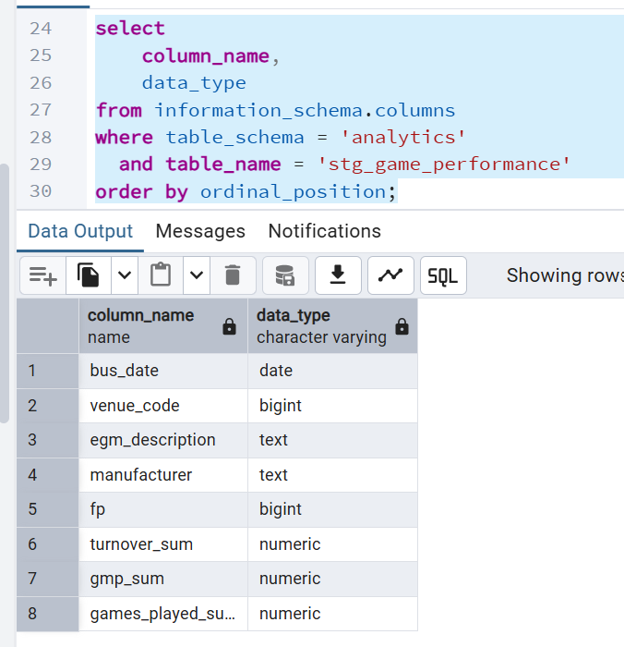
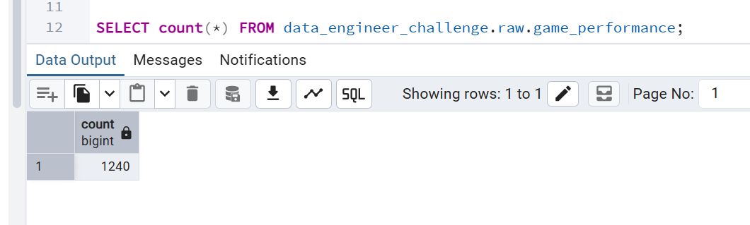
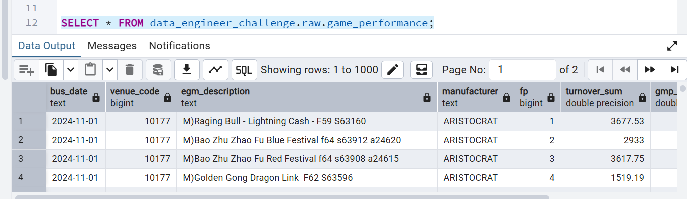
Evidence: Raw and Staging
Key database evidence without mixing screenshots into the implementation slides
13

Slide 14
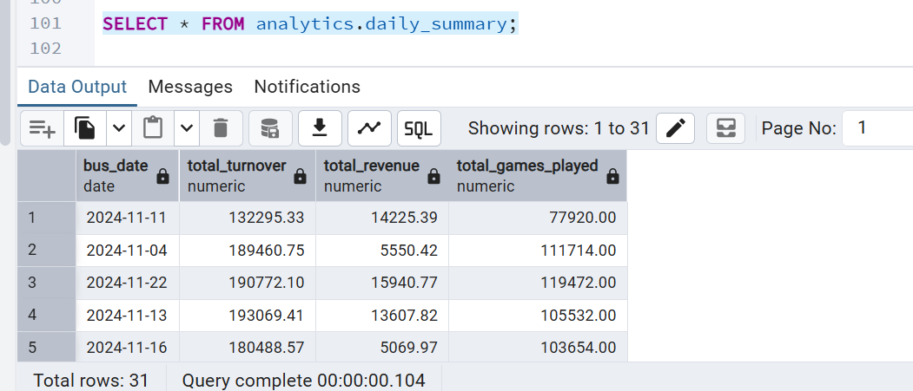
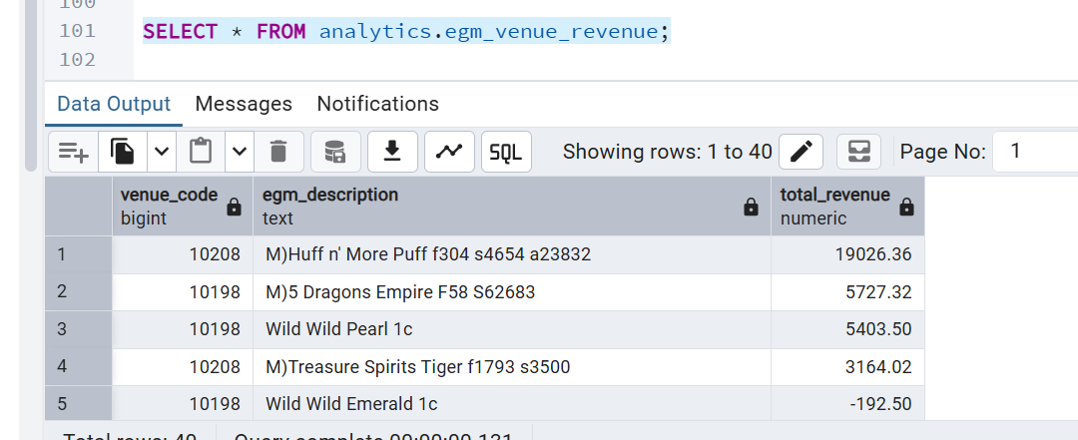
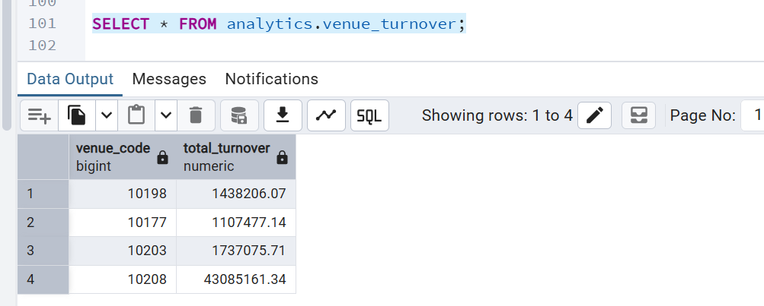
Evidence: Reporting Views
daily_summary ,egm_venue_revenue and venue_turnover are created as views in the analytics schema
Materialization
The reporting layer is VIEW-based; the staging layer remains incremental.
14

Slide 15
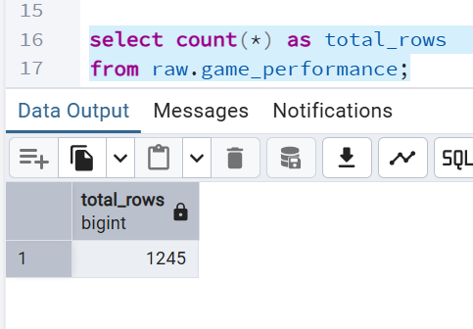
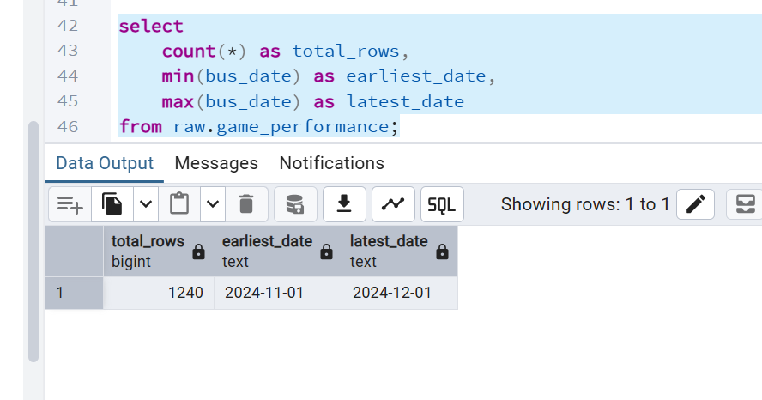
Evidence: Incremental Load
A small append demonstrates the incremental staging behaviour
Observed change
The raw dataset moves from 1,240 to 1,245 rows and includes the newer business dates.
15

Slide 16
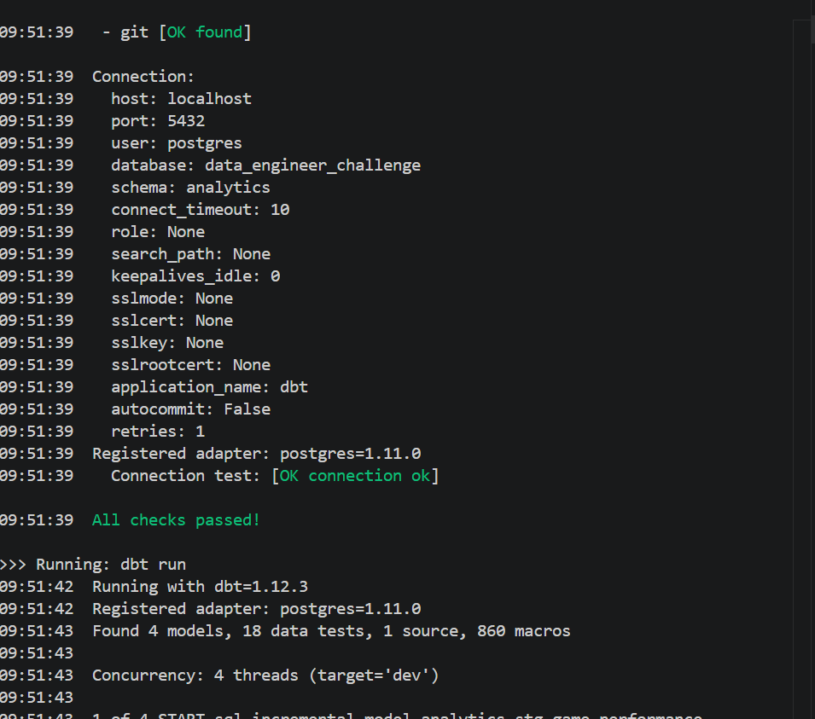
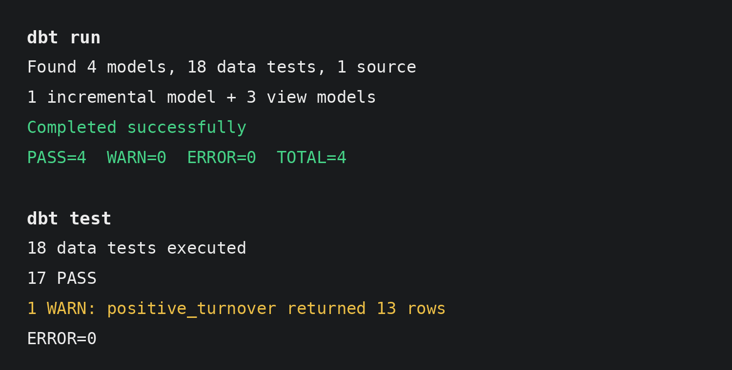
Evidence: Tests and Pipeline Run
The orchestrator completes the dbt run and surfaces the configured data-quality warning
Result
dbt run succeeds; 17 tests pass and positive_turnover returns 13 rows as a warning.
16

Slide 17
Final Outcome
A complete local pipeline with working outputs and validation
INGEST
TRANSFORM
MODEL
RUN
TEST
CSV ingestion into PostgreSQL raw storage
Incremental dbt staging model with explicit typing
Daily, venue and EGM/venue reporting views
18 automated data-quality tests
run_pipeline.py orchestrates the full workflow
17

