Slide 1
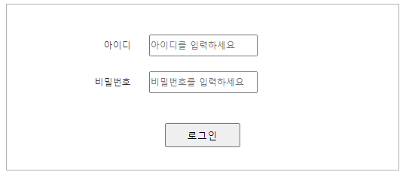
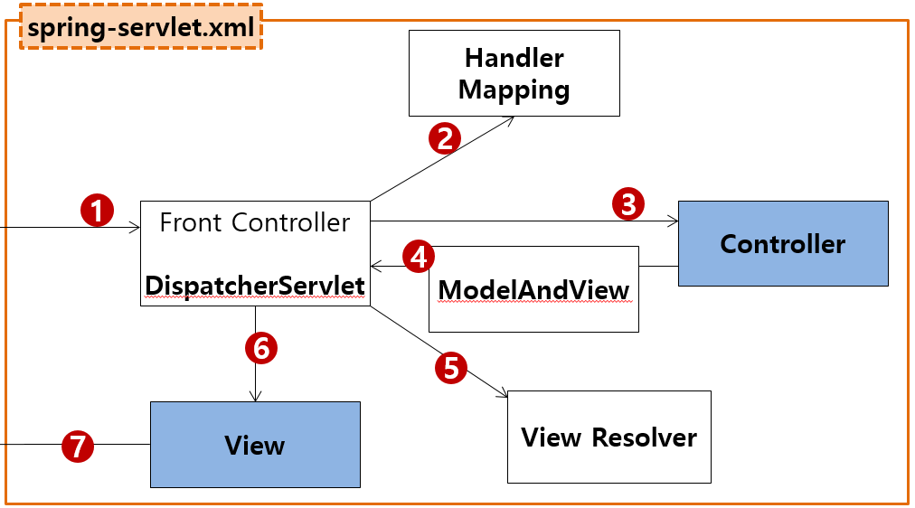
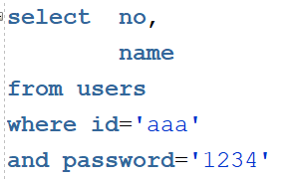

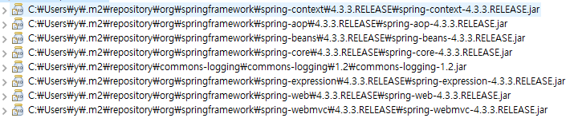
mysite4>user>login
Controller
Service
Dao=Repository
sqlSession.insert(“person.insert", vo);
sqlSession.update("person.update", vo);
sqlSession.delete("person.delete", no);
sqlSession.selectOne("person.getbyno", no);
sqlSession.selectList("person.getlist");
Rqeust(요청)
웹서버
Request header
(파라미터)
id=aaa
password=1234
Request body
web.xml
http://localhost:8088/mysite4/user/login
Tomcat
applicationContext.xml
?id=aaa&password=1234
phonebook3
/user/login get post → UserController.login()
request
*파라미터
id=aaa
password=1234
*어트리뷰트
com.javaex.controller
@Controller
@Service
@Repository
MyBatis
:0x333
userVo
UserController 객체
:0x333
userVo
UserService 객체
:0x333
userVo
UserDao 객체
:0x333
userVo
@Controller
/test
test()
login(UserVo)
getUsert(UserVo)
SqlSession (sqlSessionTemplate)
Response(응답)
login(uservo)
:0x99
authUser
:0x99
authUser
:0x99
authUser
리다이렉트
Response header
Response body (html)
response
view
SqlSessionFactioryBean
Oracle
http://localhost:8088/mysite4/main
loginForm.jsp
DataSource
configuration.xml
Pool
Connection
:0x99
출력
mapper.xml
Connection
mapper.xml
Connection
성공이면
메인
실패면
로그인폼
…
Connection
maven
pom.xml
*session에 authUser를 저장한다
JDBC Driver
0x333
UserVo
0x999
UserVo
private String id=aaa
private String password=1234
private String name=
private String gender=
-------
g/s
toString()
private int no= 1
private String id=
private String password=
private String name= "황일영"
private String gender=
-------
g/s
toString()
D.S
SqlSession
JSP
Controller
Service
Repository
(sqlSesson)
mysite4>user>login
?id=aaa&password=1234
:0x333
userVo
:0x333
userVo
:0x333
userVo
사용자
/user/login
/user/login
login(UserVo userVo){
if(성공이면){
authUser 세션저장
리다이렉트 main
}esle {
리다이렉트 loginForm
}
}
login(UserVo userVo)
getUser(UserVo userVo)
selectOne("user.getUser", userVo)
리다이렉트 /main
:0x999
authUser
:0x999
authUser
:0x999
authUser
리다이렉트 /loginForm?result=fail

Slide 2
mysite4>user>loginForm
Controller
Rqeust(요청)
웹서버
Request header
(파라미터)
result=fail
Request body
web.xml
http://localhost:8088/mysite4/user/loginForm
Tomcat
?result=fail
phonebook3
/user/loginForm get post → UserController.loginForm()
com.javaex.controller
@Controller
UserController 객체
request
*파라미터
result=fail
*어트리뷰트
@Controller
/test
test()
Response(응답)
loginForm()
Response header
Response body (html)
view
response
loginForm.jsp
http://localhost:8088/mysite4/assets/css/mysite.css
maven
pom.xml
?id=aaa&password=1234&name=황일영&gender=male
JSP
Controller
Service
Repository
(sqlSesson)
mysite4>user>loginForm
사용자
/user/loginForm
/user/loginForm
loginForm()
loginForm.jsp

Slide 3
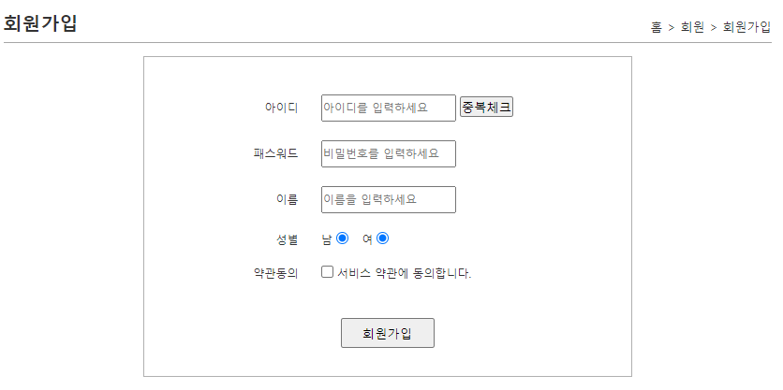
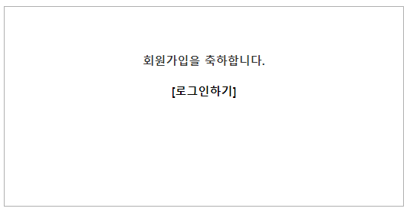
mysite4>user>join
Controller
Service
Dao=Repository
sqlSession.insert(“person.insert", vo);
sqlSession.update("person.update", vo);
sqlSession.delete("person.delete", no);
sqlSession.selectOne("person.getbyno", no);
sqlSession.selectList("person.getlist");
Rqeust(요청)
웹서버
Request header
(파라미터)
id=aaa
password=1234
name=황일영
gender=male
Request body
web.xml
http://localhost:8088/mysite4/user/join
Tomcat
applicationContext.xml
?id=aaa&password=1234&name=황일영&gender=male
phonebook3
/user/join get post → UserController.join()
request
*파라미터
id=aaa
password=1234
name=황일영
gender=male
*어트리뷰트
com.javaex.controller
@Controller
@Service
@Repository
:0x333
userVo
MyBatis
0x333
userVo
UserController 객체
:0x333
userVo
UserService 객체
:0x333
userVo
UserDao 객체
@Controller
/test
test()
join()
userInsert()
SqlSession (sqlSessionTemplate)
Response(응답)
join ()
count=1
count=1
count=1
Response header
Response body (html)
response
view
SqlSessionFactioryBean
Oracle
joinOk.jsp
DataSource
UserVo userVo = new UserVo();
userVo.setId("aaa");
userVo.setPw("1234"); userVo.setPassword("1234")
userVo.setName("황일영");
userVo.setGender("male");
출력테스트
configuration.xml
Pool
http://localhost:8088/mysite4/assets/css/mysite.css
Connection
mapper.xml
Connection
mapper.xml
Connection
…
Connection
maven
pom.xml
JDBC Driver
0x333
UserVo
private String id=aaa
private String password=1234
private String name=황일영
private String gender=male
-------
g/s
toString()
0x888
:0x333
userVo
0x999
count=1
D.S
count=1
JSP
Controller
Service
Repository
(sqlSesson)
mysite4>user>join
?id=aaa&password=1234&name=황일영&gender=male
/user/join
join(UserVo)
:0x333
userVo
:0x333
userVo
:0x333
userVo
사용자
/user/join
join(UserVo)
userInert(UserVo)
insert("user.insert" userVo)
joinOk.jsp
count=1
count=1
count=1

Slide 4
mysite4>user>joinForm
Controller
Rqeust(요청)
웹서버
Request header
(파라미터)
Request body
web.xml
http://localhost:8088/mysite4/user/joinForm
Tomcat
phonebook3
/user/joinForm get post → UserController.joinForm()
request
*파라미터
*어트리뷰트
com.javaex.controller
@controller
UserController 객체
@Controller
/test
test()
Response(응답)
joinForm()
Response header
Response body (html)
response
view
joinForm.jsp
http://localhost:8088/mysite4/assets/css/mysite.css
maven
pom.xml
JSP
Controller
Service
Repository
mysite4>user>joinForm
사용자
/user/joinForm
/user/joinForm
joinForm()
joinForm.jsp
mysite4>user>joinForm

Slide 5
mysite4>main
Controller
Rqeust(요청)
웹서버
Request header
(파라미터)
Request body
web.xml
http://localhost:8088/mysite4/main
Tomcat
phonebook3
/mian get post → MainController.main()
request
*파라미터
*어트리뷰트
com.javaex.controller
@controller
MainController 객체
@Controller
/test
test()
Response(응답)
main()
Response header
Response body (html)
response
view
main
index.jsp
http://localhost:8088/mysite4/assets/css/mysite.css
maven
pom.xml
JSP
Controller
Service
Repository
mysite4>main
사용자
/main
/main
main()
index.jsp

Slide 6
mysite4>guestbook/list
JSP
Controller
Service
Repository
(sqlSesson)
/guestbook
guestBookList
List<GuestBookVo) =
:0x333
userVo
List<GuestBookVo) =
:0x333
userVo
getGuestList
:0x333
userVo
:0x999
authUser
:0x999
authUser
:0x999
authUser
List.jsp
mysite4>guestbook/add
JSP
Controller
Service
Repository(dao)
/guestbook
/guestbook/add
service.add
repository.add
sqlSession.add
사용자
리다이렉트 gust.list
mysite4>guestbook/deleteForm
JSP
Controller
Service
Repository(dao)
/guestbook
사용자
/guestbook/deleteForm
deleteForm.jsp
mysite4>guestbook/delete
JSP
Controller
Service
Repository(dao)
/guestbook
/guestbook/delete
service.delete(no)
sqlSession.delte
사용자
Repository.delete
리다이렉트 list

Slide 7
mysite4>board/list
JSP
Controller
Service
Repository
(sqlSesson)
boardList
List<BoardVo>) =
Model.attribute
/board
List<BoardVo>) =
getBoardList
보드에 name필요하여
Sql문은 조인으로 따로 만들어야함
List.jsp
mysite4>board/ writeForm
JSP
Controller
/board
/board/writeForm
사용자
writeForm.jsp
(sqlSesson)
mysite4>board/wrtie
JSP
Controller
Service
Repository(dao)
/board
Sqlsession.write
사용자
/board/write
Dao.write
Insert문
리다이렉트 list
mysite4>board/delete
/board
JSP
Controller
Service
Repository(dao)
(sqlSesson)
로그인이랑 authUser no와
보드의 UserNo가 같아야 보임
/board/delete
service.delete(no)
사용자
Repository.delete
sqlSession.delete
delete문
리다이렉트 list

Slide 8
mysite4>board/modifyForm
JSP
Controller
/board
board/modifyForm
수정폼도 UserNo가 같을때 보임
modifyForm.jsp
mysite4>board/modify
JSP
Controller
Service
Repository(dao)
(sqlSesson)
/board
/board/modify
service.modifty
repository.mpdify
sqlSession.modift
사용자
Update문
리다이렉트 board/list
mysite4>board/read
JSP
Controller
Service
Repository(dao)
(sqlSesson)
/board
/board/read
Service.getBoard
Service.hitUpdate
Model.attribute
Repository.getBoard
Repository.hitUpdate
sqlSession.getBoard
sqlSession.hitUpdate
사용자
Select one 로 값을 다가져오고
Hit 업데이트 문으로
조회수도 오를수있게 해줌
Read.jsp

