Slide 1


Team_2:
GSU_CSC_GRADUATE_CHATBOT
Group Members:
1.Cai, Qi
2. Hameed, Jawad
3. Innocent, Mirenge
4.Muhumure, Espoir
Ask Blue

Slide 2

Problem Statement
Too much time is spent searching through the graduate handbook.
Need for a way to get quick answers to student questions.
Need for a well-designed modern solution to address the problems.
The solution should be easy to interact with and integrate with the whole GSU web ecosystems.

Slide 3

Our Goal:
We aims to develop an intelligent chatbot system capable of handling complex queries, navigating multi-level submenus, and accurately detecting user intent in order to answer any question they might have related to the student graduate handbook.
The system should process predefined user questions, provide dynamic responses (including external links), and handle ambiguous queries by offering multiple keyword options.
The ultimate goal is to enhance the user experience by improving the chatbot ability to manage intent classification, submenu logic, and real-time interactions seamlessly.

Slide 4
Challenges
Challenges We've met so far | Solutions
Accurate Intent Detection: The chatbot struggles to accurately identify user intent, which can lead to irrelevant or incorrect responses | Accurate Intent Detection: A keyword-based intent classification system is built using the spaCy library to tokenize and process the user input. The system matches user input against keywords stored in the database, considering both single-word and multi-word phrases.
2. Managing Multi-Level Interactions: When a question involves multiple layers of submenus or options, it becomes difficult to maintain conversation context, leading to confusion and disrupted interactions. | 2. Managing Multi-Level Interactions: Some intents require additional information or follow-up questions, handled by presenting submenu options. If an intent has submenu options, the system displays them after the main response, allowing the user to select one of the submenu options.
3. Student’s nuanced Questions: When a student asks a valid question but isn’t in our question database | 3. Student nuanced Questions: We intend to continually add more questions to the database.

Slide 5
Approach
1.Database design:
A structured SQLite database is created to store information about intents, keywords, responses, and submenu responses.
2. Input Handling:
The system processes user input dynamically. If the input matches a submenu option, the corresponding submenu response is retrieved and displayed.
If the input does not match a submenu option, the system attempts to classify the input into an intent using keywords.
3. User Interaction and Frontend Integration:
The frontend is built using HTML, CSS, and JavaScript, allowing users to interact with the chatbot.
Users can type messages, and the system dynamically displays both the user's messages and the chatbot's responses in a chat window.
4. . Fallback and Error Handling:
If the system cannot classify the user input or find an appropriate response, it returns a generic fallback message, such as "Sorry, I didn't understand that."This ensures the chatbot handles edge cases gracefully, avoiding dead ends in conversations.
5. Modularity and Scalability:
The system is designed to be modular, with clear separation of logic for intent classification, submenu handling, and response retrieval. This makes it easy to extend and maintain.

Slide 6
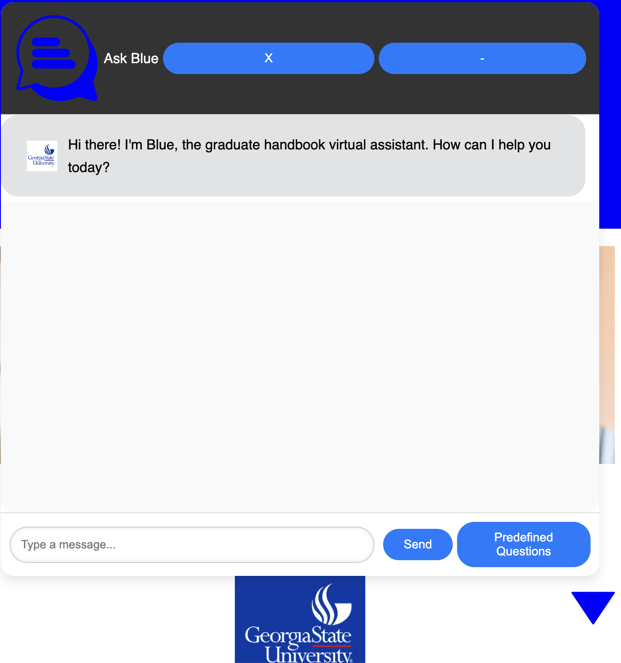
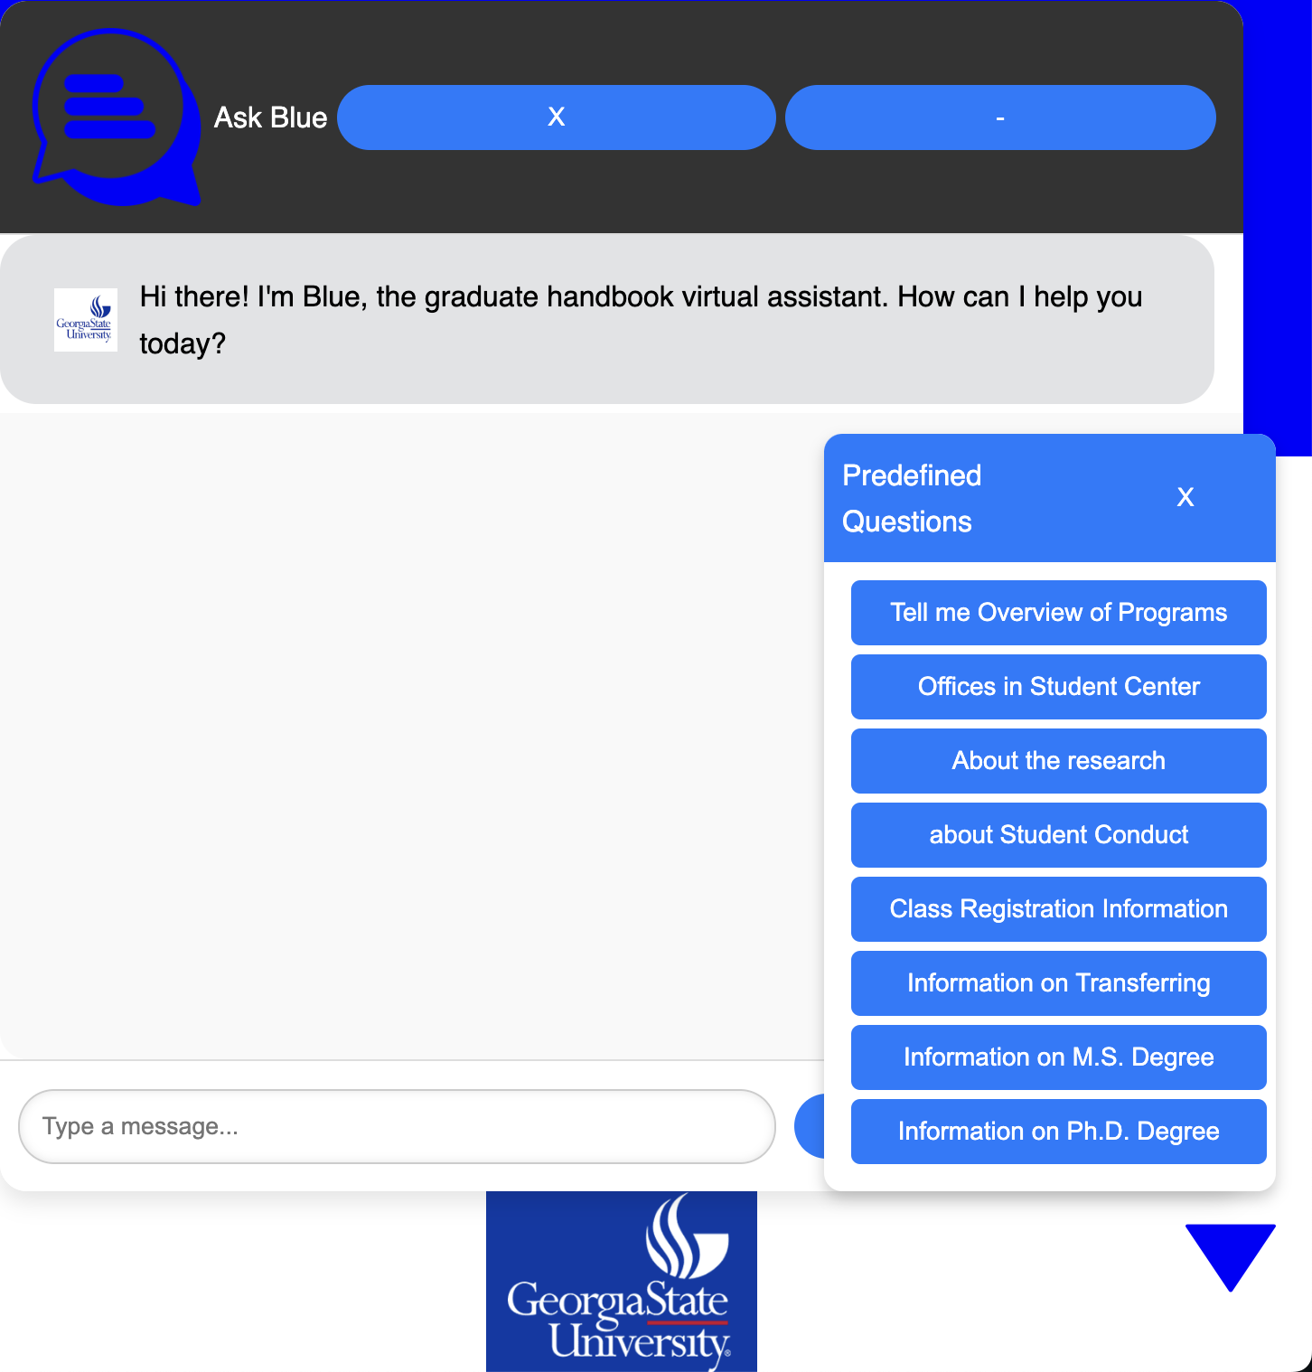
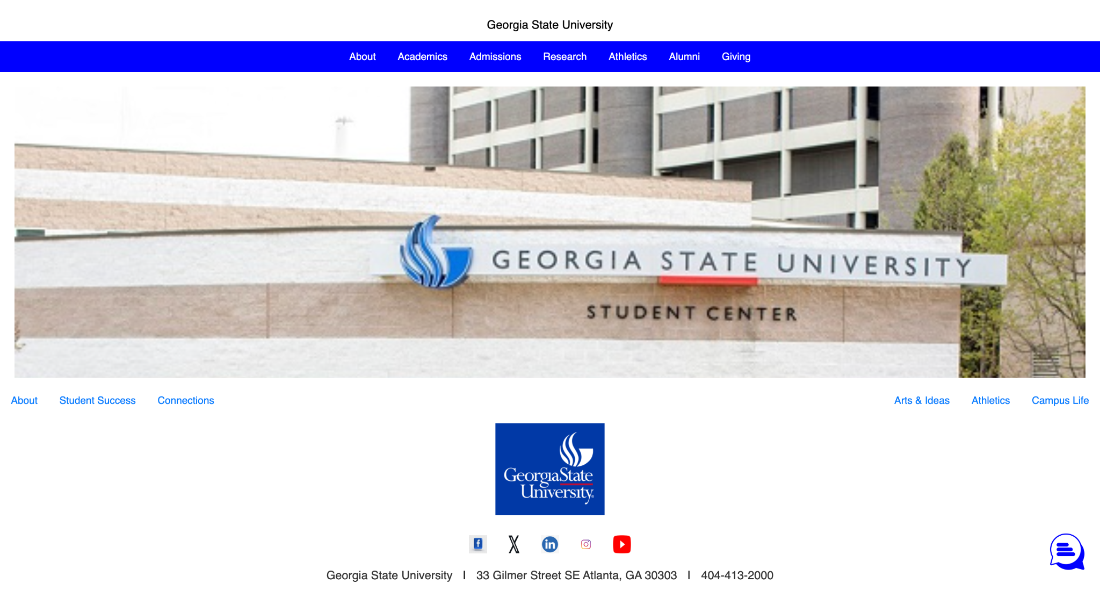
Ask Blue
Page the chatbot is embed on
Chatbot Interface.
Chatbot interface of quick questions.

Slide 7
Weekly targets and timeline
Week | Task
Week 1 | Collect and organize data, define FAQs
Week 2 | Design chatbots rule-based system
Week 3 | Implement NLP-based responses
Week 4 | Frontend and backend integration
Week 5 | Testing and debugging
Week 6 | Deploy prototype, prepare for demo

Slide 8
ROLE | SHORT DESCRIPTION/ TASK | PEOPLE ASSIGNED | HARDWARE OR SOFTWARE | PROGRESS
Database design | Design the database schema for entire system | Mirenge Innocent | Software | Completed
Index page | By using Hypertext Markup Language (HTML) create index page where the chatbot will be placed. | Muhumure Espoir | Software | Completed
Chatbot window | By using Hypertext Markup Language (HTML) create a chat window to be embedded into index page. | Qi Cai | Software | Completed
Layout and appearance of web pages | By using Cascading Style Sheets (CSS), design the layout and appearance of entire system | Jawad Hameed | Software | Completed
Chatbot interaction | By using JavaScript (JS) client-side to control interaction flow, data flow and dynamic message handling | Mirenge Innocent and Qi Cai | Software | Inprogress
Organize graduate handbook | Study the graduate handbook and come up with possible FAQS (Frequently Asked Questions) and their answers. | Muhumure Espoir and Jawad Hameed | Software | Inprogress
Predefined Question Handling | Implement function to treat predefined question as user input. | Mirenge Innocent | Software | Inprogress
Predefined Question Handling | Test predefined question flow for accuracy | Qi Cai | Software | Inprogress
Intent classification | By using python,enhance intent classification based on input keywords and priorities by integrate NLP (Natural Language processing) libraries such as spaCy and use tokenization for better keyword matching. | Mirenge Innocent | Software | Inprogress
Intent classification | test the chatbot accuracy in classifying intent with multiple keyword options. | Qi Cai | Software | Inprogress
Handling links and emails in responses | Implement function to detect and format URLs as clickable links. And add logic to detect and format email addresses as mailto links. | Muhumure Espoir | Software | Pending
Handling links and emails in responses | Test link and email handling in various chatbot responses | Jawad Hameed | Software | Pending
Mark visited options | Implement function to mark visited sub-menu options, to make it easier for users to know which sub-menu they were dealing with. | Jawad Hameed | Software | Pending
Adaptation to various screen size | Implement function to ensure the chatbot and other page element adpt seamlessly to different screen size | Jawad Hameed | Software | Pending
Typing indicator | Implement function to show if bot is typing the response and stop when it provides the responses to the user. | Muhumure Espoir | Software | Pending
Roles
&
Tasks

