Slide 1
RETAIL ANALYSIS · CUSTOMER SHOPPING BEHAVIOR
Customer
shopping
behavior

Slide 2
THE BASE
3,900 purchases reveal a loyal but under-subscribed customer base
3,900
$59.76
purchases
average purchase
25 products · 4 categories · 50 locations
Average review rating: 3.75
27%
subscribers
73% non-subscribers
A broad purchase history, strong loyalty, and a clear subscription gap.

Slide 3
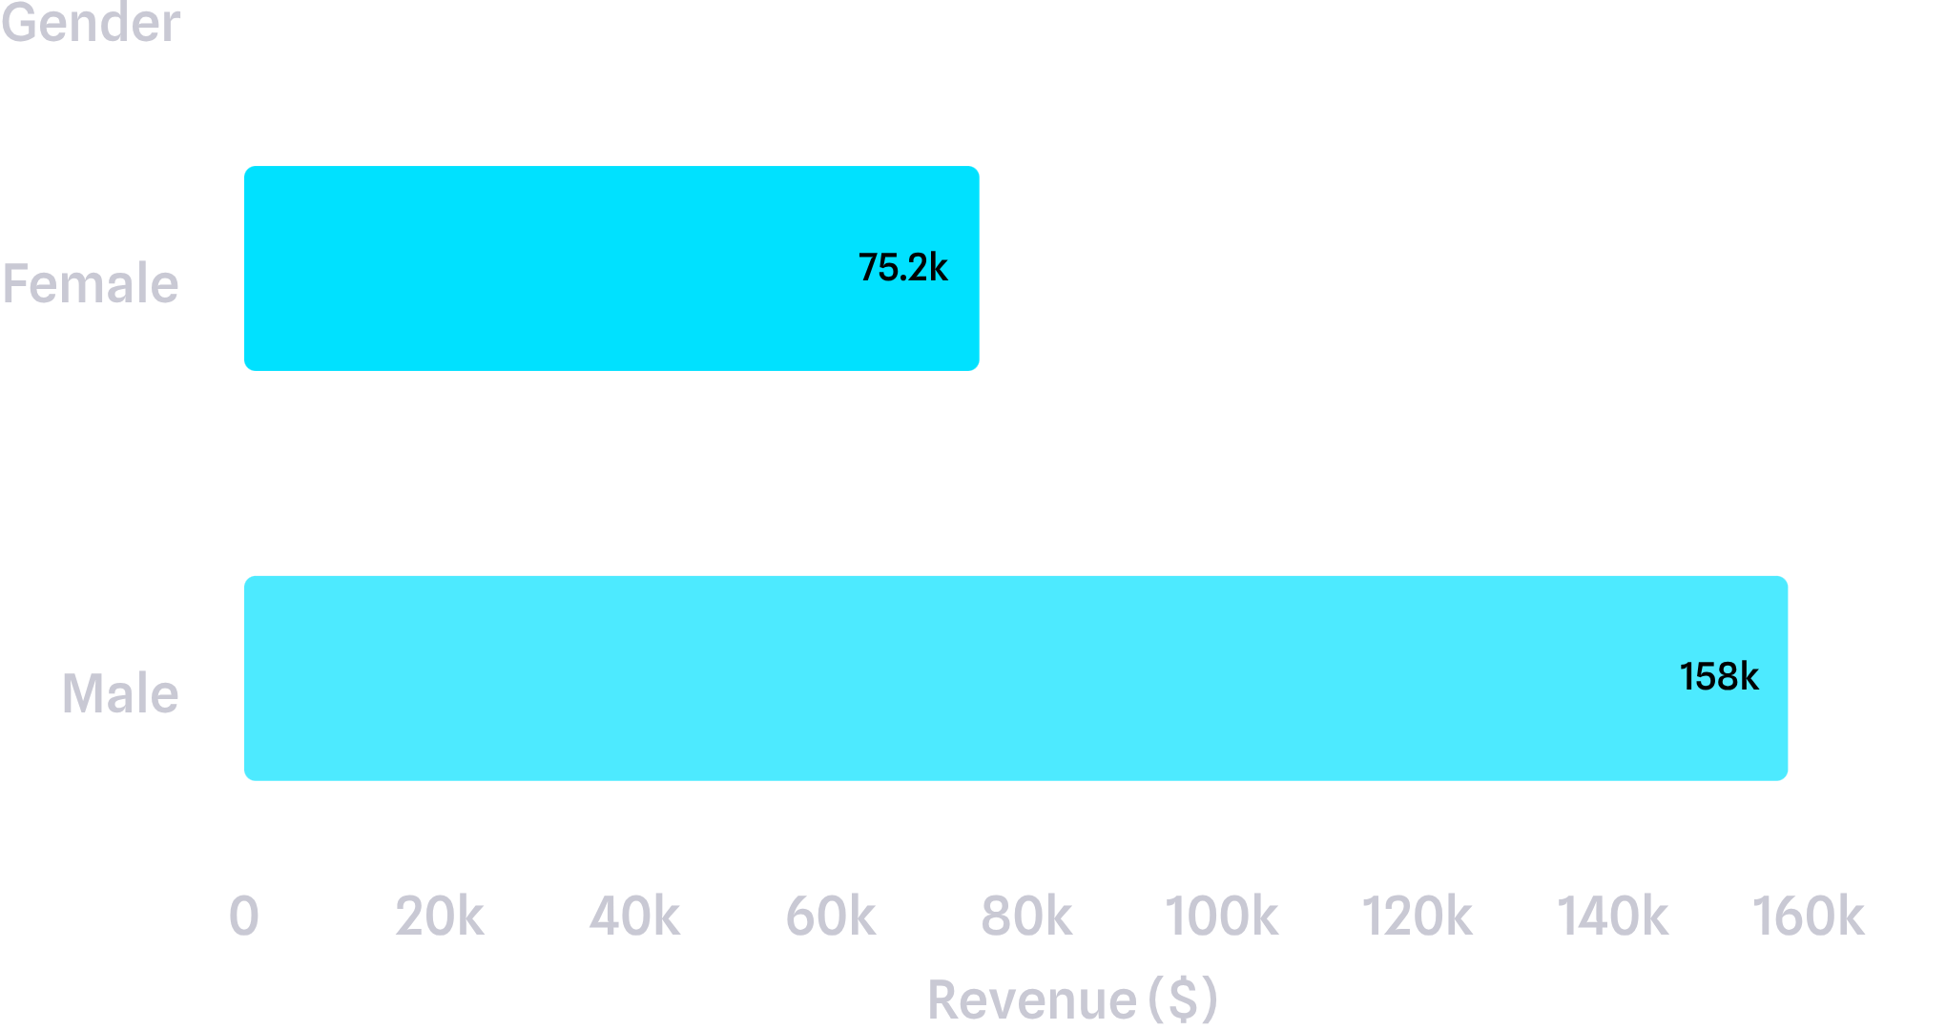
REVENUE MIX
Male customers generated 68% of recorded revenue
Use the split to guide campaign mix, while avoiding demographic assumptions beyond the observed data.
Revenue by gender

Slide 4
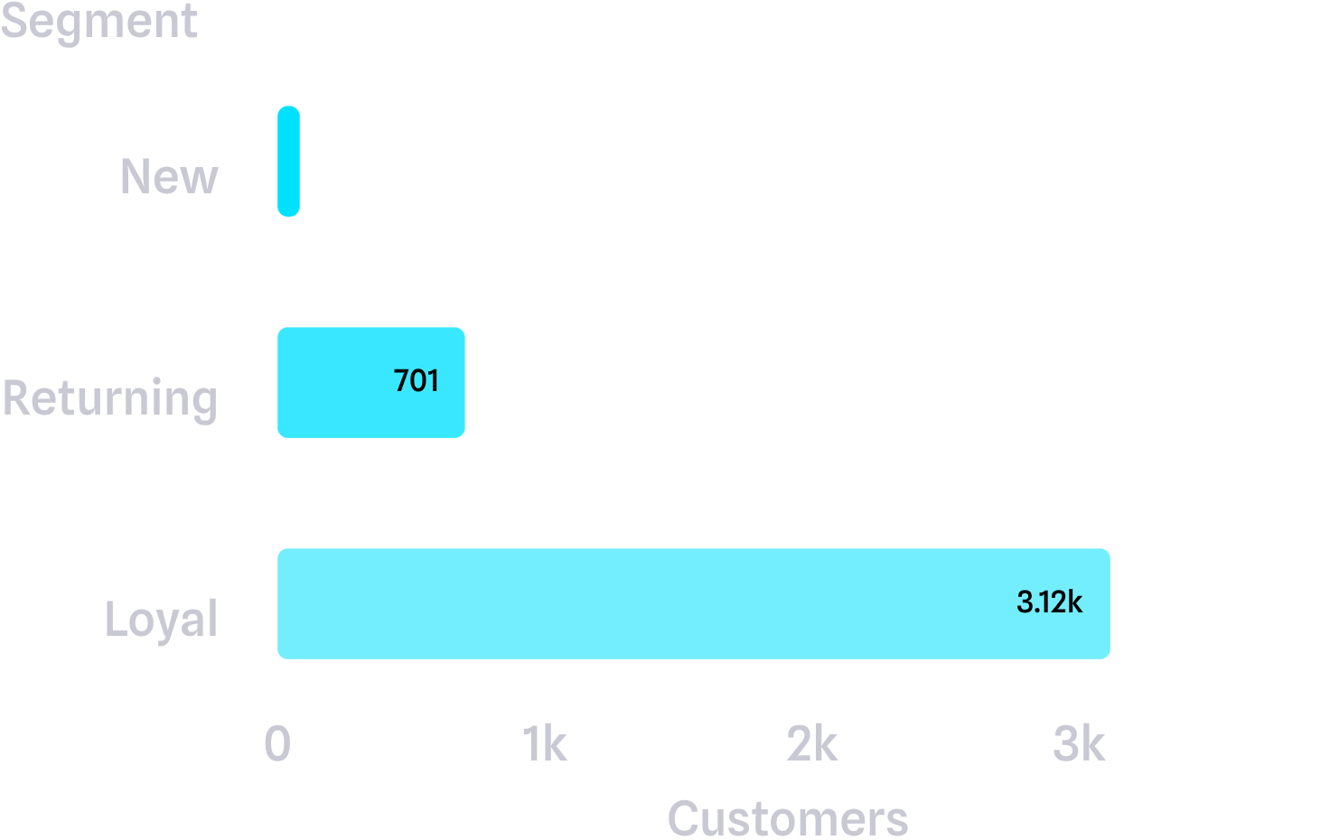
LOYALTY × SUBSCRIPTION
Customer segments
Loyal customers dominate the base, but subscriptions lag
3,116
loyal customers
1,053
subscribers
$62,645 in revenue
2,847
non-subscribers
$170,436 in revenue

Slide 5
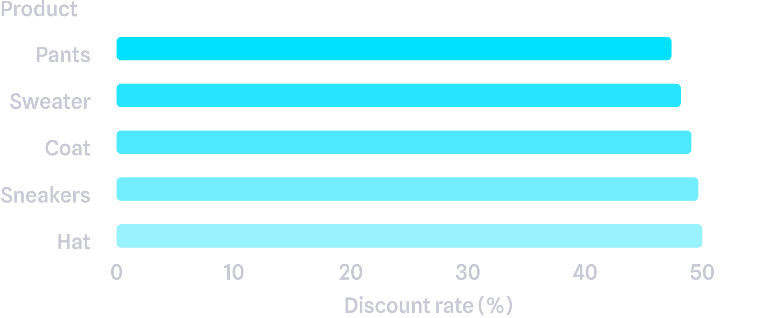
DISCOUNT DEPENDENCE
Discounts attract high spend, but some products rely on them heavily
839 customers spent above the average purchase amount while using discounts.
Highest discount rates: Hat 50.00%, Sneakers 49.66%, Coat 49.07%, Sweater 48.17%, Pants 47.37%.
Protect margin by separating acquisition offers from always-on discounting.
Highest discount rates

Slide 6
PRODUCT SIGNALS
Best sellers and highest-rated products are not the same list
TOP-RATED PRODUCTS
TOP SELLERS BY CATEGORY
Gloves · 3.86
Jewelry · Sunglasses · Belt · Blouse · Pants · Shirt · Sandals · Shoes · Sneakers · Jacket · Coat
Sandals · 3.84
Boots · 3.82
Hat · 3.80
Skirt · 3.78
Use best-rated items for proof and best-selling items for reach.

Slide 7
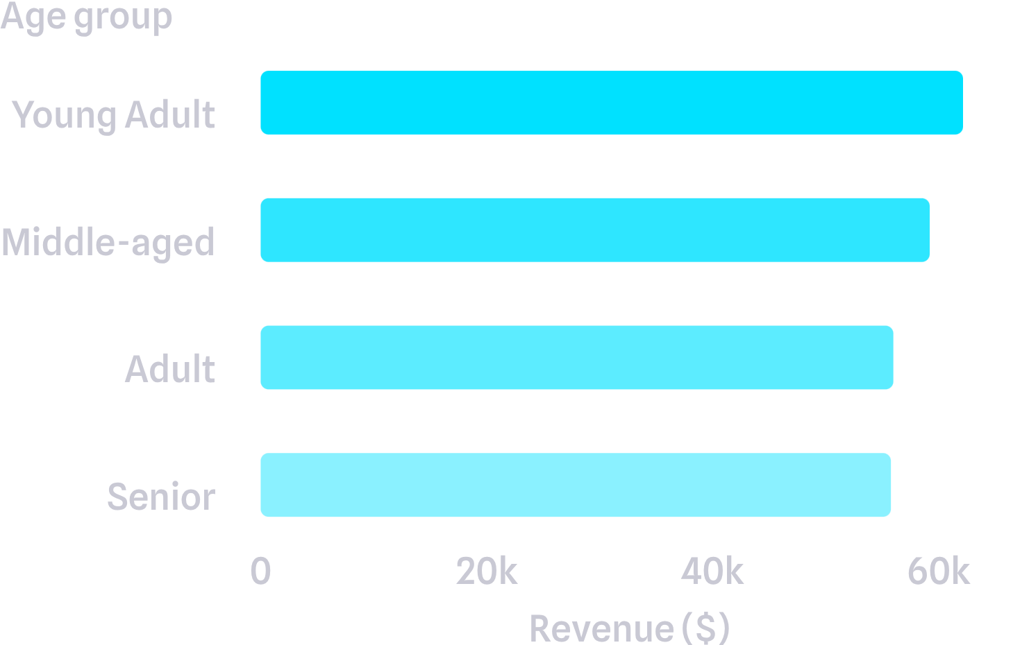
TARGETING LEVERS
Shipping and age point to two practical targeting levers
$60.48
Express shipping average purchase
Standard: $58.46
Revenue by age group
Young Adult $62,143 · Middle-aged $59,197 · Adult $55,978 · Senior $55,763
Prioritize high-revenue age groups and test express-shipping messaging where the lift is meaningful.

Slide 8
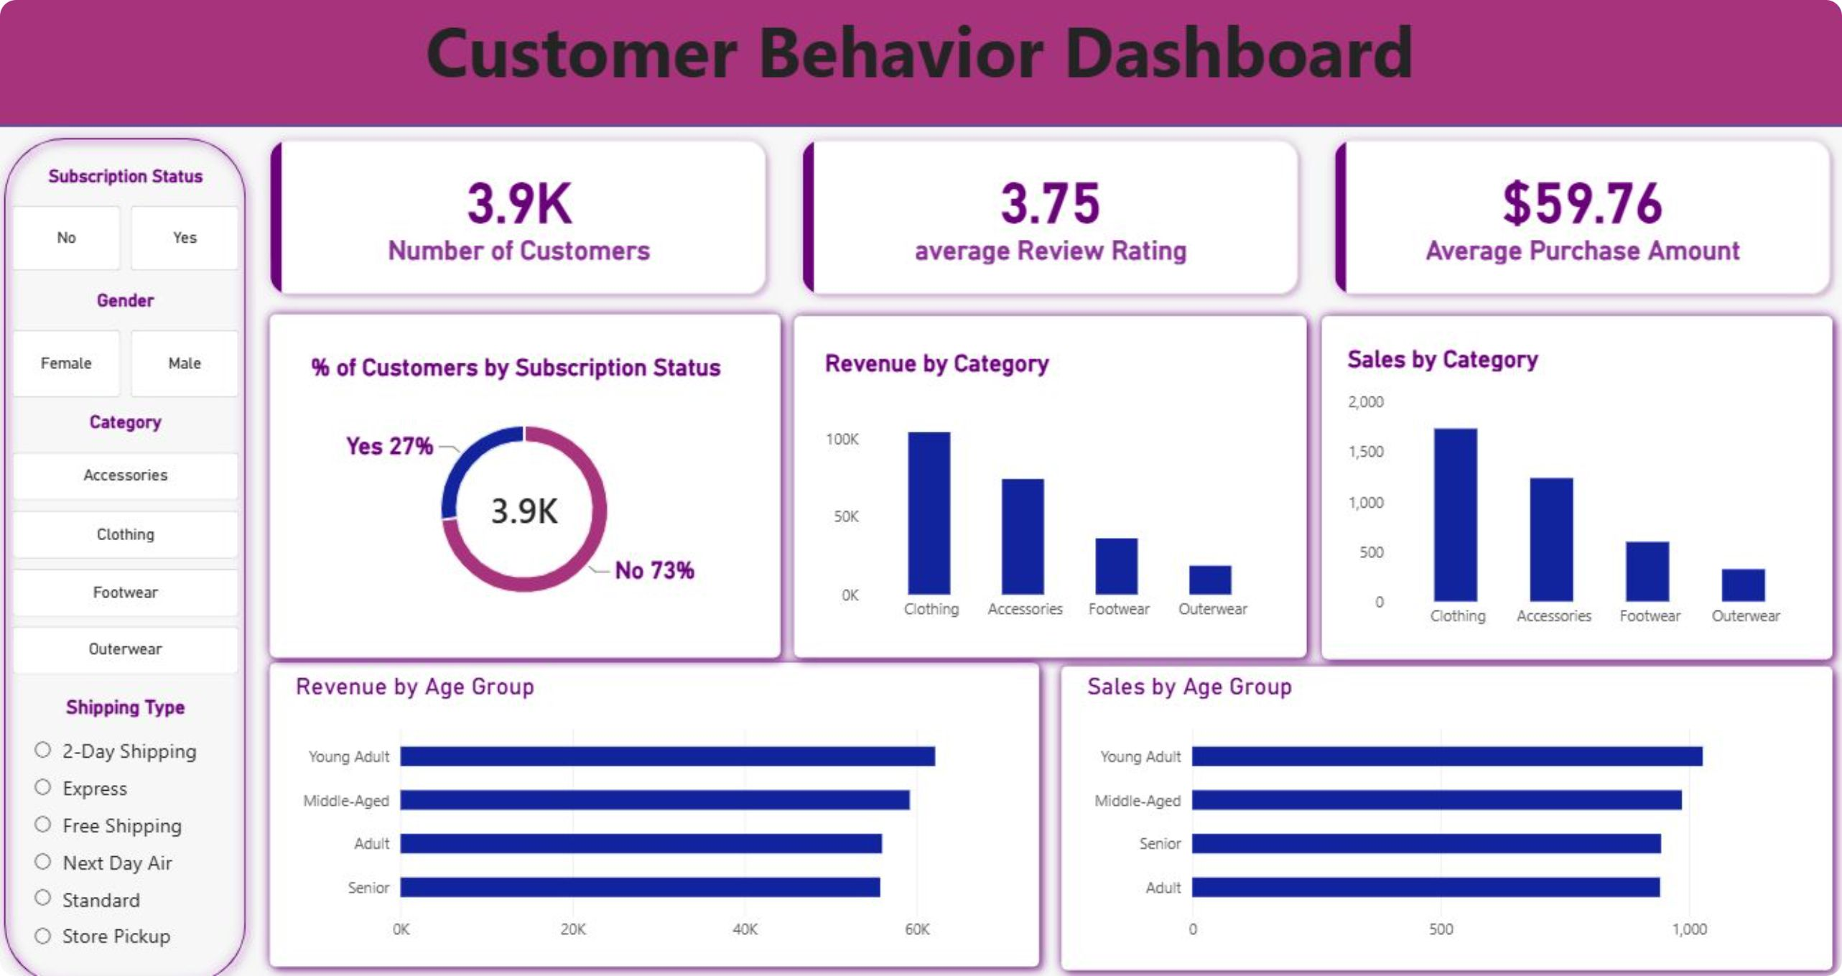
OPERATING VIEW
The dashboard makes the behavior easy to monitor
Track customer count, average purchase, review rating, subscription mix, category performance, and age-group revenue in one view.

Slide 9
FROM ANALYSIS TO ACTION
Five actions can turn the analysis into growth
01
02
Boost subscriptions: Make exclusive benefits visible at checkout and after purchase.
Reward repeat buyers: Move returning customers toward the loyal segment.
03
04
Review discount policy: Protect margin on products with the highest discount dependence.
Position the assortment: Pair best-rated products with best-selling category leaders.
05
Target with evidence: Focus campaigns on high-revenue age groups and test express-shipping messages.

Slide 10
Near-term
Test one subscription benefit and one discount-policy change.
THE NEXT DECISION
The next decision is where to focus first
Measure
Subscription conversion, repeat purchase rate, average order value, and margin by product.
Keep learning
Refresh the dashboard as new transactions arrive.

