Slide 1
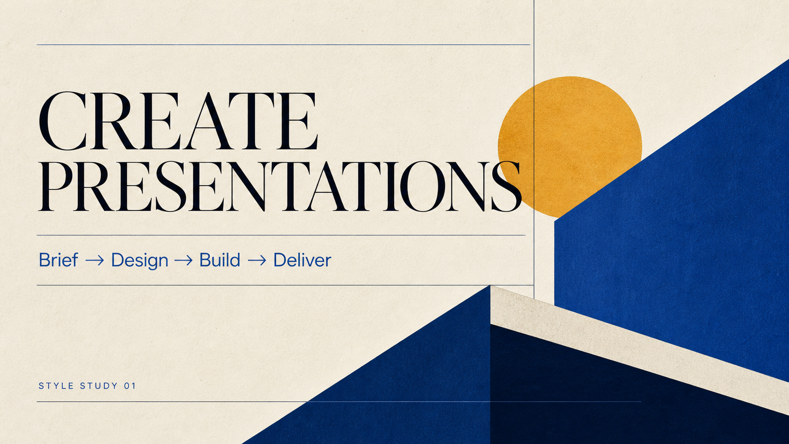

Slide 2
SYSTEM BEFORE DECORATION
A deck is five decisions, not one prompt.
01
Narrative
What changes for the audience
02
Visible copy
What the audience can actually read
03
Visual system
How the story feels and moves
04
Production route
What stays editable or visual
05
Delivery evidence
What was rendered and checked
CREATE PRESENTATIONS
02

Slide 3
FLEXIBLE PAGE NARRATIVES
Plan communication jobs before layouts.
A sequence should accumulate meaning. Page roles can change without losing the deck-level system.
01
Open
02
Frame
03
Explain
04
Compare
05
Prove
06
Resolve
CREATE PRESENTATIONS
03

Slide 4
ROUTE BEFORE RENDERING
Choose the route before you build.
VISUAL
HYBRID
HTML
NATIVE
TEMPLATE
Precise and editable
Maximum full-slide fidelity
Editable key content + visual layers
Inherit existing masters
Portable and interactive
CREATE PRESENTATIONS
04

Slide 5
PROVIDER-NEUTRAL BY DESIGN
Route each model to the work it does best.
The reasoning model, image backend, and file renderer are independent choices.
THINK
SEE
BUILD
→
→
Narrative · research · copy
Full-slide images · illustration
PPTX · HTML · PDF
Codex · Claude · GPT · Gemini
gpt-image · Gemini Image · Flux
Artifact Tool · PptxGenJS · browser
CREATE PRESENTATIONS
05

Slide 6
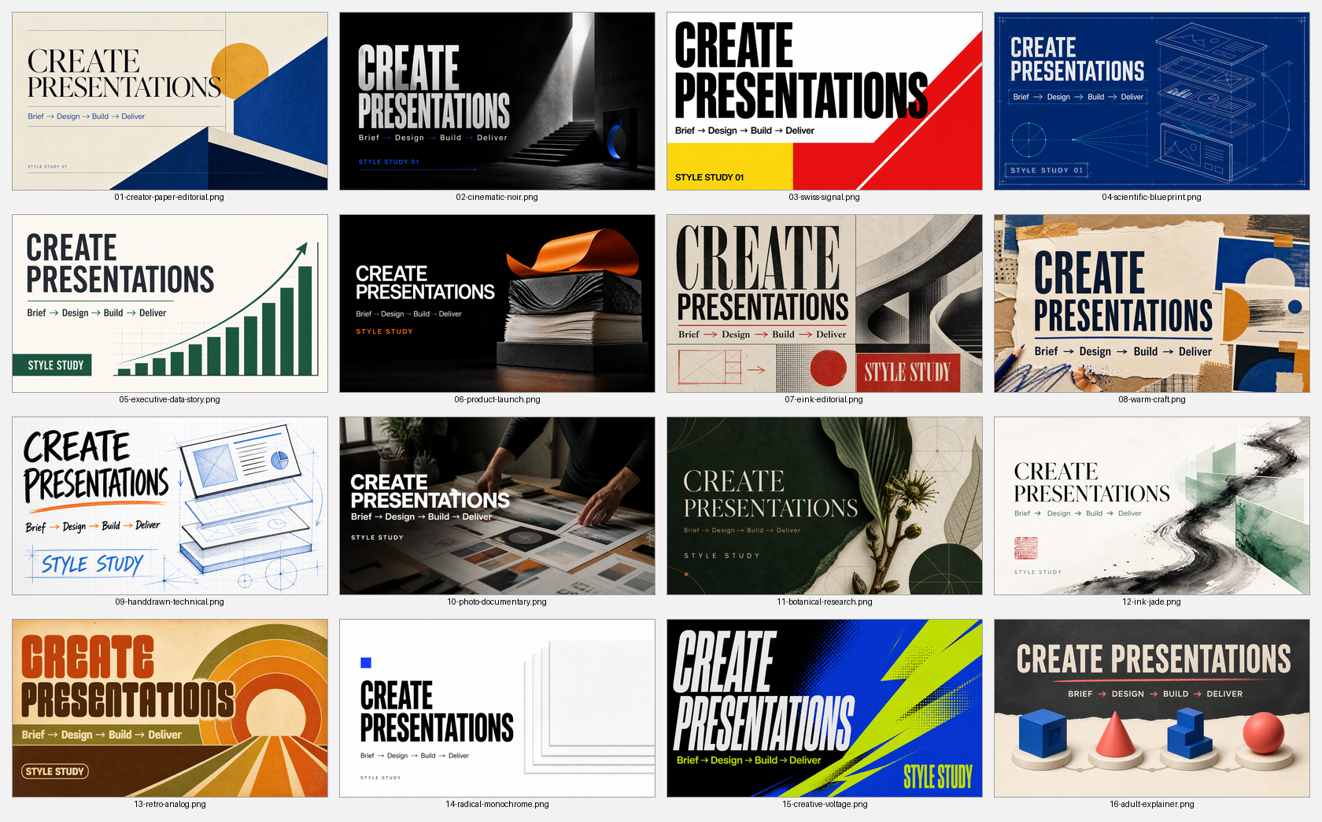
SAME BRIEF, MATERIALLY DIFFERENT DESIGN DNA
One brief can support sixteen visual systems.
CREATE PRESENTATIONS
06

Slide 7
VISIBLE-COPY INTEGRITY
Approved copy and visual instructions are different inputs.
VISIBLE COPY
VISUAL INSTRUCTIONS
Only the words the audience should read.
Composition, density, image treatment, rhythm, and constraints stay outside the slide copy.
Titles · labels · values · citations
Review unexpected dates, numbers, filenames, URLs, and prompt leakage.
CREATE PRESENTATIONS
07

Slide 8
QUALITY IS A PRODUCTION STAGE
Render, inspect, revise.
RENDER
INSPECT
REVISE
Every page
Full size + contact sheet
Fix locally before regenerating
Copy · crops · hierarchy · fonts · overflow · repetition · notes · links · editability
CREATE PRESENTATIONS
08

Slide 9
DELIVERY FOLLOWS AUDIENCE NEEDS
Deliver the format the audience can actually use.
One approved plan can produce more than one route without changing the story.
EDITABLE
Native PPTX
HIGH FIDELITY
Visual PPTX
BALANCED
Hybrid PPTX
PORTABLE
HTML / PDF
AUDITABLE
Manifest + sources
CREATE PRESENTATIONS
09

Slide 10
INSTALL · BRIEF · CHOOSE · BUILD
One skill.
Multiple models.
Presentation-ready evidence.
npx skills add
minoltaMF/create-presentations-skill
CREATE PRESENTATIONS
10

