Slide 1



Slide 2
Employee Demographics
How many employees are in the payroll?
How many are full time and how many are part-time?
What is the gender breakup?
What is the ethnicity-wise employee break-up?
What is the employee churn rate this year?
How many employees are covered by City's Health and/or Life Insurance?

Slide 3
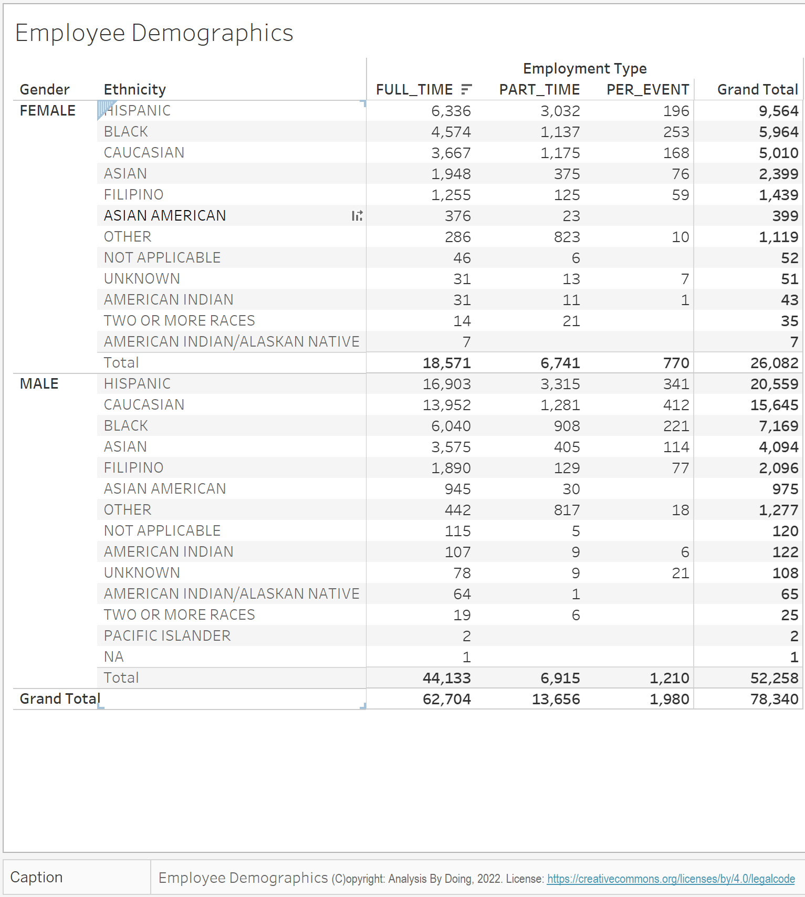

Slide 4
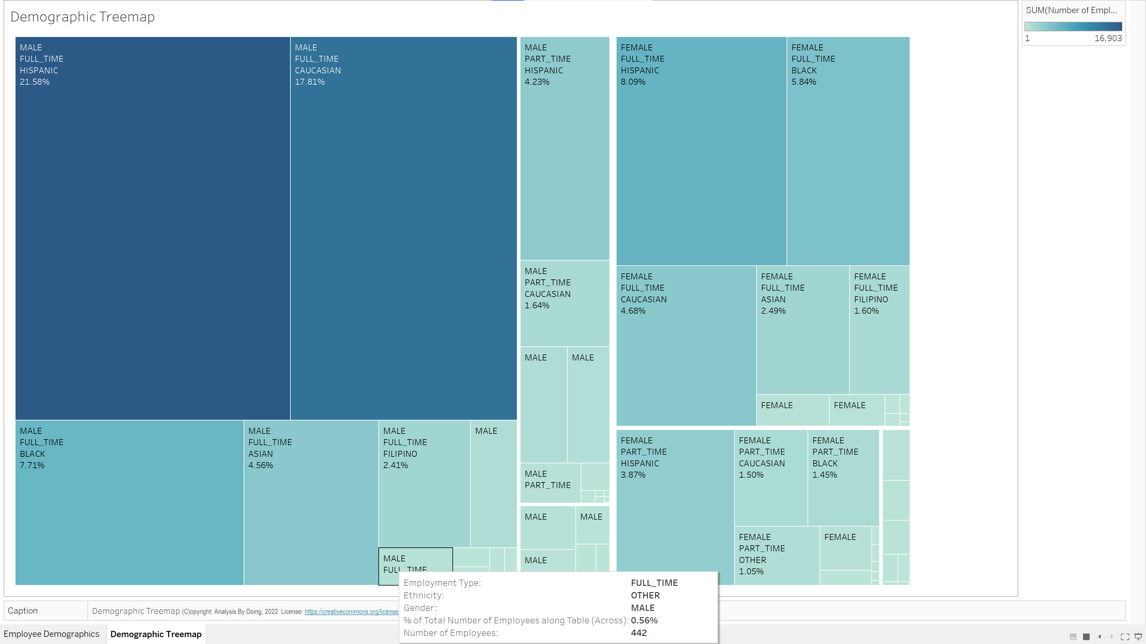

Slide 5
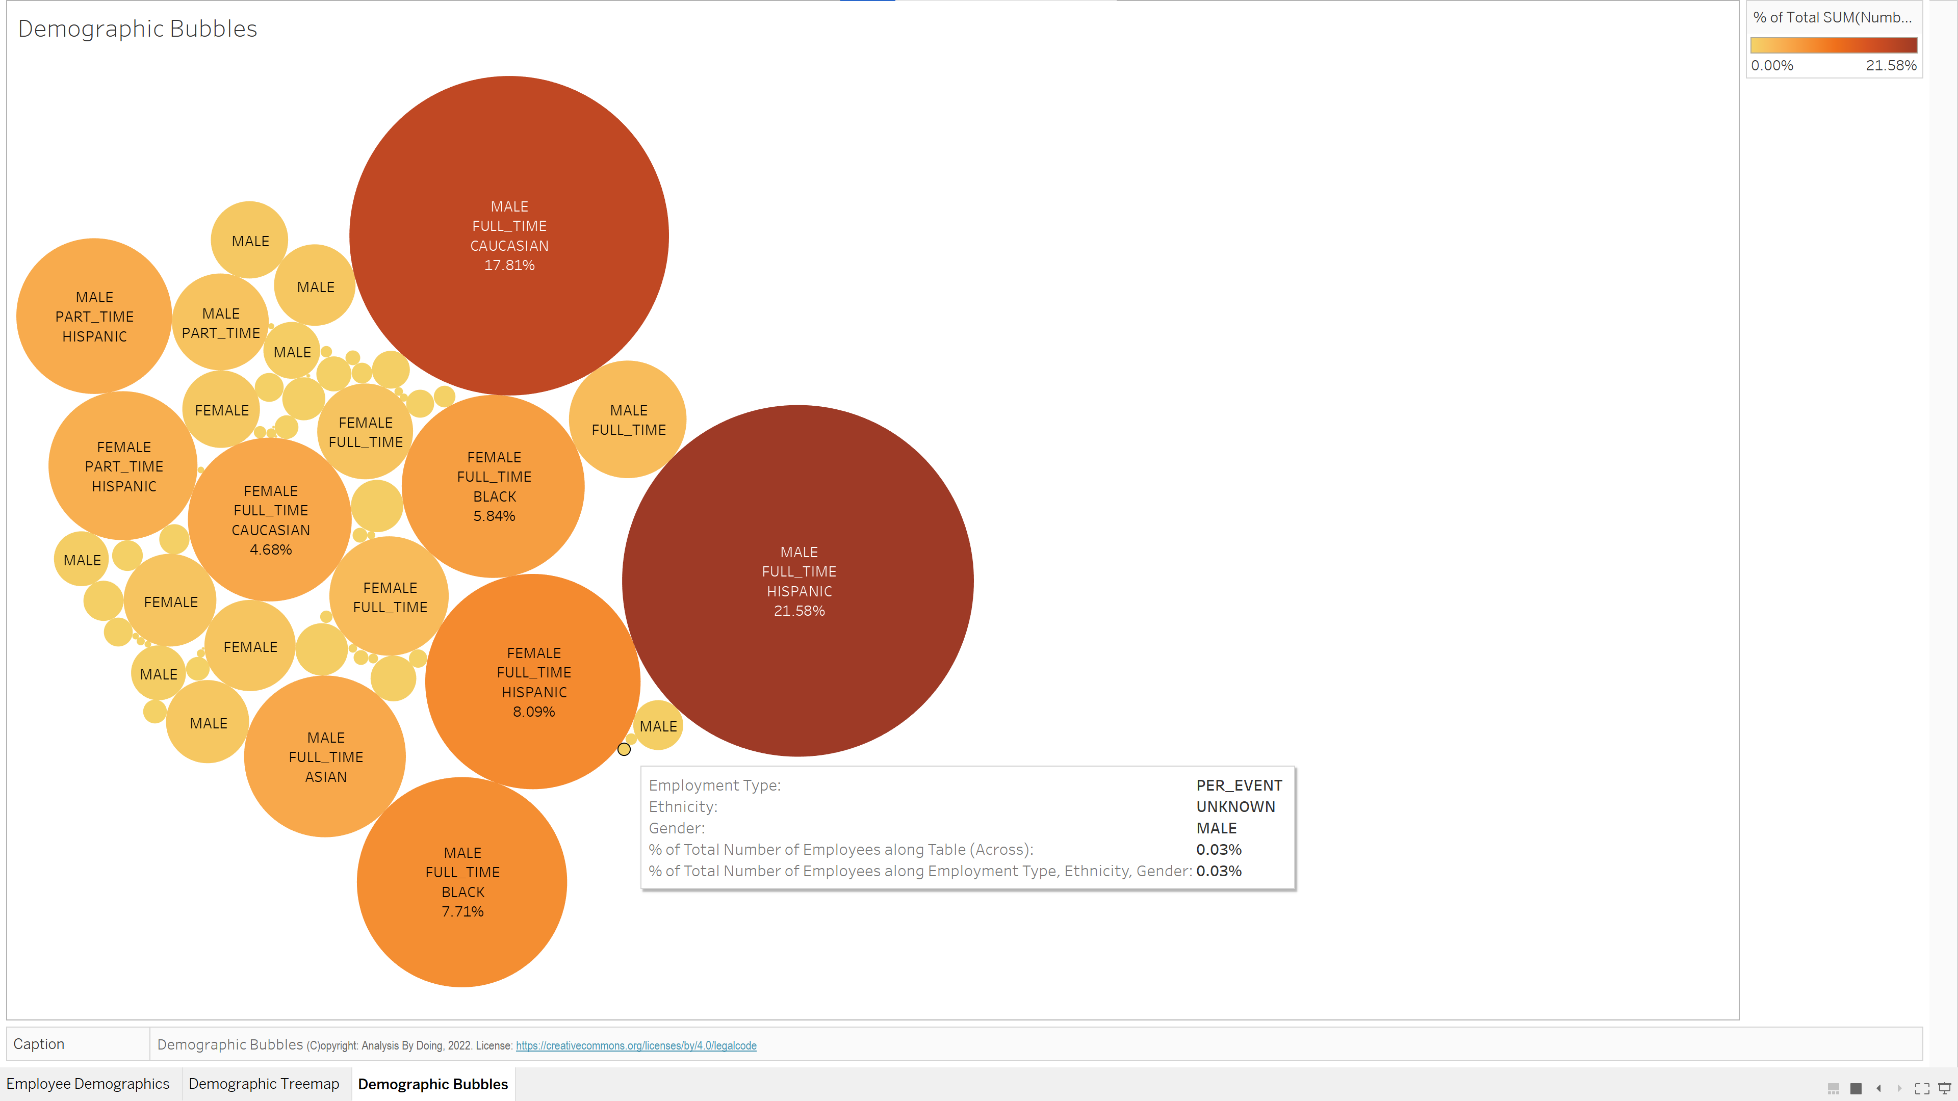

Slide 6
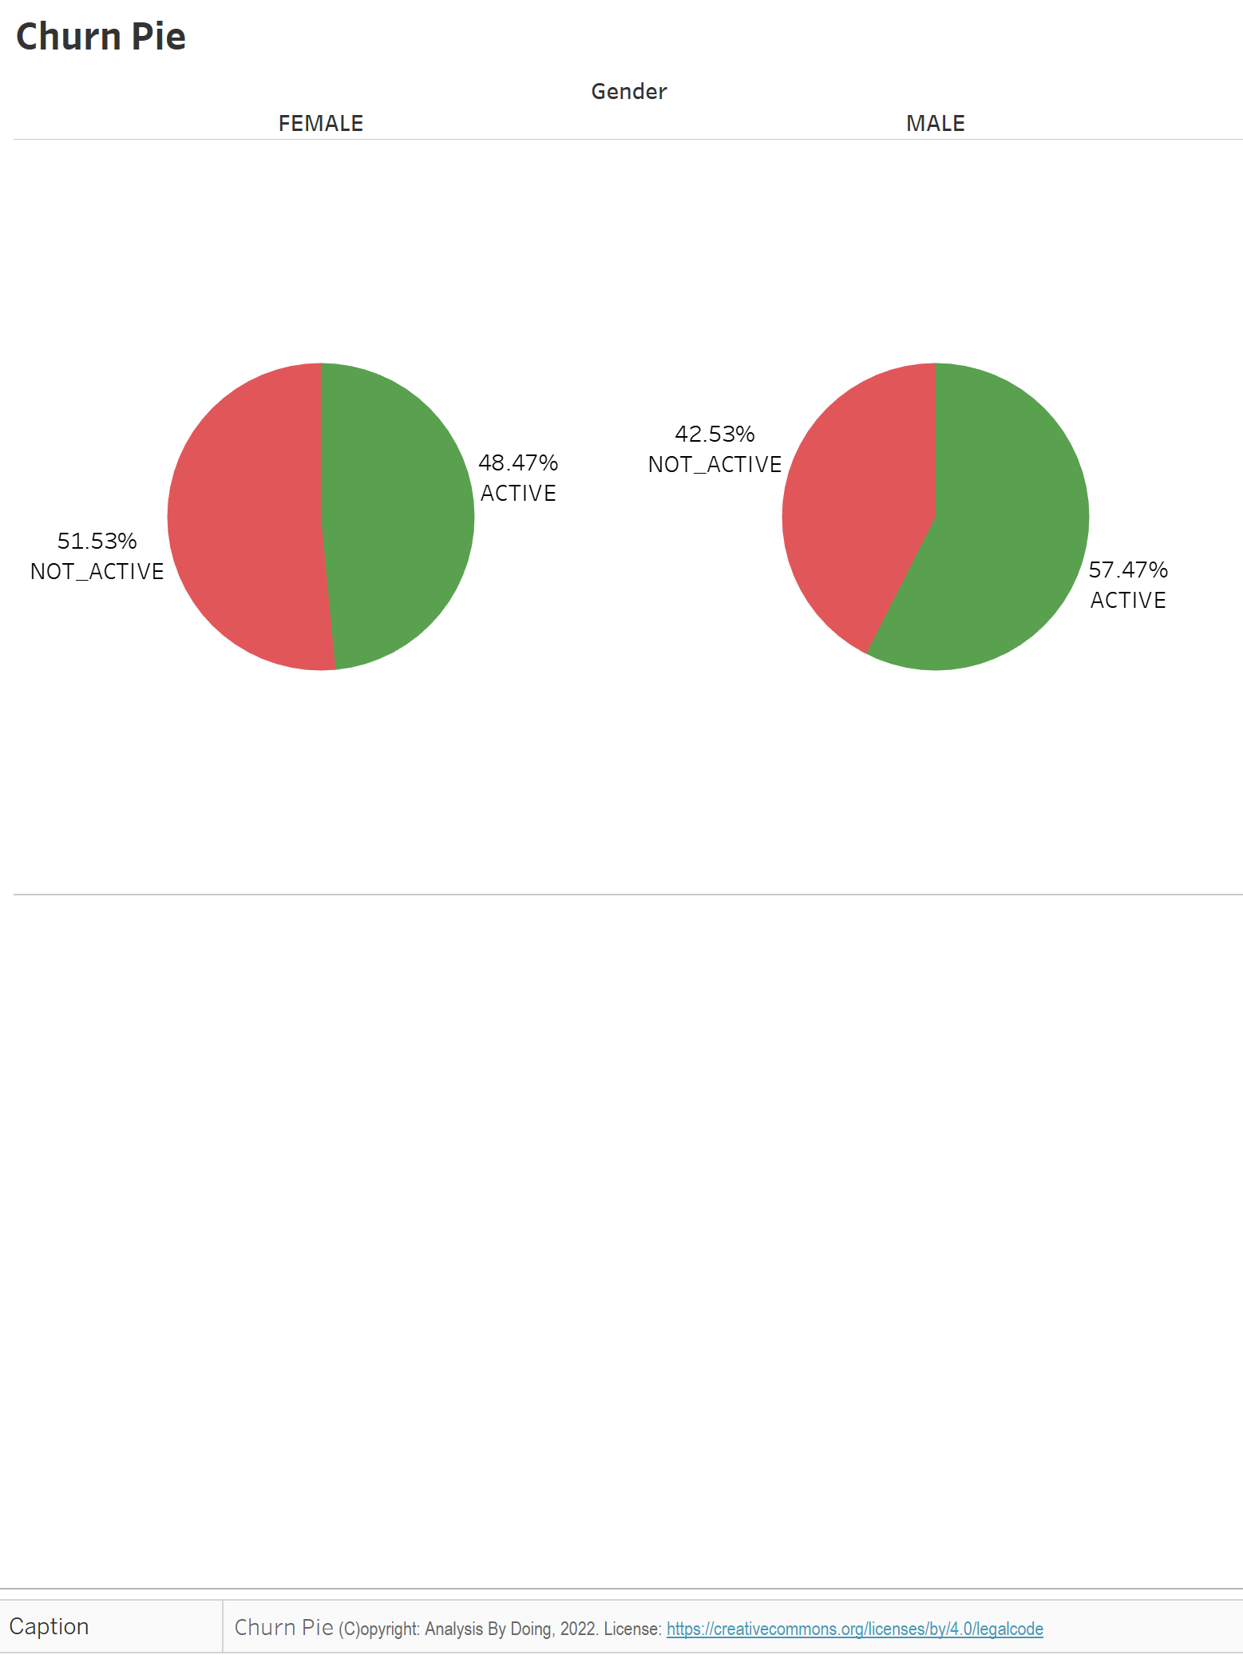

Slide 7
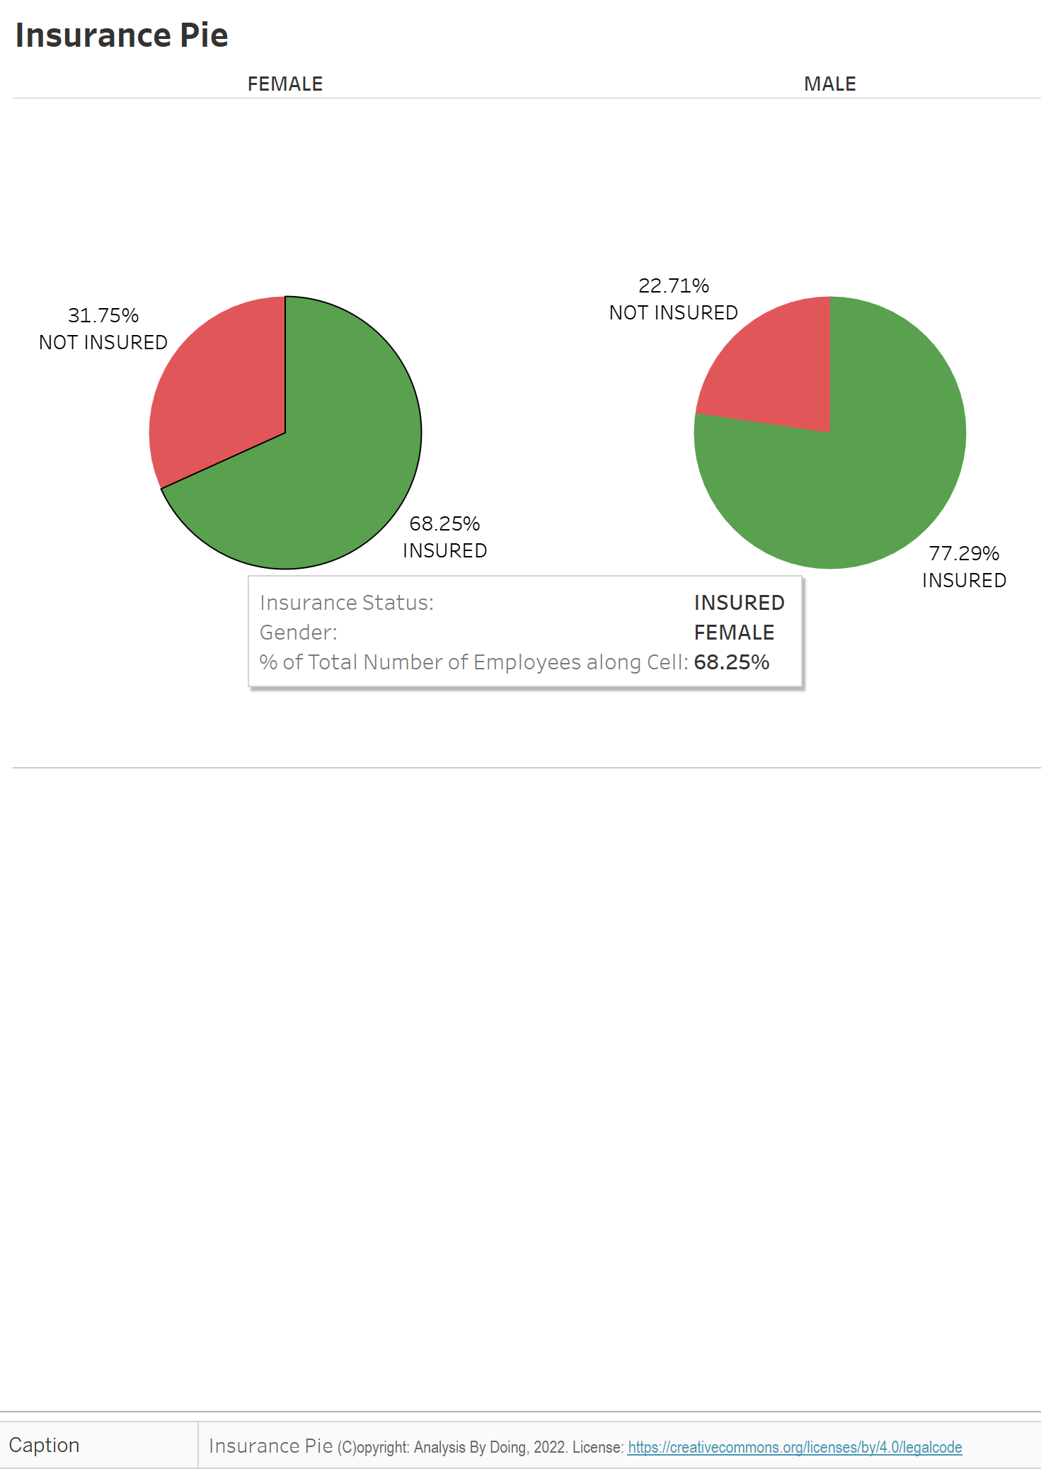

Slide 8
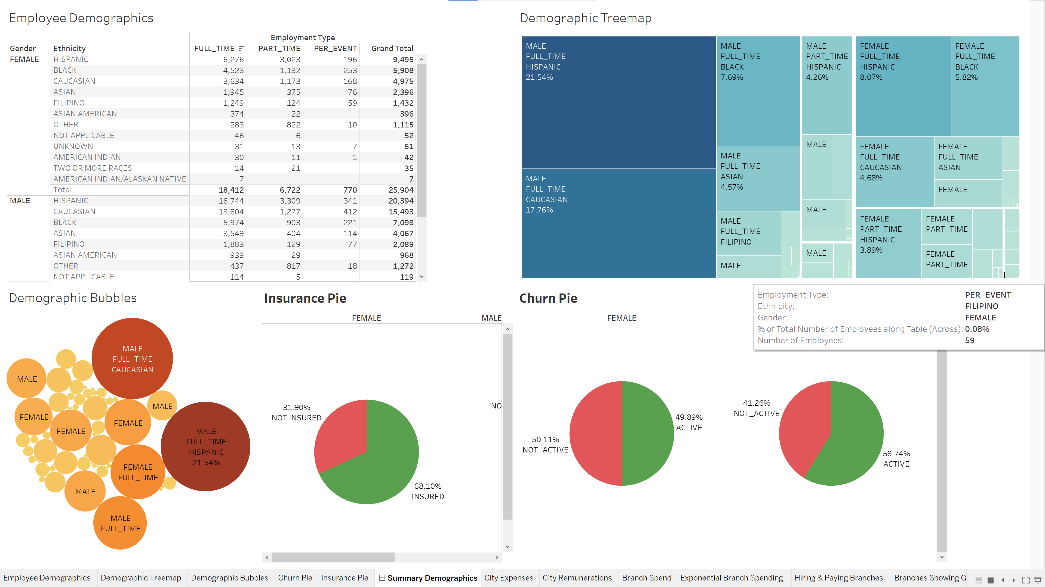

Slide 9
City Employee Expenditure
How much is the City Spending on its employees?
How much of the outlay is Salaries?
How much of the outlay is Hourly wages?
How much of the outlay is on Over Time?
How much of the outlay is on Bonus and Payouts?
How much is the outlay on Employee Health and Life Insurance?

Slide 10
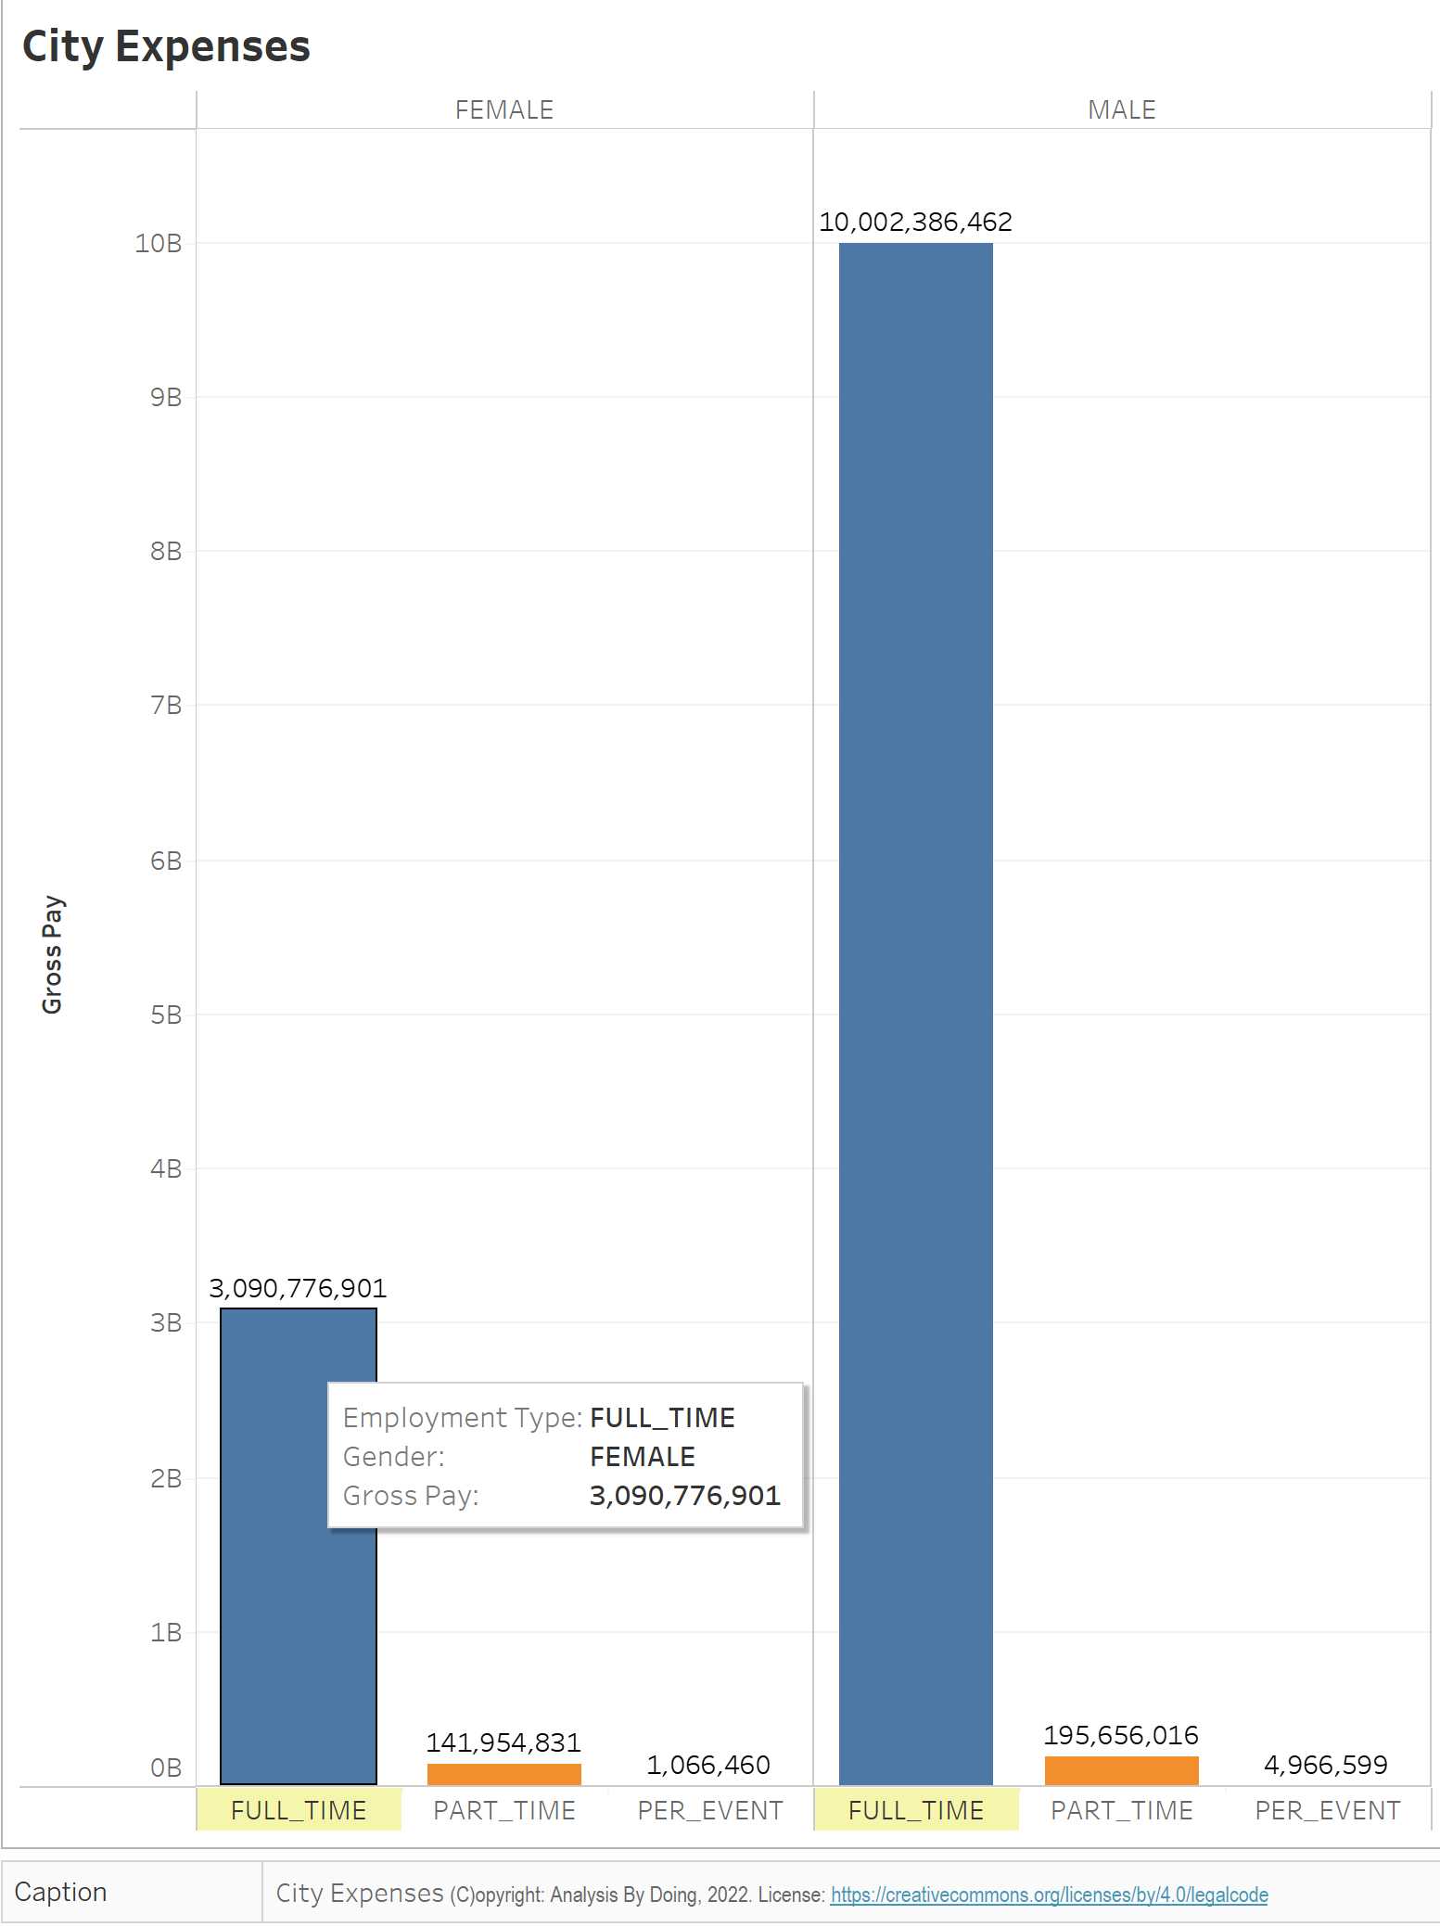

Slide 11
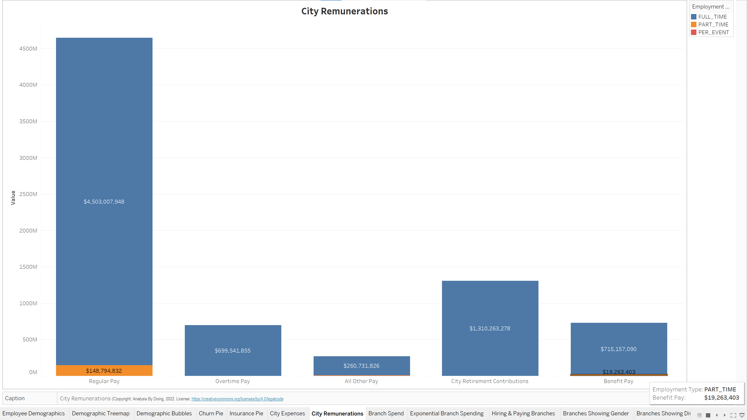

Slide 12


Slide 13
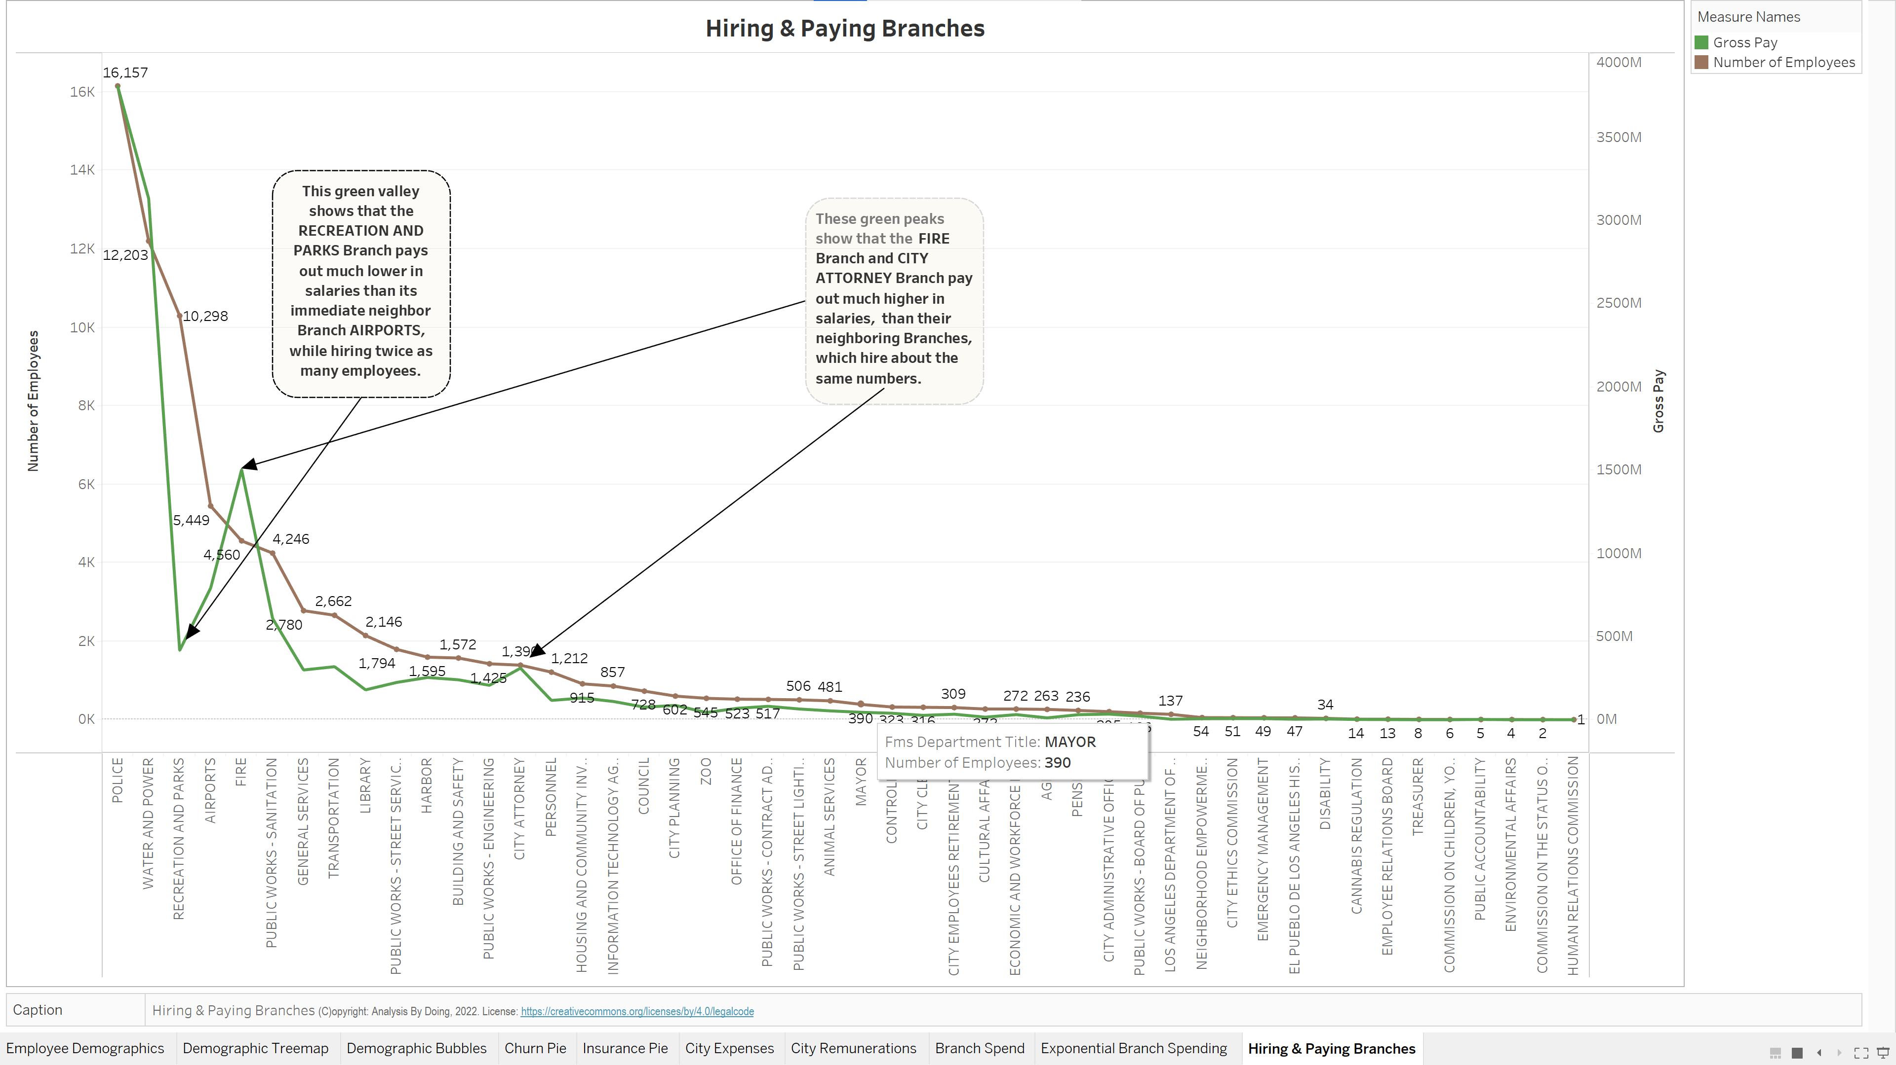

Slide 14
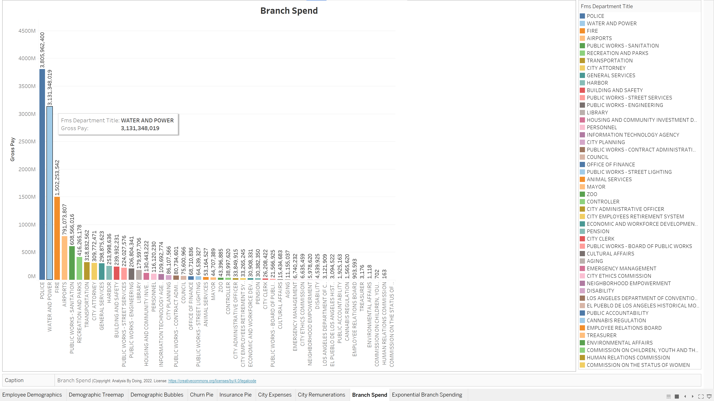

Slide 15
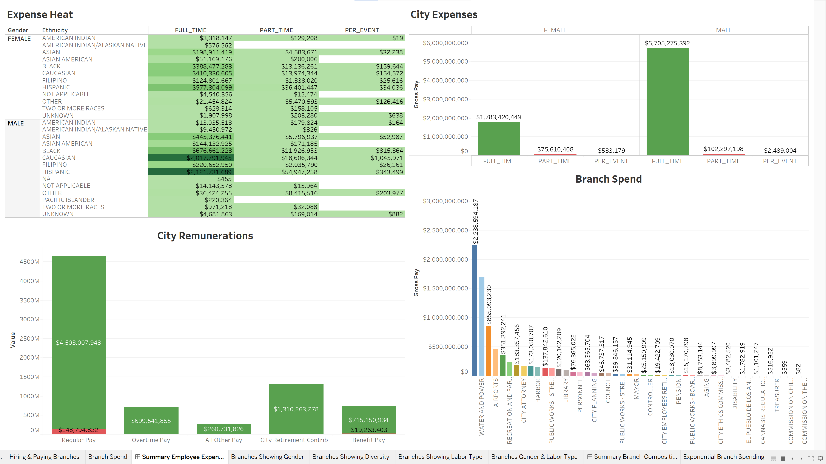

Slide 16
City Branch Composition
Which Branches hire more employees?
Which Branches hire more full-time employees?
Which Branches hire more hourly-wages employees?
Which Branches hire more women?
Which Branches are more ethnically diverse?

Slide 17
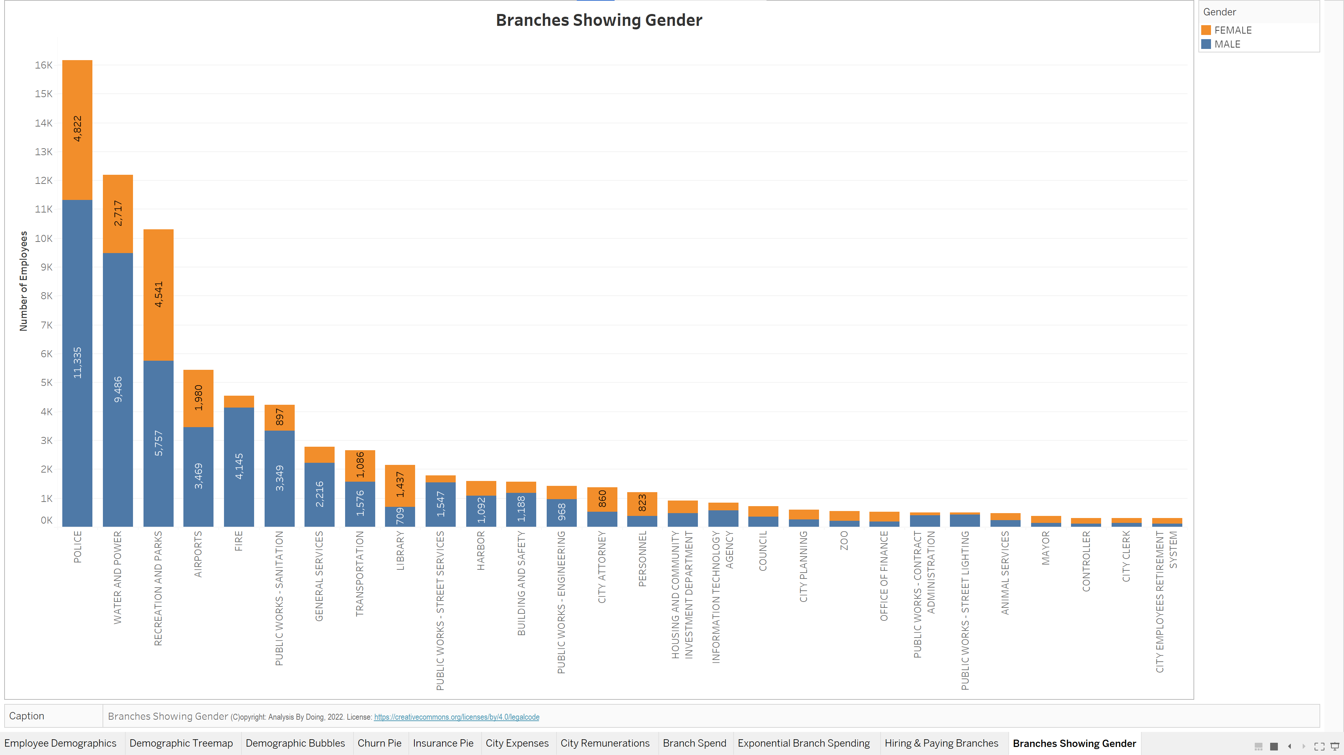

Slide 18
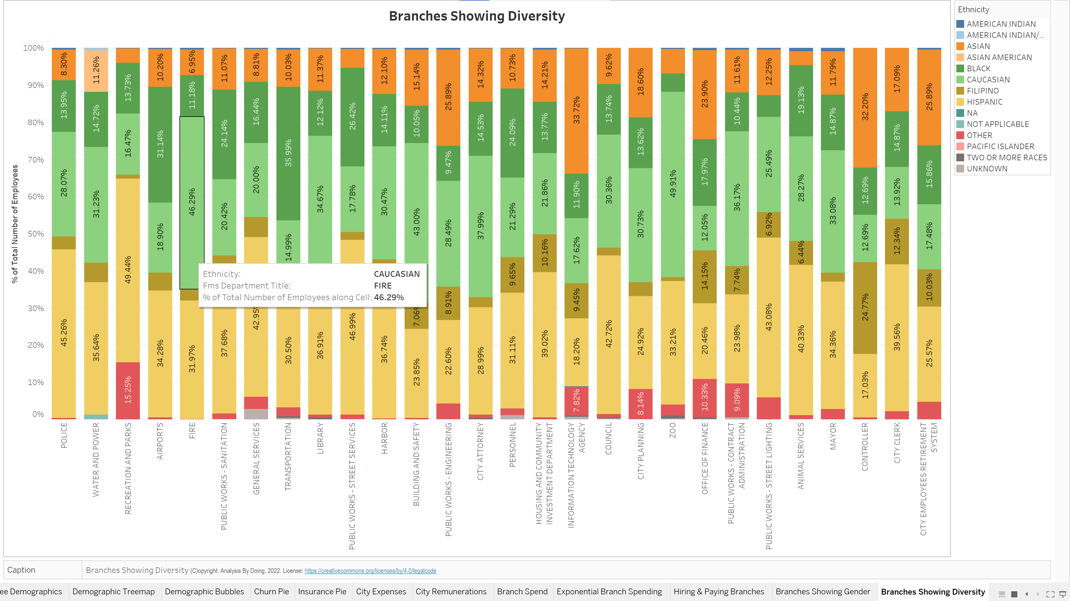

Slide 19
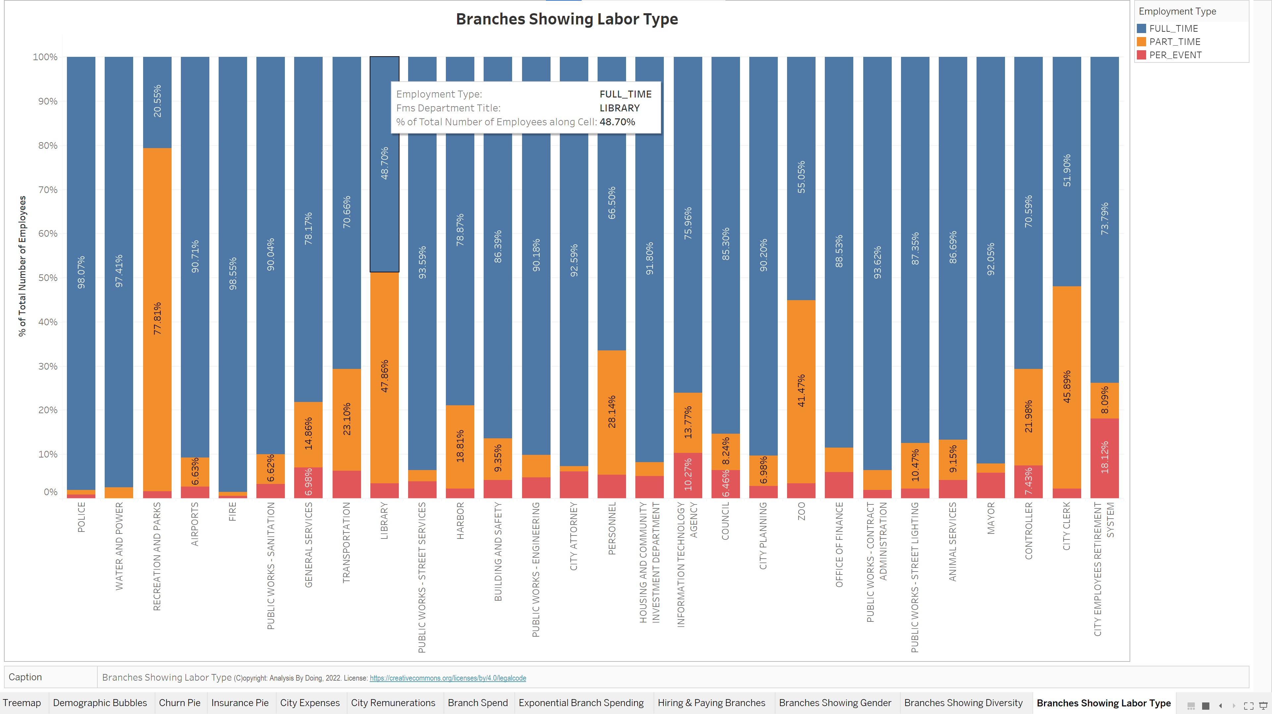

Slide 20
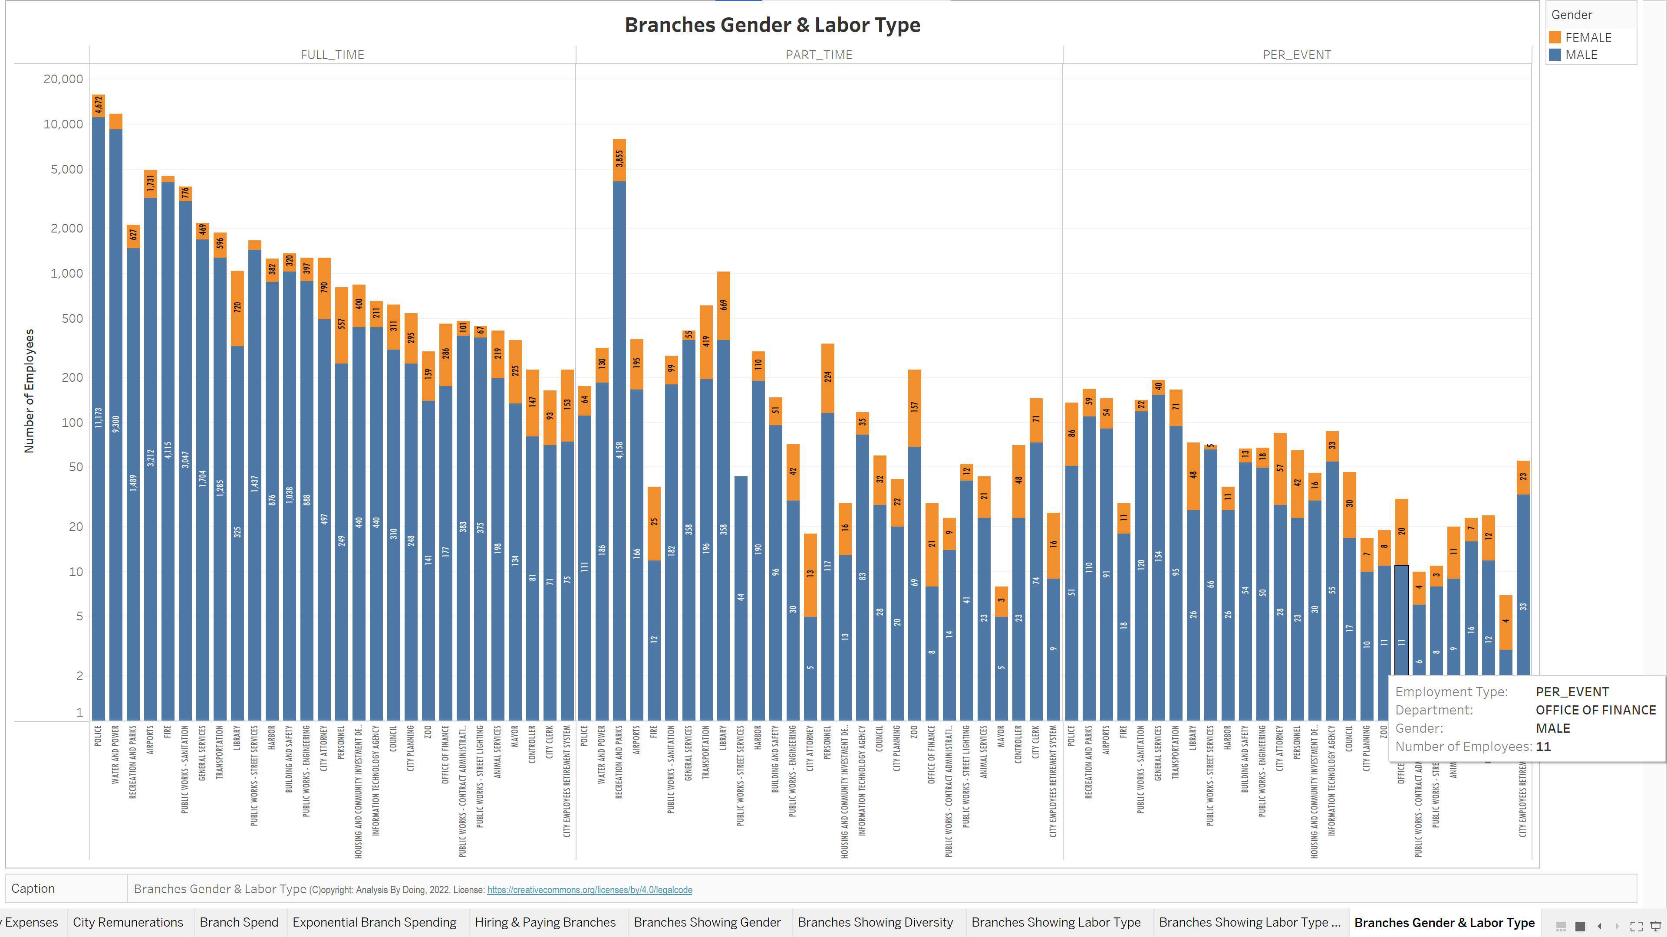

Slide 21
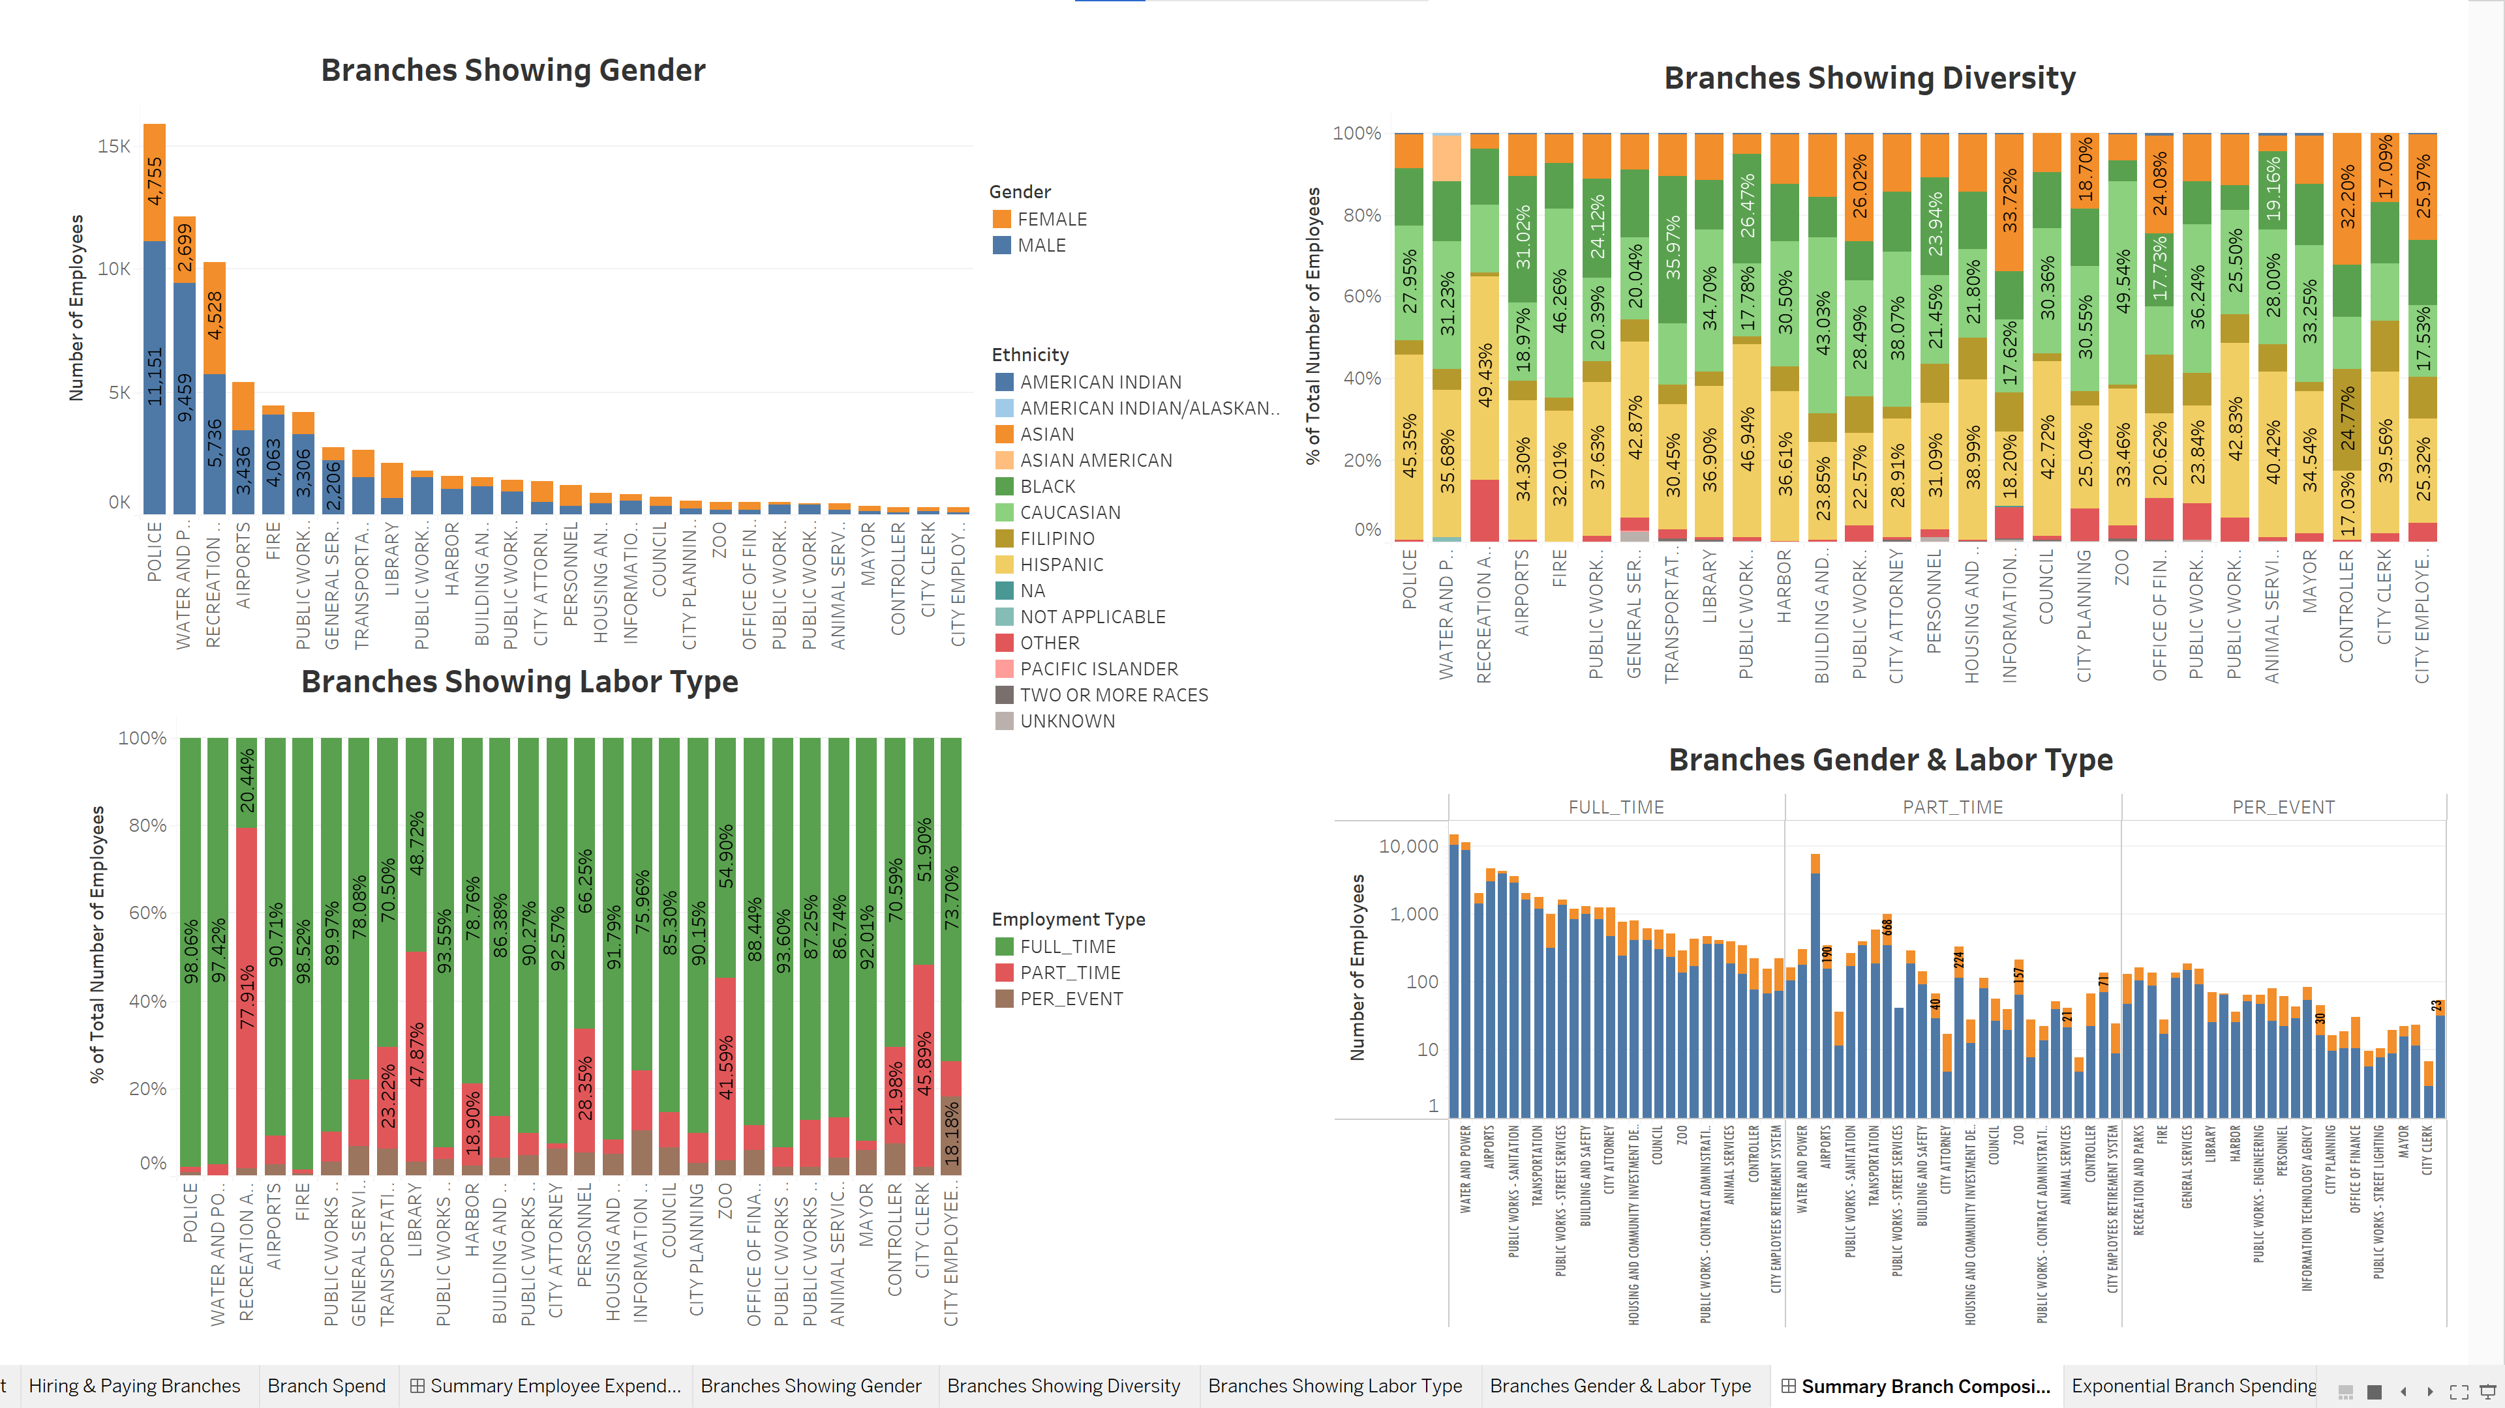

Slide 22
Branch Employee Expenditure
Which Branches give out more salaries?
Which Branches give out more wages?
Which Branches give out more Bonus and payouts?
Which Branches are experiencing the most Employee churn?

Slide 23
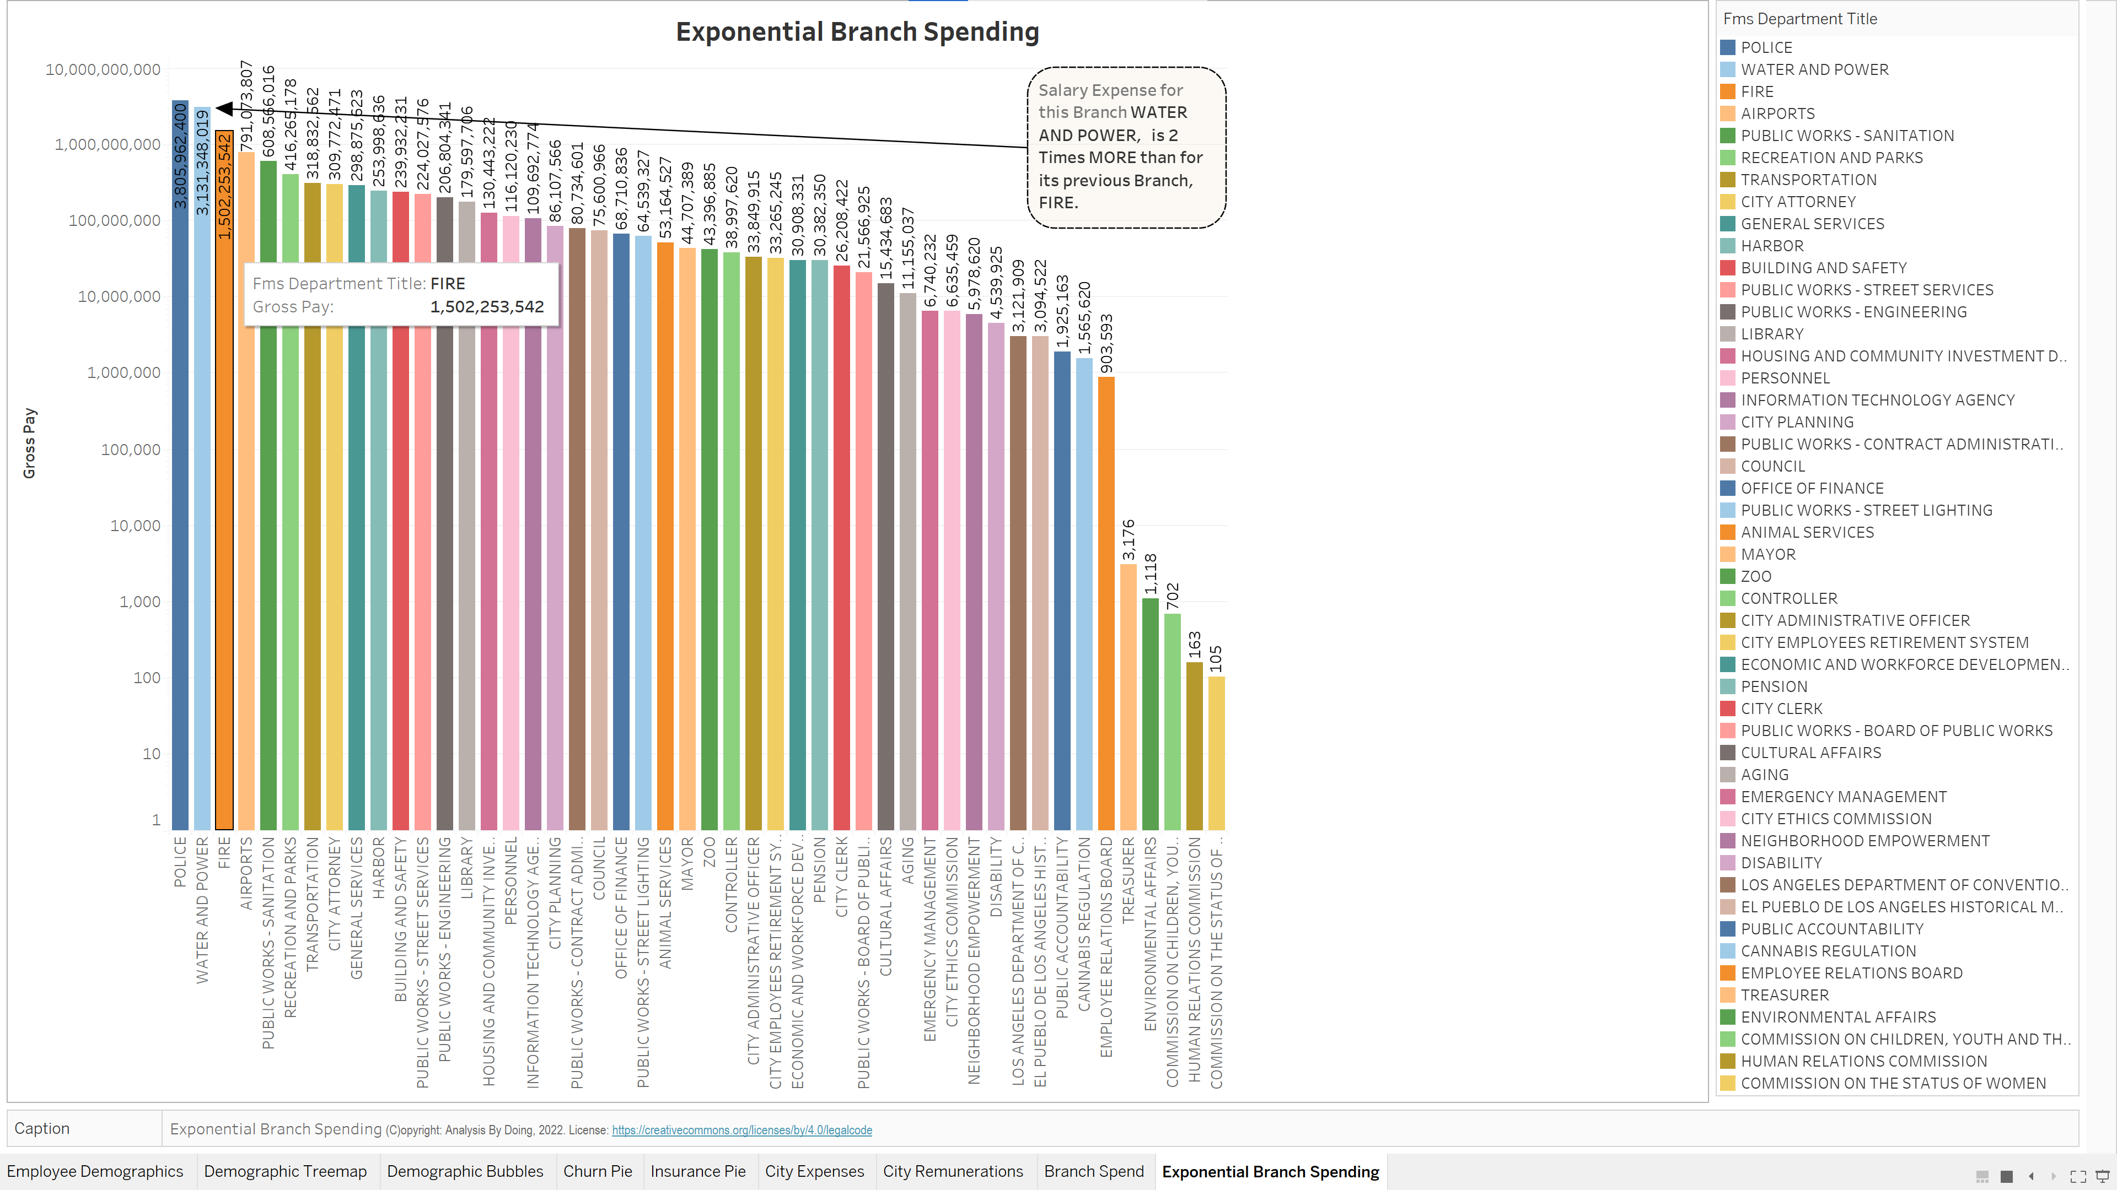

Slide 24
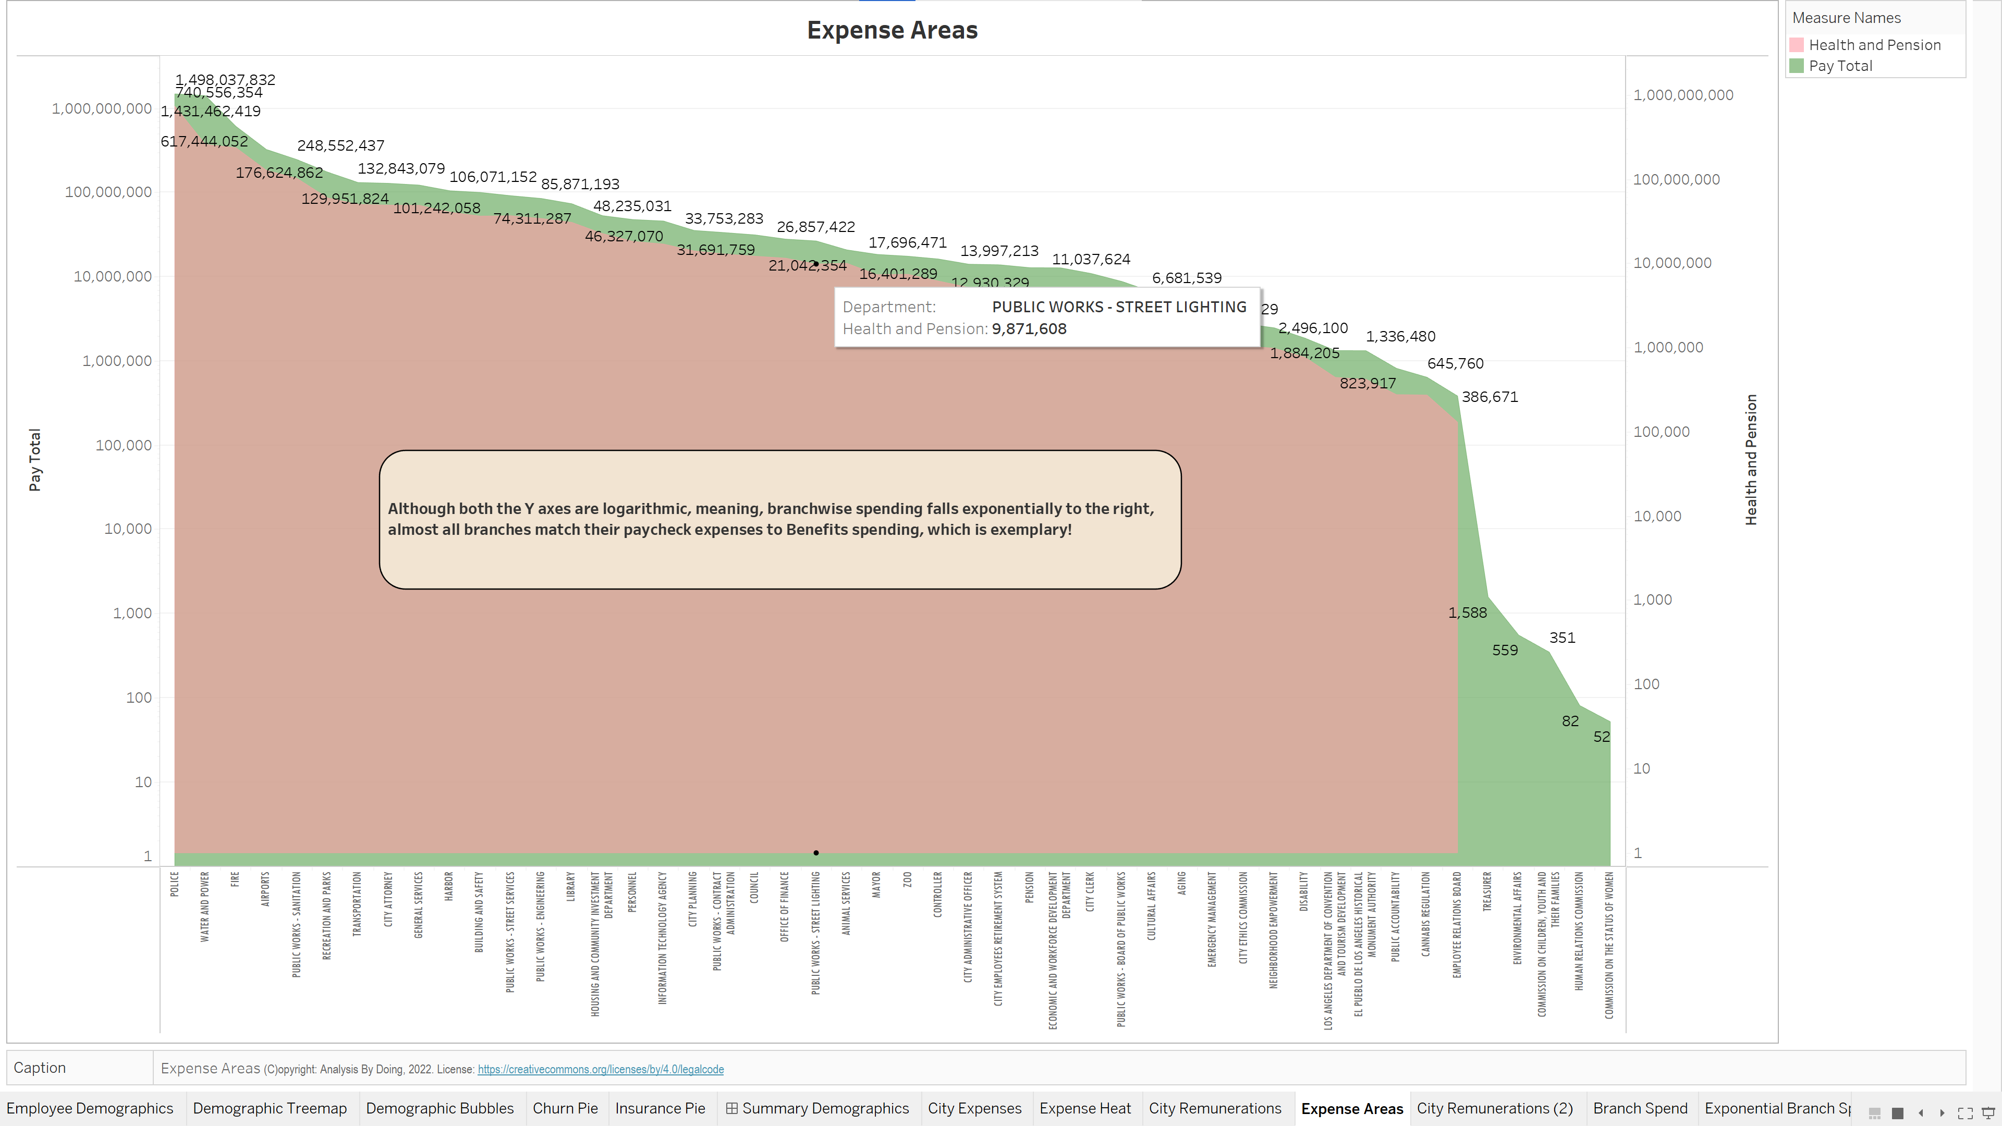

Slide 25
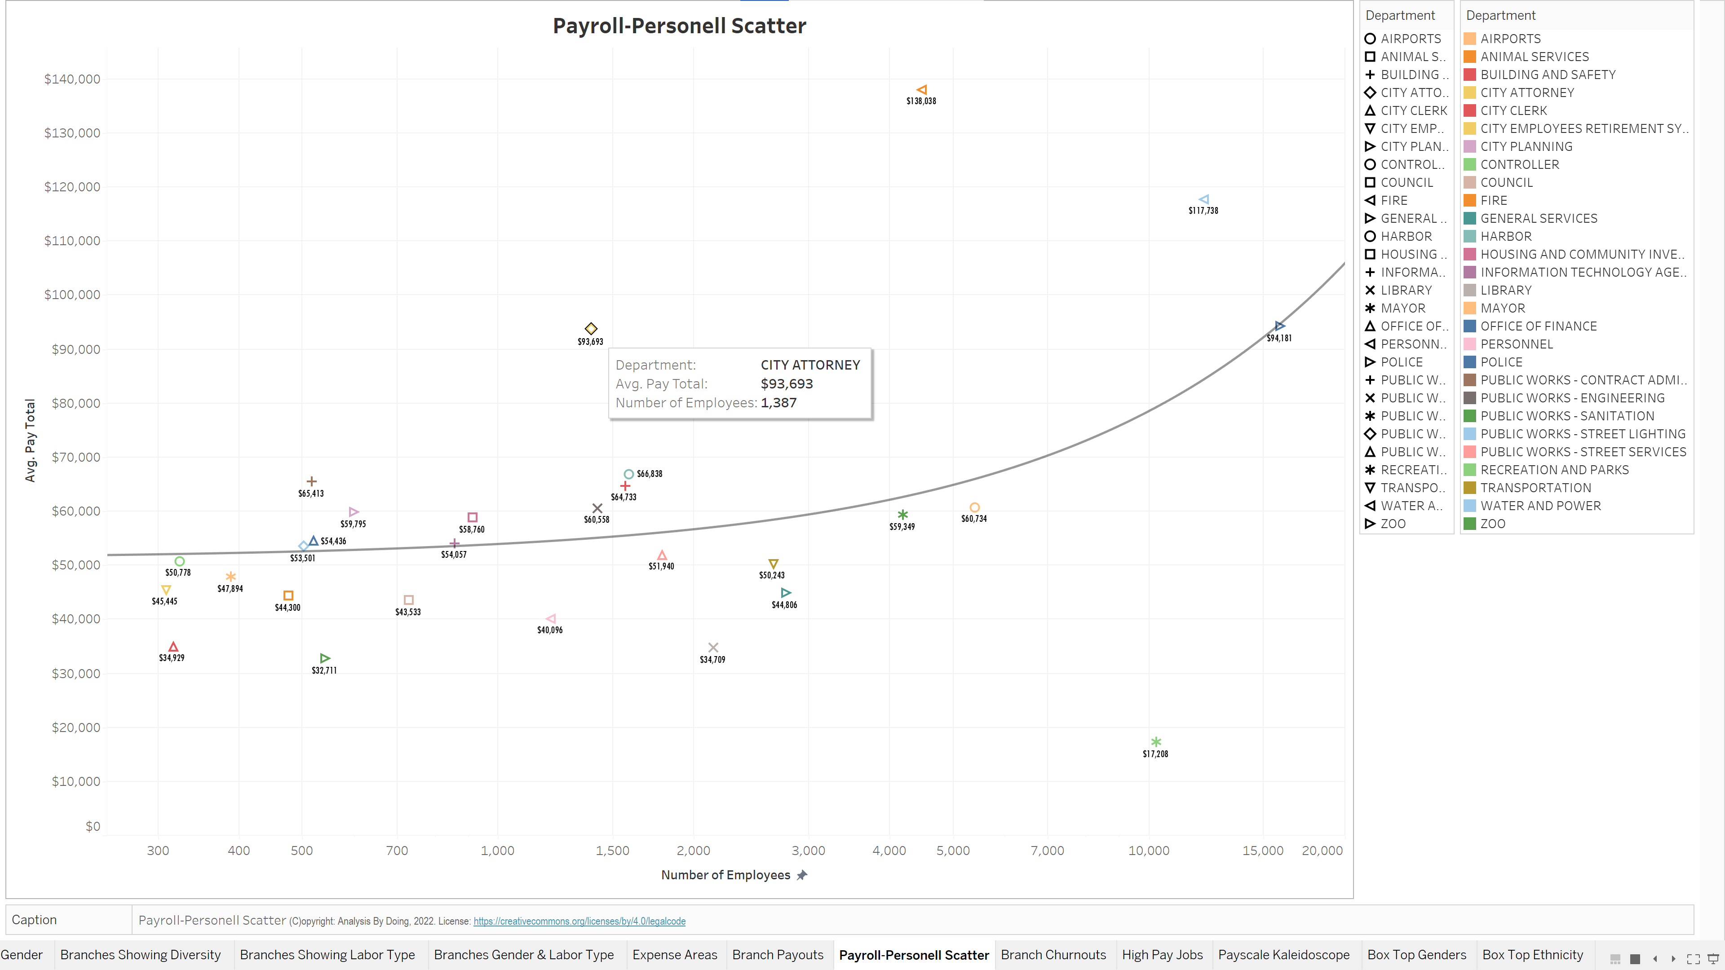

Slide 26
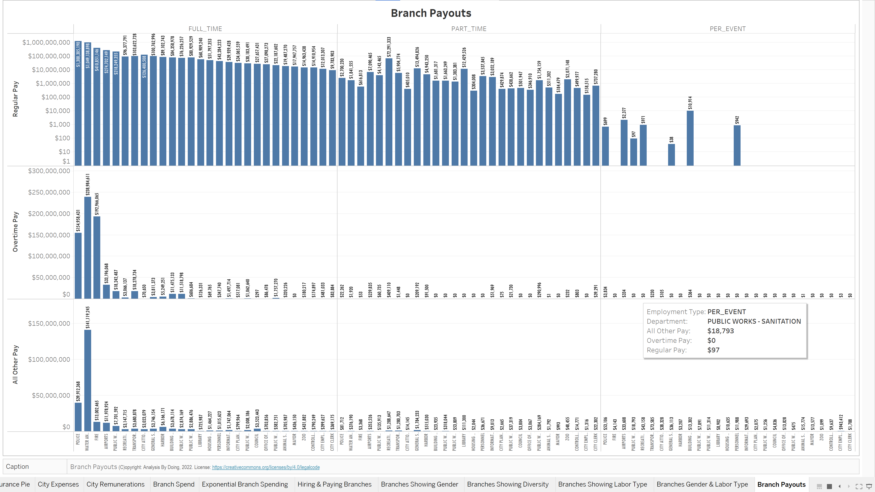

Slide 27
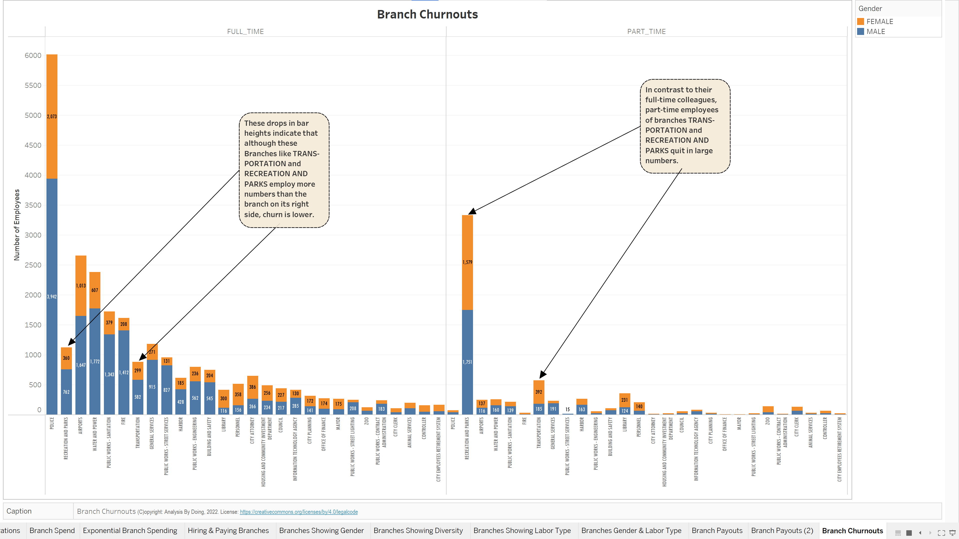

Slide 28
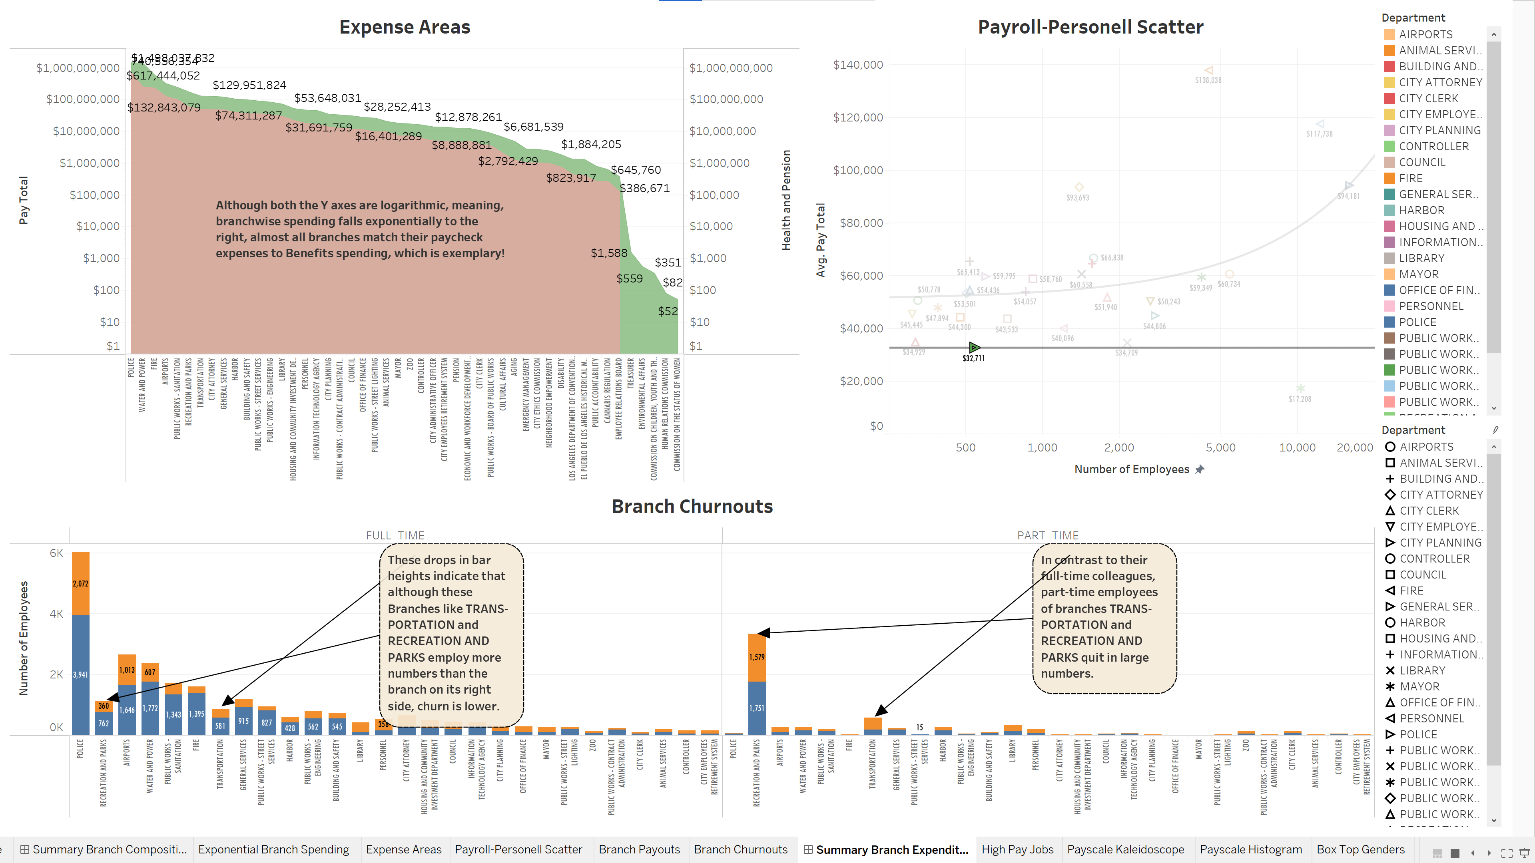

Slide 29
Employee Earnings
What are the top paying jobs, salary-wise?
What are the top paying jobs, hourly wage-wise?
Which jobs get more OverTime?
Which jobs get more Bonus and Payouts?
Which gender earns more on average?
Which ethnic groups earn more on average?

Slide 30
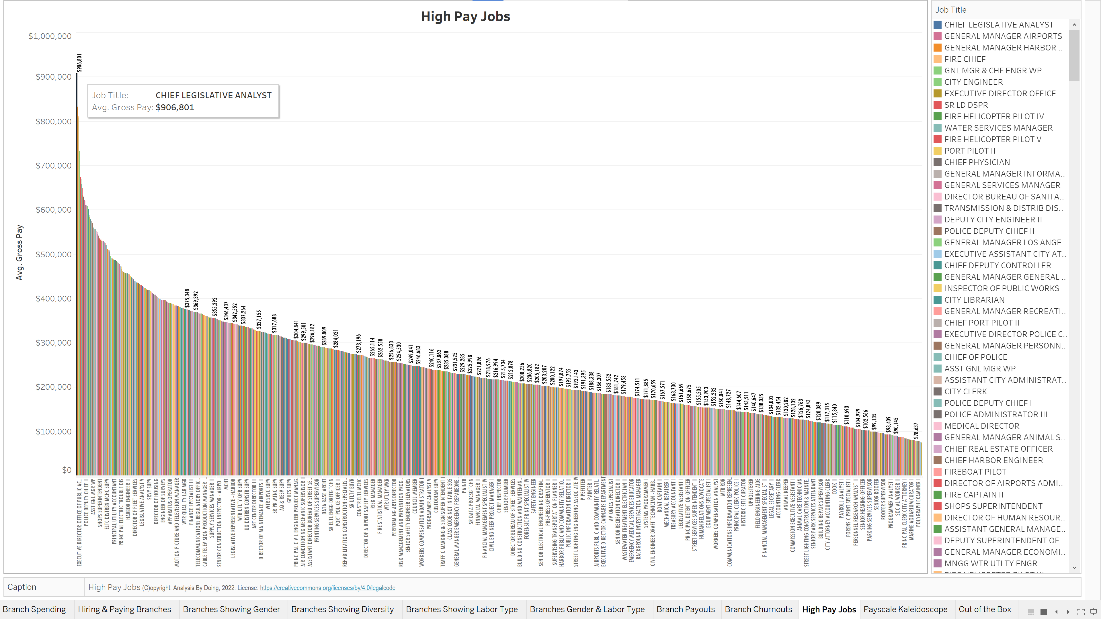

Slide 31
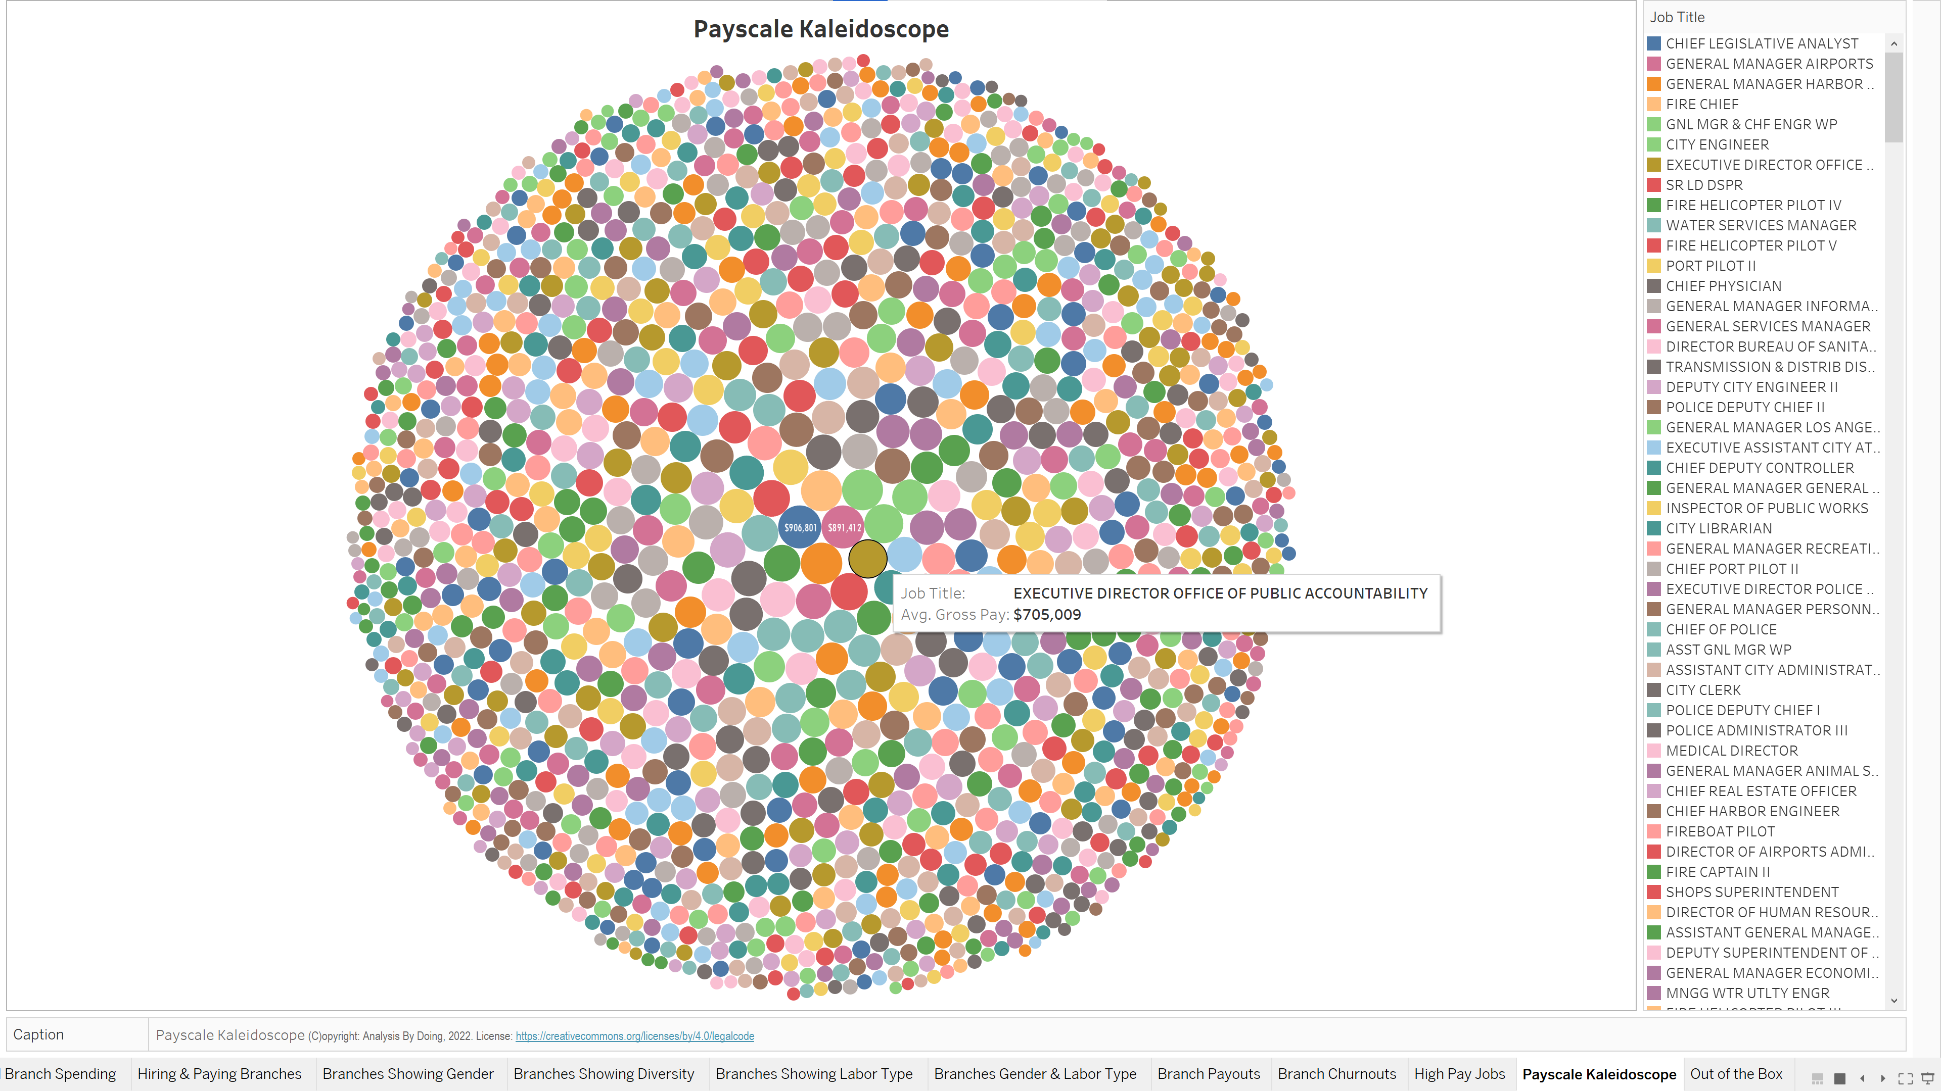

Slide 32
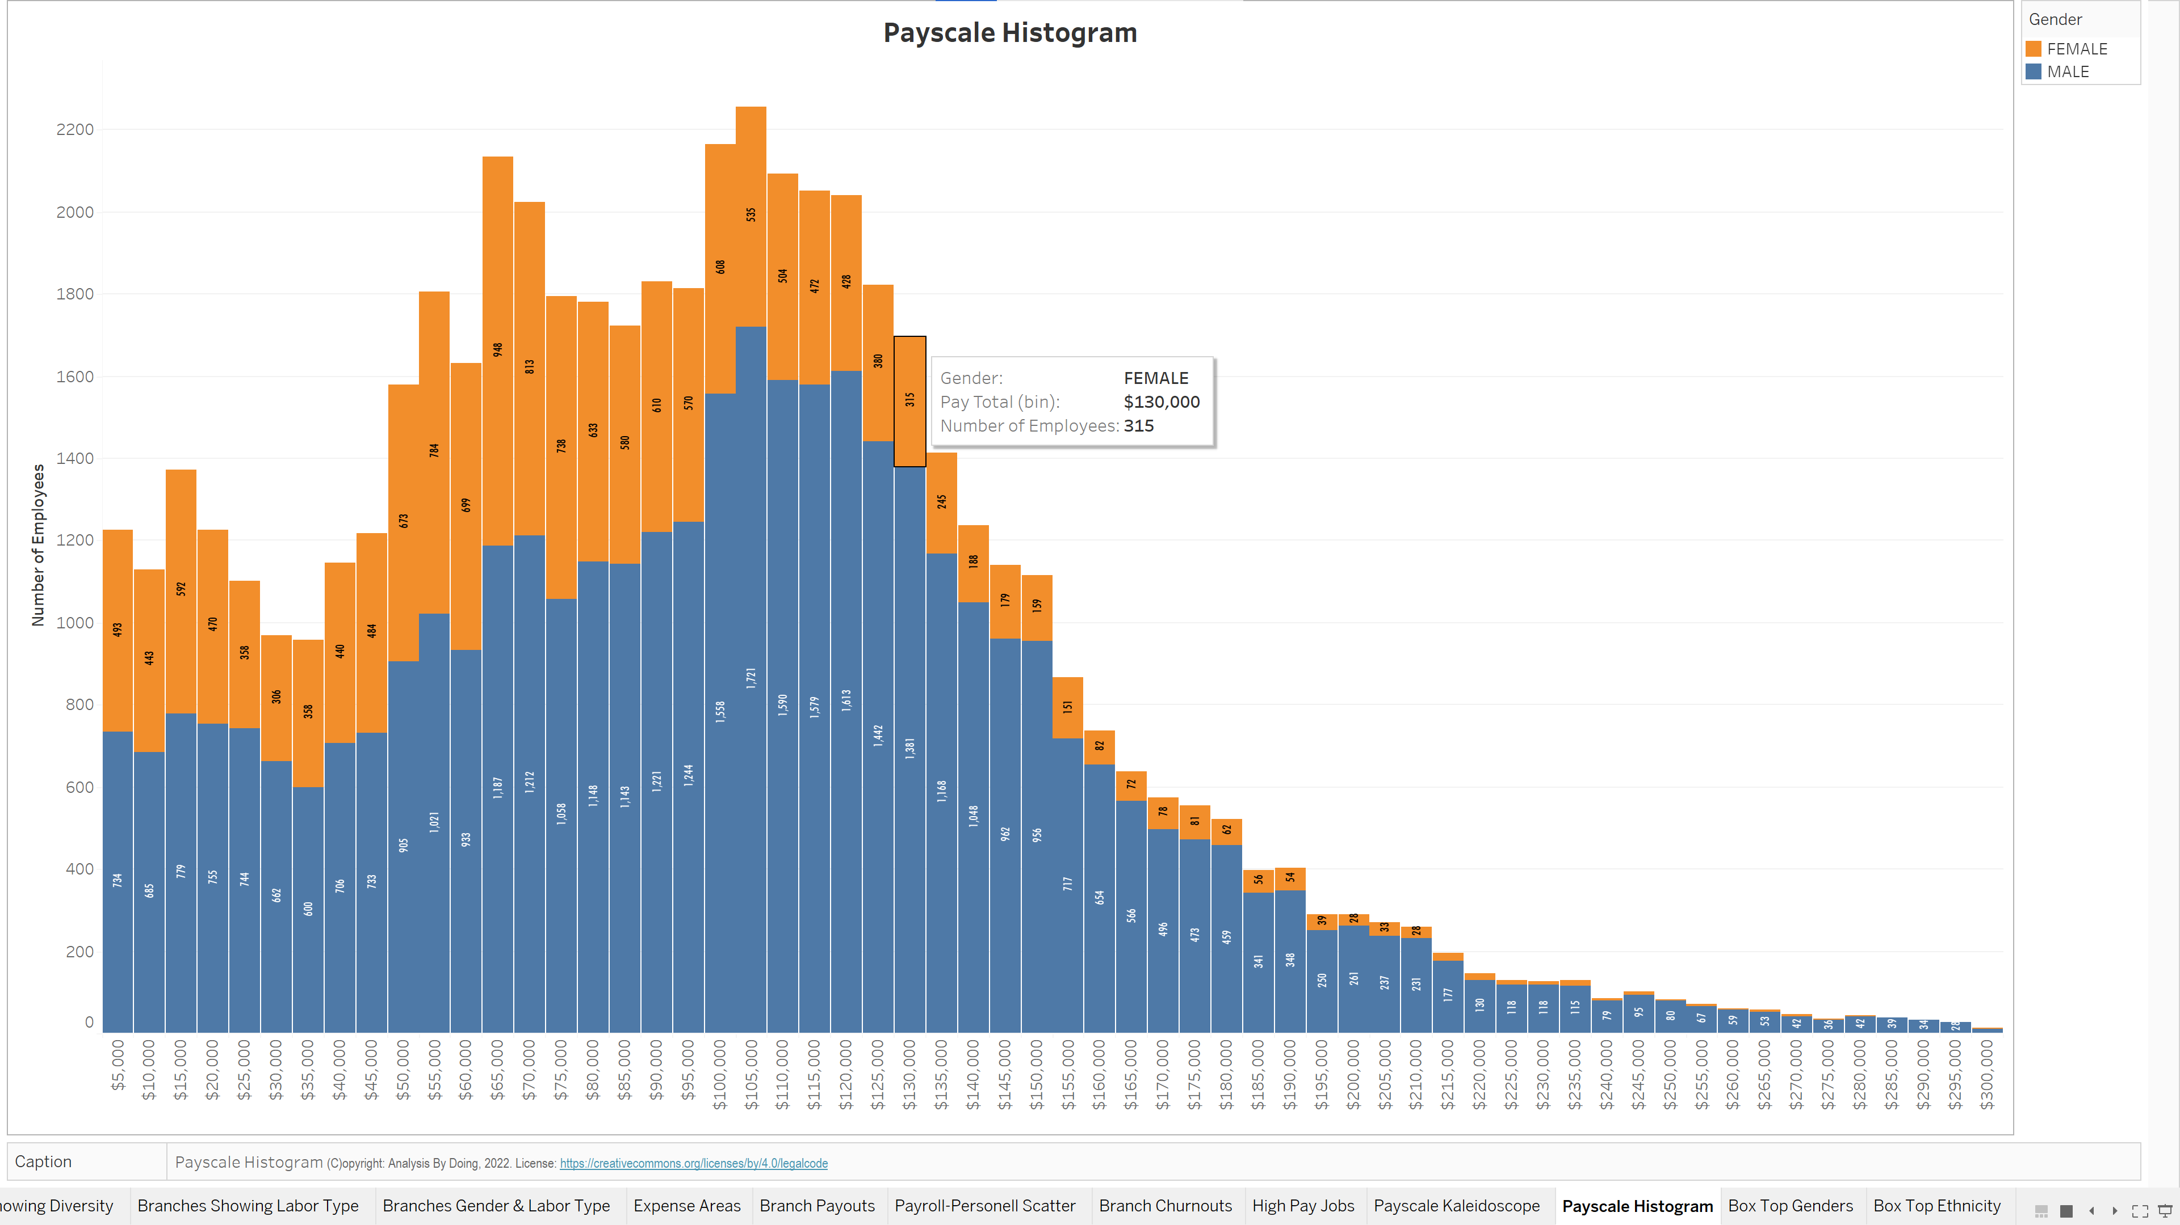

Slide 33
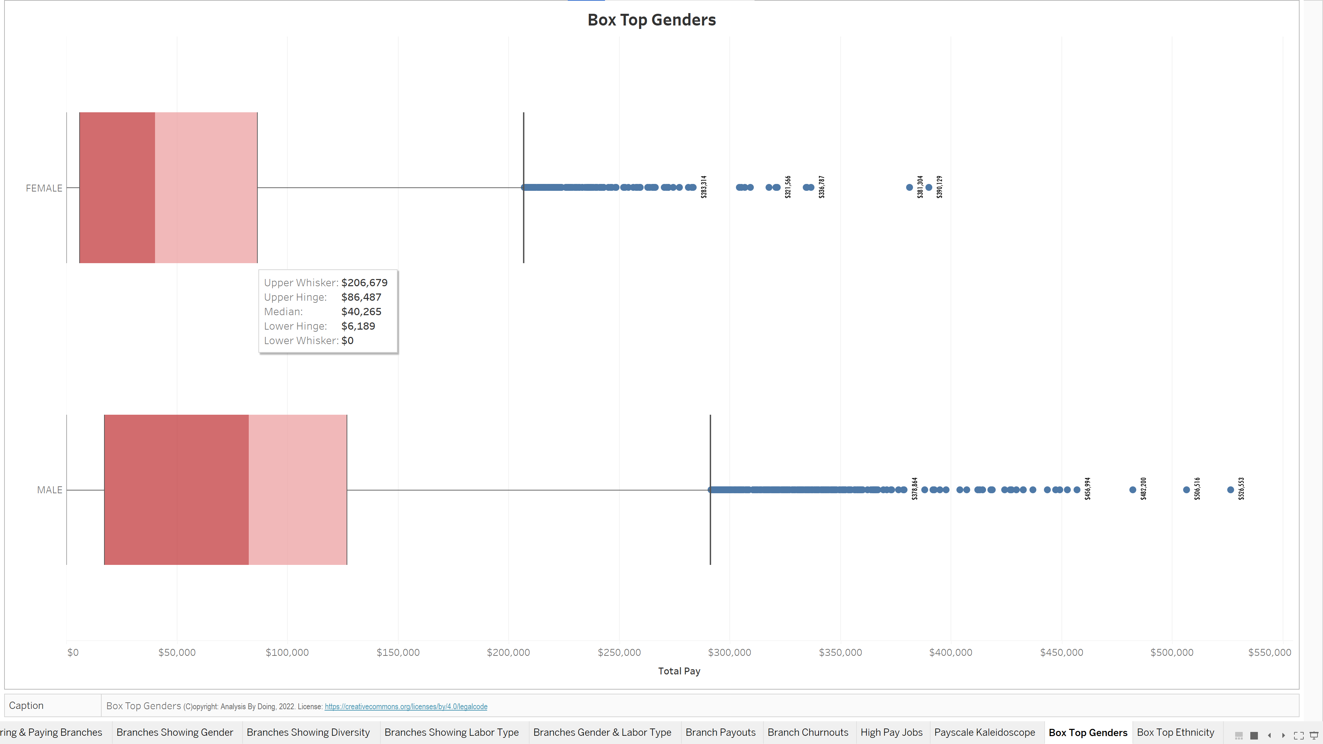

Slide 34
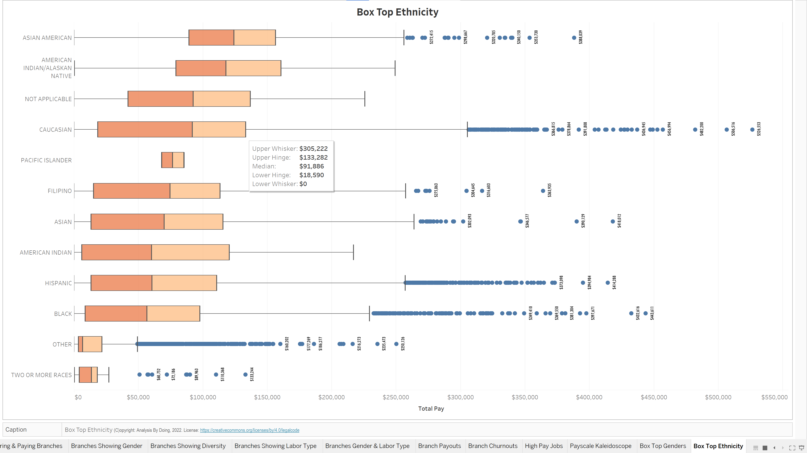

Slide 35
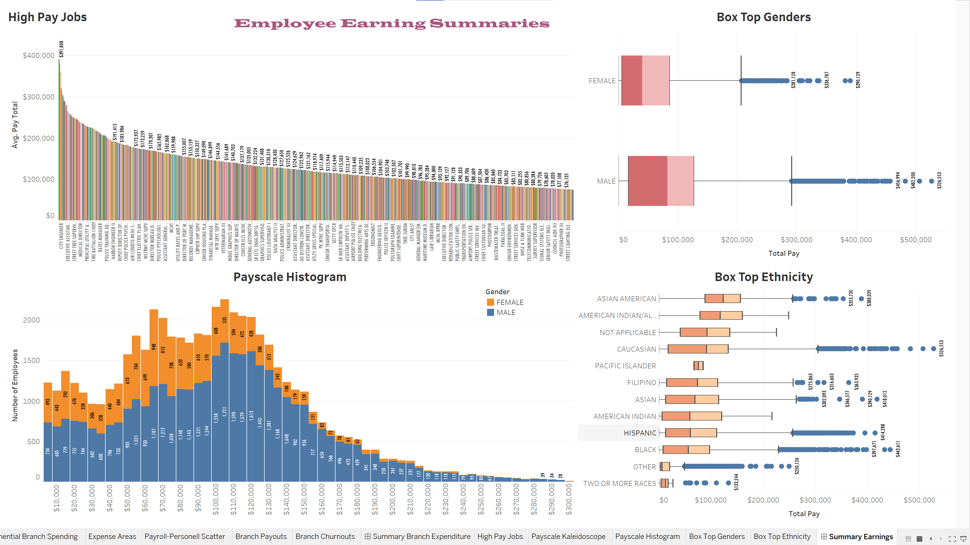

Slide 36
INSIGHTS
Among Part Time employees, ethnic Category ‘Other’ constitutes the fourth largest group; both among Males and Females.
Hispanic, Caucasian and Black are the predominant ethnic groups among both Male and Female employees.
Among full time Female employees, Blacks outnumber Caucasians.
Over 50% of Female employees and over 40% of Male employees have quit their jobs.
Over 30% of Female employees are not directly insured by the City. Hopefully many are covered by their Male partners, almost 80% of whom are insured.
Most of the expenditure is on full-time and part-time employees; very little on contractual labor.
Payments to part-time employees are dwarfed by the payments to salaried employees; but some part-time employees get Benefits!
Although Female Blacks outnumber Female Caucasians among full-time employees, the city spends comparatively more via remunerations on Female Caucasians.
Some branches like RECREATION & PARKS and PUBLIC WORKS SANITATION, hire more employees but pay less on average, compared to branches like FIRE and CITY ATTORNEY.
Like a Pareto Chart, the top handful of branches account for the major share of the City’s expenditure.
Branches PUBLIC WORKS – STREET SERVICES and LIBRARY both employ about 2000 people; however, their Male to Female ratio is the exact opposite with the LIBRARY hiring twice as many Females as Males.
Branches IT and the CONTROLLER’s office have similar ethnic composition with over one-third Asians.
At the branches RECREATION & PARKS, ZOO, LIBRARY and THE CITY CLERK’s office, almost half the staff work part-time jobs.
The branches FIRE and PUBLIC WORKS – STREET SERVICES have a very low ratio of Female employees.

Slide 37
INSIGHTS
Three diverse branches like TRANSPORTATION, CITY ATTORNEY’s office and GENERAL SERVICES, have about the same payroll expense budget.
Almost all branches match their paycheck expenses to Benefits spending.
The branch FIRE employs about the same number as PUBLIC WORKS -SANITATION, but pays out more than twice in average Gross pay.
The Branch WATER & POWER pays exceedingly high overtime pay, bonuses and handouts. Also, part-time employees get very little overtime pay.
The branches TRANSPORTATION and RECREATION & PARKS experience large churn among their part-time employees compared to full-time employees.
The highest paid city official was The General Manager & Chief Engineer WP
There is not much disparity among the highest paying jobs.
The pay is skewed to the right
Half of men earn more than three fourth of women.
Asian Americans earn the most salaries on average, but the biggest earners are among the Caucasians.

