Slide 1
TRACE
MINOR PROJECT DEMONSTRATION
1
Planner
2
Retrieval
A multi-agent research assistant that checks its own evidence
3
Summarizer
4
Fact check
Question → sub-questions → papers and web → verified quotes → labelled claims → cited report
5
Report
13 November 2026
Notes:
Introduce TRACE: a pipeline of five stages that turns a research question into a fact-checked, cited report. Add team names and guide name on this slide before presenting.

Slide 2
Agenda
The Problem
System Architecture and End-to-End Call Flow
1
5
Literature Review
The Data Behind the Project
2
6
Research Gap and Our Contribution
Progress So Far
3
7
Project Scope
Project Outcome
4
8
Notes:
Walk through the eight agenda items. Items 1 to 4 set up the problem; item 5 is the technical core; 6 to 8 cover data, progress and outcome.

Slide 3
Answers you cannot check
1 · The Problem
Ask a chatbot a research question and you get a fluent answer. Nothing tells you which sentence a paper really supports, and which sources disagree.
1
Too much to read
2
Unproven claims
3
Hidden conflicts
A literature review means finding, downloading and reading dozens of papers by hand, for every part of a question.
A language model can state a result and cite a paper that never said it. The reader cannot tell without reading the paper.
Sources contradict each other and some parts of a question have no good evidence. A fluent answer smooths both over.
What we built: TRACE finds the papers, reads them, keeps only findings with a verified quote, labels how well each claim is backed, and writes a cited report.
Notes:
A fluent answer is not the same as a supported answer. Three problems: the volume of reading, claims that cite sources that do not say them, and conflicts or gaps that a smooth answer hides. TRACE is built to address all three.

Slide 4
Related work
2 · Literature Review
Area | Representative work | What it leaves open
Retrieval-augmented generation | Lewis et al. 2020 (RAG); Asai et al. 2023 (Self-RAG) | The answer is grounded in retrieved text, but the text is not checked against each claim
Citation and attribution checks | Gao et al. 2023 (ALCE); Liu et al. 2023 (generative search engines) | Measure whether citations support the text after it is written; do not prevent unsupported text
Claim and fact verification | Thorne et al. 2018 (FEVER); Wadden et al. 2020 (SciFact); Min et al. 2023 (FActScore) | Label single claims against evidence; benchmarks, not a research workflow
Scientific question answering and report writing | Lala et al. 2023 (PaperQA); Shao et al. 2024 (STORM); Asai et al. 2024 (OpenScholar) | Cited synthesis; no per-claim label for how many sources agree
Commercial research assistants | Elicit, Consensus, deep-research modes of chat assistants | Closed systems; how a claim was checked cannot be inspected
Common thread: most work measures or improves one step. Few systems put search, reading, verification and reporting in one inspectable pipeline.
Notes:
Related work grouped into five areas. Cite the papers by name if asked: RAG (Lewis et al., 2020), Self-RAG (Asai et al., 2023), ALCE (Gao et al., 2023), Liu et al., 2023 on verifiability in generative search engines, FEVER (Thorne et al., 2018), SciFact (Wadden et al., 2020), FActScore (Min et al., 2023), PaperQA (Lala et al., 2023), STORM (Shao et al., 2024), OpenScholar (Asai et al., 2024). The 'what it leaves open' column is our reading of these works and of the tools; verify details against the papers before presenting.

Slide 5
Gap and our contribution
3 · Research Gap
The gap
What TRACE does
Generated sentences are not tied to a quote the reader can check
Every finding carries an exact quote, matched against the paper's own text (fuzzy match of 92 or more)
Few systems say how much independent evidence stands behind a claim
Claims get one of four labels: supported, partially supported, unverified or contradicted
A writing model can drift away from the evidence it was given
Python decides what may be said and builds every citation; the model only phrases one sentence, which is then checked
Missing evidence and disagreement between sources stay hidden
Coverage is judged per aspect, a second search fills gaps, and disagreements and gaps are reported
Notes:
Each gap on the left has a matching design decision on the right. The key idea of the report stage: Python decides what may be said and builds every citation; the language model only phrases one sentence at a time, and each sentence is checked.

Slide 6
Project scope
4 · Project Scope
In scope: built
Working limits
Not in scope yet
Planner: question into sub-questions and search queries
Paper and web retrieval, run at the same time
Reading with verified quotes, coverage judging, second search
Fact check: four labels per claim
Written, cited report with an answer to the question
Web app and API with live progress
One trusted user on a private machine, no login
Free-tier services: 7 Groq keys share daily token limits
Local models run on CPU only
Tested on 8 AI and ML research questions
A run takes about 14 to 30 minutes
Query compression (squeezer) agent
Loop 3: re-plan when most claims stay unverified
Login and per-user data
Production deployment: API and web Dockerfiles are empty
Cancelling a run
Human-labelled evaluation
Notes:
In scope is everything that exists today. The working limits matter for how the results should be read: one trusted user, free-tier services, CPU-only local models and a small test set of eight AI and ML questions. Not built yet: the squeezer, Loop 3 (re-plan), login and deployment.

Slide 7
System architecture
5 · Architecture
Next.js web app
FastAPI backend
LangGraph pipeline
Run page, evidence report, written report
Run manager, 3 routers, server-sent events
5 nodes: planner, retrieval, summarizer, fact check, report
Services the pipeline calls
Supabase (PostgreSQL)
Model host (over Tailscale)
Groq key pool
16 migrations: runs, papers, digests, claims, reports
Qwen3.5-9B on vLLM: planner (LoRA), relevance judge, evidence judge
gpt-oss-120b: digests, fact-check judges, report writer; 7 keys
Search APIs
Docker parsers
Local CPU models
arXiv, Semantic Scholar, OpenAlex, Scopus, IEEE; Tavily, Exa, Parallel
Docling for PDF text and sections; PDFFigures for figures
bge-base embedder and DeBERTa-v3-large NLI
Everything a run learns is written to Supabase, so the web app and the written-report endpoint read the stored run, not the live pipeline.
Notes:
Three tiers on top: the web app, the FastAPI backend with a run manager that streams progress over server-sent events, and the LangGraph pipeline. Below are the services the pipeline calls. The model host runs on another machine and is reached over Tailscale; Docling and PDFFigures run in Docker on that host. All results are written to Supabase, so the web app reads stored runs.

Slide 8
End-to-end call flow
5 · Architecture
Output of each stage and its time, from real runs (run 32; the report is from run 36)
1 Planner
2 Retrieval
3 Summarizer
4 Fact check
5 Report
Splits the question into sub-questions with search queries; fixes the field (domain anchor)
Paper search (5 indexes) and web search (3 APIs) at the same time; filter, rank, parse PDFs
Reads the best passages into findings with verified quotes; judges coverage; second search for gaps
Groups claims that say the same thing, checks each quote, finds conflicts, labels every claim
Writes the cited report from the labels; Python builds citations, the model phrases sentences
Task plan: 4 sub-questions, 11 queries
8 s
61 papers (20 full text), 48 web sources
1 m 52 s
129 findings, 121 with a verified quote
5 m 24 s
89 claims with labels
About 11 min, overlaps 3
Cited report: 61 sentences (run 36)
see slide 21
Loop 2 (built): for an aspect still uncovered, search again, cheapest first: re-read passages, parse the next papers, then new queries.
Loop 3 (not built): re-plan when most claims stay unverified; Stage 4 only sets a flag.
Retrieval branches run together; Stage 4 starts while Stage 3 is still working.
Notes:
Follow one question left to right. The numbers are from real runs: run 32 for stages 1 to 4 and run 36 for the report. Retrieval runs two branches at the same time, and Stage 4 starts on each sub-question while Stage 3 is still working on the others. Loop 2 is built; Loop 3 (re-plan) is not.

Slide 9
Stages 1 and 2: plan and retrieve
5 · Architecture
Stage 1 · Planner
Stage 2 · Retrieval (two branches at once)
Fine-tuned Qwen3.5-9B (LoRA) on the model host writes sub-questions and search queries
Domain anchor: adds the field to every query, so “transformers” does not return power transformers
Plan cache: the planner is not reproducible, so a plan can be reused to compare runs
Query gate: a query is dropped if it does not fit its sub-question (similarity below 0.55)
Groq fallback if the model host is down
Paper branch
1
Search arXiv, Semantic Scholar, IEEE, OpenAlex and Scopus, then merge duplicates
2
Embedding pre-filter, then a relevance judge reads each abstract (Qwen3.5-9B)
3
Score reliability and keep the top papers for each sub-question
4
Download the PDF through a 6-step fallback chain, parse with Docling
Web branch: Tavily, Exa and Parallel with key rotation, three query variants per sub-question, then de-duplicate and score.
Notes:
Stage 1: the planner is a Qwen3.5-9B model fine-tuned with LoRA and served on the model host. The domain anchor fixes a real failure: without it, a question about transformers returned electrical power transformers. Stage 2 searches papers and the web at the same time, filters by abstract, scores reliability and parses PDFs with Docling.

Slide 10
The planner model
5 · Architecture
Research question
Qwen3.5-9B + LoRA planner
Sub-questions and search queries (JSON)
Fine-tuned with Unsloth, served with vLLM
Why Unsloth
Training parameters
Test results
Faster LoRA training than a plain Hugging Face loop
Lower GPU memory, so a 9B model can be tuned on one GPU
Works with Hugging Face models and datasets, Qwen included
Free and open source
Parameter | Value
Base model | Qwen3.5-9B
Method | LoRA (Unsloth)
LoRA rank (r)
LoRA alpha
Learning rate
Epochs
Batch size
Training examples
Metric | Base | Tuned
Limits: not reproducible even at temperature 0 (plan cache reuses plans); writes generic background queries (domain anchor compensates).
Notes:
The planner is Qwen3.5-9B fine-tuned with LoRA using Unsloth and served on the model host with vLLM (endpoint /decompose). It returns JSON: sub-questions (topic plus detail questions) and one flat list of search queries. Latency is 15 to 35 seconds per question. Add the training parameters and test results in the two blank tables. Known limits: it is not reproducible even at temperature 0 and with a fixed seed (the LoRA path, report 13), so a plan cache reuses a stored plan when runs must be compared; it tends to write generic background queries, which the domain anchor and the answer-needs step compensate for. The Unsloth box lists general reasons; edit it to your own.

Slide 11
The judge model: dataset and testing
5 · Architecture
Stage 2 keeps a paper only if the judge, shown a sub-question, a title and an abstract, says it is relevant.
Test results
1
30 technical sub-questions across machine-learning topics
2
12 real papers each from the production retriever, sampled across similarity tiers
3
Every title and abstract labelled against a written rubric, with confidence and reason
Space for the test results (table or chart)
4
360 rows published on Hugging Face; 12 models tested with the same prompt
360
237 / 123
12
labelled rows
relevant / not
models tested
Code: evaluation/relevance_judge (collect_candidates.py, merge_labels.py, run_judge_benchmark.py, relevance_judge_benchmark.ipynb)
Notes:
Stage 2 keeps a paper only if the judge, shown a sub-question, a title and an abstract, says it is relevant. To choose the judge we built our own benchmark: 30 technical sub-questions, 12 real papers each, labelled against a written rubric. Labels were written by an LLM, not by a person; this is stated in the dataset README. Code is in evaluation/relevance_judge: collect_candidates.py builds the candidate papers, merge_labels.py validates and merges the labels, run_judge_benchmark.py and relevance_judge_benchmark.ipynb run the models. Test results to add on the right. For reference, the results table is: GLM-5.3 and GLM-5.3-flash 0.953 accuracy (online); Qwen3.5-9B 0.908 accuracy, F1 0.934, 2.3 s per paper (chosen); Nemotron-3-ultra 0.902 (348 rows); Gemma 4 E4B 0.889; Qwen3.5-4B 0.875; gpt-oss-20b 0.864; Phi-4 14B 0.853; Qwen3-8B 0.844; Phi-4-mini 0.800. Baselines: always 'relevant' 0.658; embedding filter at 0.56 similarity 0.711; best single similarity threshold (0.72) 0.833. Qwen3.5-9B was chosen for latency and because paper text stays on our own machine.

Slide 12
Stage 3: read, verify, judge
5 · Architecture
1
Sources
2
Aspects
3
Chunks
4
Digests
Top papers (full text first) and web pages for each sub-question
Splits compound detail questions into at most 3 aspects
About 300-word chunks: top 5 by similarity plus top 2 per aspect, at most 9
gpt-oss-120b writes up to 5 findings per source, each with an exact quote
5
Quote check
6
Evidence judge
7
Coverage
8
Loop 2
Fuzzy match of 92 or more against the source; unverified findings are dropped
Independent Qwen3.5-9B judge: does the quote support the claim and answer the aspect?
Covered: at least 2 yes verdicts from at least 2 different sources
Uncovered aspects: re-read, parse the next papers, then new queries; gaps are reported
Why a separate judge: the model that writes a finding should not grade it.
Notes:
Eight steps. The key design choice is the independent judge: the model that writes a finding is not the one that grades it. A quote must be found in the source text, then a separate model decides whether the quote supports the claim and answers the aspect. An aspect is covered only with at least two yes verdicts from at least two different sources.

Slide 13
Stages 4 and 5: label, then write
5 · Architecture
Stage 4 · Fact check
Stage 5 · Written report
Group claims that say the same thing (embeddings, then a judge)
Check that each quote supports its claim (Stage 3 judge, NLI, support judge)
Look for a close variant in another document (near match)
Find conflicts: topic gate, NLI prefilter, conflict judge, second reading
Tiers set the wording: supported, partly, single source, disputed
The model writes one sentence per small group of claims
Checks: numbers, names, negations, hedges; then NLI and a judge (fail closed)
A sentence that fails twice becomes a fixed template sentence
References are built by code; the report opens with an answer block
supported
partially supported
Python decides what may be said. The model only phrases it.
unverified
contradicted
Notes:
Stage 4 does not decide what is true; it labels a claim by how much independent evidence stands behind it. Stage 5 reads the labels. The tier sets the wording: for example, an unverified claim is only ever written as 'One study reports ...'. A disputed claim never appears in prose, only in a 'Sources disagree' block with both quotes.

Slide 14
Prompt tuning: judge and Groq prompts
5 · Architecture
Domain anchor prompt (Groq)
Early versions leaked examples or were too broad. Final: reasoning first, five examples. Judge passes 0–1 to 8–9.
Aspect-splitter prompt (Groq)
Splitting separate dimensions was better in only 4 of 25 changed cases (16%). Not adopted.
Stage 4 judge prompts (Groq)
Conflict: hedges and other settings are no conflict; a second reading. Near match: name the shared point.
V2.1 failed on unseen rows: 7 of 12 true answers found (needed 9), false yes 1 to 3. It fitted the rows it was written from.
Aspect wording
“What is reported about X” lifted yes verdicts from 10 to 27 but also accepted off-topic claims. Rejected.
Rule kept: no prompt change without before and after numbers on held-out labelled rows.
Notes:
One rule held throughout: no change to a prompt or threshold without before-and-after numbers on held-out labelled rows. Judge prompt: V1 was the original. The targeted audit showed it accepted answers of the wrong kind (a training process accepted as 'components of an LLM'). V2 added a 'kind of answer' rule and a list of non-answers; it is deployed. V2.1 loosened the rules for specific results and aspects that list several systems; it was written on development rows and failed on unseen ones: on 12 true answers it found 7 (needed 9), false yes rose from 1 to 3, and 76 percent of the 29 yes verdicts it added were not direct answers. All labels in these tests are LLM-assigned, so the numbers are indicative. Groq prompts: domain anchor (report 12), aspect splitter (report 11), Stage 4 judge prompts (reports 20 and STAGE4.md) and the aspect-wording experiment (report 16).

Slide 15
Technology stack
5 · Architecture
1
Orchestration and API
2
Models
3
Retrieval and parsing
LangGraph state graph
FastAPI, server-sent events
Pydantic v2 data models
747 offline pytest tests
Qwen3.5-9B + LoRA, on vLLM
Groq gpt-oss-120b
bge-base-en-v1.5 embedder
DeBERTa-v3-large NLI, CPU
Papers: arXiv, Semantic Scholar, IEEE, OpenAlex, Scopus
Web: Tavily, Exa, Parallel
Docling and PDFFigures
4
Data and caches
5
Web app
6
Infrastructure
Supabase (PostgreSQL)
16 SQL migrations
Disk caches for plans, digests, judge verdicts
Next.js 16, React 19
TypeScript, Tailwind CSS v4
Live progress over EventSource
axe-core: 0 violations, 14 views
Docker and Docker Compose
Tailscale link to the model host
API key pools with cooldown
Notes:
Everything except the Groq API, the search APIs and the model host is free or open source. The model host is a separate machine reached over Tailscale; the local machine runs only the small embedder and the NLI model, on CPU.

Slide 16
The data behind TRACE
6 · The Data
Inputs
Stored per run (Supabase)
Caches (save tokens, time)
A research question (free text)
Papers from 5 academic indexes
Web pages from 3 search APIs
Full text from open-access PDFs
research_queries, sub_questions
retrieved_papers, parsed_papers, web_sources
digests, coverage_results
fact_claims, contradictions
written_reports
Plans and domain anchors
Digests and judge verdicts
Aspect splits, chunk embeddings
NLI and Stage 4 judge answers
Stage 5 sentences
One finding, as stored
Every finding keeps its quote, its source and the judge’s verdict, so any sentence in the report can be traced back to the paper.
{ "claim": "Diffusion models reach lower FID than ...",
"quote": "exact sentence copied from the paper",
"stance": "supports",
"verified": true, // quote found in the source text
"chunk_id": 14,
"judge": { "1": { "final": "yes" } } } // illustrative values
Notes:
Three kinds of data: what comes in, what is stored for every run, and the caches that save tokens and time. The stored finding at the bottom is illustrative, but the field names are the real ones: every finding keeps its quote, its source and the judge's verdict, so any sentence in the report can be traced back to the paper.

Slide 17
Datasets built to measure TRACE
6 · The Data
Dataset | Size | Used to
Relevance-judge benchmark | 360 papers: 30 sub-questions x 12 papers | Choose the Stage 2 judge from 12 models; public on Hugging Face
Evidence-judge audits | 233 labelled rows, plus 50 fresh rows | Compare judge V1 and V2; neither reaches the 0.85 gate
Conflict pairs | 41 pairs of claims | Measure the contradiction judge: precision 0.71, recall 0.56
Stage 5 audit sample | 100 sentences from runs 35 and 36 | Check citations and NLI support; human verdict column still empty
Corrupted copies | 9 kinds of damage, up to 100 sentences each | Check that the report checker rejects damaged sentences
Pipeline runs | 36 numbered runs on 8 questions | Run reports in docs/reports/runs (22 on file)
All labels so far are LLM-assigned. A human review of the 100-sentence audit is still to do.
Notes:
These are the datasets and checks we built so that the claims in this deck can be measured. All labels so far are LLM-assigned; a human review of the 100-sentence audit is still to do. The relevance-judge benchmark is public on Hugging Face (minorproject-research/trace-relevance-judge).

Slide 18
Progress so far
7 · Progress So Far
10 Oct
Relevance-judge benchmark: 360 labelled papers, 12 models. Qwen3.5-9B chosen as the judge
11–12 Oct
Docling parsing, Scopus, Groq key pool, compliant PDF download routes
4–5 Nov
Evidence judge V2 (found and fixed a wrong-passage bug), domain anchor, plan cache
6 Nov
FastAPI backend and Next.js web app, first complete run through the API
7–8 Nov
Loop 2 second search, Stage 4 in the graph, parallel pipeline (23.5 to 13.9 min)
10 Nov
Stage 3 warm-ups, live timeline view, runs 33 and 34 through the web app
12–13 Nov
Stage 5 written report, answer block, evaluation of its checks (runs 35 and 36)
Notes:
A timeline of the documented milestones, from the relevance-judge benchmark on 10 October to the written report and its evaluation on 12 and 13 November. Each line is backed by a numbered report or a commit.

Slide 19
Measured results
7 · Progress So Far
13m 54s
121 of 129
4 of 4
747
run 32, against 23m 33s for run 30 (same question)
findings with a verified quote (run 32)
sub-questions judged sufficient (run 32)
offline tests in the suite
Run 32 is one run and part of the saving comes from caches. “Supported” is rare because few claims are worded alike across papers.
Notes:
Headline numbers from run 32 (diffusion models versus GANs): 13 minutes 54 seconds against 23 minutes 33 seconds for run 30 on the same question, 121 of 129 findings with a verified quote, 4 of 4 sub-questions judged sufficient. Be explicit that this is one run and part of the saving comes from caches. 'Supported' is rare because few claims are worded alike across different papers.

Slide 20
Where a run’s time goes
7 · Progress So Far
56–61%
of a full run is Stage 4 (runs 28, 29, 30)
6.4 of 13.7 min
in the NLI model on the CPU (run 30)
What we changed
Stage 4 starts during Stage 3, judge batches run together, the near-match judge runs beside the conflict check. Same question: 23m 33s to 13m 54s (one run, partly cached).
Notes:
Time per phase of run 28 (mixture-of-experts question, 5 sub-questions, 1,770 seconds in all). Stage 4 is 56 to 61 percent of every full run (runs 28, 29 and 30). Inside Stage 4 the NLI model on the CPU needs about 100 to 140 seconds per sub-question, about 6.4 of the 13.7 minutes of run 30; int8 quantisation was tried and was slower on this CPU. The speed-up from 23m 33s to 13m 54s came from overlapping stages, not from faster models. It is one run and partly cached.

Slide 21
Checking the written report
7 · Progress So Far
Damage added to a sentence | Rejected | Rules / NLI
Number changed | 15 / 15 | 15 / 0
Invented name | 100 / 100 | 100 / 0
Citation marker in the text | 100 / 100 | 100 / 0
Hedge removed | 96 / 96 | 96 / 0
Hedge upgraded to a fact | 96 / 96 | 96 / 0
Claim ids of another section | 100 / 100 | 100 / 0
Unrelated sentence | 40 / 40 | 34 / 6
Negation flipped | 40 / 40 | 33 / 7
Antonym swapped | 35 / 37 | 25 / 10
1.0 / 1.0
citation precision and recall (run 36)
96 of 100
audit sentences accepted by the NLI check
0 of 100
audit sentences flagged by the rule checks
Limits: two runs, one machine. The damage is mechanical; a fluent wrong paraphrase is harder. No person has read the 100-sentence audit yet.
Known miss: swapping “without” for “with” passed both layers twice. Not fixed.
Notes:
We damaged real report sentences on purpose and checked that the pipeline's checks reject them. Almost all damage is caught by the deterministic rules; the NLI model catches some meaning changes the rules miss. The known miss: swapping 'without' for 'with' passed both layers twice. Citation precision and recall are 1.0 by construction because Python builds the citations from the quotes of the claims. The audit sample has not been reviewed by a person yet.

Slide 22
Problems found and fixed
7 · Progress So Far
What went wrong | What we did
The evidence judge saw a passage from the wrong paper, so coverage looked better than it was | Fixed and re-measured: aspects covered fell from 31 to 27 of 42
The digest cache was keyed by query id, so a rerun repeated every digest | Key now depends on content; a rerun is still to be measured
Groq’s daily token limit stopped run 31 (76,617 tokens spent, no result) | Runs now watch for long rate-limit waits; limit documented
A topic-aspect experiment cut digest findings by 65% | Switched off by default; a judge-only variant was built
The contradiction judge raised a false conflict (precision 0.71, recall 0.56) | Prompt hardened, labelled set extended; still not reliable
Report sentences said “One study reports” but cited 2 to 4 documents (11 of 40 in run 35) | Rule fixed: 0 of 61 sentences had the problem in run 36
Notes:
Be open about these. Several were found by our own measurements rather than by users, which is the point of measuring. The first row is the most important: a bug had made the coverage numbers too generous, and fixing it made the results stricter, not better.

Slide 23
Project outcome
8 · Project Outcome
What TRACE delivers
Not yet proven
A question in, a cited report out, in about 14 to 30 minutes
Every finding has a verified quote and a source
Every claim is labelled by how much evidence backs it
Disagreement and missing evidence are shown, not hidden
A web app shows the run live
13m 54s is one run, partly cached
“Supported” is rare: 1 to 4 claims per run
Conflict judge precision is 0.71
No human review of the written reports yet
8 questions only, all in AI and ML
Next steps
Human review of the 100-sentence audit
Rerun to measure the digest cache
A more precise contradiction judge
Login and deployment
Notes:
What the project delivers today, what is not yet proven, and what comes next. Say the not-yet-proven list plainly: it is what makes the delivered claims credible.

Slide 24
Thank you
Questions and live demo
TRACE finds the evidence, checks it, and shows what is still unproven.
Notes:
Offer the live demo: start the API (uvicorn apps.api.main:app --port 8000) and the web app (pnpm dev in apps/web), then submit one question and show the run page, the evidence report and the written report.

Slide 25
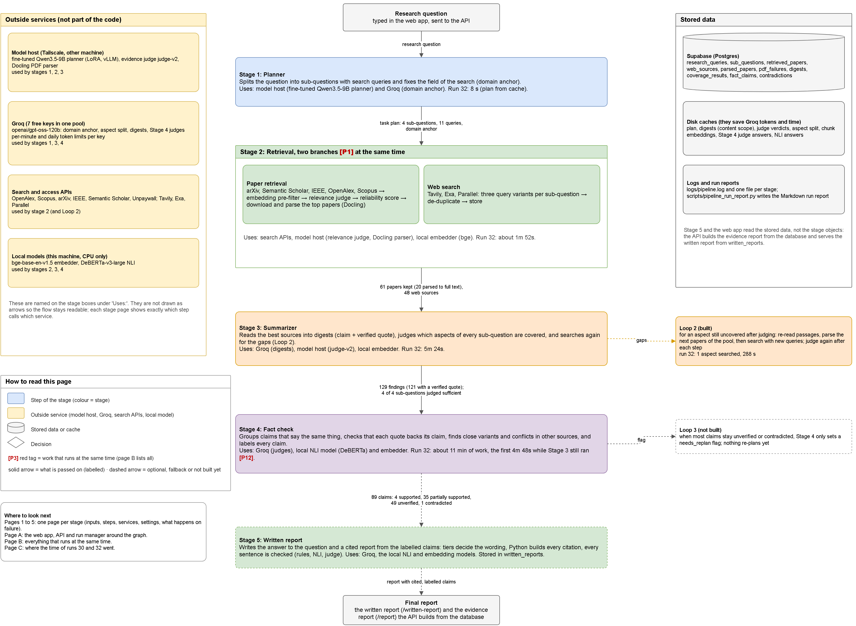
Appendix: whole pipeline diagram
Appendix · Diagram
Blue: planner. Green: retrieval. Orange: summarizer. Purple: fact check. Yellow: outside service. Grey: stored data. [P#]: work that runs at the same time.
Notes:
Page 0 (Overview) of docs/architecture/trace-architecture.drawio, rendered and cropped; it includes the Stage 5 written report. Numbers on the arrows are from run 32. The text is small by design: this is a backup slide.

Slide 26
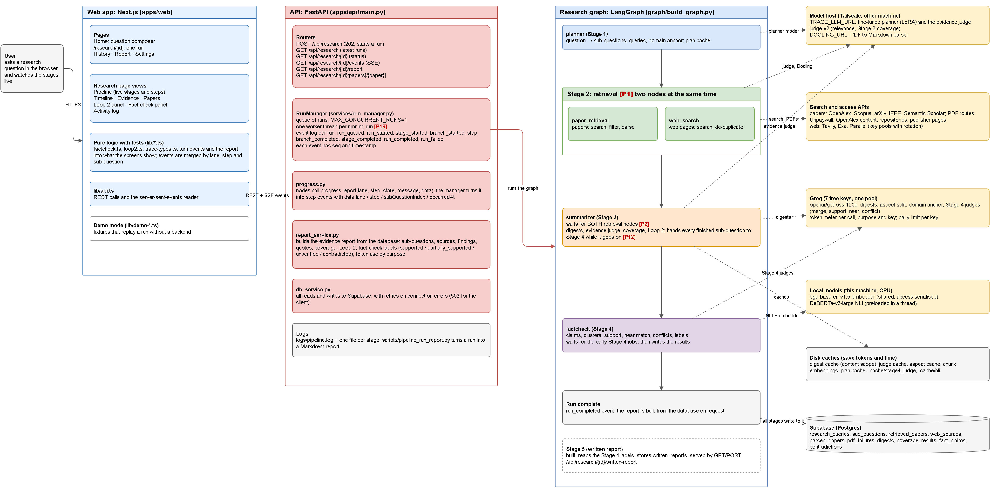
Appendix: system diagram
Appendix · Diagram
Blue: planner. Green: retrieval. Orange: summarizer. Purple: fact check. Yellow: outside service. Grey: stored data. [P#]: work that runs at the same time.
Notes:
Page A (System) of docs/architecture/trace-architecture.drawio, rendered and cropped; it includes the Stage 5 written report. Shows how the Next.js web app, the FastAPI run manager and the LangGraph pipeline fit together, and which outside service each stage calls.

Slide 27
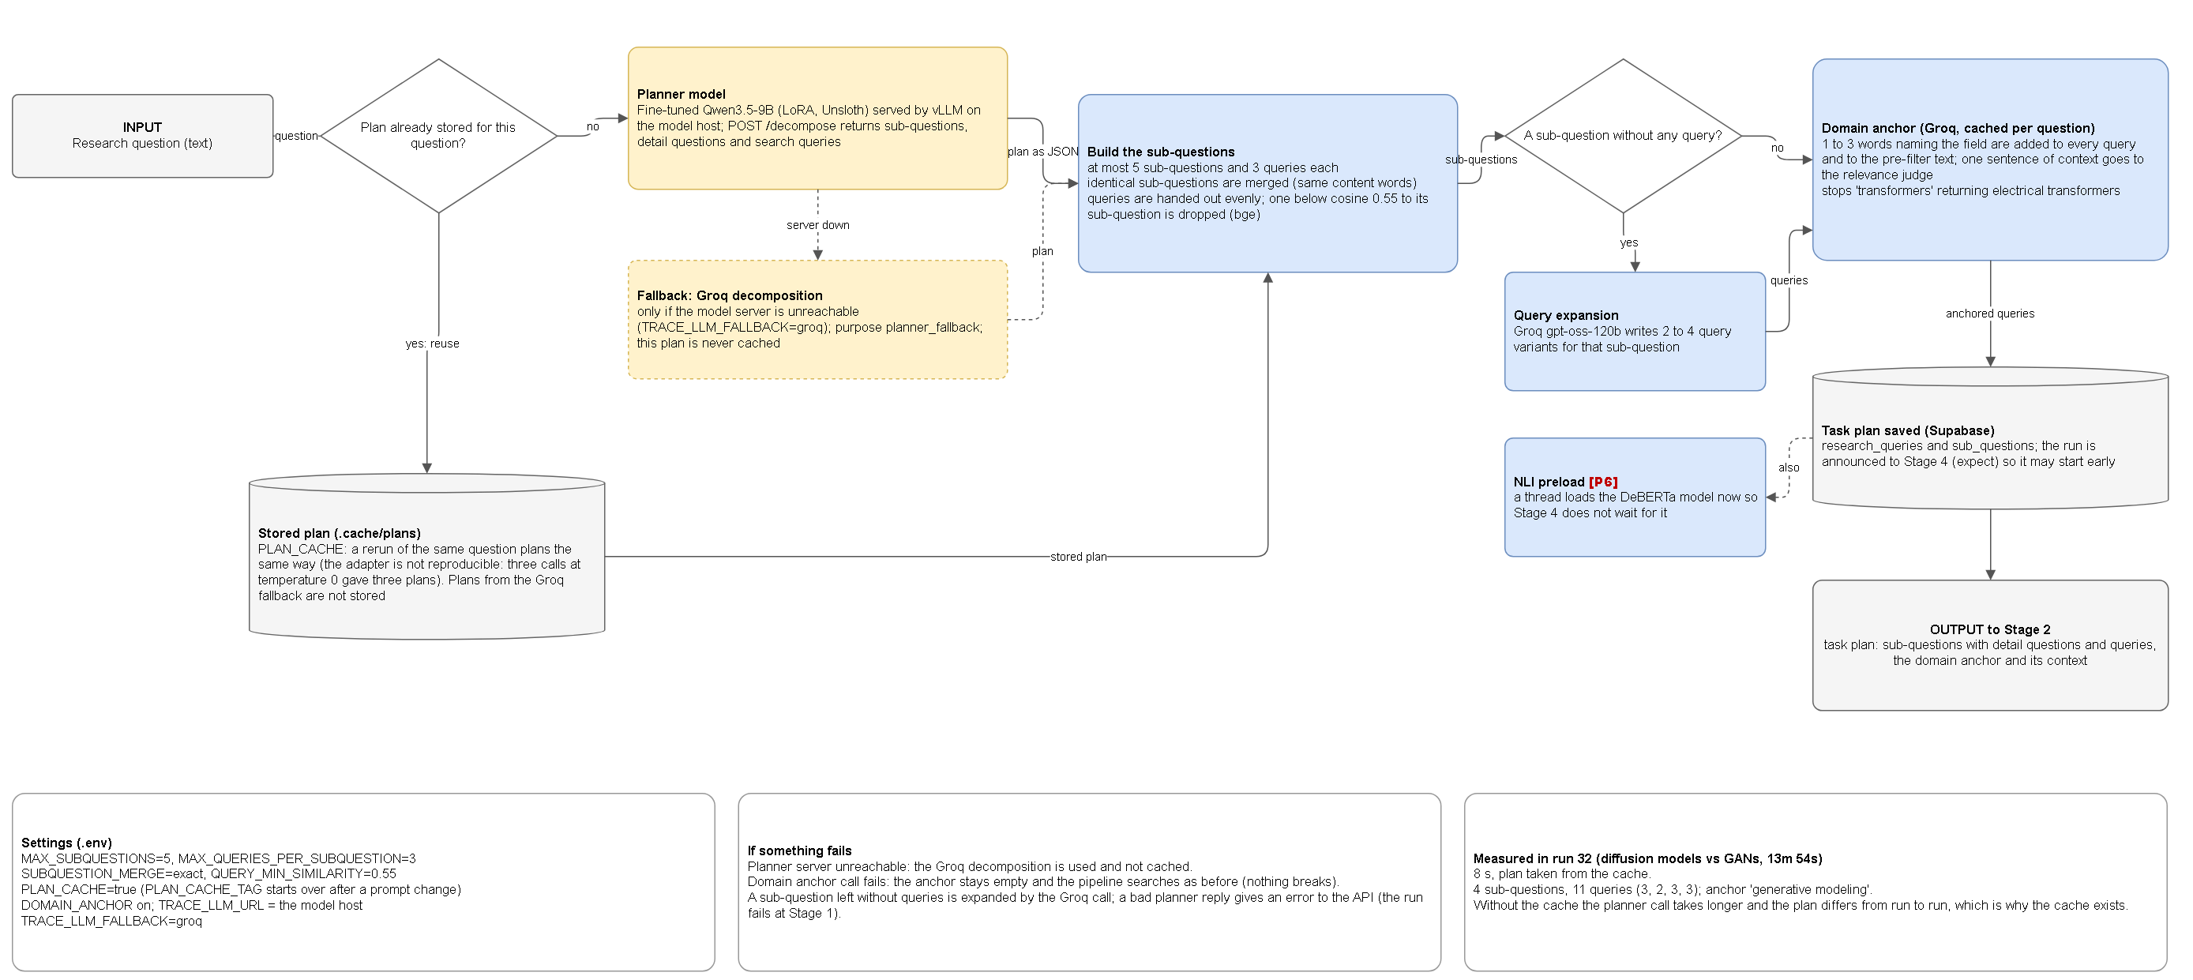
Appendix: Stage 1 diagram
Appendix · Diagram
Blue: planner. Green: retrieval. Orange: summarizer. Purple: fact check. Yellow: outside service. Grey: stored data. [P#]: work that runs at the same time.
Notes:
The repo diagram docs/architecture/trace-architecture-1-stage1-planner.png, cropped. Shows the plan cache check, the fine-tuned Qwen3.5-9B planner on the model host, the Groq fallback, the sub-question build, query expansion and the domain anchor. Run 32: 8 seconds, plan taken from the cache.

Slide 28
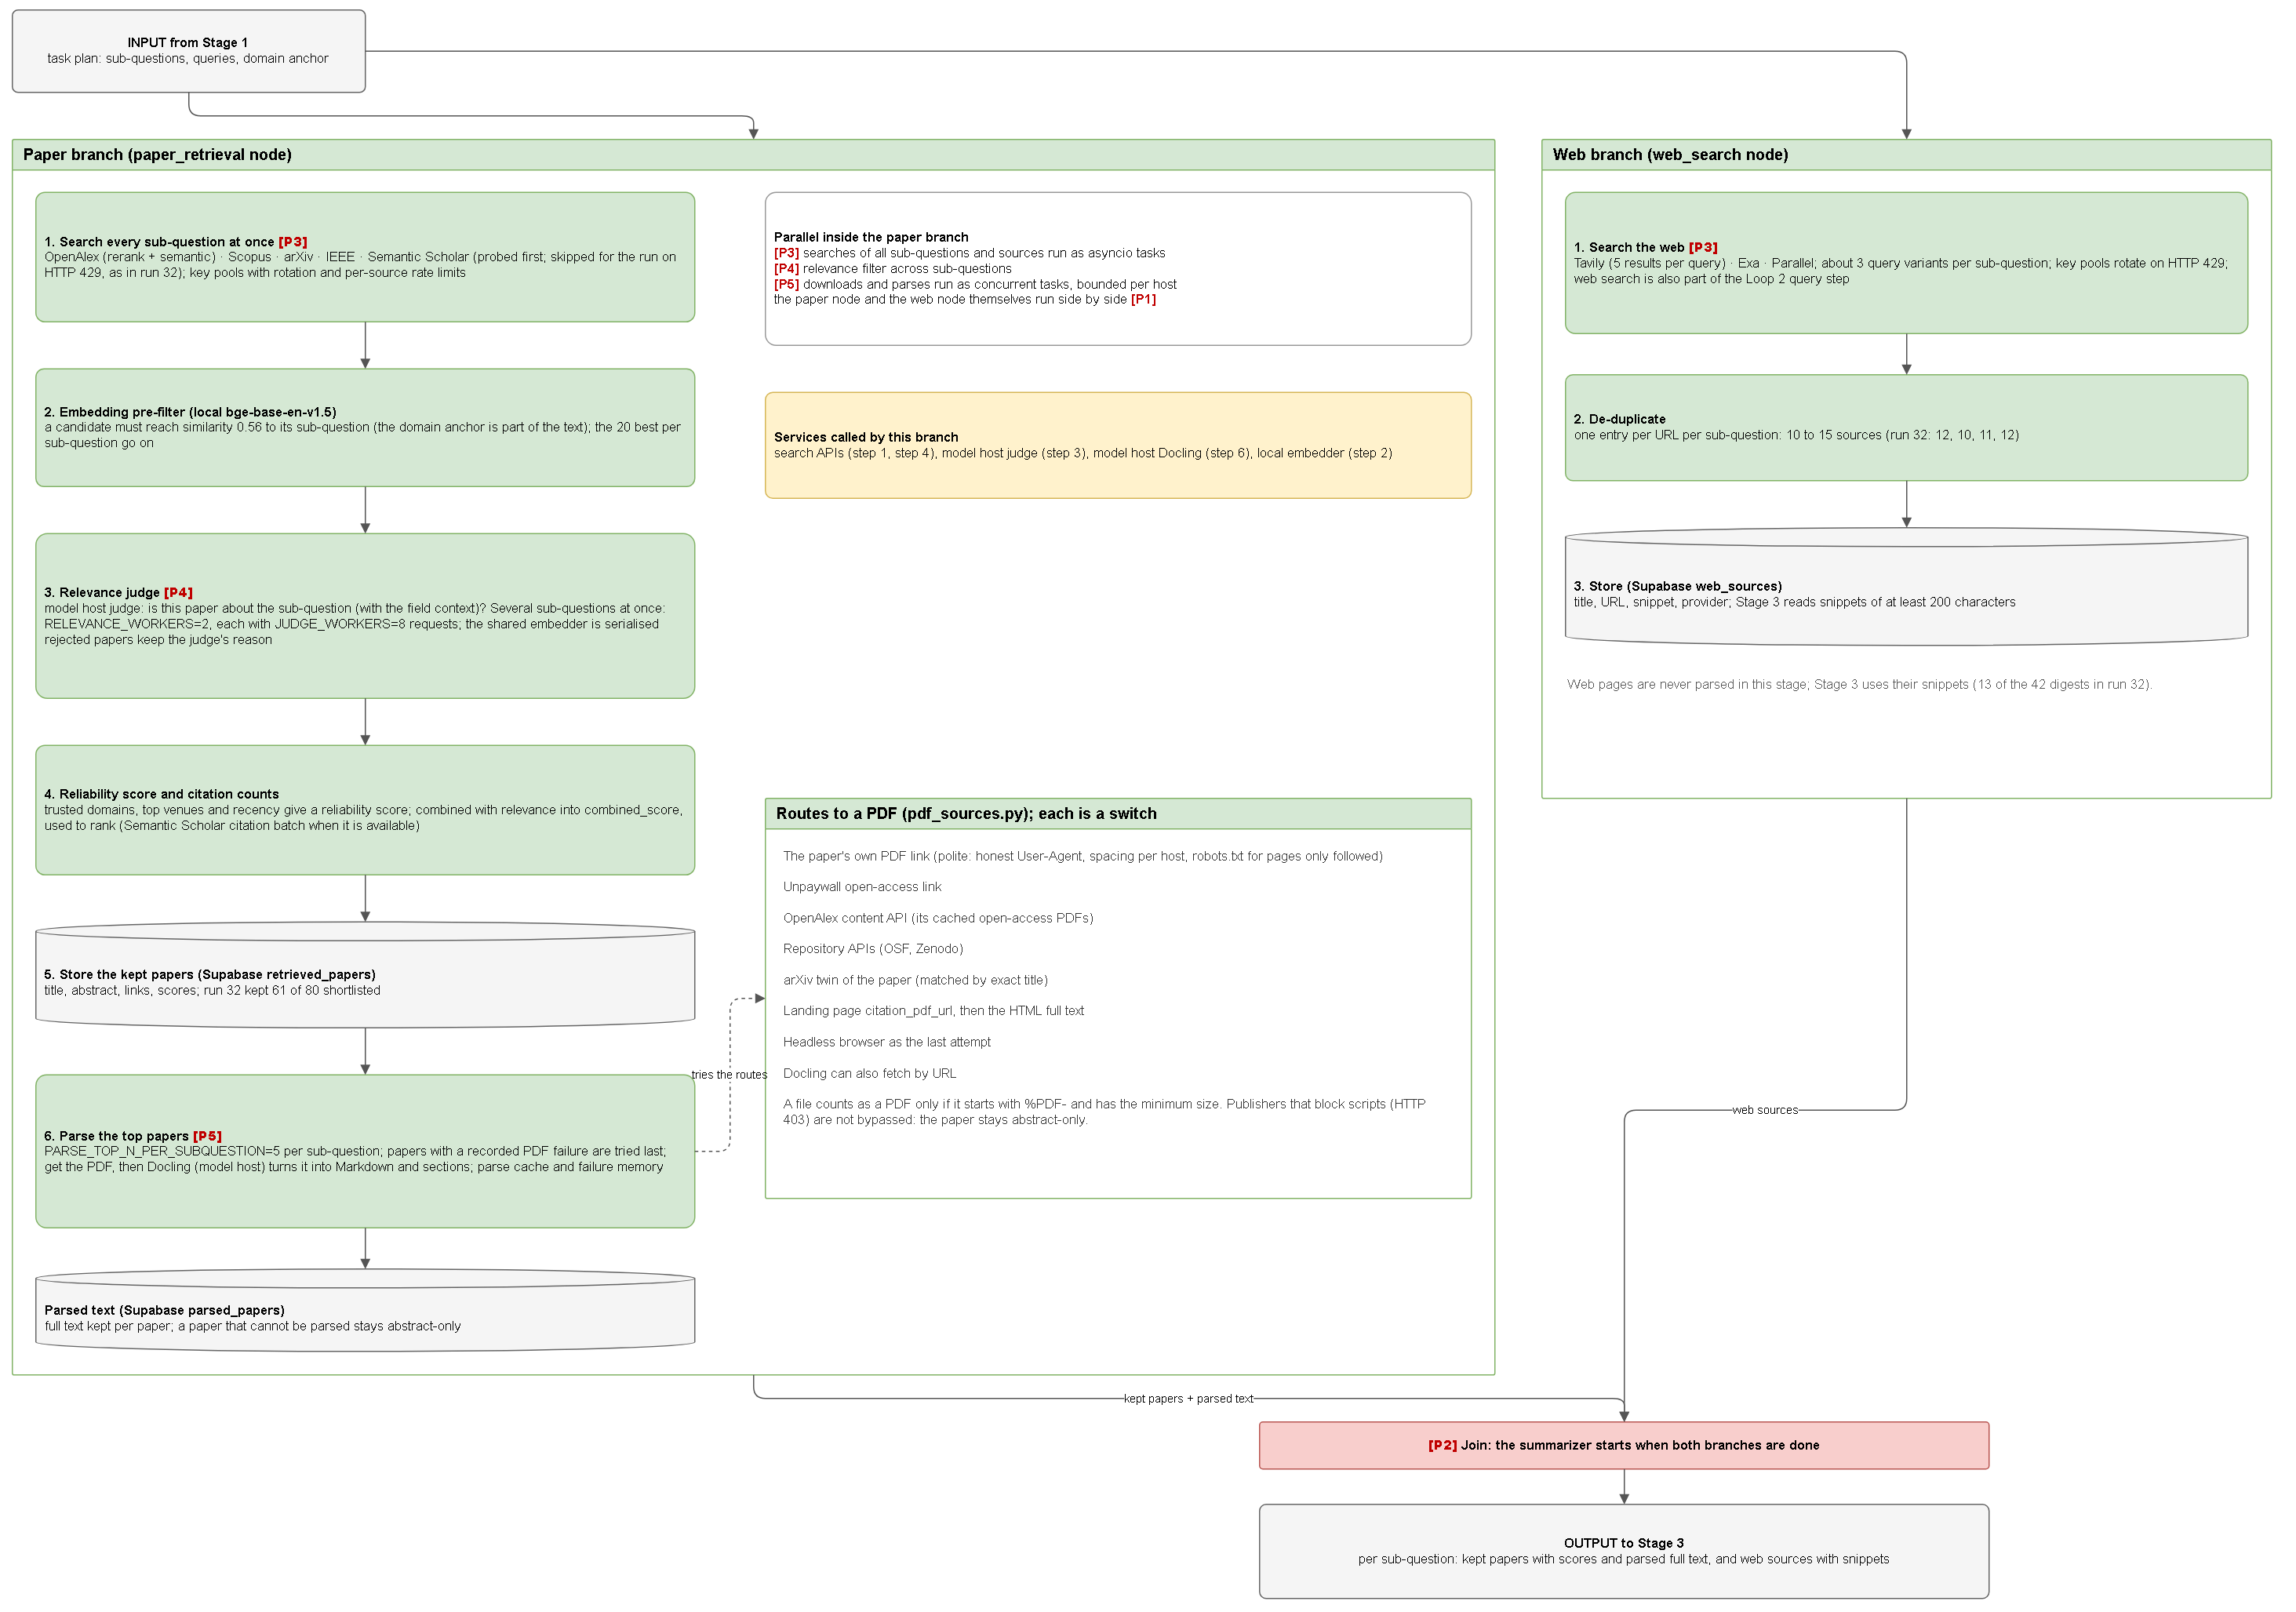
Appendix: Stage 2 diagram
Appendix · Diagram
Blue: planner. Green: retrieval. Orange: summarizer. Purple: fact check. Yellow: outside service. Grey: stored data. [P#]: work that runs at the same time.
Notes:
The repo diagram docs/architecture/trace-architecture-2-stage2-retrieval.png, cropped. Paper branch: search five indexes, embedding pre-filter, relevance judge, reliability score, store, parse with Docling; PDF routes are listed on the right. Web branch: Tavily, Exa and Parallel, de-duplicate, store. In run 32: 368 candidates, 80 shortlisted, 61 kept, 48 web sources.

Slide 29
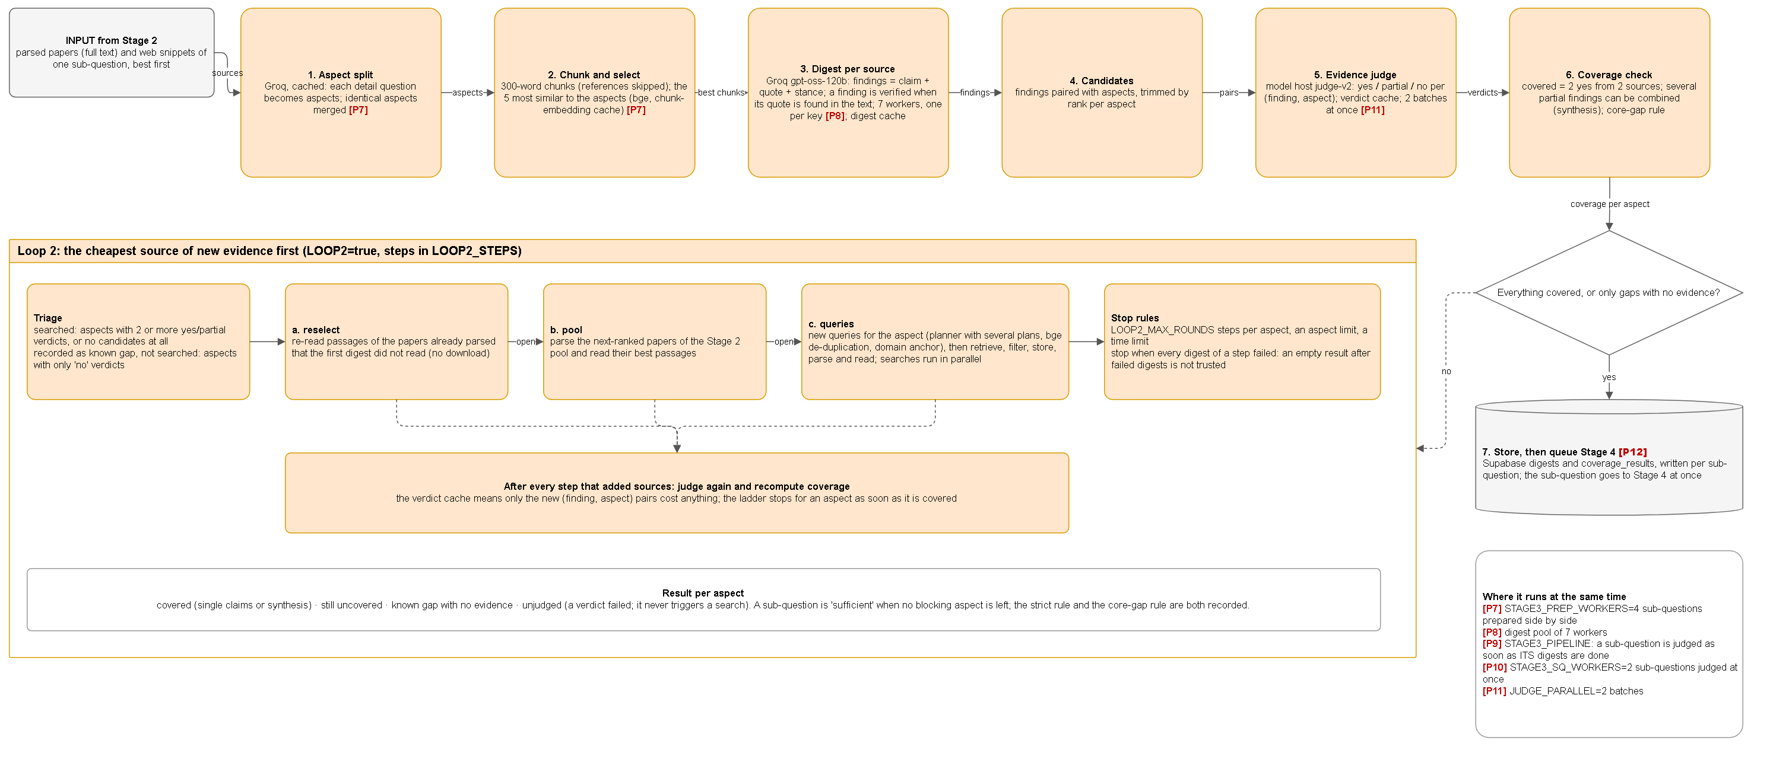
Appendix: Stage 3 diagram
Appendix · Diagram
Blue: planner. Green: retrieval. Orange: summarizer. Purple: fact check. Yellow: outside service. Grey: stored data. [P#]: work that runs at the same time.
Notes:
The repo diagram docs/architecture/trace-architecture-3-stage3-summarizer.png, cropped. Top row: aspect split, chunk selection, digests, candidates, evidence judge, coverage check. Lower box: Loop 2 (triage, reselect, pool, queries, stop rules). Run 32: 129 findings, 121 verified, 4 of 4 sub-questions sufficient.

Slide 30
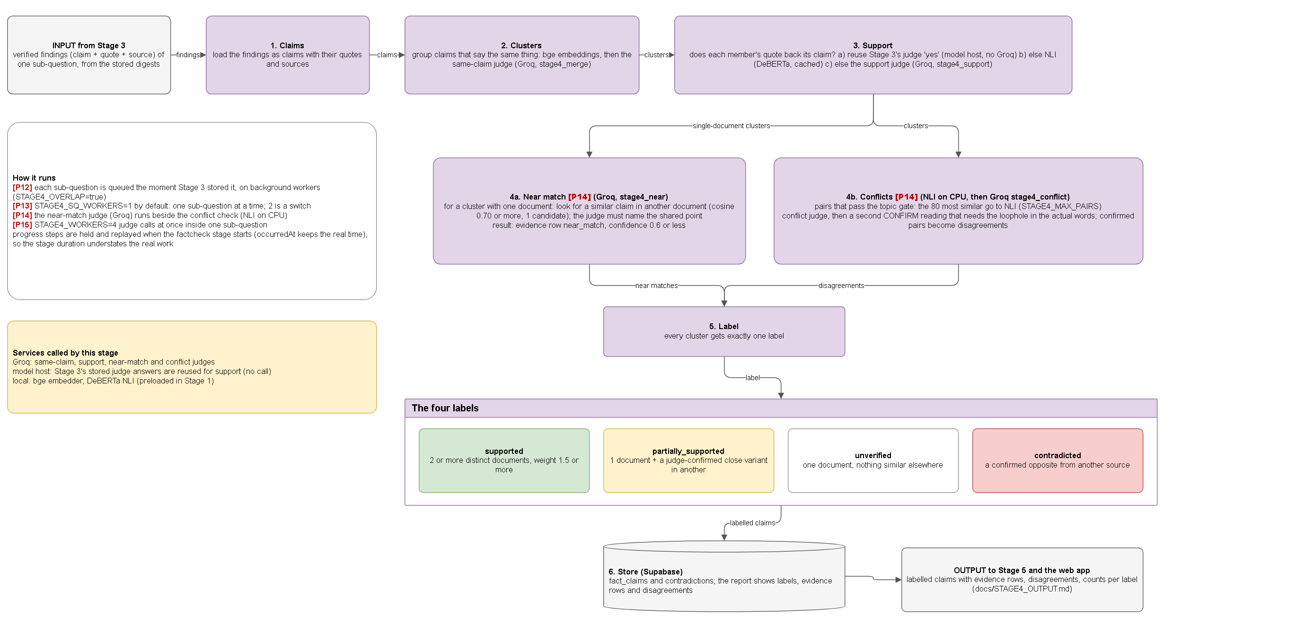
Appendix: Stage 4 diagram
Appendix · Diagram
Blue: planner. Green: retrieval. Orange: summarizer. Purple: fact check. Yellow: outside service. Grey: stored data. [P#]: work that runs at the same time.
Notes:
The repo diagram docs/architecture/trace-architecture-4-stage4-fact-check.png, cropped. Claims, clusters, support, then near match and conflicts side by side, then one label per cluster: supported, partially supported, unverified or contradicted. Run 32: 89 claims, 4 supported, 35 partially supported, 49 unverified, 1 contradicted.

Slide 31
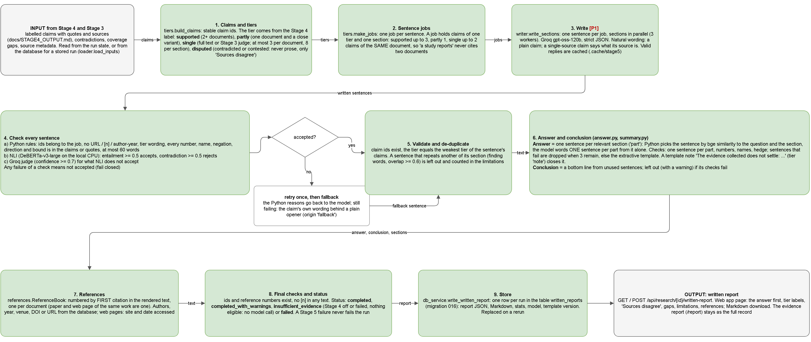
Appendix: Stage 5 diagram
Appendix · Diagram
Green: step of Stage 5. Yellow: outside service or model. Grey: stored data or settings. [P1]: work that runs at the same time.
Notes:
Page 5 (Stage 5: Report) of docs/architecture/trace-architecture.drawio, rendered and cropped. Claims get tiers from the Stage 4 labels; one job per sentence; the model writes one sentence per job; every sentence is checked by Python rules, then NLI, then a judge (fail closed); a sentence that fails twice becomes a fallback sentence; then validate and de-duplicate, answer and conclusion, references, final checks and status, store. Measured on runs 36 and 37: 61 and 69 body sentences, citation precision and recall 1.0 by construction.

Slide 32
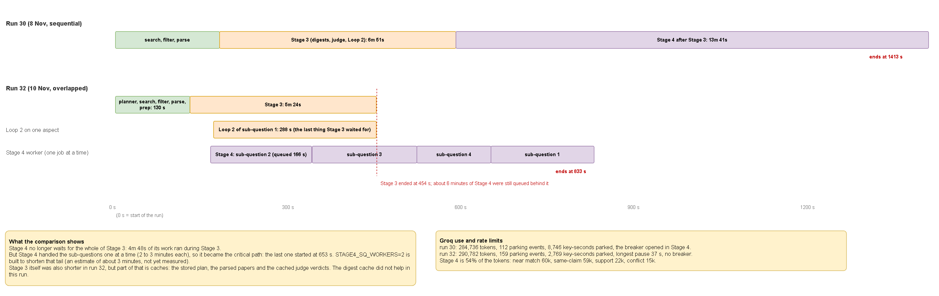
Appendix: run 30 against run 32
Appendix · Diagram
Stage 4 no longer waits for all of Stage 3: 4m 48s of its work ran during Stage 3
But it handled sub-questions one at a time, so it became the critical path
Part of Stage 3’s speed-up comes from caches (plan, parsed papers, judge verdicts)
Notes:
The repo diagram docs/architecture/trace-architecture-C-timeline-runs-30-and-32.png, cropped. Same question, same scale. Stage 4 now starts during Stage 3, but it handled the sub-questions one at a time, so it became the critical path. Part of the Stage 3 speed-up is from caches.

