Slide 1


House Price Analysis in United States
May 2019
Minoru Maeshiro

Slide 2
Structure of Presentation
Objectives
Statistical Analysis
2.1 Data Features
2.2 Cross Sectional Statistics
2.3 Time Series Statistics
3. Optimization models and prediction
3.1 Optimization
3.2 Return prediction with ARIMA models
3.3 Vector Autoregressive models
4. Conclusions

Slide 3
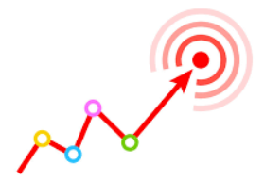
1. OBJECTIVES

Slide 4
OBJECTIVES
Analysis of prices by house size and type of house.
Define the top 10 states for investment in real state.
Create a recommended portfolio and predict its return.

Slide 5

2. STATISTICAL
ANALYSIS

Slide 6
About Descriptive Statistic Analysis
The statistical graphs and reports are structured:
Data Features
Brief resume about data structure: source, size, variables.
Cross Sectional Statistics
Price Houses in 2017 by number of bedrooms
Ratio Price/Rental analysis in 2017 by number of bedrooms
Price Houses in 2017 by type of house
Ratio Price/Rental analysis in 2017 by type of house

Slide 7
2.1 Data features

Slide 8
DATA SOURCE: Kaggle/Zillow
DATA SIZE: 13096 rows, 79 columns
VARIABLES: The summary of variables is:
Region name.
Median listing and rental price 1,2,3,4,5 or more bedrooms (total, by square foot, ZHVI adjusted seasonally, price reduction).
Median listing and rental price condo, duplex, triplex, multifamily, single family (total and by square foot, ZHVI adjusted seasonally, price reduction).

Slide 9
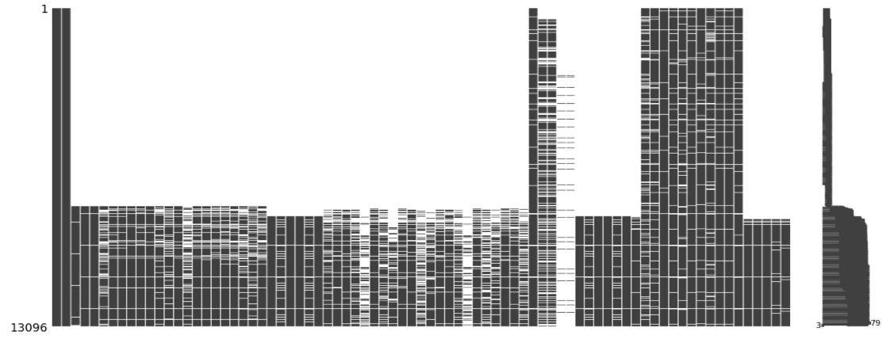
Missing data map
In the structure of the dataset, we can observe several "NAN" spaces. Even so, we can see that in last years (bottom of the graph) there is more information.

Slide 10
2.2 Cross Sectional Analysis

Slide 11
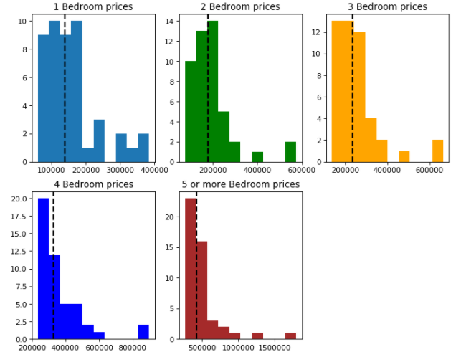
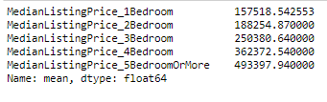
2.2.1 House price by number of bedrooms in 2017

Slide 12
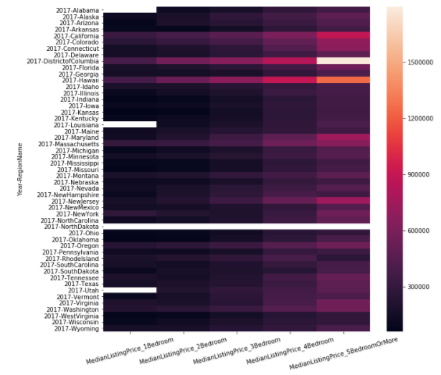
Heatmap by state and number of bedrooms
House prices in 2017

Slide 13
ABOUT PRICES BY NUMBER OF BEDROOMS:
To obtain this graphs, I’ve applied a pivot table taking the median of all 2017 prices by state.
The summary statistics shows an approximate of how much an investor will need to buy a house. As a median of all states in the country, an investor will need between 157.518 to 497.618 $us depending on the number of bedrooms.
According to the heat map, the most expensive houses are in District of Columbia, California and Hawai.
NOTE: The blanks represent NO DATA. I decided to keep the information to know what states have missings.

Slide 14
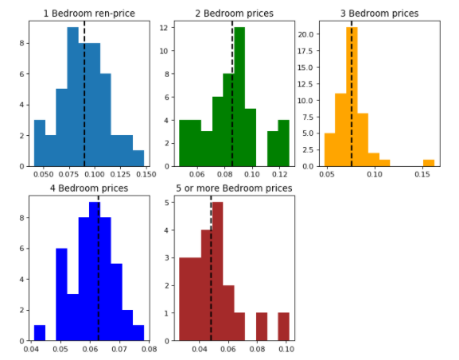
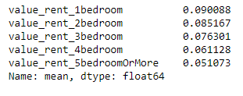
2.2.2 Ratio Annual rent/price by number of bedrooms in 2017

Slide 15
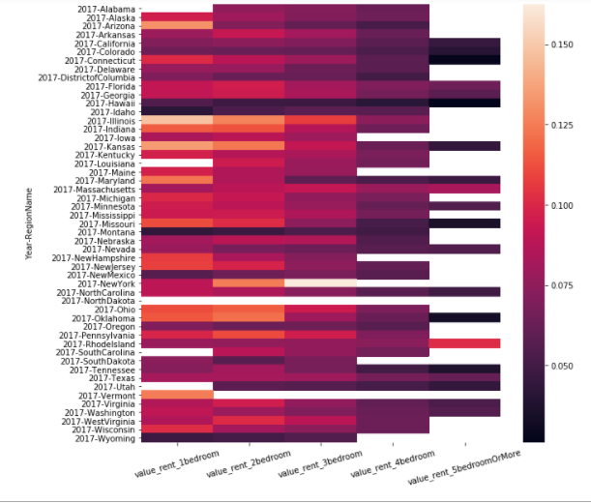
Heatmap by state and number of bedrooms
Ratio Anual Rent/House Price in 2017

Slide 16
ABOUT RATIO ANNUAL RENT/PRICE BY NUMBER OF BEDROOMS:
To obtain this graphs, I’ve applied a pivot table taking the median of all 2017 annual rent by state divided by the house price with specific number of bedrooms
The summary statistics show an approximate of the gross profit of house by calculating the annual rent and house price ratio. It ranges between 0% to 20%.
There is a pattern where more bedrooms relates with a decrease in gross profit. Under the heat map, the combination that show more gross profit are houses between 1 and two bedrooms.
The more profitable combinations are Illinois-one and two bedrooms, Kansas-one and two bedrooms, Arizona-one bedroom
NOTE: The blanks represent NO DATA. I decided to keep the information to know what states have missings.

Slide 17
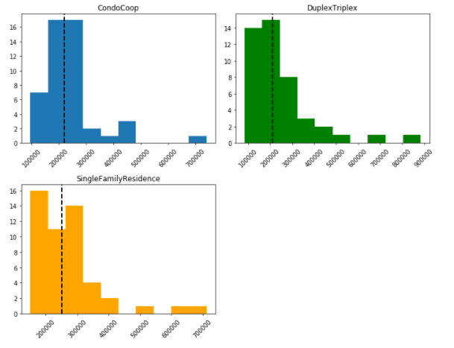

2.2.3 House price by type of house in 2017

Slide 18
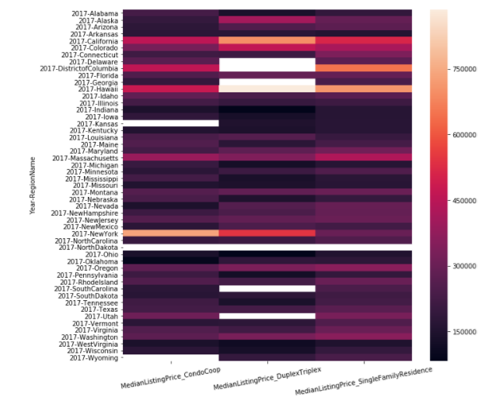
Heatmap by state and type of house
House prices in 2017

Slide 19
ABOUT PRICES BY TYPE OF HOUSE:
To obtain this graphs, I’ve applied a pivot table taking the median of all 2017 prices by type of house.
The summary statistics shows an approximate of how much an investor will need to buy a house. As a median of all states in the country, an investor will need between 241.730 to 270.679 $us depending on the number of bedrooms.
According to the heat map, the most expensive houses are in District of Columbia, California and Hawai.
NOTE: The blanks represent NO DATA. I decided to keep the information to know what states have missings.

Slide 20
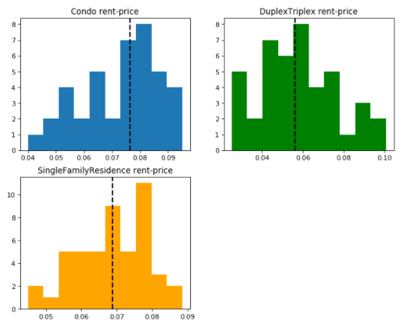

2.2.4 Ratio Annual rent/price by type of house in 2017

Slide 21
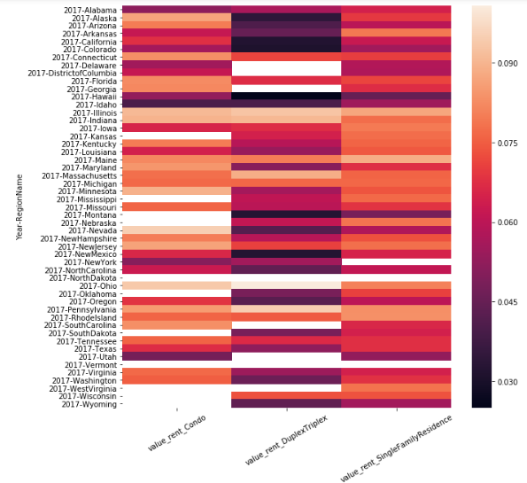
Heatmap by state and type of houses
Ratio Anual Rent/House Price in 2017

Slide 22
ABOUT RATIO ANNUAL RENT/PRICE BY TYPE OF HOUSE:
To obtain this graphs, I’ve applied a pivot table taking the median of all 2017 annual rent by state divided by the different type of house price.
The summary statistics show an approximate of the gross profitability of house by calculating the annual rent and house price ratio. It ranges between 0% to 12%.
There is a pattern where more bedrooms relates with a decrease in gross profitability. Under the heat map, the combination that show more gross profitability are condos.
NOTE: The blanks represent NO DATA. I decided to keep the information to know what states have missings.

Slide 23
2.3 Time Series Analysis

Slide 24
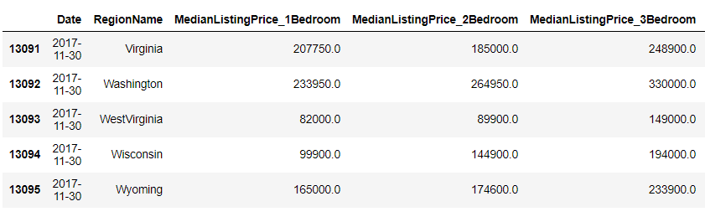
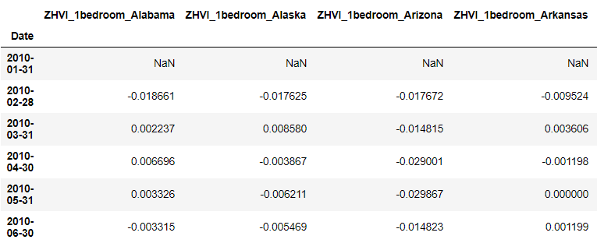
TRANSFORMING THE TABLES:
For the time series analysis, I’ve tried to structure the dataset as a group of assets. The original tables were:
The new tables are:
If we keep the last structure. There will be 5 features by each state. For example: Alabama_1bedroom, Alabama_2bedrooms….Alabama_5 or more bedrooms.

Slide 25
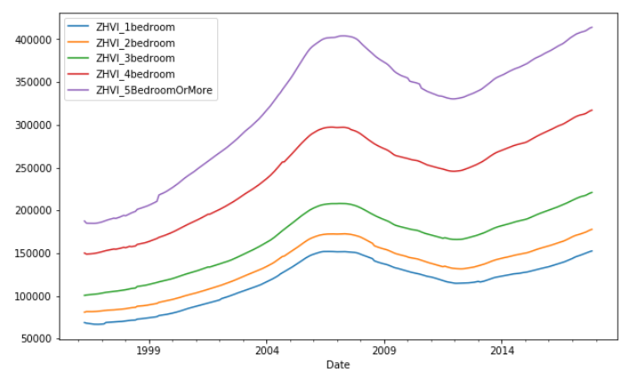
2.3.1 Historic Prices 1996-2017 by number of bedrooms
We can see in this graph the behavior of house prices as an average of all states for the different number of bedrooms. The lines follow the same pattern where we can observe how the financial crisis affected the price in the period 2008-2012.

Slide 26
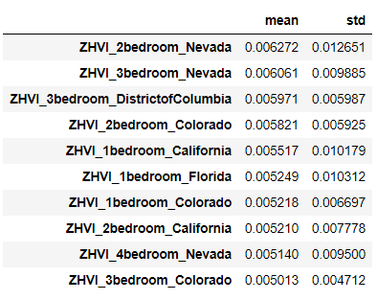
REDUCING DATA SET:
I’ve decided to reduce the dataset. I’ve follow the next steps:
I’ve reduced the timeframe horizon from 2010-2017 for two reasons: 1) Less missing data, 2) This timeframe contemplates the prices after the financial crisis in 2008.
I’ve applied the monthly percentage increase rate as a measure of return.
I’ve chosen the top10 assets (columns) with the highest returns in that timeframe horizon.

Slide 27
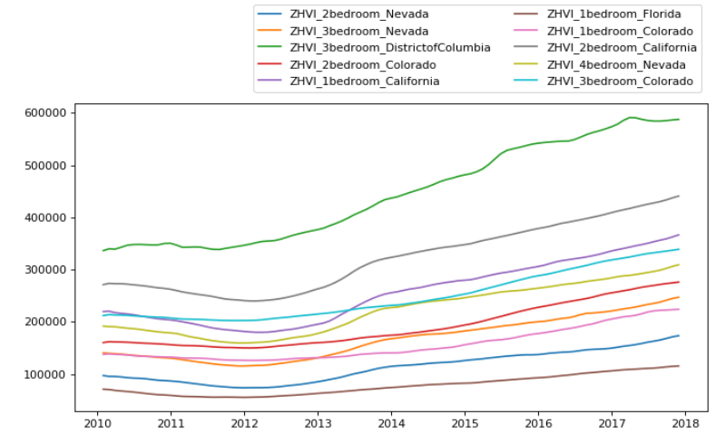
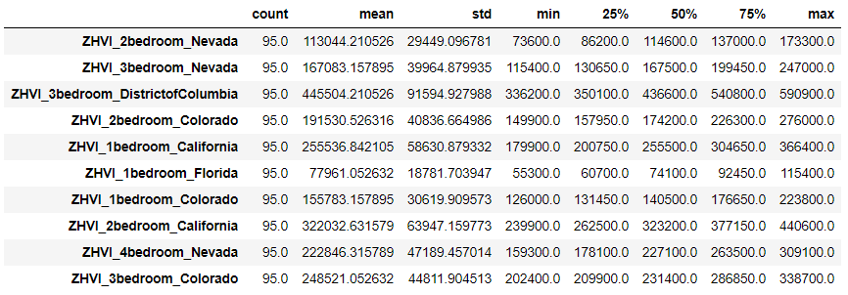
2.3.2 Historic Prices 2010-2017 (Based in Top ten return state-number of bedrooms combinations)
We can observe that all combinations state-number of bedrooms have a positive tendency after 2012.
It is interesting to observe that the average prices of 1 and 2 bedroom in California are above other 2 and 3 bedrooms in other states.

Slide 28
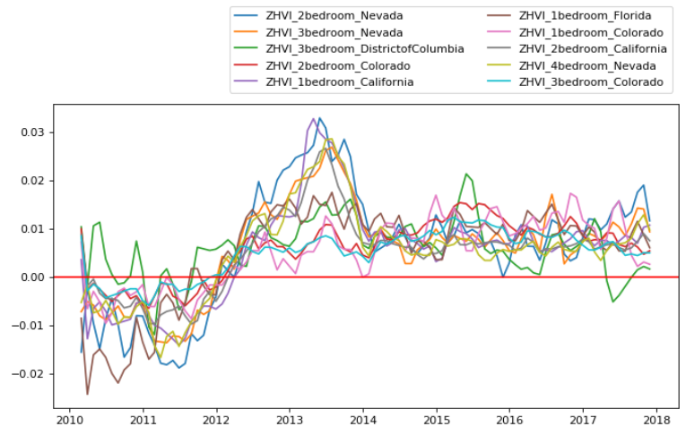
2.3.3 Historic Return 2010-2017 (Top ten return combinations)
The red line shows that after 2012, every combination state-number of bedrooms return is positive (Investors never lose in this period). There is just one exception with district of Columbia that shows negative returns in the year 2017.

Slide 29

3. Prediction and Optimization

Slide 30
3.1 Optimization

Slide 31
SPECIFICATION (Objectives and constraints):
I’ve applied this specifications to choose the optimal portfolio of the top10 assets selected in the previous section:
Objective:
Maximize cumulative return
Constraints:
Sumatory weights=1
Each weight not higher than 0.5

Slide 32
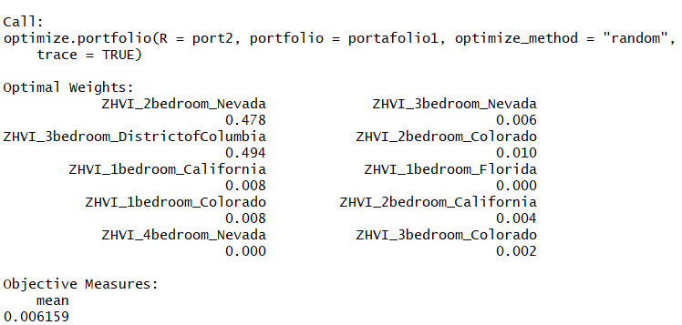
Optimization Output
According to the portfolio optimizer shareholders should invest in: 2bedrooms_Nevada (47.8%), 3bedrooms_DistricColumbia (49.4%) and the rest (less than 1%) in the other alternatives from this top10 price houses.

Slide 33
3.2 Returns predictions with ARIMA

Slide 34
In the ipython notebook I’ve created forloops to identify the stationarity of the series and the best Arima process (pdq) for the top ten stocks (house-number of bedrooms).
However, for the presentation, I’ve developed a more detailed analysis over the two main stocks according our portfolio optimization (previous section):
ZHVI_2bedroom_Nevada.
ZHVI_3bedroom_DistrictofColumbia.

Slide 35
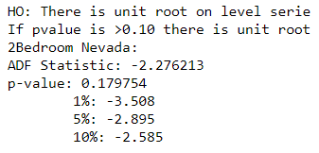
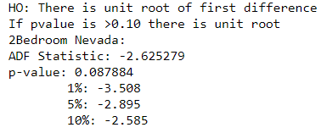
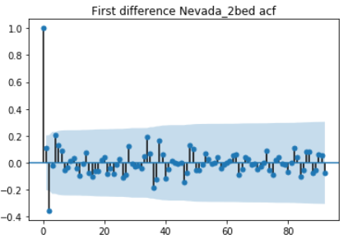
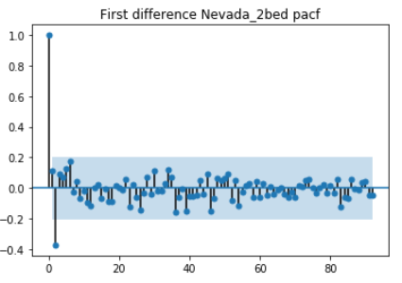
ZHVI_2bedroom_Nevada: Dickey Fuller and correlograms
According Dickey Fuller, we don’t reject Ho in level serie (level serie is not stationary). Therefore we’ve difference and run again Dickey Fuller (First difference is stationary at 10% confidence level). Then, let’s look the correlograms to define AR and MA:

Slide 36
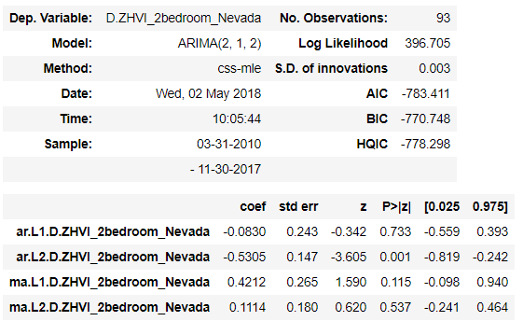
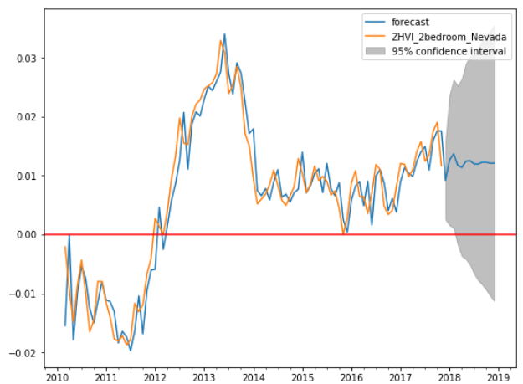
ZHVI_2bedroom_Nevada: ARIMA and forecasting
According to Dickey Fuller test and correlograms, I’ve chosen ARIMA (2,1,2)
The forecasting plot shows that the return for this asset (Nevada-2berooms) will have a monthly return over 1%. Just a small portion of the confidence interval lies in the negative return zone.

Slide 37
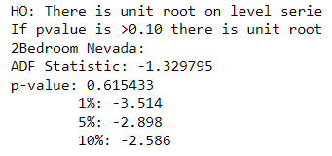
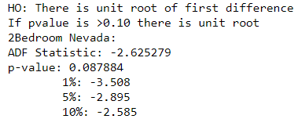
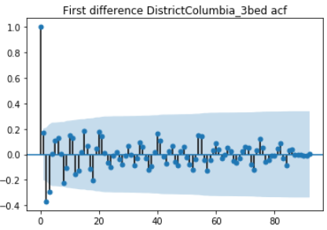
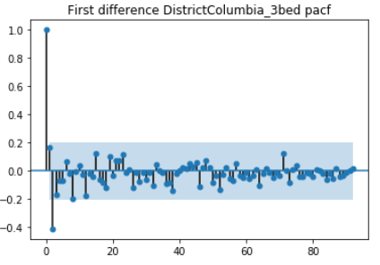
ZHVI_3bedroom_DistrictColumbia: Dickey Fuller and correlograms
According Dickey Fuller, we don’t reject Ho in level serie (level serie is not stationary). Therefore we’ve difference and run again Dickey Fuller (First difference is stationary at 10% confidence level). Then, let’s look the correlograms to define AR and MA:

Slide 38
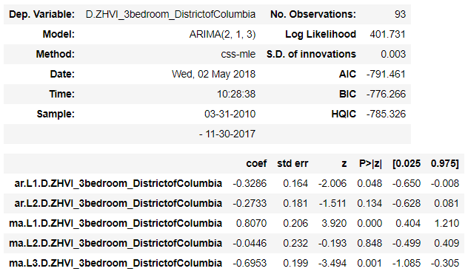
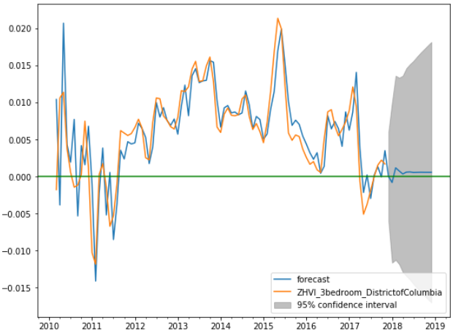
ZHVI_3bedroom_DistrictColumbia: ARIMA and forecasting
According to Dickey Fuller test and correlograms, “ive chose ARIMA (2,1,3)
The forecasting plot shows that the return for this asset (Nevada-2berooms) will have a monthly return over 1%. However a bigger portion (comparing with 2beds_Nevada) of the confidence interval lies in the negative return zone.

Slide 39
3.3 Vector Autoregressive

Slide 40
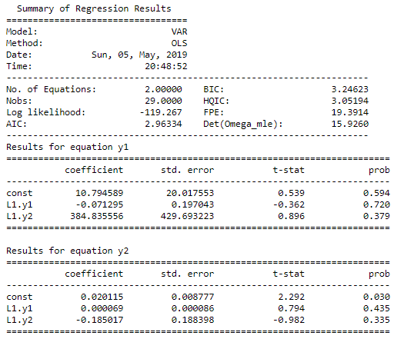
VAR: ZHVI_3bedroom_DistrictColumbia, gdp_District of Columbia
In order to improve the analysis, I’e used external datasets (beyond Zillow). I’ve chosen Quartely Gross Domestic Product (https://www.bea.gov/data/gdp/gross-domestic-product) The idea is to analyze the relation through time of assets and GDP

Slide 41
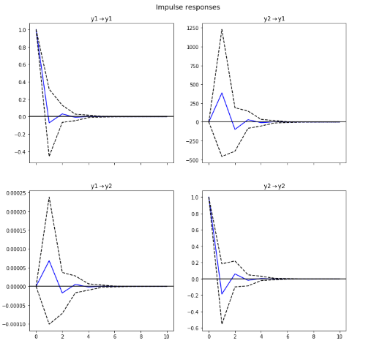
Impulse Response Function
We can see there is a positive reaction of GDP with variation of prices of the asset and, it converges at the second period. The same logic applyes with asset price reaction with a variation of GDP.

Slide 42
3. Conclusions

Slide 43
We've analyzed price houses in United States by state. We've create two types of analysis: static and dynamic.
For the cross-sectional statistical analysis I've created average prices for each state by number of bedrooms and type of houses. Later, I've analyzed the gross profits (anual rent/house prices). The best combination for investment will be in Illinois for one or two bedrooms, Kansas for one or two bedrooms and Arizona for one bedroom.
For time series analysis, I've analyzed each combination State-Number of bedrooms as a stock. I've generated the monthly return of each stock, and I've selected the top ten stocks-returns. Then I've applied optimization methods (maximizing the return) to choose the best investment. Under this methodology, the best investment is in 2 bedroom_Nevada and 3 bedroom_District of Columbia.

Slide 44
Further considerations:
Depending our objectives and the methodology of analysis, we have different investment options. For example, we can create another optimization portfolio maximizing return and minimizing variation of house prices.
The analysis can be improved with more robust methodologies such as multiple variables in Vector Autoregressive.

Slide 45
ANNEX 1
Programming details

Slide 46
Script or programming activities
The following are the main script or programming activities:
Notebook Presentation
Created an iPython navigator to check different sections of the project.
Introduced graphics to main sections
Dataframes Manipulation:
Transforming datatypes (Ex: objects to datetime)
Exploring missings through missmaps.
Subsetting dataframes with loc, iloc functions.
Worked dataframes with one and two level indexes.
Created special tables with groupby and pivot tables.
Created new variables using lambda functions.

Slide 47
Script or programming activities 2
Visualization
Created histograms and subplots with matplotlib.
Created heat maps with seaborn.
Created timeseries maps indexing time (worked with list for titles).
Modelling
Worked with Portfolioanalytics optimized to get an optimal portfolio (R software).
Worked with nested loops to analyze stationarity.
Worked with nested loops to get ARIMAS order over selected features (Autoarima). (Note: Not same results as manual analysis).
Worked with nested loops to run ARIMAS regressions.

