Slide 1
Fast Approximate Wavelet Tracking on Streams
Graham Cormode
cormode@bell-labs.com
Minos Garofalakis
minos.garofalakis@intel.com
Dimitris Sacharidis
dsachar@dblab.ntua.gr

Slide 2
outline
introduction
  motivation
  problem formulation
background
  wavelet synopses
  the AMS sketch
the GCS algorithm
  our approach
  the Group Count Sketch
  finding L₂ heavy items
  sketching the wavelet domain
experimental results
conclusions

Slide 3
motivation
numerous emerging data management applications require to continuously generate, process and analyze massive amounts of data
  e.g. continuous event monitoring applications: network-event tracking in ISPs, transaction-log monitoring in large web-server farms
the data streaming paradigm
  large volumes (~Terabytes/day) of monitoring data arriving at high rates that need to be processed on-line
analysis in data streaming scenarios rely on building and maintaining approximate synopses in real time and in one pass over streaming data
  require small space to summarize key features of streaming data
  provide approximate query answers with quality guarantees

Slide 4
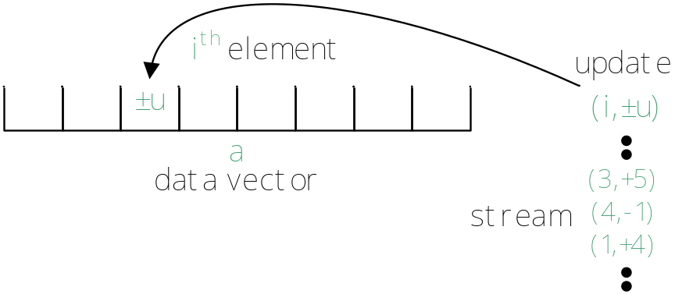
problem formulation
our focus: maintain a wavelet synopsis over data streams
algorithmic requirements:
  small memory footprint (sublinear in data size)
  fast per stream-item process time (sublinear in required memory)
  fast query time (sublinear in data size)
  quality guarantees on query answers
stream processing model
assume data vector a of size N
stream items are of the form (i,±u)
denoting a net change of ±u in the a[i] entry a[i] := a[i] ± u
interpretation
u insertions/deletions of the i^{th} entry
(we also allow entries to take negative values)
important
items are only seen once in the fixed order of arrival and do not come ordered in i

Slide 5
outline
introduction
  motivation
  problem formulation
background
  wavelet synopses
  the AMS sketch
the GCS algorithm
  our approach
  the Group Count Sketch
  finding L₂ heavy items
  sketching the wavelet domain
experimental results
conclusions

Slide 6
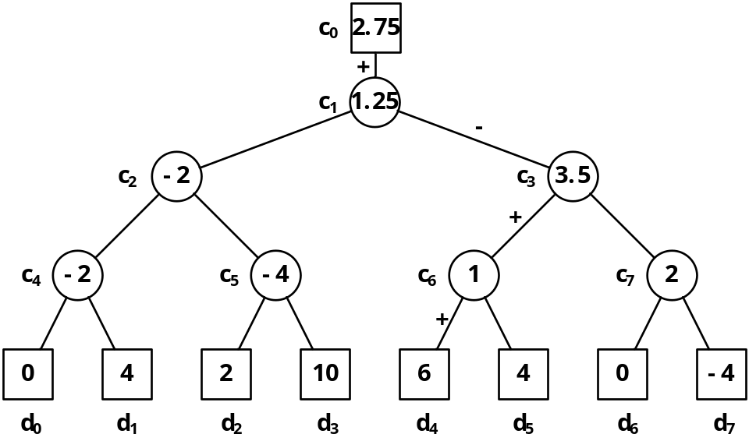
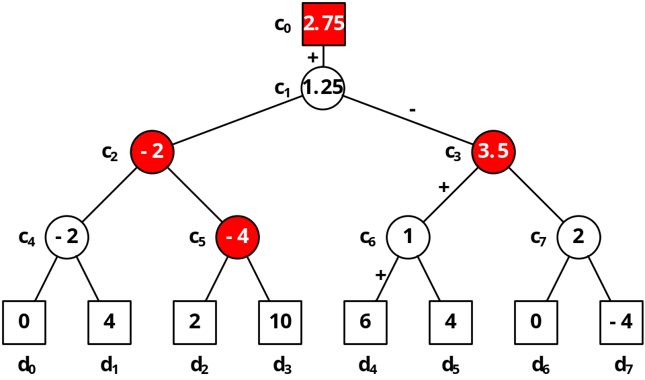
wavelet synopses
the (Haar) wavelet decomposition hierarchically decomposes a data vector
  for every pair of consequent values, compute the average and the semi-difference (a.k.a. detail) values (coefficients)
  iteratively repeat on the lower-resolution data consisting of only the averages
  final decomposition is the overall average plus all details
to obtain the optimal, in sum-squared-error sense, wavelet synopsis only keep the highest in absolute normalized value coefficients
  implicitly set other coefficients to zero
easily extendable to multiple dimensions

Slide 7
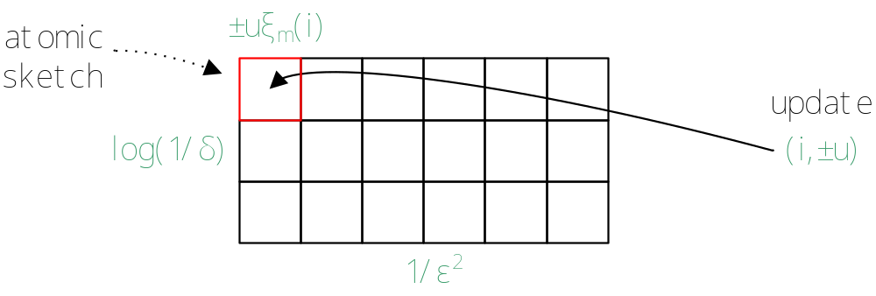
the AMS sketch (1/2)
the AMS sketch is a powerful data stream synopsis structure serving as the building block in a variety of applications:
  e.g.: estimating (multi-way) join size, constructing histograms and wavelet synopses, finding frequent items and quantiles
it consists of O(1/ε²) × O(log(1/δ)) atomic sketches
an atomic AMS sketch X of a is a randomized linear projection
  X = <a,ξ> = Σ_{i} a[i]ξ(i) , where ξ denotes a random vector of four-wise independent random variables {±1}
  the random variable can be generated in just O(logN) bits space for seeding, using standard pseudo-random hash functions
X is updated as stream updates (i, ±u) arrive: X := X ± uξ(i)

Slide 8
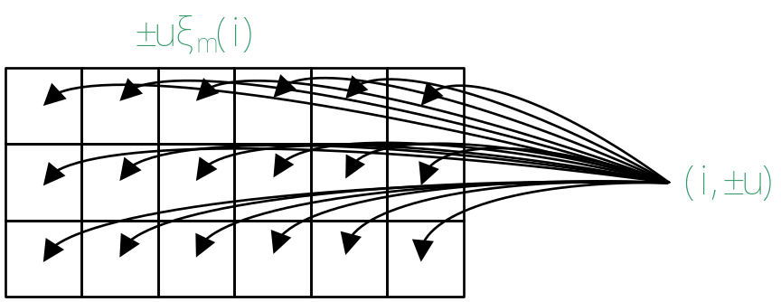
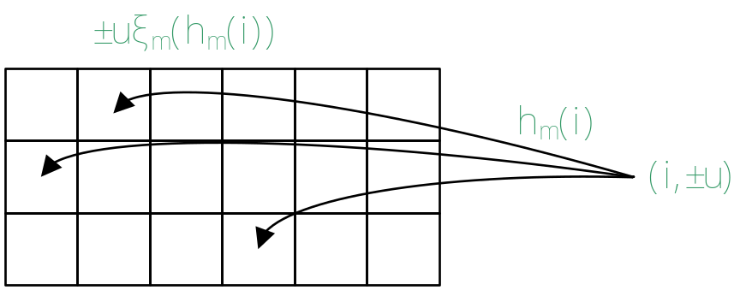
the AMS sketch (2/2)
the AMS sketch estimates the L₂ norm (energy) of a
  let Z be the O(log(1/δ))-wise median of O(1/ε²)-wise means of the square of independent atomic AMS sketches
  then Z estimates ||a||² within ±ε||a||² (w.h.p. ≥1-δ)
  it can also estimate inner products
an improvement: fast AMS sketch
  introducing a level of hashing reduces update time by O(1/ε²) while providing the same guarantees and requiring same space

Slide 9
outline
introduction
  motivation
  problem formulation
background
  wavelet synopses
  the AMS sketch
the GCS algorithm
  our approach
  the Group Count Sketch
  finding L₂ heavy items
  sketching the wavelet domain
experimental results
conclusions

Slide 10
our approach (1/3)
two shortcomings of existing approach [GKMS] (using AMS sketches):
updating the sketch requires O(|sketch|) updates per streaming item
querying for the largest coefficients requires superlinear Ω(NlogN) time (even when using range-summable random variables)
  blows up in the multi-dimensional case
can we fix it? use the fast-AMS sketch to speed up update time (not enough)
we introduce the GCS algorithm that satisfies all algorithmic requirements
makes summarizing large multi-dimensional streams feasible
streaming requirements | GKMS | fast- GKMS | GCS
small space | ✓ | ✓ | ✓
fast update time | × | ✓ | ✓
fast query time | × | × | ✓

Slide 11
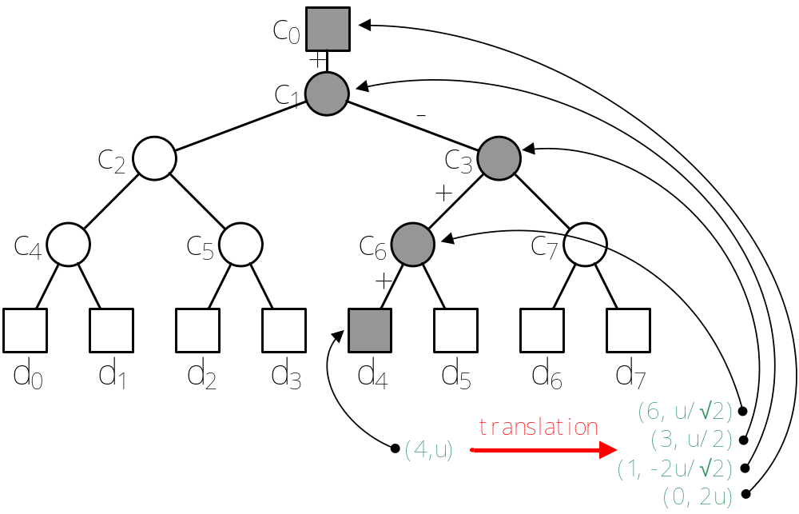
our approach (2/3)
the GCS algorithm relies on two ideas:
(1) sketch the wavelet domain
(2) quickly identify large coefficients
(1) is easy to accomplish: translate updates in the original domain to updates in the wavelet domain
  just polylog more updates are required, even for multi-d

Slide 12
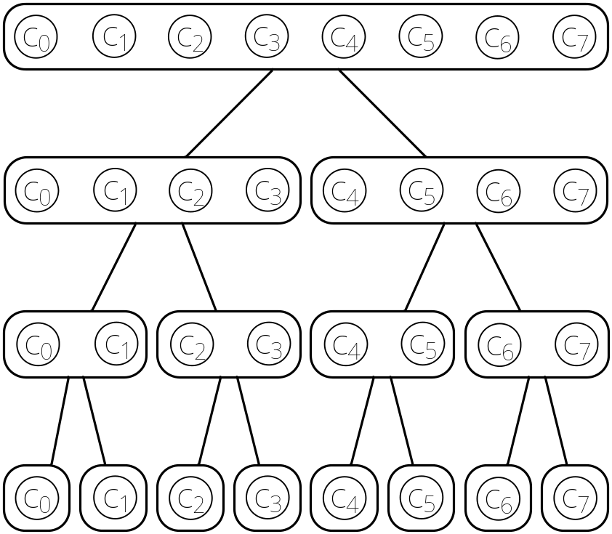
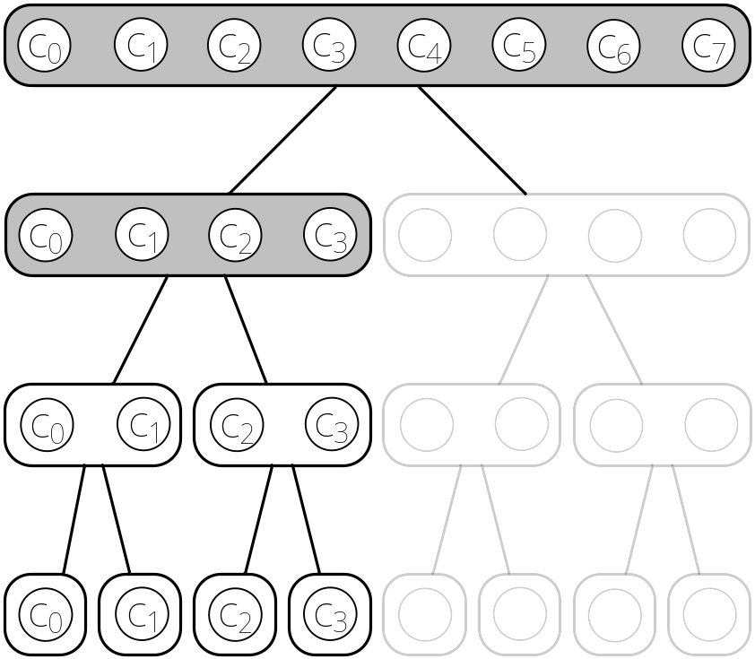
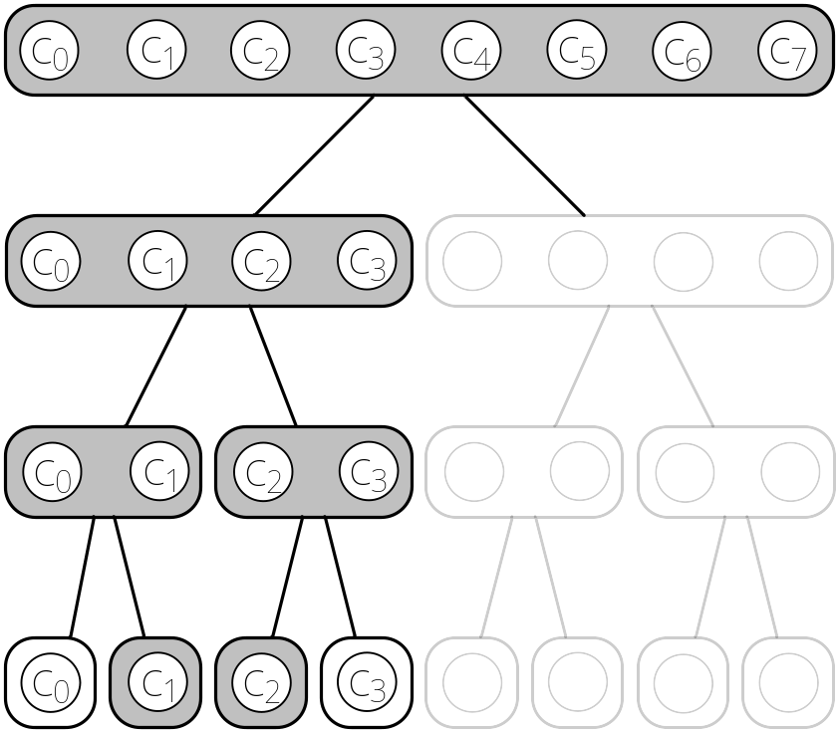
our approach (3/3)
for (2) we would like to perform a binary-search-like procedure
enforce a hierarchical grouping on coefficients
prune groups of coefficients that are not L₂-heavy, as they may not contain L₂-heavy coefficients
only the remaining groups need to be examined more closely
iteratively keep pruning until you reach singleton groups
but, how do we estimate the L₂ (energy) for groups of coefficients?
this is a difficult task, requiring a novel technical result
more difficult than finding frequent items!
enter group count sketch

Slide 13
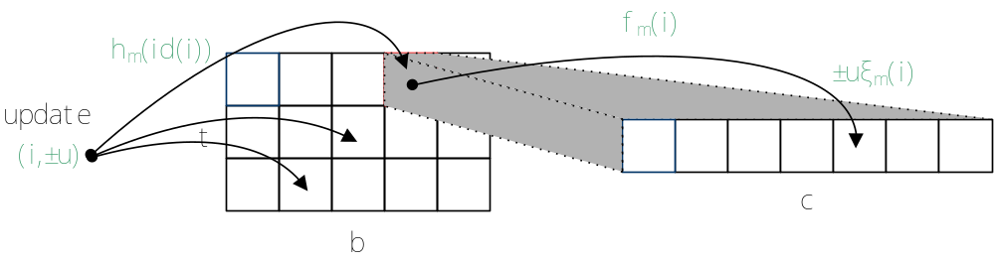
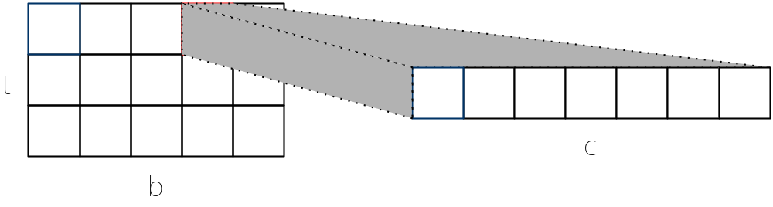
group count sketch (1/2)
goal: estimate the L₂ of all k groups forming a partition on the domain of a
the group count sketch (GCS) consists of b buckets each having c sub-buckets, repeated t times
this gives a total of t·b·c counters s[1][1][1] through s[t][b][c]
update the sketch per stream element (i, ±u)
repeat t times:
get item’s group -> hash into a bucket -> hash into a sub-bucket -> update counter by {±1}·u
id identifies the group of an item
h_{m} hashes groups into buckets
f_{m} hashes items into sub-buckets
4-wise random variables {±1} ξ_{m}

Slide 14
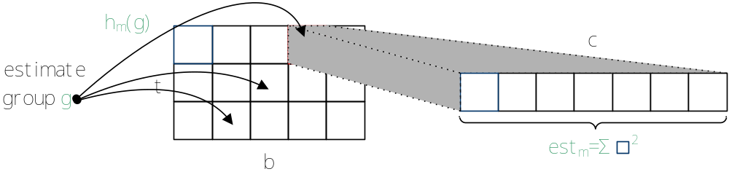
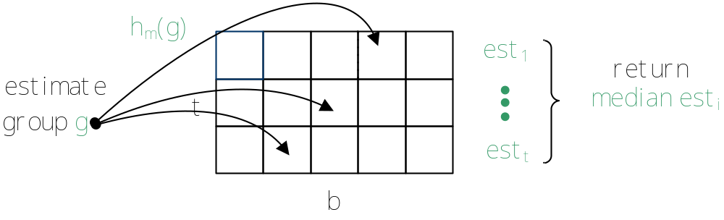
group count sketch (2/2)
estimate L₂ of group g
  return the median of m instances of Σ_{j} (s[m][h_{m}(g)][j])² for all j in [c]
  estimates are (w.h.p. 1-δ) within additive error ε·||a||²
analysis results: t=O(log(1/δ)) b=O(1/ε) c=O(1/ε²)
      space O(1/ε³ log(1/δ)) counters
      update cost O(log(1/δ))
      query cost O(1/ε² log(1/δ)

Slide 15
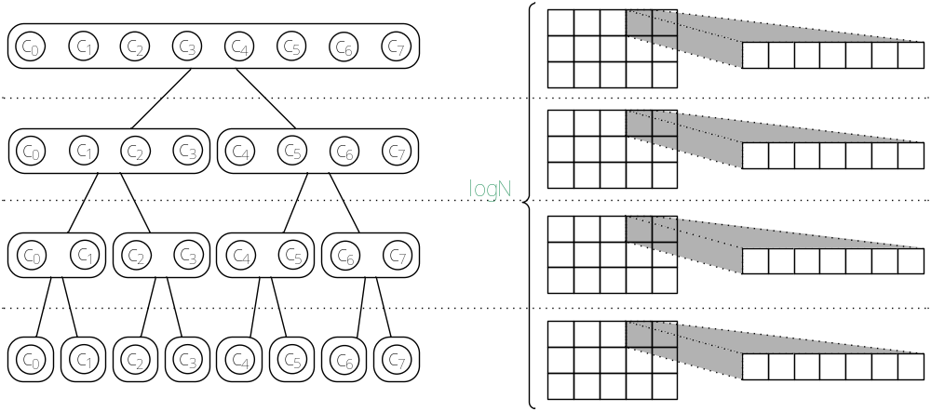
finding L₂-heavy items
keep one GCS per level of hierarchy
space and update time complexities increase (roughly) by a factor of logN
query: find all items with L₂ greater than φ||a||²
query time increases by 1/φ·logN (1/φ L₂-heavy items per level)
w.h.p. we get all items with L₂ greater than (φ+ε)||a||²
w.h.p. we get no items with L₂ less than (φ-ε)||a||²

Slide 16
sketching the wavelet domain
the GCS algorithm:
  translate updates into the wavelet domain
  maintain log_{r}N group count sketches
  find L₂ heavy coefficients with energy above φ||a||²
note: changing the degree (r) of the search tree allows for query-update time trade-off
but, what should the threshold φ be?
assuming the data satisfies the small-B property:
there is a B-term synopsis with energy at least η||a||²
setting φ = εη/Β we obtain a synopsis (with no more than B coeffs) with energy at least (1-ε)η||a||²

Slide 17
outline
introduction
  motivation
  problem formulation
background
  wavelet synopses
  the AMS sketch
the GCS algorithm
  our approach
  the Group Count Sketch
  finding L₂ heavy items
  sketching the wavelet domain
experimental results
conclusions

Slide 18
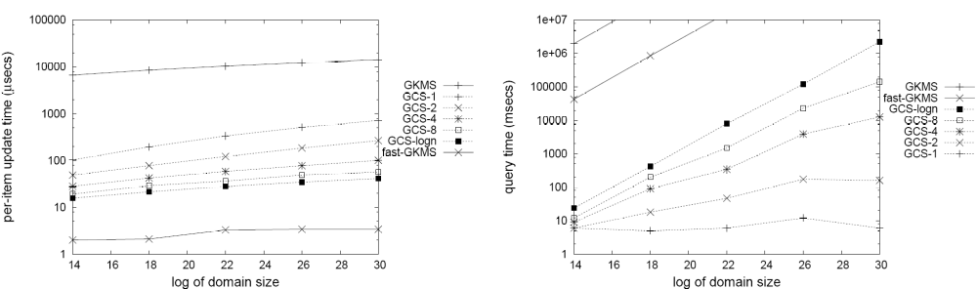
experiments
update and query time vs domain size
all methods are given same space
GCS-r is GCS with search tree of degree 2^{r}

Slide 19
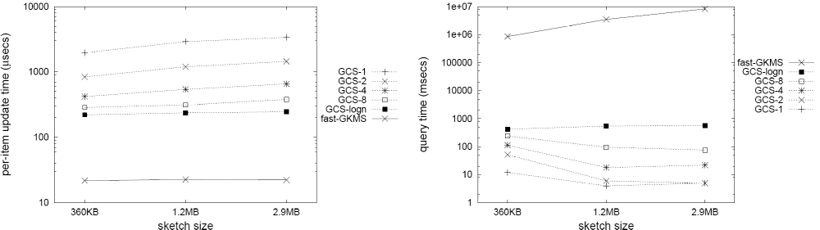
experiments
update and query time vs sketch size
GCS-r is GCS with search tree of degree 2^{r}

Slide 20
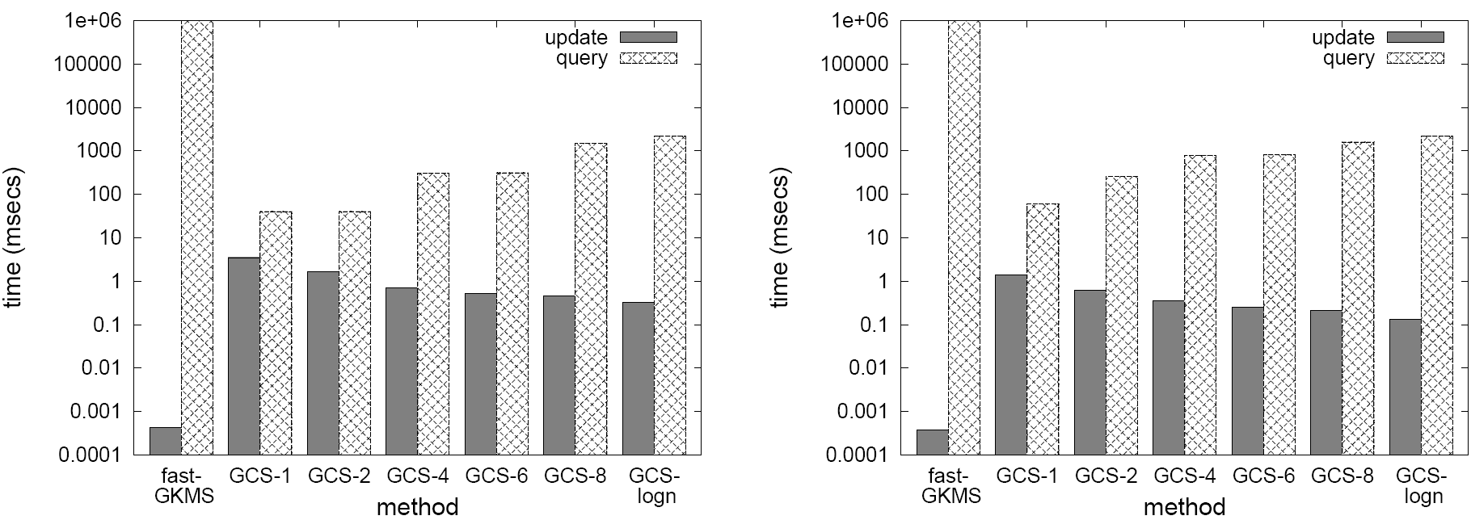
experiments
two-dimensional update and query time
for both wavelet decomposition forms
standard form
non-standard form

Slide 21
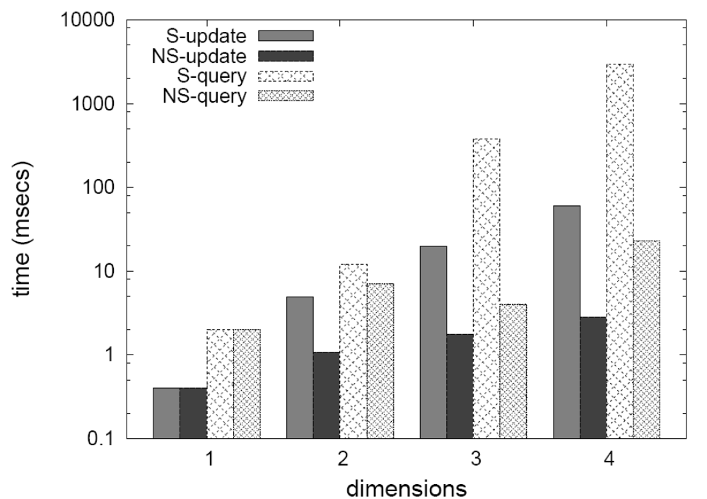
experiments
multi-dimensional update and query time
for both wavelet decomposition forms
S: standard NS: non-standard

Slide 22
conclusions
the GCS algorithm allows for efficient tracking of wavelet synopses over multi-dimensional data streams
the Group Count Sketch satisfies all streaming requirements:
  small polylog space
  fast polylog update time
  fast polylog query time
  approximate answers with quality guarantees
future research directions:
  other error metrics
  histograms

Slide 23
thank you! http://www.dblab.ntua.gr/

