Slide 1
Efficient Algorithms for
Constructing Decision Trees with Constraints
Minos Garofalakis
Bell Laboratories
minos@bell-labs.com
Dongjoon Hyun
KAIST and AITrc
djhyun@cs.kaist.ac.kr
Rajeev Rastogi
Bell Laboratories
rastogi@bell-labs.com
Kyuseok Shim
KAIST and AITrc
shim@cs.kaist.ac.kr
Notes:
The title of our paper is “Efficient Algorithms for Constructing Decision Trees with Constraints”.

Slide 2

Motivation
Necessity of Constraints
  Decision tree can be
    Complex with hundreds or thousands of nodes
    Difficult to comprehend
  Users are only interested in obtaining an overview of the patterns in their data
    A simple, comprehensible, but only approximate decision tree is much more useful
Necessity of Pushing constraints into the tree-building phase
  In tree-building phase, may waste I/O on building tree which will be pruned by applying constraints
Notes:
There are 2 main motivation in this paper.
One is necessity of constraint.
A number of popular classifiers construct decision trees to generate class models.
However, frequently the constructed trees are complex with hundreds or thousands of nodes, so it is difficult to comprehend.
Also, many users are only interested in obtaining an overview of the patterns in their data.
So, simple, comprehensible, but only approximate decision tree is much more useful.
The other motivation is necessity of pushing constraints into the tree-building phase.
If we apply constraints after tree building,
In tree-building phase, we may waste I/O on building useless nodes which will be pruned by applying constraints.
So if we can apply constraint in tree-building phase. We can reduce this I/O.

Slide 3
Our Contributions
Efficient Construction of Decision Trees with Constraints
Constraints
  Size : the number of nodes
    For a given k, find a subtree with size at most k that minimizes either the total MDL cost or the total number of misclassified records.
  Inaccuracy : the total MDL cost or the number of misclassified records
    For a given C, find a smallest subtree whose total MDL cost or the total number of misclassified records does not exceed C.
Pushing constraints into the tree-building phase
  Reduce I/O and Improve the performance by removing early such nodes which can’t satisfy the constraints
Notes:
Our contribution is “efficient construction of decision trees with constraints”
First, we consider size and accuracy as constraints.
Size means the number of nodes, and Inaccuracy means total MDL cost or the total number of misclassified records.
For size constraint,
we find a subtree with size at most k that minimize either the total MDL cost or the total number of misclassified records.
And, for inaccuracy constraints,
We find a smallest subtree with whose total MDL cost or number of misclassified records does not exceed C.
Second goal is applying this constraint in tree-building phase.
We reduce I/O and Improve the performance by removing early such nodes which can’t satisfy the constraints.

Slide 4
Related Works
Pruning Algorithms using Constraint
  OPT [Bohanec and Bratko 94]
    For a given number of leaf node, find subtree whose number of misclassified records is minimum.
  OPT-2 [Almualim 96]
    Improve OPT by using dynamic programming technique
  Cons
    Should be applied after building phase finished,
    May waste I/O to build many useless nodes and prune them.
      Much I/O cost with classification algorithms for large database (ex: SPRINT, PUBLIC)
    Don’t consider MDL cost pruning
Notes:
Next, I will show related works.
First, pruning algorithms using constraint.
There are OPT and OPT-2
In 1994, Bohanec and Bratko propose an algorithm OPT.
For a given number of leaf node, OPT find the subtree whose number of misclassifed records is minimum.
In 1996, Almuallim propose OPT-2 which improve OPT by using Dynamic programing
But, these algorithm should be applied after building phase finished.
May wastes I/O to build many useless nodes and to prune them.
So, they have much I/O cost when we use them with classification algorithms for large database.
Also, these algorithms don’t consider MDL cost pruning.

Slide 5
Related Works (cont.)
Integrated Algorithm
  PUBLIC [Rastogi and Shim 98]
    Traditional classification algorithms have two distinct phases, tree-building and tree-pruning phase.
    By Integrating tree-pruning phase into tree-building phase, PUBLIC delete useless nodes early.
      Estimates the lower bound MDL cost of nodes which can be splitted
      Execute pruning algorithm periodically on partial tree in building phase
    PUBLIC Improve the performance by reducing I/O cost
    ex) PUBLIC(1), PUBLIC(S), …
  Cons
    Does not consider size/accuracy constraints
Notes:
Second related work is Integrated algorithm
In 1998, in Bell lab., Rajeev Rastogi and Kyuseok Shim propose PUBLIC.
Traditional classification algorithms have two distinct phase, tree-building and tree-pruning phase.
PUBLIC integrate tree-pruning phase into tree-building phase, so it can delete useless nodes early.
And improve the performance by reducing I/O cost.
For integrating these two phase, PUBLIC use estimation of lower bound MDL cost for not splitted node.
For estimation level, there are PUBLIC(1), PUBLIC(S) and so on in PUBLIC.
But, PUBLIC does not consider size/accuracy constraints

Slide 6
Naive Algorithm
Size-constraint
Input
  Decision tree generated by traditional algorithm(ex: SPRINT, PUBLIC)
  Size constraint : k
Algorithm
  Compute minimum MDL cost recursively
    minCost = the MDL cost when the root become a leaf.
    For k₁ = 1 to k–2 {
    minCost = Min (minCost, minimum MDL cost whose children have constraint k₁, k – 1 – k₁ for each)
    }
  Delete all nodes which are not in the minimum cost subtree
Complexity
  Time, Space : O(nk) (n is the number of node in input tree)
Notes:
I will explain the proposed algorithms, size-constraint pruning algorithm first, then accuracy-constraint pruning algorithm.
In size-constraint pruning algorithm, there are naive algorithm and improved algorithm.
Naive size-constraint algorithm get decision tree and size constraint k as input.
And find a subtree with at most k node, and which minimize the MDL cost.
Please see the next slides for example. ➔
Algorithm basically has 2 step. ⬅
In first step, compute minimum MDL cost recursively,
Then in second step, delete all nodes which is not in the minimum cost subtree.
In first step, this algorithm considers all case like the next slides.
The time and space complexity of this algorithm is O(nk)

Slide 7
Naive Algorithm - Example
Size-constraint
Internal Node
k = 7
k = 7
Leaf Node
k = 7
k = 7
k = 7
k₁ = 1
k₂ = 5
k₁ = 3
k₂ = 3
k₁ = 5
k₂ = 1
For each internal node, check all case and choose the minimum cost tree
Notes:
Let’s consider this decision tree with size constraint k is 7.
This example show all case at the root for k is 7.
First of all, we can consider the root node become leaf node.
After that, root node become internal node, and the k is distributed to children.
When k is 7, the root node have 1 and the other 6 can be distributed to children. 1 and 5, 3 and 3, 5 and 1.
Then we do the same things recursively.
Finally, among all these case, we choose the minimum cost tree.
⬅ see the algorithm again.

Slide 8
Improved Algorithm
Size-constraint
Input
  Partially-built decision tree with n nodes, size constraint k
Algorithm
  1. For all possible case in k node(like naive algorithm), compute followings
  For each node, find the lower bound of MDL cost(Dynamic Programming)
    Compute cost or Estimate lower bound of leaf
    Propagate up in bottom-up fashion
  For each node, find the upper bound of MDL cost (Branch and Bound)
    Find the upper bound of minimum MDL cost in final tree
      Use the value of minimum MDL cost in current tree
    Compute children’s upper bound by using parent’s upper bound and the other child’s lower bound in top-down
  2. Mark all nodes whose some lower bound ≤ upper bound
  3. Delete all unmarked nodes
Complexity
  Space : O(nk)
  Time : exponential in k (in worst case),
  By “Branch and Bound” technique, almost O(nk)
Notes:
Naive algorithm is also executed after tree-building phase is finished. So it have same problem in OPT and OPT-2 in related works.
Improved algorithm integrated tree-pruning phase into tree-building phase.
Improved algorithm get “partially built tree” and size constraint k as input. And delete all nodes which cannot possibly satisfy the constraint.
Improved algorithm consists of 3 steps.
First, consider all possible case like naive algorithm.
For each possible case, compute lower bound and upper bound.
Second, Mark all node whose some lower bound is less than upper bound.
Finally, Delete all unmarked nodes.
Please see the next slides for example. ➔
Improved algorithm’s space complexity is O(nk). ⬅
But worst case time complexity is exponential in k.
But by “branch and bound” technique, almost O(nk)

Slide 9
Improved Algorithm - Example
N
L5
Expandable Node
k
L6
Lower
bound
k1
k2
L1
L2
L3
L4
U1 = the minimum MDL cost of
current tree with constraint K
U2 = U1 – L6 – cost of N
N
k
U3
k1
k2
Upper
bound
Notes:
Let’s consider this partially-built tree.
The triangle is expandable node which can be splitted more.
First, compute L1 and L4, and estimate the lower bound L2 and L3.
Then from them we can compute the lower bounds of L5, L6 and all other nodes in bottom-up fashion.
Second, compute upper bound of minimum cost of final tree.
The minimum cost of final tree must be less than or equal to the minimum cost of current tree, because current tree can be splitted more and the cost become smaller.
Then, we can use this upper bound and lower bound to compute U2 and U3.
If we subtract lower bound L6 and the cost of N from U1, then the remain is U2.
And U3 is U1 – L5 – the cost of N in same manner.
Recursively, the upper bounds of all other nodes can be computed in top-down fashion..
Finally, Mark all possible nodes whose lower bound is less than or equal to upper bound.
Then, delete unmakred nodes.
Please see the previous slide again.

Slide 10
Accuracy-Based Algorithm
Accuracy-constraint
Input
  Decision Tree : T (n : the number of nodes)
  Inaccuracy constraint : C
Algorithm
  From size l = 1, repeat until satisfying that minimum MDL cost <= C
    Find minimum MDL cost using the same algorithm in size-constraint algorithm
    l = l + 1
  Do size-constraint pruning using l
Complexity
  Time, Space : O( n l )
    (l : the first number of nodes which satisfying the constraint C)
Notes:
The last is accuracy-base decision tree pruning algorithm.
Accuracy-based pruning algorithm use size-constraint algorithm.
First, increment size l from 1 until find the minimum l which can satisfy inaccuracy constraint C.
If we increase size l more bigger, the total MDL cost of the tree become more smaller.
Second, after finding the minimum l, execute size-constraint pruning algorithm using this l.
Then we can get the smallest subtree satisfying inaccuracy constraint.
Both time and space complexity of this algorithm is O(nl)

Slide 11
Experiment
Machine
  Sun Ultra-60 / RAM 512M / Solaris 2.7
Data
  Real-life Data (UCI Machine Learning Repository)
  Synthetic Data (IBM Almaden Research Center)
      (9 attributes, 2 classes, 50000 records)
Data Set | Attributes | Classes | Records | Nodes in Final Tree
Letter | 16 | 26 | 13368 | 1989
Satimage | 36 | 7 | 4435 | 185
Function number | 3 | 4 | 5 | 6
Nodes in Final Tree | 119 | 63 | 217 | 175
Notes:
Experiment.
We use SUN Ultra-60 with Ram 512M and Solaris 2.7 for experiment.
And real-life data set and synthetic data set are tested.
Real-life data sets are come from UCI Machine Learning Repository.
Among them, we use the big data set, letter and satimage.
Letter is a data set for a classification of the kind of letters.
And satimage is Satelite images.
For Synthetic data set, we use a generator made by IBM Almaden Research Center
The generator make different distribution for a given function.
We generate data sets having 9 attributes and 2 classes and 5000 records.
Most result is similar, so we also choose big data sets and show the result of function 3, 4, 5, 6.

Slide 12
Experimented Algorithms
Size constraint
Implemented by modifying PUBLIC code
  PUBLIC(1), PUBLIC(S)
Algorithm | Name | Description
Naive | WithoutConstraintPushing(1) | After PUBLIC(1), do naive algorithm
 | WithoutConstraintPushing(S) | After PUBLIC(S), do naive algorithm
Improved | WithConstraintPushing(1) | During PUBLIC(1), do improved algorithm
 | WithConstraintPushing(S) | During PUBLIC(S), do improved algorithm
Notes:
4 size constraint algorithm are experimented. The algorithms are implemented by modifying PUBLIC code, PUBLIC(1) and PUBLIC(S).
WithoutConstraintPushing(1) executes naive algorithm after tree building phase of PUBLIC(1).
WithoutConstraintPushing(S) executes naive algorithm after tree building phase of PUBLIC(S).
WithConstraintPushing(1) executes improved algorithm during tree building phase of PUBLIC(1)
WithConstraintPushing(S) executes do improved algorithm during tree building phase of PUBLIC(S).

Slide 13
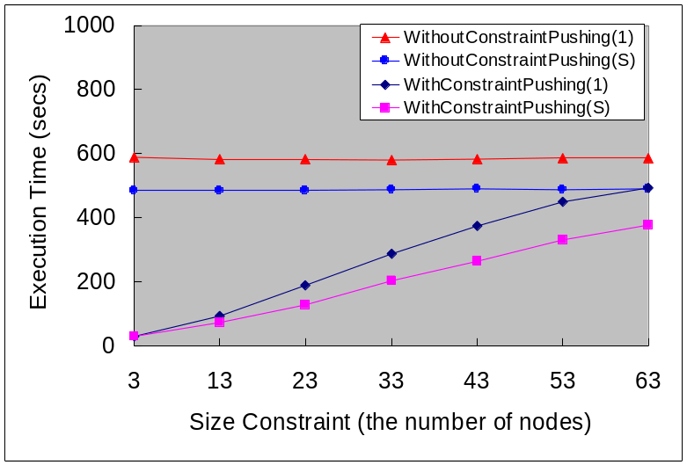
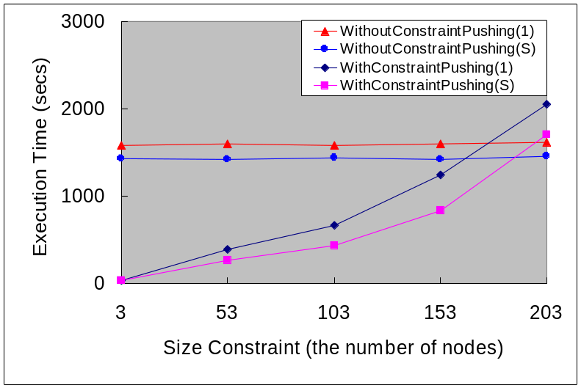
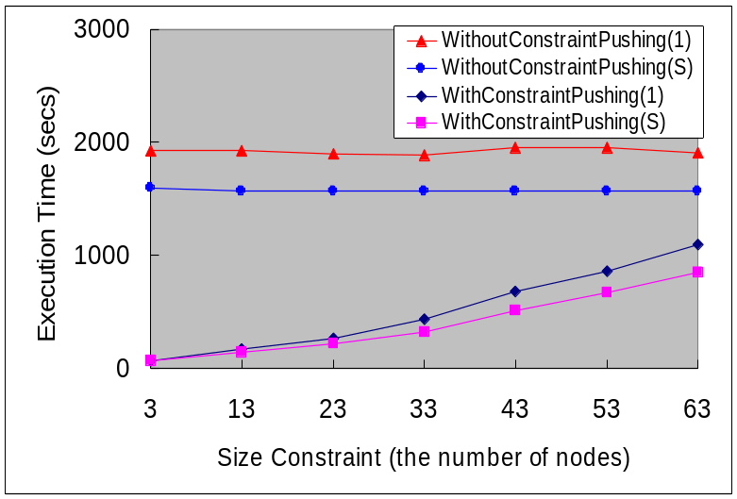
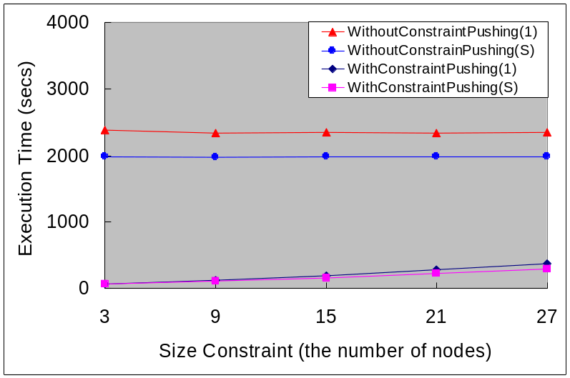
Experiment Result
Letter
Satimage
Function 3
Function 4
Parameter : noise = 0.1, g0 = 0.5
Notes:
From top to bottom,
The above two algorithms are naive algorithms and below two algorithms are improved algorithm.
And y-axis is execution time in second, and x-axis is size constraint k.
Most part of execution time is splitting time to create nodes.
Because the number of generated nodes is independent with naive algorithm, the execution time of naive algorithm is nearly constant.
But the integrated algorithm which prunes in building phase reduce the number of generated node. So the execution time is changed with k.
The graph of the number of node is similar with this graph, so we skip them.
Note that the result from letter data set.
This graph is similar with left graph. The only difference occurs when k is 203.
The improved algorithms is execute periodically in tree-building phase. So, if the number of iteration increase, the execution time is also increased.
But the goal of this paper is to produce simple tree. So the expected size-constraint is generally much smaller than 203.
So this part is not important.
From the result of the synthetic data set, we can conclude proposed algorithm is better when the size of data set is big.

Slide 14
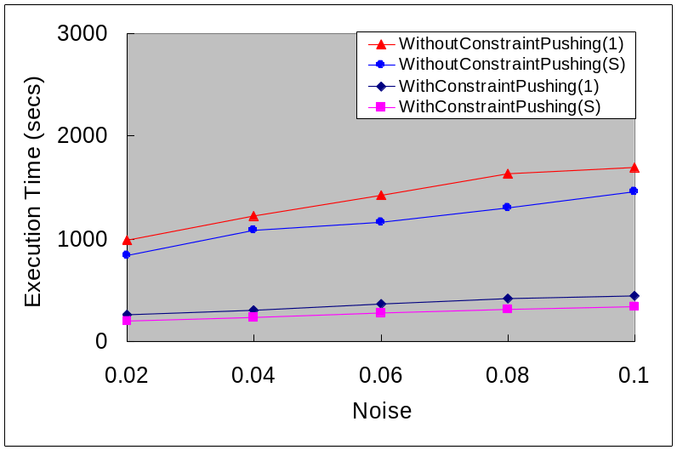
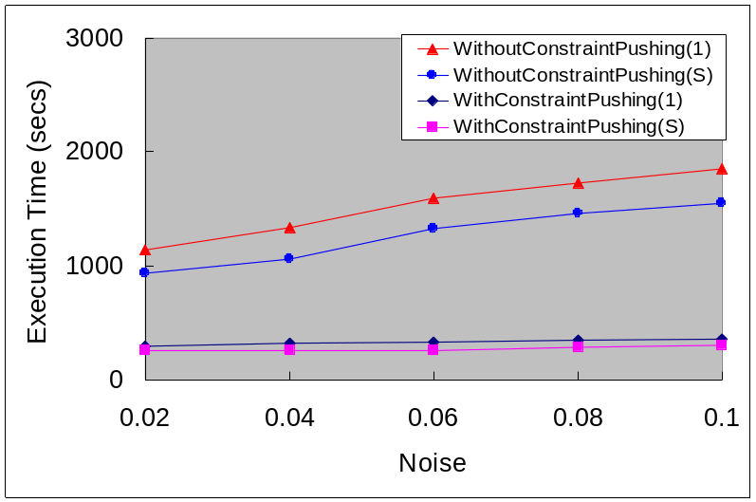
Experiment Result
Function 5
Function 6
Parameter : k = 33, g0 = 0.5
Notes:
We also do sensitivity analysis to noise.
The size constraint k is fixed to 33. And g0 means this data set have 2 classes.
We vary noise value from 2% to 10%.
As noise increase, the generated tree become more complex, so has more nodes.
Since the proposed algorithm produces relatively less number of nodes, it have small affect.
So the proposed algorithm is more efficient when noise is bigger.

Slide 15
Conclusion
Propose a general framework that enables users to specify constraints on the size and accuracy of decision trees.
Propose a novel algorithms for pushing size and accuracy constraints into the tree-building phase.
Proposed integrated algorithms deliver significant performance speed-ups in selective constraint cases.
Notes:
Finally, I conclude.
This paper propose a general framework that enable users to specify constraints on the size and accuracy of decision trees.
And propose a novel algorithm for pushing size and accuracy constraints into the tree-building phase.
And, propose integrated algorithms deliver significant performance speedups in selective constraint cases.
Any questions?

