Slide 1
Estimating Set Expression Cardinalities over Data Streams
Sumit Ganguly
Minos Garofalakis
Rajeev Rastogi
Internet Management Research Department
Bell Labs, Lucent Technologies

Slide 2
Data Streaming Assumptions
Stream: sequence of insertion and deletion operations.
    Look Once: Each operation seen once by stream processor.
    Storage is limited compared to stream size.
Streaming Sub-Models:
    Insert only.
    Sliding Window.
    Insert and Delete.
Applications
  Network Management, network anomaly detection.
  Database Statistics Maintenance, etc.

Slide 3
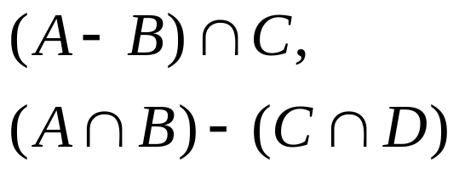
Problem Definition
Data Streams A,B,C,…, etc. viewed as sets of elements.
Given a set expression, e.g.,
Estimate Cardinality of Set Expression.
A basic problem.
Randomized approximation algorithm.

Slide 4
Previous Work
Flajolet and Martin ’84. Estimates cardinality of union of streams.
Minwise Independent Permutations (MIP), Broder et.al. ’98, Cohen ’97, Indyk ’99 .
Distinct Sampling Technique, Gibbons ’01.
Estimate set expression cardinality.
Above results easily extended to sliding windows.
No scheme when streams contain both insertion and deletion operations.
Notes:
Flajolet and Martin: presented the basic method for estimating the cardinality of a stream.

Slide 5
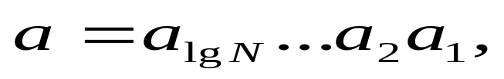



2-level sketches
N = Domain Size, a an arbitrary stream element.
  A second level array [2] by [log N] of counters per level.
  Let hashes to level b.
  At level b, SecondLevel[ ][ ] is incremented for insertion and decremented for deletion.
log N
log N-1
bit value 1
hash fn
h
b
a
b
bit value 0
bit positions 1 to log N
2
1
level levels

Slide 6

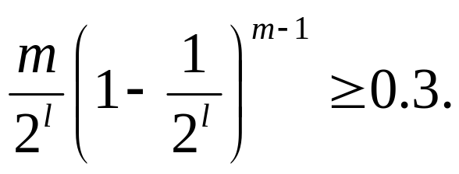
Updates to Second Level
Singleton Levels
Size of set = m.
Assume m is well-estimated.
Let
Probability level l is singleton =
Is level l singleton?
    Answered easily from second level array.
Assume level l is singleton.
    Singleton element is easily identified.
    Probability an element of set is in the singleton level is 1/m.

Slide 7



Distinct Sample
Distinct Sample
A singleton level gives an elementary distinct sample.
Suppose there are 2-level sketches. Then, number of singleton levels is at least with probability at least .
Extends Gibbons’ Distinct Sampling / Min wise permutations to update streams.

Slide 8

Singleton Level in Union of Streams
Streams A,B.
Keep one parallel (same hash function) 2-level sketch pair for A and B.
Is level l singleton for A U B?
  Level l is singleton for A and empty for B, OR
  Level l is empty for A and singleton for B, OR
  Level l is singleton for both A and B and the occupants are identical.

Slide 9
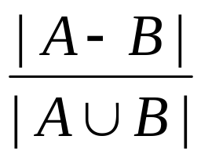
Set Difference Condition
Streams A,B.
Goal: estimate |A-B|.
Keep a parallel 2-level sketch for A and B (i.e., same hash function h).
Assume level l is singleton.
Probability that level l is singleton for A and empty for B is
A-B Condition: Level l is singleton for A and empty for B.
Notes:
Mention that the set difference condition is easy to check.

Slide 10


Estimating |A-B|
Keep independent parallel 2-level sketch pairs for A and B.
Let .
Estimate for |A-B|. At level l,
  X= Count number of singleton sketch pairs for A U B.
  D= Count number of sketch pairs satisfying A-B Condition.
  Estimate = m*D / X.
Notes:
Recall: A-B condition is singleton for A and empty for B

Slide 11


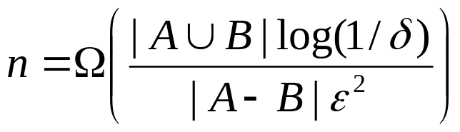
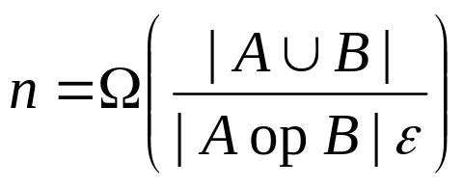


Estimation Guarantees
Estimate lies within relative error with probability at least if
Lower bound using communication complexity arguments,
where op = or .

Slide 12
Set Expression Condition
Set expression W composed out of set names X1,X2,…,Xr and operators, union, intersection and difference.
Parallel sketch array for X1, X2, …, Xr.
Transform set expression W into a boolean sketch expression E(W) over parallel sketches.
Similar transformation for MIPs, analogous for Distinct Sampling.
Notes:
Recall: A-B condition is singleton for A and empty for B

Slide 13


Set Expressions to Sketch Expressions
Given set expression W.
Create boolean expression E(W) over parallel sketches recursively.
  Replace Set name X by IsSingleton(sketch(X),l).
  Replace X Y by E(X) AND E(Y).
  Replace X-Y by E(X) AND (NOT E(Y)).
  Replace X Y by E(X) OR E(Y).
  Add final conjunct IsSingleton(sketch(X1),sketch(X2),…,sketch(Xr),l).
Suppose level l is singleton for the union. Then, Probability E(W) is satisfied by a parallel sketch =
  |W|/m

Slide 14
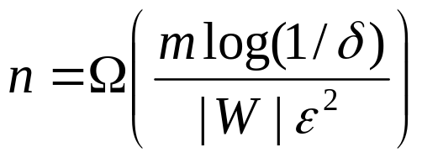
Estimating Set Expression Size
Given set expression W.
Create sketch expression E(W).
Estimate m = union size of sets in W. Let l = ceil(log m).
Keep n parallel sketches for each set in W.
At level l,
  X= Count number of singleton parallel sketches for the union.
  D= Count number of parallel sketches satisfying E(W).
  Estimate = m*D / X.
Estimate lies within relative error with probability at least if
Notes:
Recall: A-B condition is singleton for A and empty for B

Slide 15
Conclusions
Basic tool for estimating cardinality of COUNT DISTINCT single clause SQL queries over update databases involving
  Simple predicates.
  Single and Multi-dimensional Range predicates, distinct histograms etc.
  Set expression cardinality estimation.
Extends naturally to sliding window stream model.
Notes:
Recall: A-B condition is singleton for A and empty for B

Slide 16
Thank You !

