Slide 1
Declarative Networking:
Language, Execution and Optimization
Boon Thau Loo¹, Tyson Condie¹, Minos Garofalakis², David E. Gay², Joseph M. Hellerstein¹, Petros Maniatis², Raghu Ramakrishnan³, Timothy Roscoe², Ion Stoica¹
¹UC Berkeley, ²Intel Research Berkeley, ³University of Wisconsin-Madison

Slide 2
Declarative Networking
Database query language, execution and optimization for the design and implementation of networks
Success of database research:
  70’s – today: Database research has revolutionized data management
  Today: Similar opportunity to revolutionize the Internet architecture

Slide 3
Why now?
Internet faces many challenges today:
  Unwanted, harmful traffic
  Complexity/fragility in Internet routing
  Proliferation of new applications
Efforts at improving the Internet:
  Evolutionary: App-level “Overlay” networks
  Revolutionary: Clean-slate designs
    NSF GENI initiative, FIND program
Opportunity: Software tools that can significantly accelerate network innovation
Notes:
The Internet faces many challenges today, ranging from the lack of protection against unwanted or harmful traffic to the increasing complexity and fragility of Inter-domain routing. In addition, the proliferation of new applications that has also led to growing demands for new functionalities, such as support for mobility and content-based routing. As a result, in recent months, there is a growing consensus in the networking community that the current Internet architecture is in need of change.
Given these challenges, there have been several on-going efforts at improving the Internet. Today, the widely used approach involves application-level overlay networks which are layered on top the Internet. These networks are used to implement network functionality that is not available on the Internet. On the other hand, there have also been the argument that rather than try and incrementally fix the Internet along different dimensions with the use of overlay networks, we should instead redesign from scratch to fundamentally address its problems. Clean-slate design proposes have received a lot of attention recently in the networking community, and this is reflected in recent major NSF GENI initiative with potential a third of a billion in funding, and the future Internet FIND program.
Whether one believes more in the evolution or revolutionary approach, it is agreement that we are entering a period of flux in Internet research, and this is reflected in recent major NSF initiatives such as the GENI initiative with millions of dollars on building a global testbed for experimentation with new network architectures, and the FIND program on future internet design.
There are several overlay networks that are deployed and in use today, ranging from commercial networks such as Akamai content distribution network, to p2p file sharing and telephony. There are also a large number of experimental overlay networks being proposed or evaluated on global testbeds such as PlanetLab.
The high-level goal of this work is to provide ….
Raise a third of a billion dollars.

Slide 4



A Declarative Network
messages
Dataflow
Dataflow
messages
Dataflow
messages
Dataflow
Dataflow
Distributed recursive query
Dataflow
Traditional Networks
Declarative Networks
Network State
Distributed database
Network protocol
Recursive Query Execution
Network messages
Distributed Dataflow

Slide 5
Previous Work and Use Cases
Declarative routing [SIGCOMM ’05]:
  Recursive queries as a compact, high-level representation of routing protocols
  Good balance between router extensibility and safety
Beyong routing: Declarative overlays [SOSP ’05]:
  P2 declarative networking system implementation
  Chord overlay network (47 lines)
System being used:
  Code pre-release (http://p2.cs.berkeley.edu)
  Cambridge, Harvard, MPI, Rice, UT-Austin
  Distributed consensus protocols, replication protocols, debugging networks, content-based routing

Slide 6
Focus of this paper:
Important unresolved issues:
  Query language and semantics
  Asynchronous, distributed query processing
  New challenges in query optimizations
  Semantics in dynamic networks

Slide 7
Outline
Background
Query language by example
Query processing
Optimizations
Conclusion

Slide 8
Review of Datalog
Datalog rule syntax:
<result> ← <condition1>, <condition2>, … , <conditionN>.
Head
Body
Types of conditions in body:
  Input tables: link(src,dst) predicate
  Arithmetic and list operations
Head is an output table
  Recursive rules: result of head in rule body

Slide 9
Review: All-Pairs Reachability
R1: reachable(S,D) ← link(S,D)
R2: reachable(S,D) ← link(S,Z), reachable(Z,D)
“For all nodes S,D,
If there is a link from S to D, then S can reach D”.
link(a,b) – “there is a link from node a to node b”
reachable(a,b) – “node a can reach node b”
Input: link(source, destination)
Output: reachable(source, destination)

Slide 10
Review: All-Pairs Reachability
R1: reachable(S,D) ← link(S,D)
R2: reachable(S,D) ← link(S,Z), reachable(Z,D)
“For all nodes S,D and Z,
If there is a link from S to Z, AND Z can reach D, then S can reach D”.
Input: link(source, destination)
Output: reachable(source, destination)

Slide 11
Network Datalog
Location Specifier “@S”
R1: reachable(@S,D) ← link(@S,D)
R2: reachable(@S,D) ← link(@S,Z), reachable(@Z,D)
Query: reachable(@M,N)
Query: reachable(@a,N)
All-Pairs Reachability
link
link
link
link
Input table:
@S | D
@a | b
@S | D
@b | c
@b | a
@S | D
@c | b
@c | d
@S | D
@d | c
a
b
c
d
reachable
reachable
reachable
reachable
Output table:
@S | D
@a | b
@a | c
@a | d
@S | D
@b | a
@b | c
@b | d
@S | D
@c | a
@c | b
@c | d
@S | D
@d | a
@d | b
@d | c
Query: reachable(@a,N)

Slide 12
Implicit Communication
A networking language with no explicit communication:
All communication happens among neighbors:
  Link-restricted rules enforced via syntactic restrictions
R2: reachable(@S,D) ← link(@S,Z), reachable(@Z,D)
Data placement induces communication
a
b
c
tuple(@b,…)

Slide 13
Path Vector Protocol Example
Advertisement: entire path to a destination
Each node receives advertisement, add itself to path and forward to neighbors
path=[a,b,c,d]
path=[b,c,d]
path=[c,d]
a
b
c
d
b advertises [b,c,d]
c advertises [c,d]

Slide 14
Path Vector in Network Datalog
R1: path(@S,D,P) ← link(@S,D), P=(S,D).
R2:
path(@S,D,P)
←
link(@Z,S),
path(@Z,D,P₂),
P=S•P₂.
Query: path(@S,D,P)
Add S to front of P₂
Input: link(@source, destination)
Query output: path(@source, destination, pathVector)

Slide 15
Query Execution
R1: path(@S,D,P) ← link(@S,D), P=(S,D).
R2: path(@S,D,P) ← link(@Z,S), path(@Z,D,P₂), P=S•P₂.
Query: path(@a,d,P)
link
link
link
link
Neighbor table:
@S | D
@a | b
@S | D
@b | c
@b | a
@S | D
@c | b
@c | d
@S | D
@d | c
a
b
c
d
path
path
path
@S | D | P
@S | D | P
@S | D | P
@c | d | [c,d]
Forwarding table:
@S | D | P

Slide 16
Query Execution
R1: path(@S,D,P) ← link(@S,D), P=(S,D).
R2: path(@S,D,P) ← link(@Z,S), path(@Z,D,P₂), P=S•P₂.
Query: path(@a,d,P)
Matching variable Z = “Join”
link
link
link
link
Neighbor table:
@S | D
@b | c
@b | a
Communication patterns are identical to those in the actual path vector protocol
@S | D
@a | b
@S | D
@c | b
@c | d
@S | D
@d | c
a
b
c
d
path(@a,d,[a,b,c,d])
path(@b,d,[b,c,d])
path
path
path
@S | D | P
@S | D | P
@a | d | [a,b,c,d]
@S | D | P
@b | d | [b,c,d]
Forwarding table:
@S | D | P
@S | D | P
@c | d | [c,d]

Slide 17
Outline
Background
Query language by example
Query Processing
Optimizations
Conclusion

Slide 18
Recursive Query Evaluation
Semi-naïve evaluation:
  Iterations (rounds) of synchronous computation
  Results from iteration i^{th} used in (i+1)^{th}
10
9
9
3-hop
7
8
5
7
4
1
2
10
6
8
0
5
2-hop
4
3
3
2
1-hop
6
1
Link Table
Path Table
Network
Problem: Unpredictable delays and failures

Slide 19
Pipelined Semi-naïve (PSN)
Fully-asynchronous evaluation:
  Computed tuples in any iteration pipelined to next iteration
  Natural for network protocols
9
10
7
9
5
6
4
1
2
10
3
Relaxation of semi-naïve
8
8
0
5
3
2
7
6
4
1
Link Table
Path Table
Network

Slide 20
Pipelined Evaluation
Challenges:
  Does PSN produce the correct answer?
  Is PSN bandwidth efficient?
    I.e. does it make the minimum number of inferences?
In paper, proofs for
  Basic technique: local timestamps
  p(x,z) :- p₁(x,y), p₂(y,z), …, p_{n}(y,z), q(z,w)
recursive w.r.t. p

Slide 21
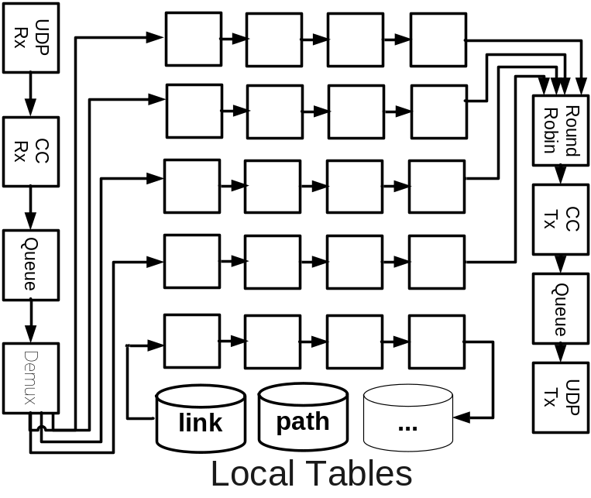
Execution Plan
Network In
Network Out
Messages
Messages
Single Node
Nodes in execution plan (“operators”):
  Network operators (send/recv, cc, retry, rate limitation)
  Relational operators (selects, projects, joins, aggregates)
  Flow operators (mux, demux, queues)

Slide 22
Localization Rewrite
Rules may have body predicates at different locations:
R2: path(@S,D,P) ← link(@S,Z), path(@Z,D,P₂), P=S•P₂.
Matching variable Z = “Join”
Rewritten rules:
R2a: linkD(S,@D) ← link(@S,D)
R2b: path(@S,D,P) ← linkD(S,@Z), path(@Z,D,P₂), P=S•P₂.
Matching variable Z = “Join”

Slide 23

Localized Rule Compilation
R2b: path(@S,D,P) ← linkD(S,@Z), path(@Z,D,P₂), P=S•P₂.
Execution Plan
Network In
Network Out
Δpath
Join
path.Z = linkD.Z
Project
path(S,D,P)
Send to path.S
linkD
ΔlinkD
Join
linkD.Z = path.Z
Project
path(S,D,P)
Send to path.S
path

Slide 24
Outline
Background
Query language by example
Query Processing
Optimizations
Conclusion

Slide 25
Role of Query Optimizations
Network protocols = query execution
Can query optimizations help implement efficient protocols?

Slide 26
Our First Steps
Traditional: evaluate in the NW context
  Aggregate Selections
  Predicate Reordering
  Magic Sets rewrite
New: motivated in the NW context
  Multi-query optimizations
  Cost-based optimizations based on network statistics

Slide 27
Predicate Reordering
R1: path(@S,D,P) ← link(@S,D), P= (S,D).
R2: path(@S,D,P) ←
Query: path(@S,D,P)
link(@S,Z), path(@Z,D,P₂),
P=S•P₂.

Slide 28
Predicate Reordering
R1: path(@S,D,P) ← link(@S,D), P= (S,D).
R2: path(@S,D,P) ←
Query: path(@S,D,P)
link(@Z,D),
path(@S,Z,P₁),
P=P₁•D.
P=S•P₂.
Predicate reordering: path vector protocol → dynamic source routing
Interesting variants:
  Predicate reordering + magic-sets rewrite
  Cost-based optimizations (work-in-progress)
    Network statistics (neighborhood density, rate of change of links)

Slide 29
Evaluation Overview
Setup:
  Routing protocols implemented using P2
  Emulab testbed
  Metrics: Convergence latency, communication
Results in paper:
  Aggregate selections
  Magic sets & predicate reordering
  Multi-query optimizations

Slide 30
Conclusion
Declarative Networking
  Database techniques for network design and implementation
  Important role to play in the innovation of networks
Paper focuses on important unresolved issues:
  Query language, query processing, optimizations, semantics in dynamic networks
Raises several interesting research challenges:
  Language and semantics
  Runtime cost-based optimizations
  Interaction between query processing and networking

Slide 31
Thank You
http://p2.cs.berkeley.edu

