Slide 1
Distributed Set-Expression Cardinality Estimation
Abhinandan Das (Cornell U.)
Sumit Ganguly (I.I.T. Kanpur)
Minos Garofalakis (Bell Labs.)
Rajeev Rastogi (Bell Labs.)
Notes:
vldb04

Slide 2
Introduction
New class of distributed data streaming applications
  Remote update streams continuously transmitted to a central system for online querying & analysis
Examples
  Network traffic statistics, call detail records, Web usage logs, sensor data
  Network monitoring (DDoS) query:
    Number of distinct source IP addresses observed in flows across an ISP’s border routers

Slide 3
Example Applications
Network Monitoring: Detecting DDoS attacks
Web content delivery service: Akamai
  Redirect users to geographically closest or least loaded server
  Example query: Number of users that access website A but not website B
  Online mining of web click-streams
    Placing advertisements on pages
    Determining the servers at which to replicate web sites
Notes:
Exact answers not required

Slide 4
Set-Expression Cardinality Tracking
Estimate the number of distinct values in the result of an arbitrary set expression over distributed data streams
Operators: union, intersection, difference (∩,∪,-)
  Generalization of distinct count estimation for single streams
Akamai example:
  |S_{A} ∩ S_{B}– S_{c}|= #users who visit site A and site B but not site C
Notes:
S_{A},S_{B},S_{c} = sets of users who visit websites A, B and C resp.

Slide 5
Objective
Important metric in monitoring applications: Minimizing communication overhead
  Naïve approach infeasible
    Eg. AT&T’s backbone routers: 500GB data/day
Exact answers usually not required
  Trade off answer accuracy for reduced data communication costs
  Provable approximation error guarantees
Notes:
Eg. Sensors with limited battery life
Approximations usually suffice. Exploit this to trade off …

Slide 6
Outline
Model and problem formulation
Estimating single stream cardinality
Estimating cardinality of arbitrary set expressions
Experimental results
Conclusions and related work

Slide 7
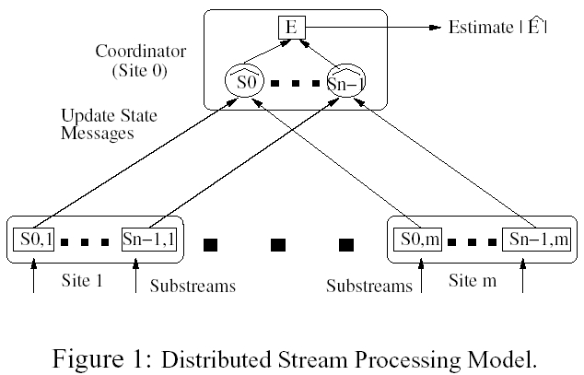
System Model
m+1 sites, n streams
S_{i,j} multisets from domain [M]={0,…M-1}
S_{i} = ∪_{j=1..m} S_{i,j} (i=1..n)
Stream updates
<i,e,±v>
Notes:
Double sided arrows needed for communication
Imagine sites are distributed web servers and each stream corresps to requests for a given web page

Slide 8
Problem Formulation
Estimate |E|, E=set expression over S₀,…S_{n-1}
E= S₀ ∩ S₁
={a,b} ⇒ |E|=2
∩
S₀={a,b}
S₀
S₁={a,b,c}
S₁
Site 1
Site 2
S_{0,1}={a}
S_{1,1}={a,b}
S_{0,2}={b}
S_{1,2}={c}
Absolute error tolerance ε
Minimize communication
Notes:
Compute estimate X’ for X=|E| at the coordinator
such that X-ε ≤ X’ ≤ X+ε
Helps tradeoff accuracy for efficiency

Slide 9
Outline
Model and problem formulation
Estimating single stream cardinality
Estimating cardinality of arbitrary set expressions
Experimental results
Conclusions and related work

Slide 10
Estimating Single Stream Cardinality
E=S₀ where S₀ = ∪_{j=1..m} S_{0,j}
Basic approach
  Distribute error tolerance ε among m sites,
  allocating budget ε_{j} ≥ 0 to site j
  s.t. Σ_{j} ε_{j} = ε
  Possible allocation approaches
    Proportional to stream update rates
    Uniform (ε_{j} = ε/m)
Notes:
Whenever any site violates its error bound, it informs coordinator of its current stream state
Explain how ej controls communication overhead at site j. We shall use S_{i} instead of S₁

Slide 11
Single Stream Approach: Overview
S’_{i,j} = most recent state of substream S_{i,j}
communicated by site j to coordinator
For each stream S_{i}, coordinator constructs global state S_{i}’ as S_{i}’=∪_{j} S’_{i,j}
Coordinator estimates
cardinality of set
expression E as |E’|
E’=f(S’_{i,1},…S’_{i,m})
Site 0
S’_{i,1}
S’_{i,3}
S’_{i,2}
Site 1
Site 2
…
Site m
S_{i,1}
S_{i,2}
S_{i,m}
Notes:
Mention the shift from S1,j to Si,j notation.
When a site violates its allocated error bound, it sends a snapshot of its current state to coordinator
MORE CORRECTLY, it sends deltas of changes…
Site j stores current stream state S_{i,j} as well as communicated state S’_{i,j}
Site j stores S_{i,j}, S’_{i,j}
* Let E’ be result of evaluating set expression E on states S’_{i} (instead of S_{i})
Mention sketch based algorithm in case of memory restrictions. Current presentation will assume
we keep track of substream states

Slide 12
Error Guarantees
Need to ensure
  Correctness: |E|- ε ≤ |E’| ≤ |E|+ ε
Naïve approach for E=S_{i}
  Each remote site j sends current state S_{i,j} to coordinator if
  | S_{i,j} – S’_{i,j} |>ε_{j} or | S’_{i,j} – S_{i,j} |>ε_{j}
  Can show this ensures correctness
Notes:
Can show this ensures |E-E’|,|E’-E|≤ε
|E|-|E’|≤ |E-E’| ➔ |E|-|E’| ≤ ε

Slide 13
Naïve Charging Scheme
Intuitively, associate charge Φ_{j}(e) with every element e at every remote site j
  Each insert charged 1: Φ_{j}⁺(e)++
  Each delete charged 1: Φ_{j}⁻(e)++
If total charges at any site j exceed ε_{j}, site communicates state to coordinator
Notes:
Formally:
Let Φ_{j}⁺(e)=1 if e ∈ S_{i,j}- S’_{i,j}, Φ_{j}⁺(e)=0 else
Let Φ_{j}⁻(e)=1 if e ∈ S’_{i,j}- S_{i,j}, Φ_{j}⁻(e)=0 else
Then Σ_{e}Φ_{j}⁺(e)=|S_{i,j}- S’_{i,j}|, Σ_{e}Φ_{j}⁻(e)=|S’_{i,j}- S_{i,j}|
Site j contacts coordinator if Σ_{e}Φ_{j}⁺(e)>ε_{j} or Σ_{e}Φ_{j}⁻(e)>ε_{j}

Slide 14
Exploiting Global Knowledge
Key idea:
  In many stream application domains, there exist a certain subset of `globally popular’ elements
    e.g.: IP network monitoring – Destination IP addresses such as Yahoo, CNN, etc.
  Updates to popular elements can be charged less
Notes:
previous scheme: element charges computed completely based on local state info
Explain meaning of “globally popular”

Slide 15
Exploiting Global Knowledge (contd…)
Site 1
Site 2
Site 3
Site 4
Site m
…
e
e
e
e
Φ₂⁻(e)=1/3
Φ₃⁺(e)=0
θ(e)=3

Slide 16
Coordinator Actions
Maintains counts of the number of remote sites containing e in S’_{i,j}
Frequent elements (counts≥τ) added to set F_{i}
Coordinator computes a lower bound θ_{i}(e) ∀e ∈ F_{i}, with invariant θ_{i}(e) ≤ count_{i}(e)
  Changes in θ_{i}(e) or F_{i} propagated to remote sites
To control message overhead
  Avoid frequent updates to θ_{i}(e) and F_{i}
Notes:
θ_{i}(e) halved when C_{i}(e) drops below θ_{i}(e)
θ_{i}(e) doubled only when C_{i}(e) exceeds 4θ_{i}(e)
Techniques for ensuring sufficient gap
Mention that pseudocode is in paper
Can mention modification that makes number of control messages relatively insensitive to value of theta
ALL changes in theta_i(e) propagated

Slide 17
Remote Site Actions
Whenever an element e is inserted or deleted; or F_{i} or θ_{i}(e) changes:
  Compute new charges Φ_{j}⁺(e), Φ_{j}⁻(e)
  Update total site charge Φ_{j}⁺, Φ_{j}⁻
  If Φ_{j}⁺ > ε_{j} or Φ_{j}⁻ > ε_{j}
  propagate all new changes to coordinator, reset all Φ’s

Slide 18
Outline
Model and problem formulation
Estimating single stream cardinality
Estimating cardinality of arbitrary set expressions
Experimental results
Conclusions and related work

Slide 19
Generalizing to Arbitrary Set Expressions
Cardinality estimation for arbitrary expression E involving S₀,…S_{n-1} and set operators ∩,∪,-
Generalized scheme identical to single stream solution except for charging procedure
Notes:
Explain “identical to single stream solution” by summarizing what we talked about for single stream case.
Framework flexible enough to allow any charge allocation scheme subject to correctness invariants
Smaller charges ➔ Lower communication overhead

Slide 20
Generalized Charging Schemes
Naïve approach: Set Φ_{j}(e)=1 if e is inserted or deleted from any substream
  Too conservative: Overcharges
Eg: E = S₁ ∩ (S₂ - S₃)
  Suppose e ∈ S’_{3,j} and e ∈ S_{3,j}
  Can set Φ_{j}⁺(e)=Φ_{j}⁻(e)=0
Notes:
Point out why computing charges is more involved: Elements may be `concurrently’ inserted/deleted from multiple substreams S_{i,j} at a site j
As this example shows Would like to exploit set expression semantics to decide charges. and that is exactly what we try to achieve with our model based scheme
Correct even if e∈ (S’_{1,j}- S_{1,j}) or e ∈ (S_{2,j}- S’_{2,j})

Slide 21
Model Based Charging Scheme
Overview:
  Construct a boolean formula Ψ_{j} that captures the semantics of expression E as well as the local and global information available at each site
  Use formula to determine scenarios modifying |E|
Notes:
Define charge Φ_{j}(e) in terms of charges for models M satisfying Ψ_{j}
Use `likelihood’ to determine charges
a possible scenario for inserts and deletes consistent with information at site j

Slide 22
Constructing Boolean Formula Ψ_{j}
Boolean variables p_{i} and p’_{i} with semantics e∈S_{i} and e∈S’_{i} respectively
E = S₁∪ S₂ → F_{E}=p₁ ∨ p₂
  ∪ → ∨ , ∩ → ∧ , - → ∧¬
  F’_{E}= p’₁ ∨ p’₂
Ψ_{j}⁺ = F_{E} ∧¬ F’_{E} = (p₁ ∨ p₂) ∧ (¬p’₁ ∧ ¬p’₂)
  Specifies conditions that must be satisfied to ensure e∈ E-E’
Ψ_{j}⁻ = ¬F_{E} ∧ F’_{E}
Notes:
F_{E} captures logic of expression E
Also captures constraints due to local information
e.g.: e∈S_{i,j} ➔ e∈S_{i} and hence p_{i} must be true
Ψ_{j}⁺, Ψ_{j}⁻ built using three formulae

Slide 23
Incorporating Local Knowledge
Suppose E = S₁∪ S₂
e∈S_{1,j} ⇒ e∈S₁ and hence p₁ must be true
  Ψ_{j}⁺ = (F_{E} ∧¬ F’_{E}) ∧ p₁
Ψ_{j}⁺ = (F_{E} ∧¬ F’_{E}) ∧ G_{j}
    G_{j}= local state formula
e∈S_{i,j} ⇒ Variable p_{i} is added to G_{j}
  e.g.: e∈S_{1,j} and e ∈ F₂⇒ G_{j}=p₁ ∧p’₂
Ψ_{j}⁻ = (¬F_{E} ∧ F’_{E}) ∧ G_{j}
Notes:
Now u have a formula which specifies the conditions that must be satisfied for set expr size to change.
Would like to AND in the local knowledge
Thus note that formula is going to be local at every site and will capture constraints and semantics for only 1 element e
Captures constraints on streams for which one can infer e∈S_{i}

Slide 24
Significance of Ψ_{j}
Model: Assignment of truth values to variables in a boolean formula that satisfies the formula
Every model M satisfying Ψ_{j} represents (from viewpoint of site j) a possible scenario for states S’_{i}, S_{i} consistent with local information
Notes:
..and specifies conditions that must hold for the set expression to change at the coordinator
Interpretation: Assignment of truth values to variables in a boolean formula
I = {p₁,p₄}

Slide 25
Model Based Charging Scheme
Multiple models for Ψ_{j}⁺ possible
A charge Φ_{j}(M) is assigned to every model M satisfying Ψ_{j}⁺ at site j
  Φ_{j}⁺(e)=max{Φ_{j}(M): M satisfies Ψ_{j}⁺}
e∈E: 1→1, 1→0
∪
Determining Φ_{j}(M):
  Details in paper
S_{1,j}
S_{2,j}
e: 1→0
e: 1→0
(θ₁(e)=4)
(θ₂(e)=2)
Notes:
1-> 0 is the only scenario in which a change occurs in the set expression and for this model, both streams need to have global state change since e can be deleted from union only if it is deleted from at least 4 sites on the first stream and 2 sites in second stream – so eithe rstream can be chosen as culprit but we choose S1 since we can charge ¼ for S1 as opposed to ½ for S2, and there is a local change at S1, that is the charge given to the model.
to ensure correctness we need to allow for worst case scenario
Details of how to compute charge for models is in paper, but give a brief sketch using an example
Idea is to select a culprit stream which must have global changes for the model to come true, and set the charge for that model to be the reciprocal of the number of changes that need to happen on the culprit
Correctness invariant:
Σ_{j} Φ_{j}⁺(M) ≥ 1 if M satisfies Ψ_{j}⁺

Slide 26
Hardness Result
Maximum Charge Model Problem:
  Given expression E, site j, element e and constant k, does there exist a model M satisfying Ψ_{j}⁺ for which Φ_{j}(M) ≥ k ?
NP Complete
  Reduction from 3-SAT
Notes:
note: above problem does not incorporate any local constraints! So hard even if local state is 0->0 for the ele for all streams
Need to develop a test for quickly determining if S_{i} is a culprit stream for some model M

Slide 27
Charge Computation Heuristic
Works on expression tree
  Tracks culprit streams at each node of expression tree
  Bottom up computation
  Use culprit at root to determine charge
See paper for details
∩
_
S₁
S₂
S₃
Notes:
Heuristic we have in the paper is fast and has some provable properties

Slide 28
Analysis of Heuristic
Computational complexity: O(s)
Correctness
Lemma: If E is a set expression in which each stream appears at most once, tree based heuristic computes identical charge values as the model based approach

Slide 29
Outline
Model and problem formulation
Estimating single stream cardinality
Estimating cardinality of arbitrary set expressions
Experimental results
Conclusions and related work

Slide 30
Experimental Setup
Comparison of Tree Based and Naïve approaches
m=16 sites ; ε_{j} = ε / m
Synthetic Dataset
  10⁶ stream updates
  Updated element chosen from Zipfian
    Site chosen uniformly at random
Performance metric: #messages
Notes:
Frequent item threshold τ=4
Zipfian: Controls the skew in the frequency with which different elements are updated

Slide 31
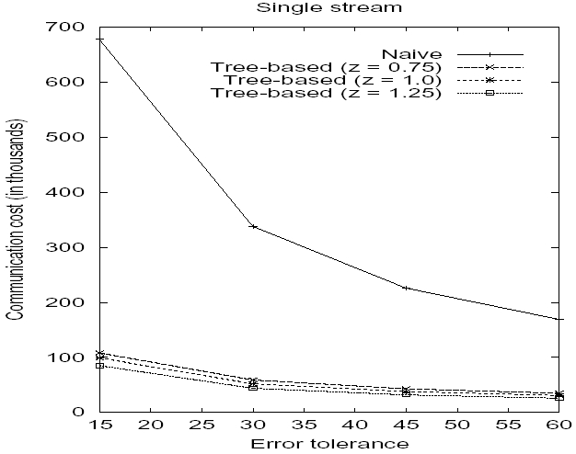
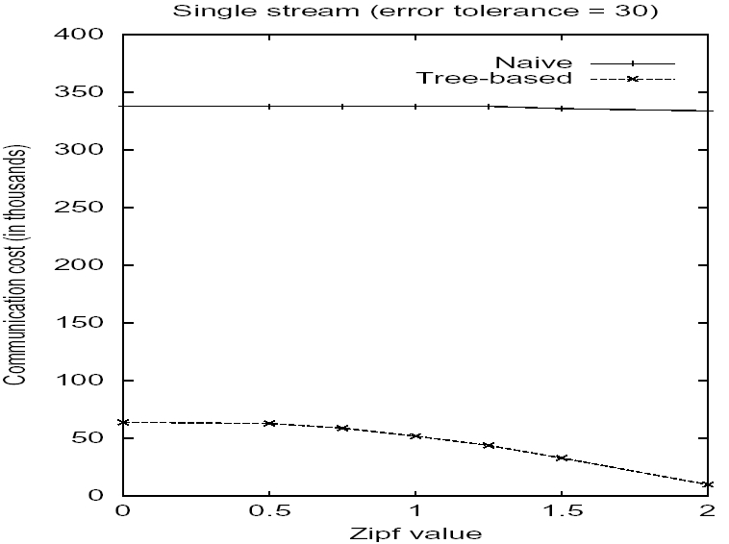
Single Stream Cardinality Estimation

Slide 32
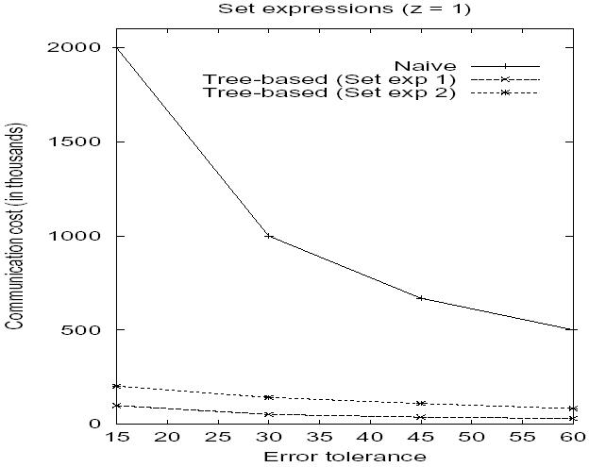
Set Expression Cardinality Estimation
E₁=(S₁- S₂)∪ S₃ E₂=(S₁∪ S₂)∩S₃

Slide 33
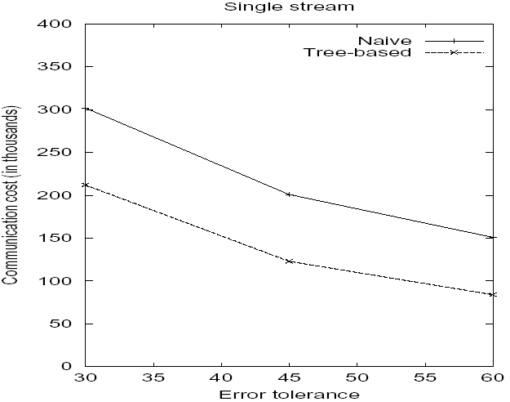
Real Life Dataset
LBL-TCP-3 dataset
http://ita.ee.lbl.gov/html/contrib/LBL-TCP-3.html
Used 500,000 records from dataset
  Timestamp, src. IP, dest. IP, next hop IP
  Sliding window of 2 seconds, m=16 sites
Notes:
2 hours worth of wide area TCP traffic between LBL and rest of world.
Induced query on number of distinct destination IP addresses

Slide 34
Related Work
Most work on streams focuses on memory efficient algorithms for a single stream
  Quantiles [GK01,GKMS02,CM04], set expression cardinality [GGR03], distinct values [Gib01], frequent elements [CCF02] etc.
Most similar to Olston et. al. [OJW03, BO03]
  [OJW03]: Aggregation queries tracking sums
  [BO03]: Track top-k items at coordinator
  Our naïve algorithm adapts scheme of [OJW03]
Notes:
Our work is most similar to Olstons in the sense that we use the same model and optimize for same metric, exploring the accuracy-comm tradeoff, except that the queries are different: Instead of aggregation or top-k
Top k: Frequencies are important: For us, ignored in distinct counts,. So in a sense ours is more cpomplex
since olston could use tricks based on additivity of frequencies at different sites…

Slide 35
Concluding Remarks
Distributed Framework for Set Expression Cardinality Estimation
  Minimize communication while providing guarantees
    Exploit Global Knowledge
    Exploit Set Expression semantics
Experimental results
  Factor of 2 to 20 improvement over naive
  Higher savings for skewed data
Notes:
Sketch based sampling techniques to reduce communication
Control message traffic negligible compared to savings in #messages
~18K for 1M updates
Protocols for efficiently propagating global knowedge
Framework generic to incorporate any charging scheme

Slide 36
Thank You!
Questions ?

Slide 37
Charge Triple Computation: Example
E = S₁∩(S₂-S₃)
e ∈ F₃, θ₃(e)=4
 | i=1 | i=2 | i=3
S’_{i,j} |  | e | e
S_{i,j} | e | e
(0,0,∞)
(0,0,1)
(0,1,3)
  Φ(S₁)= Φ(S₂)=1
  Φ(S₃)=1/4
(∧)
∩
_
(0,0,∞)
(0,1,3)
(∧¬)
Φ_{j}⁺(e)=Φ(S₃)=1/4
Φ_{j}⁻(e)=0
S₁
(1,1,∞)
(0,1,1)
S₂
S₃
(1,1,∞)
(1,1,∞)
(1,0,3)
Notes:
Leaves initialized to contain t(M,s) for models that satisfy local constraints
Truth of set expression goes from 0 to 1 if there are changes (deletions) at 4 sites!

Slide 38
Symbols
∩∪ ± ε ≤≥ εΣ∑ S_{i,j} ε e e ε ε εε
Φ ∈∉ θ_{I} Φ τ ∀ θ ∪ ∩
Φ_{j}⁺(e)=0Ψ ∨∧¬ S_{i,j} ⊆ ⇒ ∞

Slide 39
Model Based Scheme: Example
 | i=1 | i=2 | i=3
S’_{i,j} |  | e | e
S_{i,j} | e | e
E = S₁∩(S₂-S₃)
States at site j ➔
e ∈ F₃, θ₃(e)=4
Φ(S₁)= Φ(S₂)=1 , Φ(S₃)=1/4
Ψ_{j}⁺=(¬p’₁ ∨ ¬p’₂∨ p’₃) ∧ (p₁ ∧ p₂ ∧¬p₃) ∧ (p₁ ∧ p’₂ ∧ p₂ ∧ p’₃)
{p’₃, ¬p₃} ⊆ M (For any model M)
S₃ has local state change at site j
  Φ_{j}(M)=Φ(S₃)=1/4 ⇒ Φ_{j}⁺(e)=1/4
  Ψ_{j}⁻ unsatisfiable ⇒ Φ_{j}⁻(e)=0
Notes:
Any model M satisfying phi+ must have a GLOBAL state change for S_3

Slide 40
Charge Computation Heuristic
Tracks culprit streams at each node of expression tree using `charge triples’
Charge triple for model M at a node V is t(M,V) = (a,b,x)
  a=1 if M satisfies F’_{E(V)}, a=0 else
  b=1 if M satisfies F_{E(V)}, b=0 else
  x=index of culprit stream for M in V’s subtree
  (x=∞ if no stream in subtree V have global state change)
Heuristic computes triples in bottom-up fashion
Notes:
Is this first time TREE introduced?

Slide 41
Correctness
A charging scheme is correct iff it satisfies following two correctness invariants
  ∀e∈E-E’, Σ_{j} Φ_{j}⁺(e) ≥ 1
  ∀e∈E’-E, Σ_{j} Φ_{j}⁻(e) ≥ 1
Charging scheme for single stream case
  Non frequent elements
    Charge=1 for each insertion/deletion
  Frequent elements
    Φ_{j}⁺(e)=0 if e newly inserted
    Φ_{j}⁻(e)=1/θ_{i}(e) if e recently deleted

Slide 42
Computing charge Φ_{j}(M) for model M
e∈E: 1→1, 1→0
Suppose E=S₁ ∪ S₂
  e ∈ S’_{1,j} , e ∈ F₁,F₂
  Ψ_{j}⁻= (p’₁ ∨ p’₂)∧(¬p₁ ∧ ¬p₂) ∧(p’₁ ∧ p’₂)
  = (p’₁ ∧ ¬p₁) ∧(p’₂ ∧ ¬p₂)
  M: e must get deleted from S₁, S₂ globally
  Uniform culprit selection property
    Every site selects the same culprit stream S_{i}∈P
    Φ(S₁)=1/4 , Φ(S₂)=1/2 → culprit=S₁
    Φ_{j}(M) = 1/4 since S₁ has local state change at site j
    (Φ_{j}(M) = 0 else)
∪
S_{1,j}
S_{2,j}
e: 1→0
e: 0→0
(θ₁(e)=4)
(θ₂(e)=2)
Notes:
P=set of streams S_{i} with global state change in M

Slide 43
Charging the Culprit Stream
Charge Φ(S_{i}) for culprit stream S_{i}:
  Φ(S_{i}) = 1/θ_{i}(e) if e ∈ F_{i}
  Φ(S_{i}) = 1 else
Charge Φ_{j}(M) for model M defined in terms of culprit stream charge
  Φ_{j}(M) = Φ(S_{i}) if S_{i} has local state change at site j
  Φ_{j}(M) = 0 else
Lemma: Model based charging scheme is correct
Notes:
Intuition: 1/Φ(S_{i}) represents the minimum number of sites that must have local state changes for it to have a global sate change
make this slide less dense: Cut out the intuition and just explain it?

Slide 44
Culprit Stream Selection
Select culprit stream to minimize the charge Φ_{j}⁺(e) at site j
Choose stream in P with smallest charge as culprit
  Break ties in favor of stream with smaller index
Satisfies Uniform Culprit Selection property
Notes:
Φ(S_{i}) same at all sites

Slide 45
N.O.C
S₁

