Slide 1
Compact Histograms for Hierarchical Identifiers
Frederick Reiss (IBM Almaden Research Center)
Minos Garofalakis (Intel Research, Berkeley)
Joseph M. Hellerstein (U.C. Berkeley)
VLDB 2006
Seoul, South Korea

Slide 2

Application
Periodic reports on data streams, broken down according to metadata
Location
Group
Aggregate
1
1
1
2
…
1
2
3
1
…
25
34
110
4
…
Query
Table of metadata
(maps unique identifiers to object properties)
Control
Center
Streams of unique identifiers (UIDs)
  (IP addresses, RFID tag IDs, Credit card numbers, etc)
Monitor
Monitor
Data sources
(Network links, cash registers, roadway sensors, etc.)

Slide 3
Query Model
Continuous query in CQL query language
Each row in the lookup table defines a group
count(*) for ease of exposition
select T.GroupID,
count(*)
wtime(*) as windowTime
from
UIDStream S [sliding window],
LookupTable T
where
S.UID ≥ T.MinUID
and S.UID ≤ T.MaxUID
group by W.GroupID;

Slide 4
Network Monitoring Example
Packet is a stream of network packet headers
WHOIS is the lookup table
  Maps IP addresses to network owners
Query produces a breakdown of network traffic according to who owns the data source
select W.adminContact,
count(*)
wtime(*) as windowTime
from
Packet P [range ’1 min’ slide ’1 min’ ],
WHOIS W
where
P. srcIP ≥ WHOIS.minIP
and P.srcIP ≤ WHOIS.maxIP
group by W.adminContact;

Slide 5
High-Level Problem
The Monitor-Controller connection relatively low capacity
Unique identifier stream relatively high bandwidth
Unique identifer (UID) stream is at the Monitor, and lookup table is at the Controller
Want to avoid shipping either the entire UID stream or the entire lookup table

Slide 6
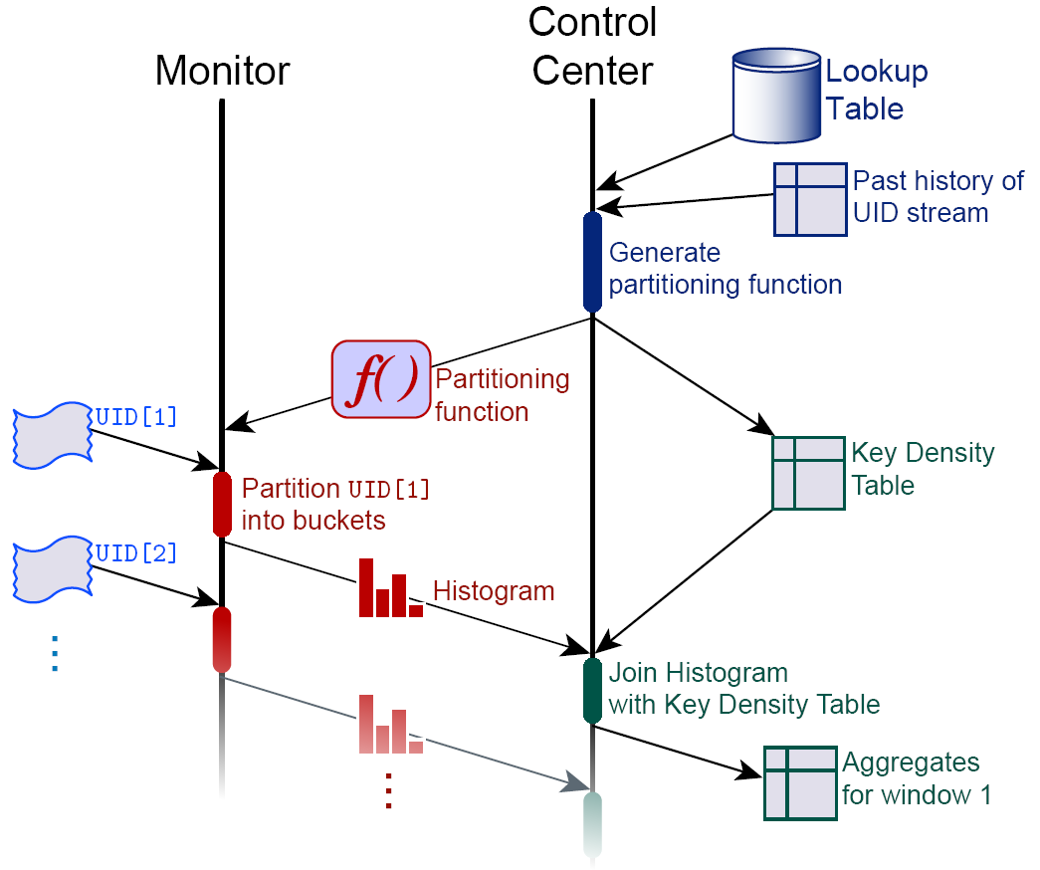
High-Level Solution
Lookup Table
GroupID
MinUID
MaxUID
1
2
3
…
1
26
101
…
25
100
200
…
Partitioning Function
PartitionID
MinUID
MaxUID
1
2
3
…
1
101
201
…
100
400
300
…
Key Density Table
Histogram
PartitionID
GroupID
Multiplier
PartitionID
Count
1
1
2
…
1
2
3
…
0.25
0.75
0.33
…
1
2
3
…
100
66
212
…
Estimated Result
GroupID
Est. Count
1
2
3
…
100 × 0.25
100 × 0.75
66 × 0.33
…
25
75
22
…

Slide 7
Low-Level Problem
Input:
  Lookup table
  Set of representative unique identifier counts
  Error metric, expressed as a distributive aggregate
Output:
  Histogram partitioning function that minimizes error for the group-by query

Slide 8
Key Insight
Unique identifiers often a hierarchical structure
  Nested ranges of identifiers
Hierarchies are correlated with typical lookup table entries
  Physical location
  Role within organization

Slide 9
Where does the hierarchy come from?
Political
  Central authority allocates identifiers in large blocks
  Sub-organizations allocate sub-blocks
Technical
  UIDs often contain subfields
    First digit of a credit card number → type of issuer
    First digit of a U.S. zip code → region of country
  Allows partial decoding
  Makes routing and sorting messages easier

Slide 10
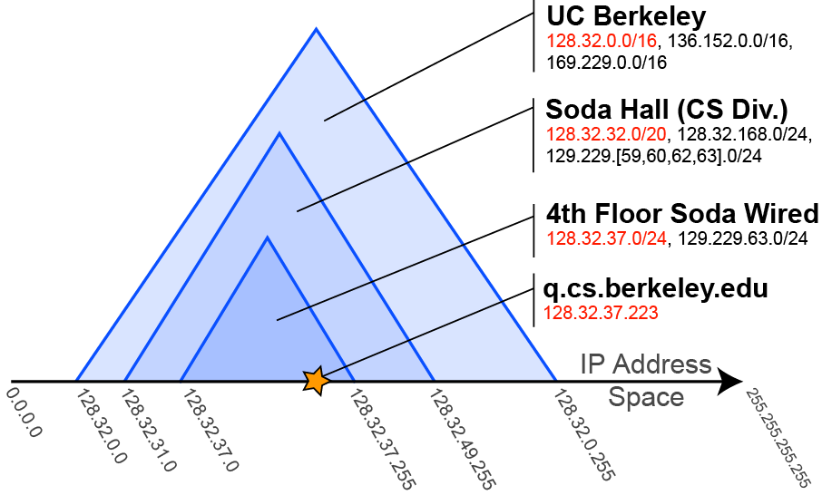
Example: The IP Address Hierarchy

Slide 11
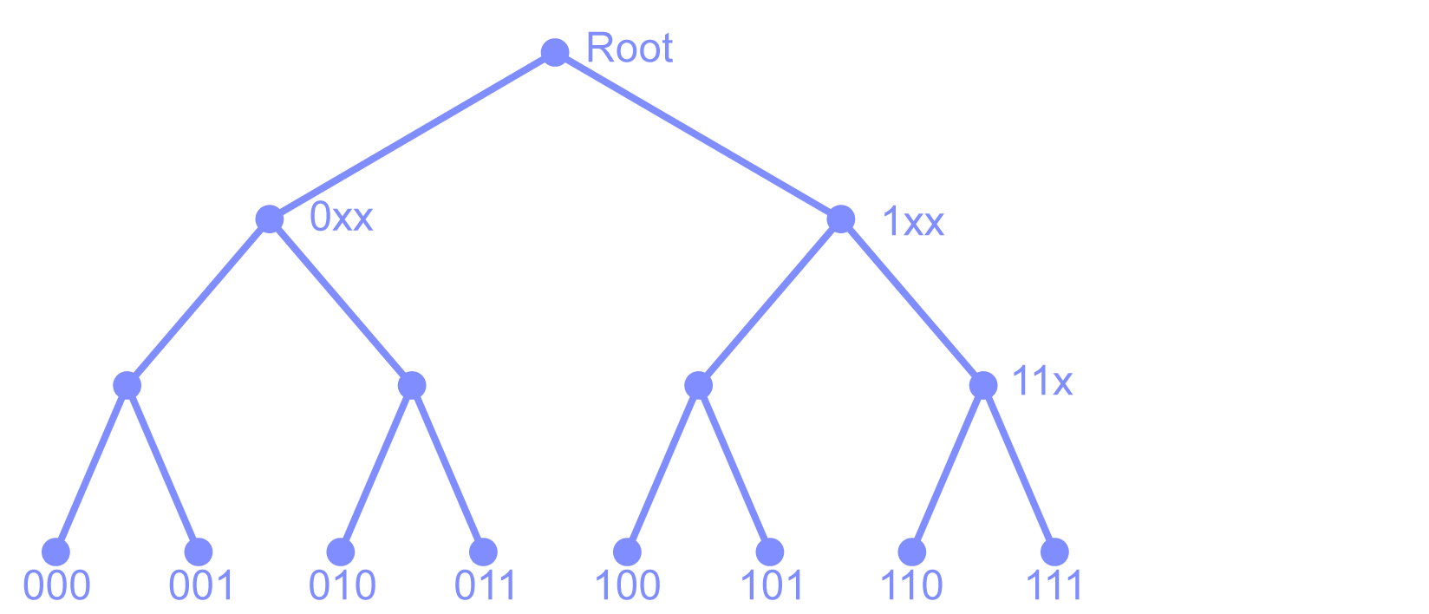
3-Bit Hierarchy

Slide 12
Types of nodes

Slide 13
Revised Problem Statement
Input:
  Hierarchy of unique identifiers (UIDs)
  Set of group nodes in the hierarchy
  Set of representative unique identifier counts
  Error metric, expressed as a distributive aggregate
Output:
  Histogram partitioning function consisting of a set of bucket nodes that minimizes error for the group-by query

Slide 14
Non-Overlapping Partitioning Functions
Bucket nodes form a cut of the hierarchy
Each unique identifier maps to the bucket node above
Very fast to find optimal partitioning…
…but relatively low accuracy

Slide 15
Overlapping “Partitioning Functions”
Bucket nodes can go anywhere
Each unique identifier maps to all bucket nodes above it
Almost as fast to find optimal partitioning
Better accuracy

Slide 16
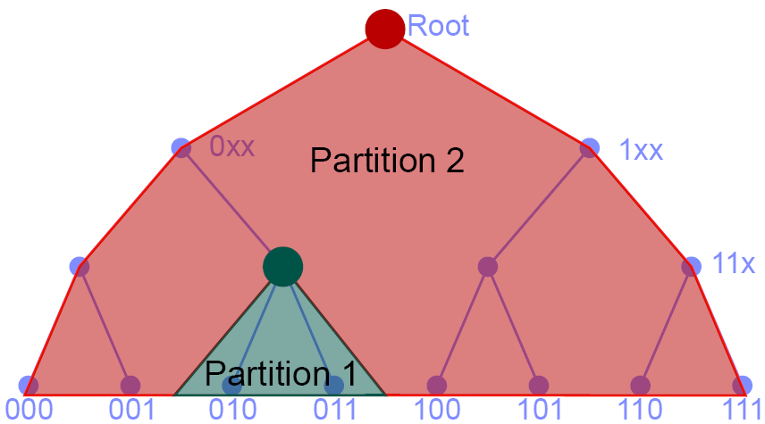
Longest-Prefix-Match Partitioning Functions
Inspired by Internet routing
Like overlapping partitioning functions, but each UID maps only to its closest ancestor
Harder to find optimal partitioning
Best accuracy
  LPM heuristics often outperform optimal algorithms for other classes

Slide 17
Basic Approach
Dynamic programming over the hierarchy
  Bottom-up version of a recursive algorithm
Base case:
  A bucket with one group produces zero error
“Recursive” case:
  Use the optimal solutions for node i’s children to compute the optimal solution for node I

Slide 18
Algorithm Diagram (Nonoverlapping Partitions)
Root
Group nodes
0xx
00x
00x
000
001
010
011
100
101
110
111
Estimated Counts
10
10
60
25
0
52
27

Slide 19
Algorithm Diagram (Nonoverlapping Partitions)
Node
Num
Partitions
Squared
Error
Root
000
1
0.0
001
1
0.0
0xx
00x
00x
000
001
010
011
100
101
110
111
Estimated Counts
10
10
60
25
0
52
27

Slide 20
Algorithm Diagram (Nonoverlapping Partitions)
Node
Num
Partitions
Squared
Error
Root
000
1
0.0
001
1
0.0
00x
1
50.0
0xx
00x
2
0.0
00x
01x
000
001
010
011
100
101
110
111
Estimated Counts
20
10
60
25
0
52
27

Slide 21
Algorithm Diagram (Nonoverlapping Partitions)
Node
Num
Partitions
Squared
Error
Root
00x
1
50.0
00x
2
0.0
01x
1
200.0
0xx
01x
2
0.0
0xx
1
1475.0
0xx
2
250.0
00x
01x
0xx
3
50.0
1 Left, 2 Right → 50.0
1 Right, 2 Left → 200.0
0xx
4
0.0
000
001
010
011
100
101
110
111
Estimated Counts
20
10
60
40
0
52
27

Slide 22
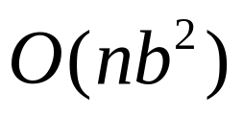
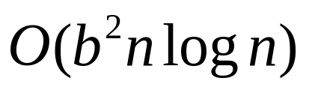
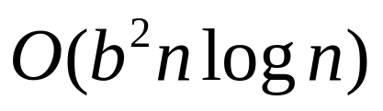
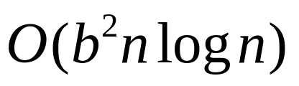
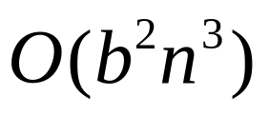
Running times:
Non-Overlapping
  time for RMS error
    b = number of buckets, n = number of nonzero groups
  time for generic distributive error
Overlapping:
Longest-Prefix-Match:
  Heuristics range from to

Slide 23
Multiple Dimensions
DP table entry for each combination of bucket nodes
time
  Polynomial time at a given dimension
  Exponential in number of dimensions
  Much better than previous results

Slide 24
Experimental Results
Data:
  Trace of “dark address” traffic from internet telescope at LBL
    187,000 unique source IP addresses
  1.1 million nonoverlapping subnets from WHOIS database
Query:
  Find packet count for each subnet
Procedure
  Generate 6 kinds of histogram of the trace
  Vary number of buckets from 10 to 1000
  Measure error in estimating the packet count in each subnet
    4 different error metrics

Slide 25
Experimental Results
500-bucket histograms
Relative error metric:
Overlapping, Longest Prefix Match:
  Better accuracy than existing histogram types
Many more graphs in paper!

Slide 26
Related Work
Histograms for OLAP drill-down queries [Koudas00,Guha02]
  No nesting of buckets
  RMS error metric
STHoles [Bruno01]
  2-D histograms with “holes” in buckets
  Heuristics for construction
Wavelet-based histograms [Matias98,Matias00,Garofalakis04,Karras05]
  Based on Haar wavelet error tree
  Differential encoding of values

Slide 27
Recap
Important class of monitoring queries:
  Use a table of metadata to map unique identifiers into groups
  Aggregate within each group
Problem: Pick a histogram partitioning function for estimating the query result
Insight: Hierarchical structure of UID spaces
Solution: New classes of partitioning function that leverages the hierarchy

Slide 28
Read the paper for…
Formal problem statement
In-depth description of algorithms, with recurrences
Why Longest-Prefix-Match is hard
Handling sparse group counts
Detailed experimental results

Slide 29
Thank you!
Questions?

Slide 30
Backup slides

Slide 31
What goes wrong
Sampling
  Many groups with small counts
Histograms
  Histogram buckets align poorly with lookup table

Slide 32
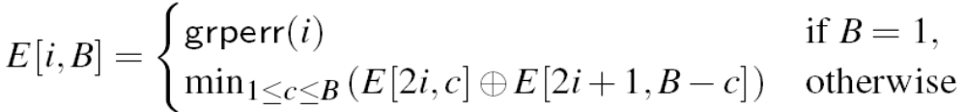
Recurrences [1]
Nonoverlapping partitioning functions:

Slide 33
Recurrences [2]
Overlapping partitioning functions:

Slide 34
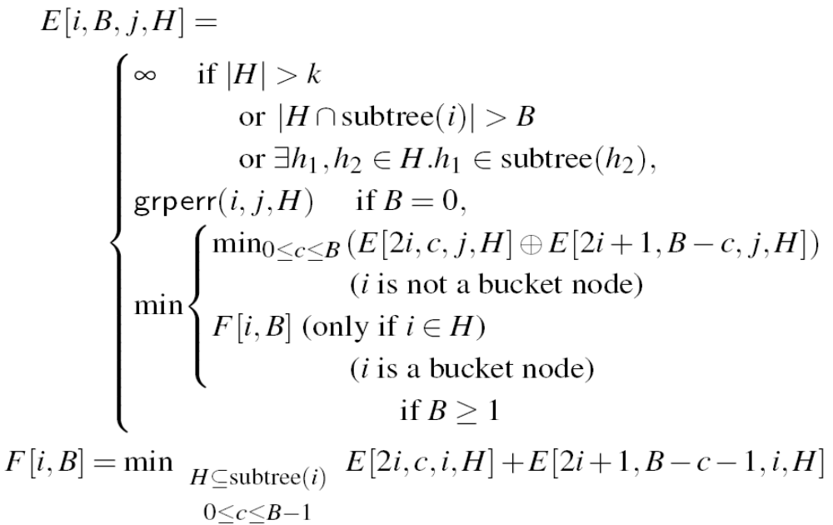
Recurrences [3]
K-holes Heuristic for Longest-Prefix-Match

Slide 35
Recurrences [4]
Quantized heuristic for Longest-Prefix-Match:

Slide 36
Histograms: Future work
More experiments
  Other data sets
  Histograms + Data Triage
Full NP hardness proof for Longest Prefix Match
Adapting partitioning functions to changes in data distribution

