Slide 1




Adaptive Cleaning for RFID Data Streams
Shawn Jeffery Minos Garofalakis Michael Franklin
UC Berkeley Intel Research Berkeley UC Berkeley
VLDB 2006
9/12/06

Slide 2
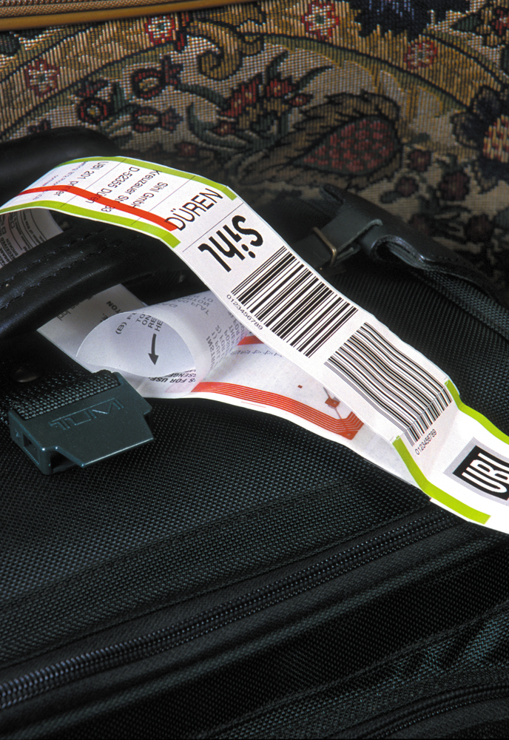
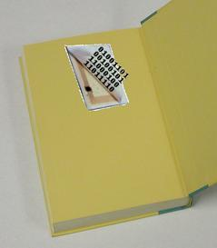
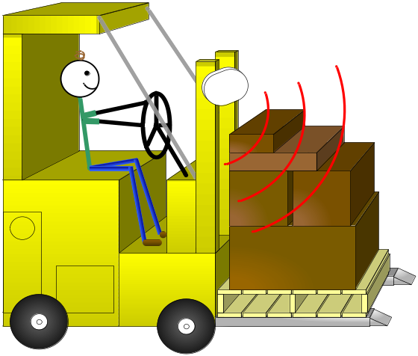
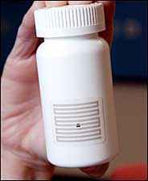
RFID: Radio Frequency IDentification

Slide 3
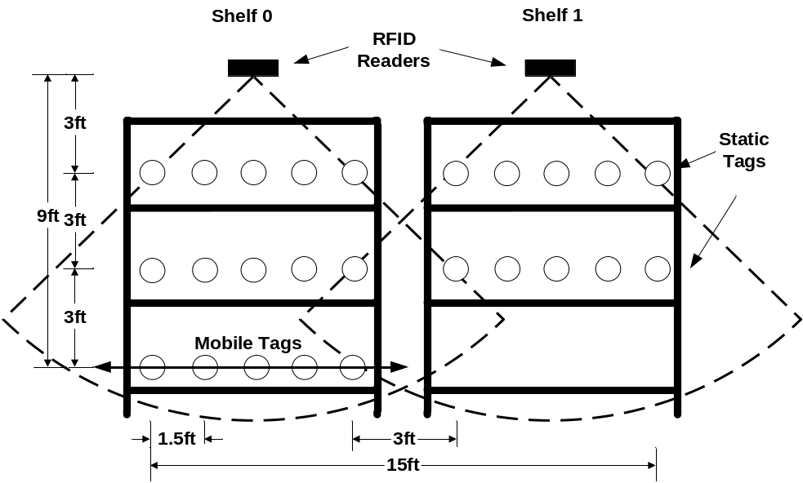
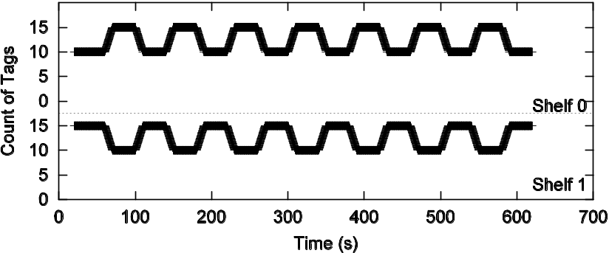
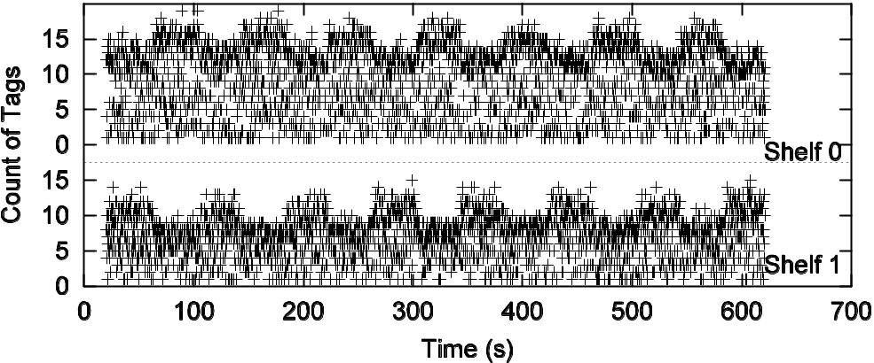
RFID data is dirty
A simple experiment:
2 RFID-enabled shelves
10 static tags
5 mobile tags

Slide 4
RFID Data Cleaning
RFID data has many dropped readings
Typically, use a smoothing filter to interpolate
SELECT distinct tag_id
FROM RFID_stream [RANGE ‘5 sec’]
GROUP BY tag_id
But, how to set the size
of the window?
Smoothed output
Smoothing Filter
Raw readings
Time

Slide 5
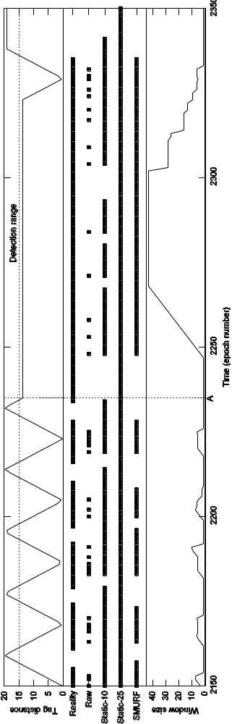
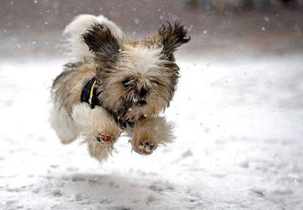
Window Size for RFID Smoothing
Fido moving
Fido resting
Reality
Raw readings
Small window
Large window
→ Need to balance completeness vs. capturing tag movement

Slide 6
Truly Declarative Smoothing
Problem: window size non-declarative
  Application wants a clean stream of data
  Window size is how to get it
Solution: adapt the window size in response to data

Slide 7
Itinerary
Introduction: RFID data cleaning
A statistical sampling perspective
SMURF
  Per-tag cleaning
  Multi-tag cleaning
Ongoing work
Conclusions

Slide 8
A Statistical Sampling Perspective
Key Insight:
RFID data ≈
random sample of present tags
Map RFID smoothing to a sampling experiment

Slide 9


RFID’s Gory Details
Antenna & reader
Tags
Read Cycle (Epoch)
E0
E1
E2
E3
E4
E5
E6
E7
E8
E9
Tag List
Tag 1
Epoch | TagID | ReadRate
0 | 1 | .9
0 | 2 | .6
0 | 3 | .3
Tag 2
Tag 3
Tag 4
(For Alien readers)

Slide 10
RFID Smoothing to Sampling
RFID | Sampling
Read cycle (epoch) | Sample trial
Reading | Single sample
Smoothing window | Repeated trials
Read rate | Probability of inclusion (p_{i})
→ Now use sampling theory to drive adaptation!

Slide 11

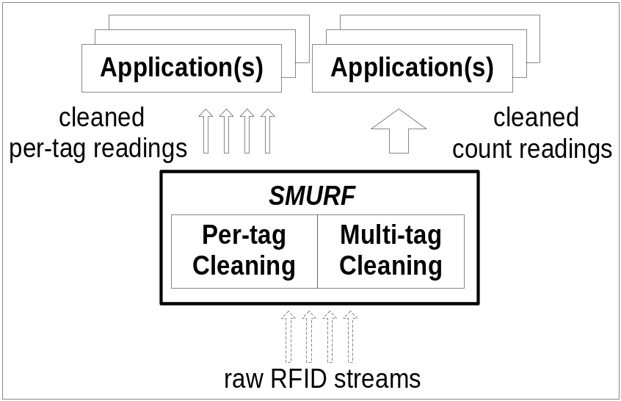
SMURF
Statistical Smoothing for Unreliable RFID Data
Adapts window based on statistical properties
Mechanisms for:
  Per-tag and multi-tag cleaning

Slide 12
Per-Tag Smoothing: Model and Background
Use a binomial sampling model
1
S_{i}
p_{i}
p_{i}^{avg}
(Read rate of tag i)
0
Time (epochs)
E0
E1
E2
E3
E4
E5
E6
E7
E8
E9
Smoothing Window
w_{i} Bernoulli trials

Slide 13
Per-Tag Smoothing: Completeness
If the tag is there, read it with high probability
→ Want a large window
1
p_{i}
0
Time (epochs)
E0
E1
E2
E3
E4
E5
E6
E7
E8
E9
Reading with a low p_{i}
Expand the window

Slide 14
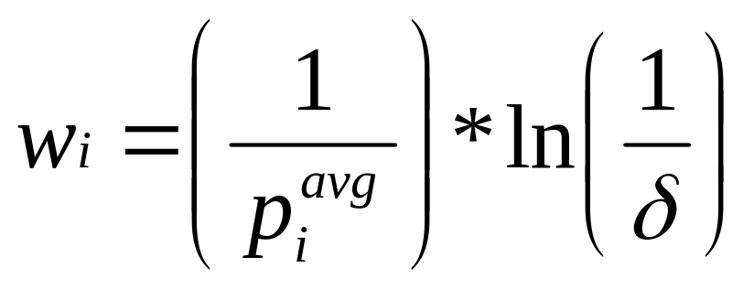
Per-Tag Smoothing: Completeness
Desired window size for tag i
Expected epochs needed to read
With probability 1- δ

Slide 15
Per-Tag Smoothing: Transitions
Detect transitions as statistically significant changes in the data
The tag has likely left by this point
1
p_{i}
0
Time (epochs)
E0
E1
E2
E3
E4
E5
E6
E7
E8
E9
Statistically significant difference
Flag a transition and shrink the window

Slide 16
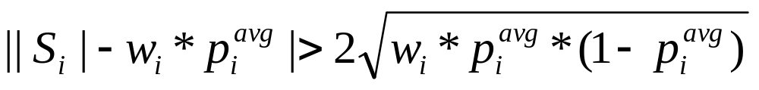
Per-Tag Smoothing: Transitions
# observed readings
# expected readings
Is the difference “statistically significant”?

Slide 17

SMURF in Action
Fido moving
Fido resting
SMURF
→ Experiments with real and simulated data show similar results

Slide 18
Multi-tag Cleaning
Some applications only need aggregates
  E.g., count of items on each shelf
  Don’t need to track each tag!
Use statistical mechanisms for both:
  Aggregate computation
  Window adaptation

Slide 19
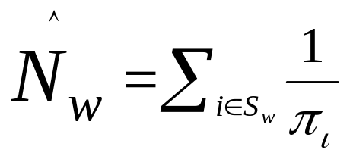
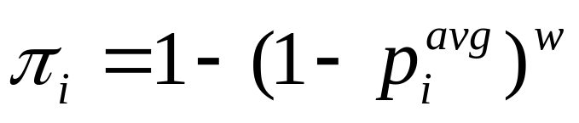
Aggregate Computation
π–estimators (Horvitz-Thompson)
Count:
P[tag i seen in a window of size w]:
→Use small windows to capture movement
→Use the estimator to compensate for lost readings

Slide 20
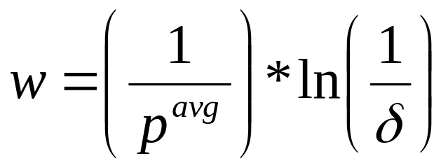
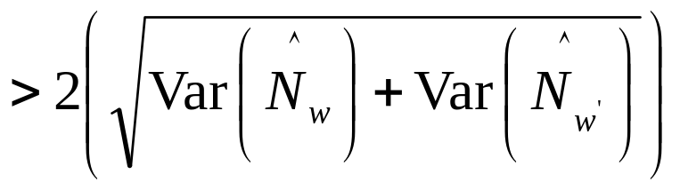
Window Adaptation
Upper bound window similar to per-tag
“Transition” based on variance within subwindows
N_{w}
Count
N_{w}’
Time (epochs)
E0
E1
E2
E3
E4
E5
E6
E7
E8
E9

Slide 21
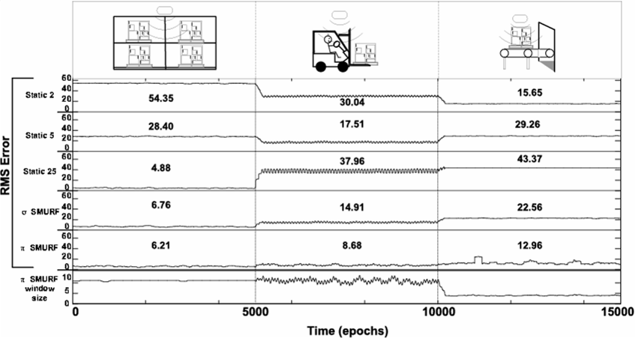
Multi-tag Scenario

Slide 22

Ongoing Work: Spatial Smoothing
With multiple readers, more complicated
Two rooms, two readers per room
A
C
B
D
Reinforcement
→ A? B? A U B? A B?
Arbitration
→ A? C?
U
→ All are addressed by statistical framework!

Slide 23
Beyond RFID
Other sensor data
π-estimator for other aggregates
Use SMURF for sensor networks
Use SMURF in general streaming systems (e.g., TelegraphCQ)
Remove RANGE clause from CQL
Other streaming data

Slide 24
Related Work
Commercial RFID middleware
  Smoothing filters: need to set smoothing window
RFID-related work
  Rao et al., StreamClean: complementary
  Intel Seattle, HiFi, ESP: static window size
BBQ, MauveDB
  Heavyweight, model-based
  SMURF is non-parametric, sampling-based
Statistical filters (digital signal processing)
  Non-linear digital filters inspired SMURF design
Notes:
Interesting point: meeting of signal processing and DB – we are trying to find the synergy

Slide 25
Conclusions
Current smoothing filters not adequate
  Not declarative!
SMURF: Declarative smoothing filter
  Uses statistical sampling to adapt window size

Slide 26


Thanks!
Questions?
jeffery@cs.berkeley.edu

