Slide 1
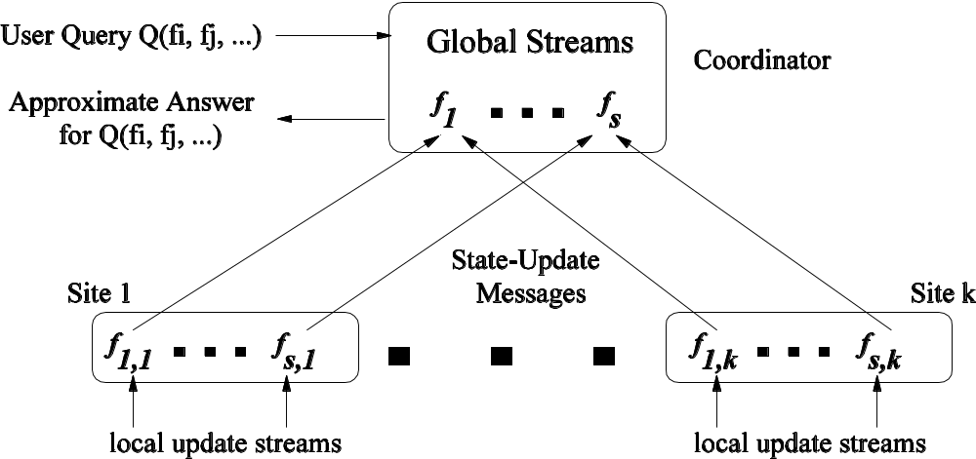
Sketching Streams through the Net:
Distributed Approximate Query Tracking
Minos Garofalakis Intel Research Berkeley minos.garofalakis@intel.com
(Joint work with Graham Cormode, Bell Labs)

Slide 2
Continuous Distributed Queries
Traditional data management supports one shot queries
  May be look-ups or sophisticated data management tasks, but tend to be on-demand
  New large scale data monitoring tasks pose novel data management challenges
  Continuous, Distributed, High Speed, High Volume…

Slide 3
Network Monitoring Example
Network Operations
Center (NOC)
BGP
Converged IP/MPLS
Network
DSL/Cable
Networks
PSTN
Network Operations Center (NOC) of a major ISP
  Monitoring 100s of routers, 1000s of links and interfaces, millions of events / second
  Monitor all layers in network hierarchy (physical properties of fiber, router packet forwarding, VPN tunnels, etc.)
Other applications: distributed data centers/web caches, sensor networks, power grid monitoring, …

Slide 4
Common Aspects / Challenges
Monitoring is Continuous…
  Need real-time tracking, not one-shot query/response
…Distributed…
  Many remote sites, connected over a network, each sees only part of the data stream(s)
  Communication constraints
…Streaming…
  Each site sees a high speed stream of data, and may be resource (CPU/Memory) constrained
…Holistic…
  Track quantity/query over the global data distribution
…General Purpose…
  Can handle a broad range of queries

Slide 5










Problem
Coordinator
Track Q( ) =
Each stream distributed across a (sub)set of remote sites
  E.g., stream of UDP packets through edge routers
Challenge: Continuously track holistic query at coordinator
  More difficult than single-site streams
  Need space/time and communication efficient solutions
But… exact answers are not needed
  Approximations with accuracy guarantees suffice
  Allows a tradeoff between accuracy and communication/ processing cost

Slide 6
Prior Work – Specialized Solutions
continuous
distributed
streaming
holistic
Distributed top-k X ✓ ✓ ✓ GK04, MSDO05
& quantiles ✓ ✓ ✓ ✓ CGMR05
Streaming top-k ✓ X ✓ ✓ GK01, MM02
& quantiles
Distributed top-k ✓ ✓ X ✓ BO03
Distributed filters ✓ ✓ ✓ X OJW03
First general-purpose approach for broad range of distributed queries

Slide 7

System Architecture
Streams at each site add to (or, subtract from) multisets/frequency distribution vectors
  More generally, can have hierarchical structure

Slide 8
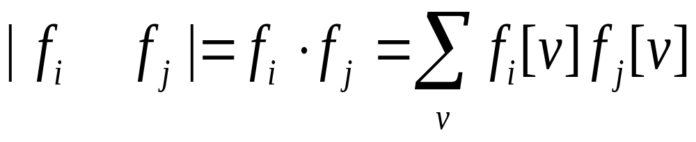
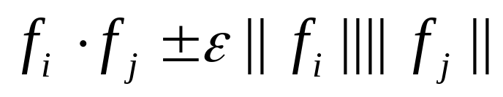
Queries
“Generalized” inner-products on the distributions
Capture join/multi-join aggregates, range queries, heavy-hitters, approximate histograms/wavelets, …
Allow approximation: Track
Goal: Minimize communication/computation overhead
  Zero communication if data distributions are “stable”

Slide 9
Our Solution: An Overview
General approach: “In-Network” Processing
  Remote sites monitor local streams, tracking deviation of local distribution from predicted distribution
  Contact coordinator only if local constraints are violated
Use concise sketch summaries to communicate…
Much smaller cost than sending exact distributions
No/little global information
Sites only use local information, avoid broadcasts
Stability through prediction
If behavior is as predicted, no communication

Slide 10
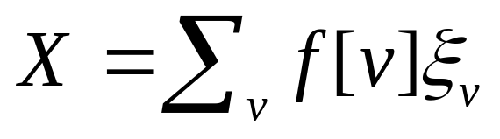


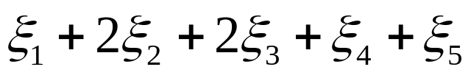

AGMS Sketching 101
Goal: Build small-space summary for distribution vector f[v] (v=1,..., N) seen as a stream of v-values
Basic Construct: Randomized Linear Projection of f = project onto dot product of f-vector
  Simple to compute: Add whenever the value v is seen
  Generate ‘s in small (logN) space using pseudo-random generators
2
2
1
1
1
Data stream: 3, 1, 2, 4, 2, 3, 5, . . .
f(1) f(2) f(3) f(4) f(5)
where = vector of random values from an appropriate distribution
Data stream: 3, 1, 2, 4, 2, 3, 5, . . .

Slide 11
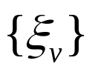
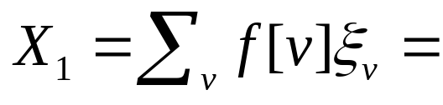
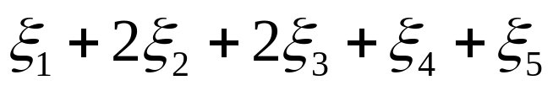
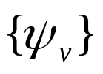
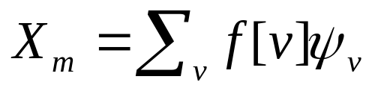
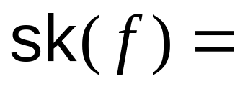
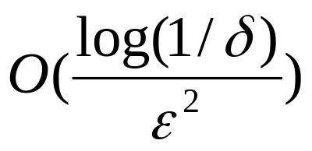
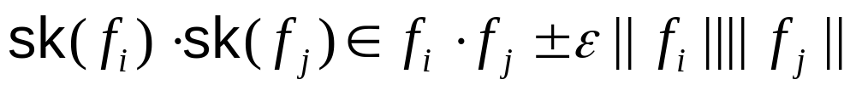
AGMS Sketching 101 (contd.)
2
2
f
1
1
1
Simple randomized linear projections of data distribution
  Easily computed over stream using logarithmic space
  Linear: Compose through simple addition
Theorem[AGMS]: Given sketches of size

Slide 12
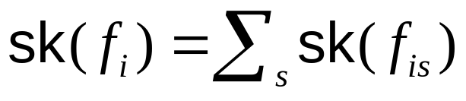
Sketch Prediction
Sites use AGMS sketches to summarize local streams
  Compose to sketch the global stream
  BUT… cannot afford to update on every arrival!
Key idea: Sketch prediction
  Try to predict how local-stream distributions (and their sketches) will evolve over time
  Concise sketch-prediction models, built locally at remote sites and communicated to coordinator
    Shared knowledge on expected local-stream behavior over time
    Allow us to achieve stability

Slide 13
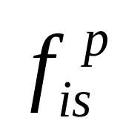
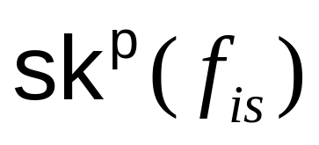
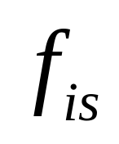
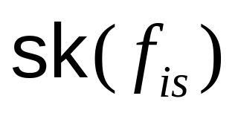
Sketch Prediction (contd.)
Prediction used at
coordinator for query answering
Predicted Distribution
Predicted Sketch
Prediction error tracked locally by sites (local constraints)
True Distribution (at site)
True Sketch (at site)

Slide 14
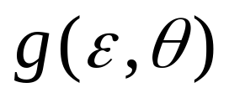


Query Tracking Scheme
Overall error guarantee at coordinator is function
  = local-sketch summarization error (at remote sites)
  = upper bound on local-stream deviation from prediction
    “Lag” between remote-site and coordinator view
Exact form of depends on the specific query Q being tracked
BUT… local site constraints are the same
  L2-norm deviation of local sketches from prediction

Slide 15
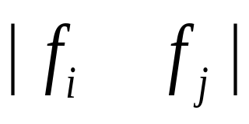




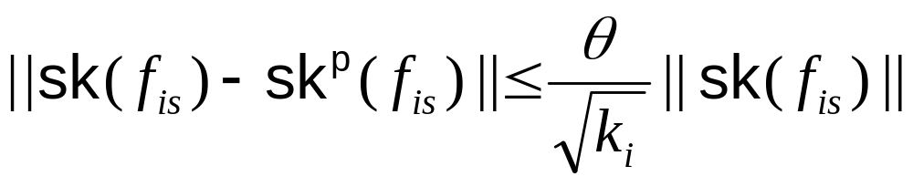
Query Tracking Scheme (contd.)
Coordinator
Continuously track Q =
Remote Site protocol
  Each site s sites( ) maintains -approx. sketch
  On each update check L2 deviation of predicted sketch
  If (*) fails, send up-to-date sketch and (perhaps) prediction model info to coordinator
(*)

Slide 16
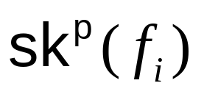
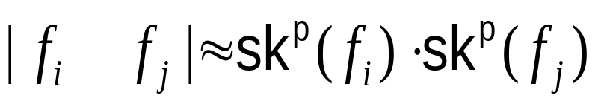
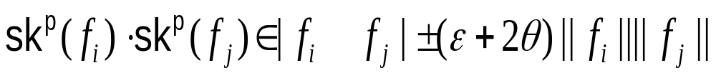

Query Tracking Scheme (contd.)
Coordinator protocol
  Use site updates to maintain sketch predictions
  At any point in time, estimate
Theorem: If (*) holds at participating remote sites, then
Extensions: Multi-joins, wavelets/histograms, sliding windows, exponential decay, …
Key Insight: Under (*), predicted sketches at coordinator are -approximate

Slide 17
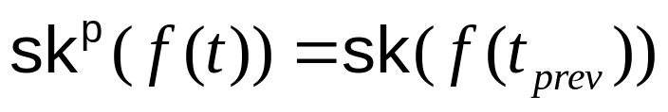
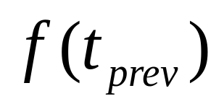
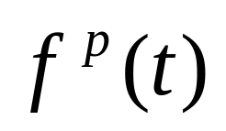
Sketch-Prediction Models
Simple, concise models of local-stream behavior
  Sent to coordinator to keep site/coordinator “in-sync”
Different Alternatives
  Static model: No change in distribution since last update
    Naïve, “no change” assumption:
    No model info sent to coordinator

Slide 18
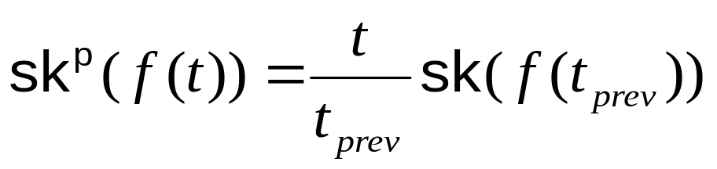
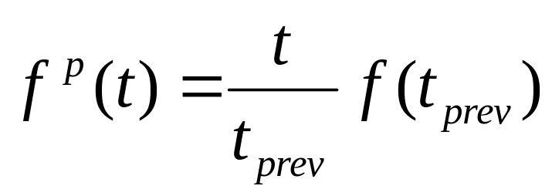
Sketch-Prediction Models (contd.)
  Linear-growth model: Uniformly scale distribution by time ticks
    (by sketch linearity)
    Model “synchronous/uniform updates”
    Again, no model info needed

Slide 19
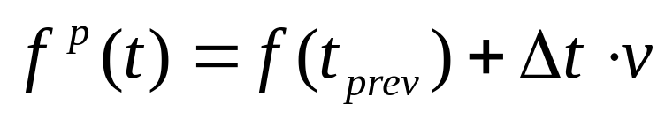
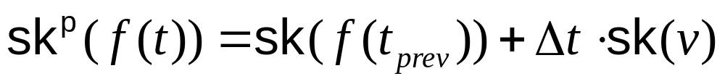
Sketch-Prediction Models (contd.)
  Velocity/acceleration model: Predict change through “velocity” & “acceleration” vectors from recent local history
    Velocity model:
      Compute velocity vector over window of W most recent updates to stream
    By sketch linearity
    Just need to communicate one more sketch (for the velocity vector)!

Slide 20

Sketch-Prediction: Summary
Model Info Predicted Sketch
Static
Linear growth
Velocity/ Acceleration
Communication cost analysis: comparable to one-shot sketch computation
Many other models possible – not the focus here…
  Need to carefully balance power & conciseness

Slide 21
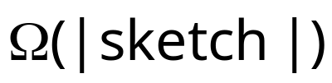
Improving Basic AGMS
1
1
1
0
0
Local stream
AGMS sketch
Update
1
0
1
1
1
0
Data stream
Update time for basic AGMS sketch is
BUT…
  Sketches can get large –- cannot afford to touch every counter for rapid-rate streams!
    Complex queries, stringent error guarantees, …
  Sketch size may not be the limiting factor (PCs with GBs of RAM)

Slide 22



The Fast AGMS Sketch
1
1
1
0
0
0
1
1
1
0
1
Update
Fast AGMS Sketch: Organize the atomic AGMS counters into hash-table buckets
  Each update touches only a few counters (one per table)
  Same space/accuracy tradeoff as basic AGMS (in fact, slightly better☺)
  BUT, guaranteed logarithmic update times (regardless of sketch size)!!

Slide 23

Experimental Study
Prototype implementation of query-tracking schemes in C
Measured improvement in communication cost (compared to sending all updates)
Ran on real-life data
  World Cup 1998 HTTP requests, 4 distributed sites, about 14m updates per day
Explored
  Accuracy tradeoffs ( vs. )
  Effectiveness of prediction models
  Benefits of Fast AGMS sketch

Slide 24
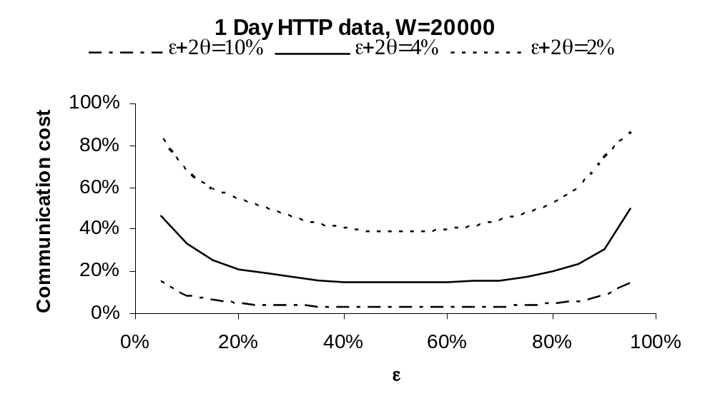
Accuracy Tradeoffs – V/A Model
Large “sweetspot” for dividing overall error tolerance

Slide 25
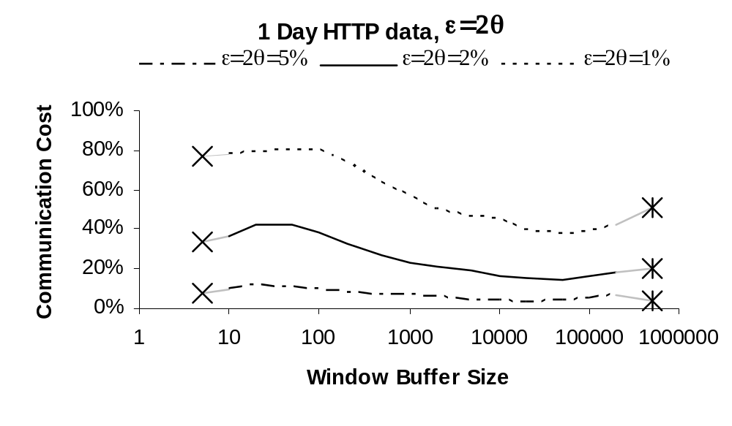
Prediction Models

Slide 26
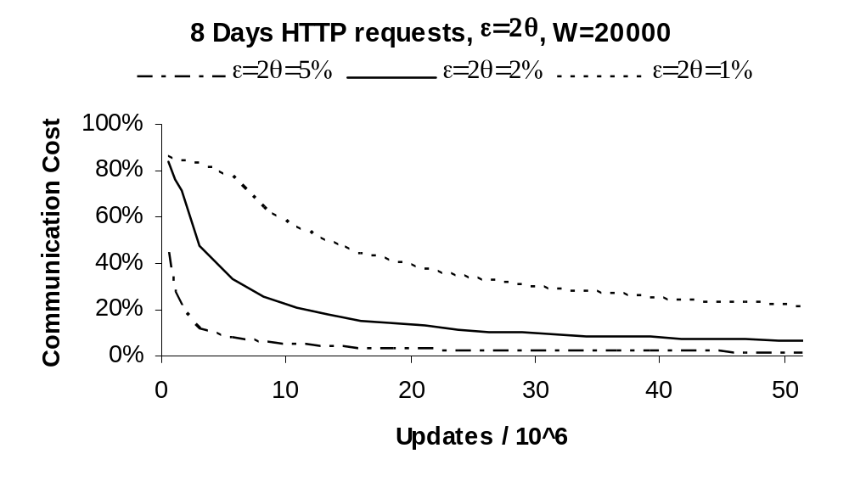
Stability – V/A Model

Slide 27
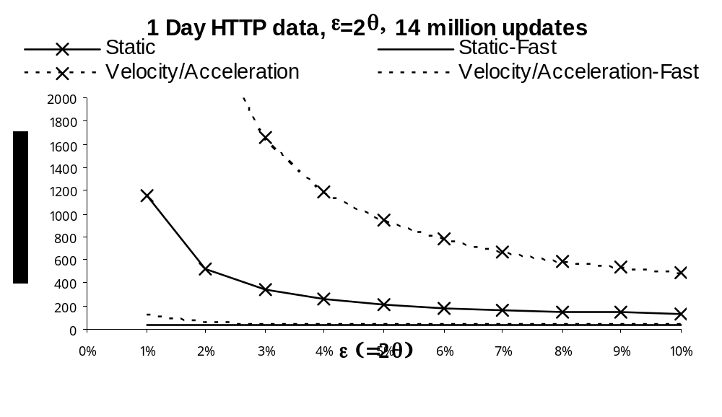
Fast AGMS vs. Standard AGMS

Slide 28
Conclusions & Future Directions
Novel algorithms for communication-efficient distributed approximate query tracking
  Continuous, sketch-based solution with error guarantees
  General-purpose: Covers a broad range of queries
  “In-network” processing using simple, localized constraints
  Novel sketch structures optimized for rapid streams
Open problems
  Specialized solutions optimized for specific query classes?
  More clever prediction models (e.g., capturing correlations across sites)?
  Efficient distributed trigger monitoring?

Slide 29

Thank you!
http://www2.berkeley.intel-research.net/~minos/
minos.garofalakis@intel.com

Slide 30
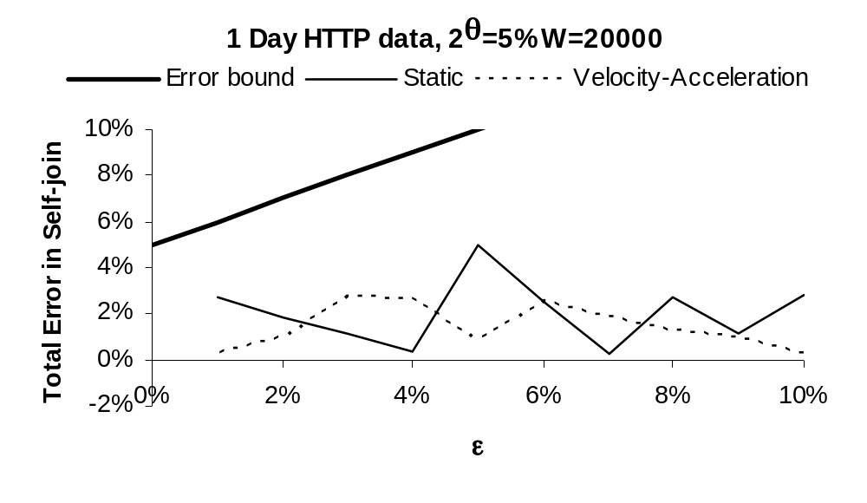
Accuracy – Total Error

Slide 31
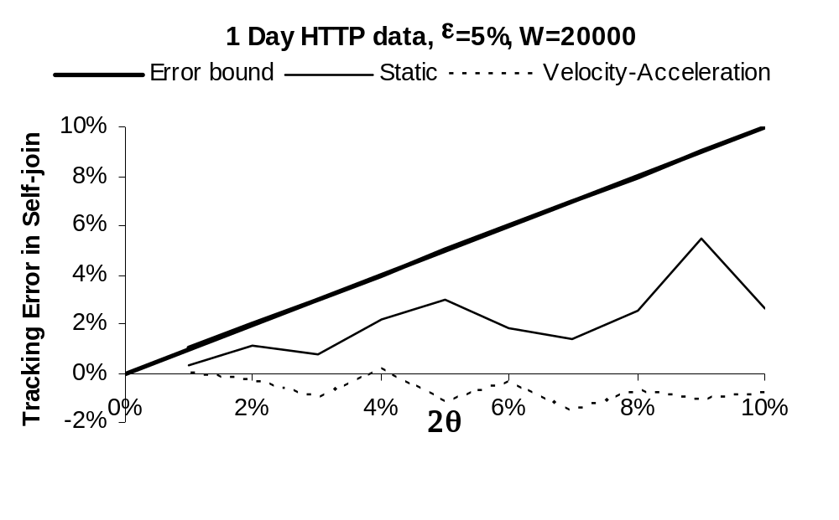
Accuracy – Tracking Error

Slide 32
Other Monitoring Applications
Sensor networks
  Monitor habitat and environmental parameters
  Track many objects, intrusions, trend analysis…
Utility Companies
  Monitor power grid, customer usage patterns etc.
  Alerts and rapid response in case of problems

