Slide 1
Processing Continuous Network-Data Streams
Minos Garofalakis
Internet Management Research Department
Bell Labs, Lucent Technologies

Slide 2
Network Management (NM): Overview
Network Management involves monitoring and configuring network hardware and software to ensure smooth operation
  Monitor link bandwidth usage, estimate traffic demands
  Quickly detect faults, congestion and isolate root cause
  Load balancing, improve utilization of network resources
Important to Service Providers as networks become increasingly complex and heterogeneous (operating system for networks!)
Network Operations
Center
Measurements
Alarms
Configuration
commands
IP Network

Slide 3
NM System Architecture (Manet Project)
Performance Monitoring
Threshold violations
Reports/Queries
Estimate demands
Provisioning
IP VPNs
MPLS primary
and backup LSPs
Fault Monitoring
Filter Alarms
Isolate root cause
Configuration
OSPF/BGP parameters
(e.g., weights, policies)
NM Applications
Monitoring
Bandwidth/latency
measurements
Alarms
Auto-Discovery
(NetInventory)
Network Topology
Data
NM Software Infrastructure
SNMP polling, traps
IP Network

Slide 4
Talk Outline
Data stream computation model
Basic sketching technique for stream joins
Partitioning attribute domains to boost accuracy
Experimental results
Extensions (ongoing work)
  Sketch sharing among multiple standing queries
  Richer data and queries
Summary

Slide 5
Answering Complex Aggregate Queries over Data Streams
(Joint Work with Alin Dobra, Johannes Gehrke, and Rajeev Rastogi)
(Appeared in ACM SIGMOD 2002)

Slide 6
Query Processing over Data Streams
Stream-query processing arises naturally in Network Management
  Data records arrive continuously from different parts of the network
  Queries can only look at the tuples once, in the fixed order of arrival and with limited available memory
  Approximate query answers often suffice (e.g., trend/pattern analyses)
Network Operations
Center (NOC)
Data-Stream Join Query:
SELECT COUNT(*)/SUM(M)
FROM R1, R2, R3
WHERE R1.A = R2.B = R3.C
Measurements
Alarms
R1
R2
R3
IP Network

Slide 7
The Relational Join
Key relational-database operator for correlating data sets
Example: Join R1 and R2 on attributes (A,B) = R1 R2
A,B
R1
R2
R1 R2
A,B
C
10
11
12
13
A B
1 2
2 3
5 1
3 2
A B
1 2
1 2
5 5
2 3
3 2
D
17
18
19
20
21
A B C D
1 2 10 17
1 2 10 18
2 3 11 20
3 2 13 21

Slide 8
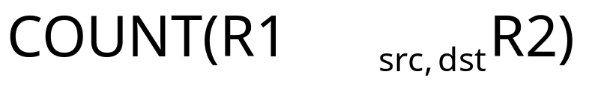
IP Network Measurement Data
IP session data (collected using Cisco NetFlow)
AT&T collects 100’s GB of NetFlow data per day!
  Massive number of records arriving at a rapid rate
Example join query:
Source Destination Duration Bytes Protocol
10.1.0.2 16.2.3.7 12 20K http
18.6.7.1 12.4.0.3 16 24K http
13.9.4.3 11.6.8.2 15 20K http
15.2.2.9 17.1.2.1 19 40K http
12.4.3.8 14.8.7.4 26 58K http
10.5.1.3 13.0.0.1 27 100K ftp
11.1.0.6 10.3.4.5 32 300K ftp
19.7.1.2 16.5.5.8 18 80K ftp

Slide 9
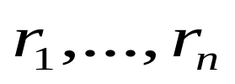
Data Stream Processing Model
A data stream is a (massive) sequence of records:
  General model permits deletion of records as well
Stream Synopses
(in memory)
Data Streams
Stream
Processing
Engine
(Approximate)
Answer
Query Q
Requirements for stream synopses
  Single Pass: Each record is examined at most once, in fixed (arrival) order
  Small Space: Log or poly-log in data stream size
  Real-time: Per-record processing time (to maintain synopses) must be low

Slide 10
Stream Data Synopses
Conventional data summaries fall short
  Quantiles and 1-d histograms [MRL98,99], [GK01], [GKMS02]
    Cannot capture attribute correlations
    Little support for approximation guarantees
  Samples (e.g., using Reservoir Sampling)
    Perform poorly for joins [AGMS99]
    Cannot handle deletion of records
  Multi-d histograms/wavelets
    Construction requires multiple passes over the data
Different approach: Randomized sketch synopses [AMS96]
  Only logarithmic space
  Probabilistic guarantees on the quality of the approximate answer
  Supports insertion as well as deletion of records

Slide 11
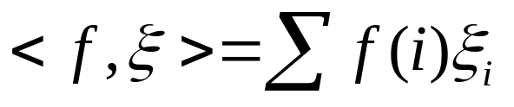


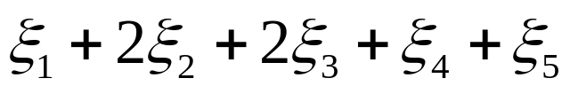
Randomized Sketch Synopses for Streams
Goal: Build small-space summary for distribution vector f(i) (i=1,..., N) seen as a stream of i-values
Basic Construct: Randomized Linear Projection of f() = inner/dot product of f-vector
  Simple to compute over the stream: Add whenever the i-th value is seen
  Generate ‘s in small (logN) space using pseudo-random generators
  Tunable probabilistic guarantees on approximation error
2
2
1
1
1
Data stream: 3, 1, 2, 4, 2, 3, 5, . . .
f(1) f(2) f(3) f(4) f(5)
where = vector of random values from an appropriate distribution
Data stream: 3, 1, 2, 4, 2, 3, 5, . . .
Used for low-distortion vector-space embeddings [JL84]

Slide 12


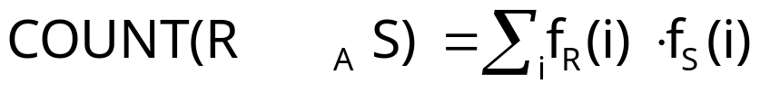
Example: Single-Join COUNT Query
Problem: Compute answer for the query COUNT(R _{A} S)
Example:
3
2
Data stream R.A: 4 1 2 4 1 4
1
0
1
2
3
4
2
2
Data stream S.A: 3 1 2 4 2 4
1
1
1
2
3
4
= 10 (2 + 2 + 0 + 6)
Exact solution: too expensive, requires O(N) space!
  N is size of domain of A

Slide 13


Basic Sketching Technique [AMS96]
Key Intuition: Use randomized linear projections of f() to define random variable X such that
  X is easily computed over the stream (in small space)
  E[X] = COUNT(R _{A} S)
  Var[X] is small
Basic Idea:
  Define a family of 4-wise independent {-1, +1} random variables
  Pr[ = +1] = Pr[ = -1] = 1/2
    Expected value of each , E[ ] = 0
  Variables are 4-wise independent
    Expected value of product of 4 distinct = 0
  Variables can be generated using pseudo-random generator using only O(log N) space (for seeding)!
Probabilistic error guarantees
(e.g., actual answer is 10±1 with
probability 0.9)

Slide 14
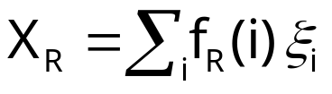
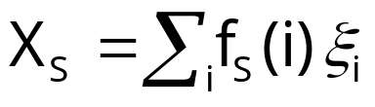




Sketch Construction
Compute random variables: and
  Simply add to X_{R}(X_{S}) whenever the i-th value is observed in the R.A (S.A) stream
Define X = X_{R}X_{S} to be estimate of COUNT query
Example:
3
2
Data stream R.A: 4 1 2 4 1 4
1
0
1
2
3
4
2
2
Data stream S.A: 3 1 2 4 2 4
1
1
1
2
3
4

Slide 15

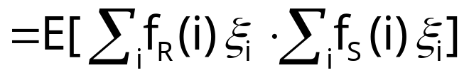
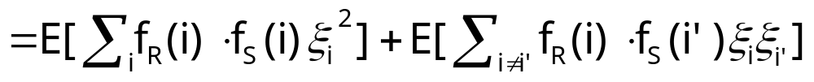
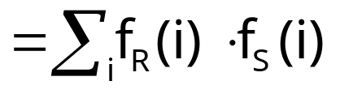


Analysis of Sketching
Expected value of X = COUNT(R _{A} S)
Using 4-wise independence, possible to show that
is self-join size of R
1
0

Slide 16
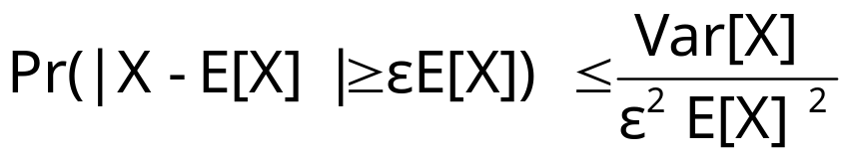

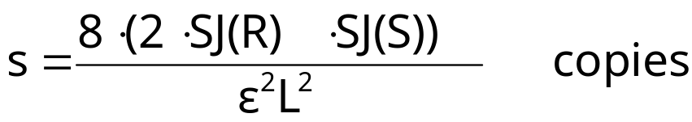

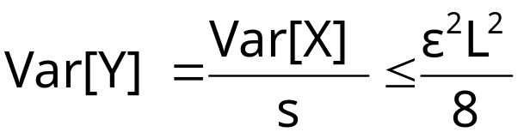
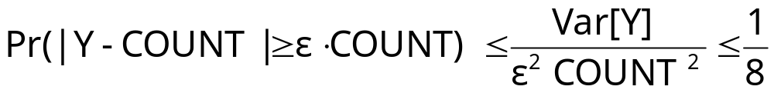
Boosting Accuracy
Chebyshev’s Inequality:
Boost accuracy to by averaging over several independent copies of X (reduces variance)
  L is lower bound on COUNT(R S)
By Chebyshev:
x
x
x
Average
y

Slide 17










Boosting Confidence
Boost confidence to by taking median of 2log(1/ ) independent copies of Y
Each Y = Binomial Trial
“FAILURE”:
y
2log(1/ )
copies
y
median
y
Pr[|median(Y)-COUNT| COUNT]
= Pr[ # failures in 2log(1/ ) trials >= log(1/ ) ]
(By Chernoff Bound)

Slide 18

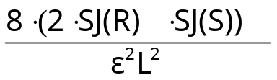



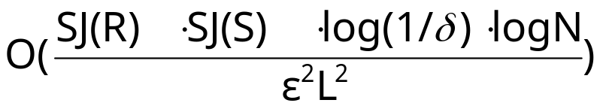
Summary of Sketching and Main Result
Step 1: Compute random variables: and
Step 2: Define X= X_{R}X_{S}
Steps 3 & 4: Average independent copies of X; Return median of averages
Main Theorem (AGMS99): Sketching approximates COUNT to within a relative error of with probability using space
  Remember: O(log N) space for “seeding” the construction of each X
copies
x
x
x
Average
y
2log(1/ )
copies
x
x
x
Average
y
median
x
x
x
Average
y

Slide 19





Using Sketches to Answer SUM Queries
Problem: Compute answer for query SUM_{B}(R _{A} S) =
  SUM_{S}(i) is sum of B attribute values for records in S for whom S.A = i
Sketch-based solution
  Compute random variables X_{R} and X_{S}
  Return X=X_{R}X_{S} (E[X] = SUM_{B}(R _{A} S))
3
2
Stream R.A: 4 1 2 4 1 4
1
0
1
2
3
4
3
3
2
2
Stream S: A 3 1 2 4 2 3
B 1 3 2 2 1 1
1
2
3
4

Slide 20
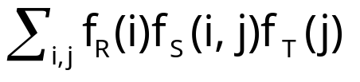



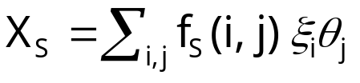

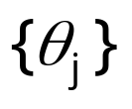

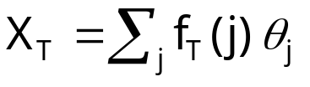

Using Sketches to Answer Multi-Join
Queries
Problem: Compute answer for COUNT(R _{A}S _{B}T) =
Sketch-based solution
  Compute random variables X_{R}, X_{S} and X_{T}
  Return X=X_{R}X_{S}X_{T} (E[X]= COUNT(R _{A}S _{B}T))
Stream R.A: 4 1 2 4 1 4
Independent families
of {-1,+1} random
variables
Stream S: A 3 1 2 1 2 1
B 1 3 4 3 4 3
Stream T.B: 4 1 3 3 1 4

Slide 21
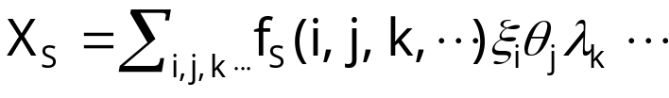


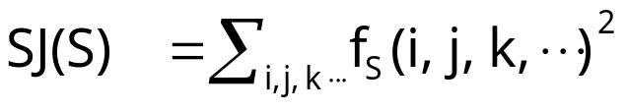
Using Sketches to Answer Multi-Join
Queries
Sketches can be used to compute answers for general multi-join COUNT queries (over streams R, S, T, ........)
  For each pair of attributes in equality join constraint, use independent family of {-1, +1} random variables
  Compute random variables X_{R}, X_{S}, X_{T}, .......
  Return X=X_{R}X_{S}X_{T} ....... (E[X]= COUNT(R S T ........))
  m: number of join attributes,
Stream S: A 3 1 2 1 2 1
B 1 3 4 3 4 3
Independent
families of {-1,+1}
random variables
C 2 4 1 2 3 1

Slide 22
Talk Outline
Data stream computation model
Basic sketching technique for stream joins
Partitioning attribute domains to boost accuracy
Experimental results
Extensions
  Sketch sharing among multiple standing queries
  Richer data and queries
Summary

Slide 23
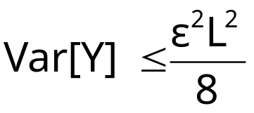
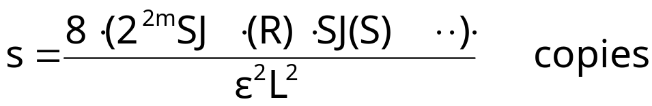
Sketch Partitioning: Basic Idea
For error, need
Key Observation: Product of self-join sizes for partitions of streams can be much smaller than product of self-join sizes for streams
  Can reduce space requirements by partitioning join attribute domains, and estimating overall join size as sum of join size estimates for partitions
  Exploit coarse statistics (e.g., histograms) based on historical data or collected in an initial pass, to compute the best partitioning
x
x
x
Average
y

Slide 24












Sketch Partitioning Example: Single-Join
COUNT Query
Without Partitioning
With Partitioning (P1={2,4}, P2={1,3})
10
10
10
10
2
1
2
1
1
3
2
4
1
3
2
4
SJ(R1)=5
SJ(R)=205
SJ(R2)=200
30
30
30
30
2
1
2
1
1
3
2
4
1
2
3
4
SJ(S1)=1800
SJ(S2)=5
SJ(S)=1805
X = X1+X2, E[X] = COUNT(R S)

Slide 25
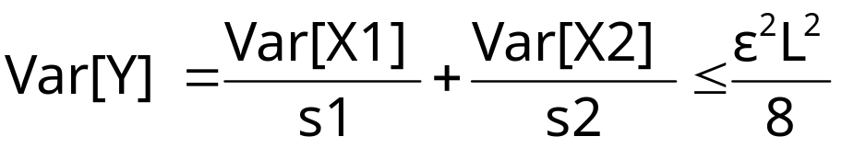
Space Allocation Among Partitions
Key Idea: Allocate more space to sketches for partitions with higher variance
Example: Var[X1]=20K, Var[X2]=2K
  For s1=s2=20K, Var[Y] = 1.0 + 0.1 = 1.1
  For s1=25K, s2=8K, Var[Y] = 0.8 + 0.25 = 1.05
X1
X1
X1
Average
Y1
s1 copies
+
Y
X2
X2
X2
Average
Y2
E[Y] = COUNT(R S)
s2 copies

Slide 26
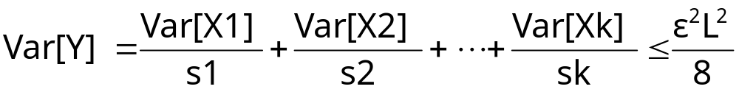
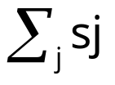
Sketch Partitioning Problems
Problem 1: Given sketches X1, ...., Xk for partitions P1, ..., Pk of the join attribute domain, what is the space sj that must be allocated to Pj (for sj copies of Xj) so that
and is minimum
Problem 2: Compute a partitioning P1, ..., Pk of the join attribute domain, and space sj allocated to each Pj (for sj copies of Xj) such that
and is minimum

Slide 27
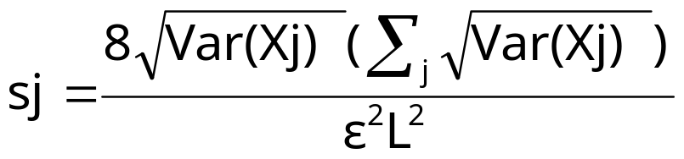

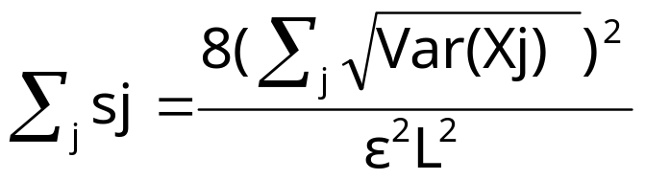
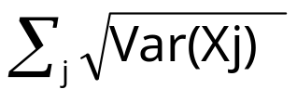
Optimal Space Allocation Among Partitions
Key Result (Problem 1): Let X1, ...., Xk be sketches for partitions P1, ..., Pk of the join attribute domain. Then, allocating space
to each Pj (for sj copies of Xj) ensures that and is minimum
Total sketch space required:
Problem 2 (Restated): Compute a partitioning P1, ..., Pk of the join attribute domain such that is minimum
  Optimal partitioning P1, ..., Pk minimizes total sketch space

Slide 28

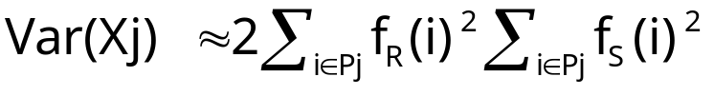
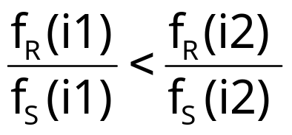

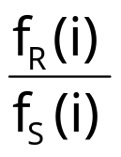
Single-Join Queries: Binary Space
Partitioning
Problem: For COUNT(R _{A} S), compute a partitioning P1, P2 of A’s domain {1, 2, ..., N} such that is minimum
  Note:
Key Result (due to Breiman): For an optimal partitioning P1, P2,
Algorithm
  Sort values i in A’s domain in increasing value of
  Choose partitioning point that minimizes

Slide 29
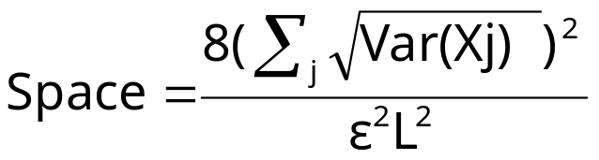
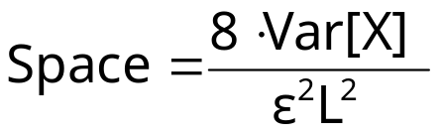
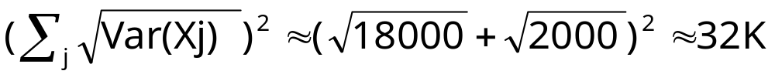


Binary Sketch Partitioning Example
Without Partitioning
With Optimal Partitioning
10
10
2
1
.03
.06
5
10
1
2
3
4
i
4
2
1
3
30
30
P1
Optimal
Point
P2
2
1
1
2
3
4

Slide 30

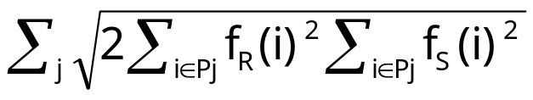
Single Join Queries: K-ary Sketch Partitioning
Problem: For COUNT(R _{A}S), compute a partitioning P1, P2, ..., Pk of A’s domain such that is minimum
Previous result (for 2 partitions) generalizes to k partitions
Optimal k partitions can be computed using Dynamic Programming
  Sort values i in A’s domain in increasing value of
  Let be the value of when [1,u] is split optimally into t partitions P1, P2, ...., Pt
Time complexity:O(kN² )
1
v
Pt=[v+1, u]
u

Slide 31
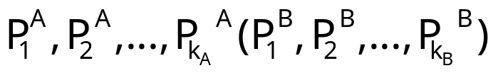
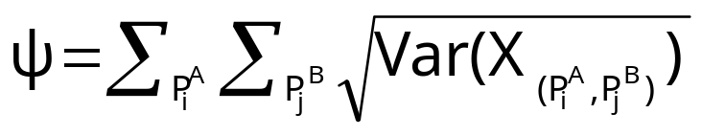

Sketch Partitioning for Multi-Join Queries
Problem: For COUNT(R _{A} S _{B}T), compute a partitioning
of A(B)’s domain such that k_{A}k_{B}<k, and the following is minimum
Partitioning problem is NP-hard for more than 1 join attribute
If join attributes are independent, then possible to compute optimal partitioning
  Choose k1 such that allocating k1 partitions to attribute A and k/k1 to remaining attributes minimizes
  Compute optimal k1 partitions for A using previous dynamic programming algorithm

Slide 32
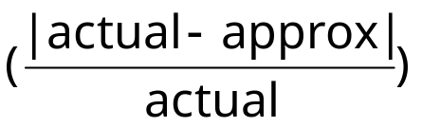
Experimental Study
Summary of findings
  Sketches are superior to 1-d (equi-depth) histograms for answering COUNT queries over data streams
  Sketch partitioning is effective for reducing error
Real-life Census Population Survey data sets (1999 and 2001)
  Attributes considered:
    Income (1:14)
    Education (1:46)
    Age (1:99)
    Weekly Wage and Weekly Wage Overtime (0:288416)
Error metric: relative error

Slide 33
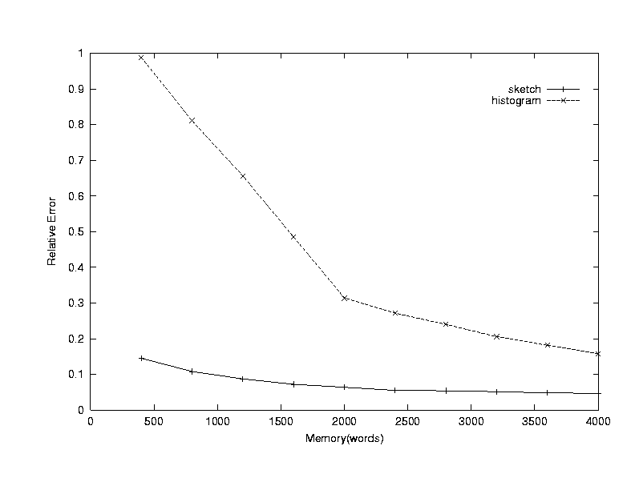
Join (Weekly Wage)

Slide 34
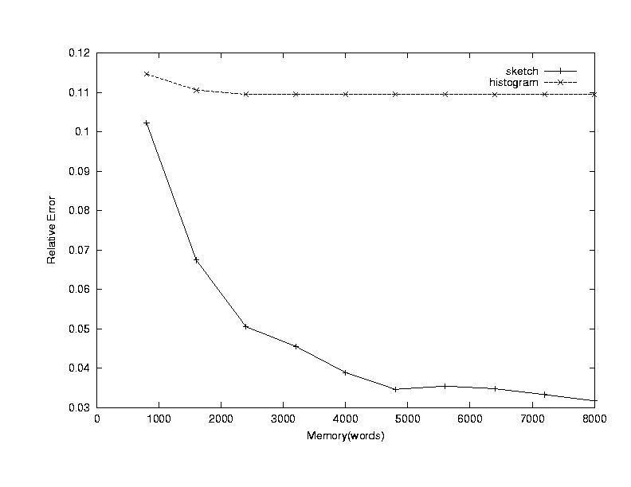
Join (Age, Education)

Slide 35
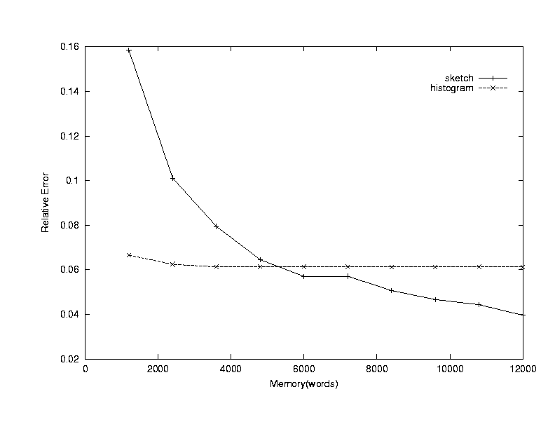
Star Join (Age, Education, Income)

Slide 36
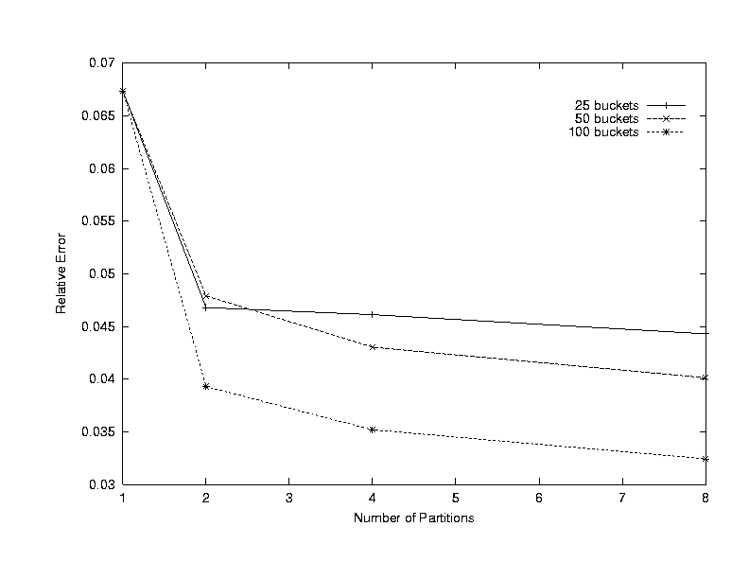
Join (Weekly Wage Overtime = Weekly
Wage)

Slide 37
Talk Outline
Data stream computation model
Basic sketching technique for stream joins
Partitioning attribute domains to boost accuracy
Experimental results
Extensions (ongoing work)
  Sketch sharing among multiple standing queries
  Richer data and queries
Summary

Slide 38






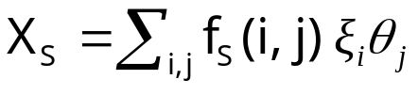
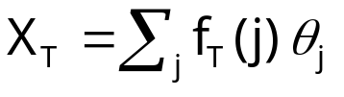





Sketching for Multiple Standing Queries
Consider queries Q1 = COUNT(R _{A} S _{B}T) and Q2 = COUNT(R _{A=B}T)
Naive approach: construct separate sketches for each join
  , , are independent families of pseudo-random variables
A
A
B
B
R
S
T
A
B
R
T

Slide 39





Sketch Sharing
Key Idea: Share sketch for relation R between the two queries
  Reduces space required to maintain sketches
Same family of
random variables
A
B
B
S
T
A
A
B
R
T
BUT, cannot also share the sketch for T !
  Same family on the join edges of Q1

Slide 40
Sketching for Multiple Standing Queries
Algorithms for sharing sketches and allocating space among the queries in the workload
  Maximize sharing of sketch computations among queries
  Minimize a cumulative error for the given synopsis space
Novel, interesting combinatorial optimization problems
  Several NP-hardness results :-)
Designing effective heuristic solutions

Slide 41




Problems with Sketch Sharing
With sharing of sketches for both R and T, estimate X for Q1 = COUNT(R _{A} S _{B}T) may be incorrect
For correct join query estimates, family of random variables for attributes of a join must be distinct and independent
  In E[X], for i=j and i’=j’,
Same family of
random variables
A
S
B
A
B
A
B
R
T

Slide 42

Sketch Sharing: Problem Formulation
Problem: Given set of queries, compute join graph with minimum number of (shared) sketches, and such that all join query estimates are correct
Problem is NP-hard (reduction from vertex cover)
Simple greedy heuristic
  Start with initial join graph with complete sharing
  In each iteration, split node that minimizes the number of “bad” edges
Initial graph
A
A
A
A
B
A
B
B
A
A
B
A
A
A
A
A
A
A
A
A
A
Join graph containing
“bad” edges (in red)
Splitting nodes in vertex
cover gets rid of “bad” edges

Slide 43
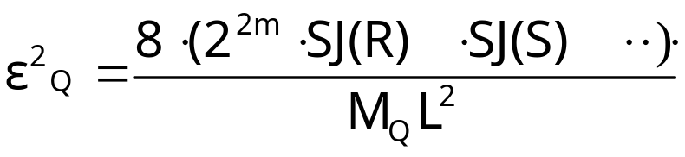
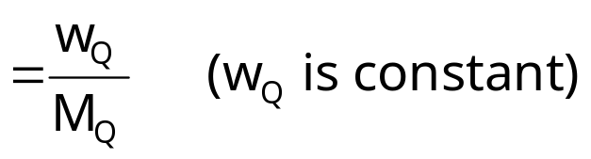
Space Allocation to Sketches of Join Graph
Key Observation: Allocating identical space to each sketch may not optimize cumulative/max error for join query estimates
Consider query Q: COUNT(R S T ....)
  Query Q estimated as X=X_{R}X_{S}X_{T}.....
  Number of copies of X, M_{Q} = min{M_{R}, M_{S}, M_{T}, ....)
    M_{R} is space allocated to sketch X_{R}
Relative square error for Q

Slide 44




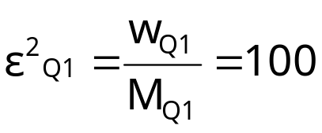
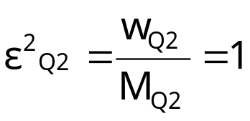


Space Allocation to Sketches: Example
Consider queries Q1 = COUNT(R _{A} S _{B}T) and Q2 = COUNT(R _{A=B}T)
  Let M = 100, w_{Q1} = 2500 and w_{Q2} = 25
S
T
More space
to Q1
S
T
Equal space
to Q1 & Q2
A
B
B
A
B
B
(25)
(30)
(30)
(25)
A
T
A
T
A
B
A
B
R
R
(25)
(30)
(10)
(25)
Est Q1 = X_{R}X_{S}X_{T}
Est Q2 = X_{R}X’_{T}
Est Q1 = X_{R}X_{S}X_{T}
Est Q2 = X_{R}X’_{T}
M_{Q1} = 25
M_{Q2} = 25
M_{Q1} = 30
M_{Q2} = 10

Slide 45



Space Allocation: Problem Formulation
Problem: Given join graph over queries Q1, ..., Qr and memory M, allocate space M_{R}, M_{S}, M_{T}, ... to nodes/sketches X_{R}, X_{S}, X_{T}, ... of join graph such that one of the following is minimized
  (cumulative error), or (max error)
subject to constraints
  M_{R}+M_{S}+M_{T}+... = M
  M_{Qi} = min{M_{R}, M_{S}, M_{T}, ...} (Qi = COUNT(R S T ....)
For cumulative error, problem is NP-hard (reduction from k-clique)
Greedy Heuristics:
  In each iteration, allocate space to sketches for Qi such that decrease in per unit space allocated is maximum
  In each iteration, allocate space to sketches for Qi with max
    Can be shown to optimize max error

Slide 46
Richer Data and Queries
Sketches are effective synopsis mechanisms for relational streams of numeric data
  What about streams of string data, or even XML documents??
For such streams, more general “correlation operators” are needed
  E.g., Similarity Join : Join data objects that are sufficiently similar
  Similarity metric is typically user/application-dependent
    E.g., “edit-distance” metric for strings
Proposing effective solutions for these generalized stream settings
  Key intuition: Exploit mechanisms for low-distortion embeddings of the objects and similarity metric in a vector space
Other relational operators
  Set operations (e.g., union, difference, intersection)
  DISTINCT clause (e.g., count only the distinct result tuples)

Slide 47
Summary and Future Work
Stream-query processing arises naturally in Network Management
  Measurements, alarms continuously collected from Network elements
Sketching is a viable technique for answering stream queries
  Only logarithmic space
  Probabilistic guarantees on the quality of the approximate answer
  Supports insertion as well as deletion of records
Key contributions
  Processing general aggregate multi-join queries over streams
  Algorithms for intelligently partitioning attribute domains to boost accuracy of estimates
Future directions
  Improve sketch performance with no a-priori knowledge of distribution
  Sketch sharing between multiple standing stream queries
  Dealing with richer types of queries and data formats

Slide 48
More work on Sketches...
Low-distortion vector-space embeddings (JL Lemma) [Ind01] and applications
  E.g., approximate nearest neighbors [IM98]
Wavelet and histogram extraction over data streams [GGI02, GIM02, GKMS01, TGIK02]
Discovering patterns and periodicities in time-series databases [IKM00, CIK02]
Quantile estimation over streams [GKMS02]
Distinct value estimation over streams [CDI02]
Maintaining top-k item frequencies over a stream [CCF02]
Stream norm computation [FKS99, Ind00]
Data cleaning [DJM02]

Slide 49

Thank you!
More details available from
http://www.bell-labs.com/~minos/

Slide 50
Optimal Configuration of OSPF Aggregates
(Joint Work with Yuri Breitbart, Amit Kumar, and Rajeev Rastogi)
(Appeared in IEEE INFOCOM 2002)

Slide 51
Motivation: Enterprise CIO Problem
As the CIO teams migrated to OSPF the protocol became busier. More areas were added and the routing table grew to more that 2000 routes. By the end of 1998, the routing table stood at 4000+ routes and the OSPF database had exceeded 6000 entries. Around this time we started seeing a number of problems surfacing in OSPF. Among these problems were the smaller premise routers crashing due to the large routing table. Smaller Frame Relay PVCs were running large percentage of OSPF LSA traffic instead of user traffic. Any problems seen in one area were affecting all other areas. The ability to isolate problems to a single area was not possible. The overall affect on network reliability was quite negative.

Slide 52
OSPF Overview
Area 0.0.0.1
Area Border Router (ABR)
1
Router
2
1
1
3
2
1
Area 0.0.0.0
Area 0.0.0.2
Area 0.0.0.3
OSPF is a link-state routing protocol
  Each router in area knows topology of area (via link state advertisements)
  Routing between a pair of nodes is along shortest path
Network organized as OSPF areas for scalability
Area Border Routers (ABRs) advertise aggregates instead of individual subnet addresses
  Longest matching prefix used to route IP packets

Slide 53
Solution to CIO Problem: OSPF Aggregation
Aggregate subnet addresses within OSPF area and advertise these aggregates (instead of individual subnets) in the remainder of the network
Advantages
  Smaller routing tables and link-state databases
  Lower memory requirements at routers
  Cost of shortest-path calculation is smaller
  Smaller volumes of OSPF traffic flooded into network
Disadvantages
  Loss of information can lead to suboptimal routing (IP packets may not follow shortest path routes)

Slide 54
Example
Source
100
100
50
10.1.2.0/24
200
10.1.5.0/24
10.1.6.0/24
1000
50
10.1.4.0/24
10.1.3.0/24
10.1.7.0/24
Undesirable low-bandwidth link

Slide 55
Example: Optimal Routing with 3 Aggregates
Source
100
100
10.1.6.0/23 (200)
10.1.4.0/23 (50)
10.1.2.0/23 (250)
50
10.1.2.0/24
200
10.1.5.0/24
10.1.6.0/24
1000
50
10.1.4.0/24
10.1.3.0/24
10.1.7.0/24
Route Computation Error: 0
  Length of chosen routes - Length of shortest path routes
  Captures desirability of routes (shorter routes have smaller errors)

Slide 56
Example: Suboptimal Routing with 2
Aggregates
Source
Optimal Route
Chosen Route
100
100
10.1.4.0/22 (1100)
10.1.4.0/22 (1250)
10.1.2.0/23 (1050)
10.1.2.0/23 (250)
50
10.1.2.0/24
200
10.1.5.0/24
10.1.6.0/24
1000
50
10.1.4.0/24
10.1.3.0/24
10.1.7.0/24
Route Computation Error: 900 (1200-300)
Note: Moy recommends weight for aggregate at ABR be set to maximum distance of subnet (covered by aggregate) from ABR

Slide 57
Example: Optimal Routing with 2 Aggregates
Source
100
100
10.1.0.0/21 (730)
10.1.0.0/21 (570)
10.1.4.0/23 (50)
10.1.4.0/23 (1450)
50
10.1.2.0/24
200
10.1.5.0/24
10.1.6.0/24
1000
50
10.1.4.0/24
10.1.3.0/24
10.1.7.0/24
Route Computation Error: 0
Note: Exploit IP routing based on longest matching prefix
Note: Aggregate weight set to average distance of subnets from ABR

Slide 58
Example: Choice of Aggregate Weights is Important!
Source
100
100
10.1.0.0/21 (1100)
10.1.0.0/21 (1250)
10.1.4.0/23 (50)
10.1.4.0/23 (1450)
50
10.1.2.0/24
200
10.1.5.0/24
10.1.6.0/24
1000
50
10.1.4.0/24
10.1.3.0/24
10.1.7.0/24
Route Computation Error: 1700 (800+900)
Note: Setting aggregate weights to maximum distance of subnets may lead to sub-optimal routing

Slide 59
OSPF Aggregates Configuration Problems
Aggregates Selection Problem:
For a given k and assignment of weights to aggregates, compute the k optimal aggregates to advertise (that minimize the total error in the shortest paths)
  Propose efficient dynamic programming algorithm
Weight Selection Problem:
For a given aggregate, compute optimal weights at ABRs (that minimize the total error in the shortest paths)
  Show that optimum weight = average distance of subnets (covered by aggregate) from ABR
Note: Parameter k determines routing table size and volume of OSPF traffic

Slide 60
Aggregates Selection Problem
Aggregate Tree: Tree structure with aggregates arranged based on containment relationship
Example
Aggregate Tree
10.1.0.0/21
10.1.4.0/22
10.1.0.0/22
10.1.4.0/23
10.1.6.0/23
10.1.2.0/23

Slide 61
Computing Error for Selected Aggregates Using Aggregate Tree
E(x,y): error for subnets under x and y is the closest selected ancestor of x
If x is an aggregate (internal node):
If x is a subnet address (leaf):
y
y
x is selected
x
x is not selected
x
u
v
u
v
E(x,y)=E(u,x)+E(v,x)
E(x,y)=E(u,y)+E(v,y)
E(x,y)=Length of chosen path to x (when y is selected)- Length of shortest path to x

Slide 62
Computing Error for Selected Aggregates Using Aggregate Tree
minE(x,y,k): minimum error for subnets under x for k aggregates and y is the closest selected ancestor of x
If x is an aggregate (internal node): minE(x,y,k) is the minimum of
If x is a subnet address (leaf): minE(x,y) = E(x,y)
y
y
x is selected
x
x is not selected
x
u
v
u
v
min{minE(u,x,i)+minE(v,x,k-1-i)}
(i between 0 and k-1)
min{minE(u,y,i)+minE(v,y,k-i)}
(i between 0 and k)

Slide 63
Dynamic Programming Algorithm: Example
*
y=10.1.0.0/21
x=10.1.4.0/22
10.1.0.0/22
u=10.1.4.0/23
v=10.1.6.0/23
10.1.2.0/23
minE(x,y,1) is minimum of
*
*
*
y
y
y
*
x
x
x
*
*
u
v
u
v
u
v
minE(u,x) + minE(v,x)
minE(u,y) + minE(v,v)
minE(u,u) + minE(v,y)
0+800
1300+0
0+0

Slide 64
Weight Selection Problem
For a given aggregate, compute optimal weights at ABRs (that minimize the total error in the shortest paths)
  Show that optimum weight = average distance of subnets (covered by aggregate) from ABR
Suppose we associate an arbitrary weight with each aggregate
  Problem becomes NP-hard
  Simple greedy heuristic for weighted case
    Start with a random assignment of weights at each ABR
    In each iteration, modify weight for a single ABR that minimizes error
    Terminate after a fixed number of iterations, or improvement in error drops below threshold

Slide 65
Summary
First comprehensive study for OSPF, of the trade-off between the number of aggregates advertised and optimality of routes
Aggregates Selection Problem:
For a given k and assignment of weights to aggregates, compute the k optimal aggregates to advertise (that minimize the total error in the shortest paths)
  Propose dynamic programming algorithm that computes optimal solution
Weight Selection Problem:
For a given aggregate, compute optimal weights at ABRs (that minimize the total error in the shortest paths)
  Show that optimum weight = average distance of subnets (covered by aggregate) from ABR

