Slide 1
Analyzing Massive Data Streams: Past, Present, and Future
Minos Garofalakis
Internet Management Research Department
Bell Labs, Lucent Technologies

Slide 2
Talk Outline
Introduction & Motivation
Data stream computation model
Basic sketching technique for relational joins
  Sketch partitioning to boost accuracy
Correlating XML data streams
  Tree-edit distance embeddings & Applications
Conclusions & Future Research Directions

Slide 3
Disclaimers
Personal, biased view of data-streaming world
  Revolve around own line of work and results
  Focus on basic algorithmic tools
    Several interesting research prototypes: Aurora, STREAM, Telegraph, . . .
    See Motwani et al. [PODS’02] for more systems perspective
Discussion necessarily short and fairly high-level
  More detailed overview: 3-hour tutorial at VLDB’02
  Ask questions!
  Talk to me afterwards

Slide 4
Query Processing over Data Streams
Stream-query processing arises naturally in Network Management
  Data records arrive continuously from different parts of the network
  Queries can only look at the tuples once, in the fixed order of arrival and with limited available memory
  Approximate query answers often suffice (e.g., trend/pattern analyses)
Network Operations
Center (NOC)
Data-Stream Join Query:
SELECT COUNT(*)/SUM(M)
FROM R1, R2, R3
WHERE R1.A = R2.B = R3.C
Measurements
Alarms
R1
R2
R3
IP Network

Slide 5
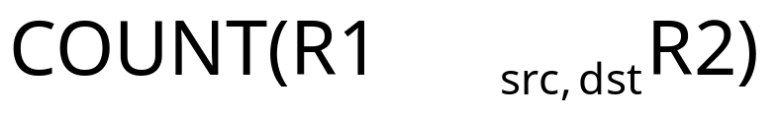
IP Network Measurement Data
IP session data (collected using Cisco NetFlow)
AT&T collects 100’s GB of NetFlow data per day!
  Massive number of records arriving at a rapid rate
Example join query:
Source Destination Duration Bytes Protocol
10.1.0.2 16.2.3.7 12 20K http
18.6.7.1 12.4.0.3 16 24K http
13.9.4.3 11.6.8.2 15 20K http
15.2.2.9 17.1.2.1 19 40K http
12.4.3.8 14.8.7.4 26 58K http
10.5.1.3 13.0.0.1 27 100K ftp
11.1.0.6 10.3.4.5 32 300K ftp
19.7.1.2 16.5.5.8 18 80K ftp

Slide 6
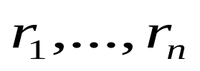
Data Stream Processing Model
A data stream is a (massive) sequence of records:
  General model permits deletion of records as well
Stream Synopses
(in memory)
Data Streams
Stream
Processing
Engine
(Approximate)
Answer
Query Q
Requirements for stream synopses
  Single Pass: Each record is examined at most once, in fixed (arrival) order
  Small Space: Log or poly-log in data stream size
  Real-time: Per-record processing time (to maintain synopses) must be low

Slide 7
Data Synopses for Relational Streams
Conventional data summaries fall short
  Quantiles and 1-d histograms [MRL98,99], [GK01], [GKMS02]
    Cannot capture attribute correlations
    Little support for approximation guarantees
  Samples (e.g., using Reservoir Sampling)
    Perform poorly for joins [AGMS99]
    Cannot handle deletion of records
  Multi-d histograms/wavelets
    Construction requires multiple passes over the data
Different approach: Randomized sketch synopses [AMS96]
  Only logarithmic space
  Probabilistic guarantees on the quality of the approximate answer
  Supports insertion as well as deletion of records

Slide 8
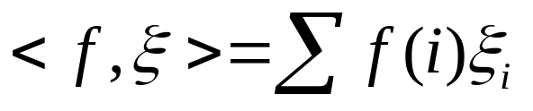


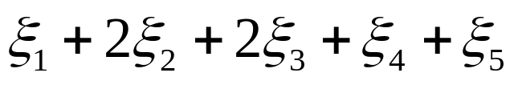
Randomized Sketch Synopses for Streams
Goal: Build small-space summary for distribution vector f(i) (i=1,..., N) seen as a stream of i-values
Basic Construct: Randomized Linear Projection of f() = inner/dot product of f-vector
  Simple to compute over the stream: Add whenever the i-th value is seen
  Generate ‘s in small (logN) space using pseudo-random generators
  Tunable probabilistic guarantees on approximation error
2
2
1
1
1
Data stream: 3, 1, 2, 4, 2, 3, 5, . . .
f(1) f(2) f(3) f(4) f(5)
where = vector of random values from an appropriate distribution
Data stream: 3, 1, 2, 4, 2, 3, 5, . . .

Slide 9


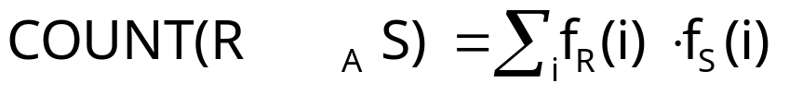
Example: Single-Join COUNT Query
Problem: Compute answer for the query COUNT(R _{A} S)
Example:
3
2
Data stream R.A: 4 1 2 4 1 4
1
0
1
2
3
4
2
2
Data stream S.A: 3 1 2 4 2 4
1
1
1
2
3
4
= 10 (2 + 2 + 0 + 6)
Exact solution: too expensive, requires O(N) space!
  N is size of domain of A

Slide 10


Basic Sketching Technique [AMS96]
Key Intuition: Use randomized linear projections of f() to define random variable X such that
  X is easily computed over the stream (in small space)
  E[X] = COUNT(R _{A} S)
  Var[X] is small
Basic Idea:
  Define a family of 4-wise independent {-1, +1} random variables
  Pr[ = +1] = Pr[ = -1] = 1/2
    Expected value of each , E[ ] = 0
  Variables are 4-wise independent
    Expected value of product of 4 distinct = 0
  Variables can be generated using pseudo-random generator using only O(log N) space (for seeding)!
Probabilistic error guarantees
(e.g., actual answer is 10±1 with
probability 0.9)

Slide 11
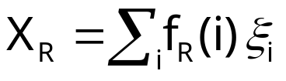
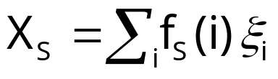




Sketch Construction
Compute random variables: and
  Simply add to X_{R}(X_{S}) whenever the i-th value is observed in the R.A (S.A) stream
Define X = X_{R}X_{S} to be estimate of COUNT query
Example:
3
2
Data stream R.A: 4 1 2 4 1 4
1
0
1
2
3
4
2
2
Data stream S.A: 3 1 2 4 2 4
1
1
1
2
3
4

Slide 12

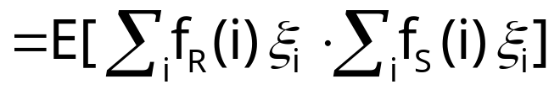
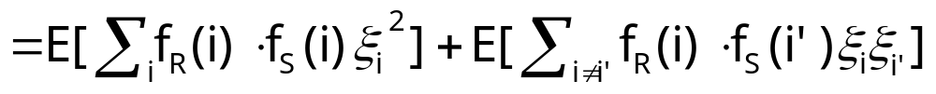
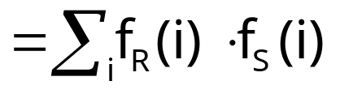


Analysis of Sketching
Expected value of X = COUNT(R _{A} S)
Using 4-wise independence, possible to show that
is self-join size of R
1
0

Slide 13
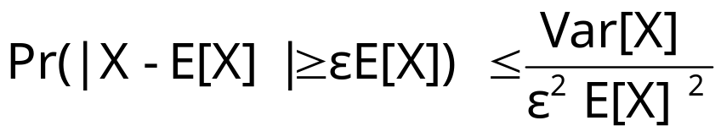

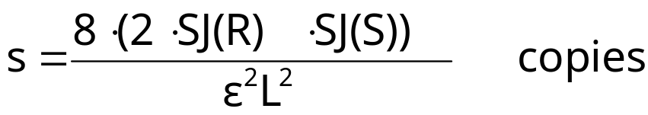

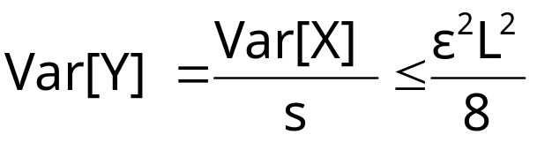
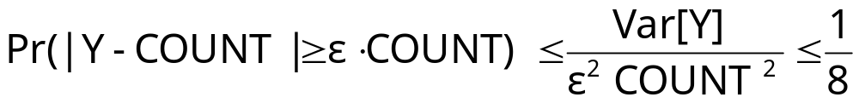
Boosting Accuracy
Chebyshev’s Inequality:
Boost accuracy to by averaging over several independent copies of X (reduces variance)
  L is lower bound on COUNT(R S)
By Chebyshev:
x
x
x
Average
y

Slide 14










Boosting Confidence
Boost confidence to by taking median of 2log(1/ ) independent copies of Y
Each Y = Binomial Trial
“FAILURE”:
y
2log(1/ )
copies
y
median
y
Pr[|median(Y)-COUNT| COUNT]
= Pr[ # failures in 2log(1/ ) trials >= log(1/ ) ]
(By Chernoff Bound)

Slide 15

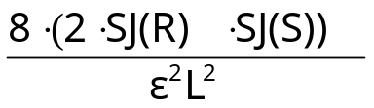



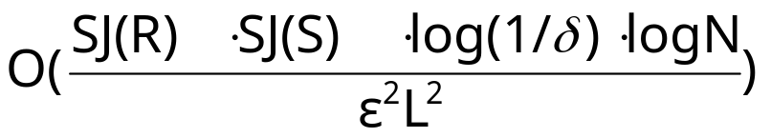
Summary of Sketching and Main Result
Step 1: Compute random variables: and
Step 2: Define X= X_{R}X_{S}
Steps 3 & 4: Average independent copies of X; Return median of averages
Main Theorem (AGMS99): Sketching approximates COUNT to within a relative error of with probability using space
  Remember: O(log N) space for “seeding” the construction of each X
copies
x
x
x
Average
y
2log(1/ )
copies
x
x
x
Average
y
median
x
x
x
Average
y

Slide 16





Using Sketches to Answer SUM Queries
Problem: Compute answer for query SUM_{B}(R _{A} S) =
  SUM_{S}(i) is sum of B attribute values for records in S for whom S.A = i
Sketch-based solution
  Compute random variables X_{R} and X_{S}
  Return X=X_{R}X_{S} (E[X] = SUM_{B}(R _{A} S))
3
2
Stream R.A: 4 1 2 4 1 4
1
0
1
2
3
4
3
3
2
2
Stream S: A 3 1 2 4 2 3
B 1 3 2 2 1 1
1
2
3
4

Slide 17
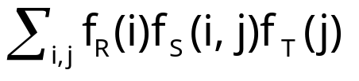



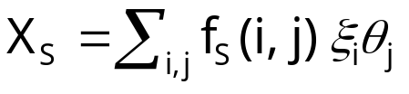

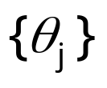

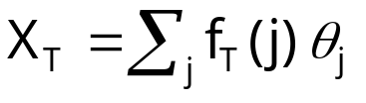

Using Sketches to Answer Multi-Join
Queries
Problem: Compute answer for COUNT(R _{A}S _{B}T) =
Sketch-based solution
  Compute random variables X_{R}, X_{S} and X_{T}
  Return X=X_{R}X_{S}X_{T} (E[X]= COUNT(R _{A}S _{B}T))
Stream R.A: 4 1 2 4 1 4
Independent families
of {-1,+1} random
variables
Stream S: A 3 1 2 1 2 1
B 1 3 4 3 4 3
Stream T.B: 4 1 3 3 1 4

Slide 18
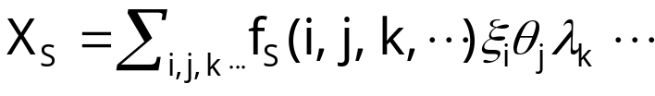


Using Sketches to Answer Multi-Join
Queries
Sketches can be used to compute answers for general multi-join COUNT queries (over streams R, S, T, ........)
  For each pair of attributes in equality join constraint, use independent family of {-1, +1} random variables
  Compute random variables X_{R}, X_{S}, X_{T}, .......
  Return X=X_{R}X_{S}X_{T} ....... (E[X]= COUNT(R S T ........))
Stream S: A 3 1 2 1 2 1
B 1 3 4 3 4 3
Independent
families of {-1,+1}
random variables
C 2 4 1 2 3 1

Slide 19
Talk Outline
Introduction & Motivation
Data stream computation model
Basic sketching technique for relational joins
  Sketch partitioning to boost accuracy
Correlating XML data streams
  Tree-edit distance embeddings & Applications
Conclusions & Future Research Directions

Slide 20
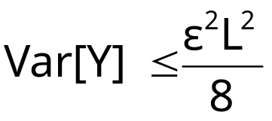
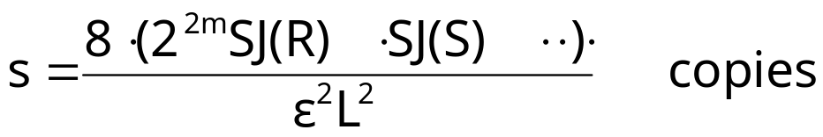
Sketch Partitioning: Basic Idea
For error, need
Key Observation: Product of self-join sizes for partitions of streams can be much smaller than product of self-join sizes for streams
  Can reduce space requirements by partitioning join attribute domains, and estimating overall join size as sum of join size estimates for partitions
  Exploit coarse statistics (e.g., histograms) based on historical data or collected in an initial pass, to compute the best partitioning
x
x
x
Average
y

Slide 21












Sketch Partitioning Example: Single-Join
COUNT Query
Without Partitioning
With Partitioning (P1={2,4}, P2={1,3})
10
10
10
10
2
1
2
1
1
3
2
4
1
3
2
4
SJ(R1)=5
SJ(R)=205
SJ(R2)=200
30
30
30
30
2
1
2
1
1
3
2
4
1
2
3
4
SJ(S1)=1800
SJ(S2)=5
SJ(S)=1805
X = X1+X2, E[X] = COUNT(R S)

Slide 22
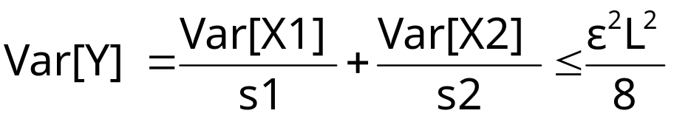
Space Allocation Among Partitions
Key Idea: Allocate more space to sketches for partitions with higher variance
Example: Var[X1]=20K, Var[X2]=2K
  For s1=s2=20K, Var[Y] = 1.0 + 0.1 = 1.1
  For s1=25K, s2=8K, Var[Y] = 0.8 + 0.25 = 1.05
X1
X1
X1
Average
Y1
s1 copies
+
Y
X2
X2
X2
Average
Y2
E[Y] = COUNT(R S)
s2 copies

Slide 23
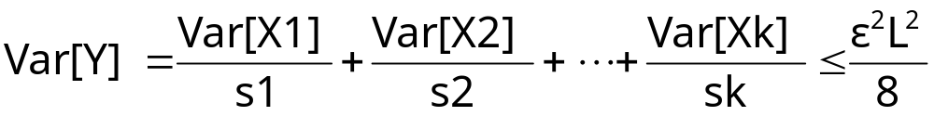
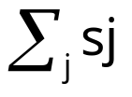
Sketch Partitioning Problems
Problem 1: Given sketches X1, ...., Xk for partitions P1, ..., Pk of the join attribute domain, what is the space sj that must be allocated to Pj (for sj copies of Xj) so that
and is minimum
Problem 2: Compute a partitioning P1, ..., Pk of the join attribute domain, and space sj allocated to each Pj (for sj copies of Xj) such that
and is minimum

Slide 24
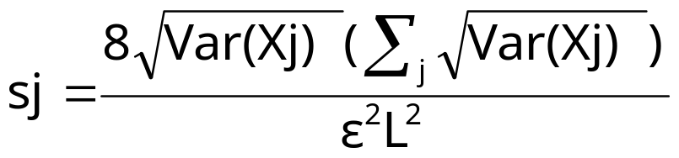

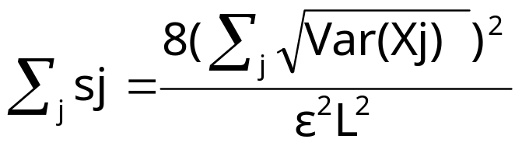
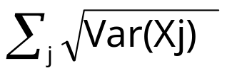
Optimal Space Allocation Among Partitions
Key Result (Problem 1): Let X1, ...., Xk be sketches for partitions P1, ..., Pk of the join attribute domain. Then, allocating space
to each Pj (for sj copies of Xj) ensures that and is minimum
Total sketch space required:
Problem 2 (Restated): Compute a partitioning P1, ..., Pk of the join attribute domain such that is minimum
  Optimal partitioning P1, ..., Pk minimizes total sketch space

Slide 25

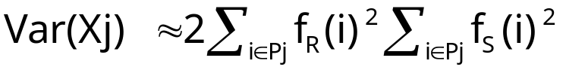
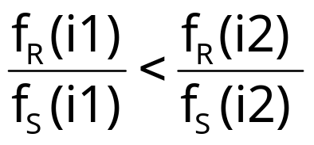

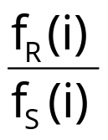
Single-Join Queries: Binary Space
Partitioning
Problem: For COUNT(R _{A} S), compute a partitioning P1, P2 of A’s domain {1, 2, ..., N} such that is minimum
  Note:
Key Result (due to Breiman): For an optimal partitioning P1, P2,
Algorithm
  Sort values i in A’s domain in increasing value of
  Choose partitioning point that minimizes

Slide 26
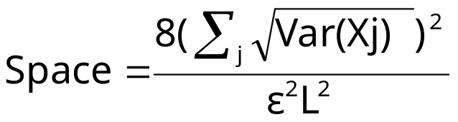
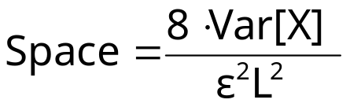
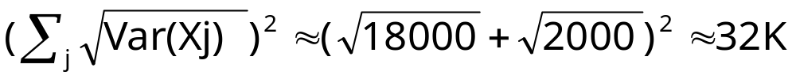


Binary Sketch Partitioning Example
Without Partitioning
With Optimal Partitioning
10
10
2
1
.03
.06
5
10
1
2
3
4
i
4
2
1
3
30
30
P1
Optimal
Point
P2
2
1
1
2
3
4

Slide 27

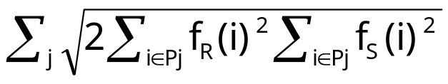
Single Join Queries: K-ary Sketch Partitioning
Problem: For COUNT(R _{A}S), compute a partitioning P1, P2, ..., Pk of A’s domain such that is minimum
Previous result (for 2 partitions) generalizes to k partitions
Optimal k partitions can be computed using Dynamic Programming
  Sort values i in A’s domain in increasing value of
  Let be the value of when [1,u] is split optimally into t partitions P1, P2, ...., Pt
Time complexity:O(kN² )
1
v
Pt=[v+1, u]
u

Slide 28
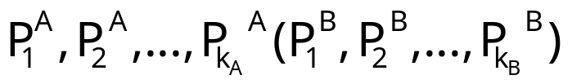
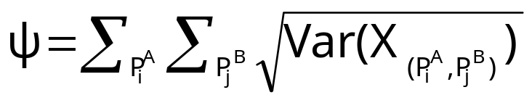

Sketch Partitioning for Multi-Join Queries
Problem: For COUNT(R _{A} S _{B}T), compute a partitioning
of A(B)’s domain such that k_{A}k_{B}<k, and the following is minimum
Partitioning problem is NP-hard for more than 1 join attribute
If join attributes are independent, then possible to compute optimal partitioning
  Choose k1 such that allocating k1 partitions to attribute A and k/k1 to remaining attributes minimizes
  Compute optimal k1 partitions for A using previous dynamic programming algorithm

Slide 29
Talk Outline
Introduction & Motivation
Data stream computation model
Basic sketching technique for relational joins
  Sketch partitioning to boost accuracy
Correlating XML data streams
  Tree-edit distance embeddings & Applications
Conclusions & Future Research Directions

Slide 30

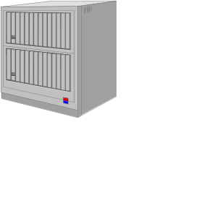
Processing XML Data Streams
XML: Much richer, (semi)structured data model
  Ordered, node-labeled data trees
Bulk of work on XML streaming: Content-based filtering of XML documents (publish/subscribe systems)
  Quickly match incoming documents against standing XPath subscriptions
XPath Subscriptions
(X/Yfilter, Xtrie, etc.)
Essentially, simple selection queries over a stream of XML records!
No work on more complex XML stream queries
  For example, queries trying to correlate different XML data streams

Slide 31


Processing XML Data Streams (cont.)
Example XML stream correlation query: Similarity-Join
Web Source 1
T1
|SimJoin(S1, S2)| = |{(T1,T2) S1xS2: dist(T1,T2) }|
Web Source 2
T2
Degree of content similarity between
streaming XML sources
Different data representation for same
information (DTDs, optional elements)
Correlation metric: Tree-edit distance ed(T1,T2)
  Node relabels, inserts, deletes - also, allow for subtree moves
publication
delete
publication
book
paper
book
paper
title
author
title
authors
title
author
title
author
author
author
author

Slide 32
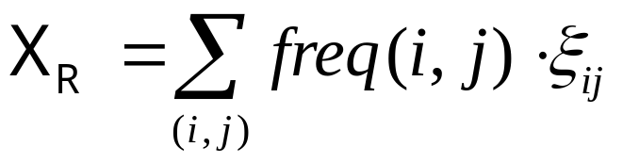


How About Sketches?
Randomized linear projections (a.k.a. sketches) are useful for points over a numeric vector space
  Not structured objects over a complex metric space (tree-edit distance)
N
Stream
R(A,B)
Atomic Sketch
O( )
N
O( )

Slide 33
Our Approach [PODS’03]
Key idea: Build a low-distortion embedding of streaming XML and the tree-edit distance metric in a multi-d normed vector space
ed(T1,T2)
Distances are (approximately)
preserved in the image vector space!!
ed(T2,T3)
V(T2)
map V()
V(T3)
V(T1)
ed(T1,T3)
Given such an embedding, sketching techniques now become relevant in the streaming XML context!
  E.g., use sketches to produce synopses of the data distribution in the image vector space

Slide 34


Our Approach [PODS’03] (cont.)
Construct low-distortion embedding for tree-edit distance over streaming XML documents -- Requirements:
  Small space/time
  Oblivious: Can compute V(T) independent of other trees in the stream(s)
  Bourgain’s Lemma is inapplicable!
First algorithm for low-distortion, oblivious embedding of the tree-edit distance metric in small space/time
  Fully deterministic, embed into L1 vector space
  Bound of on distance distortion for trees with n nodes

Slide 35

Our Approach [PODS’03] (cont.)
Applications in XML stream query processing
  Combine our embedding with existing pseudo-random sketching techniques
  Build a small-space sketch synopsis for a massive, streaming XML data tree
    Concise surrogate for tree-edit distance computations
  Approximating tree-edit distance similarity joins over XML streams in small space/time
First algorithmic results on correlating XML data in the streaming model
Other important algorithmic applications for our embedding result
  Approximate tree-edit distance in (near-linear) time

Slide 36



Our Embedding Algorithm
Key Idea: Given an XML tree T, build a hierarchical parsing structure over T by intelligently grouping nodes and contracting edges in T
  At parsing level i: T(i) is generated by grouping nodes of T(i-1) ( T(0) = T )
  Each node in the parsing structure ( T(i), for all i = 0, 1, ... ) corresponds to a connected subtree of T
  Vector image V(T) is basically the characteristic vector of the resulting multiset of subtrees (in the entire parsing structure)
V(T)[x] = no. of times subtree x appears in the parsing structure for T
Our parsing guarantees
  O(log|T|) parsing levels (constant-fraction reduction at each level)
  V(T) is very sparse: Only O(|T|) non-zero components in V(T)
    Even though dimensionality = ( = label alphabet)
    Allows for effective sketching
  V(T) is constructed in time

Slide 37

Our Embedding Algorithm (cont.)
Node grouping at a given parsing level T(i): Create groups of 2 or 3 nodes of T(i) and merge them into a single node of T(i+1)
  1. Group maximal sequence of contiguous leaf children of a node
  2. Group maximal sequence of contiguous nodes in a chain
  3. Fold leftmost lone leaf child into parent
Grouping for Cases 1,2: Deterministic coin-tossing process of Cormode and Muthukrishnan [SODA’02]
  Key property: Insertion/deletion in a sequence of length k only affects the grouping of nodes in a radius of from the point of change

Slide 38
Our Embedding Algorithm (cont.)
Example hierarchical tree parsing
T(0) = T
T(1)
T(2)
T(3)
y =
“empty” label
x =
V(T)[y] += 1
V(T)[x] += 1
O(log|T|) levels in the parsing, build V(T) in time

Slide 39



Main Embedding Result
Theorem: Our embedding algorithm builds a vector V(T) with O(|T|) non-zero components in time ; further, given trees T, S with n = max{|T|, |S|}, we have:
Upper-bound proof highlights
  Key Idea: Bound the size of “influence region” (i.e., set of affected node groups) for a tree-edit operation on T (=T(0)) at each level of parsing
    We show that this set is of size at level i
  Then, it is simple to show that any tree-edit operation can change by at most
    L1 norm of subvector at level i changes by at most O(|influence region|)

Slide 40

Main Embedding Result (cont.)
Lower-bound proof highlights
  Constructive: “Budget” of at most tree-edit operations is sufficient to convert the parsing structure for S into that for T
    Proceed bottom up, level-by-level
    At bottom level (T(0)), use budget to insert/delete appropriate labeled nodes
    At higher levels, use subtree moves to appropriately arrange nodes
See PODS’03 paper for full details . . .

Slide 41
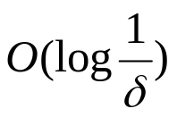



Sketching a Massive, Streaming XML Tree
Input: Massive XML data tree T (n = |T| >> available memory), seen in preorder (e.g., SAX parser output)
Output: Small space surrogate (vector) for high-probability, approximate tree-edit distance computations (to within our distortion bounds)
Theorem: Can build a -size sketch vector of V(T) for approximate tree-edit distance computations in space and time per element
  d = depth of T, = probabilistic confidence in ed() approximation
  XML trees are typically “bushy” (d<<n or d = O(polylog(n)))

Slide 42



Sketching a Massive, Streaming XML Tree (cont.)
Key Ideas
  Incrementally parse T to produce V(T) as elements stream in
  Just need to retain the influence region nodes for each parsing level and for each node in the current root-to-leaf path
  While updating V(T), also produce an L1 sketch of the V(T) vector using the techniques of Indyk [FOCS’00]
T(2)
T(O(logn))
T=T(0)
T(1)
Influence
Regions
. . .

Slide 43


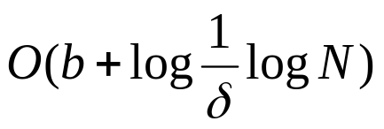
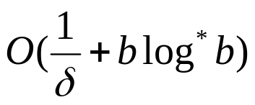
Approximate Similarity Joins over XML Streams
S1:
|SimJoin(S1, S2)| = |{(T1,T2) S1xS2: ed(T1,T2) }|
S2:
Input: Long streams S1, S2 of N (short) XML documents ( b nodes)
Output: Estimate for |SimJoin(S1, S2)|
Theorem: Can build an atomic sketch-based estimate for |SimJoin(S1, S2)| where distances are approximated to within in space and time per document
  = probabilistic confidence in distance estimates

Slide 44
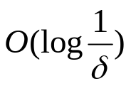
Approximate Similarity Joins over XML Streams (cont.)
Key Ideas
  Our embedding of streaming document trees, plus two distinct levels of sketching
    One to reduce L1 dimensionality, one to capture the data distribution (for joining)
    Finally, similarity join in lower-dimensional L1 space
    Some technical issues: high-probability L1 dimensionality reduction is not possible, sketching for L1 similarity joins
    Details in the paper . . .
V(T)
L1 sketch (dim. reduction)
Join Sketch
(distribution)
TreeEmbed
X(S)
dimensions

Slide 45
Conclusions
Analyzing massive data streams: Real problem with several “real-world” applications
Fundamentally rethink data management under stringent constraints
  Single-pass algorithms with limited memory resources
Sketching is a viable technique for answering relational stream queries
  Only logarithmic space
  Probabilistic guarantees on the quality of the approximate answer
  Supports insertion as well as deletion of records
Correlation queries over XML data streams
  First small space/time embedding algorithm for streaming XML and tree-edit distance
  Combined with sketching to give first algorithmic results on correlating XML data in the streaming model

Slide 46
Current/Future Research Directions
Sketch sharing between multiple standing stream queries
Improve sketch performance with no a-priori knowledge of distribution
Sketches/synopses for richer types of stream queries
  Set expressions, sliding-window joins, . . .
Other metric-space embeddings in the streaming model
Stream-data processing architectures and query languages
  Progress: Aurora, STREAM, Telegraph, . . .
Integration of streams and static relations
  Effect on DBMS components (e.g., query optimizer)
Novel, important application domains
  Sensor networks, financial analysis, Denial-Of-Service, . . .

Slide 47

Thank you!
http://www.bell-labs.com/~minos/
minos@research.bell-labs.com

Slide 48
More work on Sketches...
Low-distortion vector-space embeddings (JL Lemma) [Ind01] and applications
  E.g., approximate nearest neighbors [IM98]
Wavelet and histogram extraction over data streams [GGI02, GIM02, GKMS01, TGIK02]
Discovering patterns and periodicities in time-series databases [IKM00, CIK02]
Quantile estimation over streams [GKMS02]
Distinct value estimation over streams [CDI02]
Maintaining top-k item frequencies over a stream [CCF02]
Stream norm computation [FKS99, Ind00]
Data cleaning [DJM02]

Slide 49






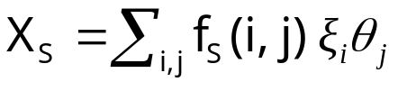
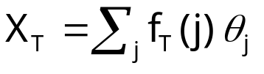





Sketching for Multiple Standing Queries
Consider queries Q1 = COUNT(R _{A} S _{B}T) and Q2 = COUNT(R _{A=B}T)
Naive approach: construct separate sketches for each join
  , , are independent families of pseudo-random variables
A
A
B
B
R
S
T
A
B
R
T

Slide 50





Sketch Sharing
Key Idea: Share sketch for relation R between the two queries
  Reduces space required to maintain sketches
Same family of
random variables
A
B
B
S
T
A
A
B
R
T
BUT, cannot also share the sketch for T !
  Same family on the join edges of Q1

Slide 51
Sketching for Multiple Standing Queries
Algorithms for sharing sketches and allocating space among the queries in the workload
  Maximize sharing of sketch computations among queries
  Minimize a cumulative error for the given synopsis space
Novel, interesting combinatorial optimization problems
  Several NP-hardness results :-)
Designing effective heuristic solutions

