Slide 1
Sketch-Based Multi-Query Processing over Data Streams
Minos Garofalakis
Internet Management Research Department
Bell Labs, Lucent Technologies
Joint work with Alin Dobra (U Florida), Johannes Gehrke (Cornell), and Rajeev Rastogi (Bell Labs)

Slide 2
Talk Outline
Introduction & Basic Stream Computation Model
Basic Sketching for the Single-Query Case
The Multiple-Query Case
  Sketch Sharing
  Correctness
  Optimality
Experimental Study
Conclusions

Slide 3
Data-Stream Management
Traditional DBMS – data stored in finite, persistent data sets
Data Streams – distributed, continuous, unbounded, rapid, time varying, noisy, . . .
Data-Stream Management – variety of modern applications
  Network monitoring and traffic engineering
  Telecom call-detail records
  Network security
  Financial applications
  Sensor networks
  Manufacturing processes
  Web logs and clickstreams
  Massive data sets

Slide 4
Data-Stream Processing Model
Stream Synopses
(in memory)
(GigaBytes)
(KiloBytes)
Continuous Data Streams
R1
Stream
Processing
Engine
Approximate Answer
with Error Guarantees
“Within 2% of exact
answer with high
probability”
Rk
Query Q
Approximate answers often suffice, e.g., trend analysis, anomaly detection
Requirements for stream synopses
  Single Pass: Each record is examined at most once, in (fixed) arrival order
  Small Space: Log or polylog in data stream size
  Real-time: Per-record processing time (to maintain synopses) must be low
  Delete-Proof: Can handle record deletions as well as insertions

Slide 5
Synopses for Relational Streams
Conventional data summaries fall short
  Quantiles and 1-d histograms [MRL98,99], [GK01], [GKMS02]
    Cannot capture attribute correlations
    Little support for approximation guarantees
  Samples (e.g., using Reservoir Sampling)
    Perform poorly for joins [AGMS99] or distinct values [CCMN00]
    Cannot handle deletion of records
  Multi-d histograms/wavelets
    Construction requires multiple passes over the data
Different approach: Pseudo-random sketch synopses
  Only logarithmic space
  Probabilistic guarantees on the quality of the approximate answer
  Support insertion as well as deletion of records

Slide 6
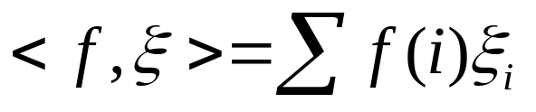


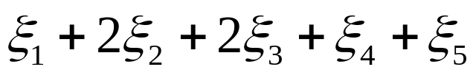
Linear-Projection (aka AMS) Sketch Synopses
Goal: Build small-space summary for distribution vector f(i) (i=1,..., M) seen as a stream of i-values
Basic Construct: Randomized Linear Projection of f() = project onto inner/dot product of f-vector
  Simple to compute over the stream: Add whenever the i-th value is seen
  Generate ‘s in small (logM) space using pseudo-random generators
  Tunable probabilistic guarantees on approximation error
  Delete-Proof: Just subtract to delete an i-th value occurrence
2
2
1
1
1
Data stream: 3, 1, 2, 4, 2, 3, 5, . . .
f(1) f(2) f(3) f(4) f(5)
where = vector of random values from an appropriate distribution
Data stream: 3, 1, 2, 4, 2, 3, 5, . . .

Slide 7


Binary-Join COUNT Query
Problem: Compute answer for the query COUNT(R _{A} S)
Example:
3
2
Data stream R.A: 4 1 2 4 1 4
1
0
1
2
3
4
2
2
Data stream S.A: 3 1 2 4 2 4
1
1
1
2
3
4
= 10 (2 + 2 + 0 + 6)
Exact solution: too expensive, requires O(M) space!
  M = sizeof(domain(A))

Slide 8


Basic AMS Sketching Technique [AMS96]
Key Intuition: Use randomized linear projections of f() to define random variable X such that
  X is easily computed over the stream (in small space)
  E[X] = COUNT(R _{A} S)
  Var[X] is small
Basic Idea:
  Define a family of 4-wise independent {-1, +1} random variables
  Pr[ = +1] = Pr[ = -1] = 1/2
    Expected value of each , E[ ] = 0
  Variables are 4-wise independent
    Expected value of product of 4 distinct = 0
  Variables can be generated using pseudo-random generator using only O(log M) space (for seeding)!
Probabilistic error guarantees
(e.g., actual answer is 10±1 with
probability 0.9)

Slide 9
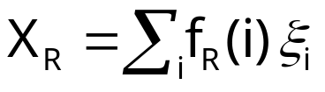
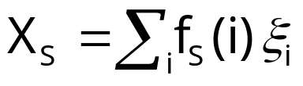






AMS Sketch Construction
Compute random variables: and
  Simply add to X_{R}(X_{S}) whenever the i-th value is observed in R.A (S.A)
Define X = X_{R}X_{S} to be estimate of COUNT query
E[X] = COUNT(R _{A} S),
  is the self-join size of R
3
2
Data stream R.A: 4 1 2 4 1 4
1
0
1
2
3
4
2
2
Data stream S.A: 3 1 2 4 2 4
1
1
1
2
3
4

Slide 10
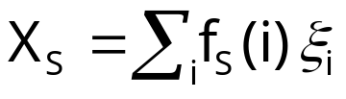
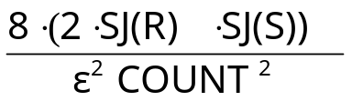



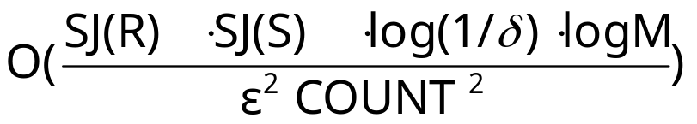
Summary of Binary-Join AMS Sketching
Step 1: Compute random variables: and
Step 2: Define X= X_{R}X_{S}
Steps 3 & 4: Average independent copies of X; Return median of averages
Main Theorem (AGMS99): Sketching approximates COUNT to within a relative error of with probability using space
  Remember: O(log M) space for “seeding” the construction of each X
copies
x
x
x
Average
y
2log(1/ )
copies
x
x
x
Average
y
median
x
x
x
Average
y

Slide 11
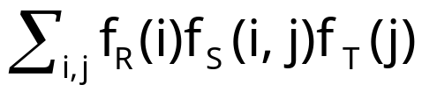
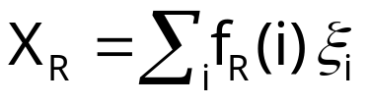


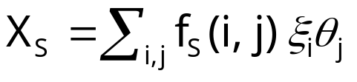
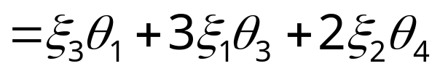
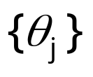

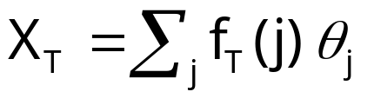

AMS Sketching for Multi-Joins [DGGR02]
Problem: Compute answer for COUNT(R _{A}S _{B}T) =
Sketch-based solution
  Compute random variables X_{R}, X_{S} and X_{T}
  Return X=X_{R}X_{S}X_{T} (E[X]= COUNT(R _{A}S _{B}T))
Stream R.A: 4 1 2 4 1 4
Independent families
of {-1,+1} random
variables
Stream S: A 3 1 2 1 2 1
B 1 3 4 3 4 3
Stream T.B: 4 1 3 3 1 4

Slide 12
What About Multiple Queries?
Stream Synopses
(in memory)
(GigaBytes)
(KiloBytes)
Continuous Data Streams
R1
Stream
Processing
Engine
Approximate Answers
to Q1, Q2, …, Qn
Rk
Q1
Q2
…
Qn
Query Workload
Q1
Q2
A
A
B
B
A
B
R
S
T
R
T
For example, network monitoring can require 100’s of standing queries
  Different trends/anomalies, different parts/elements of the network

Slide 13






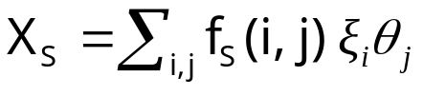






Sketching for Multiple Standing Queries
Consider queries Q1 = COUNT(R _{A} S _{B}T) and Q2 = COUNT(R _{A=B}T)
Naive approach: construct separate sketches for each join
  , , are independent families of pseudo-random variables
A
A
B
B
R
S
T
A
B
R
T

Slide 14





Sketch Sharing
Key Idea: Share sketch for relation R between the two queries
  Reduces space required to maintain sketches (random seed + sketch itself)
  Can be seen as vertex coalescing in the workload join graph
Same family of
random variables
A
B
B
S
T
A
A
B
R
T
Share sketch only for queries using same attributes of the same stream
  Only sufficient condition!
  Correctness of estimates may be an issue

Slide 15



Sketch Sharing: Correctness of Estimates
With sharing of sketches for both R and T, estimate X for Q1 = COUNT(R _{A} S _{B}T) may be incorrect
For correctness, families of random variables for distinct edges of a join query must be independent
  Otherwise, unbiasedness and variance bounds are lost
  Vertex coalescing and transitivity can cause this to be violated!
  Very different from traditional MQO – probabilistic estimation
Same family of
random variables
A
S
B
A
B
A
B
R
T

Slide 16

Sketch Sharing: Correctness & Optimality
Formalize the problem using notion of -equivalent join-graph edges
  Edges using the same random family (directly or by transitivity)
Look for well-formed workload join graphs
  No -equivalent edges from the same query
  Necessary and sufficient condition for correctness
  Many such well-formed graphs may exist
Optimality: Find well-formed join graph and allocation of sketching space to per-vertex sketches that is “optimal”
  Minimizes some aggregate error metric over the query workload
    E.g., average or maximum error over all queries

Slide 17
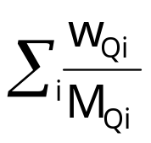
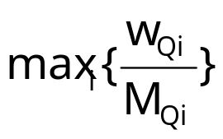
The Space Allocation Problem
Simpler problem: Well-formed join graph is given! Allocate space…
Query Q = COUNT(R S T ....)
  Basic estimate X=X_{R}X_{S}X_{T}.....
  M_{R} is space (number of iid sketch copies) allocated to vertex/stream R
  Number of copies of X, M_{Q} = min{M_{R}, M_{S}, M_{T}, ....)
Problem: Given join graph over queries Q1, ..., Qr and memory M, allocate space M_{R}, M_{S}, M_{T}, ... to nodes/sketches X_{R}, X_{S}, X_{T}, ... of join graph such that one of the following is minimized
  (average error), or (max error)
subject to constraints
  M_{R}+M_{S}+M_{T}+... = M
  M_{Qi} = min{M_{R}, M_{S}, M_{T}, ...} (Qi = COUNT(R S T ....)

Slide 18
The Space Allocation Problem (contd.)
For average error, the space-allocation problem is NP-hard (reduction from k-clique)
  Propose a near-optimal heuristic
    Novel algorithm for solving the continuous relaxation
    Round to get a near-optimal integer solution
For maximum error, a greedy algorithm based on marginal gains is actually optimal

Slide 19
The General Problem
Discover both a well-formed join graph and an allotment of sketching space to its vertices such that workload error is minimized
  NP-hard even for “easy” cases
    E.g., find well-formed join graph with minimum number of vertices
Propose an iterative greedy strategy
  Start with disjoint per-query join graphs
  At each step, determine the pair of join-graph vertices to coalesce such that
    Well-formedness is preserved
    Decrease in error is maximized
  Use space-allocation algorithms to determine error decrease

Slide 20
Experimental Study
Compare our sketch sharing techniques vs. no sharing; also, measure effectiveness of our space-allocation techniques
Database schema and query workloads inspired by the TPC-H benchmark
  Workload 1: 12 TPC-H queries
  Workload 2: Workload 1 plus 17 random join queries
Synthetically-generated clustered, multi-dimensional data sets controlled by Zipfian skew parameters
Error metric for a single query: squared relative error
  Average or Maximum of per-query errors in the workload
  Repeat each experiment 100 times and average measurements

Slide 21
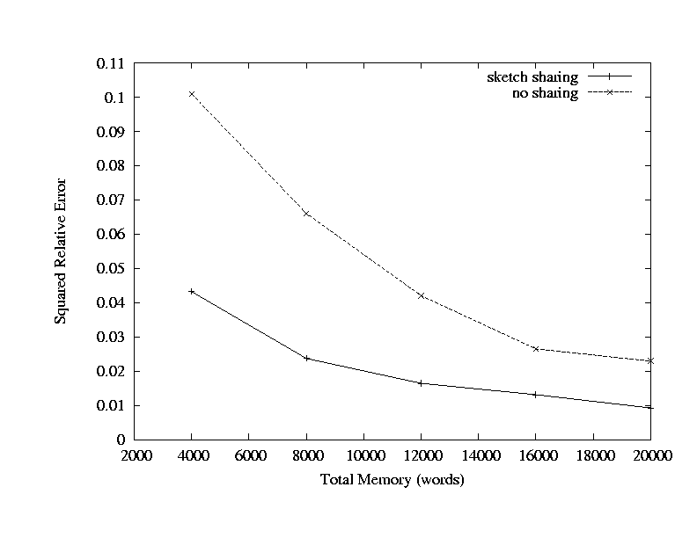
Average Error, Workload 1

Slide 22
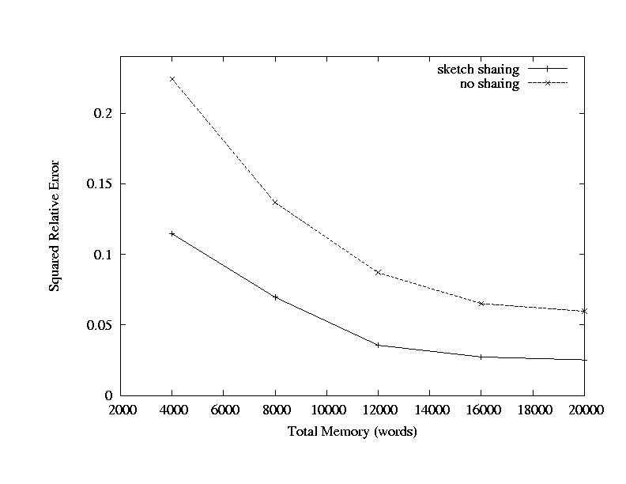
Maximum Error, Workload 1

Slide 23
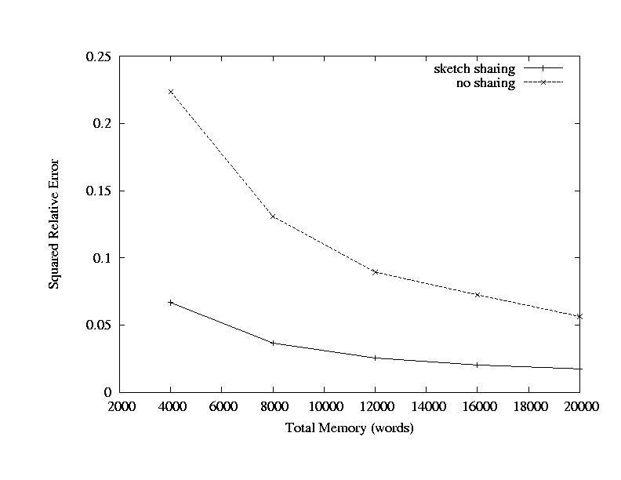
Average Error, Workload 2

Slide 24
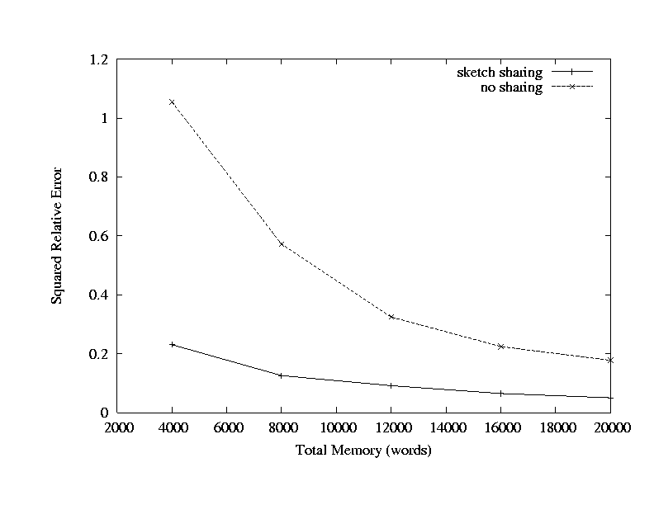
Maximum Error, Workload 2

Slide 25
Conclusions
Addressed the problem of processing multiple data-stream queries concurrently using sketches
Introduced the concept of sketch sharing
  Effectively share sketching space and computation across queries
Necessary and sufficient conditions for correct sketch-sharing
  Well-formed workload join graphs
Novel algorithms for optimal sketch sharing
  Space allocation and strategies for coalescing sketches
Experimental study verified benefits of our sketch-sharing techniques
  Improvements in accuracy ranging from a factor of 2 to 4

Slide 26

Thank you!
http://www.bell-labs.com/~minos/
minos@research.bell-labs.com

Slide 27

Sketch Sharing: Problem Formulation
Problem: Given set of queries, compute join graph with minimum number of (shared) sketches, and such that all join query estimates are correct
Problem is NP-hard (reduction from vertex cover)
Simple greedy heuristic
  Start with initial join graph with complete sharing
  In each iteration, split node that minimizes the number of “bad” edges
Initial graph
A
A
A
A
B
A
B
B
A
A
B
A
A
A
A
A
A
A
A
A
A
Join graph containing
“bad” edges (in red)
Splitting nodes in vertex
cover gets rid of “bad” edges

Slide 28
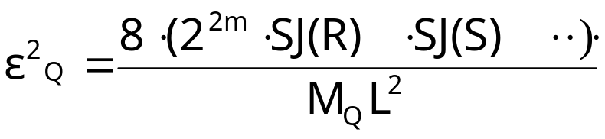
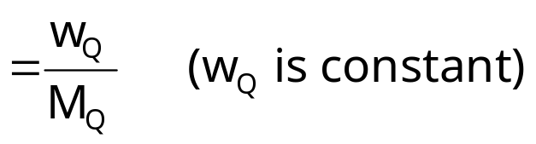
Space Allocation to Sketches
Key Observation: Allocating identical space to each sketch may not optimize cumulative/max error for join query estimates
Consider query Q: COUNT(R S T ....)
  Query Q estimated as X=X_{R}X_{S}X_{T}.....
  Number of copies of X, M_{Q} = min{M_{R}, M_{S}, M_{T}, ....)
    M_{R} is space allocated to sketch X_{R}
Relative square error for Q

Slide 29




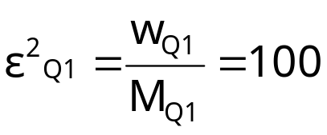
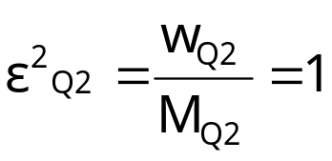
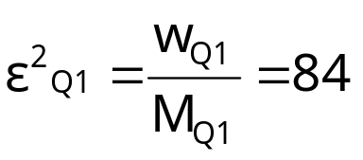
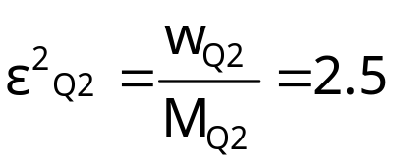
Space Allocation to Sketches: Example
Consider queries Q1 = COUNT(R _{A} S _{B}T) and Q2 = COUNT(R _{A=B}T)
  Let M = 100, w_{Q1} = 2500 and w_{Q2} = 25
S
T
More space
to Q1
S
T
Equal space
to Q1 & Q2
A
B
B
A
B
B
(25)
(30)
(30)
(25)
A
T
A
T
A
B
A
B
R
R
(25)
(30)
(10)
(25)
Est Q1 = X_{R}X_{S}X_{T}
Est Q2 = X_{R}X’_{T}
Est Q1 = X_{R}X_{S}X_{T}
Est Q2 = X_{R}X’_{T}
M_{Q1} = 25
M_{Q2} = 25
M_{Q1} = 30
M_{Q2} = 10

Slide 30
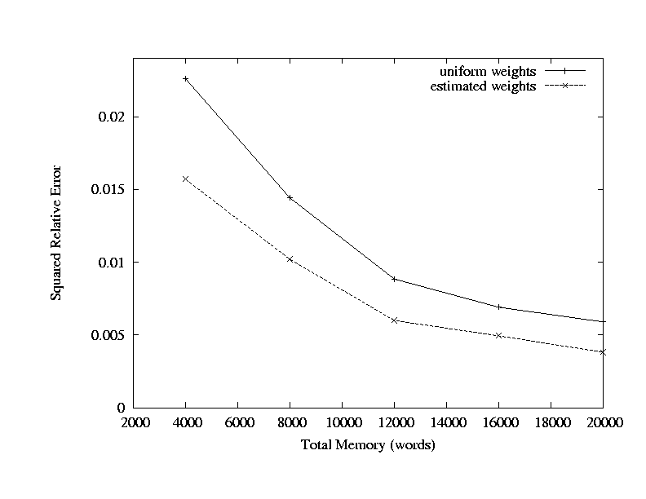
Average Error, Workload 3

