Slide 1
Processing Data-Stream Joins Using Skimmed Sketches
Minos Garofalakis
Internet Management Research Department
Bell Labs, Lucent Technologies
Joint work with Sumit Ganguly and Rajeev Rastogi (Bell Labs)

Slide 2
Talk Outline
Introduction & Basic Stream Computation Model
Basic Sketching for Binary Joins
The Problems with Basic Sketching
Our Solution
  Sketch Skimming
  Hash Sketches
Experimental Study
Conclusions

Slide 3
Data-Stream Management
Traditional DBMS – data stored in finite, persistent data sets
Data Streams – distributed, continuous, unbounded, rapid, time varying, noisy, . . .
Data-Stream Management – variety of modern applications
  Network monitoring and traffic engineering
  Telecom call-detail records
  Network security
  Financial applications
  Sensor networks
  Manufacturing processes
  Web logs and clickstreams
  Massive data sets

Slide 4
Data-Stream Processing Model
Stream Synopses
(in memory)
(GigaBytes)
(KiloBytes)
Continuous Data Streams
R
Stream
Processing
Engine
Approximate Answer
with Error Guarantees
“Within 2% of exact
answer with high
probability”
S
AGG(R S)
Approximate answers often suffice, e.g., trend analysis, anomaly detection
Requirements for stream synopses
  Single Pass: Each record is examined at most once, in (fixed) arrival order
  Small Space: Log or polylog in data stream size
  Real-time: Per-record processing time (to maintain synopses) must be low
  Delete-Proof: Can handle record deletions as well as insertions

Slide 5
Synopses for Relational Streams
Conventional data summaries fall short
  Quantiles and 1-d histograms [MRL98,99], [GK01], [GKMS02]
    Cannot capture attribute correlations
    Little support for approximation guarantees
  Samples (e.g., using Reservoir Sampling)
    Perform poorly for joins [AGMS99] or distinct values [CCMN00]
    Cannot handle deletion of records
  Multi-d histograms/wavelets
    Construction requires multiple passes over the data
Different approach: Pseudo-random sketch synopses
  Only logarithmic space
  Probabilistic guarantees on the quality of the approximate answer
  Support insertion as well as deletion of records

Slide 6
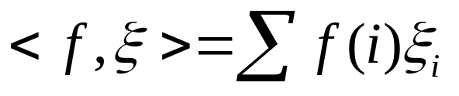


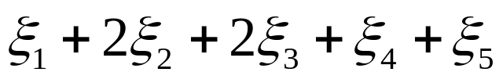
Linear-Projection (aka AMS) Sketch Synopses
Goal: Build small-space summary for distribution vector f(i) (i=1,..., M) seen as a stream of i-values
Basic Construct: Randomized Linear Projection of f() = project onto inner/dot product of f-vector
  Simple to compute over the stream: Add whenever the i-th value is seen
  Generate ‘s in small (logM) space using pseudo-random generators
  Tunable probabilistic guarantees on approximation error
  Delete-Proof: Just subtract to delete an i-th value occurrence
2
2
1
1
1
Data stream: 3, 1, 2, 4, 2, 3, 5, . . .
f(1) f(2) f(3) f(4) f(5)
where = vector of random values from an appropriate distribution
Data stream: 3, 1, 2, 4, 2, 3, 5, . . .

Slide 7


Binary-Join COUNT Query
Problem: Compute answer for the query COUNT(R _{A} S)
Example:
3
2
Data stream R.A: 4 1 2 4 1 4
1
0
1
2
3
4
2
2
Data stream S.A: 3 1 2 4 2 4
1
1
1
2
3
4
= 10 (2 + 2 + 0 + 6)
Exact solution: too expensive, requires O(N) space!
  M = sizeof(domain(A))

Slide 8


Basic AMS Sketching Technique [AMS96]
Key Intuition: Use randomized linear projections of f() to define random variable X such that
  X is easily computed over the stream (in small space)
  E[X] = COUNT(R _{A} S)
  Var[X] is small
Basic Idea:
  Define a family of 4-wise independent {-1, +1} random variables
  Pr[ = +1] = Pr[ = -1] = 1/2
    Expected value of each , E[ ] = 0
  Variables are 4-wise independent
    Expected value of product of 4 distinct = 0
  Variables can be generated using pseudo-random generator using only O(log M) space (for seeding)!
Probabilistic error guarantees
(e.g., actual answer is 10±1 with
probability 0.9)

Slide 9
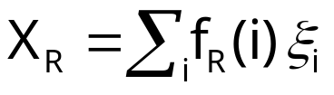
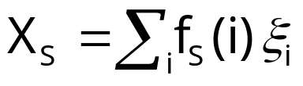






AMS Sketch Construction
Compute random variables: and
  Simply add to X_{R}(X_{S}) whenever the i-th value is observed in R.A (S.A) Define X = X_{R}X_{S} to be estimate of COUNT query
E[X] = COUNT(R _{A} S),
  is the self-join size of R
3
2
Data stream R.A: 4 1 2 4 1 4
1
0
1
2
3
4
2
2
Data stream S.A: 3 1 2 4 2 4
1
1
1
2
3
4

Slide 10
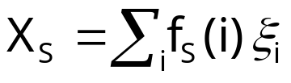
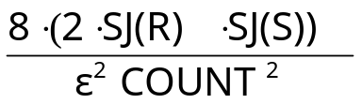



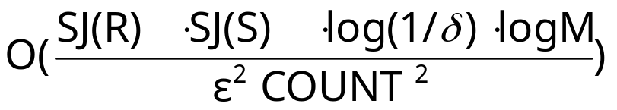
Summary of Binary-Join AMS Sketching
Step 1: Compute random variables: and
Step 2: Define X= X_{R}X_{S}
Steps 3 & 4: Average independent copies of X; Return median of averages
Main Theorem (AGMS99): Sketching approximates COUNT to within a relative error of with probability using space
  Remember: O(log M) space for “seeding” the construction of each X
copies
x
x
x
Average
y
2log(1/ )
copies
x
x
x
Average
y
median
x
x
x
Average
y

Slide 11



Problems with Basic Sketching
Accurate estimates only for large joins (wrt self-join product)
  Lower bound [AGMS99]: Any technique for estimating a join of size J requires at least space
    N is the number of stream tuples
  BUT the worst-case space requirement of basic sketching is
    Each self-join is in the worst case
    Quite far from the AGMS lower bound!
Another important problem: Sketch-update time
  Time per stream element is proportional to total synopsis size
    Must update every atomic sketch on each arrival
  Problematic for rapid-rate data streams!

Slide 12
Our Solution: Skimmed Sketches
Solves both problems of basic sketching for data-stream joins
First streaming method to
  Match the AGMS lower bound for join-size estimation
  Guarantee small, logarithmic-time updates per stream element
Extends naturally to other aggregates, multi-joins, multiple queries, etc…
  Essentially gives same guarantees as basic sketching using only square root the synopsis space and log-time updates!
Two key technical ideas
  Sketch skimming
  Hash sketches

Slide 13
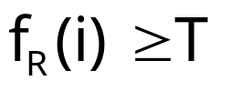
Sketch Skimming
Remember: Variance is proportional to product of self-join sizes
Key Idea: Skim large (“dense”) frequencies away from the sketches built for R and S (with high probability)
  i is “dense” in R iff (appropriately-defined threshold T)
  Use extracted frequencies directly to estimate the “dense-dense” sub-join
  Use left-over “skimmed” sketches for the other sub-joins
  Residual frequencies left in the skimmed sketches are small (“sparse”)
    Small self-join sizes => Improved accuracy/space!
Discover dense frequencies efficiently using dyadic intervals
    “Binary search” over logM dyadic levels

Slide 14


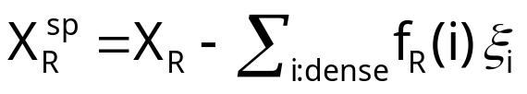

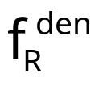
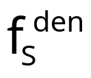




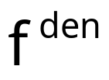
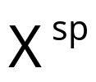

Sketch Skimming (contd.)
skim
Find large frequencies (using variant of [CCF02]) and skim them from the sketches
Estimate “dense-dense” directly from the extracted dense frequencies
Estimate “dense-sparse” combinations from and
Estimate “sparse-sparse” from the skimmed sketches
  Self-join sizes for residual vectors are much smaller!

Slide 15
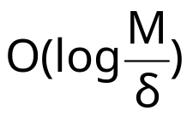
Hash Sketches
Key Idea: Organize atomic sketches for each stream in hash tables, with one sketch per bucket (one random family/table)
  Each element only updates the sketch for the bucket it hashes into
For join-size estimation: Join corresponding buckets for each table pair in the two streams and add across the table; Take median across tables
  Similar accuracy guarantees with only update cost
h2(e)
stream element e
h1(e)
h3(e)
h4(e)

Slide 16

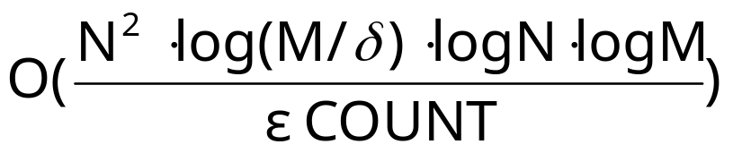
Main Result
Our Skimmed-Sketches method approximates COUNT to within a relative error of with probability using time per stream element and space
Matches the lower bound of [AGMS99] to within log and constant factors

Slide 17
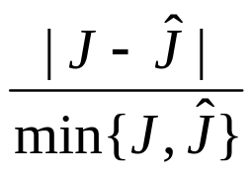
Experimental Study
Compare our skimmed-sketches technique against the basic AGMS method for stream joins
  Basic metric = estimation accuracy
  Modified relative error
    Treat over/under-estimation symmetrically
Joins between Zipfian and right-shifted Zipfian
  Domain size = 256K, number of stream tuples = 4M
  Qualitatively similar results for Census data

Slide 18
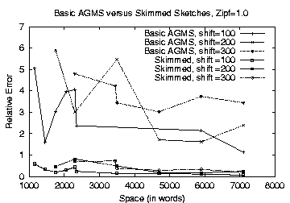

Synthetic Data, z=1.0

Slide 19
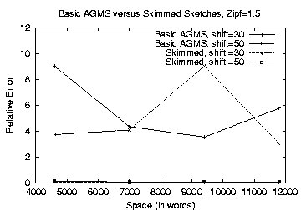
Synthetic Data, z=1.5

Slide 20
Conclusions
Introduced the Skimmed-Sketches technique for stream joins -- first streaming method to
  Match the AGMS space lower bound for join estimation
  Offer guaranteed log-time updates for the synopsis
  Handle insertions as well as deletions
Two key technical ideas: Sketch Skimming and Hash Sketches
Experimental results verify its superiority over basic sketching for join-size estimation
  Accuracy improvements from factor of 5 up to orders of magnitude

Slide 21

Thank you!
http://www.bell-labs.com/~minos/
minos@research.bell-labs.com

Slide 22
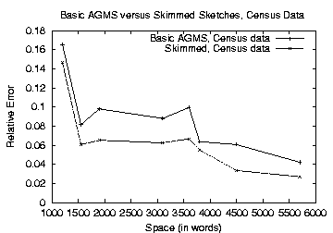
Census Data

