Slide 1
Streaming Algorithms for Robust, Real-Time Detection of DDoS Attacks
S. Ganguly, M. Garofalakis, R. Rastogi, K. Sabnani
Krishan Sabnani
Bell Labs Research

Slide 2
Agenda
TCP-SYN-flooding attack detection problem
Distinct samples
Distinct-Count sketches
Experimental results
Summary

Slide 3


TCP-SYN-flooding attack
attacker
SYN
victim
SYN-ACK
ACK
Packets with spoofed
source IP addresses
Victim
Large number of half-open connections
Victim runs out of resources & crashes
Attackers

Slide 4
TCP-SYN-flooding attack: Salient characteristics
TCP-SYN-flooding attacks are different from flash crowds
 | TCP-SYN-floods | Flash crowds
Traffic volume | low | high
# of half-open connections | high | low
# of distinct connecting sources | high | high
Tracking top-k destinations with the highest traffic volume to detect attack victims won’t work
  Attack traffic may not be high
Right metric for robust attack detection:
Top-k destinations wrt number of distinct sources with half-open connections

Slide 5
System model
Continuous stream of (src IP, dst IP, ±1) flow updates
+1 for SYN packet from src to dst (insert)
-1 for ACK packet from src to dst (delete)
Assumptions
32-bit IP addresses; 64-bit (src, dst) pairs
Number of distinct (src, dst) pairs: U
Constraints
Single pass over update stream
Small space (logarithmic in U)
  Solutions that store state for U (src, dst) pairs won’t work
Small processing time per update
Continuous tracking of attack metric (top-k destinations)
Attack
Detector
Top-k dst
Flow update streams

Slide 6


Problem formulation
Distinct frequency f_{v} for dst v = number of distinct src’s with unacknowledged SYN pkts (half-open connections) to v
Key observation: Attack victims will have high f_{v} values
To detect attack, track top-k f_{v} frequency values (f_{v1},…., f_{vk})
Exact tracking of f_{v} values requires Θ(U) space, and is thus impractical
Approximate top-k dst tracking problem: Track top-k frequencies with a small (ε) relative error; if f_{v} is the estimate for top-k frequency value f_{v} then

Slide 7
Our contribution
Distinct-Count Sketch structure
Enables tracking of top-k distinct frequencies with guaranteed accuracy
Is resilient to deletes (necessary to ignore legitimate TCP connections)
Low storage space overhead
Low update processing time

Slide 8
Related work
Estan and Varghese [SIGCOMM 02]
  Use samples and hash-based filtering to identify large flows
  A half-opened TCP flow is not large because no packets are exchanged
Kompella et al. [IMC 04], Gao et al. [ICDCS 04]
  Maintain multiple hash tables, dst that hashes into buckets with large counters in all hash tables is potential attack victim
  No provable guarantees
Gibbons [VLDB 01], Cormode and Muthukrishnan [PODS 05]
  Distinct samples, cascaded summaries for (distinct) frequency estimation
  Cannot handle deletions in update stream
Venkataraman et al.[NDSS 05]
  For threshold k, k-superspreaders identify src’s that connect to >k dst
  Determining threshold k may be difficult in practice

Slide 9
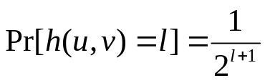

Revisiting the basics: Distinct samples [Gibbons, VLDB 01]
Good for distinct frequency estimation, but cannot handle deletes
Stream of (src, dst, +1) flow updates (inserts)
Hash function h maps (src, dst) pairs to buckets with exponentially decreasing probabilities
(src, dst) pairs that hash into buckets b yield distinct sample of size U/2^{b}
64
U/2 (src, dst) pairs hash into bucket 0, U/4 into bucket 1, …
(s,d)
Distinct sample
h(u,v)
(u,v)
b
(s,d)
(s,d)
0

Slide 10

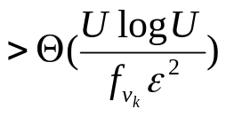
Top-k frequency estimation procedure
s
s
Let v₁, ..., v_{k} be dst with highest frequencies (say f_{v1}, …, f_{vk}) in distinct sample from buckets b
Return (v₁ , f_{v1}= 2^{b}f_{v1}), …, (v_{k} , f_{vk}= 2^{b}f_{vk})
s
s
Key result: If distinct sample size , then for each top-k distinct frequency f_{v} whp

Slide 11
Distinct-Count Sketch
Distinct-Count Sketches produce distinct samples in the presence of deletions
Hash function g_{j} randomly maps (src, dst) pairs to one of the s buckets of hash table j
s
g₁(u,v)
count0₁
count0_{i}
count0₆₄
0 bit counts
64
count1₁
count1_{i}
count1₆₄
1 bit counts
Number of (src, dst) pairs in bucket with i^{th} bit 0/1
h(u,v)
r second level
hash tables
1
Counts help to extract (src, dst) pair in bucket when there are deletions
s
g_{r}(u,v)
count0₁
count0_{i}
count0₆₄
0
count1₁
count1_{i}
count1₆₄
first level hash buckets (as before)
1
rs second level
hash buckets

Slide 12
Maintenance procedure for incoming stream update (u, v, Δ)
Consider first-level hash bucket h(u,v)
For j = 1 to r
Update counts in second-level bucket g_{j}(u,v)
count0₁
count0_{i}
count0₆₄
g₁(u,v)
count1₁
count1_{i}
count1₆₄
If i^{th} bit of (u, v) is 0/1
then adjust count0/1_{i} by Δ
h(u,v)
g_{r}(u,v)
count0₁
count0_{i}
count0₆₄
count1₁
count1_{i}
count1₆₄
Example (updating counts):
2 0 0 2
0 bit
2 0 0 2
0 bit
0 2 2 0
1 bit
0 2 2 0
1 bit
(u,v) = 0110, Δ=+1
(u,v) = 1010, Δ=+1
3 0 0 3
2 1 0 3
No collision
1 2 3 0
Collision
0 3 3 0

Slide 13
Extracting (src, dst) pair from second-level bucket
If for all i=1 to 64, exactly one of count0_{i} or count1_{i} is non-zero /* no collision */
Then
(src, dst) = sequence of bit values with non-zero counts
Return (src, dst)
Else /* collision */
Return “empty (src, dst)”
Example (extracting (src, dst) pair):
3 0 0 3
0 bit
2 1 0 3
0 bit
0 3 3 0
1 bit
1 2 3 0
1 bit
no collision
collision
(src, dst) = 0110
empty (src, dst)

Slide 14

Top-k frequency estimation procedure
Let DS_{l} be (src, dst) pairs from (second-level buckets of) first-level buckets l
Let b be the largest first-level bucket such that size of distinct sample DS_{b} > Θ(s)
Let v₁, ..., v_{k} be dst with highest frequencies (say f_{v1}, …, f_{vk}) in distinct sample DS_{b}
Return (v₁ ,f_{v1} = 2^{b}f_{v1}), …, (v_{k} , f_{vk}= 2^{b}f_{vk})
s
s
s
s
s
count0₁
count0_{i}
count0₆₄
count1₁
count1_{i}
count1₆₄
64
Distinct sample size > Θ(s)
1
First-level bucket b
r second-level
hash tables
Extract (src, dst) pairs from second-level buckets
s
count0₁
count0_{i}
count0₆₄
count1₁
count1_{i}
count1₆₄
0
1

Slide 15
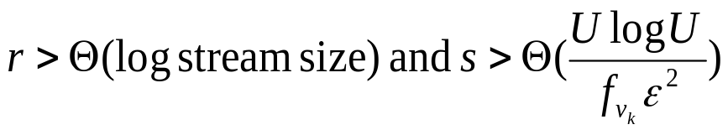
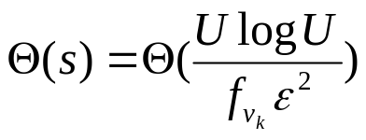
Distinct-Count Sketch: Key result
Key result: If , then for each top-k distinct frequency f_{v} whp
Intuition: Consider first-level bucket with Θ(s) (src, dst) pairs
With r = Θ(log streamsize) second-level hash tables with s buckets each, every pair occurs without collisions in some second-level bucket whp
Thus, possible to obtain a distinct sample of size

Slide 16
Experimental results
Synthetic data generator used to produce stream of (src, dst) pair updates
Number of distinct (src, dst) pairs (U): 8 million
Number of distinct dst: 50K
Dst IP addresses follow Zipf distribution
  Zipf parameter varied between 1 and 2.5 to control skew
Distinct-Count Sketch
r=3 second-level hash tables with s=5 buckets each
Size = 4.5 MB
  → over an order of magnitude space savings
  Space to maintain counts for 8 million (src, dst) pairs = 96 MB
Processing time per stream update = 40-60 microsec on 1GHz Pentium-III

Slide 17
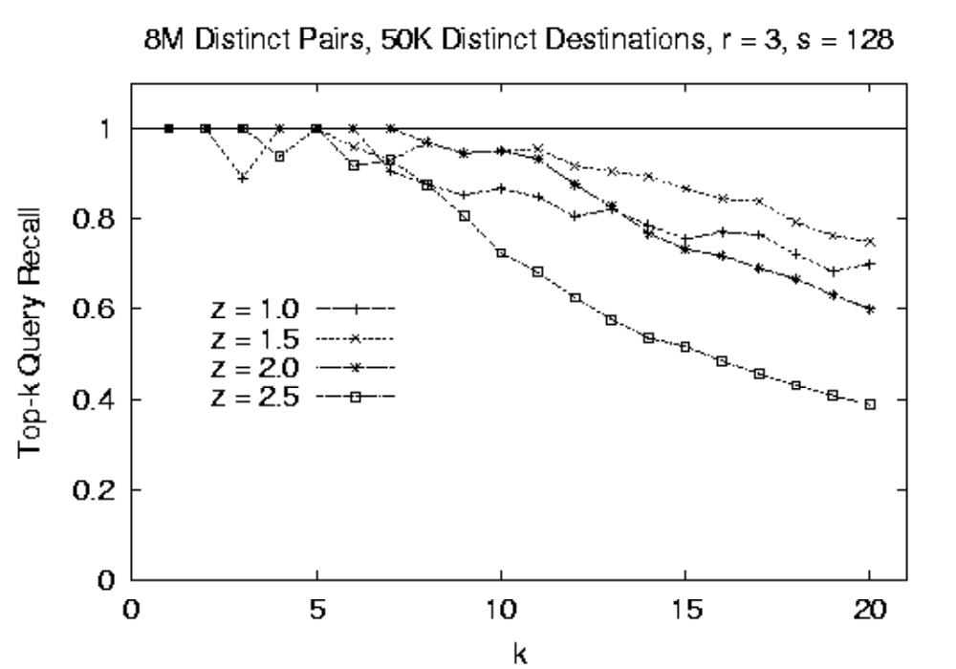
Top-k recall
Recall for top-5 dst is almost always 100% (for all skew values z)
For z < 2, recall is >86% and >73% for top-10 and top-15 dst, respectively

Slide 18
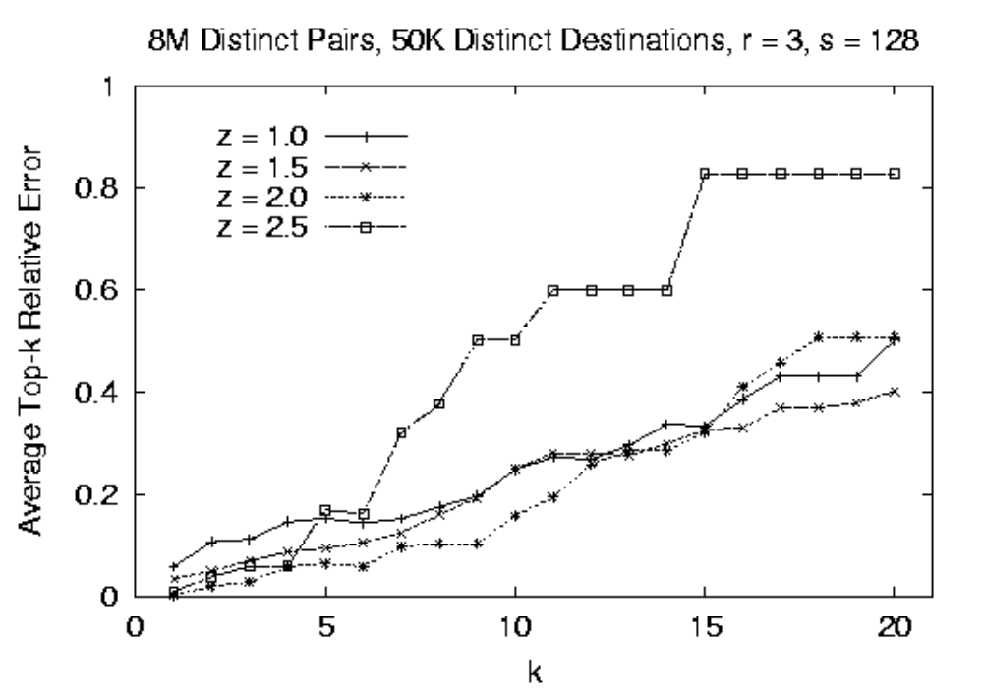
Estimate relative errors
Relative error is < 17% for top-5 dst (for all skew values z)
For z<2, relative error is < 25% and < 35% for top-10 and top-15 dst, respectively

Slide 19
Summary
Robust, real-time TCP-SYN-flooding attack detection requires the ability to track top-k destinations wrt
Number of distinct connecting sources (as opposed to traffic volumes)
Number of half-open connections (to distinguish from flash crowds)
Our proposed Distinct-Count Sketch
Enables tracking of top-k distinct frequencies with guaranteed accuracy
Is resilient to deletes (necessary to ignore legitimate TCP connections)
Experimental results indicate that Distinct-Count Sketches can accurately track top-k frequent destinations
Low storage space overhead
Low update processing time
Low errors

