Slide 1
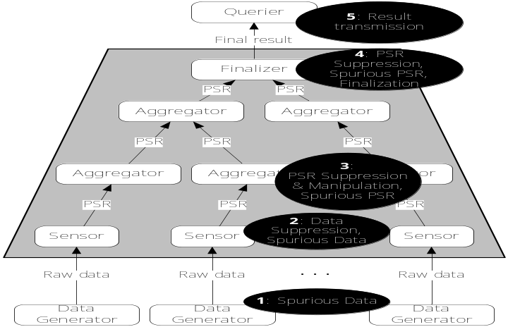
Proof Sketches: Verifiable In-Network Aggregation
Minos Garofalakis Joe Hellerstein Petros Maniatis Yahoo! Research, UC Berkeley, Intel Research Berkeley minos@yahoo-inc.com, minos@cs.berkeley.edu

Slide 2

Introduction & Motivation
Context: Distributed, in-network aggregation
  Network monitoring, sensornet/p2p query processing, …
  Data is distributed – cannot afford to warehouse!
  Approximations are often sufficient
    Can tradeoff approximation quality with communication
Querier: “How many Win-XP hosts running patch X have CPU utilization > 95%?”
“Predicate poll” query
More general aggregate queries (SUM, AVG), general-purpose summaries (e.g., random samples) of (sub)populations

Slide 3
In-Network Aggregation
Typical assumption: Benign aggregation infrastructure
  Aggregator nodes cannot “misbehave”
BUT, aggregators are often untrusted!
  3rd party hosted operations (e.g., Akamai), shared infrastructure, viruses/worms, …
Challenge: Verifiable, efficient, in-network aggregation
  Provide trustworthy, guaranteed-quality results with potentially malicious aggregators

Slide 4
Our Contributions
Proof Sketches: Family of certificates for verifiable, approximate, in-network aggregation
  Concise sketch synopses ➔ Communication-efficient
  Guarantee detection of malicious tampering whp if result is perturbed by more than a small error bound
Basic Technique: Combines FM sketch with compact Authentication Manifest (AM)
  Prevents inflation through crypto signatures; bounds deflation through complementary deflation detection
Extensions: Verifiable random sampling; verifiable aggregates over multi-tuple nodes

Slide 5
Talk Outline
Introduction and Motivation
Overview of Contributions
System Model
AM-FM Proof Sketches
Extensions
  Verifiable random samples
  Verifiable aggregation over multi-tuple nodes
Experimental Results
Conclusions

Slide 6
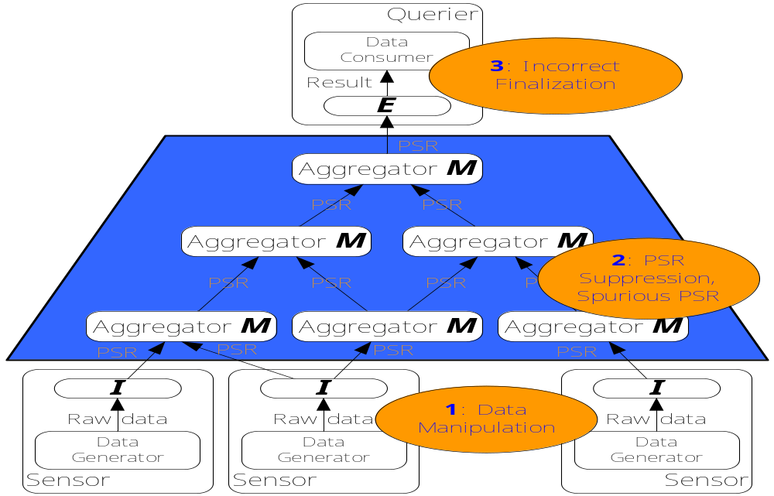
System Model
U = size of sensor population
Inflation Attacks: Aggregators can manipulate or inject spurious PSRs
Deflation Attacks: Aggregators can suppress valid PSRs

Slide 7
A Naïve Inflation Detector
Straightforward application of crypto signatures
  Each sensor node crypto signs each tuple satisfying the predicate poll, and sends up the tuple + signature
  Aggregators simply union the signed tuple sets and forward up the tree
Aggregators cannot forge sensor tuples
  Within crypto function guarantees
BUT, size of Authentication Manifest (AM) = size of answer set
  O(U) in general!

Slide 8
Solution: AM-FM Proof Sketches
Sketch and AM structure of size only O(logU)
Based on the FM sketch for distinct-element counting
Index of rightmost zero ~ log(Count)
O(log(1/δ)/ε²) sketches to get an (ε,δ)−estimate of the Count
Bitmap of size O(logU)
1
k
. . .
2
1
0
h()
with prob 1/2^{k+1}
P[h(x)=0] = ½, P[h(x)=1] = ¼, P[h(x)=2] = 1/8, …

Slide 9
Adding AM to FM: Inflation Prevention
Observation: Each FM sketch bit is an independent function of the input tuples
AM = Authenticate each 1-bit in the FM sketch using a signed “witness”/exemplar sensor tuple
  Crypto-signed tuple that turns that bit on
Aggregators: Merge input PSRs (AM-FM sketches)
  OR the FM sketches
  Keep a single exemplar for each 1-bit
  Size = O(logU) – Cannot forge 1-bits
1
1
<t3,…>
<t1,a1,s(a1,t1)>
<t3,…>
1
1
1
1
1
<t4,…>
<t2,a2,s(a2,t2)>
<t4,…>
<t2,a2,s(a2,t2)>

Slide 10
AM-FM Proof Sketches: Bounding Deflation
Malicious aggregator can omit 1-bits & witnesses from sketch → Underestimate predicate poll count
Approach: Complementary Deflation Detection
  Assumes that we know sensor count U
  Use AM-FM to estimate count for both pred and !pred
  Check that C_{pred} + C_{!pred} is close to U (based on sketching approximation guarantees)
    Adversary cannot inflate C_{!pred} to compensate for deflating C_{pred}
    Sum check will catch significant deviations

Slide 11
More Formally…
Assume O(log(2/δ)/ε²) AM-FM proof sketches to estimate C_{pred} and C_{!pred}
Verification Condition: Flag adversarial attack if C_{pred} + C_{!pred} < (1-ε)U
Theorem: If verification step is successful, the AM-FM estimate is within §2εU of the true C_{pred} whp
  Adversary cannot deflate the result by more than 2εU without being detected whp
  Relative error guarantees for high-selectivity predicates

Slide 12
Verifiable Random Sampling
Build a general-purpose, verifiable synopsis of node data
  Can support arbitrary predicates, quantile/heavy-hitter queries, …
Traditional (eg, reservoir) sampling + authentication fails
  Adversary can arbitrarily bias the sample
Solution: AM-Sample Proof Sketches
  Use FM hashing to sample, retain tuples + AMs for all tuples mapping above a certain level
  A la Distinct Sampling [Gibbons’01] – adapt level based on target sample size
  Easily merged up the tree using max-level
  Verification condition and error guarantees based on target sample size and knowledge of U

Slide 13
Aggregates over Multi-Tuple Nodes
So far, focus on predicate poll queries
  Each sensor contributes · 1 tuple to result
Key Issue: Knowing the total number of tuples M
  With known M, our earlier results and analysis apply
Approach: Verifiable approximate counting algorithm
  Estimate M using a logarithmic number of simple AM-FM predicate polls
  To within a given accuracy θ, using predicate polls of the form
  Detailed algorithm, analysis, … in the paper
Fraction of sensors with #tuples ¸ (1+θ)^{k}

Slide 14
Other Extensions / Issues
Discuss “generalized template” for proof sketches to support verifiable query results
  E.g., Bloom-filter proof sketch
Accountability: Trace-back mechanisms for pinpointing attackers
Only approximate knowledge of population size U

Slide 15
Experimental Study
Study average-case behavior of AM-FM proof sketches for verifiable predicate polls
Population of 100K sensors, fixed number of sketches to 256
  About 4% of space for “naïve”
  ε ¼ 0.15 wp 0.8
Parameters
  Predicate selectivity
  “Coverage” of malicious aggregators
  Two adversarial strategies (Targeted, Safe)

Slide 16
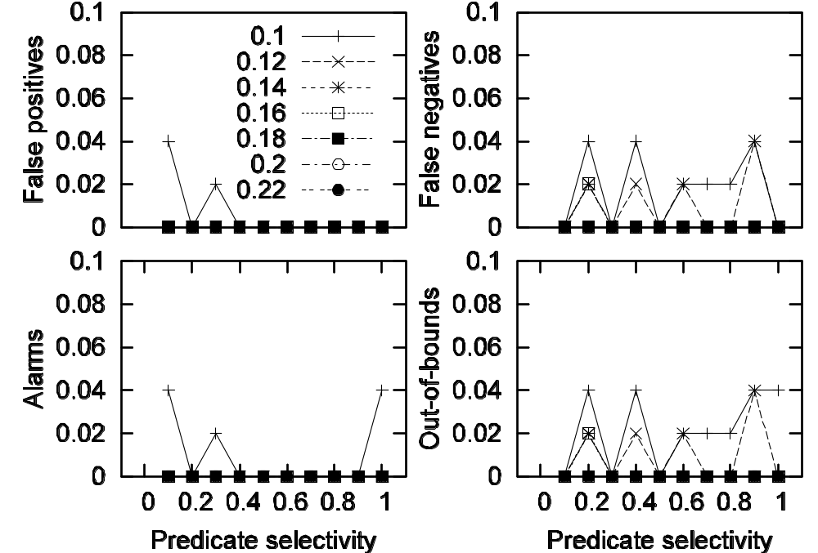
Some Results: Benign Population

Slide 17
Experimental Summary
Average case behavior is better than (worst-case) bounds suggest
  Adversary has even less “wiggle room” to deflate result without being detected
Bounds based on worst case for sketch approximation and combination of pred/!pred estimates
Adversary typically has limited coverage in the aggregation tree
  Can only affect a small fraction of the aggregated results

Slide 18
Conclusions
Introduced Proof-Sketches – first compact certificate structure for verifiable, in-network aggregation
Basic technique: AM-FM proof sketch
  Adds concise AM to basic FM sketch; prevents deflation through complementary deflation detection
Extensions
  Verifiable random sampling
  Approximate verifiable counting for general aggregates over multi-tuple nodes
Future: Extending ideas and methodology to more general approximate in-network queries (e.g., joins)

Slide 19

Thank you!
http://www.cs.berkeley.edu/~minos/
minos@yahoo-inc.com, minos@cs.berkeley.edu

Slide 20
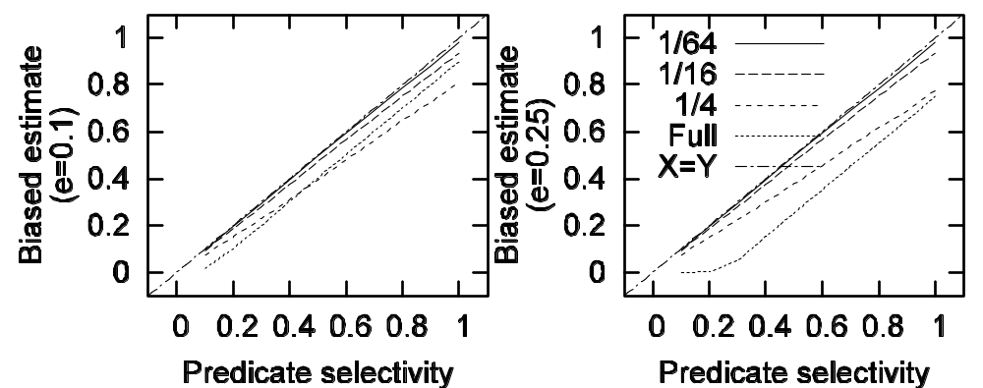
Some Results: Safe Adversary

