Slide 1
Tree-Pattern Similarity Estimation for Scalable Content-based Routing
R. Chand
University of Geneva
Raphael.Chand@cui.unige.ch
http://cui.unige.ch/
Based on joint work with:
P. Felber (University of Neuchatel)
M. Garofalakis (Yahoo Research)

Slide 2







Content-based publish/subscribe
Consumers register subscriptions
Producers publish events (messages)
Messages are routed to interested consumers
  Interested ≡ message matches subscription
Matching based on the content of messages
Weather Forecast
City = Nice
Stock Quotes
Symbol = LU and
Price ≥ 10
Stock Quotes
Volume > 100,000
Internet
Symbol: LU
Price: $10
Volume: 101,000
City: Nice
Weather: Sunny
Temp: 24ºC

Slide 3
Broker-based approach
Fixed infrastructure of reliable brokers
(Subset of) subscriptions stored at brokers in routing tables
  Typically takes advantage of “containment” relationship
Filtering engine matches message against subscriptions to determine next hop(s)
Cons: dedicated infrastructure, large routing tables, complex filtering algorithms

Slide 4
P2P approach
Gather consumers in semantic communities according to interests (subscriptions)
Disseminate messages in community & stop when reaching boundaries
Pros: broker-less, space-
efficient, low filtering cost
Challenge: identify subscription proximity
“are two distinct subscriptions likely to match the same set of documents?”

Slide 5
Problem statement
Given
  S: valid tree patterns (subscriptions)
  D: valid documents
  p, q ∈ S
compute the similarity between p and q
  p ~ q ~: S² → [0,1]
  (probability that p matches the same subset of D as q)
Algorithms use
  H ⊂ D: historical data about document stream
  k: space bound

Slide 6
Basic approach
Summarize the document stream
  Synopsis maintained incrementally
  Accurate yet compact (compression, pruning)
Evaluate selectivity of tree pattern using synopsis
  Recursive algorithm matches TP against synopsis
Estimate similarity using various metrics
  Similarity computed from selectivity

Slide 7
1. Document-tree synopsis
Maintain a concise, accurate synopsis H_{S}
  Built on-line as documents stream by
  Captures the path distribution of documents in H
  Captures cross-pattern correlations in the stream
    p, q match the same documents (not just the same number)
  Allows us to estimate the fraction of documents matching different patterns

Slide 8
1. Document-tree synopsis
Document-tree synopsis: tree with paths labeled with matching sets (documents containing path)
  Summary of path-distribution characteristics of documents
Adding a document to the synopsis:
  Trace each path from the root of the synopsis, updating the matching sets and adding new nodes where necessary
Synopsis:
1
x
3
x
/.
a
a
b
2
x
a
a
b
x
{1,2,3}
b
c
c
d
a
b
c
b
d
a
a
{1,2,3}
b
{1,2,3}
c
d
a
a
d
{1,3}
b
c
d
{2,3}
a
{2,3}
d
{1}
XML documents:
{1,2,3}
c
d
{2}
c
d
{2,3}

Slide 9
1. Matching set compression
Problem: cannot maintain full matching set
  With N documents: O(N)
Approach 1: only maintain document count
  Independence assumption unrealistic (no cross-pattern correlation)
    P(S₁) = 2/3 * 1/3 = 2/9 vs. 0
    P(S₂) = 2/3 * 2/3 = 4/9 vs. 2/3
/.
x
#3
//
//
a
#3
b
#3
S₁
S₂
b
a
b
#2
b
c
d
#2
a
#2
d
#1
#3
a
d
d
a
#1
c
d
#2

Slide 10
1. Matching set compression
Approach 2: use fixed-size sample sets
  Keep uniform sample of s documents
  [Vitter’s reservoir-sampling scheme]
  P(k^{th} document in synopsis) = min(1,s/k)
  Once replaced, document ID deleted from whole tree
  Sampling rate decided uniformly over all nodes
  ⇒ Inefficient utilization of the space budget
  ⇒ Poor estimates
1
1
1
1
4/5
2/3
4/7
1/2
4/9
Document stream
1
1
2
2
3
3
4
4
5
5
6
6
7
7
8
8
9
9
10
11
12
Sample set
1
2
5
3
7
4

Slide 11
1. Matching set compression
Approach 3: use per-node hash samples
  Gibbons’ distinct sampling: hash function maps document IDs on logarithmic range of levels
  Pr[h(x)≥l] = 1/2^{l}
  Hash samples start at level l=0, keep d ⇔ h(d)≥l
  Once sample is full, increment level and “sub-sample”
  Fine sampling granularity, keep low frequency paths
  ⇒ Much better estimates
  ⇒ Good utilization of the space budget
1
2
3
4
Hash sample
1
2
3
4
l=0
6
5
7
8
l=0
l=1
l=2
3
…
5
2
8
4
l=1
0
1/2
3/4
7/8
1

Slide 12
1. Matching set compression
Approach 3: (cont’d)
  Computing union/intersection: sub-sample lower level to higher prior to union/intersection, then possibly once more
  Estimate cardinality of sample with n elements: n2^{l}
  Only need to store document ID in hash samples at final nodes of incoming paths
    Matching set of parent can be reconstructed by recursively unioning those of descendants
  ⇒ Reduced memory requirements
/.
x
{ }
1
x
x
a
b
{ }
{ }
a
a
b
a
b
{1,3}
b
c
d
{2,3}
a
{ }
d
{1}
{1,2,3}
b
c
c
d
b
c
d
{2}
c
d
{2,3}

Slide 13
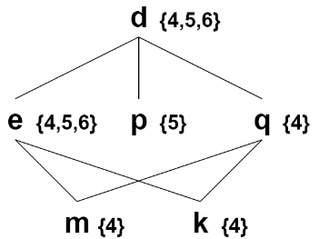
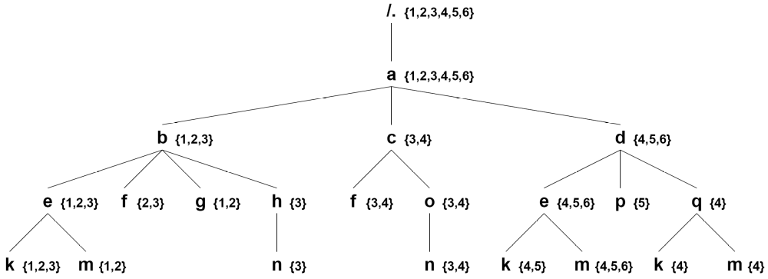
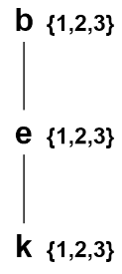

1. Synopsis pruning
Synopsis may grow very large (due to path diversity)
  ⇒ Prune nodes with little influence on selectivity estimation
  1. Merge same-label leaf nodes with high similarity
  2. Fold leaf nodes in parent with high similarity
  3. Delete low-cardinality nodes
  Similar: ⏐S(t) ∩ S(t’)⏐ / ⏐S(t) ∪ S(t’)⏐ ≈ 1
1
3
2

Slide 14
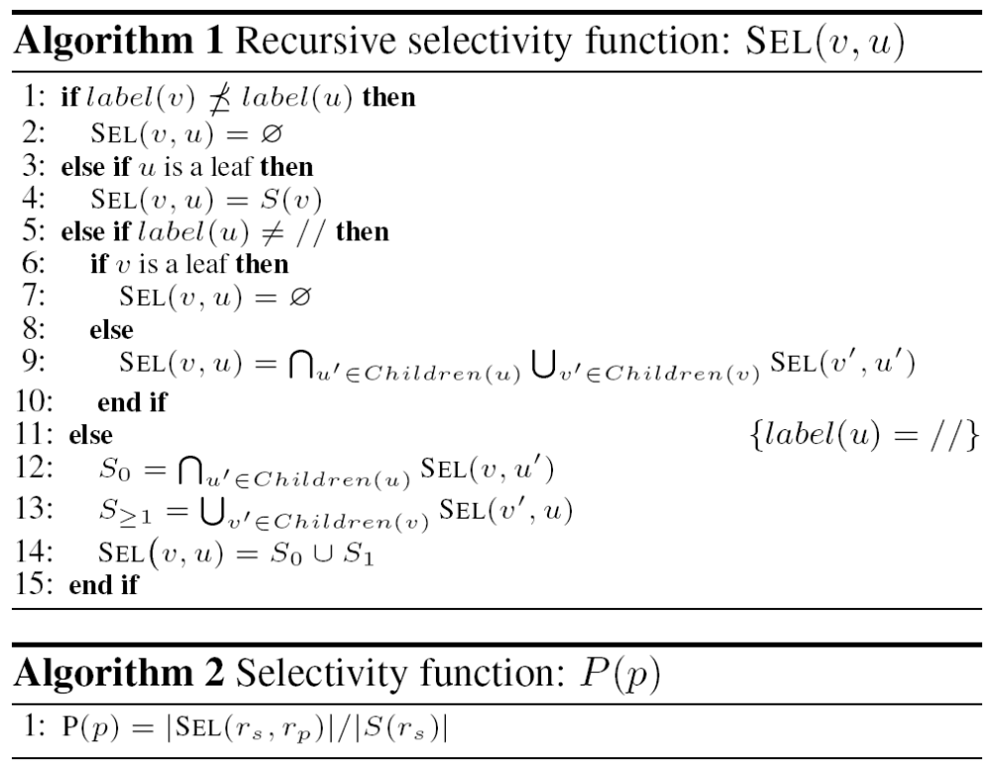
2. Evaluate selectivity
Recursive algorithm matches TP against synopsis
u: node of tree pattern p
v: node of synopsis
≥: at least as general (// ≥ * ≥ a)
⇒ No matching path
Found matching path for root→u in synopsis
⇒ Return matching set
Leaf of synopsis, not leaf of TP
⇒ No matching path
Look for any path in synopsis
for each branch of TP
Maps // to empty path…
For Counters
∪→max
∩→*
…or to path of length ≥2
Selectivity is # of matching documents / # total documents

Slide 15
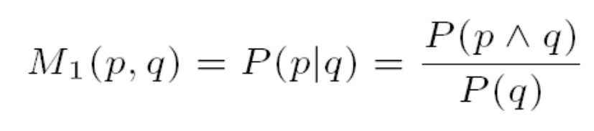
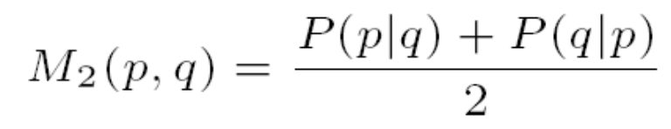

3. Estimate similarity
Metrics to estimate similarity using selectivity
  Conditional probability of p given q (if p and q match the same set of documents as q alone, then p ~ q)
  Symmetrical conditional probability
  Ratio of joint to union probability (also symmetric)
  P(p∧q) computed by merging root nodes of p and q

Slide 16
Evaluation: setup
NITF and xCBL DTDs
  D: 10,000 documents with approx. 100 tag pairs, 10 levels
  S_{p}: 1,000 “positive” TPs (some match in D)
    * (10%), // (10%), branches (10%), ≤10 levels, Zipf skew (1)
  S_{n}: 1,000 “negative” TPs (no match in D)
Synopses with 3 variants for matching sets
Different space budgets (sizes of matching sets, compression degrees for pruning)
Compare result of proximity metrics with exact value computed from sets of matching documents

Slide 17
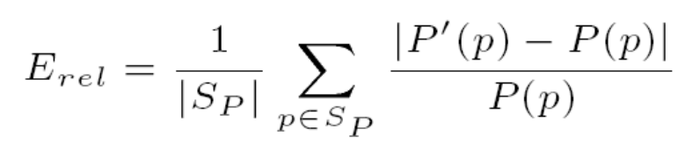
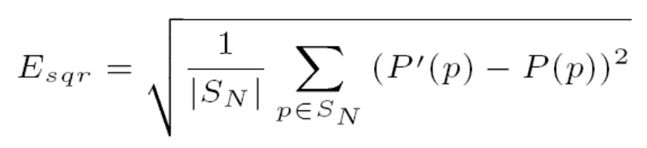
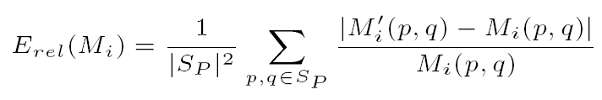
Evaluation: error metrics
Let
  P(p): exact selectivity of p
  P’(p): our estimate of the selectivity of p
  M_{i}(p,q): exact proximity of p and q using metric M_{i}
  M’_{i}(p,q): our estimate of the proximity of p and q using M_{i}
Positive error:
Negative error:
Metrics error:

Slide 18
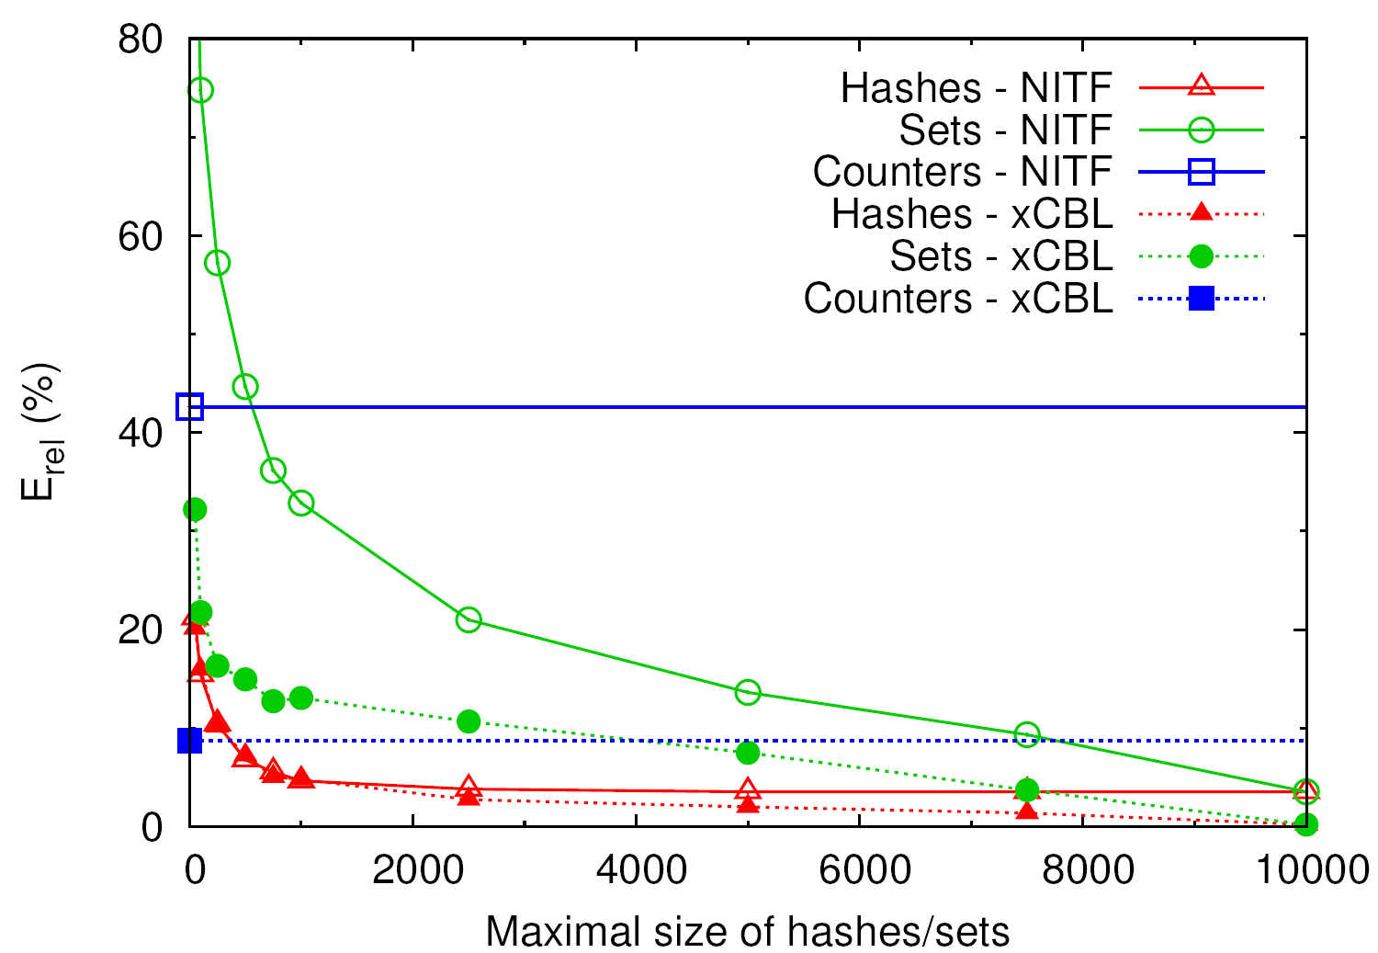
Positive error vs. MS size
Hashes outperforms other approaches in terms of accuracy
Less than 5% with 1,000 entries

Slide 19
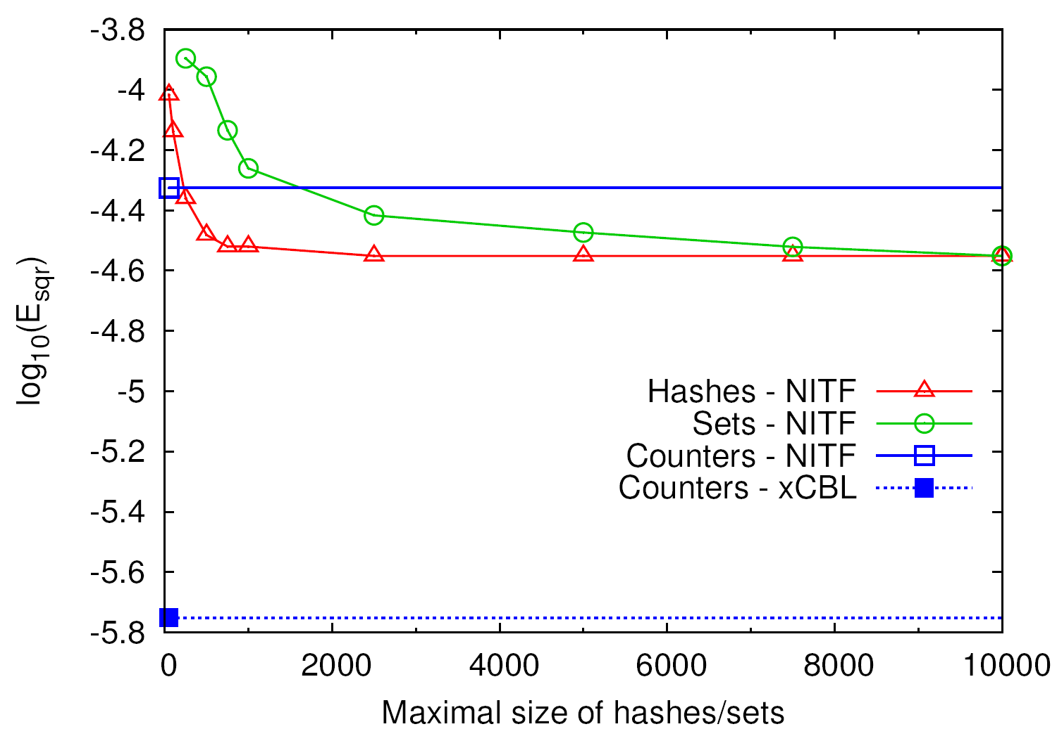
Negative error vs. MS size
Hashes also outperforms other approaches (no error with xCBL for Hashes & Sets)

Slide 20
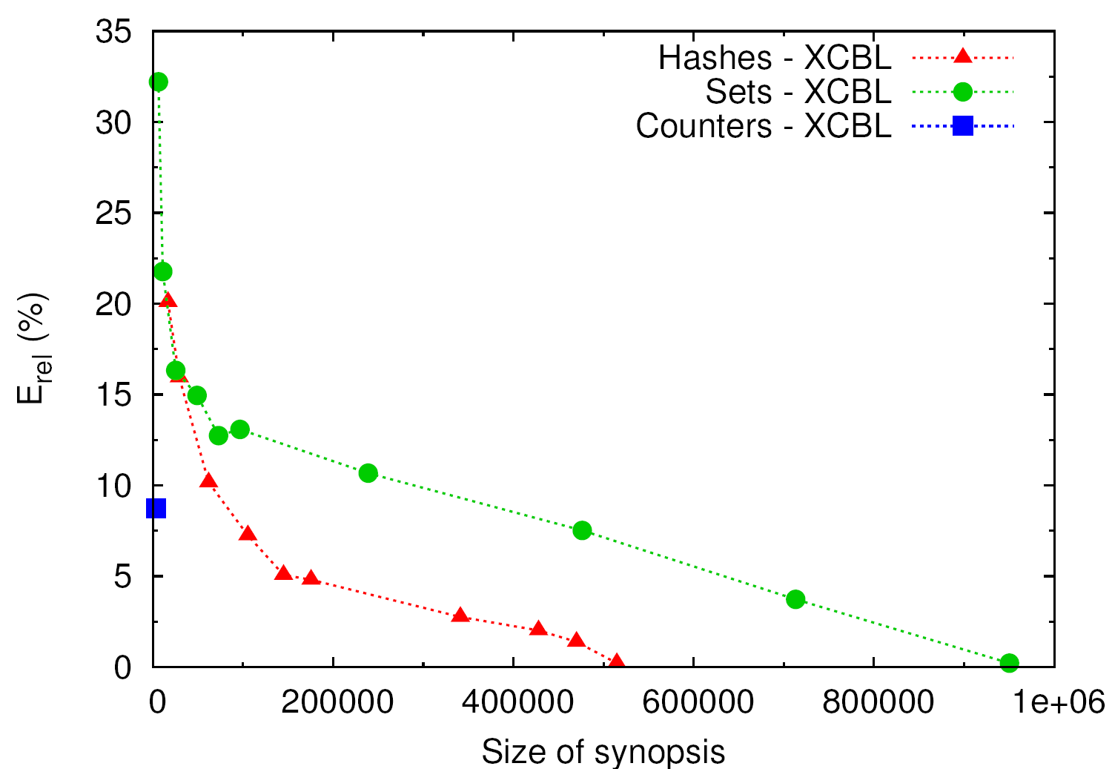
Positive error vs. synopsis size
For a given space budget, Hashes is the most accurate (after some threshold)
Hashes becomes more accurate than Counters

Slide 21
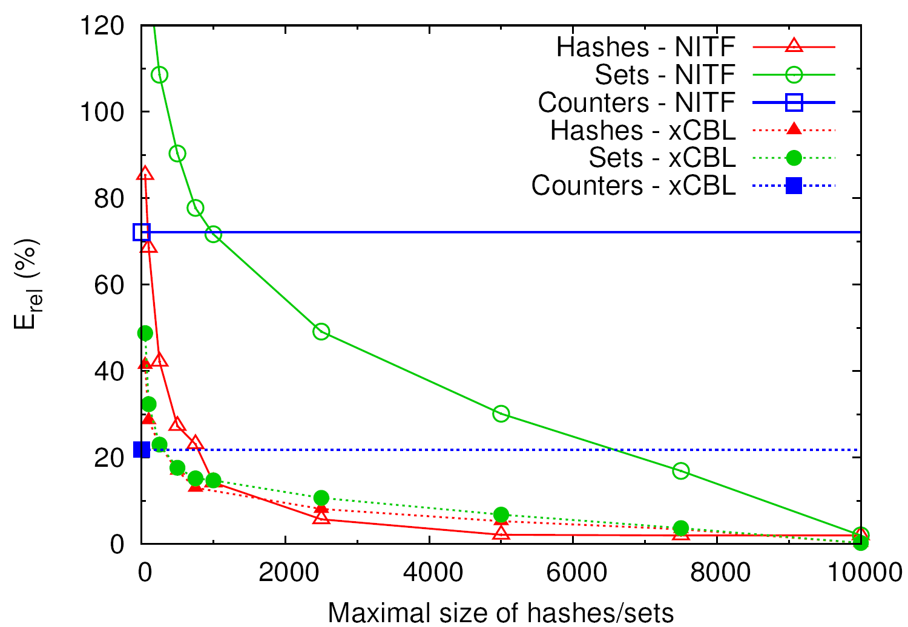
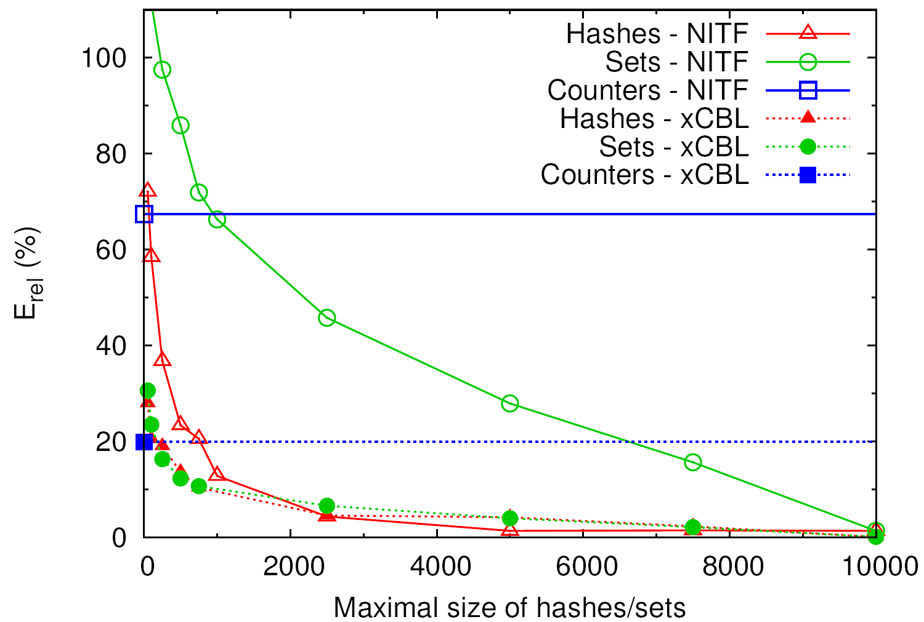


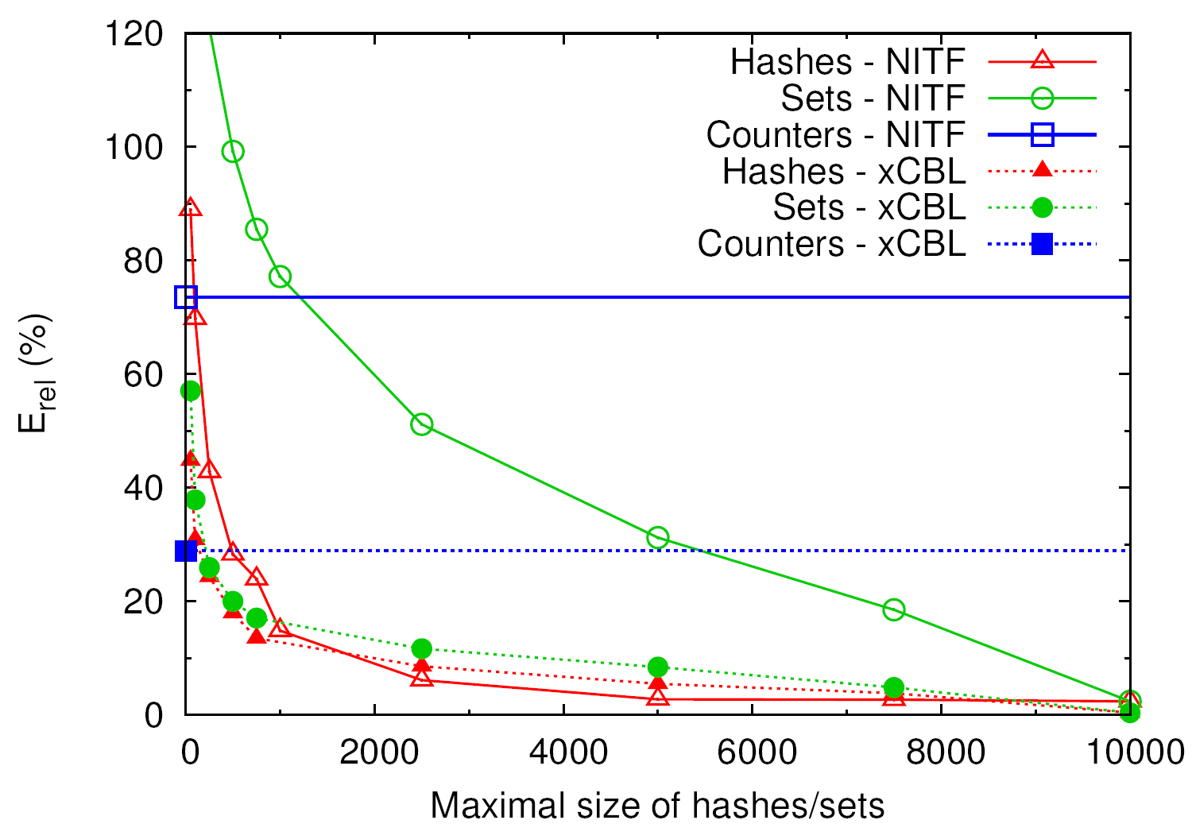

Error of proximity metrics
Hashes produces the best estimates

Slide 22
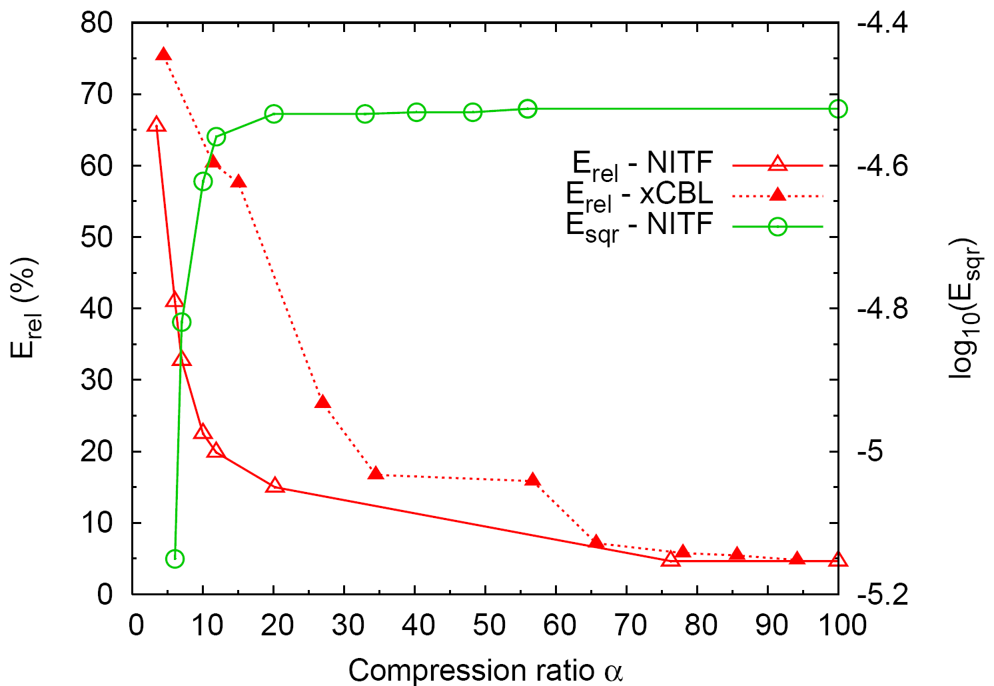
Error vs. compression ratio
Error remains small even for relatively high compression degrees
Less than 15% error with 1:5 compression

Slide 23
Conclusion
Goal: semantic communities for publish/subscribe
Problem: estimate similarity of (seemingly unrelated) tree patterns
Similarity metric is very accurate and consistent
Other usages (e.g., approximate XML queries)

Slide 24
Thank You!

Slide 25
Context: XML (messages)
Extensible Markup Language: universal interchange (meta-)language, standard, semi-structured
Type/structure (tags, defined by DTD or schema) vs. content (values, data associated with tags)
Well-formed: syntactically correct
Valid: matches DTD or schema
XML documents : single-rooted trees
Start/End Tags
(properly nested)
<quotes>
<stock>
<name>Lucent Tech.</name>
<symbol>LU</symbol>
<price>10</price>
</stock>
<stock>
<name>Cisco Systems, Inc.</name>
<symbol>CSCO</symbol>
<price>17</price>
</stock>
</quotes>
quotes
stock
stock
Character Data
name
symbol
price
name
symbol
price
Lucent
LU
10
Cisco
CSCO
17

Slide 26
Context: XPath (subscriptions)
Simple language: navigate/select parts of XML tree
XPath Expression: sequence of node tests, child (/), descendant (//), wildcard (*), qualifiers ([...])
  Constraints on structure and content of messages
  Using qualifiers, define tree pattern: specifies existential condition for paths with conjunctions at branching nodes
XPath fragment, binary output: selection ⇒ match
quotes
//
*
//
quotes
stock
price
stock
stock
stock
stock
symbol
symbol
symbol
price
name
symbol
price
name
symbol
price
/quotes/stock/symbol
=LU
=LU
>15
Lucent
LU
10
Cisco
CSCO
17
//price
/*/stock[symbol=“LU”]
//stock[price>15][symbol=“LU”]

Slide 27
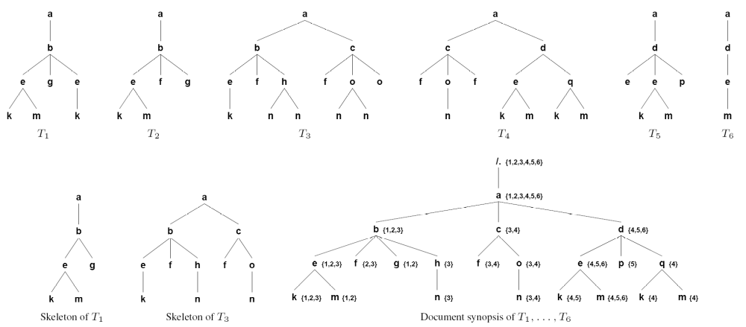
Document-tree synopsis

Slide 28
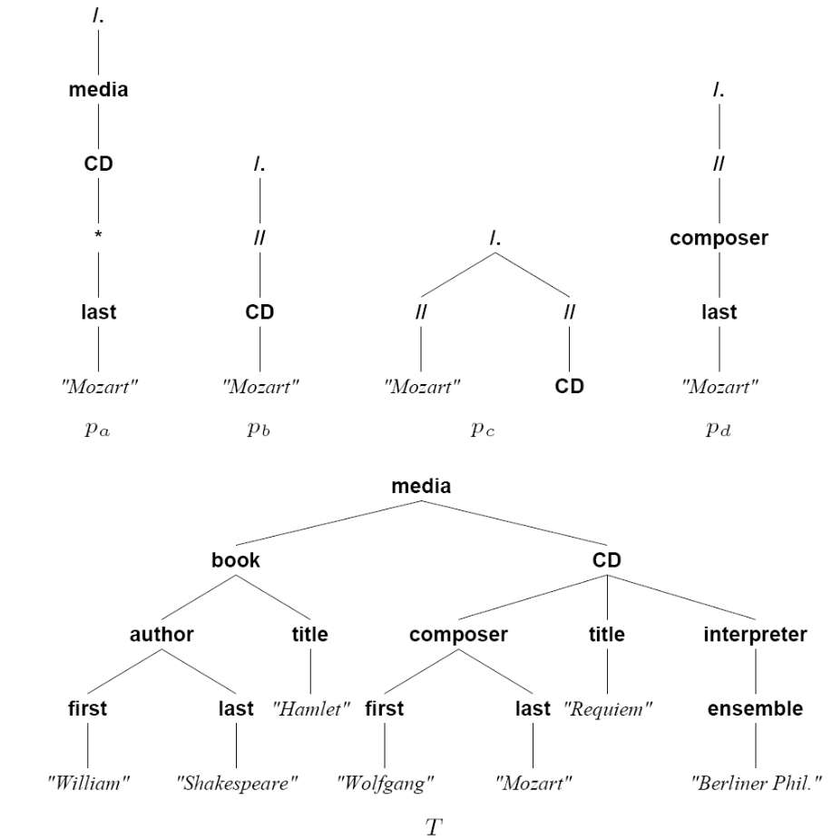
Tree patterns and XML tree

Slide 29
1. Document-tree synopsis
Document-tree synopsis: tree with paths labeled with matching sets (IDs of documents containing that path)
  Summary of path-distribution characteristics of documents
Adding a document to the synopsis:
I) Identify distinct document paths ⇒ skeleton-tree
x
Coalesce same-tag siblings
x
a
a
b
a
b
b
c
c
d
b
c
d
XML document
Skeleton-tree

Slide 30
1. Document-tree synopsis
II) Install all skeleton-tree paths in synopsis
  Trace each path from the root of the synopsis, updating the matching sets and adding new nodes where necessary
Synopsis:
1
x
3
x
/.
a
a
b
2
x
a
a
b
x
{1,2,3}
b
c
c
d
a
b
c
b
d
a
a
{1,2,3}
b
{1,2,3}
c
d
a
a
d
{1,3}
b
c
d
{2,3}
a
{2,3}
d
{1}
XML documents:
{1,2,3}
c
d
{2}
c
d
{2,3}

