Slide 1
Communication-Efficient Online Detection of Network-Wide Anomalies
Ling Huang* XuanLong Nguyen*
Minos Garofalakis§ Joe Hellerstein*
Michael Jordan* Anthony Joseph* Nina Taft§
*UC Berkeley §Intel Research
Notes:
This is a joint project between RadLab and Intel Research. I worked with XuanLong, Minos Garofalakis, Joe Hellerstein, Mike Jordan, Anthony Joseph and Nina Taft together on the project.

Slide 2
Towards Decentralized Detection
Today: Distributed Monitoring & Centralized Computation
  Stream-based data collection
  Periodically evaluate detection function over collected data
  Doesn’t scale well in network size or timescale
Our contribution: Decentralized Detection
  Continuously evaluate detection function in a decentr. way
  Low-overhead, rapid response, accurate and scalable
  Detection accuracy controllable by a “tuning knob”
    Provable guarantees on detection error (false alarm rate)
    Flexible tradeoff between overhead and accuracy
Notes:
How to do coordinated detection in an efficient and decentralized way is an important, but very challenge problem. Today’s approaches are either based on data streaming, or periodically collecting all data for analysis. They suffer from high communication overhead. For example, streaming protocol always aim to continuously approximate system global status within an epsilon-error, regardless system conditions. They waste resource for detection problem
On the contrary, my research follows the line of distributed detection. I always focus on evaluating detection function over continuous data streams in a decentralized way. I always aim to fire alarms when bad events happen in the system. My approach incurs low overhead when the system behaves well, and triggers alarms rapidly and accurately when anomalies happen.

Slide 3



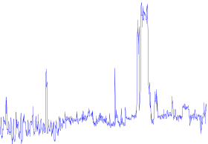
Detection Problems in Enterprise Network
Send at rate .95*allowed
to victim X
command
& control
victim
V
Operation Center
Data: Byte rate on a network link.
Do machines in my network participate in a Botnet to attack other machines?
Approximate but accurate detection!
For efficient and scalable detection, push data processing to the edge of network!
Coordinated Detection!
CAN’T AFFORD TO DO THE DETECTION CONTINUOUSLY !
Notes:
In a contrast to the previous work, my work focuses on detection problems, which are critical in the distributed monitoring systems. Here is an example of botnet detection in enterprise network: I want to find out whether the machines inside my network are participating in a botnet to attack other machines. The botnet command&control center could be smart. It asks each machine to send packets at an allowed rate to the victim V. So when you look at each individual machine, you could not find anything. Only after you aggregate statistics from your edge routers and do a correlated analysis, could you find out this malicious activity. This requires a coordinated detection in a global scale!
The problem is, if we have to ship all the monitoring data, which is usually high frequency and noisy, to the operation center, we cannot afford to do the detection continuously in many situaitons.

Slide 4
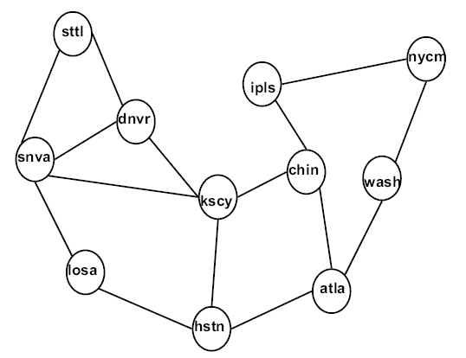
Detection of Network-wide Anomalies
A volume anomaly is a sudden change in an Origin-Destination flow (i.e., point to point traffic)
Given link traffic measurements, detect the volume anomalies
The backbone network
H₁
H₂
Regional network 1
Regional network 2
Notes:
On a backbone network, A volume anomaly is a sudden change in an Origin-Destination flow (i.e., point to point traffic). They usually happen at PoP flow level. As shown in this animation, when an anomaly happens between two end host, it usually propagates through network along the path, and can be observed on multiple observation points.
It is difficult to monitor the network at flow level, which requires huge monitoring cost. So, the problem is, if we monitoring network at link level, and, if we are given the link traffic measurement, can we detection and diagnose the volume anomalies.
Detection on the entire network

Slide 5
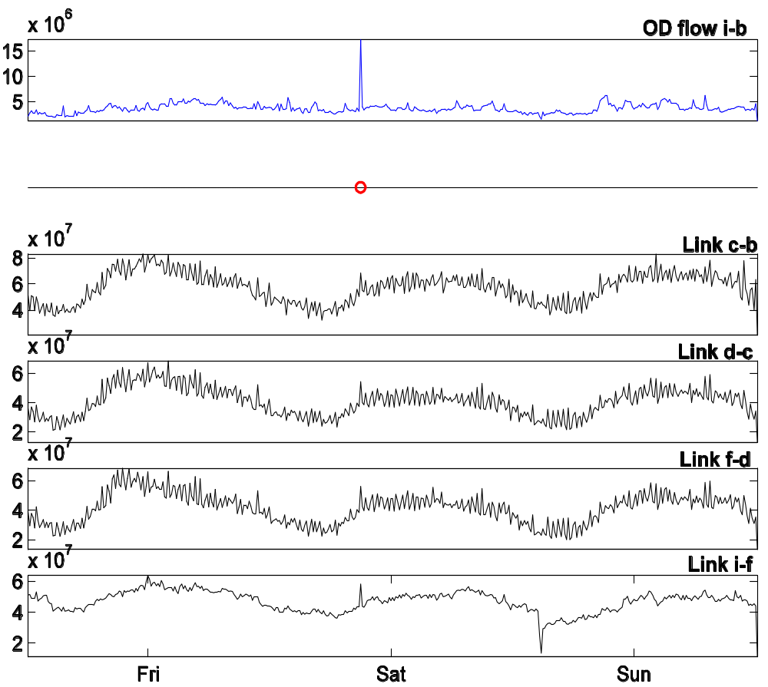
An Illustration
Anomalies in (unobserved) flow data
Observed network link data = aggregate of application-level flows
Each link is a dimension
Finding anomalies
in high-dimensional, noisy data is difficult !
Notes:
This slide illustrate the difference between the detection at flow level and the detection at link level. The top diagram shows a flow data with a volume anomaly. We can see that the anomaly is obvious and easy to detect if we have access to flow data. The story are totally different if we are given the link data. Because the link traffic are highly aggregate from hundreds even thousands of o-d flows, the big anomaly spike in the flow data are just looks tiny in the link data. Those flow anomalies are hidden in the link data! Finding anomalies in high-dimensional, noisy data is difficult !

Slide 6

The Subspace Method (Lakhina’04)
Say: An centralied approach based on PCA: Lakhina 2004 develop PCA: High dim projected down to low dim, looked at the residual traffic. For detail, see their paper.
An approach to separate normal from anomalous traffic based on Principal Component Analysis (PCA)
Normal Subspace : space spanned by the top k principal components
Anomalous Subspace : space spanned by the remaining components
Then, decompose traffic on all links by projecting onto and to obtain:
Traffic vector of all
links at a particular
point in time
Normal traffic
vector
Residual traffic
vector
[3] Lakhina et al. Diagnosing Network-Wide Traffic Anomalies. In ACM SIGCOMM (2004).
[4] Zhang et al. Network Anomography, In IMC (2005).
Notes:
Lakhina and his colleague propose the PCA method to detect and diagnose network-wide anomaly in SIGCOMM 2004. Their main point is to separate the high dimensional network traffic into two subspace: normal subspace and anomalous subspace. The normal Subspace is spanned by the top k principal components, and the anomalous Subspace is spanned by the remaining principal components. Then, with an incoming traffic vector, we can project it the onto those two subspaces, and decomposed it into two component: the normal traffic and residual traffic.
Anomaly detection can be preformed on both components. Here we focus on detection on the residual traffic

Slide 7
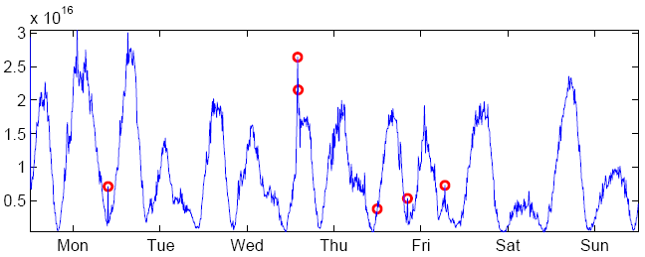

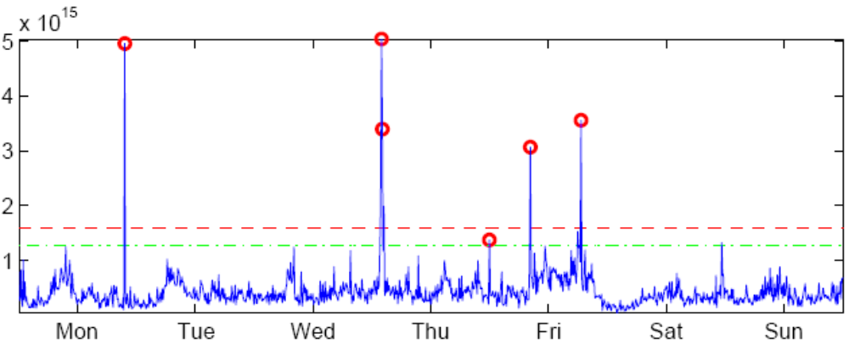


Detection Illustration
No detail, high level intution.
Value of
over time
(all traffic)
Value of
over time
Red dots: anomalies Blue curve: traffic data
Notes:
You may wondering why bother to perform the PCA transformation. This slide illustrate the improvement of PCA on detection using real data: the top diagram shows the original signals, in which the anomalies are buried in. The bottom are the data after we do the PCA decomposition and look at the residual signals only.

Slide 8
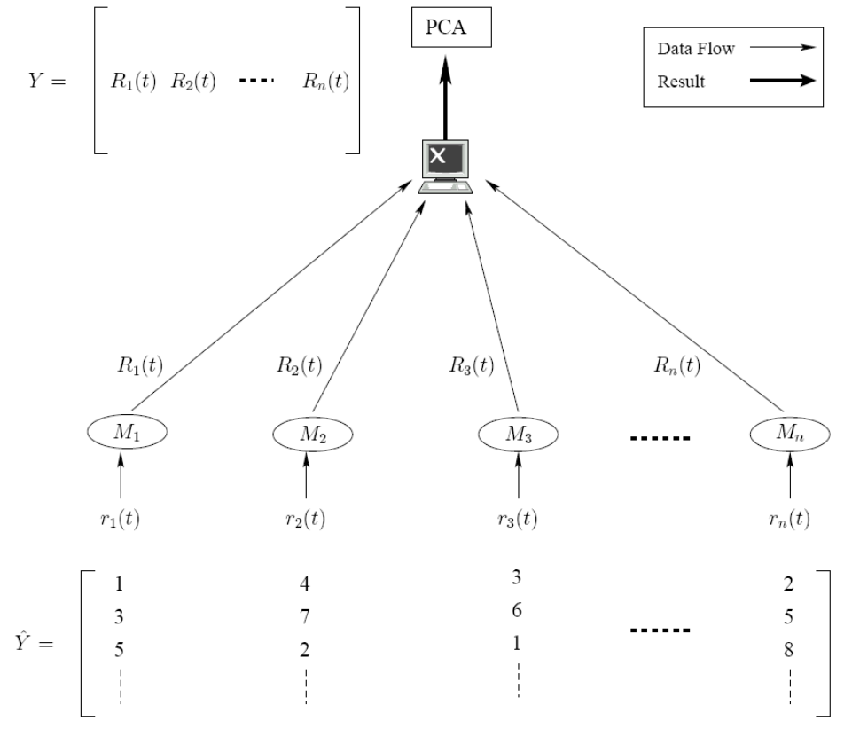


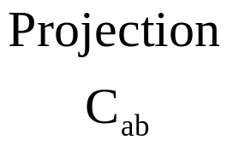
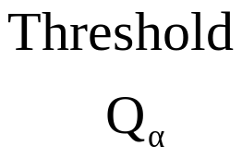


The Centralized Algorithm
The Network
Data matrix Dat
1) Each link produces a column of m data over time.
2) n links produces a row data y at each time instance.
Doesn’t scale well to large network or to smaller timescales
  The number of monitoring devices may grow to thousands
  The anomalies may occur on second or sub-second time scales
The detection is:
Periodically
Dat₁(t)
Dat₂(t)
Dat₃(t)
Dat_{n}(t)
m
(timestep)
n (nodeID)
Eigen vectors
Eigen values
Operation center
Notes:
In the network, you may attach a monitor to each link. Local monitors continuous measure total volume of traffic on each network link, and periodically pushed all its data to a central operation center for analysis. The operation center maintains a time window of measurements from all links, which form data matrix Dat as follows
In the data matrix
Each link produces a column data Y_{i}(t) of size m
n links produces a row signals y at each time inst.
You may view the data matrix as training data, and periodically (e.g. once a week) the operation center perform PCA and get two statistics for anomaly detection
Use eigenvectors to compute projection matrix C_{ab} and use eigenvalues to compute threshold Q_{α}, and
As the number of monitoring devices grow to thousands or more, and when the data collection time scale goes to second or less,
the volume of data collected and transmitted through network would explode
The central processing site would be overloaded

Slide 9

Our In-Network Detection Framework
Distr. Monitors
user inputs: detection
error
data₁(t)
original
monitored
time series
filtered_data₁(t)
Alarms
Coordinator
data₂(t)
Perturbation
Analysis
filtered_data₂(t)
PCA-Based
Detection
Adjust Filter
Parameters
data_{n}(t)
filtered_data_{n}(t)
Notes:
Here is our in-network detection framework in more detail. Inside the network, there is a set of distributed monitors. There is a coordinator at operation center. As monitor continuously monitor local network condition, it produces a continuous time series little r_i(t). This sample shows the link counts on 5-minute interval at a link of Abelen network. We assume communication only happens between monitors and coordinator, and monitors always want to send as less information to coordinator as possible in order to reduce communication cost.
Monitors process information locally and ship a filtered version of the signals, capital R_i, and update filtered signals to coordinator when necessary.
Coordinator is aggregation, detection center. Users specify detection function and detection accuracy at the coordinator. Here we use PCA decomposition. The coordinator doesn’t have access to the original signals, and have to perform detection on the filtered signal. Upon anomaly, an alarm is fired to notify system admin. According to the aggregate condition, coordinator computes a set of slack parameters and ships them to monitors. They tell monitors which level of accuracy monitors should update there signals, i.e., they control the filtering accuracy from little Yi to capital Ri.
Highlight: push-based approach. The detection is performed on the approximate data. We Perturbation analysis tool to bound the detection error by computing the a set filter parameters, which control the data approximation at all moniotrs. We guarantee that: if the monitor process data according to the parameters, the detection error is no more than the specified value.

Slide 10
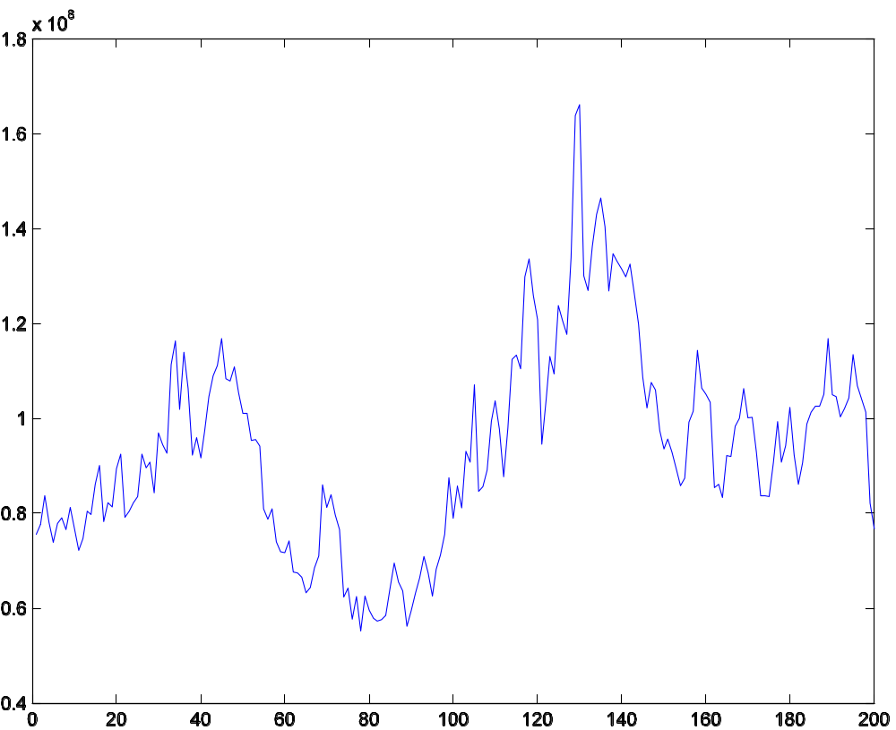

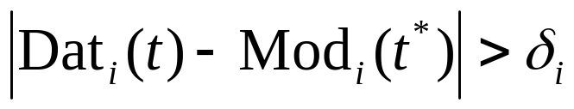
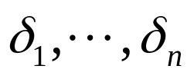



The Protocol At Monitors
Monitor i updates information if
are the filtering parameters
can be based on any prediction model built on historical data
  e.g., the average of last 5 signal values observed locally
  Simple but enough to achieve 10x data reduction
Notes:
This slides shows the protocol at the monitors. At a time t*, assume an value or model at monitor Mi is updated to the coordinator. Then at any subsequent time t, only when the new data of monitor I has surprising change, which is definite by this equation, should a new value be updated to the coordinator again.
The model can be based on any prediction model built by monitor i based on its history data at an update time t*. An specific example is average, which is shown in this diagram, filtering by average on the noisy data. The blue curve are the orginal signals, the red step function are the filtered data updated to the coordinator. We make two lines observation on this diagram: 1) you can see that the red curve change must less frequently than the original signal, which result in much less communication overhead for update; 2) the red curve, which represent the processed signals, is always within delta error from the blue curve, the original signals. This plays an key role in control the detection error.

Slide 11

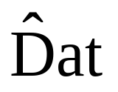
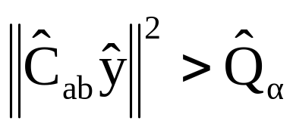
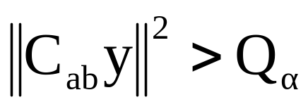
The Communication and Error Tradeoff
Approximate Info.
PCA on
Difference?
Full Info.
filtered_data(t)
data(t)
12
9
45
PCA on Dat
Dat=
7
63
24
31
72
The coordinator computes a set of good δ₁, …, δ_{n} to manage this difference.
The bigger the filtering parameter δ_{i}, the less the communication overhead, but the more the detection error!
Notes:
Coordinate maintains the detection statistics, using the incoming data to perform detection according to this inequality. How ever, the coordinator only has the approximate data
The bigger the filtering slack di, the more data will be filtered out at locally and the less data will be shipped to the detection center, so the less communication overhead. However, because less data will be available for decision making, there will be more detection error! We need theoretical result to establish the connection between filtering error and detection error.

Slide 12

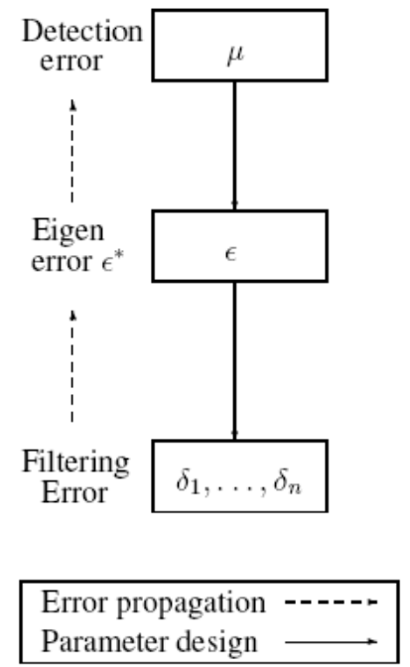

Parameter Design and Error Control (I)
Users specify an upper bound on false alarm rate, then we determine the filtering parameters δ’s
Actual
Approximate
Monte Carlo and fast binary search
Stochastic Matrix Perturbation Theory
Data vs. Model
Eigen error: L₂ norm of the difference between the approximate eigenvalues and the actual ones
An algorithmic analysis for the tradeoff between detection accuracy and data communication cost
  monitor parameters determined from the target accuracy
  technical tool relies on stochastic matrix perturbation theory
Notes:
We let user to specify the detection error to determine the monitor slack, that is the deviation of false alarm rate mu. This diagram describe the relationship between the detection error and the filtering parameter: when monitor filters data locally, it incurs filtering error, the data at that the coordinator has are different from those at the monitor; the egenvalues and eigen vectors compute at the coordinator are different from what monitors have, resulting in eigen error. So the detection performed at the coordinator incurs detection error mu.
Reversing this process, we may determine filtering parameters by detection error.
To be general more than eigen error:

Slide 13
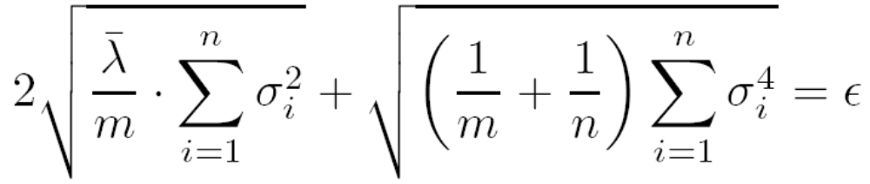


Parameter Design and Error Control (II)
Detection Error μ → Eigen-Error ε
  Mont Carol simulation to find the mapping from ε to μ
  For the given μ, using fast binary search to find an ε
Eigen-Error ε → Filtering parameters δ’s
μ
ε

Slide 14

Evaluation
Given user-specified false alarm rate, evaluate the actual detection accuracy and communication overhead
Experiment setup
  Abilene backbone network data
  Traffic matrices of size 1008 X 41
  Set uniform slack for all monitors

Slide 15
Performance
μ | Missed Detections |  | False Alarms |  | Data Reduction
 | Week 1 | Week 2 | Week 1 | Week 2 | Week 1 | Week 2
0.01 | 0 | 0 | 0 | 0 | 75% | 70%
0.03 | 0 | 1 | 1 | 0 | 82% | 76%
0.06 | 0 | 1 | 0 | 0 | 90% | 79%
error tolerance = upper bound on error
Data Used: Abilene traffic matrix, 2 weeks, 41 links.

Slide 16
Summary
A communication-efficient framework that
  detects anomalies at desired accuracy level
  with minimal communication cost
A distributed protocol for data processing
  local monitors decide when to update data to coordinator
  coordinator makes global decision and feedback to monitors
An algorithmic framework to guide the tradeoff between communication overhead and detection accuracy

Slide 17

Questions
Reference
[Lakhina’04] Diagnosing Network-Wide Traffic Anomalies. A. Lakhina, M. Crovella and C. Diot. In SIGCOMM '04.
[Huang’06] In-Network PCA and Anomaly Detection. L. Huang, X. Nguyen, M. Garofalakis, M. Jordan, A. Joseph and N. Taft. In NIPS 19, 2006.
[Huang’07] Communication-Efficient Online Detection of Network-Wide Anomalies. L. Huang, X. Nguyen, M. Garofalakis, J. Hellerstein, M. Jordan, A. Joseph and N. Taft. To appear in INFOCOM'07.

Slide 18
Backup Slides

Slide 19
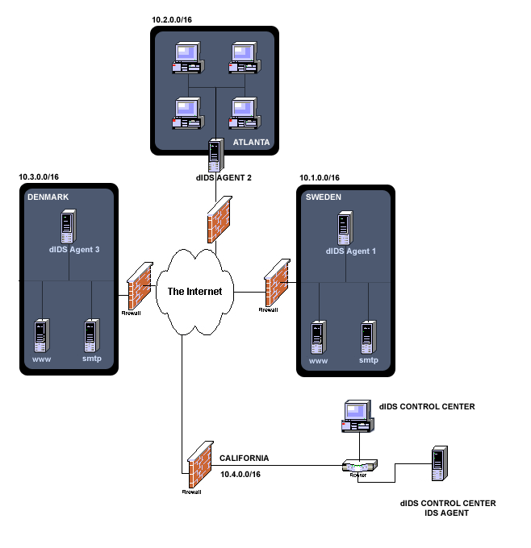
Traditional Distributed Monitoring
Large-scale network monitoring and detection systems
  Distributed and collaborative monitoring boxes
  Continuously generating time series data
Existing research focuses on data streaming
  Centrally collect, store and aggregate network state
  Well suited to answering
  approximate queries and
  continuously recording
  system state
  Incur high overhead!
Local Network 2
Monitor 2
Monitor 1
Local Network 3
Local Network 1
Operation Center
Monitor 3
Bandwidth
Bottleneck!
Overloaded!
Notes:
1) As all you know, large-scale monitoring and intrusion detection systems have been widely deployed on the Internet. In these systems, distributed boxes have been placed inside the networks. They continuously monitoring local system status and generate massive time series data in a distributed way.
2) A lot of research, especially in Database, has proposed continuous query and data streaming protocols for efficient data management. They aim at collect, store and aggregate network conditions to an operation center, for example, for correlation and trend analysis. They are Well suited for approximate query answers and continuously recording system state.
3) However, this kind of approaches incur high overhead. If one aims to monitor large-size networks on a small time scale, large amount of data have to be shipped to the operation center for analysis, which will cause two big problems: the link to the operation center will become a bottleneck, and, if you are trying to do sophisticated analysis at the operation center, the central processing site will be overloaded. This situation will become more problematic in a sensor network environment.

Slide 20
Our Distributed Processing Approach
A coordinator
  Is aggregation, correlation and detection center
A set of distributed monitors
  Each produces a time series signals
  Processes data locally, only sends needed info. to coordinator
  No communication among monitors
  Coordinator tells monitors the level of accuracy for signal updates
Detection
Accuracy
Coordinator
adjust
“push”
x
x
Filters
Filters
Hosts/Monitors
Notes:
A typical monitoring and detection is as follows. It consists of a set of distributed monitors and one coordinator.
Coordinator is aggregation, detection center. Constraints and global functions are specified through the coordinator, and trigger is fired if any constraint is violated. However, constraints are defined on the distribution information stored on the monitors. In my framework, the coordinator X gives instruction to monitors and tells them the level of accuracy for signal updates.
Monitors are inside the distributed network, each of which produce a continuous time series as the monitoring results. Monitors always want to send as less information to coordinator as possible in order to reduce communication cost:
Don’t send all the data! Don’t need most of them anyway
Our applications are anomaly detectors
Most of the traffic is normal so don’t need to send. Ideally hosts should only be sending rare events
In my detection system, applications can specify detection accuracy at the operation center. My algorithm can determine a set of filters, and install them at the monitors. As long as the data value of a monitor is within the window size of the filters, the value is within the expectation of operation center and the monitor don’t need to update the value. At the monitor, only when its value goes outside the filter, should the monitor update its value, and the operation center adjust filters accordingly.

Slide 21
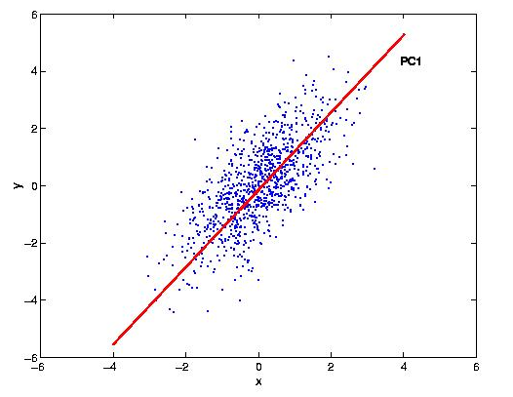

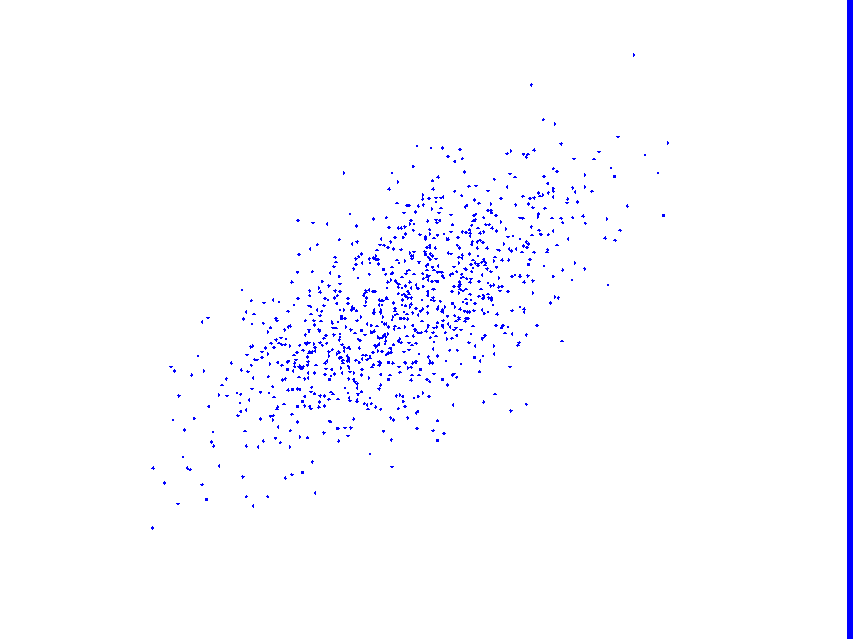







Principal Component Analysis (PCA)
: minor components
: principal components
Principal components are top eigenvectors of covariance matrix. They form the subspace projection matrices C_{no} and C_{ab}
Traffic on Link 2
y
Traffic on Link 1
Anomalous traffic usually results in a large value of

