Slide 1
Correlating XML Data Streams Using Tree-Edit Distance Embeddings
Minos Garofalakis
&
Amit Kumar
Internet Management Research Department
Bell Labs, Lucent Technologies

Slide 2
Talk Outline
Introduction & Motivation
  Relational & XML stream-query processing
  The problem
Brief description of our idea & contributions
Embedding algorithm for XML trees
Applications to XML stream queries
  Sketching a massive, streaming XML data tree
  Similarity joins over streaming XML data sources
Conclusions

Slide 3
Query Processing over Data Streams
A data stream is a massive, continuous sequence of data records
Data Streams
Stream Query
Processing Engine
(Approximate)
Answer
Query Q
Requirements for stream query processing
  Single Pass: Each record is examined at most once, in fixed (arrival) order
  Small Space: Log or poly-log in data stream size
  Real-time: Per-record processing time must be low
Example Application: Network Management
Network Operations
Center (NOC)
Data-Stream Join
IP Network
Measurements/
Alarms
R2
SELECT COUNT(*)
FROM R1, R2
WHERE R1.A = R2.B
R1

Slide 4
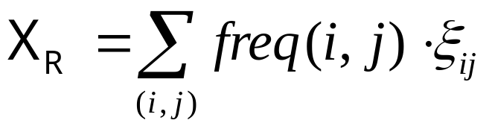


Processing Relational Data Streams
Lots of interesting work and results based on the idea of pseudo-random sketches
  Essentially, randomized linear projections of the data distribution
N
Atomic Sketch
Stream
R(A,B)
are random variates from appropriate distribution
Trivial to maintain over stream: Add whenever tuple (i, j) is seen
Only O(logN) space (instead of )
N
Surprisingly powerful idea: Use a small number of sketches to
  Estimate stream norms, build approximate histograms/wavelet coefficients, . . .
  Estimate join aggregates AGGR(R S) (using sketches of R and S)

Slide 5

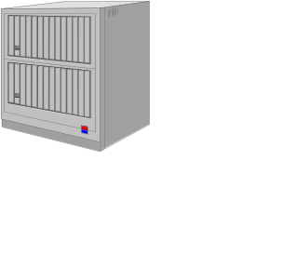
Processing XML Data Streams
XML: Much richer, (semi)structured data model
  Ordered, node-labeled data trees
Bulk of work on XML streaming: Content-based filtering of XML documents (publish/subscribe systems)
  Quickly match incoming documents against standing XPath subscriptions
XPath Subscriptions
(X/Yfilter, Xtrie, etc.)
Essentially, simple selection queries over a stream of XML records!
No work on more complex XML stream queries
  For example, queries trying to correlate different XML data streams

Slide 6


Processing XML Data Streams (cont.)
Example XML stream correlation query: Similarity-Join
Web Source 1
T1
|SimJoin(S1, S2)| = |{(T1,T2) S1xS2: dist(T1,T2) }|
Web Source 2
T2
Degree of content similarity between
streaming XML sources
Different data representation for same
information (DTDs, optional elements)
Correlation metric: Tree-edit distance ed(T1,T2)
  Node relabels, inserts, deletes - also, allow for subtree moves
publication
delete
publication
book
paper
book
paper
title
author
title
authors
title
author
title
author
author
author
author

Slide 7
How About Relational Techniques/Sketches?
Randomized linear projections (a.k.a. sketches) are useful for points over a numeric vector space
  Not structured objects over a complex metric space (tree-edit distance)
Our idea: Build a low-distortion embedding of streaming XML and the tree-edit distance metric in a multi-d normed vector space
ed(T1,T2)
Distances are (approximately)
preserved in the image vector space!!
ed(T2,T3)
V(T2)
map V()
V(T3)
ed(T1,T3)
V(T1)
Given such an embedding, sketching techniques now become relevant in the streaming XML context!
  E.g., use sketches to produce synopses of the data distribution in the image vector space

Slide 8


Our Approach & Contributions
Construct low-distortion embedding for tree-edit distance over streaming XML documents -- Requirements:
  Small space/time
  Oblivious: Can compute V(T) independent of other trees in the stream(s)
  Bourgain’s Lemma is inapplicable!
First algorithm for low-distortion, oblivious embedding of the tree-edit distance metric in small space/time
  Fully deterministic, embed into L1 vector space
  Bound of on distance distortion for trees with n nodes

Slide 9

Our Approach & Contributions (cont.)
Applications in XML stream query processing
  Combine our embedding with existing pseudo-random sketching techniques
  Build a small-space sketch synopsis for a massive, streaming XML data tree
    Concise surrogate for tree-edit distance computations
  Approximating tree-edit distance similarity joins over XML streams in small space/time
First algorithmic results on correlating XML data in the streaming model
Other important algorithmic applications for our embedding result
  Approximate tree-edit distance in (near-linear) time

Slide 10



Our Embedding Algorithm
Key Idea: Given an XML tree T, build a hierarchical parsing structure over T by intelligently grouping nodes and contracting edges in T
  At parsing level i: T(i) is generated by grouping nodes of T(i-1) ( T(0) = T )
  Each node in the parsing structure ( T(i), for all i = 0, 1, ... ) corresponds to a connected subtree of T
  Vector image V(T) is basically the characteristic vector of the resulting multiset of subtrees (in the entire parsing structure)
V(T)[x] = no. of times subtree x appears in the parsing structure for T
Our parsing guarantees
  O(log|T|) parsing levels (constant-fraction reduction at each level)
  V(T) is very sparse: Only O(|T|) non-zero components in V(T)
    Even though dimensionality = ( = label alphabet)
    Allows for effective sketching
  V(T) is constructed in time

Slide 11

Our Embedding Algorithm (cont.)
Node grouping at a given parsing level T(i): Create groups of 2 or 3 nodes of T(i) and merge them into a single node of T(i+1)
  1. Group maximal sequence of contiguous leaf children of a node
  2. Group maximal sequence of contiguous nodes in a chain
  3. Fold leftmost lone leaf child into parent
Grouping for Cases 1,2: Deterministic coin-tossing process of Cormode and Muthukrishnan [SODA’02]
  Key property: Insertion/deletion in a sequence of length k only affects the grouping of nodes in a radius of from the point of change

Slide 12
Our Embedding Algorithm (cont.)
Example hierarchical tree parsing
T(0) = T
T(1)
T(2)
T(3)
y =
“empty” label
x =
V(T)[y] += 1
V(T)[x] += 1
O(log|T|) levels in the parsing, build V(T) in time

Slide 13



Main Embedding Result
Theorem: Our embedding algorithm builds a vector V(T) with O(|T|) non-zero components in time ; further, given trees T, S with n = max{|T|, |S|}, we have:
Upper-bound proof highlights
  Key Idea: Bound the size of “influence region” (i.e., set of affected node groups) for a tree-edit operation on T (=T(0)) at each level of parsing
    We show that this set is of size at level i
  Then, it is simple to show that any tree-edit operation can change by at most
    L1 norm of subvector at level i changes by at most O(|influence region|)

Slide 14

Main Embedding Result (cont.)
Lower-bound proof highlights
  Constructive: “Budget” of at most tree-edit operations is sufficient to convert the parsing structure for S into that for T
    Proceed bottom up, level-by-level
    At bottom level (T(0)), use budget to insert/delete appropriate labeled nodes
    At higher levels, use subtree moves to appropriately arrange nodes
See paper for full details . . .

Slide 15
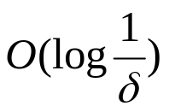



Sketching a Massive, Streaming XML Tree
Input: Massive XML data tree T (n = |T| >> available memory), seen in preorder
Output: Small space surrogate (vector) for high-probability, approximate tree-edit distance computations (to within our distortion bounds)
Theorem: Can build a -size sketch vector of V(T) for approximate tree-edit distance computations in space and time per element
  d = depth of T, = probabilistic confidence in ed() approximation
  XML trees are typically “bushy” (d<<n or d = O(polylog(n)))

Slide 16



Sketching a Massive, Streaming XML Tree (cont.)
Key Ideas
  Incrementally parse T to produce V(T) as elements stream in
  Just need to retain the influence region nodes for each parsing level and for each node in the current root-to-leaf path
  While updating V(T), also produce an L1 sketch of the V(T) vector using the techniques of Indyk [FOCS’00]
T(2)
T(O(logn))
T=T(0)
T(1)
Influence
Regions
. . .

Slide 17


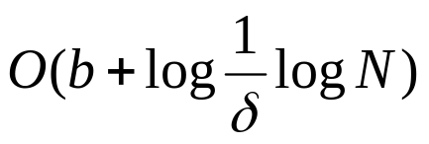
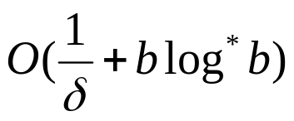
Approximate Similarity Joins over XML Streams
S1:
|SimJoin(S1, S2)| = |{(T1,T2) S1xS2: ed(T1,T2) }|
S2:
Input: Long streams S1, S2 of N (short) XML documents ( b nodes)
Output: Estimate for |SimJoin(S1, S2)|
Theorem: Can build an atomic sketch-based estimate for |SimJoin(S1, S2)| where distances are approximated to within in space and time per document
  = probabilistic confidence in distance estimates

Slide 18
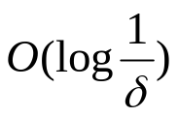
Approximate Similarity Joins over XML Streams (cont.)
Key Ideas
  Our embedding of streaming document trees, plus two distinct levels of sketching
    One to reduce L1 dimensionality, one to capture the data distribution (for joining)
    Finally, similarity join in lower-dimensional L1 space
    Some technical issues: high-probability L1 dimensionality reduction is not possible, sketching for L1 similarity joins
    Details in the paper . . .
V(T)
L1 sketch (dim. reduction)
Join Sketch
(distribution)
TreeEmbed
X(S)
dimensions

Slide 19
Conclusions
Considered the problem of processing complex correlation queries based on tree-edit distance over XML data streams
New approach, based on a novel algorithm for low-distortion vector-space embedding of streaming XML and the tree-edit distance metric
  First oblivious, small space/time algorithm with guaranteed logarithmic worst-case bound on distance distortion
Combined our embedding with sketching techniques to give first algorithmic results on correlating XML data in the streaming model
  Sketching an XML database, approximate similarity joins
Other algorithmic applications of our results
  Tool for very fast (near-linear time) approximate tree-edit distance computations
Future: Other metric-space embeddings in the streaming model??

Slide 20

Thank you!
http://www.bell-labs.com/~minos/
minos@research.bell-labs.com

Slide 21
Stream Data Synopses
Conventional data summaries fall short
  Quantiles and 1-d histograms [MRL98,99], [GK01], [GKMS02]
    Cannot capture attribute correlations
    Little support for approximation guarantees
  Samples (e.g., using Reservoir Sampling)
    Perform poorly for joins [AGMS99]
    Cannot handle deletion of records
  Multi-d histograms/wavelets
    Construction requires multiple passes over the data
Different approach: Randomized sketch synopses [AMS96]
  Only logarithmic space
  Probabilistic guarantees on the quality of the approximate answer
  Supports insertion as well as deletion of records

Slide 22
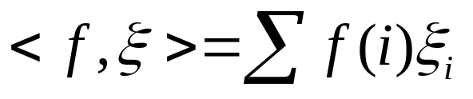


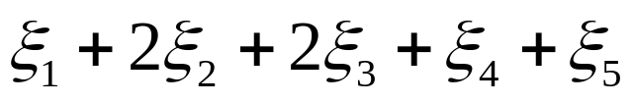
Randomized Sketch Synopses for Streams
Goal: Build small-space summary for distribution vector f(i) (i=1,..., N) seen as a stream of i-values
Basic Construct: Randomized Linear Projection of f() = inner/dot product of f-vector
  Simple to compute over the stream: Add whenever the i-th value is seen
  Generate ‘s in small (logN) space using pseudo-random generators
  Tunable probabilistic guarantees on approximation error
2
2
1
1
1
Data stream: 3, 1, 2, 4, 2, 3, 5, . . .
f(1) f(2) f(3) f(4) f(5)
where = vector of random values from an appropriate distribution
Data stream: 3, 1, 2, 4, 2, 3, 5, . . .
Used for low-distortion vector-space embeddings [JL84]

Slide 23
More work on Sketches...
Low-distortion vector-space embeddings (JL Lemma) [Ind01] and applications
  E.g., approximate nearest neighbors [IM98]
Wavelet and histogram extraction over data streams [GGI02, GIM02, GKMS01, TGIK02]
Discovering patterns and periodicities in time-series databases [IKM00, CIK02]
Quantile estimation over streams [GKMS02]
Distinct value estimation over streams [CDI02]
Maintaining top-k item frequencies over a stream [CCF02]
Stream norm computation [FKS99, Ind00]
Data cleaning [DJM02]

