Slide 1
Deterministic Wavelet Thresholding for Maximum-Error Metrics
Minos Garofalakis
Internet Management Research Dept.
Bell Labs, Lucent Technologies
minos@research.bell-labs.com
http://www.bell-labs.com/user/minos/
[ Joint work with Amit Kumar (IIT–Delhi) ]

Slide 2
Outline
Preliminaries & Motivation
  Approximate query processing
  Haar wavelet decomposition, conventional wavelet synopses
  The problem
Earlier Approach: Probabilistic Wavelet Synopses [Garofalakis & Gibbons, SIGMOD’02]
  Randomized Selection and Rounding
Our Approach: Efficient Deterministic Thresholding Schemes
  Deterministic wavelet synopses optimized for maximum relative/absolute error
Extensions to Multi-dimensional Haar Wavelets
  Efficient polynomial-time approximation schemes
Conclusions & Future Directions

Slide 3

Approximate Query Processing
Decision
Support
Systems
(DSS)
SQL Query
Exact Answer
GB/TB
Long Response Times!
Compact Data Synopses
“Transformed” Query
Approximate Answer
KB/MB
FAST!!
Exact answers NOT always required
  DSS applications usually exploratory: early feedback to help identify “interesting” regions
  Aggregate queries: precision to “last decimal” not needed
    e.g., “What percentage of the US sales are in NJ?”
Construct effective data synopses ??

Slide 4
Haar Wavelet Decomposition
Wavelets: mathematical tool for hierarchical decomposition of functions/signals
Haar wavelets: simplest wavelet basis, easy to understand and implement
  Recursive pairwise averaging and differencing at different resolutions
Resolution Averages Detail Coefficients
3
D = [2, 2, 0, 2, 3, 5, 4, 4]
----
2
[2, 1, 4, 4]
[0, -1, -1, 0]
1
[1.5, 4]
[0.5, 0]
0
[2.75]
[-1.25]
Haar wavelet decomposition:
[2.75, -1.25, 0.5, 0, 0, -1, -1, 0]
Construction extends naturally to multiple dimensions

Slide 5

Haar Wavelet Coefficients
Hierarchical decomposition structure ( a.k.a. Error Tree )
  Conceptual tool to “visualize” coefficient supports & data reconstruction
2.75
Reconstruct data values d(i)
  d(i) = (+/-1) * (coefficient on path)
Range sum calculation d(l:h)
  d(l:h) = simple linear combination of coefficients on paths to l, h
Only O(logN) terms
+
+
-1.25
-
0.5
0
+
-
+
-
0
-1
-1
0
+
-
+
-
+
-
+
-
Original data
2 2 0 2 3 5 4 4
3 = 2.75 - (-1.25) + 0 + (-1)
6 = 4*2.75 + 4*(-1.25)

Slide 6
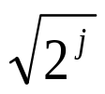
Wavelet Data Synopses
Compute Haar wavelet decomposition of D
Coefficient thresholding : only B<<|D| coefficients can be kept
  B is determined by the available synopsis space
Approximate query engine can do all its processing over such compact coefficient synopses (joins, aggregates, selections, etc.)
  Matias, Vitter, Wang [SIGMOD’98]; Vitter, Wang [SIGMOD’99]; Chakrabarti, Garofalakis, Rastogi, Shim [VLDB’00]
Conventional thresholding: Take B largest coefficients in absolute normalized value
  Normalized Haar basis: divide coefficients at resolution j by
  All other coefficients are ignored (assumed to be zero)
  Provably optimal in terms of the overall Sum-Squared (L2) Error
Unfortunately, this methodology gives no meaningful approximation-quality guarantees for
  Individual reconstructed data values
  Individual range-sum query results

Slide 7
Problems with Conventional Synopses
An example data vector and wavelet synopsis (|D|=16, B=8 largest coefficients retained)
Always accurate!
Over 2,000% relative error!
Original Data Values 127 71 87 31 59 3 43 99 100 42 0 58 30 88 72 130
Wavelet Answers 65 65 65 65 65 65 65 65 100 42 0 58 30 88 72 130
Estimate = 195, actual values: d(0:2)=285, d(3:5)=93!
Large variation in answer quality
  Within the same data set, when synopsis is large, when data values are about the same, when actual answers are about the same
  Heavily-biased approximate answers!
Root causes
  Thresholding for aggregate L2 error metric
  Independent, greedy thresholding ( large regions without any coefficient!)
  Heavy bias from dropping coefficients without compensating for loss

Slide 8
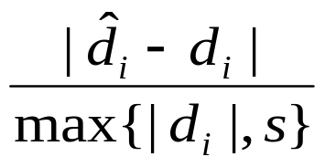
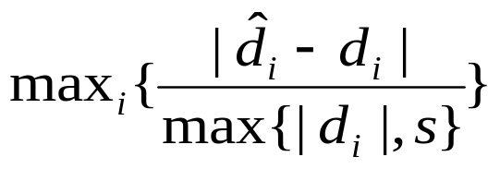
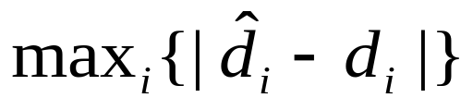
Solution: Optimize for Maximum-Error Metrics
Key metric for effective approximate answers: Relative error with sanity bound
  Sanity bound “s” to avoid domination by small data values
To provide tight error guarantees for all reconstructed data values
  Minimize maximum relative error in the data reconstruction
Another option: Minimize maximum absolute error
Minimize

Slide 9



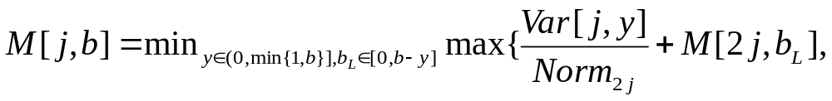
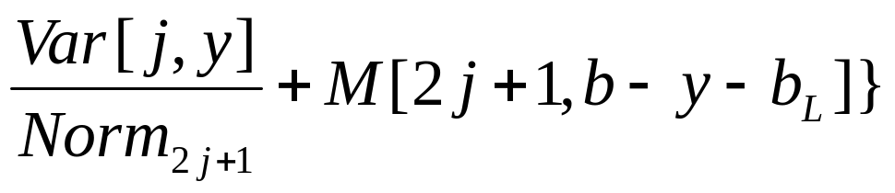


Earlier Approach: Probabilistic Wavelet Synopses [GG,SIGMOD’02]
Determine = the probability of retaining ci
  yi = “fractional space” allotted to coefficient ci ( yi B )
  Flip biased coins to select coefficients for the synopsis
Probabilistically control maximum relative error by minimizing the maximum Normalized Standard Error (NSE)
M[j,b] = optimal value of the maximum NSE for the subtree rooted at coefficient cj for a space allotment of b
j
2j
2j+1
Quantize choices for y to {1/q, 2/q, ..., 1}
  q = input integer parameter
  time, memory

Slide 10
But, still…
Potential concerns for probabilistic wavelet synopses
  Pitfalls of randomized techniques
    Possibility of a “bad” sequence of coin flips resulting in a poor synopsis
  Dependence on a quantization parameter/knob q
    Effect on optimality of final solution is not entirely clear
“Indirect” Solution: Schemes in [GG,SIGMOD’02] try to probabilistically control maximum relative error through appropriate probabilistic metrics
    E.g., minimizing maximum NSE
Natural Question
  Can we design an efficient deterministic thresholding scheme for minimizing non-L2 error metrics, such as maximum relative error?
    Completely avoid pitfalls of randomization
    Guarantee error-optimal synopsis for a given space budget B

Slide 11


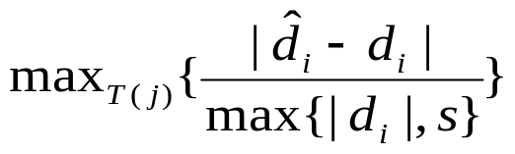


Do the GG Ideas Apply?
Unfortunately, DP formulations in [GG,SIGMOD’02] rely on
  Ability to assign fractional storage to each coefficient ci
  Optimization metrics (maximum NSE) with monotonic/additive structure over the error tree
j
M[j,b] = optimal NSE for subtree T(j) with space b
Principle of Optimality
  Can compute M[j,*] from M[2j,*] and M[2j+1,*]
+
-
2j
2j+1
When directly optimizing for maximum relative (or, absolute) error with storage {0,1}, principle of optimality fails!
  Assume that M[j,b] = optimal value for with at most b coefficients selected in T(j)
  Optimal solution at j may not comprise optimal solutions for its children
    Remember that = (+/-)* SelectedCoefficient, where coefficient values can be positive or negative
Schemes in [GG,SIGMOD’02] do not apply – BUT, it can be done!!

Slide 12

Our Approach: Deterministic Wavelet Thresholding for Maximum Error
Key Idea: Dynamic-Programming formulation that conditions the optimal solution on the error that “enters” the subtree (through the selection of ancestor nodes)
root=0
S = subset of proper ancestors of j included in the synopsis
Our DP table:
M[j, b, S] = optimal maximum relative (or, absolute) error in T(j) with space budget of b coefficients (chosen in T(j)), assuming subset S of j’s proper ancestors have already been selected for the synopsis
  Clearly, |S| min{B-b, logN+1}
  Want to compute M[0, B, ]
j
+
-
2j
2j+1
Basic Observation: Depth of the error tree is only logN+1 we can explore and tabulate all S-subsets for a given node at a space/time cost of only O(N) !

Slide 13

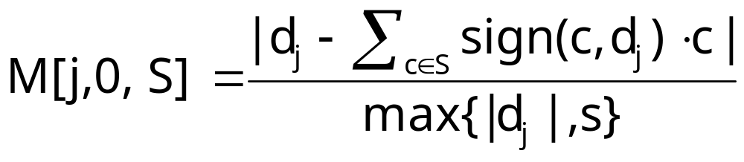

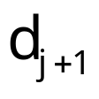
Base Case for DP Recurrence: Leaf (Data) Nodes
Base case in the bottom-up DP computation: Leaf (i.e., data) node
  Assume for simplicity that data values are numbered N, …, 2N-1
Selected coefficient subset S
M[j, b, S] is not defined for b>0
  Never allocate space to leaves
For b=0
root=0
j/2
+
-
for each coefficient subset with |S| min{B, logN+1}
  Similarly for absolute error
Again, time/space complexity per leaf node is only O(N)

Slide 14
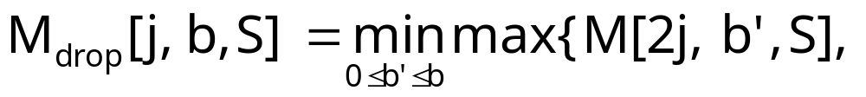
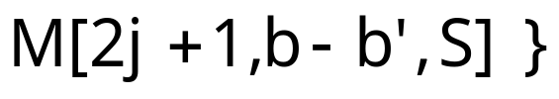
DP Recurrence: Internal (Coefficient) Nodes
Two basic cases when examining node/coefficient j for inclusion in the synopsis: (1) Drop j; (2) Keep j
Case (1): Drop Coefficient j
S = subset of selected j-ancestors
In this case, the minimum possible maximum relative error in T(j) is
root=0
j
  Optimally distribute space b between j’s two child subtrees
Note that the RHS of the recurrence is well-defined
  Ancestors of j are obviously ancestors of 2j and 2j+1
+
-
2j
2j+1

Slide 15
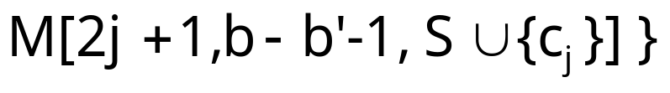


DP Recurrence: Internal (Coefficient) Nodes (cont.)
Case (2): Keep Coefficient j
S = subset of selected j-ancestors
In this case, the minimum possible maximum relative error in T(j) is
root=0
j
  Take 1 unit of space for coefficient j, and optimally distribute remaining space
  Selected subsets in RHS change, since we choose to retain j
Again, the recurrence RHS is well-defined
+
-
2j
2j+1
Finally, define
Overall complexity: time, space

Slide 16
Outline
Preliminaries & Motivation
  Approximate query processing
  Haar wavelet decomposition, conventional wavelet synopses
  The problem
Earlier Approach: Probabilistic Wavelet Synopses [Garofalakis & Gibbons, SIGMOD’02]
  Randomized Selection and Rounding
Our Approach: Efficient Deterministic Thresholding Schemes
  Deterministic wavelet synopses optimized for maximum relative/absolute error
Extensions to Multi-dimensional Haar Wavelets
  Efficient polynomial-time approximation schemes
Conclusions & Future Directions

Slide 17
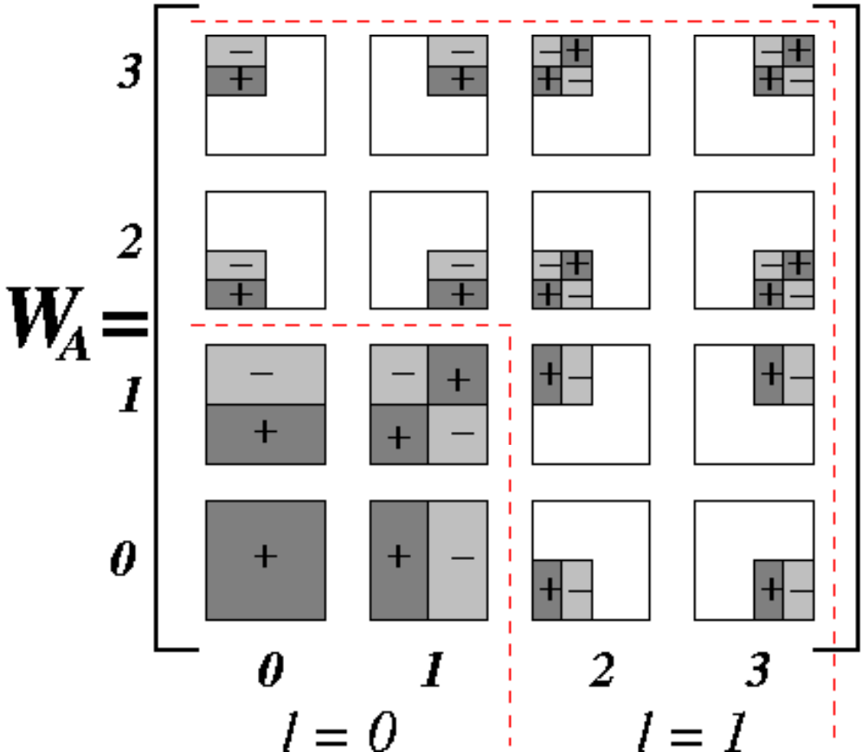
Multi-dimensional Haar Wavelets
Haar decomposition in d dimensions = d-dimensional array of wavelet coefficients
  Coefficient support region = d-dimensional rectangle of cells in the original data array
  Sign of coefficient’s contribution can vary along the quadrants of its support
Support regions & signs for the 16 nonstandard 2-dimensional Haar coefficients of a 4X4 data array A

Slide 18


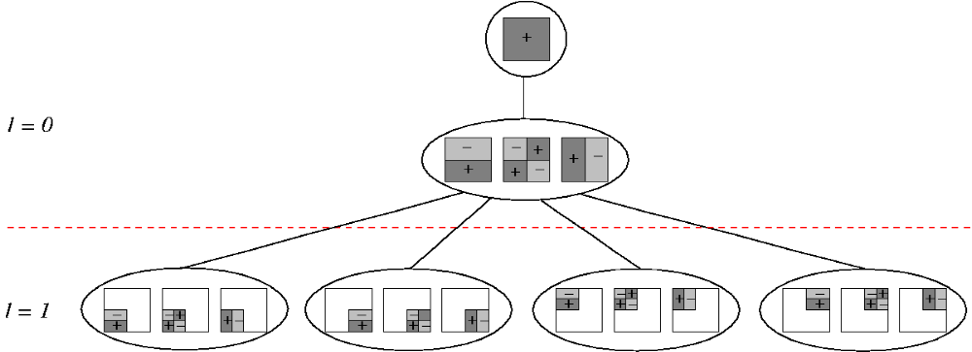
Multi-dimensional Haar Error Trees
Conceptual tool for data reconstruction – more complex structure than in the 1-dimensional case
  Internal node = Set of (up to) coefficients (identical support regions, different quadrant signs)
  Each internal node can have (up to) children (corresponding to the quadrants of the node’s support)
Maintains linearity of reconstruction for data values/range sums
Error-tree structure for 2-dimensional
4X4 example (data values omitted)

Slide 19


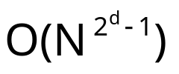

Can we Directly Apply our DP?
dimensionality d=2
Problem: Even though depth is still O(logN), each node now comprises up to coefficients, all of which contribute to every child
  Data-value reconstruction involves up to coefficients
  Number of potential ancestor subsets (S) explodes with dimensionality
  Space/time requirements of our DP formulation quickly become infeasible (even for d=3,4)
Our Solution: -approximation schemes for multi-d thresholding
Up to ancestor subsets per node!

Slide 20

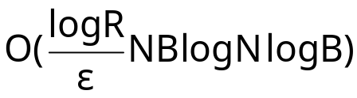
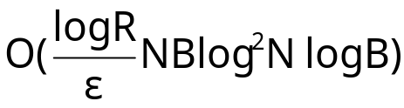
Approximate Maximum-Error Thresholding in Multiple Dimensions
Time/space efficient approximation schemes for deterministic multi-dimensional wavelet thresholding for maximum error metrics
Propose two different approximation schemes
  Both are based on approximate dynamic programs
  Explore a much smaller number of options while offering -approximation gurantees for the final solution
Scheme #1: Sparse DP formulation that rounds off possible values for subtree-entering errors to powers of
  time
  Additive -error guarantees for maximum relative/absolute error
Scheme #2: Use scaling & rounding of coefficient values to convert a pseudo-polynomial solution to an efficient approximation scheme
  time
  -approximation algorithm for maximum absolute error
Details in the paper…

Slide 21
Conclusions & Future Work
Introduced the first efficient schemes for deterministic wavelet thresholding for maximum-error metrics
  Based on a novel DP formulation
  Avoid pitfalls of earlier probabilistic solutions
  Meaningful error guarantees on individual query answers
Extensions to multi-dimensional Haar wavelets
  Complexity of exact solution becomes prohibitive
  Efficient polynomial-time approximation schemes based on approximate DPs
Future Research Directions
  Streaming computation/incremental maintenance of max-error wavelet synopses
  Extend methodology and max-error guarantees for more complex queries (joins??)
  Hardness of multi-dimensional max-error thresholding?
  Suitability of Haar wavelets, e.g., for relative error? Other bases??

Slide 22

Thank you! Questions?

