Slide 1
Estimating Join-Distinct Aggregates over Update Streams
Minos Garofalakis
Bell Labs, Lucent Technologies
(Joint work with Sumit Ganguly, Amit Kumar, Rajeev Rastogi)

Slide 2

Motivation: Massive Network-Data Streams
SNMP/RMON,
NetFlow records
Network Operations
Center (NOC)
Example NetFlow IP Session Data
Source Destination Duration Bytes Protocol
10.1.0.2 16.2.3.7 12 20K http
18.6.7.1 12.4.0.3 16 24K http
13.9.4.3 11.6.8.2 15 20K http
15.2.2.9 17.1.2.1 19 40K http
12.4.3.8 14.8.7.4 26 58K http
10.5.1.3 13.0.0.1 27 100K ftp
11.1.0.6 10.3.4.5 32 300K ftp
19.7.1.2 16.5.5.8 18 80K ftp
Peer
BGP
Converged IP/MPLS
Network
Enterprise
Networks
PSTN
FR, ATM, IP VPN
DSL/Cable
Networks
Broadband
Internet Access
Voice over IP
SNMP/RMON/NetFlow data records arrive 24x7 from different parts of the network
Truly massive streams arriving at rapid rates
  AT&T collects 600-800 GigaBytes of NetFlow data each day!
Typically shipped to a back-end data warehouse for off-line analysis

Slide 3
Real-Time Data-Stream Querying
Back-end Data Warehouse
How many distinct (source,dest) pairs are seen by R1 where “source” is also seen by R2?
DBMS
(Oracle, DB2)
Network Operations
Center (NOC)
Off-line analysis – Data access is slow, expensive
R1
SELECT COUNT DISTINCT (R1.source,R1.dest)
FROM R1(source,dest), R2(source,dest)
WHERE R1.source = R2.source
BGP
R2
Peer
Converged IP/MPLS
Network
Enterprise
Networks
PSTN
Need ability to process/analyze network-data streams in real-time
  As records stream in: look at records only once in arrival order!
  Within resource (CPU, memory) limitations of the NOC
  Different classes of analysis queries: top-k, quantiles, joins, …
Our focus: Join-Distinct (JD) aggregate queries
  Estimating cardinality of duplicate-eliminating projection over a join
Critical to important NM tasks
  Denial-of-Service attacks, SLA violations, real-time traffic engineering,…

Slide 4
Talk Outline
Introduction & Motivation
Data Stream Computation Model
Key Prior Work
  FM sketches for distinct counting
  2-level hash sketches for set-expression cardinalities
Our Solution: JD-Sketch Synopses
  The basic structure
  JD-sketch composition algorithm & JD estimator
  Extensions
Experimental Results
Conclusions

Slide 5

Data-Stream Processing Model
(GigaBytes)
R(A,B) synopsis
S(B,C) synopsis
(KiloBytes)
Data Stream R(A,B)
Memory
Stream
Processing
Engine
Approximate Answer
with Error Guarantees
“Within 2% of exact
answer with high
probability”
Data Stream S(B,C)
Query Q =
Approximate answers often suffice, e.g., trend analysis, anomaly detection
  Exact solution requires linear space (SET-DISJOINTNESS)
Requirements for stream synopses
  Single Pass: Each record is examined at most once, in (fixed) arrival order
  Small Space: Log or polylog in data stream size
  Real-time: Per-record processing time (to maintain synopses) must be low
  Delete-Proof: Can handle record deletions as well as insertions
  Composable: Built in a distributed fashion and combined later

Slide 6
Existing Synopses for Relational Streams?
Conventional data summaries fall short
  Samples (e.g., using Reservoir Sampling)
    Bad for joins and DISTINCT counting, cannot handle deletions
  Multi-d histograms/wavelets
    Construction requires multiple passes, not useful for DISTINCT clauses
Combine existing stream-sketching solutions?
  Hash (aka FM) sketches for distinct-value counting
  AMS sketches for join-size estimation
  Fundamentally different : Hashing vs. Random linear projections
    Effective combination seems difficult
Our Solution: JD-Sketch stream synopses
  Novel, hash-based, log-sized stream summaries
  Built independently over R, S streams, then composed to give JD estimate
  Strong probabilistic accuracy guarantees

Slide 7
Hash (aka FM) Sketches for Distinct Value Counting [FM85]
Problem: Estimate the number of distinct items in a stream of values from [0,…, M-1]
Assume a hash function h(x) that maps incoming values x in [0,…, M-1] uniformly across [0,…, 2^L-1], where L = O(logM)
Let lsb(y) denote the position of the least-significant 1 bit in the binary representation of y
  A value x is mapped to lsb(h(x))
Maintain FM Sketch = BITMAP array of L bits, initialized to 0
  For each incoming value x, set BITMAP[ lsb(h(x)) ] = 1
Data stream: 3 0 5 3 0 1 7 5 1 0 3 7
Number of distinct values: 5
BITMAP
5 4 3 2 1 0
x = 5
h(x) = 101100
lsb(h(x)) = 2
0
0
0
1
0
0

Slide 8
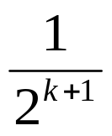

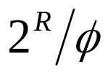
Hash (aka FM) Sketches for Distinct Value Counting [FM85]
By uniformity through h(x): Prob[ BITMAP[k]=1 ] = Prob[ ] =
  Assuming d distinct values: expect d/2 to map to BITMAP[0] , d/4 to map to BITMAP[1], . . .
Let R = position of rightmost zero in BITMAP
  Use as indicator of log(d)
  Estimate d =
  Average several iid instances (different hash functions) to reduce estimator variance
BITMAP
L-1
0
0
0
0
0
0
0
1
0
1
0
1
1
1
1
1
1
1
1
fringe of 0/1s around log(d)
position >> log(d)
position << log(d)

Slide 9


2-Level Hash Sketches for Set Expression Cardinalities [GGR03]
Estimate cardinality of general set expressions over streams of updates
  E.g., number of distinct (source,dest) pairs seen at both R1 and R2? |R1 R2|
2-Level Hash-Sketch (2LHS) stream synopsis: Generalizes FM sketch
  First level: buckets with exponentially-decreasing probabilities (using lsb(h(x)), as in FM)
  Second level: Count-signature array (logM+1 counters)
    One “total count” for elements in first-level bucket
    logM “bit-location counts” for 1-bits of incoming elements
insert(17)
lsb(h(17))
+1
+1
+1
TotCount
count7
count6
count5
count4
count3
count2
count1
count0
17 = 0 0 0 1 0 0 0 1

Slide 10
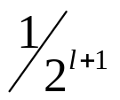
Processing Set Expressions over Update Streams: Key Ideas
Build several independent 2LHS, fix a level l, and look for singleton first-level buckets at that level l
Singleton buckets and singleton element (in the bucket) are easily identified using the count signature
Singletons discovered form a distinct-value sample from the union of the streams
  Frequency-independent, each value sampled with probability
Determine the fraction of “witnesses” for the set expression E in the sample, and scale-up to find the estimate for |E|
level l
Singleton bucket count signature
Total=11
0
0
0
0
11
0
11
0
Singleton element = 1010 = 10
2

Slide 11

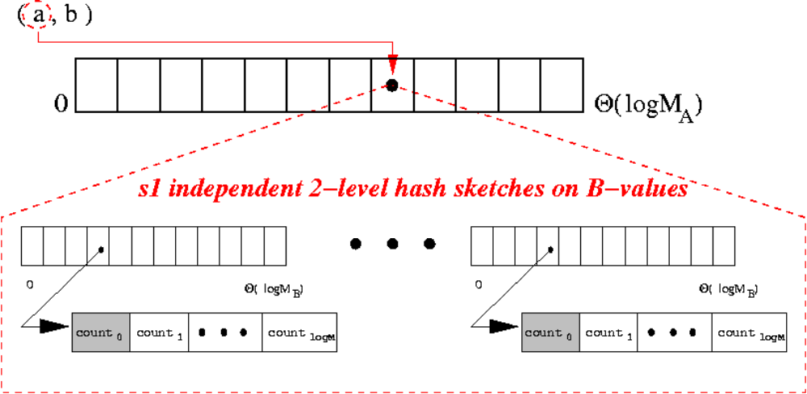
The JD-Sketch Synopsis: Basic Structure
First level of hashing (hash fn+lsb) on the projected stream attribute
Second level of hashing (collection of independent 2LHS) on the join stream attribute
Maintenance: straightforward (based on 2LHS)
  Composable, delete-proof, …
Q = | (R(A,B) S(B,C))|
A,C
lsb(h (a))
JD-sketch for R(A,B)
A

Slide 12
Our JD Estimator: Composing JD-Sketch Synopses
Input: Pair of (independently-built) parallel JD-sketches on the R(A,B) and S(B,C) streams
  Same hash functions for corresponding 2LHS pairs
Output: FM-like summary (bitmap) for estimating the number of distinct joining (A,C) pairs
Key Technical Challenges
  Want only (A,C) pairs that join to make it to our bitmap
    Idea: Use 2LHS in the A- and C-buckets to determine (approximately) if the corresponding B-multisets intersect
  A- and C-values are observed independently and in arbitrary order in their respective streams
    Cannot directly hash arriving (A,C) pairs to a bitmap (traditional FM) -- all that we have are the JD-sketches for R, S!
    Idea: Employ novel, composable hash functions h (), h (), and a sketch-composition algorithm that guarantees FM-like properties
A
C

Slide 13

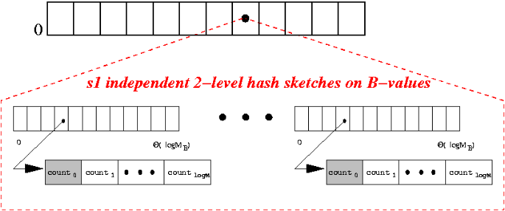

Our JD Estimator: Composing JD-Sketch Synopses
k
R(A,B)
JD-sketch
|BValueIntersect(k,m)|>=1 ?
m
S(B,C)
JD-sketch
min{k,m}
1
Final, composed “FM-like” bitmap
for joining (A,C) pairs
Theorem: Using novel, composable linear hash functions, the above composition algorithm guarantees that
  (A,C)-pairs map to final bitmap levels with exponentially-decreasing probabilities ( )
  (A,C)-pair mappings are pairwise-independent
Both facts are crucial for our analysis…

Slide 14


Our JD Estimator: Estimation Algorithm & Analysis
Build and maintain s2 independent, parallel JD-sketch pairs over the R(A,B) and S(B,C) streams
At estimation time
  Compose each parallel JD-sketch pair, to obtain s2 “FM-like” bitmaps for joining (A,C) pairs
  Find a level l in the composed bitmaps s.t. the fraction f of 1-bits lies in a certain range -- use f to estimate jd x Prob[level=l]
    Return jd f x
level l
count(1’s)
jd
s2

Slide 15

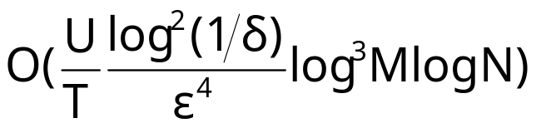
Our JD Estimator: Estimation Algorithm & Analysis
Theorem: Our JD estimator returns an ( )-estimate of JD cardinality using JD-sketches with a total space requirement of
  U/T |B-value neighborhood|/ no. of joining B-values for randomly-chosen (A,C) pairs
    JDs with low “support” are harder to estimate
Lower bound based on information-theoretic arguments and Yao’s lemma
  Our space requirements are within constant and log factors of best possible

Slide 16

Extensions
Other forms of JD-cardinality queries are easy to handle with JD-sketches – for instance,
  One-sided (semi)joins (e.g., )
  “Full-projection” joins (e.g., )
  Just choose the right stream attributes to hash on at the two levels of the JD-sketch
Other JD-aggregates – e.g., estimating predicate selectivities over a JD operation
  Key observation: Can use the JD-sketch to obtain a distinct-value sample of the JD result
For cases where |B| is small, we propose a different, -space JD synopsis and estimator
  Based on simpler FM sketches built with composable hash functions
  Conceptually simpler & easier to analyze, BUT requires at least linear space!
| (R(A,B) S(B,C))|
A,B
| (R(A,B) S(B,C))|
A,B,C

Slide 17
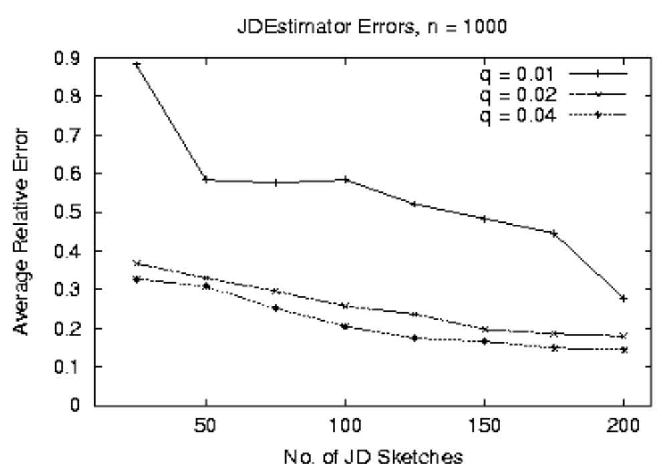
Experimental Results: JD-Sketches on Random-Graph Data

Slide 18
Conclusions
First space-efficient algorithmic techniques for estimating JD aggregates in the streaming model
Novel, hash-based sketch synopses
  Log-sized, delete-proof (general update streams)
  Independently built over individual streams
  Effectively composed at estimation time to provide approximate answers with strong probabilistic accuracy guarantees
Verified effectiveness through preliminary experiments
One key technical idea: Composable Hash Functions
  Build hash-based sketches on individual attributes that can be composed into a sketch for attribute combinations
  Powerful idea that could have applications in other streaming problems…

Slide 19

Thank you!
http://www.bell-labs.com/~minos/
minos@research.bell-labs.com

Slide 20
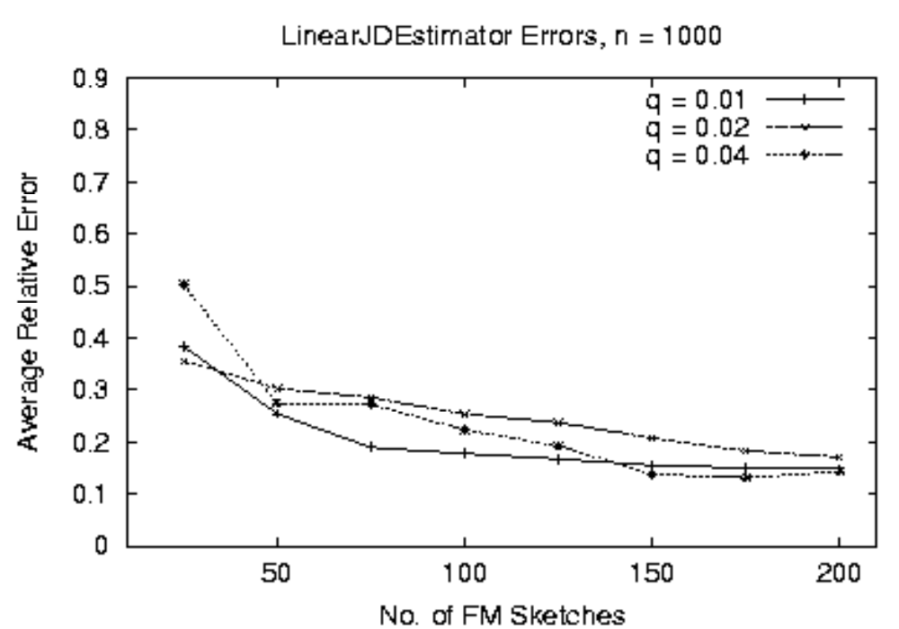
Experimental Results: Linear-Space JD-Estimator on Random-Graph Data

