Slide 1
Wavelet Synopses with Error Guarantees
Minos Garofalakis and Phillip B. Gibbons*
Information Sciences Research Center
Bell Labs, Lucent Technologies
*Currently with Intel Research-Pittsburgh
http://www.bell-labs.com/user/minos/
http://www.intel-research.net/pittsburgh/people/gibbons/

Slide 2
Outline
Preliminaries & Motivation
  Approximate query processing
  Haar wavelet decomposition, conventional wavelet synopses
  The problem
Our Solution: Probabilistic Wavelet Synopses
  The general approach
Algorithms for Tuning our Probabilistic Synopses
  Maximum relative error
  Relative bias
Extensions to Multi-dimensional Haar Wavelets
Experimental Study
  Results with synthetic & real-life data sets
Conclusions

Slide 3

Approximate Query Processing
Decision
Support
Systems
(DSS)
SQL Query
Exact Answer
GB/TB
Long Response Times!
Compact Data Synopses
“Transformed” Query
Approximate Answer
KB/MB
FAST!!
Exact answers NOT always required
  DSS applications usually exploratory: early feedback to help identify “interesting” regions
  Aggregate queries: precision to “last decimal” not needed
    e.g., “What percentage of the US sales are in NJ?”
Construct effective data synopses ??

Slide 4
Haar Wavelet Decomposition
Wavelets: mathematical tool for hierarchical decomposition of functions/signals
Haar wavelets: simplest wavelet basis, easy to understand and implement
  Recursive pairwise averaging and differencing at different resolutions
Resolution Averages Detail Coefficients
3
D = [2, 2, 0, 2, 3, 5, 4, 4]
----
2
[2, 1, 4, 4]
[0, -1, -1, 0]
1
[1.5, 4]
[0.5, 0]
0
[2.75]
[-1.25]
Haar wavelet decomposition:
[2.75, -1.25, 0.5, 0, 0, -1, -1, 0]
Construction extends naturally to multiple dimensions

Slide 5

Haar Wavelet Coefficients
Hierarchical decomposition structure ( a.k.a. Error Tree )
Reconstruct data values d(i)
  d(i) = (+/-1) * (coefficient on path)
Range sum calculation d(l:h)
  d(l:h) = simple linear combination of coefficients on paths to l, h
Only O(logN) terms
2.75
+
+
-1.25
-
0.5
0
+
-
+
-
0
-1
-1
0
+
-
+
-
+
-
+
-
Original data
2 2 0 2 3 5 4 4
3 = 2.75 - (-1.25) + 0 + (-1)
6 = 4*2.75 + 4*(-1.25)

Slide 6
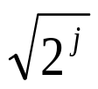
Wavelet Data Synopses
Compute Haar wavelet decomposition of D
Coefficient thresholding : only B<<|D| coefficients can be kept
  B is determined by the available synopsis space
Conventional thresholding: Take B largest coefficients in absolute normalized value
  Normalized Haar basis: divide coefficients at resolution j by
  All other coefficients are ignored (assumed to be zero)
  Provably optimal in terms of the overall Sum Squared (L2) Error
Unfortunately, this methodology gives no approximation-quality guarantees for
  Individual reconstructed data values
  Individual range-sum query results

Slide 7
Problems with Conventional Synopses
An example data vector and wavelet synopsis (|D|=16, B=8 largest coefficients retained)
Always accurate!
Over 2,000% relative error!
Original Data Values 127 71 87 31 59 3 43 99 100 42 0 58 30 88 72 130
Wavelet Answers 65 65 65 65 65 65 65 65 100 42 0 58 30 88 72 130
Estimate = 195, actual values: d(0:2)=285, d(3:5)=93!
Large variation in answer quality
  Within the same data set, when synopsis is large, when data values are about the same, when actual answers are about the same
  Heavily-biased approximate answers!
Root causes
  Strict deterministic thresholding
  Independent thresholding ( large regions without any coefficient!)
  Heavy bias from dropping coefficients without compensating for loss

Slide 8

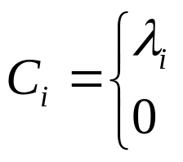
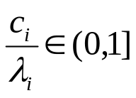
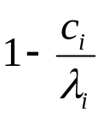

Our Solution: Probabilistic Wavelet Synopses
Prob
Novel, probabilistic thresholding scheme for Haar coefficients
  Ideas based on Randomized Rounding
In a nutshell
  Assign coefficient probability of retention (based on importance)
  Flip biased coins to select the synopsis coefficients
  Deterministically retain most important coefficients, randomly rounding others either up to a larger value or down to zero
  Key: Each coefficient is correct on expectation
Basic technique
  For each non-zero Haar coefficient ci, define random variable Ci
  Round each ci independently to or zero by flipping a coin with success probability (zeros are discarded)
204
1
204
+
-9
2/3
-6
-8
+
1/2
-4
-
20
1
20
-
8
1/2
4
with probability
+
-6
1/6
with probability
-1
-
183
185

Slide 9

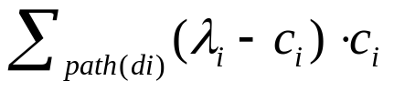
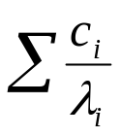

Probabilistic Wavelet Synopses (cont.)
Each Ci is correct on expectation, i.e., E[Ci] = ci
  Our synopsis guarantees unbiased estimators for data values and range sums (by Linearity of Expectation)
Holds for any ‘s , BUT choice of ‘s is crucial to quality of approximation and synopsis size
  Variance of Ci: Var[Ci] =
  By independent rounding, Variance[reconstructed di] =
    Better approximation/error guarantees for smaller (closer to ci)
  Expected size of the final synopsis E[size] =
    Smaller synopsis size for larger
Novel optimization problems for “tuning” our synopses
  Choose ‘s to ensure tight approximation guarantees (i.e., keep reconstruction variances small), while not exceeding the space bound B for the synopsis (i.e., E[size] B)
  Alternative probabilistic scheme
    Retain exact coefficient with probabilities chosen to minimize bias

Slide 10
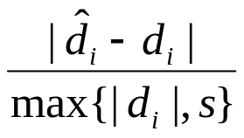

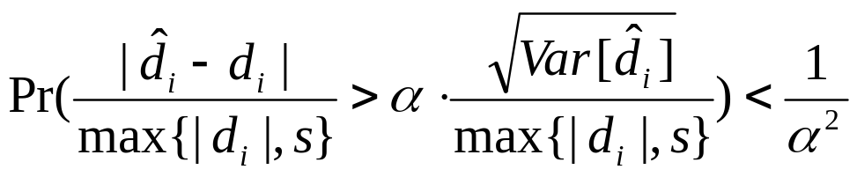
MinRelVar: Minimizing Max. Relative Error
Key metric for effective approximate answers: Relative error with sanity bound
  Sanity bound “s” to avoid domination by small data values
Since estimate is a random variable, we want to ensure a tight bound for our relative error metric with high probability
  By Chebyshev’s inequality
Normalized Standard Error (NSE) of reconstructed value
To provide tight error guarantees for all data values
  Minimize the Maximum NSE among all reconstructed values

Slide 11
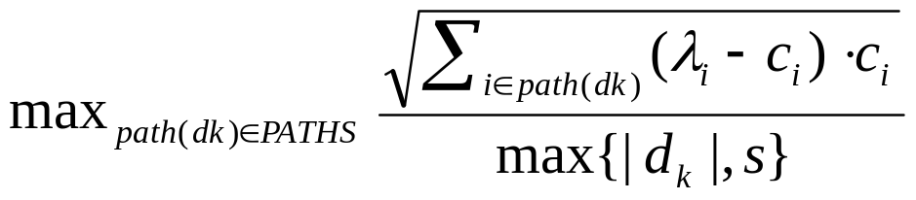
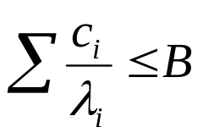

Minimizing Maximum Relative Error (cont.)
Problem: Find rounding values to minimize the maximum NSE
Hard non-linear optimization problem!
Propose solution based on a Dynamic Programming formulation
  Key technical ideas
    Exploit the hierarchical structure of the problem (error tree for Haar coefficients)
    Quantizing the solution space
Error Tree
root
subject to and
sum variances on path and normalize
dk

Slide 12


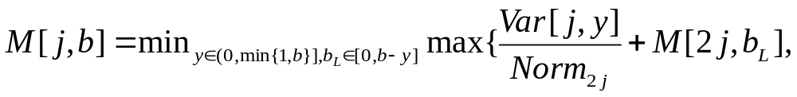
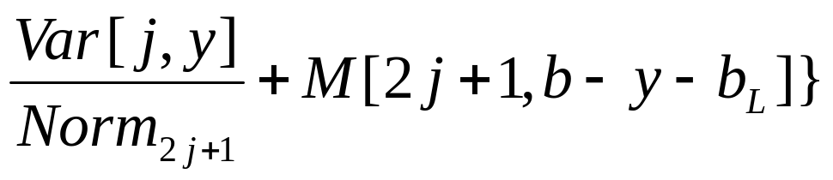
Minimizing Maximum Relative Error (cont.)
Let = the probability of retaining ci
  yi = “fractional space” allotted to coefficient ci ( yi B )
M[j,b] = optimal value of the (squared) maximum NSE for the subtree rooted at coefficient cj for a space allotment of b
j
2j
2j+1
Normalization factors “Norm” depend only on the minimum data value in each subtree
  See paper for full details...
Quantize choices for y to {1/q, 2/q, ..., 1}
  q = input integer parameter, “knob” for run-time vs. solution accuracy
  O(NBq^2) time, O(qB logN) memory

Slide 13
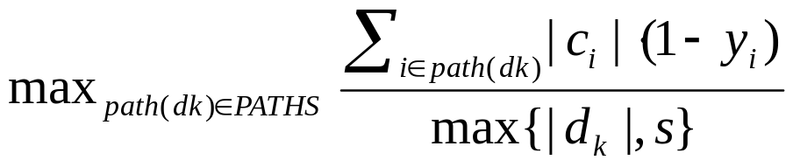


MinRelBias: Minimizing Normalized Bias
Scheme: Retain the exact coefficient ci with probability yi and discard with probability (1-yi) -- no randomized rounding
  Our Ci random variables are no longer unbiased estimators for ci
    Bias[Ci] = | E[Ci] - ci | = |ci|*(1-yi)
Choose yi’s to minimize an upper bound on the normalized reconstruction bias for each data value; that is, minimize
Same dynamic-programming solution as MinRelBias works!
Avoids pitfalls of conventional thresholding due to
  Randomization
  Choice of optimization metric (minimize max. resulting bias)
subject to and

Slide 14
Extensions to Multi-dimensional Wavelets
Previous approaches suffer from additional bias due to construction-time thresholding
  Data density can increase dramatically due to recursive pairwise averaging/differencing
Probabilistic thresholding ideas and algorithms can be extended to d-dimensional Haar wavelets
  “Adaptively threshold” wavelet coefficients during the wavelet decomposition without introducing reconstruction bias
Basic ideas carry over directly
  Linear data/range-sum reconstruction
  Hierarchical “error-tree” structure for coefficients
  Runtime of our dynamic-programming schemes increases by 2^d
Details in the paper...

Slide 15
Experimental Study
Our probabilistic wavelet synopses vs. conventional (deterministic) wavelet synopses
Synthetic and real-life data sets
  Zipfian data distributions
    Various permutations, skew z = 0.3 - 2.0
  Forest Cover-Type data (UCI KDD repository)
Relative error metrics
  Sanity bound = 10-percentile value in data
  Mean, Maximum, and 25-percentile relative error in the approximation
    Similar behavior for all metrics
    Maximum relative error can be used as a “reconstruction error” guarantee
Quantization parameter q=10 for MinRelVar, MinRelBias

Slide 16
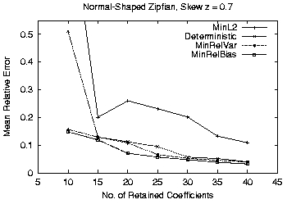
Mean Relative Error vs. Size
256 distinct values 10 coefficients = 4% data synopsis

Slide 17
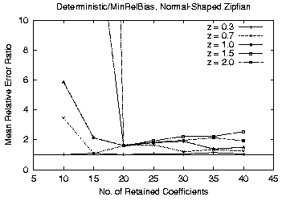
Relative Error Ratio vs. Size

Slide 18
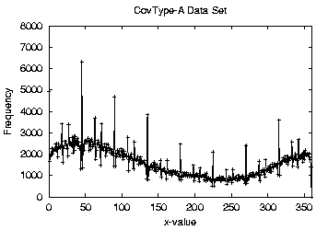
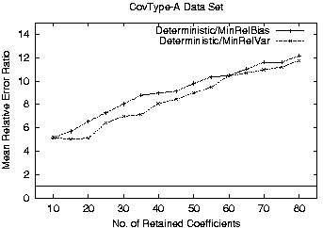
Relative Error Ratio vs. Size:
CovType Aspect Data

Slide 19
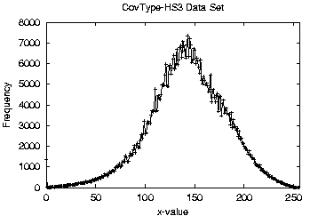
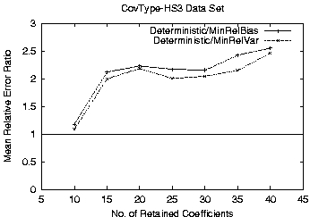
Relative Error Ratio vs. Size:
CovType HillShade Data

Slide 20
Conclusions
Introduced Probabilistic Wavelet Synopses
  First wavelet-based data-reduction scheme to provably enable
    Unbiased data reconstruction
    Error guarantees on individual query answers
Novel optimization techniques for “tuning” our synopses
  Minimize various desired error metrics
Extensions to multi-dimensional data
Experimental validation on synthetic and real-life data
  Improve relative error by factors of 2 up to 80!
Future
  Incremental maintenance of probabilistic wavelet synopses
  Extend methodology & error guarantees to more complex queries (joins??)

Slide 21

Thank you!

Slide 22
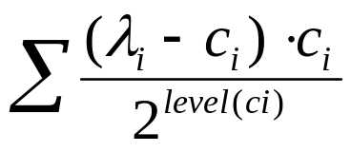
MinL2: Minimizing Expected L2 Error
Goal: Compute rounding values to minimize expected value of overall L2 error
  Expectation since L2 error is now a random variable
Problem: Find that minimize , subject to the constraints
Can be solved optimally: Simple iterative algorithm, O(N logN) time
BUT, again, overall L2 error cannot offer error guarantees for individual approximate answers (data/range-sum values)
and

Slide 23
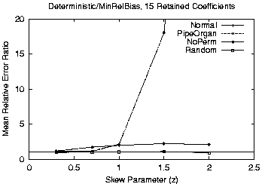

Slide 24
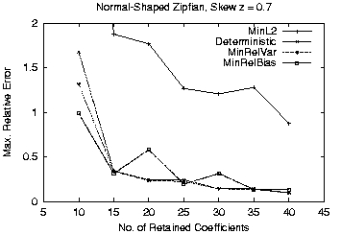

Slide 25
