Slide 1
Sharing Aggregate Computation for Distributed Queries
Ryan Huebsch, UC Berkeley
Minos Garofalakis, Yahoo! Research†
Joe Hellerstein, UC Berkeley
Ion Stoica, UC Berkeley
† Work done at Intel Research Berkeley
SIGMOD 6/13/07

Slide 2

Distributed Aggregation
SELECT count(*) FROM tableR
32
32
R1
R2
R1
R2
3
3
4
R3
3
R3
4
4
1
1
1
R7
R7
8
8
8
R4
R4
7
7
7
R6
R6
6
6
6
R5
R5
3
3
3

Slide 3
Cost of Aggregation
Bottleneck is normally network communication
Query requires 1 network message (partial state record) per node
  q unique queries ➔ requires q messages per node?
  No, it can be done in fewer than q messages!

Slide 4
Goal of this Work
Share network communication for multiple aggregation queries that have varying selection predicates
  SELECT agg(a) FROM tableR WHERE <predicate>
  Paper shows how technique applies to
    Multiple aggregation functions
    Queries w/ GROUP BY clauses
    Continuous queries w/ varying windows
Outline
  Example and Intuition
  Architecture
  Techniques
  Evaluation

Slide 5
Example
5 queries: SELECT count(*) FROM tableR
  WHERE noDNS = TRUE
  WHERE suspicious = TRUE
  WHERE noDNS = TRUE OR suspicious = TRUE
  WHERE onSpamList = TRUE
  WHERE onSpamList = TRUE AND suspicious = TRUE
Options:
  Run each independently
  Statically analyze predicates for containment
  Dynamically analyze queries AND the data

Slide 6
Fragments
Build on Krishnamurthy’s [SIGMOD 06] centralized scheme: examine which queries each tuple satisfies:
  Some tuples satisfy queries 1 and 3 only
  Some tuples satisfy queries 2 and 3 only
  Some tuples satisfy query 4 only
  Etc…
These are called fragments
The set of fragments formed by the data and queries can be represented as a matrix, F

Slide 7
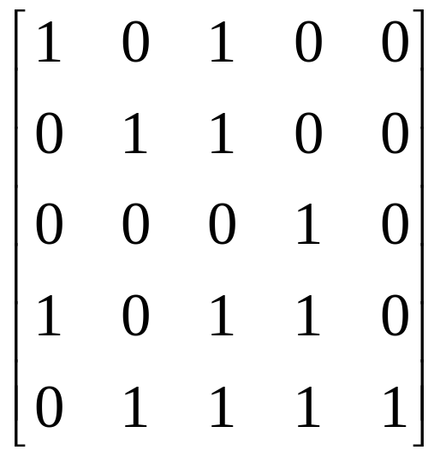
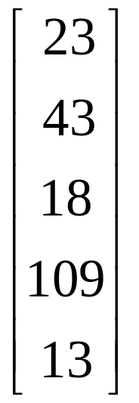
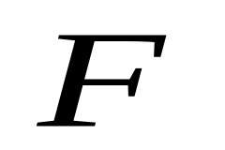
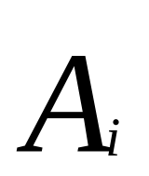
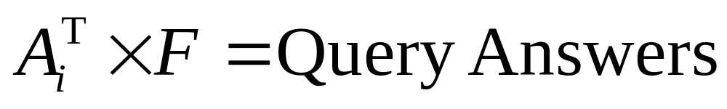
Fragment Matrix
18+109+13=140
Queries
PSRs
Q1
Q2
Q3
Q4
Q5
Fragments

Slide 8
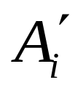
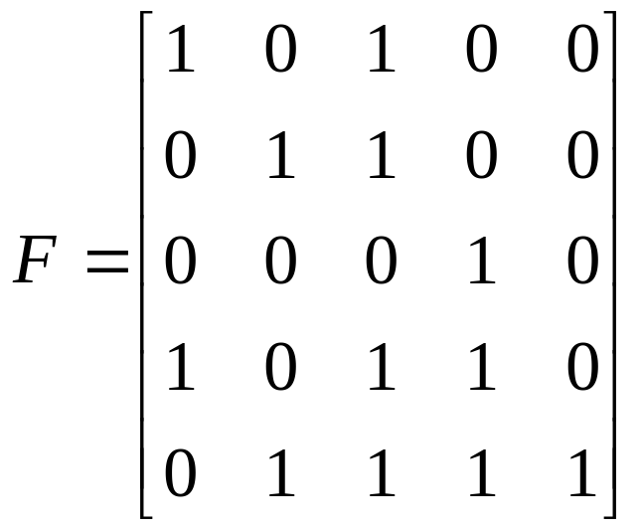
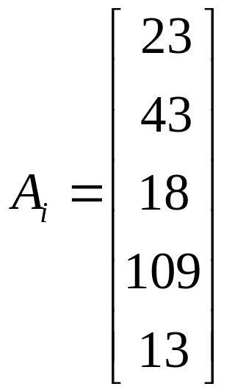
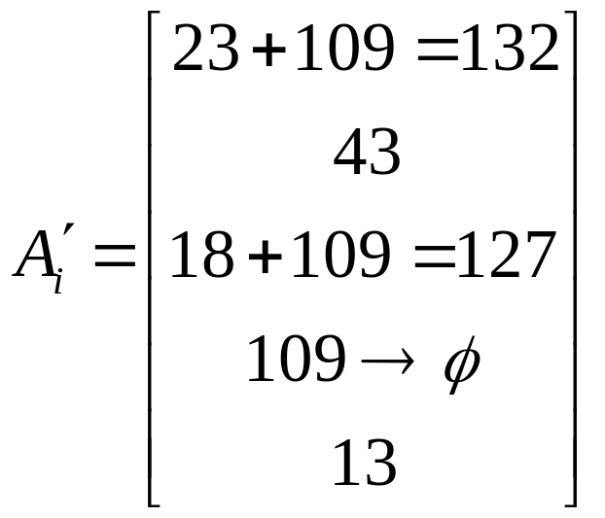
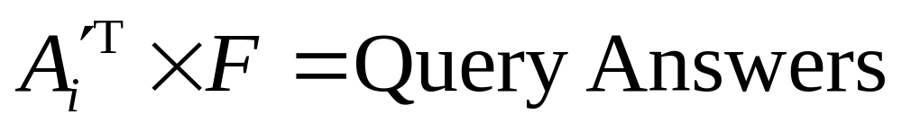
Challenge
Find a reduced which has empty entries, but still produces the correct answers
127+13=140

Slide 9
Independence
The optimal size for A’ is equal to the number of independent vectors in F
The notion of independence varies based on the aggregation function
Linear
SUM, COUNT, AVERAGE
Duplicate Insensitive
MIN, MAX
Logical AND/OR
Spectral Bloom Filters
Independence defined using logical OR
Linear Independence
  Other aggregates (such as k-MAX/MIN) define independence using a 3-valued logic function

Slide 10

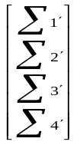
Architecture
Phase 1: Fragmentation
Phase 2:
Decompose
Phase 3:
Global Aggregation
Tuples
Queries
Fragments
F
A_{i}
A_{i}’
…
Tuples
Queries
Fragments
F
A_{i}
A_{i}’

Slide 11

Architecture
Phase 1: Fragmentation
Phase 2:
Decompose
Phase 3:
Global Aggregation
Phase 4:
Reconstruct
Tuples
Queries
Fragments
F
A_{i}
A_{i}’
F
…
A’
Query Answers
Tuples
Queries
Fragments
F
A_{i}
A_{i}’

Slide 12
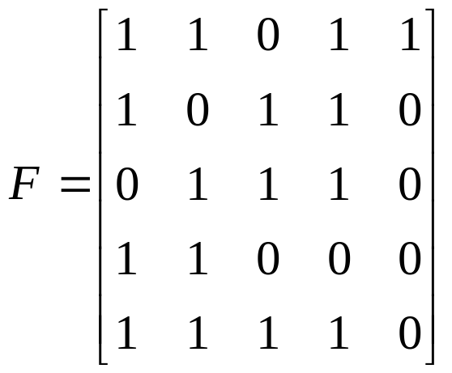
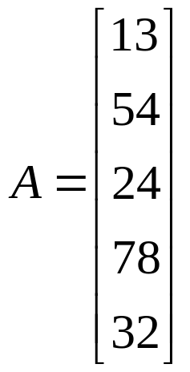
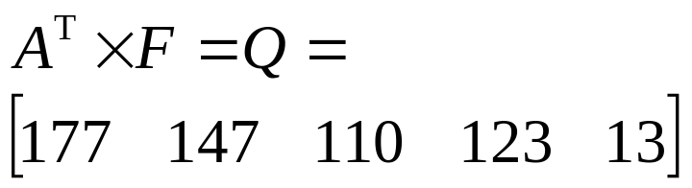
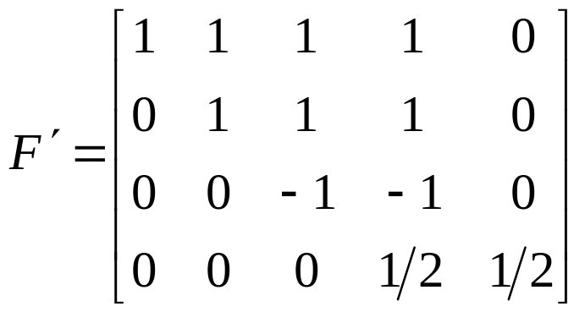
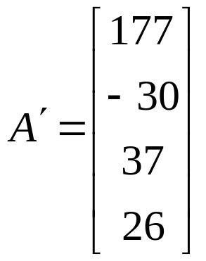
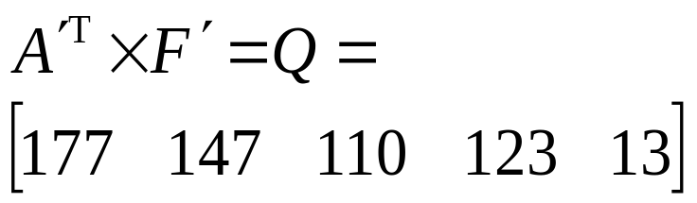
Linear Aggregates
Queries: SELECT count(*) FROM tableR WHERE <predicate>
13+54+24+32
Entries in F’ can be any scalar number
Decompose
177+(-30)-37+(.5)26

Slide 13
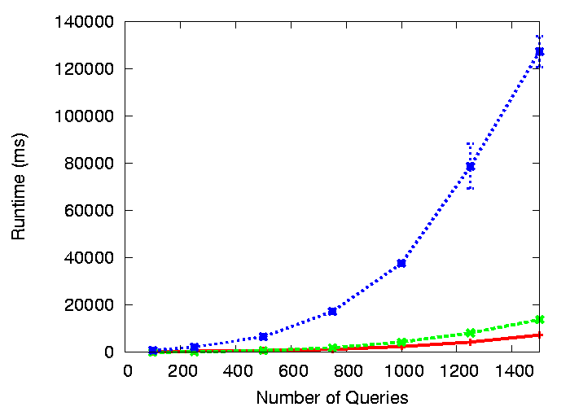
Linear Aggregates
Use rank revealing decomposition algorithms from the numerical computing literature
LU, QR, SVD are the most common
  Theory: All have ~O(n³) running time, find optimal answer
  Practice: LU is non-optimal due to rounding errors in F.P. computation, running times vary by order of magnitude
SVD
QR
LU

Slide 14
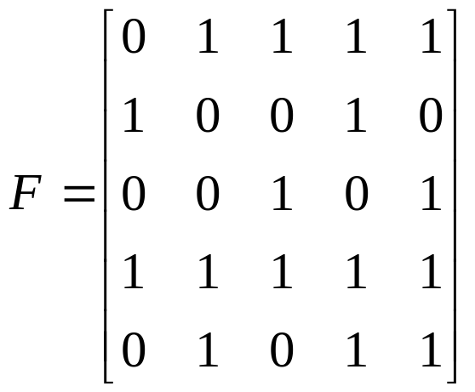
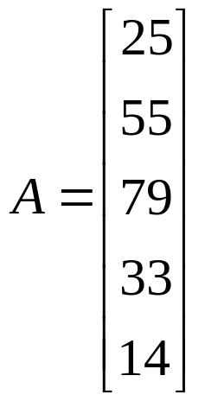
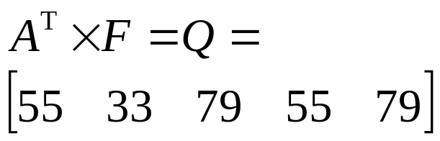
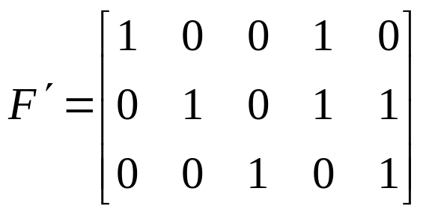
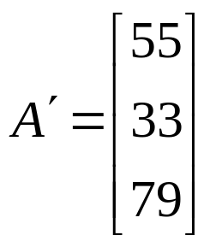
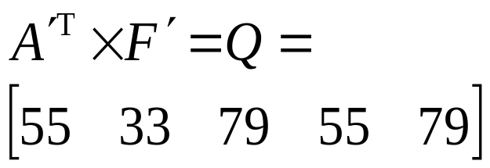
Duplicate Insensitive Aggregates
Queries: SELECT max(*) FROM tableR WHERE <predicate>
max(25,55,33,14)
Decompose
max(55,33)

Slide 15
Duplicate Insensitive Aggregates
Given F, find an F’ with fewer rows such that every vector in F can be composed by OR’ing vectors in F ➔ F’ is the Set Basis of F
Proven NP-Hard in 1975, No good approximations (both in theory and practice)
  Except in very specific cases which don’t apply here

Slide 16
Heuristic Approach
Start with F’ as the identity matrix
  This is equivalent to a no-sharing solution
Apply transformations to F’
  Simplest transformations
    OR two vectors in F’
    Remove a vector from F’
  Exhaustive search takes O(₂^{2n})
We apply two constraints for each OR transformation
  At least one vector must be removed
  F’ must be always valid set-basis solution
This significantly reduces the search space, but may eliminate the optimal answers

Slide 17
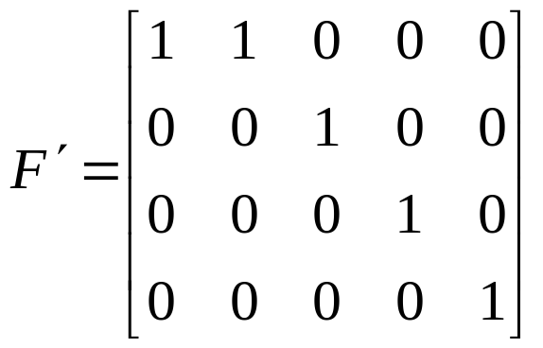
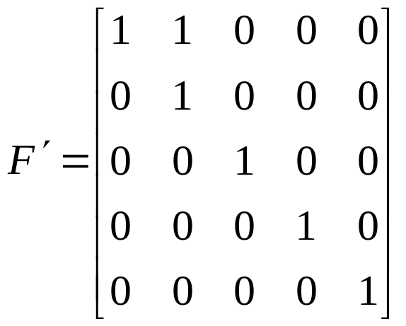
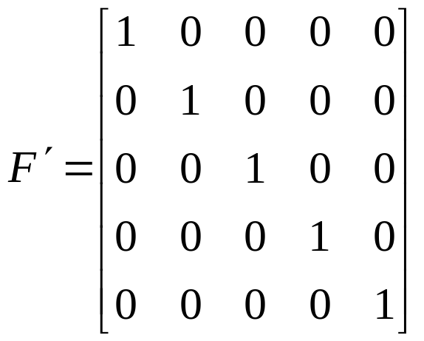
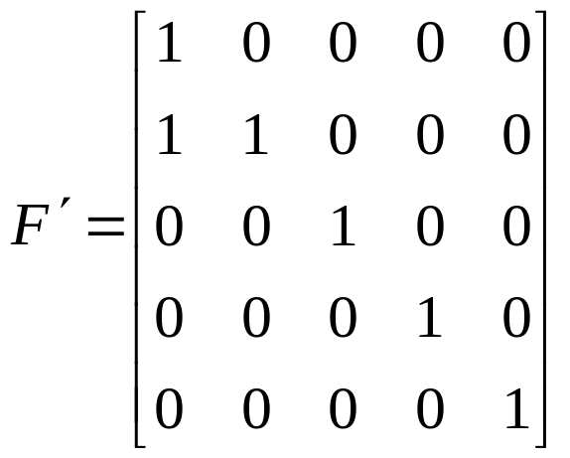
Example
✗ Not a basis
OR and remove both input
✗ Not a basis
OR and remove one input
✗ Not a basis

Slide 18
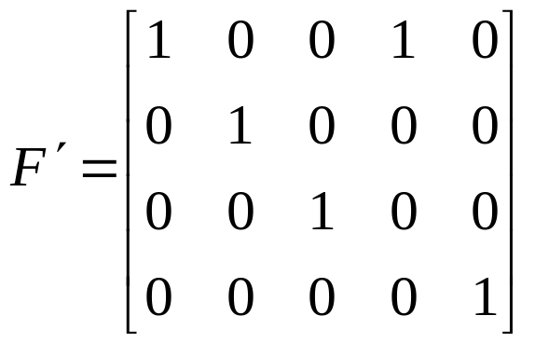
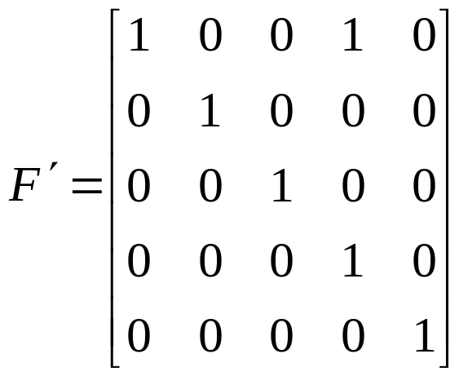
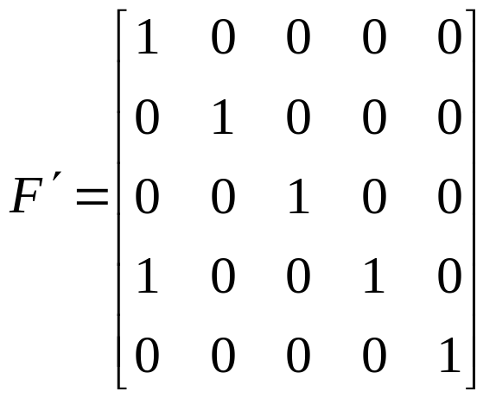
Example
✗ Not a basis
OR and remove both input
✓ Valid basis
OR and remove one input
✗ Not a basis

Slide 19
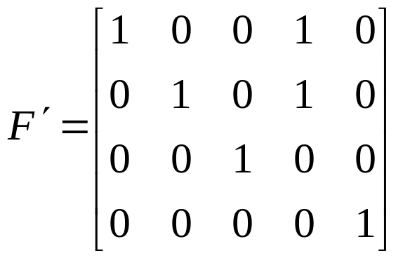
Example
✓ Valid basis
OR and remove both input
Continue applying transformations exhaustively

Slide 20
Optimizations
The order the transformations are applied effects effectiveness and runtime
  We developed 12 strategies and evaluated them
For 100 queries ~O(minutes), 50% optimal
Optimization: Add each query incrementally
  Start with 2 queries, optimize fully
  Add another query
    Add the identity vector for the new query to F’
    Optimize but only consider transformations that involve new vectors
    Repeat adding one query at a time
  Each “mini” optimization can use any of the 12 strategies for determining order

Slide 21
Evaluation
Random Generator
  Evaluate a wide range of possible workloads
  Control the degree of possible sharing/gain
  Know the optimal answer
Implementation
  Java on dual 3.06GHz Pentium 4 Xeon
Data is averaged over 10 runs, error bars show 1 standard deviation
Complete results in the paper

Slide 22
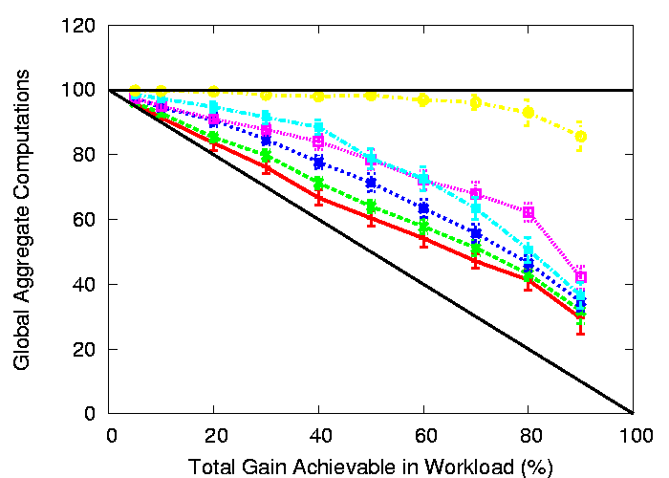
Duplicate Insensitive
Initial Basic Algorithm
Best Incremental Algorithm

Slide 23
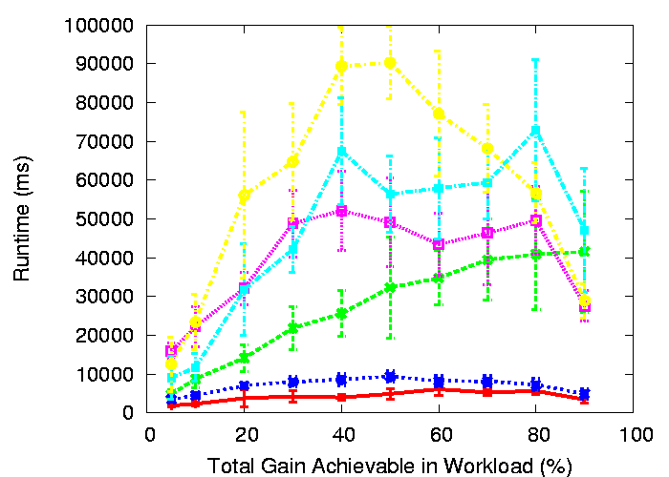
Duplicate Insensitive
Initial Basic Algorithm
Best Incremental Algorithm

Slide 24
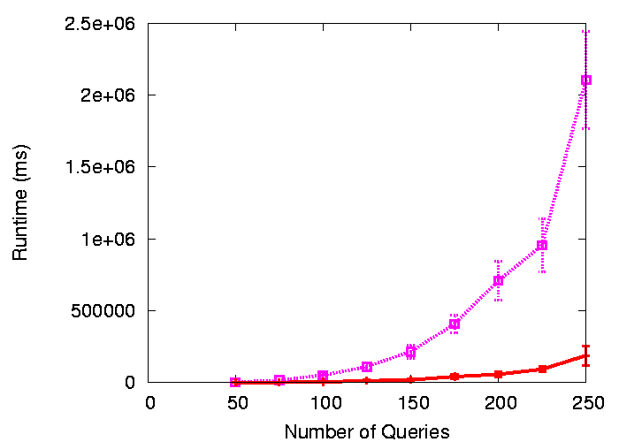
Duplicate Insensitive
Initial Basic Algorithm
Best Incremental Algorithm

Slide 25
Conclusion
Analyzing data and queries enables sharing
Type of aggregate function determines optimization technique
  Linear ➔ Rank-revealing numerical algorithms
  Duplicate Insensitive ➔ Set-basis, heuristic approach
Very effective and modest runtimes up to
  500 queries with linear aggregates
  100 queries with duplicate insensitive aggregates

