Slide 1
Querying and Mining Data Streams: You Only Get One Look
A Tutorial
Minos Garofalakis Johannes Gehrke Rajeev Rastogi
Bell Laboratories
Cornell University

Slide 2
Outline
Introduction & Motivation
  Stream computation model, Applications
Basic stream synopses computation
  Samples, Equi-depth histograms, Wavelets
Mining data streams
  Decision trees, clustering, association rules
Sketch-based computation techniques
  Self-joins, Joins, Wavelets, V-optimal histograms
Advanced techniques
  Sliding windows, Distinct values, Hot lists
Future directions & Conclusions

Slide 3
Processing Data Streams: Motivation
A growing number of applications generate streams of data
  Performance measurements in network monitoring and traffic management
  Call detail records in telecommunications
  Transactions in retail chains, ATM operations in banks
  Log records generated by Web Servers
  Sensor network data
Application characteristics
  Massive volumes of data (several terabytes)
  Records arrive at a rapid rate
Goal: Mine patterns, process queries and compute statistics on data streams in real-time

Slide 4
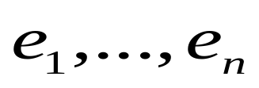
Data Streams: Computation Model
A data stream is a (massive) sequence of elements:
Stream processing requirements
  Single pass: Each record is examined at most once
  Bounded storage: Limited Memory (M) for storing synopsis
  Real-time: Per record processing time (to maintain synopsis) must be low
Synopsis in Memory
Data Streams
Stream
Processing
Engine
(Approximate)
Answer

Slide 5
Network Management Application
Network Management involves monitoring and configuring network hardware and software to ensure smooth operation
  Monitor link bandwidth usage, estimate traffic demands
  Quickly detect faults, congestion and isolate root cause
  Load balancing, improve utilization of network resources
Network Operations
Center
Measurements
Alarms
Network

Slide 6
IP Network Measurement Data
IP session data (collected using Cisco NetFlow)
AT&T collects 100 GBs of NetFlow data each day!
AT&T collects 100 GB of NetFlow data per day!
Source Destination Duration Bytes Protocol
10.1.0.2 16.2.3.7 12 20K http
18.6.7.1 12.4.0.3 16 24K http
13.9.4.3 11.6.8.2 15 20K http
15.2.2.9 17.1.2.1 19 40K http
12.4.3.8 14.8.7.4 26 58K http
10.5.1.3 13.0.0.1 27 100K ftp
11.1.0.6 10.3.4.5 32 300K ftp
19.7.1.2 16.5.5.8 18 80K ftp

Slide 7
Network Data Processing
Traffic estimation
  How many bytes were sent between a pair of IP addresses?
  What fraction network IP addresses are active?
  List the top 100 IP addresses in terms of traffic
Traffic analysis
  What is the average duration of an IP session?
  What is the median of the number of bytes in each IP session?
Fraud detection
  List all sessions that transmitted more than 1000 bytes
  Identify all sessions whose duration was more than twice the normal
Security/Denial of Service
  List all IP addresses that have witnessed a sudden spike in traffic
  Identify IP addresses involved in more than 1000 sessions

Slide 8


Data Stream Processing Algorithms
Generally, algorithms compute approximate answers
  Difficult to compute answers accurately with limited memory
Approximate answers - Deterministic bounds
  Algorithms only compute an approximate answer, but bounds on error
Approximate answers - Probabilistic bounds
  Algorithms compute an approximate answer with high probability
    With probability at least , the computed answer is within a factor of the actual answer
Single-pass algorithms for processing streams also applicable to (massive) terabyte databases!

Slide 9
Outline
Introduction & Motivation
Basic stream synopses computation
  Samples: Answering queries using samples, Reservoir sampling
  Histograms: Equi-depth histograms, On-line quantile computation
  Wavelets: Haar-wavelet histogram construction & maintenance
Mining data streams
Sketch-based computation techniques
Advanced techniques
Future directions & Conclusions

Slide 10
Sampling: Basics
Idea: A small random sample S of the data often well-represents all the data
  For a fast approx answer, apply “modified” query to S
  Example: select agg from R where R.e is odd
  (n=12)
  If agg is avg, return average of odd elements in S
  If agg is count, return average over all elements e in S of
    n if e is odd
    0 if e is even
Data stream: 9 3 5 2 7 1 6 5 8 4 9 1
Sample S: 9 5 1 8
answer: 5
answer: 12*3/4 =9
Unbiased: For expressions involving count, sum, avg: the estimator
is unbiased, i.e., the expected value of the answer is the actual answer

Slide 11
Probabilistic Guarantees
Example: Actual answer is within 5 ± 1 with prob ≥ 0.9
Use Tail Inequalities to give probabilistic bounds on returned answer
  Markov Inequality
  Chebyshev’s Inequality
  Hoeffding’s Inequality
  Chernoff Bound

Slide 12



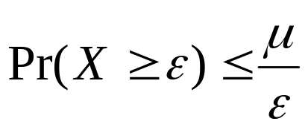
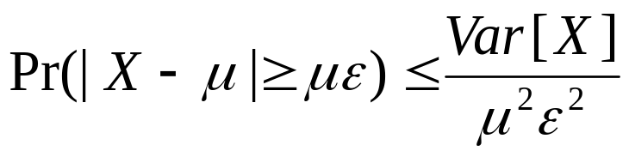
Tail Inequalities
General bounds on tail probability of a random variable (that is, probability that a random variable deviates far from its expectation)
Basic Inequalities: Let X be a random variable with expectation and variance Var[X]. Then for any
Probability
distribution
Tail probability
Markov:
Chebyshev:

Slide 13
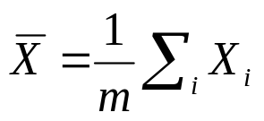

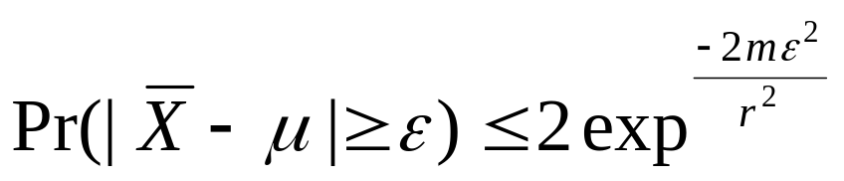
Tail Inequalities for Sums
Possible to derive stronger bounds on tail probabilities for the sum of independent random variables
Hoeffding’s Inequality: Let X1, ..., Xm be independent random variables with 0<=Xi <= r. Let and be the expectation of . Then, for any ,
Application to avg queries:
  m is size of subset of sample S satisfying predicate (3 in example)
  r is range of element values in sample (8 in example)
Application to count queries:
  m is size of sample S (4 in example)
  r is number of elements n in stream (12 in example)
More details in [HHW97]

Slide 14



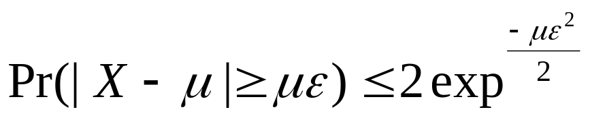
Tail Inequalities for Sums (Contd.)
Possible to derive even stronger bounds on tail probabilities for the sum of independent Bernoulli trials
Chernoff Bound: Let X1, ..., Xm be independent Bernoulli trials such that Pr[Xi=1] = p (Pr[Xi=0] = 1-p). Let and be the expectation of . Then, for any ,
Application to count queries:
  m is size of sample S (4 in example)
  p is fraction of odd elements in stream (2/3 in example)
Remark: Chernoff bound results in tighter bounds for count queries compared to Hoeffding’s inequality

Slide 15
Computing Stream Sample
Reservoir Sampling [Vit85]: Maintains a sample S of a fixed-size M
  Add each new element to S with probability M/n, where n is the current number of stream elements
  If add an element, evict a random element from S
  Instead of flipping a coin for each element, determine the number of elements to skip before the next to be added to S
Concise sampling [GM98]: Duplicates in sample S stored as <value, count> pairs (thus, potentially boosting actual sample size)
  Add each new element to S with probability 1/T (simply increment count if element already in S)
  If sample size exceeds M
    Select new threshold T’ > T
    Evict each element (decrement count) from S with probability 1-T/T’
  Add subsequent elements to S with probability 1/T’

Slide 16
Counting Samples [GM98]
Effective for answering hot list queries (k most frequent values)
  Sample S is a set of <value, count> pairs
  For each new stream element
    If element value in S, increment its count
    Otherwise, add to S with probability 1/T
  If size of sample S exceeds M, select new threshold T’ > T
    For each value (with count C) in S, decrement count in repeated tries until C tries or a try in which count is not decremented
      First try, decrement count with probability 1- T/T’
      Subsequent tries, decrement count with probability 1-1/T’
  Subject each subsequent stream element to higher threshold T’
Estimate of frequency for value in S: count in S + 0.418*T

Slide 17

Histograms
Histograms approximate the frequency distribution of element values in a stream
A histogram (typically) consists of
  A partitioning of element domain values into buckets
  A count per bucket B (of the number of elements in B)
Long history of use for selectivity estimation within a query optimizer [Koo80], [PSC84], etc.
[PIH96] [Poo97] introduced a taxonomy, algorithms, etc.

Slide 18
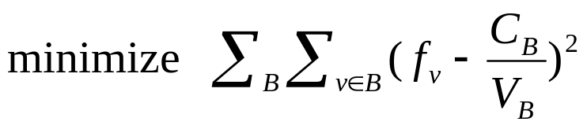
Types of Histograms
Equi-Depth Histograms
  Idea: Select buckets such that counts per bucket are equal
V-Optimal Histograms [IP95] [JKM98]
  Idea: Select buckets to minimize frequency variance within buckets
Count for
bucket
1 2 3 4 5 6 7 8 9 10 11 12 13 14 15 16 17 18 19 20
Domain values
Count for
bucket
1 2 3 4 5 6 7 8 9 10 11 12 13 14 15 16 17 18 19 20
Domain values

Slide 19
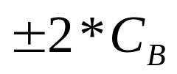
Answering Queries using Histograms [IP99]
(Implicitly) map the histogram back to an approximate relation, & apply the query to the approximate relation
Example: select count(*) from R where 4 <= R.e <= 15
For equi-depth histograms, maximum error:
Count spread
evenly among
bucket values
1 2 3 4 5 6 7 8 9 10 11 12 13 14 15 16 17 18 19 20
4 ≤ R.e ≤ 15
answer: 3.5 *

Slide 20
Equi-Depth Histogram Construction
For histogram with b buckets, compute elements with rank n/b, 2n/b, ..., (b-1)n/b
Example: (n=12, b=4)
Data stream: 9 3 5 2 7 1 6 5 8 4 9 1
After sort: 1 1 2 3 4 5 5 6 7 8 9 9
rank = 3
(.25-quantile)
rank = 9
(.75-quantile)
rank = 6
(.5-quantile)

Slide 21
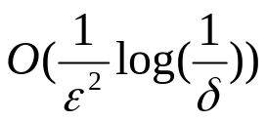






Computing Approximate Quantiles Using Samples
Problem: Compute element with rank r in stream
Simple sampling-based algorithm
  Sort sample S of stream and return element in position rs/n in sample (s is sample size)
  With sample of size , possible to show that rank of returned element is in with probability at least
    Hoeffding’s Inequality: probability that S contains greater than rs/n elements from is no more than
[CMN98][GMP97] propose additional sampling-based methods
Stream:
r
Sample S:
rs/n

Slide 22


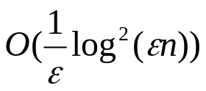
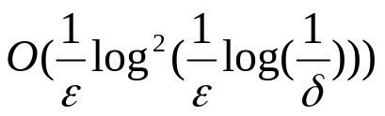
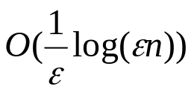
Algorithms for Computing Approximate Quantiles
[MRL98],[MRL99],[GK01] propose sophisticated algorithms for computing stream element with rank in
  Space complexity proportional to instead of
[MRL98], [MRL99]
  Probabilistic algorithm with space complexity
  Combined with sampling, space complexity becomes
[GK01]
  Deterministic algorithm with space complexity

Slide 23


Single-Pass Quantile Computation Algorithm [MRL 98]
Split memory M into b buffers of size k (M = bk)
For each successive set of k elements in stream
  If free buffer B exists
    insert k elements into B, set level of B to 0
  Else
    merge two buffers B and B’ at same level l
    output result of merge into B’, set level of B’ to l+1
    insert k elements into B, set level of B to 0
Output element in position r after making copies of each element in final buffer and sorting them
Merge operation (input buffers B and B’ at level l)
  Make copies of each element in B and B’
  Sort copies
  Output elements in positions in sorted sequence, j=0, ..., k-1

Slide 24
Single-Pass Algorithm (Example)
M=9, b=3, k=3, r =10
Computed quantile (r=10)
1 1 1 1 3 3 5 5 7 7 8 8
1 3 7
level = 2
1 2 3 5 7 9
1 3 7
1 5 8
level = 1
9 3 5
2 7 1
6 5 8
4 9 1
level = 0
1 1 1 1 3 3 3 3 7 7 7 7

Slide 25


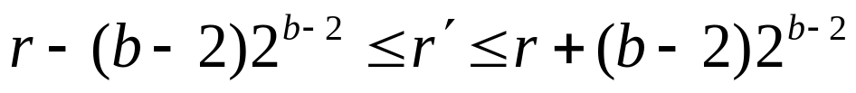

Analysis of Algorithm
b
Number of elements that are neither definitely small, nor definately large:
Algorithm returns element with rank r’, where
Choose smallest b such that and bk = M

Slide 26



















Computing Approximate Quantiles [GK01]
Synopsis structure S: sequence of tuples
: min/max rank of
: number of stream elements covered by
Invariants:
Sorted
sequence

Slide 27







Computing Quantile from Synopsis
Theorem: Let i be the max index such that . Then,

Slide 28








Inserting a Stream Element into the Synopsis
Let v be the value of the stream element, and and be tuples in S such that
Maintains invariants
elements per value
  for a tuple is never modified, after it is inserted
Inserted tuple
with value v

Slide 29




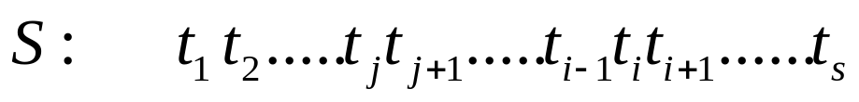









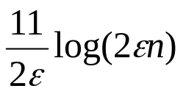
Overview of Algorithm & Analysis
Partition the values into “bands”
  Remember: we need to maintain => tuples in higher bands have more capacity ( = max. no. of observations that can be counted in )
Periodically (every observations) compress the quantile synopsis in a right-to-left pass
  Collapse ti into t(i+1) if: (a) t(i+1) is at a higher -band than ti, and (b)
Maintain our error invariant
Theorem: Maximum number of “alive” tuples from each -band is
  Overall space complexity:

Slide 30










Bands
values split into bands
size of band (adjusted as n increases)
Higher bands have higher capacities (due to smaller values)
Maximum value of in band :
Number of elements covered by tuples with bands in [0, ..., ]:
  elements per value
Bands:

Slide 31
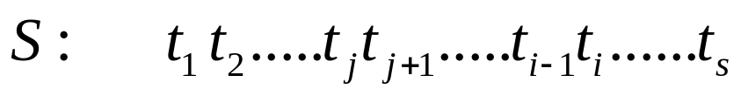


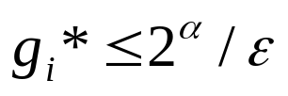
Tree Representation of Synopsis
Parent of tuple ti: closest tuple tj (j>i) with band(tj) > band(ti)
Properties:
  Descendants of ti have smaller band values than ti (larger values)
  Descendants of ti form a contiguous segment in S
  Number of elements covered by ti (with band ) and descendants:
    Note: gi* is sum of gi values of ti and its descendants
Collapse each tuple with parent or sibling in tree
root
Longest sequence of tuples
with band less than band(ti)

Slide 32


Compressing the Synopsis
Every elements, compress synopsis
For i from s-1 down to 1
    delete ti and all its descendants from S
Maintains invariants:
root

Slide 33




Analysis
Lemma: Both insert and compress preserve the invariant
Theorem: Let i be the max index in S such that . Then,
Lemma: Synopsis S contains at most tuples from each band
  For each tuple ti in S,
  Also, and
Theorem: Total number of tuples in S is at most
  Number of bands:

Slide 34
One-Dimensional Haar Wavelets
Wavelets: Mathematical tool for hierarchical decomposition of functions/signals
Haar wavelets: Simplest wavelet basis, easy to understand and implement
  Recursive pairwise averaging and differencing at different resolutions
Resolution Averages Detail Coefficients
3
[2, 2, 0, 2, 3, 5, 4, 4]
----
2
[2, 1, 4, 4]
[0, -1, -1, 0]
1
[1.5, 4]
[0.5, 0]
0
[2.75]
[-1.25]
Haar wavelet decomposition:
[2.75, -1.25, 0.5, 0, 0, -1, -1, 0]

Slide 35
Haar Wavelet Coefficients
Hierarchical decomposition structure (a.k.a. “error tree”)
Coefficient “Supports”
₊
2.75
₋
2.75
₊
+
-1.25
₋
+
-1.25
-
₊
0.5
₋
0.5
0
₊
+
-
+
-
0
₋
0
-1
-1
0
₊
0
₋
+
-
+
-
+
-
+
-
₊
₋
-1
2 2 0 2 3 5 4 4
₊
-1
₋
₊
Original frequency distribution
0

Slide 36
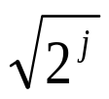
Wavelet-based Histograms [MVW98]
Problem: Range-query selectivity estimation
Key idea: Use a compact subset of Haar/linear wavelet coefficients for approximating frequency distribution
Steps
  Compute cumulative frequency distribution C
  Compute Haar (or linear) wavelet transform of C
  Coefficient thresholding : only m<<n coefficients can be kept
    Take largest coefficients in absolute normalized value
      Haar basis: divide coefficients at resolution j by
      Optimal in terms of the overall Mean Squared (L2) Error
    Greedy heuristic methods
      Retain coefficients leading to large error reduction
      Throw away coefficients that give small increase in error

Slide 37
Using Wavelet-based Histograms
Selectivity estimation: count(a<= R.e<= b) = C’[b] - C’[a-1]
  C’ is the (approximate) “reconstructed” cumulative distribution
  Time: O(min{m, logN}), where m = size of wavelet synopsis (number of coefficients), N= size of domain
Empirical results over synthetic data
  Improvements over random sampling and histograms
At most logN+1 coefficients are needed to reconstruct any C’ value
C’[a]

Slide 38


Dynamic Maintenance of Wavelet-based Histograms [MVW00]
Build Haar-wavelet synopses on the original frequency distribution
  Similar accuracy with CDF, makes maintenance simpler
Key issues with dynamic wavelet maintenance
  Change in single distribution value can affect the values of many coefficients (path to the root of the decomposition tree)
Change propagates up to the root coefficient
  As distribution changes, “most significant” (e.g., largest) coefficients can also change!
    Important coefficients can become unimportant, and vice-versa

Slide 39



Effect of Distribution Updates
Key observation: for each coefficient c in the Haar decomposition tree
  c = ( AVG(leftChildSubtree(c)) - AVG(rightChildSubtree(c)) ) / 2
+
-
+
-
Only coefficients on path(v) are affected and each can be updated in constant time
h

Slide 40


Maintenance Algorithm [MWV00] - Simplified Version
Histogram H: Top m wavelet coefficients
For each new stream element (with value v)
  For each coefficient c on path(v) and with “height” h
    If c is in H, update c (by adding or substracting )
  For each coefficient c on path(v) and not in H
    Insert c into H with probability proportional to (Probabilistic Counting [FM85])
      Initial value of c: min(H), the minimum coefficient in H
    If H contains more than m coefficients
      Delete minimum coefficient in H

Slide 41
Outline
Introduction & motivation
  Stream computation model, Applications
Basic stream synopses computation
  Samples, Equi-depth histograms, Wavelets
Mining data streams
  Decision trees, clustering
Sketch-based computation techniques
  Self-joins, Joins, Wavelets, V-optimal histograms
Advanced techniques
  Sliding windows, Distinct values, Hot lists
Future directions & Conclusions

Slide 42
Clustering Data Streams [GMMO01]
K-median problem definition:
Data stream with points from metric space
Find k centers in the stream such that the sum of distances from data points to their closest center is minimized.
Previous work: Constant-factor approximation algorithms
Two-step algorithm:
STEP 1: For each set of M records, S_{i}, find O(k) centers in S₁, …, S_{l}
  Local clustering: Assign each point in S_{i}to its closest center
STEP 2: Let S’ be centers for S₁, …, S_{l} with each center weighted by number of points assigned to it. Cluster S’ to find k centers
Algorithm forms a building block for more sophisticated algorithms (see paper).

Slide 43


One-Pass Algorithm - First Phase (Example)
M= 3, k=1, Data Stream:
1
2
4
5
3
1
2
4
5
3

Slide 44
One-Pass Algorithm - Second Phase (Example)
M= 3, k=1, Data Stream:
1
2
4
5
3
1
w=3
5
w=2
S’

Slide 45
Analysis
Observation 1: Given dataset D and solution with cost C where medians do not belong to D, then there is a solution with cost 2C where the medians belong to D.
Argument: Let m be the old median. Consider m’ in D closest to the m, and a point p.
  If p is closest to the median: DONE.
  If is not closest to the median: d(p,m’) <= d(p,m) + d(m,m’) <= 2*d(p,m)
1
m’
5
m
p

Slide 46
Analysis: First Phase
Observation 2: The sum of the optimal solution costs for the k-median problem for S₁, …, S_{l} is at most twice the cost of the optimal solution for S
1
1
cost S
2
2
4
4
5
cost S
3
3
Data Stream

Slide 47
Analysis: Second Phase
Observation 3: Cluster weighted medians S’
  Consider point x with median m* in S and median m in S_{i}.
  Let m belong to median m’ in S’
  Cost due to x in S’ = d(m,m’)
  Note that d(m,m*) <= d(m,x) + d(x,m*)
  → Optimal cost (with medians m* in S) <= sum cost(Si) + cost(S)
  Use Observation 1 to construct solution for medians m’ in S’ with additional factor 2.
cost Si
m
x
m’
cost S
5
m*

Slide 48


Overall Analysis of Algorithm
Final Result:
Cost of final solution is at most the sum of costs of S’ and S₁, …, S_{l,} which is at most a constant times (8) cost of S
If constant factor approximation algorithm is used to cluster S₁, …, S_{l} then simple algorithm yields constant factor approximation
Algorithm can be extended to cluster in more than 2 phases
1
1
w=3
cost
cost S’
2
2
4
w=2
4
5
5
cost
3
3
Data Stream
S’

Slide 49
Decision Trees
Age
Minivan
<30
>=30
YES
Sports,
Truck
YES
Car Type
YES
NO
Minivan
Sports, Truck
YES
NO
0
30
60
Age

Slide 50
Decision Tree Construction
Top-down tree construction schema:
  Examine training database and find best splitting predicate for the root node
  Partition training database
  Recurse on each child node
  BuildTree(Node t, Training database D, Split Selection Method S)
  (1) Apply S to D to find splitting criterion
  (2) if (t is not a leaf node)
  (3) Create children nodes of t
  (4) Partition D into children partitions
  (5) Recurse on each partition
  (6) endif

Slide 51
Decision Tree Construction (cont.)
Three algorithmic components:
  Split selection (CART, C4.5, QUEST, CHAID, CRUISE, …)
  Pruning (direct stopping rule, test dataset pruning, cost-complexity pruning, statistical tests, bootstrapping)
  Data access (CLOUDS, SLIQ, SPRINT, RainForest, BOAT, UnPivot operator)
Split selection
  Multitude of split selection methods in the literature
  Impurity-based split selection: C4.5

Slide 52
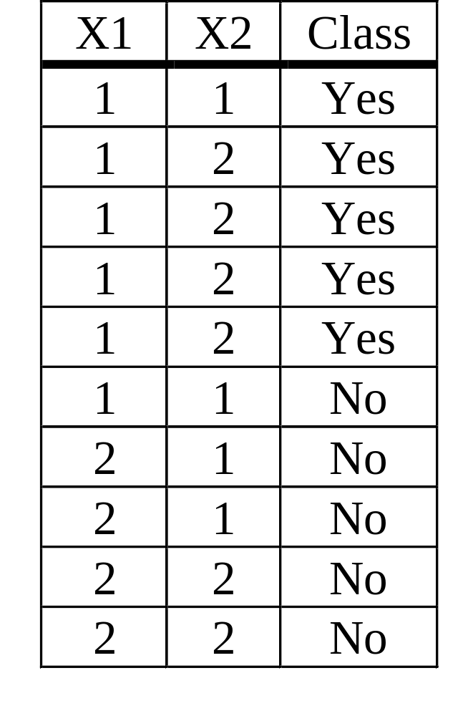
Intuition: Impurity Function
X1<=1 (50%,50%)
Yes
(83%,17%)
No
(0%,100%)
X2<=1 (50%,50%)
No
(25%,75%)
Yes
(66%,33%)

Slide 53

Impurity Function
Let p(j|t) be the proportion of class j training records at node t. Then the node impurity measure at node t:
i(t) = phi(p(1|t), …, p(J|t)) [estimated by empirical prob.]
Properties:
  phi is symmetric, maximum value at arguments (J⁻¹, …, J⁻¹),
  phi(1,0,…,0) = … =phi(0,…,0,1) = 0
The reduction in impurity through splitting predicate s on attribute X:
(s,X,t) = phi(t) – p_{L} phi(t_{L}) – p_{R} phi(t_{R})

Slide 54
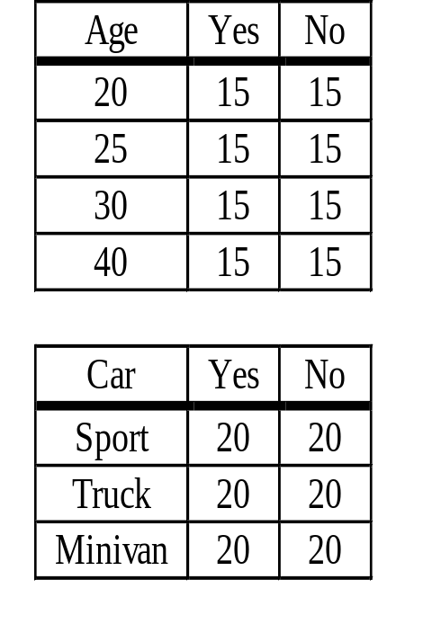
Split Selection
Select split attribute and predicate:
For each categorical attribute X, consider making one child node per category
For each numerical or ordered attribute X, consider all binary splits s of the form X <= x, where x in dom(X)
At a node t, select split s* such that
(s*,X*,t) is maximal over all
s,X considered
Estimation of empirical probabilities:
Use sufficient statistics

Slide 55
VFDT/CVFDT [DH00,DH01]
VFDT:
  Constructs model from data stream instead of static database
  Assumes the data arrives iid
  With high probability, constructs the identical model that a traditional (greedy) method would learn
CVFDT: Extension to time changing data

Slide 56
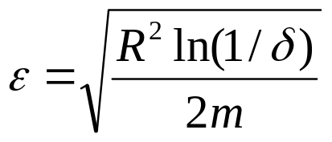
VFDT (Contd.)
Initialize T to root node with counts 0
For each record in stream
  Traverse T to determine appropriate leaf L for record
  Update (attribute, class) counts in L and compute best split function
  (s*,X,L) for each attribute X_{i}
  If there exists i: (s*, X_{i},L) - (s_{i}*,X,L) > ε for all X_{i} neq X -- (1)
    split L using attribute X_{i}
Compute value for ε using Hoeffding Bound
  Hoeffding Bound: If (s,X,L) takes values in range R, and L contains m records, then with probability 1-δ, the computed value of (s,X,L) (using m records in L) differs from the true value by at most ε
  Hoeffding Bound guarantees that if (1) holds, then X_{i} is correct choice for split with probability 1-δ

Slide 57

Single-Pass Algorithm (Example)
Packets > 10
Data Stream
yes
no
Protocol = http
Packets > 10
Data Stream
yes
no
Bytes > 60K
Protocol = http
yes
Protocol = ftp

Slide 58
Analysis of Algorithm
Result: Expected probability that constructed decision tree classifies a record differently from conventional tree is less than δ/p
  Here p is probability that a record is assigned to a leaf at each level

Slide 59
Comparison
Approach to decision trees:
Use inherent partially incremental offline construction of the data mining model to extend it to the data stream model
  Construct tree in the same way, but wait for significant differences
  Instead of re-reading dataset, use new data from the stream
  “Online aggregation model”
Approach to clustering:
Use offline construction as a building block
  Build larger model out of smaller building blocks
  Argue that composition does not loose too much accuracy
  “Composing approximate query operators”?

Slide 60
Outline
Introduction & motivation
  Stream computation model, Applications
Basic stream synopses computation
  Samples, Equi-depth histograms, Wavelets
Mining data streams
  Decision trees, clustering, association rules
Sketch-based computation techniques
  Self-joins, Joins, Wavelets, V-optimal histograms
Advanced techniques
  Distinct values, Sliding windows, Hot lists
Future directions & Conclusions

Slide 61
Query Processing over Data Streams
Stream-query processing arises naturally in Network Management
  Data tuples arrive continuously from different parts of the network
  Archival storage is often off-site (expensive access)
  Queries can only look at the tuples once, in the fixed order of arrival and with limited available memory
Network Operations
Center (NOC)
Data-Stream Join Query:
SELECT COUNT(*)
FROM R1, R2, R3
WHERE R1.A = R2.B = R3.C
Measurements
Alarms
R1
R2
R3
Network

Slide 62
Data Stream Processing Model
Approximate query answers often suffice (e.g., trend/pattern analyses)
  Build small synopses of the data streams online
  Use synopses to provide (good-quality) approximate answers
Stream Synopses
(in memory)
Data Streams
Stream
Processing
Engine
(Approximate)
Answer
Requirements for stream synopses
  Single Pass: Each tuple is examined at most once, in fixed (arrival) order
  Small Space: Log or poly-log in data stream size
  Real-time: Per-record processing time (to maintain synopsis) must be low

Slide 63
Stream Data Synopses
Conventional data summaries fall short
  Quantiles and 1-d histograms: Cannot capture attribute correlations
  Samples (e.g., using Reservoir Sampling) perform poorly for joins
  Multi-d histograms/wavelets: Construction requires multiple passes over the data
Different approach: Randomized sketch synopses
  Only logarithmic space
  Probabilistic guarantees on the quality of the approximate answer
Overview
  Basic technique
  Extension to relational query processing over streams
  Extracting wavelets and histograms from sketches
  Extensions (stable distributions, distinct values, quantiles)

Slide 64
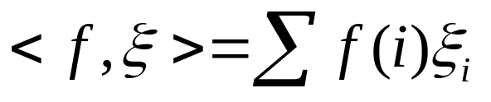


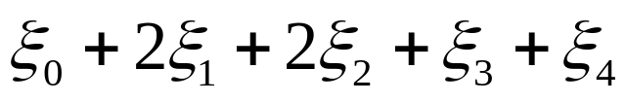
Randomized Sketch Synopses for Streams
Goal: Build small-space summary for distribution vector f(i) (i=0,..., N-1) seen as a stream of i-values
Basic Construct: Randomized Linear Projection of f() = inner/dot product of f-vector
  Simple to compute over the stream: Add whenever the i-th value is seen
  Generate ‘s in small space using pseudo-random generators
  Tunable probabilistic guarantees on approximation error
2
2
1
1
1
Data stream: 2, 0, 1, 3, 1, 2, 4, . . .
f(0) f(1) f(2) f(3) f(4)
where = vector of random values from an appropriate distribution
Data stream: 2, 0, 1, 3, 1, 2, 4, . . .
Used for low-distortion vector-space embeddings [JL84]
  Applicability to bounded-space stream computation in [AMS96]

Slide 65
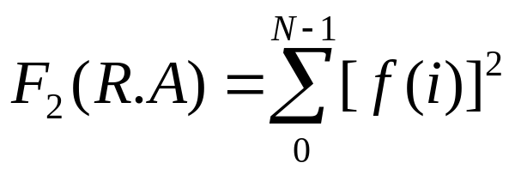

Sketches for 2nd Moment Estimation over Streams [AMS96]
Problem: Tuples of relation R are streaming in -- compute the 2nd frequency moment of attribute R.A, i.e.,
, where f(i) = frequency( i-th value of R.A)
(size of the self-join on R.A)
Exact solution: too expensive, requires O(N) space!!
  How do we do it in small (O(logN)) space??
COUNT( R R )
A

Slide 66
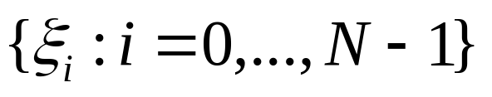
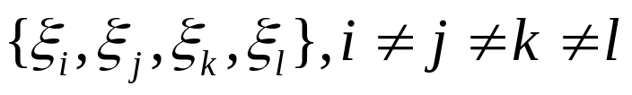

Sketches for 2nd Moment Estimation over Streams [AMS96] (cont.)
Key Intuition: Use randomized linear projections of f() to define a random variable X such that
  X is easily computed over the stream (in small space)
  E[X] = F2 (unbiased estimate)
  Var[X] is small
Technique
  Define a family of 4-wise independent {-1, +1} random variables
    P[ =1] = P[ =-1] = 1/2
    Any 4-tuple is mutually independent
    Generate values on the fly : pseudo-random generator using only O(logN) space (for seeding)!
Probabilistic Error Guarantees

Slide 67
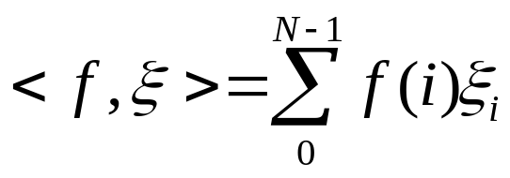


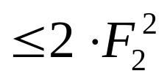
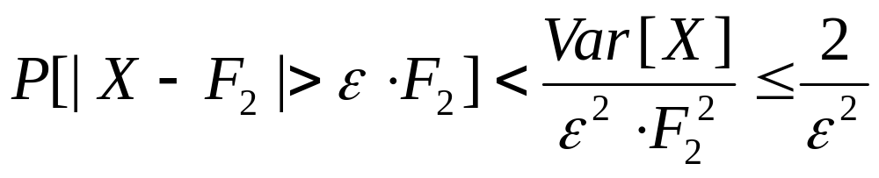
Sketches for 2nd Moment Estimation over Streams [AMS96] (cont.)
Technique (cont.)
  Compute the random variable Z =
    Simple linear projection: just add to Z whenever the i-th value is observed in the R.A stream
  Define X =
Using 4-wise independence, show that
  E[X] = and Var[X]
By Chebyshev:

Slide 68
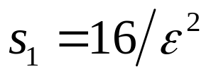
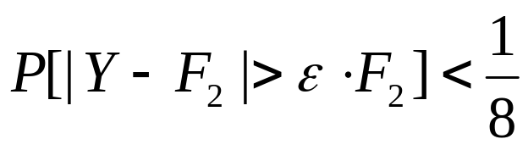




Sketches for 2nd Moment Estimation over Streams [AMS96] (cont.)
Boosting Accuracy and Confidence
  Build several independent, identically distributed (iid) copies of X
  Use averaging and median-selection operations
  Y = average of iid copies of X (=> Var[Y] = Var[X]/s1 )
    By Chebyshev:
  W = median of iid copies of Y
“failure” , Prob < 1/8
F2 (1-epsilon)
F2
F2 (1+epsilon)
Each Y = Binomial trial
“success”
Prob[ # failures in s2 trials s2/2 = (1+3) s2/8]
(by Chernoff bounds)

Slide 69



Sketches for 2nd Moment Estimation over Streams [AMS96] (cont.)
Total space = O(s1*s2*logN)
  Remember: O(logN) space for “seeding” the construction of each X
Main Theorem
  Construct approximation to F2 within a relative error of with probability using only space
[AMS96] also gives results for other moments and space-complexity lower bounds (communication complexity)
  Results for F2 approximation are space-optimal (up to a constant factor)

Slide 70
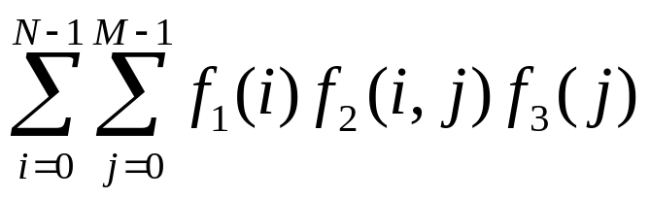

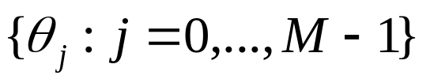
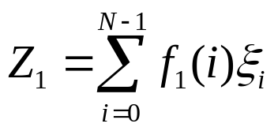
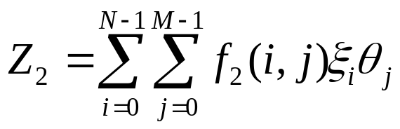
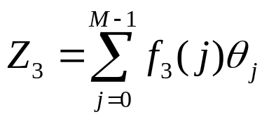
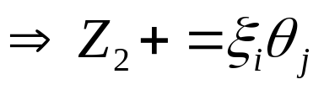
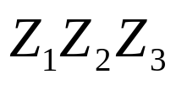
Sketches for Stream Joins and Multi-Joins [AGM99, DGG02]
COUNT =
SELECT COUNT(*)/SUM(E)
FROM R1, R2, R3
WHERE R1.A = R2.B, R2.C = R3.D
( fk() denotes frequencies in Rk )
4-wise independent {-1,+1} families
(generated independently)
R1
R2
R3
A
B
C
D
Update:
R2-tuple with (B,C) = (i,j)
Define X = -- E[X] = COUNT (unbiased), O(logN+logM) space

Slide 71

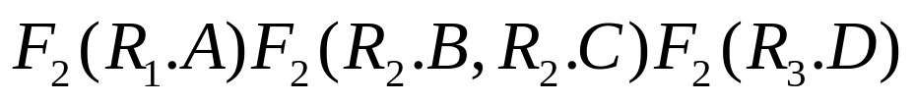
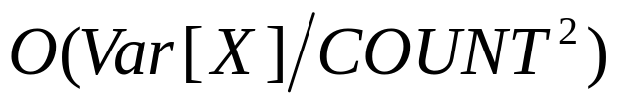
Sketches for Stream Joins and Multi-Joins [AGM99, DGG02] (cont.)
SELECT COUNT(*)
FROM R1, R2, R3
WHERE R1.A = R2.B, R2.C = R3.D
Define X = , E[X] = COUNT
Unfortunately, Var[X] increases with the number of joins!!
Var[X] = O( self-join sizes) = O( )
By Chebyshev: Space needed to guarantee high (constant) relative error probability for X is
  Strong guarantees in limited space only for joins that are “large” (wrt self-join sizes)!
Proposed solution: Sketch Partitioning [DGG02]

Slide 72

Overview of Sketch Partitioning [DGG02]
Key Intuition: Exploit coarse statistics on the data stream to intelligently partition the join-attribute space and the sketching problem in a way that provably tightens our error guarantees
  Coarse historical statistics on the stream or collected over an initial pass
  Build independent sketches for each partition ( Estimate = partition sketches, Variance = partition variances)
10
10
self-join(R1.A)*self-join(R2.B) = 205*205 = 42K
2
1
dom(R1.A)
10
10
self-join(R1.A)*self-join(R2.B) +
self-join(R1.A)*self-join(R2.B) = 200*5 +200*5 = 2K
2
1
dom(R2.B)

Slide 73
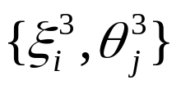
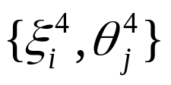
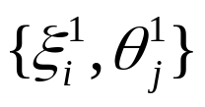
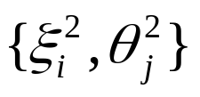
Overview of Sketch Partitioning [DGG02] (cont.)
M
X3
X4
SELECT COUNT(*)
FROM R1, R2, R3
WHERE R1.A = R2.B, R2.C = R3.D
dom(R2.C)
Independent
Families
X1
X2
dom(R2.B)
N
Maintenance: Incoming tuples are mapped to the appropriate partition(s) and the corresponding sketch(es) are updated
  Space = O(k(logN+logM)) (k=4= no. of partitions)
Final estimate X = X1+X2+X3+X4 -- Unbiased, Var[X] = Var[Xi]
Improved error guarantees
  Var[X] is smaller (by intelligent domain partitioning)
  “Variance-aware” boosting
    More space for iid sketch copies to regions of high expected variance (self-join product)

Slide 74
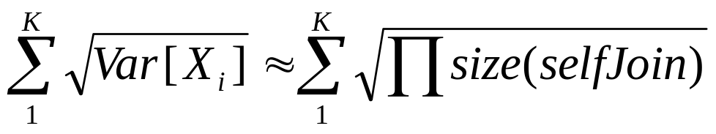

Overview of Sketch Partitioning [DGG02] (cont.)
Space allocation among partitions: Easy to solve optimally once the domain partitioning is fixed
Optimal domain partitioning: Given a K, find a K-partitioning that minimizes
Can solve optimally for single-join queries (using Dynamic Programming)
NP-hard for queries with 2 joins!
Proposed an efficient DP heuristic (optimal if join attributes in each relation are independent)
More details in the paper . . .

Slide 75


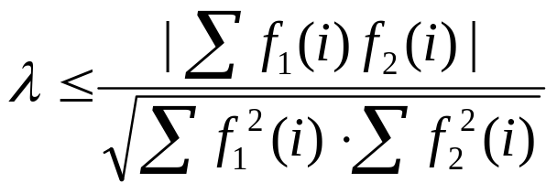

Stream Wavelet Approximation using Sketches [GKM01]
Single-join approximation with sketches [AGM99]
  Construct approximation to |R1 R2| = within a relative error of with probability using space
, where
= |R1 R2| / Sqrt( self-join sizes)
Observation: |R1 R2| = = inner product!!
  General result for inner-product approximation using sketches
Other inner products of interest: Haar wavelet coefficients!
  Haar wavelet decomposition = inner products of signal/distribution with specialized (wavelet basis) vectors

Slide 76
Haar Wavelet Decomposition
Wavelets: mathematical tool for hierarchical decomposition of functions/signals
Haar wavelets: simplest wavelet basis, easy to understand and implement
  Recursive pairwise averaging and differencing at different resolutions
Resolution Averages Detail Coefficients
3
D = [2, 2, 0, 2, 3, 5, 4, 4]
----
2
[2, 1, 4, 4]
[0, -1, -1, 0]
1
[1.5, 4]
[0.5, 0]
0
[2.75]
[-1.25]
Haar wavelet decomposition:
[2.75, -1.25, 0.5, 0, 0, -1, -1, 0]
Compression by ignoring small coefficients

Slide 77

Haar Wavelet Coefficients
Hierarchical decomposition structure ( a.k.a. Error Tree )
2.75
Reconstruct data values d(i)
  d(i) = (+/-1) * (coefficient on path)
+
+
-1.25
-
0.5
0
+
-
+
-
0
-1
-1
0
+
-
+
-
+
-
+
-
Original data
2 2 0 2 3 5 4 4
Coefficient thresholding : only B<<|D| coefficients can be kept
  B is determined by the available synopsis space
  B largest coefficients in absolute normalized value
  Provably optimal in terms of the overall Sum Squared (L2) Error

Slide 78

Stream Wavelet Approximation using Sketches [GKM01] (cont.)
Each (normalized) coefficient ci in the Haar decomposition tree
  ci = NORMi * ( AVG(leftChildSubtree(ci)) - AVG(rightChildSubtree(ci)) ) / 2
Overall average c0 = <f, w0> = <f , (1/N, . . ., 1/N)>
1/N
w0 =
0
N-1
+
-
+
-
ci = <f, wi>
wi =
0
N-1
f()
Use sketches of f() and wavelet-basis vectors to extract “large” coefficients
Key: “Small-B Property” = Most of f()’s “energy” = is concentrated in a small number B of large Haar coefficients

Slide 79








Stream Wavelet Approximation using Sketches [GKM01]: The Method
Input: “Stream of tuples” rendering of a distribution f() that has a B-Haar coefficient representation with energy
Build sufficient sketches on f() to accurately (within ) estimate all Haar coefficients ci = <f, wi> such that |ci|
  By the single-join result (with ) the space needed is
  comes from “union bound” (need all coefficients with probability )
Keep largest B estimated coefficients with absolute value
Theorem: The resulting approximate representation of (at most) B Haar coefficients has energy with probability
First provable guarantees for Haar wavelet computation over data streams

Slide 80
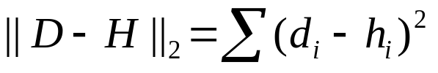
Multi-d Histograms over Streams using Sketches [TGI02]
Multi-dimensional histograms: Approximate joint data distribution over multiple attributes
Distribution D
Histogram H
B
B
v1
v5
v4
v2
v3
A
A
“Break” multi-d space into hyper-rectangles (buckets) & use a single frequency parameter (e.g., average frequency) for each
  Piecewise constant approximation
  Useful for query estimation/optimization, approximate answers, etc.
Want a histogram H that minimizes L2 error in approximation, i.e., for a given number of buckets (V-Optimal)
  Build over a stream of data tuples??

Slide 81

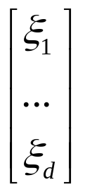
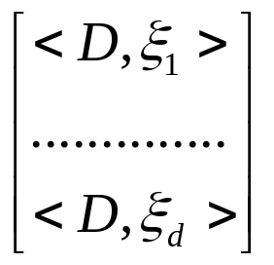





Multi-d Histograms over Streams using Sketches [TGI02] (cont.)
View distribution and histograms over {0,...,N-1}x...x{0,...,N-1} as -dimensional vectors
Use sketching to reduce vector dimensionality from N^k to (small) d
D (N^k entries)
d entries (sketches of D)
*
* D =
Johnson-Lindenstrauss Lemma[JL84]: Using d= guarantees that L2 distances with any b-bucket histogram H are approximately preserved with high probability; that is, is within a relative error of from for any b-bucket H

Slide 82




Multi-d Histograms over Streams using Sketches [TGI02] (cont.)
Algorithm
  Maintain sketch of the distribution D on-line
  Use the sketch to find histogram H such that is minimized
    Start with H = and choose buckets one-by-one greedily
    At each step, select the bucket that minimizes
Resulting histogram H: Provably near-optimal wrt minimizing (with high probability)
  Key: L2 distances are approximately preserved (by [JL84])
Various heuristics to improve running time
  Restrict possible bucket hyper-rectangles
  Look for “good enough” buckets

Slide 83



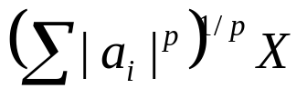



Extensions: Sketching with Stable Distributions [Ind00]
Idea: Sketch the incoming stream of values rendering the distribution f() using random vectors from “special” distributions
p-stable distribution
    If X1,..., Xn are iid with distribution , a1,..., an are any real numbers
    Then, has the same distribution as , where X has distribution
Known to exist for any p (0,2]
  p=1: Cauchy distribution
  p=2: Gaussian (Normal) distribution
For p-stable : Know the exact distribution of
    Basically, sample from where X = p-stable random var.
    Stronger than reasoning with just expectation and variance!
    NOTE: the Lp norm of f()

Slide 84



Extensions: Sketching with Stable Distributions [Ind00] (cont.)
Use independent sketches with p-stable ‘s to approximate the Lp norm of the f()-stream ( ) within with probability
  Use the samples of to estimate
  Works for any p (0,2] (extends [AMS96], where p=2)
  Describe pseudo-random generator for the p-stable ‘s
[CDI02] uses the same basic technique to estimate the Hamming (L0) norm over a stream
  Hamming norm = number of distinct values in the stream
    Hard estimation problem!
  Key observation: Lp norm with p->0 gives good approximation to Hamming
    Use p-stable sketches with very small p (e.g., 0.02)

Slide 85
Key Benefit of Linear-Projection Summaries: Deletions!
Straightforward to handle item deletions in the stream
  To delete element i ( f(i) = f(i) –1 ) simply subtract from the running randomized linear projection estimate
  Applies to all techniques described earlier
[GKM02] use randomized linear projections for quantile estimation
  First method to provide guaranteed-error quantiles in small space in the presence of general transactions (inserts + deletes)
  Earlier techniques
    Cannot be extended to handle deletions, or
    Require re-scanning the data to obtain fresh sample

Slide 86


Random-Subset-Sums (RSSs) for Quantile Estimation [GKM02]
Key Idea: Maintain frequency sums for random subsets of intervals at multiple resolutions
For each level j
  Pick a random subset S of points (intervals): each point is chosen w/ prob. ½
  Maintain the sum of all frequencies in S’s intervals: f(S) = f(I)
  Repeat to boost accuracy & confidence
f(U) = N = total element count
Points at different levels correspond to dyadic intervals: [k2^i, (k+1)2^i)
1 + log|U| levels
0
U-1
Random-Subset-Sum (RSS) Synopsis

Slide 87
Random-Subset-Sums (RSSs) for Quantile Estimation [GKM02] (cont.)
Each RSS is a randomized linear projection of the frequency vector f()
  = 1 if i belongs in the union of intervals in S; 0 otherwise
Maintenance: Insert/Delete element i
  Find dyadic intervals containing i ( check high-order bits of binary(i) )
  Update (+1/-1) all RSSs whose subsets contain these intervals
Making it work in small space & time
  Cannot explicitly maintain the random subsets S ( O(|U|) space! )
  Instead, use a O(log|U|) size seed and a pseudo-random function to determine each random subset S
    pairwise independence amongst the members of S is sufficient
    Membership can be tested in only O(log|U|) time

Slide 88


Random-Subset-Sums (RSSs) for Quantile Estimation [GKM02] (cont.)
Estimating f(I), I = interval
For a dyadic interval I: Go to the appropriate level, and use the RSSs to compute the conditional expectation
  Only use the maintained RSSs whose subset contains S (about half the RSSs at that level)
  Note that:
  Use this expression to obtain an estimate for f(I)
For an arbitrary interval I: Write I as the disjoint union of at most O(log|U|) dyadic intervals
  Add up the estimates for all dyadic-interval components
  Variance of the estimate increases by O(log|U|)
Use averaging and median-selection over iid copies (as in [AMS96]) to boost accuracy and confidence

Slide 89



Random-Subset-Sums (RSSs) for Quantile Estimation [GKM02] (cont.)
Estimating approximate quantiles
Want a value v such that:
  Use f(I) estimates in a binary search over the domain [0…U-1]
Theorem: The RSS method computes an -approximate quantile over a stream of insertions/deletions with probability using space of
First technique to deal with general transaction streams
RSS synopses are composable
  Can be computed independently over different parts of the stream (e.g., in a distributed setting)
  RSSs for the entire stream can be composed by simple summation
  Another benefit of linear projections!!

Slide 90
More work on Sketches...
Low-distortion vector-space embeddings (JL Lemma) [Ind01] and applications
  E.g., approximate nearest neighbors [IM98]
Discovering patterns and periodicities in time-series databases [IKM00, CIK02]
Maintaining top-k item frequencies over a stream [CCF02]
Data cleaning [DJM02]
Other sketching references
  Histogram/wavelet extraction [GGI02, GIM02]
  Stream norm computation [FKS99]

Slide 91
Outline
Introduction & motivation
  Stream computation model, Applications
Basic stream synopses computation
  Samples, Equi-depth histograms, Wavelets
Mining data streams
  Decision trees, clustering
Sketch-based computation techniques
  Self-joins, Joins, Wavelets, V-optimal histograms
Advanced techniques
  Distinct values, Sliding windows
Future directions & Conclusions

Slide 92

Distinct Value Estimation
Problem: Find the number of distinct values in a stream of values with domain [0,...,N-1]
  Zeroth frequency moment , L0 (Hamming) stream norm
  Statistics: number of species or classes in a population
  Important for query optimizers
  Network monitoring: distinct destination IP addresses, source/destination pairs, requested URLs, etc.
Example (N=8)
Data stream: 3 0 5 3 0 1 7 5 1 0 3 7
Number of distinct values: 5

Slide 93
Distinct Value Estimation
Uniform Sampling-based approaches
  Collect and store uniform random sample, apply an appropriate estimator
  Extensive literature (see, e.g., [CCM00]) – hard problem for sampling!!
    Many estimators proposed, but estimates are often inaccurate
    [CCM00] proved must examine (sample) almost the entire table to guarantee the estimate is within a factor of 10 with probability > 1/2, regardless of the function used!
One-pass approaches (single scan + incremental maintenance)
  Hash functions to map domain values values to bit positions in a bitmap [FM85, AMS96]
  Extension to handle predicates (“distinct values queries”) [Gib01]

Slide 94
Distinct Value Estimation Using Hashing [FM85]
Assume a hash function h(x) that maps incoming values x in [0,…, N-1] uniformly across [0,…, 2^L-1], where L = O(logN)
Let r(y) denote the position of the least-significant 1 bit in the binary representation of y
  A value x is mapped to r(h(x))
We maintain a BITMAP array of L bits, initialized to 0
  For each incoming value x, set BITMAP[ r(h(x)) ] = 1
BITMAP
5 4 3 2 1 0
x = 5
h(x) = 101100
r(h(x)) = 2
0
0
0
1
0
0

Slide 95





Distinct Value Estimation Using Hashing [FM85] (cont.)
By uniformity through h(x): Prob[ BITMAP[k]=1 ] = Prob[ ] =
  Assuming d distinct values: expect d/2 to map to BITMAP[0] , d/4 to map to BITMAP[1], . . .
Let R = position of rightmost zero in BITMAP
  Use as indicator of log(d)
[FM85] prove that E[R] = , where
  Estimate d =
  Averaging over several iid instances (different hash functions) to reduce estimator variance
BITMAP
L-1
0
0
0
0
0
0
0
1
0
1
0
1
1
1
1
1
1
1
1
fringe of 0/1s around log(d)
position >> log(d)
position << log(d)

Slide 96


Distinct Value Estimation
[FM85] assume “ideal” hash functions h(x) (N-wise independence)
  [AMS96] prove a similar result using simple linear hash functions (only pairwise independence)
    h(x) = , where a, b are random binary vectors in [0,…,2^L-1]
[CDI02] Hamming norm estimation using p-stable sketching with p->0
  Based on randomized linear projections can readily handle deletions
  Also, composable: Hamming norm estimation over multiple streams
    E.g., number of positions where two streams differ

Slide 97
Generalization: Distinct Values Queries
SELECT COUNT( DISTINCT target-attr )
FROM relation
WHERE predicate
SELECT COUNT( DISTINCT o_custkey )
FROM orders
WHERE o_orderdate >= ‘2002-01-01’
  “How many distinct customers have placed orders this year?”
  Predicate not necessarily only on the DISTINCT target attribute
Approximate answers with error guarantees over a stream of tuples?
Template
TPC-H example

Slide 98
Distinct Sampling [Gib01]
Key Ideas
Use FM-like technique to collect a specially-tailored sample over the distinct values in the stream
  Uniform random sample of the distinct values
  Very different from traditional URS: each distinct value is chosen uniformly regardless of its frequency
  DISTINCT query answers: simply scale up sample answer by sampling rate
To handle additional predicates
  Reservoir sampling of tuples for each distinct value in the sample
  Use reservoir sample to evaluate predicates

Slide 99

Building a Distinct Sample [Gib01]
Use FM-like hash function h() for each streaming value x
  Prob[ h(x) = k ] =
Key Invariant: “All values with h(x) >= level (and only these) are in the distinct sample”
DistinctSampling( B , r )
// B = space bound, r = tuple-reservoir size for each distinct value
level = 0; S =
for each new tuple t do
let x = value of DISTINCT target attribute in t
if h(x) >= level then // x belongs in the distinct sample
use t to update the reservoir sample of tuples for x
if |S| >= B then // out of space
evict from S all tuples with h(target-attribute-value) = level
set level = level + 1

Slide 100



Using the Distinct Sample [Gib01]
If level = l for our sample, then we have selected all distinct values x such that h(x) >= l
  Prob[ h(x) >= l ] =
  By h()’s randomizing properties, we have uniformly sampled a fraction of the distinct values in our stream
Query Answering: Run distinct-values query on the distinct sample and scale the result up by
Distinct-value estimation: Guarantee ε relative error with probability 1 - δ using O(log(1/δ)/ε^2) space
  For q% selectivity predicates the space goes up inversely with q
Experimental results: 0-10% error vs. 50-250% error for previous best approaches, using 0.2% to 10% synopses
Our sampling rate!

Slide 101
Distinct Sampling Example
B=3, N=8 (r = 0 to simplify example)
Data stream: 3 0 5 3 0 1 7 5 1 0 3 7
0 1 3 5 7
0 1 0 1 0
hash:
Data stream: 1 7 5 1 0 3 7
S={3,0,5}, level = 0
S={1,5}, level = 1
Computed value: 4

Slide 102
Sliding Window Model
Model
  At every time t, a data record arrives
  The record “expires” at time t+N (N is the window length)
When is it useful?
  Make decisions based on “recently observed” data
  Stock data
  Sensor networks

Slide 103
Remark: Data Stream Models
Tuples arrive X₁, X₂, X₃, …, X_{t}, …
Function f(X,t,NOW)
  Input at time t: f(X₁,1,t), f(X₂,2,t). f(X₃,3,t), …, f(X_{t},t,t)
  Input at time t+1: f(X₁,1,t+1), f(X₂,2,t+). f(X₃,3,t+1), …, f(X_{t+1},t+1,t+1)
Full history: F == identity
Partial history: Decay
  Exponential decay: f(X,t, NOW) = 2^{-(NOW-t)}*X
    Input at time t: 2^{-(t-1)}*X₁, 2^{-(t-2)}*X₂,, …, ½ * X_{t-1},X_{t}
    Input at time t+1: 2^{-t}*X₁, 2^{-(t-1)}*X₂,, …, 1/4 * X_{t-1}, ½ *X_{t,} X_{t+1}
  Sliding window (special type of decay):
    f(X,t,NOW) = X if NOW-t < N
    f(X,t,NOW) = 0, otherwise
    Input at time t: X₁, X₂, X₃, …, X_{t}
    Input at time t+1: X₂, X₃, …, X_{t,} X_{t+1,}

Slide 104
Simple Example: Maintain Max
Problem: Maintain the maximum value over the last N numbers.
Consider all non-decreasing arrangements of N numbers (Domain size R):
  There are ((N+R) choose N) arrangement
  Lower bound on memory required:
  log(N+R choose N) >= N*log(R/N)
  So if R=poly(N), then lower bound says that we have to store the last N elements (Ω(N log N) memory)

Slide 105
Statistics Over Sliding Windows
Bitstream: Count the number of ones [DGIM02]
  Exact solution: Θ(N) bits
  Algorithm BasicCounting:
    1 + ε approximation (relative error!)
    Space: O(1/ε (log²N)) bits
    Time: O(log N) worst case, O(1) amortized per record
  Lower Bound:
    Space: Ω(1/ε (log²N)) bits

Slide 106
Approach 1: Temporal Histogram
Example: … 01101010011111110110 0101 …
Equi-width histogram:
… 0110 1010 0111 1111 0110 0101 …
Issues:
  Error is in the last (leftmost) bucket.
  Bucket counts (left to right): C_{m},C_{m-1}, …,C₂,C₁
  Absolute error <= C_{m}/2.
  Answer >= C_{m-1}+…+C₂+C₁+1.
  Relative error <= C_{m}/2(C_{m-1}+…+C₂+C₁+1).
  Maintain: C_{m}/2(C_{m-1}+…+C₂+C₁+1) <= ε (=1/k).

Slide 107
Naïve: Equi-Width Histograms
Goal: Maintain C_{m}/2 <= ε (C_{m-1}+…+C₂+C₁+1)
Problem case:
… 0110 1010 0111 1111 0110 1111 0000 0000 0000 0000 …
Note:
  Every Bucket will be the last bucket sometime!
  New records may be all zeros ➔
  For every bucket i, require C_{i}/2 <= ε (C_{i-1}+…+C₂+C₁+1)

Slide 108
Exponential Histograms
Data structure invariant:
  Bucket sizes are non-decreasing powers of 2
  For every bucket other than the last bucket, there are at least k/2 and at most k/2+1 buckets of that size
  Example: k=4: (1,1,2,2,2,4,4,4,8,8,..)
Invariant implies:
  Case 1: C_{i} > C_{i}-1: C_{i}=2^{j}, C_{i-1}=2^{j-1}
  C_{i-1}+…+C₂+C₁+1 >= k*(Σ(1+2+4+..+2^{j-1})) >= k*2^{j} >= k*C_{i}
  Case 2: C_{i} = C_{i}-1: C_{i}=2^{j}, C_{i-1}=2^{j}
  C_{i-1}+…+C₂+C₁+1 >= k*(Σ(1+2+4+..+2^{j-1})) + 2^{j} >= k*2^{j}/2 >= k*C_{i}/2

Slide 109
Complexity
Number of buckets m:
  m <= [# of buckets of size j]*[# of different bucket sizes]
  <= (k/2 +1) * ((log(2N/k)+1) = O(k* log(N))
Each bucket requires O(log N) bits.
Total memory:
O(k log² N) = O(1/ε * log² N) bits
Invariant maintains error guarantee!

Slide 110
Algorithm
Data structures:
For each bucket: timestamp of most recent 1, size
LAST: size of the last bucket
TOTAL: Total size of the buckets
New element arrives at time t
If last bucket expired, update LAST and TOTAL
If (element == 1)
Create new bucket with size 1; update TOTAL
Merge buckets if there are more than k/2+2 buckets of the same size
Update LAST if changed
Anytime estimate: TOTAL – (LAST/2)

Slide 111
Example Run
If last bucket expired, update LAST and TOTAL
If (element == 1)
Create new bucket with size 1; update TOTAL
Merge buckets if there are more than k/2+2 buckets of the same size
Update LAST if changed
  32,16,8,8,4,4,2,1,1
  32,16,8,8,4,4,2,2,1
  32,16,8,8,4,4,2,2,1,1
  32,16,16,8,4,2,1

Slide 112
Lower Bound
Argument: Count number of different arrangements that the algorithm needs to distinguish
  log(N/B) blocks of sizes B,2B,4B,…,2^{i}B from right to left.
  Block i is subdivided into B blocks of size 2^{i} each.
  For each block (independently) choose k/4 sub-blocks and fill them with 1.
Within each block: (B choose k/4) ways to place the 1s
(B choose k/4)^{log(N/B)} distinct arrangements

Slide 113
Lower Bound (Continued)
Example:
Show: An algorithm has to distinguish between any such two arrangements

Slide 114
Lower Bound (Continued)
Assume we do not distinguish two arrangements:
  Differ at block d, sub-block b
Consider time when b expires
  We have c full sub-blocks in A1, and c+1 full sub-blocks in A2 [note: c+1<=k/4]
  A1: c2^{d}+sum1 to d-1 k/4*(1+2+4+..+2^{d-1})
  = c2^{d}+k/2*(2^{d}-1)
  A2: (c+1)2^{d}+k/4*(2^{d}-1)
  Absolute error: 2^{d-1}
  Relative error for A2:
  2^{d-1}/[(c+1)2^{d}+k/4*(2^{d}-1)] >= 1/k = ε
b

Slide 115
Lower Bound (cont.)
Calculation:
  A1: c2^{d}+sum1 to d-1 k/4*(1+2+4+..+2^{d-1})
  = c2^{d}+k/2*(2^{d}-1)
  A2: (c+1)2^{d}+k/4*(2^{d}-1)
  Absolute error: 2^{d-1}
  Relative error:
  2^{d-1}/[(c+1)2^{d}+k/4*(2^{d}-1)] >=
  2^{d-1}/[2*k/4* 2^{d}] = 1/k = ε
A2
A1

Slide 116
More Sliding Window Results
Maintain the sum of last N positive integers in range {0,…,R}.
Results:
  1 + ε approximation.
  1/ε(log N) (log N + log R) bits.
  O( log R/log N) amortized, (log N + log R) worst case.
Lower Bound:
  1/ε(logN)(log N + log R) bits.
Variance
Clusters

Slide 117
Outline
Introduction & motivation
  Stream computation model, Applications
Basic stream synopses computation
  Samples, Equi-depth histograms, Wavelets
Mining data streams
  Decision trees, clustering
Sketch-based computation techniques
  Self-joins, Joins, Wavelets, V-optimal histograms
Advanced techniques
  Distinct values, Sliding windows
Future directions & Conclusions

Slide 118
Future Research Directions
Three favorite problems; generic laundry list follows:
Appropriate “stream algebra” (operators + composition rules)
  Progress: Aurora, Telegraph, STREAM
Lower bounds & tradeoffs for data-streaming problems
  E.g., no. of passes vs. space requirements (“p passes f(N,p) space”)
Making sketches ready for prime-time
  Approximating set-valued query results
  Multiple standing queries
  Beyond relational tuples and numeric attributes
  Most appropriate sketching technique for incorporation in DBMSs?

Slide 119
Data Streaming - Future Research Laundry List
Stream processing system architectures
Memory management for stream processing
Integration of stream processing and databases
Stream indexing, searching, and similarity matching
Exploiting prior knowledge for stream computation
User-interface issues
  Exposing approximation model to the user
Content-based routing, filtering, and correlation of XML data streams
Novel stream processing applications
  Sensor networks, financial analysis, etc.

Slide 120
Conclusions
Querying and finding patterns in massive streams is a real problem with many “real-world” applications
Fundamentally rethink data-management issues under stringent constraints
  Single-pass algorithms with limited memory resources
A lot of progress in the last few years
  Algorithms, system models & architectures
    Aurora (Brandeis/Brown/MIT)
    Niagara (Wisconsin)
    STREAM (Stanford)
    Telegraph (Berkeley)
Commercial acceptance still lagging, but will most probably grow in coming years
  Specialized systems (e.g., fraud detection), but still far from “DSMSs”
Great Promise: Still lots of interesting research to be done!!

Slide 121

Thank you!
Updated slides & references available from
http://www.bell-labs.com/~{minos, rastogi}
http://www.cs.cornell.edu/johannes/

Slide 122
References (1)
[AGM99] N. Alon, P.B. Gibbons, Y. Matias, M. Szegedy. Tracking Join and Self-Join Sizes in Limited Storage. ACM PODS, 1999.
[AMS96] N. Alon, Y. Matias, M. Szegedy. The space complexity of approximating the frequency moments. ACM STOC, 1996.
[CIK02] G. Cormode, P. Indyk, N. Koudas, S. Muthukrishnan. Fast mining of tabular data via approximate distance computations. IEEE ICDE, 2002.
[CMN98] S. Chaudhuri, R. Motwani, and V. Narasayya. “Random Sampling for Histogram Construction: How much is enough?”. ACM SIGMOD 1998.
[CDI02] G. Cormode, M. Datar, P. Indyk, S. Muthukrishnan. Comparing Data Streams Using Hamming Norms. VLDB, 2002.
[DGG02] A. Dobra, M. Garofalakis, J. Gehrke, R. Rastogi. Processing Complex Aggregate Queries over Data Streams. ACM SIGMOD, 2002.
[DJM02] T. Dasu, T. Johnson, S. Muthukrishnan, V. Shkapenyuk. Mining database structure or how to build a data quality browser. ACM SIGMOD, 2002.
[DH00] P. Domingos and G. Hulten. Mining high-speed data streams. ACM SIGKDD, 2000.
[EKSWX98] M. Ester, H.-P. Kriegel, J. Sander, M. Wimmer, and X. Xu. Incremental Clustering for Mining in a Data Warehousing Environment. VLDB 1998.
[FKS99] J. Feigenbaum, S. Kannan, M. Strauss, M. Viswanathan. An approximate L1-difference algorithm for massive data streams. IEEE FOCS, 1999.
[FM85] P. Flajolet, G.N. Martin. “Probabilistic Counting Algorithms for Data Base Applications”. JCSS 31(2), 1985.

Slide 123
References (2)
[Gib01] P. Gibbons. Distinct sampling for highly-accurate answers to distinct values queries and event reports, VLDB 2001.
[GGI02] A.C. Gilbert, S. Guha, P. Indyk, Y. Kotidis, S. Muthukrishnan, M. Strauss. Fast, small-space algorithms for approximate histogram maintenance. ACM STOC, 2002.
[GGRL99] J. Gehrke, V. Ganti, R. Ramakrishnan, and W.-Y. Loh: BOAT-Optimistic Decision Tree Construction. SIGMOD 1999.
[GK01] M. Greenwald and S. Khanna. “Space-Efficient Online Computation of Quantile Summaries”. ACM SIGMOD 2001.
[GKM01] A.C. Gilbert, Y. Kotidis, S. Muthukrishnan, M. Strauss. Surfing Wavelets on Streams: One Pass Summaries for Approximate Aggregate Queries. VLDB 2001.
[GKM02] A.C. Gilbert, Y. Kotidis, S. Muthukrishnan, M. Strauss. “How to Summarize the Universe: Dynamic Maintenance of Quantiles”. VLDB 2002.
[GKS01b] S. Guha, N. Koudas, and K. Shim. “Data Streams and Histograms”. ACM STOC 2001.
[GM98] P. B. Gibbons and Y. Matias. “New Sampling-Based Summary Statistics for Improving Approximate Query Answers”. ACM SIGMOD 1998.
  Proposes the “concise sample” and “counting sample” techniques for improving the accuracy of sampling-based estimation for a given amount of space for the sample synopsis.
[GMP97] P. B. Gibbons, Y. Matias, and V. Poosala. “Fast Incremental Maintenance of Approximate Histograms”. VLDB 1997.
[GT01] P.B. Gibbons, S. Tirthapura. “Estimating Simple Functions on the Union of Data Streams”. ACM SPAA, 2001.

Slide 124
References (3)
[HHW97] J. M. Hellerstein, P. J. Haas, and H. J. Wang. “Online Aggregation”. ACM SIGMOD 1997.
[HSD01] Mining Time-Changing Data Streams. G. Hulten, L. Spencer, and P. Domingos. ACM SIGKD 2001.
[IKM00] P. Indyk, N. Koudas, S. Muthukrishnan. Identifying representative trends in massive time series data sets using sketches. VLDB, 2000.
[Ind00] P. Indyk. Stable Distributions, Pseudorandom Generators, Embeddings, and Data Stream Computation. IEEE FOCS, 2000.
[IP95] Y. Ioannidis and V. Poosala. “Balancing Histogram Optimality and Practicality for Query Result Size Estimation”. ACM SIGMOD 1995.
[IP99] Y.E. Ioannidis and V. Poosala. “Histogram-Based Approximation of Set-Valued Query Answers”. VLDB 1999.
[JKM98] H. V. Jagadish, N. Koudas, S. Muthukrishnan, V. Poosala, K. Sevcik, and T. Suel. “Optimal Histograms with Quality Guarantees”. VLDB 1998.
[JL84] W.B. Johnson, J. Lindenstrauss. Extensions of Lipshitz Mapping into Hilbert space. Contemporary Mathematics, 26, 1984.
[Koo80] R. P. Kooi. “The Optimization of Queries in Relational Databases”. PhD thesis, Case Western Reserve University, 1980.
[MRL98] G.S. Manku, S. Rajagopalan, and B. G. Lindsay. “Approximate Medians and other Quantiles in One Pass and with Limited Memory”. ACM SIGMOD 1998.
[MRL99] G.S. Manku, S. Rajagopalan, B.G. Lindsay. Random Sampling Techniques for Space Efficient Online Computation of Order Statistics of Large Datasets. ACM SIGMOD, 1999.

Slide 125
References (4)
[MVW98] Y. Matias, J.S. Vitter, and M. Wang. “Wavelet-based Histograms for Selectivity Estimation”. ACM SIGMOD 1998.
[MVW00] Y. Matias, J.S. Vitter, and M. Wang. “Dynamic Maintenance of Wavelet-based Histograms”. VLDB 2000.
[PIH96] V. Poosala, Y. Ioannidis, P. Haas, and E. Shekita. “Improved Histograms for Selectivity Estimation of Range Predicates”. ACM SIGMOD 1996.
[PJO99] F. Provost, D. Jenson, and T. Oates. Efficient Progressive Sampling. KDD 1999.
[Poo97] V. Poosala. “Histogram-Based Estimation Techniques in Database Systems”. PhD Thesis, Univ. of Wisconsin, 1997.
[PSC84] G. Piatetsky-Shapiro and C. Connell. “Accurate Estimation of the Number of Tuples Satisfying a Condition”. ACM SIGMOD 1984.
[SDS96] E.J. Stollnitz, T.D. DeRose, and D.H. Salesin. “Wavelets for Computer Graphics”. Morgan-Kauffman Publishers Inc., 1996.
[T96] H. Toivonen. Sampling Large Databases for Association Rules. VLDB 1996.
[TGI02] N. Thaper, S. Guha, P. Indyk, N. Koudas. Dynamic Multidimensional Histograms. ACM SIGMOD, 2002.
[U89] P. E. Utgoff. Incremental Induction of Decision Trees. Machine Learning, 4, 1989.
[U94] P. E. Utgoff: An Improved Algorithm for Incremental Induction of Decision Trees. ICML 1994.
[Vit85] J. S. Vitter. “Random Sampling with a Reservoir”. ACM TOMS, 1985.
This is only a partial list of references on Data Streaming. Further important references can be found, e.g., in the proceedings of KDD, SIGMOD, PODS, VLDB, ICDE, STOC, FOCS, and other conferences or journals, as well as in the reference lists given in the above papers.

