Slide 1
Approximate Query Processing:
Taming the TeraBytes!
A Tutorial
Minos Garofalakis and Phillip B. Gibbons
Information Sciences Research Center
Bell Laboratories
http://www.bell-labs.com/user/{minos, pbgibbons}/

Slide 2
Outline
Intro & Approximate Query Answering Overview
  Synopses, System architecture, Commercial offerings
One-Dimensional Synopses
  Histograms, Samples, Wavelets
Multi-Dimensional Synopses and Joins
  Multi-D Histograms, Join synopses, Wavelets
Set-Valued Queries
  Using Histograms, Samples, Wavelets
Discussion & Comparisons
Advanced Techniques & Future Directions
  Dependency-based, Workload-tuned, Streaming data
Conclusions

Slide 3

Introduction & Motivation
Decision
Support
Systems
(DSS)
SQL Query
Exact Answer
Long Response Times!
Exact answers NOT always required
  DSS applications usually exploratory: early feedback to help identify “interesting” regions
  Aggregate queries: precision to “last decimal” not needed
    e.g., “What percentage of the US sales are in NJ?” (display as bar graph)
  Preview answers while waiting. Trial queries
  Base data can be remote or unavailable: approximate processing using locally-cached data synopses is the only option

Slide 4
Fast Approximate Answers
Primarily for Aggregate queries
Goal is to quickly report the leading digits of answers
  In seconds instead of minutes or hours
  Most useful if can provide error guarantees
  E.g., Average salary
  $59,000 +/- $500 (with 95% confidence) in 10 seconds
    vs. $59,152.25 in 10 minutes
Achieved by answering the query based on samples or other synopses of the data
Speed-up obtained because synopses are orders of magnitude smaller than the original data

Slide 5
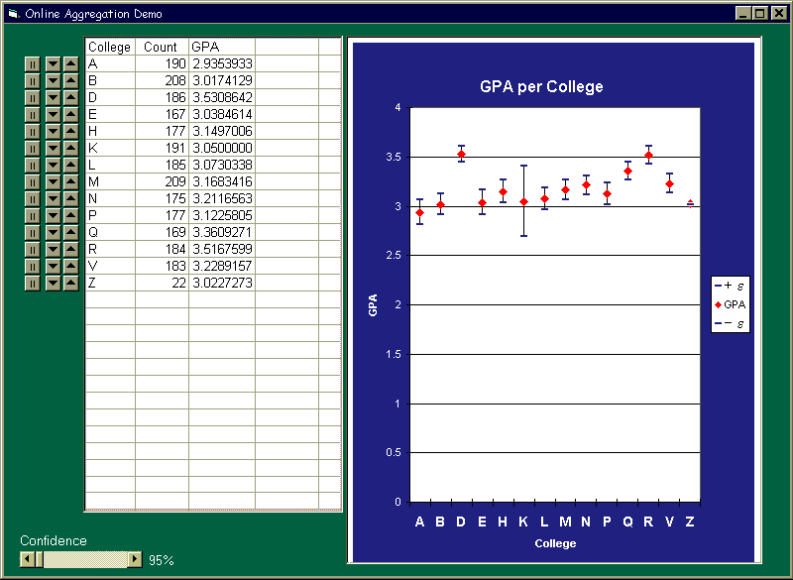
Approximate Query Answering
Basic Approach 1: Online Query Processing
  e.g., Control Project [HHW97, HH99, HAR00]
  Sampling at query time
  Answers continually improve, under user control

Slide 6
Approximate Query Answering
Basic Approach 2: Precomputed Synopses
  Construct & store synopses prior to query time
  At query time, use synopses to answer the query
  Like estimation in query optimizers, but
    reported to the user (need higher accuracy)
    more general queries
  Need to maintain synopses up-to-date
  Most work in the area based on the precomputed approach
    e.g., Sample Views [OR92, Olk93], Aqua Project [GMP97a, AGP99,etc]

Slide 7

The Aqua Architecture
SQL
Query Q
Q
Data
Warehouse
(e.g., Oracle)
Network
Result
HTML
XML
Browser
Excel
Warehouse
Data
Updates
Picture without Aqua:
User poses a query Q
Data Warehouse executes Q and returns result
Warehouse is periodically updated with new data

Slide 8

The Aqua Architecture
[GMP97a, AGP99]
Picture with Aqua:
Aqua is middleware, between the user and the warehouse
Aqua Synopses are stored in the warehouse
Aqua intercepts the user query and rewrites it to be a query Q’ on the synopses. Data warehouse returns approximate answer
SQL
Query Q
Q’
Data
Warehouse
(e.g., Oracle)
Network
Rewriter
Result
(w/ error bounds)
HTML
XML
Browser
Excel
Warehouse
Data
Updates
AQUA
Synopses
AQUA
Tracker

Slide 9
Online vs. Precomputed
Online:
  + Continuous refinement of answers (online aggregation)
  + User control: what to refine, when to stop
  + Seeing the query is very helpful for fast approximate results
  + No maintenance overheads
  + See [HH01] Online Query Processing tutorial for details
Precomputed:
  + Seeing entire data is very helpful (provably & in practice)
    (But must construct synopses for a family of queries)
  + Often faster: better access patterns,
  small synopses can reside in memory or cache
  + Middleware: Can use with any DBMS, no special index striding
  + Also effective for remote or streaming data

Slide 10
Commercial DBMS
Oracle, IBM Informix: Sampling operator (online)
IBM DB2: “IBM Almaden is working on a prototype version of DB2 that supports sampling. The user specifies a priori the amount of sampling to be done.”
Microsoft SQL Server: “New auto statistics extract statistics [e.g., histograms] using fast sampling, enabling the Query Optimizer to use the latest information.” The index tuning wizard uses sampling to build statistics.
  see [CN97, CMN98, CN98]
In summary, not much announced yet

Slide 11
Outline
Intro & Approximate Query Answering Overview
One-Dimensional Synopses
  Histograms: Equi-depth, Compressed, V-optimal, Incremental maintenance, Self-tuning
  Samples: Basics, Sampling from DBs, Reservoir Sampling
  Wavelets: 1-D Haar-wavelet histogram construction & maintenance
Multi-Dimensional Synopses and Joins
Set-Valued Queries
Discussion & Comparisons
Advanced Techniques & Future Directions
Conclusions

Slide 12
Histograms
Partition attribute value(s) domain into a set of buckets
Issues:
  How to partition
  What to store for each bucket
  How to estimate an answer using the histogram
Long history of use for selectivity estimation within a query optimizer [Koo80], [PSC84], etc.
[PIH96] [Poo97] introduced a taxonomy, algorithms, etc.

Slide 13
1-D Histograms: Equi-Depth
Count in
bucket
1 2 3 4 5 6 7 8 9 10 11 12 13 14 15 16 17 18 19 20
Domain values
Goal: Equal number of rows per bucket (B buckets in all)
Can construct by first sorting then taking B-1 equally-spaced splits
Faster construction: Sample & take equally-spaced splits in sample
  Nearly equal buckets
  Can also use one-pass quantile algorithms (e.g., [GK01])
1 2 2 3 4 7 8 9 10 10 10 10 11 11 12 12 14 16 16 18 19 20 20 20

Slide 14
1-D Histograms: Equi-Depth
Count in
bucket
1 2 3 4 5 6 7 8 9 10 11 12 13 14 15 16 17 18 19 20
Domain values
Can maintain using one-pass algorithms (insertions only), or
Use a backing sample [GMP97b]: Maintain a larger sample on disk in support of histogram maintenance
  Keep histogram bucket counts up-to-date by incrementing on row insertion, decrementing on row deletion
  Merge adjacent buckets with small counts
  Split any bucket with a large count, using the sample to select a split value, i.e, take median of the sample points in bucket range
    Keeps counts within a factor of 2; for more equal buckets, can recompute from the sample
Split
4 5 6 7 8 9
4 5 6 7 8 9

Slide 15
1-D Histograms: Compressed
Create singleton buckets for largest values, equi-depth over the rest
Improvement over equi-depth since get exact info on largest values, e.g., join estimation in DB2 compares largest values in the relations
Construction: Sorting + O(B log B) + one pass; can use sample
Maintenance: Split & Merge approach as with equi-depth, but must also decide when to create and remove singleton buckets [GMP97b]
[PIH96]
1 2 3 4 5 6 7 8 9 10 11 12 13 14 15 16 17 18 19 20

Slide 16
1-D Histograms: V-Optimal
[IP95] defined V-optimal & showed it minimizes the average selectivity estimation error for equality-joins & selections
  Idea: Select buckets to minimize frequency variance within buckets
[JKM98] gave an O(B*N^2) time dynamic programming algorithm
  F[k] = freq. of value k; AVGF[i:j] = avg freq for values i..j
  SSE[i:j] = sum{k=i..j} (F[k]^2 – (j-i+1)*AVGF[i:j]^2)
  For i=1..N, compute P[i] = sum{k=1..i} F[k] & Q[i] = sum{k=1..i} F[k]^2
  Then can compute any SSE[i:j] in constant time
  Let SSEP(i,k) = min SSE for F[1]..F[i] using k buckets
  Then SSEP(i,k) = min{j=1..i-1} (SSEP(j,k-1) + SSE[j+1:i]), i.e.,
  suffices to consider all possible left boundaries for kth bucket
  Also gave faster approximation algorithms

Slide 17
Answering Queries: Equi-Depth
  Answering queries:
    select count(*) from R where 4 <= R.A <= 15
    approximate answer: F * |R|/B, where
      F = number of buckets, including fractions, that overlap the range
      error guarantee: ± 2 * |R|/B
1 2 3 4 5 6 7 8 9 10 11 12 13 14 15 16 17 18 19 20
4 ≤ R.A ≤ 15
answer: 3.5 * |R|/6
± 0.5 * |R|/6

Slide 18
Answering Queries: Histograms
Answering queries from 1-D histograms (in general):
  (Implicitly) map the histogram back to an approximate relation, & apply the query to the approximate relation
  Continuous value mapping [SAC79]:
Count spread
evenly among
bucket values
1 2 3 4 5 6 7 8 9 10 11 12 13 14 15 16 17 18 19 20
- Uniform spread mapping [PIH96]:
Need number
of distinct in
each bucket
1 2 3 4 5 6 7 8 9 10 11 12 13 14 15 16 17 18 19 20
3 2 1 2 3 1

Slide 19
Self-Tuning 1-D Histograms
1. Tune Bucket Frequencies:
  Compare actual selectivity to histogram estimate
  Use to adjust bucket frequencies
[AC99]
query range
30
30
Actual = 60
Estimate = 40
Error = +20
25
16
10
12
12
12
10
10
1 10
11 20
21 30
31 60
61 64
65 69
70 70
71 79
80 89
90 99
- Divide d*Error proportionately, d=dampening factor
30
30
d=½ of Error
= +10
So divide
+4,+3,+3
25
20
16
15
15
10
12
12
12
10
10
1 10
11 20
21 30
31 60
61 64
65 69
70 70
71 79
80 89
90 99

Slide 20
Self-Tuning 1-D Histograms
2. Restructure:
  Merge buckets of near-equal frequencies
  Split large frequency buckets
69
split
in 3
merge
merge
30
split
25
17
10
13
13
13
10
10
1 10
11 20
21 30
31 60
61 64
65 69
70 70
71 79
80 89
90 99
36
25
23
23
23
23
17
15
15
10
Also Extends
to Multi-D
1 20
21 30
31 69
70 70
71 73
74 76
77 79
80 89
90 94
95 99

Slide 21
Sampling: Basics
Idea: A small random sample S of the data often well-represents all the data
  For a fast approx answer, apply the query to S & “scale” the result
  E.g., R.a is {0,1}, S is a 20% sample
  select count(*) from R where R.a = 0
  select 5 * count(*) from S where S.a = 0
1 1 0 1
1 1 1 1 0 0 0
0 1 1 1 1 1 0 1
1 1 0 1 0 1 1
0 1 1 0
R.a
Red =
in S
Est. count = 5*2 = 10, Exact count = 10
Unbiased: For expressions involving count, sum, avg: the estimator
is unbiased, i.e., the expected value of the answer is the actual answer,
even for (most) queries with predicates!
Leverage extensive literature on confidence intervals for sampling
  Actual answer is within the interval [a,b] with a given probability
    E.g., 54,000 ± 600 with prob ≥ 90%

Slide 22
Sampling: Confidence Intervals
Method
90% Confidence Interval (±)
Guarantees?
Central Limit Theorem
1.65 * σ(S) / sqrt(|S|)
as |S| → ∞
Hoeffding
1.22 * (MAX-MIN) / sqrt(|S|)
always
Chebychev (known σ(R))
3.16 * σ(R) / sqrt(|S|)
always
Chebychev (est. σ(R))
3.16 * σ(S) / sqrt(|S|)
as σ(S) → σ(R)
Confidence intervals for Average: select avg(R.A) from R
(Can replace R.A with any arithmetic expression on the attributes in R)
σ(R) = standard deviation of the values of R.A; σ(S) = s.d. for S.A
If predicates, S above is subset of sample that satisfies the predicate
Quality of the estimate depends only on the variance in R & |S| after the predicate: So 10K sample may suffice for 10B row relation!
  Advantage of larger samples: can handle more selective predicates

Slide 23
Sampling from Databases
Sampling disk-resident data is slow
  Row-level sampling has high I/O cost:
    must bring in entire disk block to get the row
  Block-level sampling: rows may be highly correlated
  Random access pattern, possibly via an index
  Need acceptance/rejection sampling to account for the variable number of rows in a page, children in an index node, etc
Alternatives
  Random physical clustering: destroys “natural” clustering
  Precomputed samples: must incrementally maintain (at specified size)
    Fast to use: packed in disk blocks, can sequentially scan, can store as relation and leverage full DBMS query support, can store in main memory

Slide 24
One-Pass Uniform Sampling
Best choice for incremental maintenance
  Low overheads, no random data access
Reservoir Sampling [Vit85]: Maintains a sample S of a fixed-size M
  Add each new item to S with probability M/N, where N is the current number of data items
  If add an item, evict a random item from S
  Instead of flipping a coin for each item, determine the number of items to skip before the next to be added to S
  To handle deletions, permit |S| to drop to L < M, e.g., L = M/2
    remove from S if deleted item is in S, else ignore
    If |S| = M/2, get a new S using another pass (happens only if delete roughly half the items & cost is fully amortized) [GMP97b]

Slide 25
Biased Sampling
Often, advantageous to sample different data at different rates (Stratified Sampling)
  E.g., outliers can be sampled at a higher rate to ensure they are accounted for; better accuracy for small groups in group-by queries
  Each tuple j in the relation is selected for the sample S with some probability Pj (can depend on values in tuple j)
  If selected, it is added to S along with its scale factor sf = 1/Pj
  Answering queries from S: e.g.,
    select sum(R.a) from R where R.b < 5
    select sum(S.a * S.sf) from S where S.b < 5
    Unbiased answer. Good choice for Pj’s results in tighter confidence intervals
R.a 10 10 10 50 50
Pj 1/3 1/3 1/3 ½ ½
S.sf --- 3 --- --- 2
Sum(R.a) = 130
Sum(S.a*S.sf) =
10*3 + 50*2 = 130

Slide 26
One-Dimensional Haar Wavelets
Wavelets: mathematical tool for hierarchical decomposition of functions/signals
Haar wavelets: simplest wavelet basis, easy to understand and implement
  Recursive pairwise averaging and differencing at different resolutions
Resolution Averages Detail Coefficients
3
[2, 2, 0, 2, 3, 5, 4, 4]
----
2
[2, 1, 4, 4]
[0, -1, -1, 0]
1
[1.5, 4]
[0.5, 0]
0
[2.75]
[-1.25]
Haar wavelet decomposition:
[2.75, -1.25, 0.5, 0, 0, -1, -1, 0]

Slide 27
Haar Wavelet Coefficients
Hierarchical decomposition structure (a.k.a. “error tree”)
Coefficient “Supports”
₊
2.75
₋
2.75
₊
+
-1.25
₋
+
-1.25
-
₊
0.5
₋
0.5
0
₊
+
-
+
-
0
₋
0
-1
-1
0
₊
0
₋
+
-
+
-
+
-
+
-
₊
₋
-1
2 2 0 2 3 5 4 4
₊
-1
₋
₊
Original data
0

Slide 28
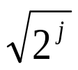
Wavelet-based Histograms [MVW98]
Problem: range-query selectivity estimation
Key idea: use a compact subset of Haar/linear wavelet coefficients for approximating the data distribution
Steps
  compute cumulative data distribution C
  compute Haar (or linear) wavelet transform of C
  coefficient thresholding : only b<<|C| coefficients can be kept
    take largest coefficients in absolute normalized value
      Haar basis: divide coefficients at resolution j by
      Optimal in terms of the overall Mean Squared (L2) Error
    Greedy heuristic methods
      Retain coefficients leading to large error reduction
      Throw away coefficients that give small increase in error

Slide 29
Using Wavelet-based Histograms
Selectivity estimation: sel(a<= X<= b) = C’[b] - C’[a-1]
  C’ is the (approximate) “reconstructed” cumulative distribution
  Time: O(min{b, logN}), where b = size of wavelet synopsis (no. of coefficients), N= size of domain
Empirical results over synthetic data
  Improvements over random sampling and histograms (MaxDiff)
At most logN+1 coefficients are needed to reconstruct any C value
C[a]

Slide 30

Dynamic Maintenance of Wavelet-based Histograms [MVW00]
Build Haar-wavelet synopses on the original data distribution
  Similar accuracy with CDF, makes maintenance simpler
Key issues with dynamic wavelet maintenance
  Change in single distribution value can affect the values of many coefficients (path to the root of the decomposition tree)
Change propagates up to the root coefficient
d
d+
  As distribution changes, “most significant” (e.g., largest) coefficients can also change!
    Important coefficients can become unimportant, and vice-versa

Slide 31

Effect of Distribution Updates
Key observation: for each coefficient c in the Haar decomposition tree
  c = ( AVG(leftChildSubtree(c)) - AVG(rightChildSubtree(c)) ) / 2
c’ = c’ + /2^h
c = c - /2^h
+
-
+
-
Only coefficients on path(d) are affected and each can be updated in constant time
h
d’+
d+

Slide 32
Maintenance Architecture
m
Histogram H
m+m’ top coefficients
INSERTIONS/
DELETIONS
Auxiliary
Histogram H’
m’
Activity Log
“Shake up” when log reaches max size: for each insertion at d
  for each coefficient c on path(d) and in H’ : update c
  for each coefficient c on path(d) and not in H or H’:
    insert c into H’ with probability proportional to 1/2^h, where h is the “height” of c (Probabilistic Counting [FM85])
  Adjust H and H’ (move largest coefficients to H)

Slide 33
Outline
Intro & Approximate Query Answering Overview
One-Dimensional Synopses
Multi-Dimensional Synopses and Joins
  Multi-dimensional Histograms
  Join sampling
  Multi-dimensional Haar Wavelets
Set-Valued Queries
Discussion & Comparisons
Advanced Techniques & Future Directions
Conclusions

Slide 34
Multi-dimensional Data Synopses
Problem: Approximate the joint data distribution of multiple attributes
Salary
35
  Motivation
    Selectivity estimation for queries with multiple predicates
    Approximating OLAP data cubes and general relations
90
40
120
20
10
Age
Conventional approach: Attribute-Value Independence (AVI) assumption
  sel(p(A1) & p(A2) & . . .) = sel(p(A1)) * sel(p(A2) * . . .
  Simple -- one-dimensional marginals suffice
  BUT: almost always inaccurate, gross errors in practice (e.g., [Chr84, FK97, Poo97]

Slide 35
Multi-dimensional Histograms
Use small number of multi-dimensional buckets to directly approximate the joint data distribution
Uniform spread & frequency approximation within buckets
  n(i) = no. of distinct values along Ai, F = total bucket frequency
  approximate data points on a n(1)*n(2)*. . . uniform grid, each with frequency F / (n(1)*n(2)*. . .)
Actual Distribution (ONE BUCKET)
Approximate Distribution
35
16
90
40
120
20
10

Slide 36


Multi-dimensional Histogram Construction
Construction problem is much harder even for two dimensions [MPS99]
Multi-dimensional equi-depth histograms [MD88]
  Fix an ordering of the dimensions A1, A2, . . ., Ak, let kth root of desired no. of buckets, initialize B = { data distribution }
  For i=1, . . ., k: Split each bucket in B in equi-depth partitions along Ai; return resulting buckets to B
  Problems: limited set of bucketizations; fixed and fixed dimension ordering can result in poor partitionings
MHIST-p histograms [PI97]
  At each step
    Choose the bucket b in B containing the attribute Ai whose marginal is the most in need of partitioning
    Split b along Ai into p (e.g., p=2) buckets

Slide 37
Equi-depth vs. MHIST Histograms
Equi-depth (a1=2,a2=3) [MD88]
MHIST-2 (MaxDiff) [PI97]
A2
A2
1
1
4
150
30
280
460
360
250
150
30
280
4
3
2
5
150
200
10
150
200
10
3
5
2
150
50
50
150
50
50
A1
A1
450 280 340
MHIST: choose bucket/dimension to split based on its criticality ; allows for much larger class of bucketizations (hierarchical space partitioning)
Experimental results verify superiority over AVI and equi-depth

Slide 38
Other Multi-dimensional Histogram Techniques -- GENHIST [GKT00]
Key idea: allow for overlapping histogram buckets
    Allows for a much larger no. of distinct frequency regions for a given space budget (= #buckets)
a
a
+
b
b
a
b
a+b+c+d
a+c
b+d
9 distinct frequencies (13 if different-size buckets are used)
c
d
c
+
d
c
d
Greedy construction algorithm: Consider increasingly-coarser grids
  At each step select the cell(s) c of highest density and move enough randomly-selected points from c into a bucket to make c and its neighbors “close-to-uniform”
  Truly multi-dimensional “split decisions” based on tuple density -- unlike MHIST

Slide 39

Other Multi-dimensional Histogram Techniques -- STHoles [BCG01]
Multi-dimensional, workload-based histograms
  Allow bucket nesting -- “bucket tree”
  Intercept query result stream and count |q b| for each bucket b (< 10% overhead in MS SQL Server 2000)
  Drill “holes” in b for regions of different tuple density and “pull” them out as children of b (first-class buckets)
  Consolidate/merge buckets of similar densities (keep #buckets constant)
|q&b|=160
b1
b1
q
160
Refine
b2
b3
200
40
b2
b3
b4
150
150
b5
b4
100
300
100
300

Slide 40
Sampling for Multi-D Synopses
Taking a sample of the rows of a table captures the attribute correlations in those rows
  Answers are unbiased & confidence intervals apply
  Thus guaranteed accuracy for count, sum, and average queries on single tables, as long as the query is not too selective
Problem with joins [AGP99,CMN99]:
  Join of two uniform samples is not a uniform sample of the join
  Join of two samples typically has very few tuples
3 1 0 3
7 3 7 1 4 2 4
0 1 2 1 2 7 0 8
5 1 9 1 0 7 1
3 8 2 0
0 1
2 3
4 5
6 7 8 9
Foreign Key Join
40% Samples in Red
Size of Actual Join = 30
Size of Join of samples = 3

Slide 41
Join Synopses for Foreign-Key Joins [AGP99]
Based on sampling from materialized foreign key joins
  Typically < 10% added space required
  Yet, can be used to get a uniform sample of ANY foreign key join
  Plus, fast to incrementally maintain
Significant improvement over using just table samples
  E.g., for TPC-H query Q5 (4 way join)
    1%-6% relative error vs. 25%-75% relative error, for synopsis size = 1.5%, selectivity ranging from 2% to 10%
    10% vs. 100% (no answer!) error, for size = 0.5%, select. = 3%

Slide 42
Multi-dimensional Haar Wavelets
Basic “pairwise averaging and differencing” ideas carry over to multiple data dimensions
Two basic methodologies -- no clear winner [SDS96]
  Standard Haar decomposition
  Non-standard Haar decomposition
Discussion here: focus on non-standard decomposition
  See [SDS96, VW99] for more details on standard Haar decomposition
  [MVW00] also discusses dynamic maintenance of standard multi-dimensional Haar wavelet synopses

Slide 43
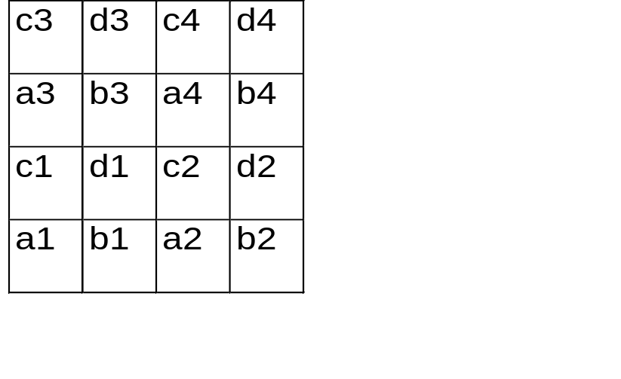
Two-dimensional Haar Wavelets -- Non-standard decomposition
A1 = (a1+b1+c1+d1)/4
Detail coeff = (a1+b1-c1-d1)/4
Detail coeff = (a1-b1+c1-d1)/4
Detail coeff = (a1-b1-c1+d1)/4
A = (A1+A2+A3+A4)/4
Detail coeff = (A1+A2-A3-A4)/4
Detail coeff = (A1-A2+A3-A4)/4
Detail coeff = (A1-A2-A3+A4)/4
-
+
+
-
-
+
+
-
+
-
+
A3
A4
+
-
A1
A2
-
+
+
-

Slide 44
Two-dimensional Haar Wavelets -- Non-standard decomposition
(a+b-c-d)/4
(a-b-c+d)/4
-
+
Averaging &
Differencing
+
-
c
d
(a+b+c+d)/4
(a-b+c-d)/4
a
b
+
-
“Supports”
Wavelet Transform Array:
RECURSE

Slide 45
Two-dimensional Haar Wavelets -- Non-standard decomposition
Data Array
After averaging and differencing
3
4
3
4
-1
0
-1
0
1
2
1
2
2.5
-.5
2.5
-.5
3
4
3
4
-1
0
-1
0
1
2
1
2
2.5
-.5
2.5
-.5
After distributing results
Final wavelet transform array
-1
-1
0
0
0
0
-1
-1
-1
-1
0
0
-1
-1
0
0
2.5
2.5
-.5
-.5
0
0
-.5
-.5
2.5
2.5
-.5
-.5
2.5
0
-.5
-.5
RECURSE

Slide 46
Non-standard Two-dimensional Haar Basis -- Coefficient Supports
-
-
-
+
-
+
+
+
+
-
+
-
-
-
-
+
-
+
+
+
+
-
+
-
-
-
+
+
-
+
-
+
+
-
+
+
-
+
-
+
-
Notes:
10

Slide 47
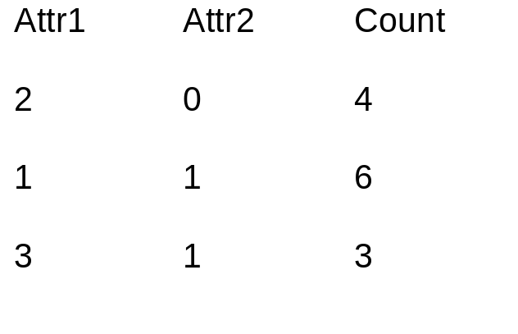
Constructing the Wavelet Decomposition
Joint Data Distribution
Array
Relation (ROLAP)
Representation
Attr2
3
2
1
0
₆
₃
₄
0 1 2 3
Attr1
Joint data distribution can be very sparse!
Key to I/O-efficient decomposition algorithms: Work off the ROLAP representation
  Standard decomposition [VW99]
  Non-standard decomposition [CGR00]
Typically require a small (logarithmic) number of passes over the data
Notes:
11

Slide 48
Range-sum Estimation Using Wavelet Synopses
Coefficient thresholding
  As in 1-d case, normalizing by appropriate constants and retaining the largest coefficients minimizes the overall L2 error
Range-sums: selectivity estimation or OLAP-cube aggregates [VW99] (“measure attribute” as count)
Only coefficients with support regions intersecting the query hyper-rectangle can contribute
  Many contributions can cancel each other [CGR00, VW99]
Contribution to range sum = 0
Only nodes on the path to range endpoints can have nonzero contributions
(Extends naturally to multi-dimensional
range sums)
Decomposition
Tree (1-d)
+
-
Query Range
Notes:
11

Slide 49
Outline
Intro & Approximate Query Answering Overview
One-Dimensional Synopses
Multi-Dimensional Synopses and Joins
Set-Valued Queries
  Error Metrics
  Using Histograms
  Using Samples
  Using Wavelets
Discussion & Comparisons
Advanced Techniques & Future Directions
Conclusions

Slide 50
Approximating Set-Valued Queries
Problem: Use synopses to produce “good” approximate answers to generic SQL queries -- selections, projections, joins, etc.
  Remember: synopses try to capture the joint data distribution
  Answer (in general) = multiset of tuples
Unlike aggregate values, NO universally-accepted measures of “goodness” (quality of approximation) exist
Query Answer
Subset Approximation
(e.g., from 20% sample)
“Better” Approximation
S
a
l
a
r
y
Age

Slide 51
Error Metrics for Set-Valued Query Answers
Need an error metric for (multi)sets that accounts for both
  differences in element frequencies
  differences in element values
Traditional set-comparison metrics (e.g., symmetric set difference, Hausdorff distance) fail
Proposed Solutions
  MAC (Match-And-Compare) Error [IP99]: based on perfect bipartite graph matching
  EMD (Earth Mover’s Distance) Error [CGR00, RTG98]: based on bipartite network flows

Slide 52
Using Histograms for Approximate Set-Valued Queries [IP99]
Store histograms as relations in a SQL database and define a histogram algebra using simple SQL queries
Implementation of the algebra operators (select, join, etc.) is fairly straightforward
  Each multidimensional histogram bucket directly corresponds to a set of approximate data tuples
Experimental results demonstrate histograms to give much lower MAC errors than random sampling
Potential problems
  For high-dimensional data, histogram effectiveness is unclear and construction costs are high [GKT00]
  Join algorithm requires expanding into approximate relations
    Can be as large (or larger!) than the original data set

Slide 53
Set-Valued Queries via Samples
Applying the set-valued query to the sampled rows, we very often obtain a subset of the rows in the full answer
  E.g., Select all employees with 25+ years of service
  Exceptions include certain queries with nested subqueries (e.g., select all employees with above average salaries: but the average salary is known only approximately)
Extrapolating from the sample:
  Can treat each sample point as the center of a cluster of points (generate approximate points, e.g., using kernels [BKS99, GKT00])
  Alternatively, Aqua [GMP97a, AGP99] returns an approximate count of the number of rows in the answer and a representative subset of the rows (i.e., the sampled points)
    Keeps result size manageable and fast to display

Slide 54
Approximate Query Processing Using Wavelets [CGR00]
Reduce relations into compact wavelet-coefficient synopses
Entire query processing in the compressed (wavelet) domain
Query Results in Wavelet Domain
_{Querying in Wavelet Domain}
_{Render}
Compressed domain (FAST)
_{Wavelet Synopses}
_{Final Approximate Results}
Relation domain (SLOW)
_{Approximate Relations}
_{Querying in Relation Domain}
_{Render}

Slide 55
Wavelet Query Processing
Each operator (e.g., select, project, join, aggregates, etc.)
  input: set of wavelet coefficients
  output: set of wavelet coefficients
Finally, rendering step
  input: set of wavelet coefficients
  output: (multi)set of tuples
render
set of coefficients
join
project
select
select
set of
coefficients
set of
coefficients

Slide 56
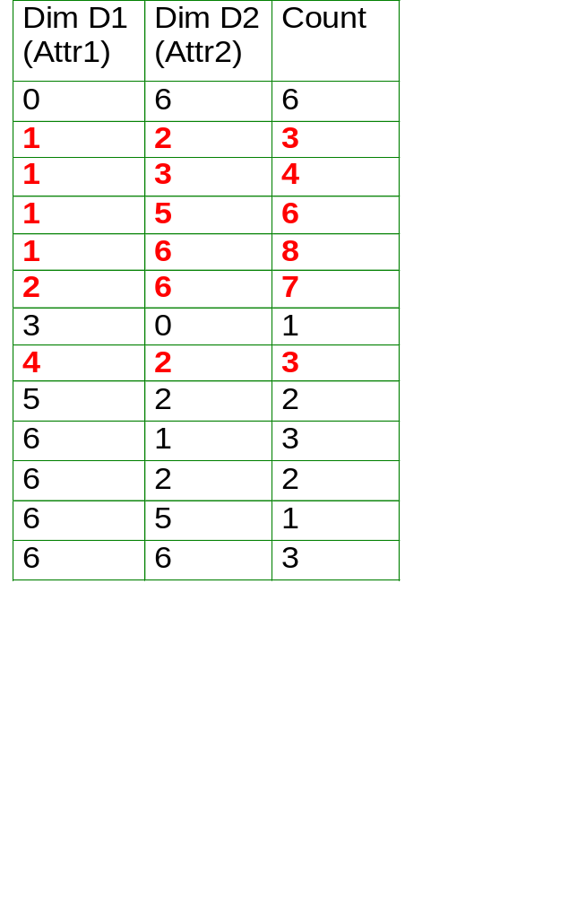
Selection -- Relational Domain
Relation
Joint Data Distribution Array
₃
₂
₁
₃
_{Dim.}
_{D1}
₂
₃
₁
₇
₃
₄
₆
₈
₆
_{Dim. D2}
_{Query Range}
In relational domain, interested in only those cells inside query range
In wavelet domain, interested in only the coefficients that contribute to those cells

Slide 57
Selection -- Wavelet Domain
_{D1}
_{D1}
+
-
+
-
_{Query}
_{Range}
+
-
+
-
+
+
-
-
-
+
-
+
_{D2}
_{D2}

Slide 58
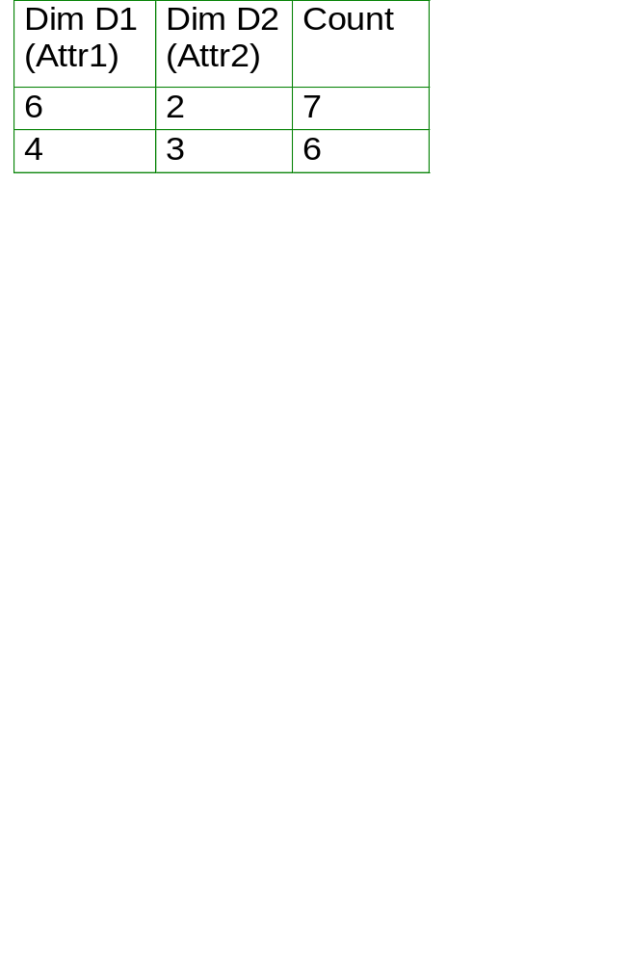
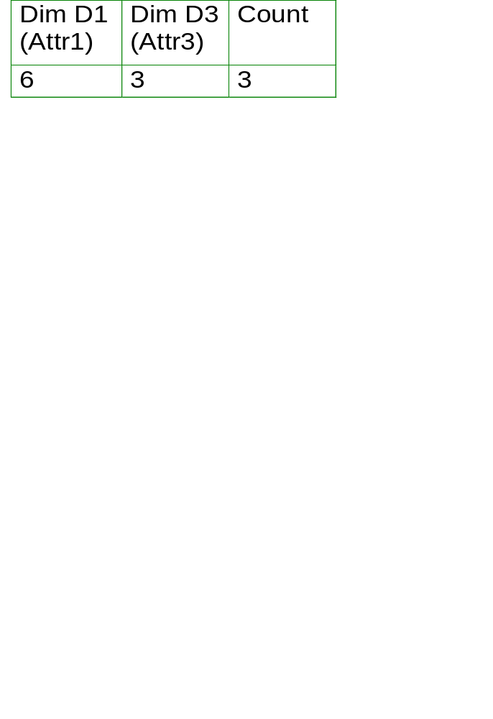
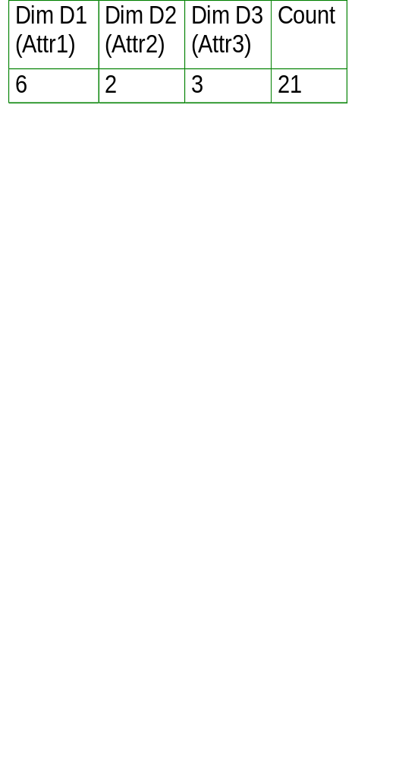
Equi-join -- Relational Domain
Coefficients A1 (+) and A3 (-) contribute to this cell
Coefficients B2 (+), and B3 (+) contribute to this cell
Relation 1
₇
₃
₆
_{Join Dim.}
_{D1}
Relation 2
_{Join along D1}
_{Dim. D2}
_{Dim. D3}
Joint Data Distribution
of Relation 1
Joint Data Distr.
of Relation 2
Relational domain: Join count= 7*3 = (A1-A3)*(B2+B3)
Wavelet domain: A1*B2 + A1*B3 - A3*B2 - A3*B3
Consider all pairs of coefficients: (1) check joinability (overlap in join dimension(s)), (2) compute output coefficients

Slide 59
Equi-join -- Wavelet Domain
v1
_{D1}
v2
_{D1}
+
-
+
-
+
-
_{D1}
_{D2}
_{D3}
_{D1}
-
v = v1 * v2
Join output coefficient:
+
_{D3}
_{D2}

Slide 60
Outline
Intro & Approximate Query Answering Overview
One-Dimensional Synopses
Multi-Dimensional Synopses and Joins
Set-Valued Queries
Discussion & Comparisons
Advanced Techniques & Future Directions
Conclusions

Slide 61
Discussion & Comparisons (1)
Histograms & Wavelets: Limited by “curse of dimensionality”
  Rely on data space partitioning in “regions”
  Ineffective above 5-6 dimensions
    Value/frequency uniformity assumptions within buckets break down in medium-to-high dimensionalities!!
Sampling: No such limitations, BUT...
  Ineffective for ad-hoc relational joins over arbitrary schemas
    Uniformity property is lost
    Quality guarantees degrade
  Effectiveness for set-valued approximate queries is unclear
    Only (very) small subsets of the answer set are returned (especially, when joins are present)

Slide 62
Discussion & Comparisons (2)
Histograms & Wavelets: Compress data by accurately capturing rectangular “regions” in the data space
  Advantage over sampling for typical, “range-based” relational DB queries
  BUT, unclear how to effectively handle unordered/non-numeric data sets (no such issues with sampling...)
Sampling: Provides strong probabilistic quality guarantees (unbiased answers) for individual aggregate queries
  Histograms & Wavelets: Can guarantee a bound on the overall error (e.g., L2) for the approximation, BUT answers to individual queries can be heavily biased!!
No clear winner exists!! (Hybrids??)

Slide 63
Outline
Intro & Approximate Query Answering Overview
One-Dimensional Synopses
Multi-Dimensional Synopses and Joins
Set-Valued Queries
Discussion & Comparisons
Advanced Techniques & Future Directions
  Dependency-based Synopses
  Workload-tuned Biased Sampling
  Distinct-values Queries
  Streaming Data
Conclusions

Slide 64
Dependency-based Histogram Synopses [DGR01]
Multi-dimensional histograms
on joint data distribution
* expensive
* ineffective in high dimensions
Attribute Value
Independence
* simplistic
* inaccurate
Fully independent
attributes
Fully correlated
attributes
Extremes in terms of the underlying correlations!!
Dependency-Based Histograms: explore space between extremes by explicitly identifying data correlations/independences
  Build a statistical interaction model on data attributes
  Based on the model, build a collection of low-dimensional histograms
  Use this histogram collection to provide approximate answers
General methodology, also applicable to other synopsis techniques (e.g., wavelets)
Notes:
Emphasize the last bullet
Two main approaches have been proposed previously for handling this problem. The first one is to assume that all the attributes are distributed independently of each other and then build one dimensional histograms on each of the attributes separately. To answer a range sum query over multiple attributes, we can use the independence assumption and multiply the probabilities for each of the attributes to get the combined probability. Though this approach is simple and easy to implement in a system which already supports one-dimensional histograms, it can be highly inaccurate if there are correlations between the attributes, as will be the case in most real-life datasets.
The other approach that has been suggested is to build a multi-dimensional histogram over all the attributes directly. There have been a variety of algorithms suggested, including using wavelets for this. These kinds of histograms are expensive to build and maintain, and though they work well for a small number of dimensions, a large number of buckets may be required for reasonable accuracy in high dimensions. Also, these kinds of histograms are not very suitable for queries over a small subset of dimensions, a scenario that we believe is more common.
These two approaches can be thought of as extremes in terms of the underlying correlations in the data. The first approach assumes that attributes are fully independent of each other, whereas the second approach assumes that they are fully dependent on each other. We propose to explore the space of possibilities between these two extremes through use of statistical models.

Slide 65
Dependency-based Histograms
Identify (and exploit) attribute correlation and independence
  Partial Independence :
  p(salary, height, weight) = p(salary) * p(height, weight)
  Conditional Independence :
  p(salary, age | YPE) = p(salary| YPE) * p(age | YPE)
Use forward selection to build a decomposable statistical model [BFH75], [Lau96] on the attributes
  A,D are conditionally independent given B,C
    p(AD|BC) = p(A|BC) * p(D|BC)
  Joint distribution
    p(ABCD) = p(ABC) * p(BCD) / p(BC)
  Build histograms on model cliques
Significant accuracy improvements (factor of 5) over pure MHIST
More details, construction & usage algorithms, etc. in the paper
A
B
C
D
Notes:
Fonts…
Give real examples here… like age and weight and height…. Instead of using A, B, C.
The class of models that we use to model the correlations in the data is known as decomposable models. The kinds of correlations these models allow us to specify are partial independence and conditional independence. Partial independence between attributes means that the attributes are independent of each other. For example, in a typical employee relation, we might find that the employee’s salary is independent of her weight and height. This can be written down as shown. On the other hand, the attributes height and weight are most likely not independent of each other and hence, we should not break this down further. The other class of correlations, and potentially more interesting ones, are conditional independences, where two attributes may not be independent of each other, but may become largely independent given the value of another attributes. For example, ……..
Decomposable models possess several very attractive properties that make them more desirable for our scenario over a more general class of models. First of all, there always exists a closed form expression for the joint probability distribution in terms of a set of probability marginals over subsets of attributes. Any more general class of models does not possess this probability and requires use of numerical techniques to retrieve the joint probability distribution, something we would like to avoid. Secondly, the model can be interpreted in terms of conditional and partial independence statements, of the nature that we saw above. Again, a more general class of models does not necessarily possess this property. Finally, these models can be represented graphically, making the search through these models tractable.

Slide 66
Workload-tuned Biased Sampling --Congressional Samples [AGP00]
Decision support queries routinely segment data into groups & then aggregate the information within each group
  Each table has a set of “grouping columns”: queries can group by any subset of these columns
Goal: Maximize the accuracy for all groups (large or small) in each Group-by query
  E.g., census DB with state (s), gender(g), and income (i)
  Q: Avg(i) group-by s : seek good accuracy for all 50 states
  Q: Avg(i) group-by s,g : seek good accuracy for all 100 groups
Technique: Congressional Samples
  House: Uniform sample: good for when no group-by
  Senate: Same size sample per group when use all grouping columns: good for queries with all columns
  Congress: Combines House & Senate, but considers all subsets of grouping columns, and then scales down

Slide 67
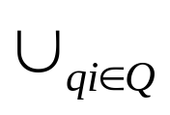
Workload-tuned Biased Sampling -- ICICLES [GLR00]
Biased sampling scheme that dynamically adapts to query workload
  Exploit data locality -- more focus (i.e., #sample points) in frequently-queried regions
  Let Q = {q1, q2, . . .} be a query workload, R(qi) = subset of R used in answering query qi
  L(R, Q) = Extension of R wrt Q = R R(qi) (multiset of tuples)
Icicle: Uniform random sample of L(R,Q)
Incrementally maintained and adapt (“self-tune”) to workload through Reservoir Sampling technique [Vit85]
Unbiased Icicle estimators: New formulas to account for duplicates and bias in sample selection
Provably better (smaller variance) than uniform for “focused” queries (that follow the workload model)

Slide 68
Workload-tuned Biased Sampling -- Lifted Workloads [CDN01]
Formulate sample selection as an optimization problem
  Minimize query-answering error for a given workload model
Technique for “lifting a fixed workload W” to produce a probability distribution over all possible queries
  Similar to kernel density estimation (queries in W = “sample points”)
W = { q1, q2 }
R
q1
q2
prob(q|W) = parametric function of q’s overlap with queries in W
q
“Fundamental regions” induced by W

Slide 69
Workload-tuned Biased Sampling -- Lifted Workloads
Problem: Find sample of size k that minimizes expected error for a given “lifted” workload
Solution: Stratified sampling [Coc77]
  Collection of uniform samples (of total size k) over disjoint subsets (“strata”) of the population
  Much better estimates when variance within strata is small [Coc77]
Stratification: Selecting appropriate partitioning of R
  Using “fundamental regions” as strata is optimal for COUNT
  For SUM, partition “fundamental regions” further to reduce variance of the aggregated attribute (Neymann technique [Coc77])
Allocation: Dividing k among strata
  Closed form solutions (valid under certain simplifying assumptions)

Slide 70
Distinct Values Queries
select count(distinct target-attr)
from rel
where P
select count(distinct o_custkey)
from orders
where o_orderdate >= ‘2001-01-01’
  How many distinct customers have placed orders this year?
Includes: column cardinalities, number of species, number of distinct values in a data set / data stream
Template
TPCH example

Slide 71
Distinct Values Queries
Uniform Sampling-based approaches
  Collect and store uniform sample. At query time, apply predicate to sample. Estimate based on a function of the distribution. Extensive literature (see, e.g., [CCM00])
    Many functions proposed, but estimates are often inaccurate
    [CCM00] proved must examine (sample) almost the entire table to guarantee the estimate is within a factor of 10 with probability > 1/2, regardless of the function used!
One pass approaches
  A hash function maps values to bit position according to an exponential distribution [FM85] (cf. [Coh97,AMS96])
    00001011111 estimate based on rightmost 0-bit
    Produces a single count: Does not handle subsequent predicates

Slide 72
Distinct Values Queries
One pass, sampling approach: Distinct Sampling [Gib01]:
  A hash function assigns random priorities to domain values
  Maintains O(log(1/δ)/ε^2) highest priority values observed thus far, and a random sample of the data items for each such value
  Guaranteed within ε relative error with probability 1 - δ
  Handles ad-hoc predicates: E.g., How many distinct customers today vs. yesterday?
    To handle q% selectivity predicates, the number of values to be maintained increases inversely with q (see [Gib01] for details)
  Good for data streams: Can even answer distinct values queries over physically distributed data. E.g., How many distinct IP addresses across an entire subnet? (Each synopsis collected independently!)
  Experimental results: 0-10% error vs. 50-250% error for previous best approaches, using 0.2% to 10% synopses

Slide 73
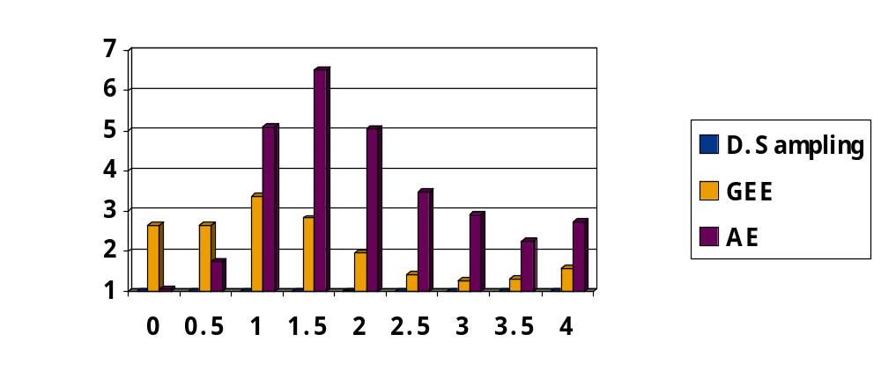
Distinct Values Queries
Data set size = 1M
Sample sizes = 1%
Ratio
Error
Zipf Parameter
Over the entire range of skew :
Distinct Sampling has 1.00-1.02 ratio error (1.00=no error)
At least 25 times smaller relative error than best
approaches based on uniform sampling (GEE & AE)

Slide 74
Approximate Reports
  Distinct sampling also provides fast, highly-accurate approximate answers for report queries arising in high-volume, session-based event recording environments
  Environment: Record events, produce precanned reports
    Many overlapping sessions: multiple events comprise a session (single IP flow, single call set-up, single customer service call)
    Events are time-stamped and tagged with session id, and then dumped to append-only databases
    Logs sent to central data warehouse. Precanned reports executed every minute or hour. TPC-R benchmark
  Must maintain a uniform sample of the sessions & all the events in those sessions in order to produce good approximate reports. Distinct sampling provides this. Improves accuracy by factor of 10+

Slide 75
Data Streams
Data is continually arriving. Collect & maintain synopses on the data. Goal: Highly-accurate approximate answers
  State-of-the-art: Good techniques for narrow classes of queries
  E.g., Any one-pass algorithm for collecting & maintaining a synopsis can be used effectively for data streams
Alternative scenario: A collection of data sets. Compute a compact sketch of each data set & then answer queries (approximately) comparing the data sets
  E.g., detecting near-duplicates in a collection of web pages: Altavista
  E.g., estimating join sizes among a collection of tables [AGM99]

Slide 76
Looking Forward...
Optimizing queries for approximation
  e.g., minimize length of confidence interval at the plan root
Exploiting mining-based techniques (e.g., decision trees) for data reduction and approximate query processing
  see, e.g., [BGR01], [GTK01], [JMN99]
Dynamic maintenance of complex (e.g., dependency-based [DGR01] or mining-based [BGR01]) synopses
Improved approximate query processing over continuous data streams
  see, e.g., [GKS01a], [GKS01b], [GKM01b]

Slide 77
Conclusions
Commercial data warehouses: approaching several 100’s TB and continuously growing
  Demand for high-speed, interactive analysis (click-stream processing, IP traffic analysis) also increasing
Approximate Query Processing
  “Tame” these TeraBytes and satisfy the need for interactive processing and exploration
  Great promise
  Commercial acceptance still lagging, but will most probably grow in coming years
  Still lots of interesting research to be done!!

Slide 78

http://www.bell-labs.com/user/{minos, pbgibbons}/

Slide 79
References (1)
[AC99] A. Aboulnaga and S. Chaudhuri. “Self-Tuning Histograms: Building Histograms Without Looking at Data”. ACM SIGMOD 1999.
[AGM99] N. Alon, P. B. Gibbons, Y. Matias, M. Szegedy. “Tracking Join and Self-Join Sizes in Limited Storage”. ACM PODS 1999.
[AGP00] S. Acharya, P. B. Gibbons, and V. Poosala. ”Congressional Samples for Approximate Answering of Group-By Queries”. ACM SIGMOD 2000.
[AGP99] S. Acharya, P. B. Gibbons, V. Poosala, and S. Ramaswamy. “Join Synopses for Fast Approximate Query Answering”. ACM SIGMOD 1999.
[AMS96] N. Alon, Y. Matias, and M. Szegedy. “The Space Complexity of Approximating the Frequency Moments”. ACM STOC 1996.
[BCC00] A.L. Buchsbaum, D.F. Caldwell, K.W. Church, G.S. Fowler, and S. Muthukrishnan. “Engineering the Compression of Massive Tables: An Experimental Approach”. SODA 2000.
  Proposes exploiting simple (differential and combinational) data dependencies for effectively compressing data tables.
[BCG01] N. Bruno, S. Chaudhuri, and L. Gravano. “STHoles: A Multidimensional Workload-Aware Histogram”. ACM SIGMOD 2001.
[BDF97] D. Barbara, W. DuMouchel, C. Faloutsos, P. J. Haas, J. M. Hellerstein, Y. Ioannidis, H. V. Jagadish, T. Johnson, R. Ng, V. Poosala, K. A. Ross, and K. C. Sevcik. “The New Jersey Data Reduction Report”. IEEE Data Engineering bulletin, 1997.

Slide 80
References (2)
[BFH75] Y.M.M. Bishop, S.E. Fienberg, and P.W. Holland. “Discrete Multivariate Analysis”. The MIT Press, 1975.
[BGR01] S. Babu, M. Garofalakis, and R. Rastogi. “SPARTAN: A Model-Based Semantic Compression System for Massive Data Tables”. ACM SIGMOD 2001.
  Proposes a novel, “model-based semantic compression” methodology that exploits mining models (like CaRT trees and clusters) to build compact, guaranteed-error synopses of massive data tables.
[BKS99] B. Blohsfeld, D. Korus, and B. Seeger. “A Comparison of Selectivity Estimators for Range Queries on Metric Attributes”. ACM SIGMOD 1999.
  Studies the effectiveness of histograms, kernel-density estimators, and their hybrids for estimating the selectivity of range queries over metric attributes with large domains.
[CCM00] M. Charlikar, S. Chaudhuri, R. Motwani, and V. Narasayya. “Towards Estimation Error Guarantees for Distinct Values”. ACM PODS 2000.
[CDD01] S. Chaudhuri, G. Das, M. Datar, R. Motwani, and V. Narasayya. “Overcoming Limitations of Sampling for Aggregation Queries”. IEEE ICDE 2001.
  Precursor to [CDN01]. Proposes a method for reducing sampling variance by collecting outliers to a separate “outlier index” and using a weighted sampling scheme for the remaining data.
[CDN01] S. Chaudhuri, G. Das, and V. Narasayya. “A Robust, Optimization-Based Approach for Approximate Answering of Aggregate Queries”. ACM SIGMOD 2001.
[CGR00] K. Chakrabarti, M. Garofalakis, R. Rastogi, and K. Shim. “Approximate Query Processing Using Wavelets”. VLDB 2000. (Full version to appear in The VLDB Journal)

Slide 81
References (3)
[Chr84] S. Christodoulakis. “Implications of Certain Assumptions on Database Performance Evaluation”. ACM TODS 9(2), 1984.
[CMN98] S. Chaudhuri, R. Motwani, and V. Narasayya. “Random Sampling for Histogram Construction: How much is enough?”. ACM SIGMOD 1998.
[CMN99] S. Chaudhuri, R. Motwani, and V. Narasayya. “On Random Sampling over Joins”. ACM SIGMOD 1999.
[CN97] S. Chaudhuri and V. Narasayya. “An Efficient, Cost-Driven Index Selection Tool for Microsoft SQL Server”. VLDB 1997.
[CN98] S. Chaudhuri and V. Narasayya. “AutoAdmin “What-if” Index Analysis Utility”. ACM SIGMOD 1998.
[Coc77] W.G. Cochran. “Sampling Techniques”. John Wiley & Sons, 1977.
[Coh97] E. Cohen. “Size-Estimation Framework with Applications to Transitive Closure and Reachability”. JCSS, 1997.
[CR94] C.M. Chen and N. Roussopoulos. “Adaptive Selectivity Estimation Using Query Feedback”. ACM SIGMOD 1994.
  Presents a parametric, curve-fitting technique for approximating an attribute’s distribution based on query feedback.
[DGR01] A. Deshpande, M. Garofalakis, and R. Rastogi. “Independence is Good: Dependency-Based Histogram Synopses for High-Dimensional Data”. ACM SIGMOD 2001.

Slide 82
References (4)
[FK97] C. Faloutsos and I. Kamel. “Relaxing the Uniformity and Independence Assumptions Using the Concept of Fractal Dimension”. JCSS 55(2), 1997.
[FM85] P. Flajolet and G.N. Martin. “Probabilistic counting algorithms for data base applications”. JCSS 31(2), 1985.
[FMS96] C. Faloutsos, Y. Matias, and A. Silbershcatz. “Modeling Skewed Distributions Using Multifractals and the `80-20’ Law”. VLDB 1996.
  Proposes the use of “multifractals” (i.e., 80/20 laws) to more accurately approximate the frequency distribution within histogram buckets.
[GGM96] S. Ganguly, P.B. Gibbons, Y. Matias, and A. Silberschatz. “Bifocal Sampling for Skew-Resistant Join Size Estimation”. ACM SIGMOD 1996.
[Gib01] P. B. Gibbons. “Distinct Sampling for Highly-Accurate Answers to Distinct Values Queries and Event Reports”. VLDB 2001.
[GK01] M. Greenwald and S. Khanna. “Space-Efficient Online Computation of Quantile Summaries”. ACM SIGMOD 2001.
[GKM01a] A.C. Gilbert, Y. Kotidis, S. Muthukrishnan, and M.J. Strauss. “Optimal and Approximate Computation of Summary Statistics for Range Aggregates”. ACM PODS 2001.
  Presents algorithms for building “range-optimal” histogram and wavelet synopses; that is, synopses that try to minimize the total error over all possible range queries in the data domain.

Slide 83
References (5)
[GKM01b] A.C. Gilbert, Y. Kotidis, S. Muthukrishnan, and M.J. Strauss. “Surfing Wavelets on Streams: One-Pass Summaries for Approximate Aggregate Queries”. VLDB 2001.
[GKT00] D. Gunopulos, G. Kollios, V.J. Tsotras, and C. Domeniconi. “Approximating Multi-Dimensional Aggregate Range Queries over Real Attributes”. ACM SIGMOD 2000.
[GKS01a] J. Gehrke, F. Korn, and D. Srivastava. “On Computing Correlated Aggregates over Continual Data Streams”. ACM SIGMOD 2001.
[GKS01b] S. Guha, N. Koudas, and K. Shim. “Data Streams and Histograms”. ACM STOC 2001.
[GLR00] V. Ganti, M.L. Lee, and R. Ramakrishnan. “ICICLES: Self-Tuning Samples for Approximate Query Answering“. VLDB 2000.
[GM98] P. B. Gibbons and Y. Matias. “New Sampling-Based Summary Statistics for Improving Approximate Query Answers”. ACM SIGMOD 1998.
  Proposes the “concise sample” and “counting sample” techniques for improving the accuracy of sampling-based estimation for a given amount of space for the sample synopsis.
[GMP97a] P. B. Gibbons, Y. Matias, and V. Poosala. “The Aqua Project White Paper”. Bell Labs tech report, 1997.
[GMP97b] P. B. Gibbons, Y. Matias, and V. Poosala. “Fast Incremental Maintenance of Approximate Histograms”. VLDB 1997.

Slide 84
References (6)
[GTK01] L. Getoor, B. Taskar, and D. Koller. “Selectivity Estimation using Probabilistic Relational Models”. ACM SIGMOD 2001.
  Proposes novel, Bayesian-network-based techniques for approximating joint data distributions in relational database systems.
[HAR00] J. M. Hellerstein, R. Avnur, and V. Raman. “Informix under CONTROL: Online Query Processing”. Data Mining and Knowledge Discovery Journal, 2000.
[HH99] P. J. Haas and J. M. Hellerstein. “Ripple Joins for Online Aggregation”. ACM SIGMOD 1999.
[HHW97] J. M. Hellerstein, P. J. Haas, and H. J. Wang. “Online Aggregation”. ACM SIGMOD 1997.
[HNS95] P.J. Haas, J.F. Naughton, S. Seshadri, and L. Stokes. “Sampling-Based Estimation of the Number of Distinct Values of an Attribute”. VLDB 1995.
  Proposes and evaluates several sampling-based estimators for the number of distinct values in an attribute column.
[HNS96] P.J. Haas, J.F. Naughton, S. Seshadri, and A. Swami. “Selectivity and Cost Estimation for Joins Based on Random Sampling”. JCSS 52(3), 1996.
[HOT88] W.C. Hou, Ozsoyoglu, and B.K. Taneja. “Statistical Estimators for Relational Algebra Expressions”. ACM PODS 1988.
[HOT89] W.C. Hou, Ozsoyoglu, and B.K. Taneja. “Processing Aggregate Relational Queries with Hard Time Constraints”. ACM SIGMOD 1989.

Slide 85
References (7)
[IC91] Y. Ioannidis and S. Christodoulakis. “On the Propagation of Errors in the Size of Join Results”. ACM SIGMOD 1991.
[IC93] Y. Ioannidis and S. Christodoulakis. “Optimal Histograms for Limiting Worst-Case Error Propagation in the Size of join Results”. ACM TODS 18(4), 1993.
[Ioa93] Y.E. Ioannidis. “Universality of Serial Histograms”. VLDB 1993.
  The above three papers propose and study serial histograms (i.e., histograms that bucket “neighboring” frequency values, and exploit results from majorization theory to establish their optimality wrt minimizing (extreme cases of) the error in multi-join queries.
[IP95] Y. Ioannidis and V. Poosala. “Balancing Histogram Optimality and Practicality for Query Result Size Estimation”. ACM SIGMOD 1995.
[IP99] Y.E. Ioannidis and V. Poosala. “Histogram-Based Approximation of Set-Valued Query Answers”. VLDB 1999.
[JKM98] H. V. Jagadish, N. Koudas, S. Muthukrishnan, V. Poosala, K. Sevcik, and T. Suel. “Optimal Histograms with Quality Guarantees”. VLDB 1998.
[JMN99] H. V. Jagadish, J. Madar, and R.T. Ng. “Semantic Compression and Pattern Extraction with Fascicles”. VLDB 1999.
  Discusses the use of “fascicles” (i.e., approximate data clusters) for the semantic compression of relational data.
[KJF97] F. Korn, H.V. Jagadish, and C. Faloutsos. “Efficiently Supporting Ad-Hoc Queries in Large Datasets of Time Sequences”. ACM SIGMOD 1997.

Slide 86
References (8)
  Proposes the use of SVD techniques for obtaining fast approximate answers from large time-series databases.
[Koo80] R. P. Kooi. “The Optimization of Queries in Relational Databases”. PhD thesis, Case Western Reserve University, 1980.
[KW99] A.C. Konig and G. Weikum. “Combining Histograms and Parametric Curve Fitting for Feedback-Driven Query Result-Size Estimation”. VLDB 1999.
  Proposes the use of linear splines to better approximate the data and frequency distribution within histogram buckets.
[Lau96] S.L. Lauritzen. “Graphical Models”. Oxford Science, 1996.
[LKC99] J.H. Lee, D.H. Kim, and C.W. Chung. “Multi-dimensional Selectivity Estimation Using Compressed Histogram Information”. ACM SIGMOD 1999.
  Proposes the use of the Discrete Cosine Transform (DCT) for compressing the information in multi-dimensional histogram buckets.
[LM01] I. Lazaridis and S. Mehrotra. “Progressive Approximate Aggregate Queries with a Multi-Resolution Tree Structure”. ACM SIGMOD 2001.
  Proposes techniques for enhancing hierarchical multi-dimensional index structures to enable approximate answering of aggregate queries with progressively improving accuracy.
[LNS90] R.J. Lipton, J.F. Naughton, and D.A. Schneider. “Practical Selectivity Estimation through Adaptive Sampling”. ACM SIGMOD 1990.
  Presents an adaptive, sequential sampling scheme for estimating the selectivity of relational equi-join operators.

Slide 87
References (9)
[LNS93] R.J. Lipton, J.F. Naughton, D.A. Schneider, and S. Seshadri. “Efficient sampling strategies for relational database operators”, Theoretical Comp. Science, 1993.
[MD88] M. Muralikrishna and D.J. DeWitt. “Equi-Depth Histograms for Estimating Selectivity Factors for Multi-Dimensional Queries”. ACM SIGMOD 1988.
[MPS99] S. Muthukrishnan, V. Poosala, and T. Suel. “On Rectangular Partitionings in Two Dimensions: Algorithms, Complexity, and Applications”. ICDT 1999.
[MVW98] Y. Matias, J.S. Vitter, and M. Wang. “Wavelet-based Histograms for Selectivity Estimation”. ACM SIGMOD 1998.
[MVW00] Y. Matias, J.S. Vitter, and M. Wang. “Dynamic Maintenance of Wavelet-based Histograms”. VLDB 2000.
[NS90] J.F. Naughton and S. Seshadri. “On Estimating the Size of Projections”. ICDT 1990.
  Presents adaptive-sampling-based techniques and estimators for approximating the result size of a relational projection operation.
[Olk93] F. Olken. “Random Sampling from Databases”. PhD thesis, U.C. Berkeley, 1993.
[OR92] F. Olken and D. Rotem. “Maintenance of Materialized Views of Sampling Queries”. IEEE ICDE 1992.
[PI97] V. Poosala and Y. Ioannidis. “Selectivity Estimation Without the Attribute Value Independence Assumption”. VLDB 1997.

Slide 88
References (10)
[PIH96] V. Poosala, Y. Ioannidis, P. Haas, and E. Shekita. “Improved Histograms for Selectivity Estimation of Range Predicates”. ACM SIGMOD 1996.
[PSC84] G. Piatetsky-Shapiro and C. Connell. “Accurate Estimation of the Number of Tuples Satisfying a Condition”. ACM SIGMOD 1984.
[Poo97] V. Poosala. “Histogram-Based Estimation Techniques in Database Systems”. PhD Thesis, Univ. of Wisconsin, 1997.
[RTG98] Y. Rubner, C. Tomasi, and L. Guibas. “A Metric for Distributions with Applications to Image Databases”. IEEE Intl. Conf. On Computer Vision 1998.
[SAC79] P. G. Selinger, M. M. Astrahan, D. D. Chamberlin, R. A. Lorie, and T. T. Price. “Access Path Selection in a Relational Database Management System”. ACM SIGMOD 1979.
[SDS96] E.J. Stollnitz, T.D. DeRose, and D.H. Salesin. “Wavelets for Computer Graphics”. Morgan-Kauffman Publishers Inc., 1996.
[SFB99] J. Shanmugasundaram, U. Fayyad, and P.S. Bradley. “Compressed Data Cubes for OLAP Aggregate Query Approximation on Continuous Dimensions”. KDD 1999.
  Discusses the use of mixture models composed of multi-variate Gaussians for building compact models of OLAP data cubes and approximating range-sum query answers.
[V85] J. S. Vitter. “Random Sampling with a Reservoir”. ACM TOMS, 1985.

Slide 89
References (11)
[VL93] S. V. Vrbsky and J. W. S. Liu. “Approximate—A Query Processor that Produces Monotonically Improving Approximate Answers”. IEEE TKDE, 1993.
  Uses class hierarchies on the data to iteratively fetch blocks relevant to the answer, producing tuples certain to be in the answer while narrowing the possible classes containing the answer.
[VW99] J.S. Vitter and M. Wang. “Approximate Computation of Multidimensional Aggregates of Sparse Data Using Wavelets”. ACM SIGMOD 1999.
This is only a partial list of references on Approximate Query Processing. Further important references can be found, e.g., in the proceedings of SIGMOD, PODS, VLDB, ICDE, and other conferences or journals, and in the reference lists given in the above papers.

Slide 90
Additional Resources
Related Tutorials
  [FJ97] C. Faloutsos and H.V. Jagadish. “Data Reduction”. KDD 1998.
    http://www.research.att.com/~drknow/pubs.html
  [HH01] P.J. Haas and J.M. Hellerstein. “Online Query Processing”. SIGMOD 2001.
    http://control.cs.berkeley.edu/sigmod01/
  [KH01] D. Keim and M. Heczko. “Wavelets and their Applications in Databases”. IEEE ICDE 2001.
    http://atlas.eml.org/ICDE/index_html
Research Project Homepages
  The AQUA and NEMESIS projects (Bell Labs)
    http://www.bell-labs.com/project/{aqua, nemesis}/
  The CONTROL project (UC Berkeley)
    http://control.cs.berkeley.edu/
  The Approximate Query Processing project (Microsoft Research)
    http://www.research.microsoft.com/research/dmx/ApproximateQP/
  The Dr. Know project (AT&T Research)
    http://www.research.att.com/~drknow/

