Slide 1
Tree-Pattern Aggregation for Scalable XML Data Dissemination
Minos Garofalakis
[ Joint work with Chee-Yong Chan, Wenfei Fan, Pascal Felber, Rajeev Rastogi ]
Information Sciences Research Center
Bell Labs, Lucent Technologies
http://www.bell-labs.com/user/{cychan, wenfei, minos, rastogi}
http://www.eurecom.fr/~felber/

Slide 2
Outline
Introduction & Motivation
  Content-based XML data dissemination
Problem Fomulation
  Tree-pattern model
  Pattern aggregation problem
Our Solution: Basic Algorithmic Tools
  Tree-pattern containment and minimization algorithms
  Least-Upper-Bound (LUB) computation
Our Solution: Selectivity-based Tree-Pattern Aggregation
  Statistical synopsis and algorithms for estimating aggregate “quality”
  The overall tree-pattern aggregation algorithm
Experimental Study
  Results with real-life DTDs
Conclusions

Slide 3


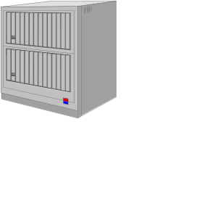
Content-based XML Data Dissemination
XML: Dominant standard for data exchange on the Internet (B2B/B2C)
Key Problem: Content-based filtering and routing of XML documents
  Effective XML data delivery based on document contents and user subscriptions (Publish/Subscribe model)
  User subscriptions indicate patterns of XML content that interest users (e.g., in Xpath)
Content-based XML routers
  Quickly match incoming XML documents against standing subscriptions
  Route documents to interested data consumers
User Subscriptions
Work on effective indexing structures for fast subscription matching
  XFilter/YFilter [VLDB’00,ICDE’02], XTrie [ICDE’02]

Slide 4
XML Data Dissemination in the Wide Area
Large, complex network of data producers and data consumers
To effectively route XML traffic, routers in the core/backbone of the distribution network need to be aware of all user subscriptions
  Potentially huge volume of subscriptions!
  Filtering speed at the core will suffer!
Need a technique that can effectively aggregate user subscriptions to a smaller set of aggregated content specifications
  Networking analog: Heavy aggregation of IP addresses in the routing tables of routers on the Internet backbone
Serious scalability concerns
for Pub/Sub Systems

Slide 5
Wide-Area XML Data Dissemination (cont.)
However, subscription aggregation also implies a “precision loss”
  False positives matching the aggregated content specifications without matching the original subscriptions
  Implies that users may receive content that they are not interested in
Our goal: Aggregate user subscriptions to a small collection while minimizing the “precision loss” due to aggregation
Several novel challenges for XML/XPath-based Publish/Subscribe
  Aggregating hierarchically-structured subscriptions with possible wildcards
  Quantifying “precision loss” due to aggregation in the context of streaming, hierarchical XML documents
  Effectively aggregating large subscription collections

Slide 6
User-Subscription Model: Tree Patterns
Tree patterns: Unordered, node-labeled trees specifying content & structure conditions on XML documents
  Wildcards: “*” = any tag , “//” = any subpath (descendant operator)
  Significant fragment of XPath (used earlier in XML/LDAP applications)
A tree pattern basically specifies an existential condition for each one of its paths with conjunctions at each branching node
Special root node “/.” allows for conjunctive conditions at the root level. For example:
/.
Example Document Trees
Root node with tag “a” s.t. (1) on some document path “a” has a “b” grandchild AND (2) on some document path “a” has a “c” descendant
a
a
a
f
d
*
//
g
g
b
c
g
b
c
b
c
/.
a
//
a
a

Slide 7





Tree Patterns: Basic Definitions
Tree pattern p contains tree pattern q ( ) iff every document T that satisfies q also satisfies p
  p “generalizes” q
Extends naturally to sets of tree patterns S, S’
  iff for each there exists s.t.
Size of a tree pattern p (|p|) = number of tree nodes in p
/.
/.
/.
/.
a
a
a
a
a
*
//
*
//
b
c
b
c
b
b

Slide 8
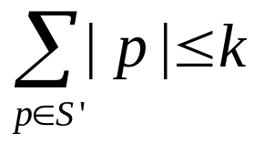
Problem Statement
Given a set of tree patterns S and a space bound k, compute a new set S’ of aggregate patterns such that:
  (i.e., S’ “generalizes” S)
  (i.e., S’ is concise)
  S’ is as precise as possible (i.e., any other set of patterns satisfying (1) and (2) is at least as general as S’)
    Minimize extra coverage (false positives) for the aggregated set S’
Basic algorithmic tools
  Containment, Minimization, Least-Upper-Bound (LUB) computation
  May be of independent interest (e.g., XML query optimization)

Slide 9


Basic Algorithms: Pattern Containment and Minimization
Basic Question: “Given tree patterns p and q, does p contain q?”
Propose an algorithm based on Dynamic Programming
Basic DP recurrence -- p(v) , q(w) = sub-patterns rooted at nodes v, w of patterns p, q respectively
  CONTAINS[ p(v), q(w) ] = [ tag(v) >= tag(w) ] AND
  If tag(v) = “//” then
    CONTAINS[ p(v), q(w) ] = CONTAINS[ p(v), q(w) ] OR
tag(v) is at least as general; e.g., // >= * >= a
( CONTAINS[ p(v’), q(w’) ] )
v’ = child(v)
w’ = child(w)
( CONTAINS[ p(v’), q(w) ] ) OR
/* “//” maps to empty path */
v’ = child(v)
( CONTAINS[ p(v), q(w’) ] )
/* “//” maps to path >= 2 */
w’ = child(w)

Slide 10
Basic Algorithms: Pattern Containment and Minimization (cont.)
Theorem: Our CONTAINS[p, q] algorithm determines whether in O(|p|*|q|) time
Tree -Pattern Minimization: we are interested in patterns with minimal no. of nodes -- want to eliminate “redundant” sub-trees
Algorithm MINIZE[p]: Minimize pattern p by recursive, top-down applications of the CONTAINS[] algorithm
Theorem: Our MINIMIZE[p] algorithm minimizes the tree pattern p in O(|p|^2) time
/.
Contains the left-child sub-pattern => can be eliminated without changing pattern semantics !
a
//
a
b
c
b
c

Slide 11
Basic Algorithms: Least-Upper-Bound (LUB) Computation
Given tree patterns p and q (in general, a set of patterns), we want to find the most precise/specific tree pattern containing both p and q
  Least-Upper-Bound of p, q -- LUB(p,q) = tightest generalization of p, q
  Shown that LUB(p,q) exists and is unique (up to pattern equivalence)
  Straightforward generalization to any set of input tree patterns
Proposed an algorithm for LUB computation
  Makes use of our pattern containment and minimization algorithms
  Similar, dynamic-programming flavor as our CONTAINS[] procedure, but somewhat more complicated
    Need to keep track of several possible container sub-patterns
Details of LUB algorithm in the paper ...

Slide 12
Outline
Introduction & Motivation
  Content-based XML data dissemination
Problem Fomulation
  Tree-pattern model
  Pattern aggregation problem
Our Solution: Basic Algorithmic Tools
  Tree-pattern containment and minimization algorithms
  Least-Upper-Bound (LUB) computation
Our Solution: Selectivity-based Tree-Pattern Aggregation
  Statistical synopsis and algorithms for estimating aggregate “quality”
  The overall tree-pattern aggregation algorithm
Experimental Study
  Results with real-life DTDs
Conclusions

Slide 13
Quantifying Precision Loss: Pattern Selectivities
Consider aggregated pattern p that generalizes a set of patterns S (i.e., for each )
  Want to quantify the “loss in precision” when using p instead of S
Selectivity(p) = fraction of incoming documents matching p
Selectivity(S) = fraction of documents matching any
Clearly, Selectivity(p) >= Selectivity(S)
  Difference = fraction of “false positives” induced by the aggregate p
Loss of precision due to aggregation = Selectivity(p) - Selectivity(S)
Idea: Use document distribution statistics to estimate selectivities and quantify precision loss during tree-pattern aggregation
  Cannot afford to keep the entire document distribution!
  Use coarse statistics (“Document Tree” Synopsis) computed on-the-fly over the streaming XML documents

Slide 14
The Document-Tree Synopsis
Compute summary of path-distribution characteristics as documents are streaming by
Document-Tree Synopsis = label paths with frequency counts (indicating no. of documents containing that path)
Construction
  Identify distinct document paths
  Install all Skeleton-Tree paths in the Document-Tree synopsis
    Trace each path from the root of the synopsis, increasing the frequency counts and adding new nodes where necessary
x
Coalesce same-tag siblings
x
Contains all distinct label paths in the document
a
a
b
a
b
b
c
b
c
c
d
d
XML Document
Skeleton Tree

Slide 15
Example Document-Tree Synopsis
XML Documents:
x
x
x
a
b
a
b
b
a
a
a
c
d
a
a
a
b
c
c
b
d
c
d
c
d
d
/.
/.
Synopsis:
Merge low-frequency nodes
3
x
3
x
for further compression
3
3
3
3
a
b
a
b
a
2
d
1.5
b
c
d
*
*
1
2
3
2
c
d
2.3
*
1.5
1
2

Slide 16

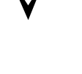

Estimating Pattern Selectivities
Problem is different from traditional XML selectivity estimation
  Want selectivity at the level of documents rather than XML elements
For patterns that are simple label paths (no branching or wildcards), get the selectivity directly from the synopsis
For branching label paths: assume independence at branch points
  Selectivity = (individual branch selectivities)
Selectivity(set of patterns S) = Selectivity( q)
  Summing all q selectivities can overestimate (overlap!)
  We define: Selectivity(S) = max { Selectivity(q) } ( like “fuzzy-OR”)
  Same idea for handling wildcards
    Max. over all possible wildcard instantiations
x
3
x
x
Selectivity = (2/3)*(2/3) = 4/9
3
a
b
3
Selectivity = 2/3
a
a
a
2
d
b
c
d
1
2
3
2
c
d
d
b
d
1
2

Slide 17

Selectivity Estimation Algorithm
Estimate selectivity of pattern p over document-tree synopsis T
  Apply our estimation model in a Dynamic-Programming recurrence
    p(v) = sub-pattern rooted at node v of p; t = node of T
  If tag(v) = “//” then
Estimate tree-pattern selectivity in O(|p|*|T|) time
SEL[ p(v), T ] = max { SEL[ p(v’), t’ ] }
v’ = child(v)
t’ = child(t)
SEL[ p(v), T ] = max { SEL[ p(v), t ] ,
/* “//” maps to empty path */
SEL[ p(v’), t ] ,
v’ = child(v)
max { SEL[ p(v), t’ ] } }
/* “//” maps to path >= 2 */
t’ = child(t)

Slide 18
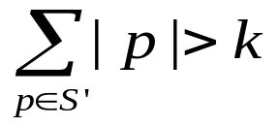

Selectivity-based Pattern Aggregation
Algorithm AGGREGATE( S , k )
  // S = set of tree patterns; k = space bound
  Initialize S’ = S
  while ( ) do
  C = candidate aggregate patterns generated using LUB computations & node pruning on patterns in S’
  Select pattern x in C such that BENEFIT(x) is maximized
  S’ = S’ + { x } - { p in S’ that are contained in x }
BENEFIT(x) based on marginal gain : maximize the gain in space per unit of “precision loss” ( let c(x) = { p in S’ that are contained in x } )
BENEFIT(x) = ( |p| - |x| ) / ( Selectivity(x) - Selectivity(c(x)) )
c(x)

Slide 19
Experimental Study
Our selectivity-based aggregation algorithm (AGGR) against a “naive” generalization algorithm based on node pruning (PRUNE)
  PRUNE: delete “prunable” nodes with highest frequencies from patterns
Key metrics
  Selectivity loss (due to aggregation) = (#False matches) / (#Documents not matching any of the original patterns)
  Filtering Speed
XML documents and tree patterns generated using IBM’s XML generator tool with the XHTML and NITF DTDs
  Used Zipfian parameters to inject skew into document and/or pattern tags
  1,000 documents used to “learn” the document-tree synopsis, another 1,000 to measure algorithm performance
  10,000 tree patterns, max. height = 10, Prob[branch] = prob[wildcard] = .1 (>= 100,000 tree nodes)

Slide 20
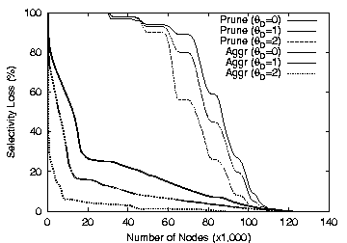
Skewed Data

Slide 21
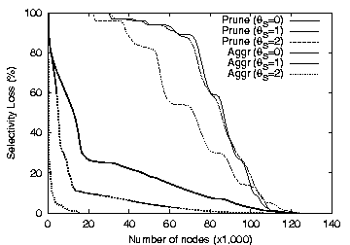
Skewed Patterns

Slide 22
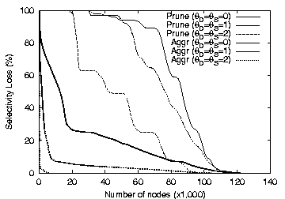
Skewed Patterns & Skewed Data

Slide 23
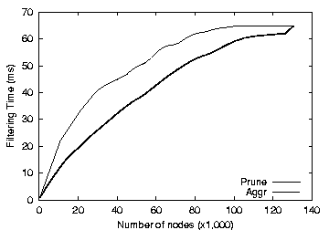
Filtering Speed (XTrie Index)

Slide 24
Conclusions
Introduced Tree-Pattern Aggregation problem
  Crucial for building scalable XML-based Pub/Sub systems
Novel, selectivity-based pattern-aggregation algorithm
  LUB computations & coarse document statistics to compute “precise” aggregates
  Selection of aggregates based on marginal gains
Basic algorithmic tools may be of independent interest
  E.g., XML query optimization
Experimental validation with real-life DTDs
Future
  Build more accurate document statistics on the fly?
  Increasing the expressiveness of subscription model (e.g., value predicates)

Slide 25

Thank you!

